Slide 1
MAN’S PROBLEM FROM THE BEGINNING IS HIS SIN; AND GOD’S SOLUTION - HIS ABUNDANT LOVE EMBODIED IN HIS BELOVED SON, JESUS THE CHRIST
I. Let us start with the biblical definition of sin:
A. Greek – hamartia Any thing that violates divine will, an offense, missing a standard, missing.
the mark.
1. W. E. Vine, Expository Dictionary of New Testament Terms -
2. J. B. Thayer, The New Thayer’s Greek-English Lexicon -
B. New Testament verses:
1. 1 Jn 3:4
2. 1 Jn 5:17
3. Jas 4:17

Slide 2
II. Our topic is man’s problem from the beginning, so let us go back to the beginning and look at several examples in the history of man.
A. Garden of Eden (Gen 3).
B. World at Noah’s time (Gen 6:5, 11-13).
C. Sodom and Gomorrah (Gen 13:13; 18:20; 2 Pet 2:7,8).
D. Period of the judges (Jud 17:6).
E. Israel during the divided kingdom
III. How does sin work in our lives?
A. How did it work in the Garden (Gen 3:6)?
B. 1 Jn 2:16
C. Jas 1:14,15

Slide 3
III. How does sin work in our lives?
A. How did it work in the Garden (Gen 3:6)?
B. 1 Jn 2:16
C. Jas 1:14,15

Slide 4
IV. What is the result of sin?
A. Isa 59:1,2. ¶Behold, the LORD'S hand is not shortened, that it cannot save; neither his ear heavy, that it cannot hear: 2 But your iniquities have separated between you and your God, and your sins have hid his face from you, that he will not hear.
B. Jas 1:15. Then when lust hath conceived, it bringeth forth sin: and sin, when it is finished, bringeth forth death.

Slide 5
IV. What is the result of sin?
C. Rom 6:23. For the wages of sin is death; but the gift of God is eternal life through Jesus Christ our Lord.
D. Jn 8:21. Then said Jesus again unto them, I go my way, and ye shall seek me, and shall die in your sins: whither I go, ye cannot come.

Slide 6
V. God’s answer to man’s problem.
A. Predicted - Isa 53:5,6,12
B. His motivation - Jn 3:16
C. Prophecy fulfilled: 1. Mt 1:21. 2. Mt 2:1
D. What price did God pay to make salvation available to mankind?
1. Heb 9:22; 2. 1 Pet 1:18,19; 3. Eph 1:7; 4. Rev 1:5

Slide 7
VI. How does man receive the benefits of the saving blood of Jesus? (How is it that we can contact that cleansing blood?)
A. Through works of the old law or man-made laws, customs or traditions? 1. Rom 3:20
B. If not, then what is the answer? 1. Rom 3:20-28

Slide 8
VI. How does man receive the benefits of the saving blood of Jesus? (How is it that we can contact that cleansing blood?)
C. Is that the “faith only” that is taught by so many today? 1. Jas 2:14-26
D. Then how is it that our faith is expressed in such a way that our sins are removed, we are saved and we are closely associated with Jesus?
Let’s see what the Bible says! (See charts entitled, “The Great Commission” Examples of Conversion:

Slide 9
PREACHING | BELIEVED | REPENTED | CONFESSES | BAPTIZED | SAVED
PENTECOST ACTS 2:14-41 |  | REPENT 37,38 |  | BAPTIZED 38-41 | REMISSION OF SINS SAVED-37,47
SAMARIA ACTS 8:5-13 | BELIEVED 12 |  |  | BAPTIZED 12,13
EUNUCH ACTS 8:35-39. | BELIEVED 37 |  | CONFESSED 37 | BAPTIZED 38 | REJOICED 39
SAUL ACTS 9:17,18 ACTS 22:12-16 |  |  |  | BAPTIZED 18 | SINS WASHED AWAY 22,16
CORNELIUS ACTS 10:34-48 | BELIEVED 43 CF. 48 |  |  | BAPTIZED 48 | REMISSION OF SINS-43
THE JAILER ACTS 16:25-32 | BELIEVED 34 |  |  | BAPTIZED 33
LYDIA ACTS 16:13,14 | HEEDED 14 |  |  | BAPTIZED 15
PREACHING RO.10:14 | FAITH HEB.11:6 HEB 5:8,9 | REPENTANCE LK. 13:3,5 | CONFESSION RO. 10:10 2 THESS. 1:7-9 | BAPTIISM GAL. 3:27 | SALVATION 2 TIM. 2:10.

Slide 10
A. By record of growth:
1. 2:41 - 3,000 souls.
2. 4:4 - number of men about 5,000.
3. 5:14 - believers increasingly added - multitudes.
4. 6:7 - number of disciples multiplied greatly - great many priests obedient.
5. 9:31 - churches ... were multiplied.
6. 12:24 - word of God grew and multiplied.
7. 16:5 - churches ... increased in number daily.
8. 19:20 - word of God grew mightily and prevailed.

Slide 11
E. What does the rest of the New Testament say about baptism?
1. Rom 6:3,4,17,18
2. 1 Cor 12:13
3. Gal 3:26,27
4. Eph 4:5
5. Col 2:12,13
6. 1 Pet 3:20,21
F. Now, with all of those Scriptures in mind, is baptism optional or essential in God’s eyes?

Slide 12
VII. What happens if we sin after we are baptized? Has God made provision for that?
A. First, are we “bad” if we sin after becoming a Christian?
1. We must keep in mind how much our sins hurt God and His Son.
Consider the price that God paid to redeem us from our sins.
a. 1 Pet 1:19

Slide 13
VII. What happens if we sin after we are baptized? Has God made provision for that?
2. We must temper that with the knowledge that God knows that we will fall occasionally because we are human.
(But we need to be careful that we do not use that as a crutch or excuse!)
a. Rom 3:23

Slide 14
VII. What happens if we sin after we are baptized? Has God made provision for that?
b. 1 Jn 1:8
B. God, knowing us very well and loving us deeply, has provided for our continuing forgiveness, IF we meet HIS conditions.
1. 1 Jn 1:7

Slide 15
VII. What happens if we sin after we are baptized? Has God made provision for that?
2. Acts 8:22
3. 1 Jn 1:9
C. Don’t be deceived, it will be a constant battle against sin.
1. 1 Pet 5:8

Slide 16
VII. What happens if we sin after we are baptized? Has God made provision for that?
2. Lk 22:31
3. Eph 6:12
D. But God hasn’t left us defenseless here.
1. Eph 6:10

Slide 17
VII. What happens if we sin after we are baptized? Has God made provision for that?
2. Eph 6:11ff
3. 1 Jn 2:14
4. Jas 4:7
E. With God’s help then, we can win the victory over sin and death.

Slide 18
1. 1 Jn 5:4,5
2. 1 Jn 4:4
3. 1 Cor 15:57
4. Rom 8:37-39

Slide 19
F. After our battle, there is MUCH in store for us if we have remained faithful to the Lord!
1. Rev 2:10
2. 2 Tim 4:6-8
3. Mt 25:21

Slide 20
VIII. Since Jesus is God’s answer to man’s problem of sin, exactly what does Jesus mean to the Christian?
A. He is God.
1. Jn 1:1-3,14
2. Jn 20:28

Slide 21
1. Acts 2:36
2. Lord - Greek - kurios = having power or authority; owner; master; one to whom service is owed on any ground.
a. Christians then are the servants of the Lord (master) Jesus Christ (cf. Jas 1:1; Phil 1:1).
b. But what does that mean to you and me?
c. That means that we are to submit ourselves totally to His will.

Slide 22
B. He is our Lord and Christ.
1) Eph 6:5-8
d. How did Jesus earn the right to be our Lord (master)?
1) Eph 5:2
2) Titus 2:14
3) 1 Cor 6:19,20
3. Christ - Greek - Christos; Hebrew - Messiah = anointed; often used to refer to kings; then came to be used for the coming King whom the Jews expected to be the savior of their nation.

Slide 23
C. He is our King.
1. Rev 17:14
D. HE IS OUR GREAT HIGH PRIEST.
1. Heb 2:17,18
2. Heb 4:14-16
3. Heb 7:23,24

Slide 24
4. Heb 8:1
5. Heb 9:12,24
6. Heb 10:18-24
7. And each Christian is a priest!
a. 1 Pet 2:5,9
b. Rev 1:5,6
E. He will be our Judge.
1. Acts 17:30,31
2. Rom 2:16
3. 2 Cor 5:10,11

Slide 25
F. He is the Christian’s best friend! 1. What is a friend?
a. Webster - a person who has a strong liking for and trust in another really close friends who like to do everything together and are always sharing secrets
b. God’s definition:
1) Prov 17:17¶A friend loveth at all times, and a brother is born for adversity.
2) Prov 18:24, A man that hath friends must shew himself friendly: and there is a friend that sticketh closer than a brother.

Slide 26
3) Prov 27:9, Ointment and perfume rejoice the heart: so doth the sweetness of a man's friend by hearty counsel.
4) Ruth 1:16,17, And Ruth said, Intreat me not to leave thee, or to return from following after thee: for whither thou goest, I will go; and where thou lodgest, I will lodge: thy people shall be my people, and thy God my God:
17 Where thou diest, will I die, and there will I be buried: the LORD do so to me, and more also, if ought but death part thee and me.

Slide 27
2. SOME REASONS WHY JESUS IS THE CHRISTIAN’S BEST FRIEND:
a. His LIFE upon this earth.
b. His HUMILIATION and SUFFERING for us.
c. His DEATH and SHED BLOOD.
d. His RESURRECTION and present REIGN.

Slide 28
3. One reason that Jesus is our best friend is His LIFE upon this earth.
a. Lk 19:10
Mt 1:21
b. Jn 6:33-35
c. Jn 6:68
d. Jn 8:12
e. Jn 10:10

Slide 29
f. Jn 11:25,26
g. Jn 14:6
h. 1 Pet 2:21
1) Jn 6:38
2) Mt 3:15
3) Acts 10:38
4) Phil 2:5ff
5) Mk 7:37
i. 1 Jn 3:8
j. 2 Cor 8:9

Slide 30
4. A second reason that Jesus is our best friend is His HUMILIATION and SUFFERING for us.
a. Remember that He came to seek and save the lost and to save His people from their sins.
b. Jn 1:10,11
c. Isa 53:3-7.
d. 2 Cor 5:21
e. Mt 27:26-50
f. Heb 12:2-4
g. 1 Pet 2:23
h. 1 Pet 3:18

Slide 31
This Photo by Unknown Author is licensed under CC BY-SA-NC

Slide 32
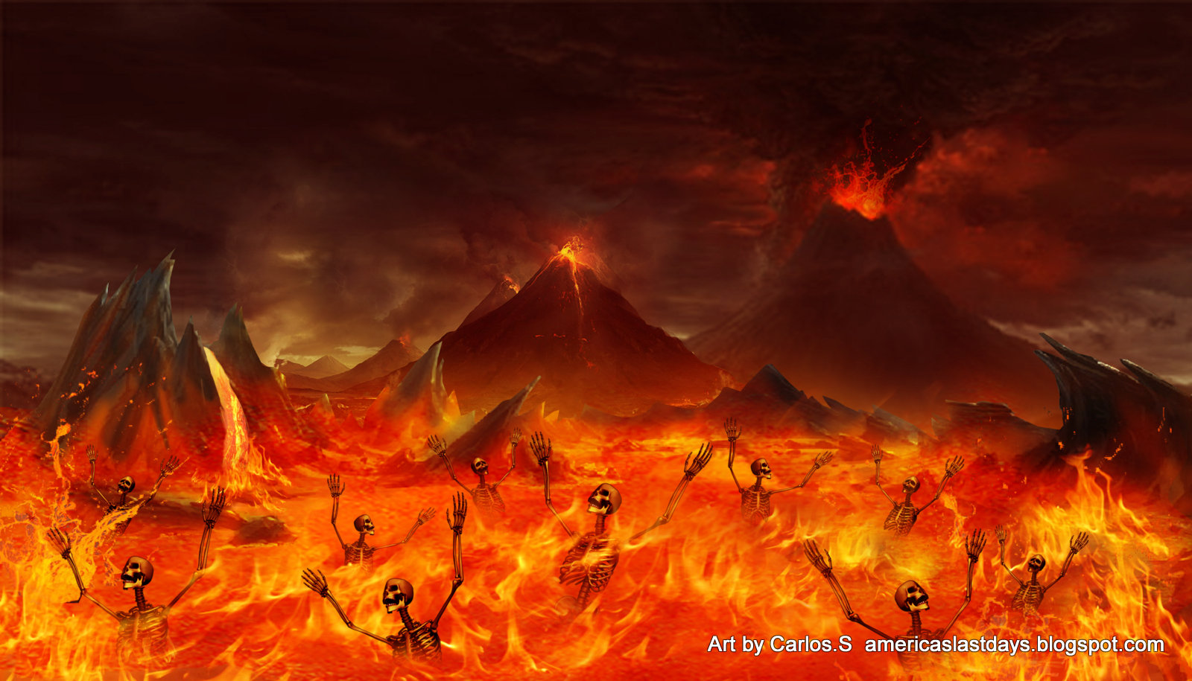
This Photo by Unknown Author is licensed under CC BY-NC-ND

Slide 33
This Photo by Unknown Author is licensed under CC BY-SA

Slide 34
5. A third reason that Jesus is our best friend is His DEATH and SHED BLOOD.
a. Jn 15:13
b. Rom 5:6-8
c. Jn 10:11,15
d. Jn 1:29
e. Heb 2:9

Slide 35
f. 1 Tim 2:6
g. Gal 1:4
h. Gal 2:20
i. Heb 7:26,27
j. 1 Cor 5:7
k. 1 Pet 2:24

Slide 36
l. In loving us enough to die for us, Jesus shed His blood for us, again demonstrating that He is the best friend that we have:
1) Heb 9:22
2) Jn 19:34
3) Heb 9:12,14
4) Mt 26:28

Slide 37
5) Rev 1:5
6) Eph 1:7
7) 1 Pet 1:18,19
8) Heb 10:19,20
9) Heb 13:20
10) Acts 20:28
11) Rom 5:9-11
12) Col 1:20

Slide 38
6. Finally, a fourth reason that Jesus is our best friend is His RESURRECTION from the dead and His present REIGN as head over all things.
a. We have seen that Jesus lived, suffered, shed His blood and died for us.
b. But, Christianity does not end at the grave of Jesus!
c. Remember when His disciples came to the sepulcher and found it empty?

Slide 39
Then they saw the two angels who said, “Why do you seek the living among the dead?
He is not here, but is risen.” (Lk 24:5,6).
d. Thus, with great joy, we sing: “Up from the grave He arose With a mighty triumph over His foes He arose a victor from the dark domain And He lives forever – death He overcame.”

Slide 40
And, we also sing: “Living He loved me Dying He saved me Buried, He carried my sins far away Rising, He justified, freely forever One day He’s coming – Oh glorious day!”
e. What is the importance of His resurrection to us?
1) Rom 1:4
2) 1 Pet 1:3,4
3) Titus 1:2
4) Heb 6:18,19
5) Heb 2:14,15
6) Rom 4:25

Slide 41
7) Now, we can say with the Apostle Paul (1 Cor 15:54ff):
8) Not only did the Father raise Jesus from the dead, but let us turn to Eph 1:20ff:
9) Now, in that position as ruler over all things, Jesus performs the following functions for each Christian:
a) 1 Tim 2:5. b) 1 Jn 2:1. c) Heb 7:25. d) Eph 5:23
e) Eph 5:29
f) Jn 14:6
g) Mt 11:28-30.
10) Truly, as we sing in the song, “What a friend we have in Jesus!”

Slide 42
H. Since God and Jesus have done ALL this to make it possible to have them as our best friend, surely we are obligated to return that love to them and to those around us!
1. Eph 3:17-19
2. 2 Cor 9:15
3. 2 Cor 5:14

Slide 43
4. Jn 14:15
5. Gal 2:20
6. Eph 5:24
7. 2 Cor 10:5
8. Phil 1:20,21
9. Mk 5:19
10. Eph 3:8
11. Phil 3:7-14

