Slide 1
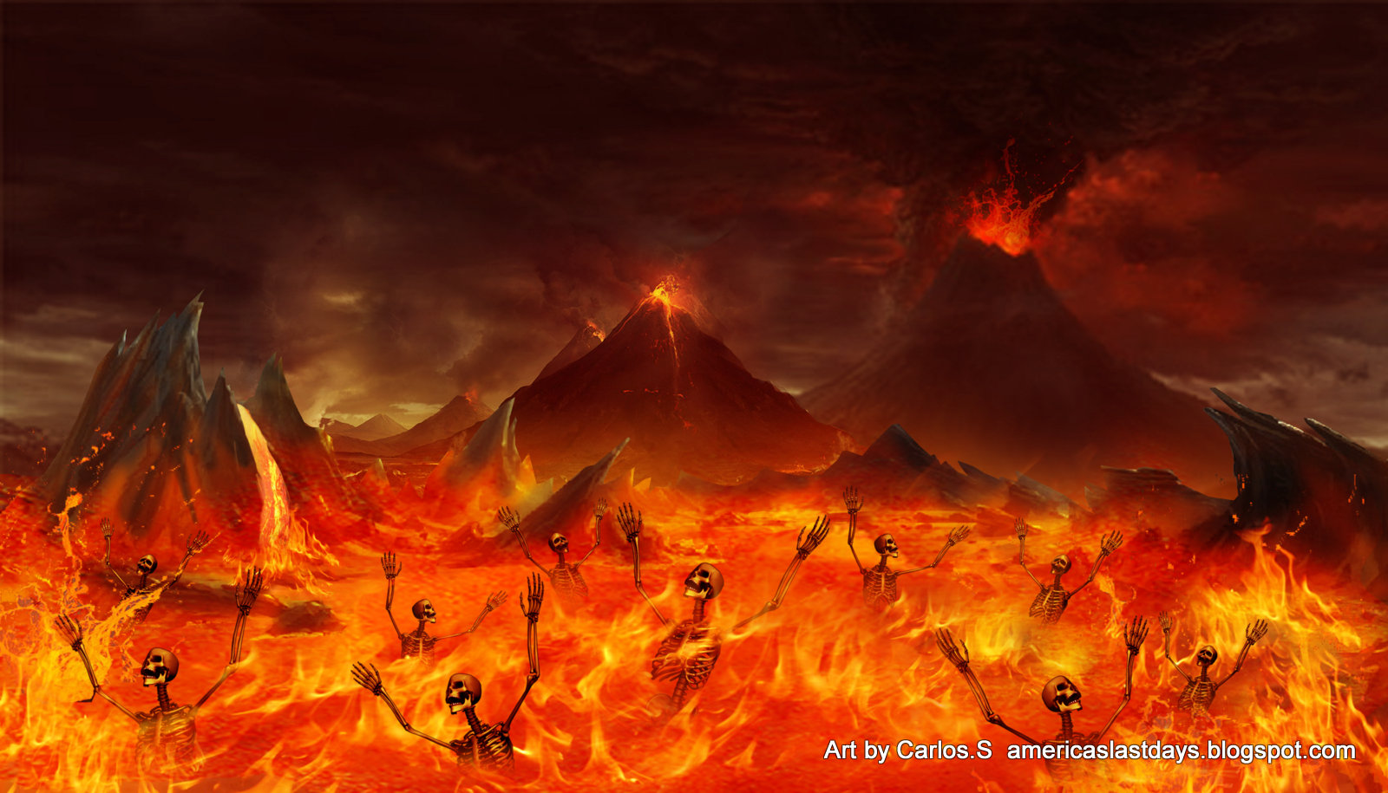
A JOURNEY THROUGH HELL
Millions of people do not believe in Hell.
It is real!
It would only take three seconds in hell to convince anyone who does not believe.
WE WANT TO TAKE AN IMAGINARY JOURNEY THROUGH HELL, BUT, BEFORE WE DO, THERE ARE SOME THINGS TO CONSIDER ABOUT HELL.

Slide 2
I. FACTS ABOUT HELL.
All that we know about Hell we find in the Bible.
The majority of people will go there. Matt. 7:13-14.
The condition there. Luke 16:23. Torment, flame.
Better maimed in life than whole in Hell. Mark 9:43-48.
Lake of fire. Rev. 20:15. Fire and brimstone. Rev. 21:8.

Slide 3
I. FACTS ABOUT HELL.
Separation from God. “Depart.” Matt. 25:41.
Class of people there. Rev. 21:8; Gal. 5:19; 1 Cor. 6:9-10; Rom. 1:24-27.
All those not found in the Book of Life. Rev. 20:15.

Slide 4
II. AS WE START THIS JOURNEY THROUGH HELL WE ARE SURPRISED TO FIND SOME.
We can see the smoke ascending up, the reflection of the fire.
As we get near we can feel the heat and begin to hear the cries and moans of the inhabitants of Hell.

Slide 5
As we start into Hell, the heat is unbearable and the cries and moans and gnashing of teeth are horrible.
As we walk along we hear, “Help me!” Who are you?
RICH MAN. Luke 16. “What are you doing here?”
I was all prepared to tell God what a clean life I lived.

Slide 6
I did not drink, curse, lie, gamble, etc. I minded my own business. I was stingy.
God made me read Matt. 25:42; For I was an hungered, and ye gave me no meat: I was thirsty, and ye gave me no drink:
Gal. 6:2. Bear ye one another's burdens, and so fulfil the law of Christ.
Some stingy with time, talent, money, etc. 2 Cor. 9:6,7. Rich man we must leave, we cannot do anything for you

Slide 7
PILATE: WHY ARE YOU HERE?
I thought I had passed the burden of Guilt.
I washed my hands. Jesus had me read Matt. 6:24 and Matt. 12:30. No man can serve two masters: for either he will hate the one, and love the other; or else he will hold to the one, and despise the other. Ye cannot serve God and mammon. He that is not with me is against me; and he that gathereth not with me scattereth abroad.

Slide 8
PILATE: WHY ARE YOU HERE?
The sin of neutrality will send many to Hell.
James 4:17. We must go.
What do you want us to tell people back on earth? Oh yes, take a stand for God. Gal. 6:6-7. Let him that is taught in the word communicate unto him that teacheth in all good things. 7 Be not deceived; God is not mocked: for whatsoever a man soweth, that shall he also reap.

Slide 9
KING AGRIPPA: WHY ARE YOU HERE?
You were a good king: you did not have Paul killed.
I had planned to become a Christian. Jesus said read 2 Tress. 1:7-9.
Many like Agrippa will be in Hell.
Well we must leade.
Nothing is worth this.
Do not put off preparing.
Life is too shout; death is sure and eternity it to long.

Slide 10
DEMETRIUS: I NEVER HEARD OF YOU!
C. Agrippa. Why are you here? You were a good king; you did not have
Paul killed. I had planned to become a Christian. Jesus read
2 Thess. 1:7-9. Many like Agrippa will be in Hell. We must leave.
Nothing is worth this. Do not put off preparing. Life is too short;
death is sure.
D. Demetrius. Never heard of you; I am the silversmith in Acts 19:24
29. Idolatry sent me here. John 4:24. Nothing is worth this. As we
start, one cries, “Help me brethren.” Who are you?
E. Demas. You were a Christian, why are you here? I tried to flirt with
the Devil. I know worldliness and Christianity do not mix. I made my
choice. “Demas hath forsaken me.” 2 Tim. 4:10. Many like Demas
stay in the church, clinging to a false hope. They think they cannot
fall from grace. Anything you want us to tell people on earth? Yes,
stay faithful to God; present yourselves a living sacrifice. Must go.
We hear a group crying in pain. Who are you?
F. Pharisees and Lawyers. Why are you here? You read of us in Luke
7:30. We rejected the counsel of God and were not baptized of Him.
We were like those in John 12:42, afraid we would not be popular or
be put out of synagogue. We have to get out of here. We cannot
stand it any longer. What would you like for us to tell the people
back on earth? “Yes, tell them to be in favor with God means more
than anything; do what God says while they can.”
CONCL: From this imaginary journey into Hell, we should be convinced that
we could not pay the price of Hell. It is too expensive. Hell will be
forever. Come now and obey God while you can.
Who are you? I am the silversmith in Ac. 19:24-29.
Idolatry sent men here.
Jo. 4:24. Nothing is worth this.
As we start, one cries, “Help me brethren.”
Who are you?

Slide 11
DEMAS:
Demas. You were a Christian, why are you here? I tried to flirt with the Devil.
I know worldliness and Christianity do not mix.
I made my choice. “Demas hath forsaken me.” 2 Tim. 4:10.

Slide 12
DEMAS:
Many like Demas stay in the church, clinging to a false hope.
They think they cannot fall from grace.
Anything you want us to tell people on earth?
Yes, stay faithful to God; present yourselves a living sacrifice. Must go.
We hear a group crying in pain. Who are you?

Slide 13
PHARISEES AND LAWYERS.
Why are you here? You read of us in Luke 7:30.
We rejected the counsel of God and were not baptized of Him.
We were like those in John 12:42, afraid we would not be popular or be put out of synagogue.
We have to get out of here. We cannot stand it any longer.

Slide 14
PHARISEES AND LAWYERS.
What would you like for us to tell the people back on earth?
“Yes, tell them to be in favor with God means more than anything; do what God says while they can.”

Slide 15
PHARISEES AND LAWYERS.
CONCL: From this imaginary journey into Hell, we should be convinced that we could not pay the price of Hell.
It is too expensive. Hell will be forever.
Come now and obey God while you can.
F + R + C + B.

