Slide 1
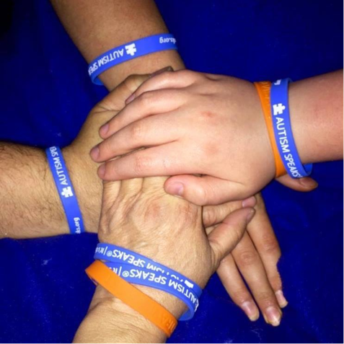


Education for EMS-Disability Awareness
Travis Alert Act
43.70.490 RCW, 38.52 RCW (SHB-1258)
For more information or additional copies of this document contact
Washington State Department of Health
Office of Community Health Systems
111 Israel Road SW
Olympia, WA 98504-7424
360-236-2840
HSQA.EMS@doh.wa.gov
DOH 530-223 September 2018
Notes:
It’s a day Threasa and Darren King will never forget. Shortly after moving to their new home in Wapato (near Yakima), their then-6-year-old son, Travis, wandered away from the house. Threasa described the moment she realized Travis was gone “like [her] feet were in concrete.” He was eventually found, thankfully unharmed, in an irrigation ditch near their property. Travis King, a 12-year-old boy with autism and the bill's namesake, joined his family and the bill's sponsor, Rep. Gina McCabe, in Olympia for the signing. House Bill 1258, otherwise known as the Travis Alert Act, was originally crafted with Travis and other individuals with autism in mind, until the bill was expanded to address all persons with special needs. Now that the bill has become law, Travis says more lives will be saved.
The bill calls for an assessment of the resources necessary to improve the Enhanced 911 program so information pertaining to an individual's disability or special need can be available to first responders before they arrive to the scene of an emergency. It would also require the Department of Health — in concert with other agencies — to review existing procedures and create a training program for first responders, providing instruction for how to best respond to emergencies involving individuals with special needs.
Threasa King, says she can rest easy knowing fire departments and emergency medical service personnel will be provided critical information tailored to an individual's specific disability or need when responding to emergencies.
McCabe began work on the bill after the 2015 legislative session, when the King family reached out to her with an idea to alert first responders of the presence of an individual with special needs at the scene of an emergency. The Kings had already adopted their own alert system by painting a blue-colored puzzle piece on their mailbox, a symbol often used for autism awareness.

Slide 2
Overall Goals of Travis Alert Act
Maximize the safety of persons with disabilities
Minimize the likelihood of injury to persons with disabilities
Promote the safety of all persons present
Provide tools for fire departments and emergency medical services personnel to easily and quickly determine the specific scenario into which they are entering
DOH 530-223 September 2018
Notes:
RCW 43.70.490
The program must include:
A checklist of disabilities;
Symptoms of such disabilities, and
Actions to take and not to take relevant to a particular disability.
Fire departments and emergency medical services agencies must ensure their employees are adequately trained and familiarized with techniques, procedures and protocols for best handling situations in which people with particular disabilities are present at the scene of an emergency.

Slide 3
Training Program Goals
Cognitive Goals
  Identify ways to maximize the safety on the scene for patients, providers and the public.
  Identify ways to minimize the likelihood of injury to a person with disabilities on the scene of an emergency.
  Identify the following for each main disability topic:
    Definitions,
    Essential tips and etiquette,
    Best practices for communication techniques,
    Best practices for providing assistance & removing barriers.
  Apply the checklist for disabilities.
  Identify resources for information related to different disabilities.
DOH 530-223 September 2018

Slide 4
Training Program Goals
Affective Goals
  Be aware of the importance of understanding and using people first language.
  Be aware of the effects related to health, safety, and independence.
  Understand the importance of allowing people to maintain health, safety, and independence.
  Exemplify a commitment to excellence as an EMS professional in regard to the care of people with disabilities and others with access and functional needs.
DOH 530-223 September 2018

Slide 5
Training Program Goals
Psychomotor Goals
  Expresses techniques that minimize the likelihood of injury to person with disabilities on the scene of an emergency.
  Expresses the ability to use the checklist tool.
  Expresses the ability to use de-escalation techniques.
DOH 530-223 September 2018

Slide 6
Building Community Understanding
Americans with Disabilities Act (ADA) definition of a person with a disability
  Impairment
  Disability
People First Language
  People with disabilities are people first
DOH 530-223 September 2018
Notes:
The Americans with Disabilities Act (ADA) defines a person with a disability as a person who has a physical or mental impairment that substantially limits one or more major life activities.
This includes people who have a record of such an impairment, even if they do not currently have a disability.
It also includes people who do not have a disability but are regarded as having a disability.
Impairment: any loss or abnormality of psychological, physiological or anatomical structure or function.
Disability: any restriction or lack (resulting from an impairment) of ability to perform a major life activity in the manner or within the range considered normal for a human being.
Major life activities: Include, but are not limited to, caring for oneself, performing manual tasks, seeing, hearing, eating, sleeping, walking, standing, lifting, bending, breathing, learning, reading, concentrating, thinking, communicating, and working. Major life activities also include the operation of major bodily functions, such as the immune system and normal cell growth, which covers people with HIV or cancer.
People with disabilities are people first. People with disabilities are no more easily defined by their disability than they are by their gender, age, race, or national origin.
The way we refer to people with disabilities in our communication is important.
Lack of awareness about disabilities can lead to unintended stereotypes and discrimination.
The way we view and communicate with and about people with disabilities shapes our relationships.
People first language puts the emphasis on the person before the disability. Examples given in the table.
Refer to a person’s disability only if it is relevant.
Avoid terms that lead to exclusion (e.g., “special” is associated with “separate” and “segregated” plans and services).
period

Slide 7
Building Community Understanding
Essential Tips and Etiquette
  Be nice and use common sense.
Communication Techniques
  The most important tool in communicating with anybody is respect; treat the other person as you would like to be treated.
Community Outreach Suggestions
  Building partnerships with local community resources provides benefits for EMS providers and community members.
DOH 530-223 September 2018
Notes:
ET&T: Use common sense.
Do not separate people from assistive devices or essential equipment if possible.
Disabilities are not always apparent.
Do not get tunnel vision or classify based on assumptions.
Do not assume. Clarify by asking questions.
Avoid making assumptions or generalizations about the level of functioning or understanding of a person based on a disability.
Do not label people. Many people with disabilities have excellent health. Likewise, use of “normal person” implies that the person with a disability is abnormal. No one wants to be labeled as abnormal.
Always ask if you can offer assistance before you provide assistance.
Respect personal space. Be sensitive about physical contact.
Always speak directly to the person, not to his or her escort.
Be patient and respectful. Apply basic courtesies to all people.
Try to avoid interrupting a person.Do not finish the person’s sentence.
Do not give multiple commands – ask or state one thing at a time and allow time for a person to respond.
Communication-The most important tool in communicating with anybody is respect; treat the other person as you would like to be treated.
Identify yourself, and others with you when you approach the person. Tell him or her your name and role if it’s appropriate.
Talk face to face. Maintain eye contact if possible and appropriate.
Always speak directly to the person. Unless a communication barrier is obvious, it is best not to assume one exists unless the person, a family member, or other caregiver tells you about the barrier. Even when a communication difficulty exists, the exact barrier and the best way to address it often varies.
Communicate clearly and plainly. Avoid jargon.
Speak at your regular speed and volume.
Do not pretend to understand when you do not – repeat what you do understand, and ask for the part you didn’t understand to be repeated.
Let people share or indicate how they communicate best.
Community Outreach Suggestions
Building partnerships with local community resources provides benefits for EMS providers and community members. EMS providers should establish relationships with people within their jurisdiction who have disabilities so that they can better respond during emergencies.
No one knows the needs or abilities of a person with disabilities more than that person themselves. It is recommended that EMS professionals involve people with disabilities in emergency planning and training. ‘Nothing About Us Without Us’ is the philosophy that all people have the right to provide input into how they receive care.

Slide 8
Module 1: People with
Mobility/Physical Impairments
Definition of Physical and Mobility Disabilities
Examples of Conditions with Mobility or Physical Impairments:
Amyotrophic lateral sclerosis (ALS) | Amputation
Arthritis | Absent limb/ reduced limb function
Cerebral palsy | Neuromuscular disorders
Back disorders | Developmental coordination disorder
Dwarfism | Parkinson’s disease
Poliomyelitis | Post-polio syndrome
Spina bifida | Spinal cord injury
Stroke | Obesity
DOH 530-223 September 2018
Notes:
Definitions: Physical disability is a condition that substantially limits one or more basic physical activities in life (i.e., walking, climbing stairs, reaching, carrying, or lifting). These limitations hinder the person from performing activities of daily living.
Activities of daily living, or ADLs, are the basic tasks of everyday life, such as eating, bathing, dressing, toileting, and transferring.
Some mobility impairments are caused by conditions present at birth, while others are the result of illness or physical injury. Injuries cause different types of mobility impairments depending on what area of the body is affected.
People with physical impairments often use mobility aids such as crutches, canes, wheelchairs, and walkers to obtain mobility.

Slide 9
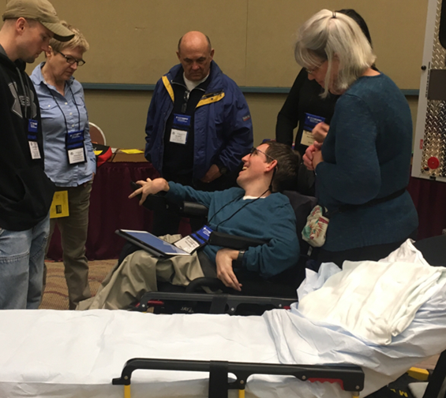
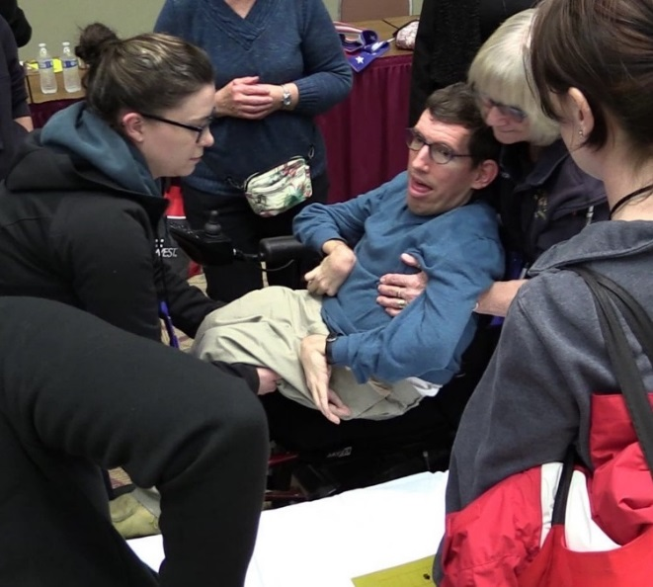
Module 1: People with
Mobility/Physical Impairments
Essential Tips / Etiquette
  Ask the person about how best to move them or assist them
  Ask people before removing them from their wheelchair
  Do not separate people from their assistive devices
DOH 530-223 September 2018
Notes:
Essential Tips / Etiquette
Ask how the person has been transported before.
Not all lift, carry, load and position techniques will be safe.
Avoid using the classic “fireman carry.”
Ask people before removing them from their wheelchair.
Do not separate people from their assistive devices. However, most ambulances are not equipped to transport people in wheelchairs.
Find local transportation resources (i.e. lift-equipped vans or buses) to assist.
Learn where special ramps, winch systems, bariatric tarps and stretchers are available.
People with mobility impairments are not deaf, visually impaired or cognitively impaired. The only accommodations you may need to make are those related to the mobility impairment.
People who use a wheelchair, walker, or cane often consider this technology to be an extension of their body. They are part of the person’s personal space and should be treated with dignity and respect.
Do not lean on assistive devices, push them, or move them without explicit permission.
When given permission to push a wheelchair, push slowly at first. Wheelchairs can pick up momentum fast.

Slide 10
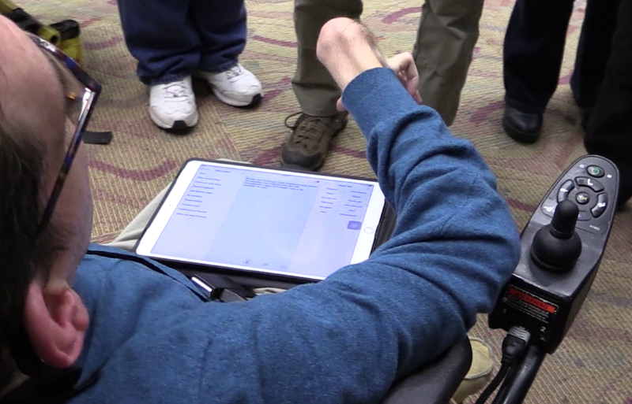
Module 1: People with
Mobility/Physical Impairments
Suggested Communication Techniques
  Always ask the person how you can help before beginning any assistance
  Do not make assumptions about the person’s abilities
DOH 530-223 September 2018
Notes:
Suggested Communication Techniques
Always ask the person how you can help before beginning any assistance. Even though it may be important to evacuate quickly, respect the person’s independence to the extent possible.
Do not make assumptions about the person’s abilities.
Ask people whether they have limitations or problems that may affect their safety.
Some people may need assistance getting out of bed or out of a chair, but then can proceed without assistance. Ask!
Other questions you may find helpful:
“Are you able to stand or walk without the help of a mobility device like a cane, walker or a wheelchair?”
“You might have to [stand] [walk] for quite a while on your own. Will this be OK? Please be sure and tell someone if you think you need assistance.”
“Do you have full use of your arms?”

Slide 11
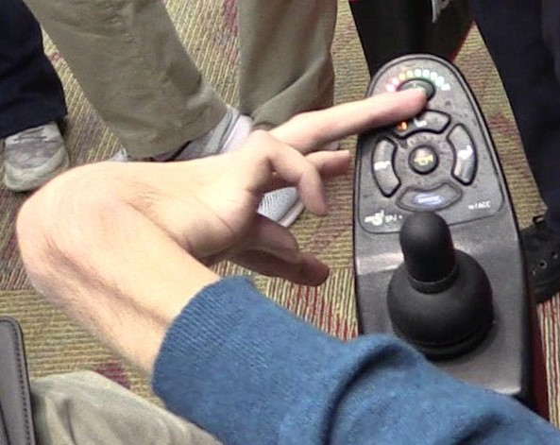
Module 1: People with
Mobility/Physical Impairments
Providing Assistance and Removing Barriers
  Crutches, Canes or Other Mobility Devices
  Carrying Techniques for People who use Non-motorized Wheelchairs
  Motorized Wheelchairs
  Training video for responders
http://www.readysandiego.org/training/first-responder-access-functional-needs-training-series/#8
DOH 530-223 September 2018
Notes:
When carrying the person, avoid putting pressure on his or her arms, legs or chest.
This may result in spasms, pain, and may even interfere with their ability to breathe.
Crutches, Canes or Other Mobility Devices
A person using a mobility device may be able to negotiate stairs independently. One hand is used to grasp the handrail while the other hand is used for the crutch or cane. Do not interfere with the person’s movement unless asked to do so, or the nature of the emergency is such that absolute speed is the primary concern. If this is the case, tell the person what you will need to do and why.
Ask if you can help by offering to carry the extra crutch.
If the stairs are crowded, act as a buffer and run interference for the person.
People using wheelchairs are trained in special techniques to transfer from one chair to another. Depending on their upper body strength, they may be able to do much of the work themselves.
Carrying techniques for people who use non-motorized wheelchairs.
The in-chair carry is the most desirable technique to use, if possible.
One-person assist – going down steps or stairs:
Grasp the pushing grips, if available.
Stand one step above and behind the wheelchair.
Tilt the wheelchair backward until a balance (fulcrum) is achieved.
Keep your center of gravity low.
Descend frontward.
Let the back wheels gradually lower to the next step.
Two-person assist – going down steps or stairs.
Position the first rescuer as described in the ‘one-person assist’ above.
Position the second rescuer in front of the wheelchair and face the wheelchair.
Stand one, two, or three steps down (depending on the height of the other rescuer).
Grasp the frame of the wheelchair.
Push into the wheelchair.
Descend the stairs backwards.
Motorized Wheelchairs
Motorized wheelchairs may weigh more than 100 pounds unoccupied, and may be longer than manual wheelchairs. Lifting a motorized wheelchair and user up or down stairs requires two to four people.
People who use motorized wheelchairs probably know their equipment much better than you do.
Before lifting, ask about heavy chair parts that can be temporarily detached, how you should position yourselves, where you should grab hold, and what, if any, angle to tip the chair backward.
Turn the wheelchair’s power off before lifting it.
Most people who use motorized wheelchairs have limited arm and hand motion.
Ask if they have any special requirements for being transported up or down the stairs.

Slide 12
Module 2: People with Sensory Impairments
2A: d/Deaf, Hard of Hearing
Definitions of Deaf, deaf, Deafened, Hard of Hearing, Hearing Impaired, Hearing
Examples of what a person who is d/Deaf or hard of hearing may display:
Is not responding or inappropriately responds | Has a visual doorbell, telecom equipment, TV captioning
Is asking for repetition or clarification | Is using sign language
Is staring intently at your face | Has a hearing aid or cochlear implant
Seems confused | Has a visual (e.g. flashing) fire alarm system.
Is pointing to his or her ears and mouth and shaking his or her head “no”
DOH 530-223 September 2018
Notes:
Deaf (uppercase D) – The "uppercase D" Deaf is used to describe people who identify as culturally Deaf and are actively engaged with the Deaf community. Deaf with a capital D indicates a cultural identity for people with hearing loss who share a common culture and have a shared sign language.
People who identify as Deaf are often born deaf and sometimes also have other family members who are deaf. However, many people who may have hearing parents or were not born deaf but lost their hearing later in life have become part of the Deaf community. Deaf people often prefer to use sign language and it may be their first language. Deaf people have often attended schools and programs for the deaf where they have been able to immerse themselves in Deaf culture. People who are Deaf take great pride in their Deaf identity.
deaf (lowercase d) The "lowercase d" deaf simply refers to the medical condition of having hearing loss. People who identify as deaf with a lowercase d often do not have a strong connection to the Deaf community and most likely do not use sign language, preferring to communicate orally.
There are a variety of reasons a person identifies as deaf with a lowercase d. For instance, he or she may have been born to hearing parents and grown up in the hearing world with little or no exposure to the Deaf community.
Deafened or Late Deafened Usually refers to a person who becomes deaf as an adult and, therefore, faces different challenges than those of a person who became deaf at birth or as a child.
Hard of Hearing Hard of Hearing (HOH) is a widely accepted term to describe someone with mild to moderate hearing loss. A person who is hard of hearing often does not use sign language as the first or preferred language. This may be due to never having the opportunity to learn a sign language or preferring not to.
Someone with mild to moderate hearing loss may identify as Deaf, and be involved in Deaf culture and the Deaf community. Likewise, someone who has a very small amount or no hearing may like to identify as hard of hearing, rather than deaf or Deaf. Ultimately, all people have their own preferred term for how they identify themselves. If you are unsure about how someone identifies himself or herself, just ask.
Hearing Impaired Hearing impaired is another commonly used term to describe a person with hearing loss, but many people in the Deaf and hard-of-hearing communities find the term offensive. This is because of the implication it holds of being "impaired." However, there are people with hearing loss who are comfortable with this term and self-identify as hearing impaired. However, to be on the safe side, it is best to avoid using this term when referring to someone else.
Hearing Within the Deaf culture, the term “hearing” is used to identify people who are members of the dominant American culture. One might think the ASL sign for “hearing” is related to the group’s ability to hear (e.g., pointing to the ear). However, the sign for “hearing” is related to the ability to “talk.” The act of talking is clearly visible to Deaf people, whereas listening or hearing is not. From the Deaf culture perspective, it is the act of “talking” that clearly separates the two groups.

Slide 13
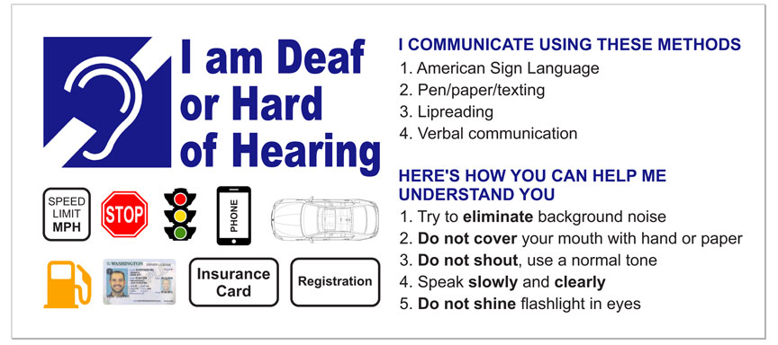
Module 2: People with Sensory Impairments
2A: d/Deaf, Hard of Hearing
Essential Tips / Etiquette
  "People-first" language rejected
  A person may present a pre-written note or card
  Wide range of communication preferences and styles among people with hearing loss
DOH 530-223 September 2018
Notes:
Essential Tips / Etiquette
"People-first" language rejected
In Deaf culture, person-first language (i.e., "Person who is deaf," "person who is hard of hearing") has long been rejected because being culturally Deaf is seen as a source of positive identity and pride. Instead, Deaf culture uses Deaf-first language: "Deaf person" or "hard-of-hearing person."
A person may present a pre-written note or card. He or she may also have some type of recording on a device or phone. Be aware of a person reaching for something (from a pocket or bag) to present to you.
People who have hearing loss may be difficult to identify.
Some people who have hearing loss do not accept or identify themselves as d/Deaf or hard of hearing.
Hearing aids and/or cochlear implants do not guarantee that the person can hear and understand speech.
Some people who are deaf or HOH read lips, while some do not. Lip reading cannot be relied on for communication.
Only 30 to 35 percent of spoken language is visible on the lips.
Some people who are d/Deaf or HOH use their voice, and some do not. Deaf does not mean mute.
Some who are d/Deaf or HOH may have difficulty with written or spoken English. English may be their second language.
Sign language is different from English and might be their first language.
Not all people who are d/Deaf or HOH know sign language (American Sign Language [ASL] or any other form).
There is a wide range of communication preferences and styles among people with hearing loss.
Some may use hearing but rely on amplification and/or lip reading; others may use sign language.
Most people who are hard of hearing do not use sign language while others may speak, gesture or choose to write to communicate.

Slide 14
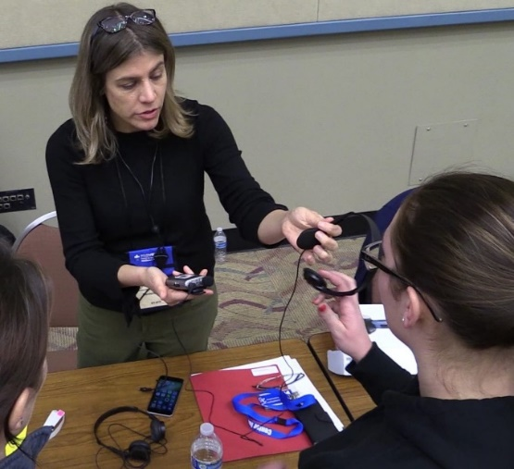

Module 2: People with Sensory Impairments
2A: d/Deaf, Hard of Hearing
Suggested Communication Techniques
  Look at the person for whom the interpreter is interpreting; do not look at a sign language interpreter.
  Follow the person’s cues to find out the communication style preference
DOH 530-223 September 2018
Notes:
Suggested Communication Techniques
Look at the person for whom the interpreter is interpreting; do not look at a sign language interpreter.
Do not exclude a person who is d/Deaf or hard of hearing from a conversation.
Take any card or note that is provided to you, so that the person knows you have received the message. Then hand it back, unless instructed otherwise. A person who is deaf might communicate using written messages or pre-recorded messages. These are used to convey essential information about their activities.
Before speaking to a person who is d/Deaf or has a loss of hearing make sure you get the person’s attention.
Gently touch the person on the shoulder, extend your arm or wave your hand.
If you are aware that a person is d/Deaf or hard of hearing, flick the lights when entering an area or room to get his or her attention.
Follow the person’s cues to find out the communication style preference. When in doubt, ask the person the preferred mode.
If you have trouble understanding the speech of a person who is deaf or hard of hearing, let the person know.
Face the person and offer unobstructed view of mouth. Be aware, facial hair on a speaker may affect understanding.
Maintain eye contact.
Consider using pen and paper. Write slowly and let the person read as you write.
Use facial expressions and body language to convey tone.
Minimize audible and visual environmental distractions.
Do not whisper or yell into their ears.
Do not shine flashlight in face/eyes (use of penlights for diagnostic information is acceptable).

Slide 15


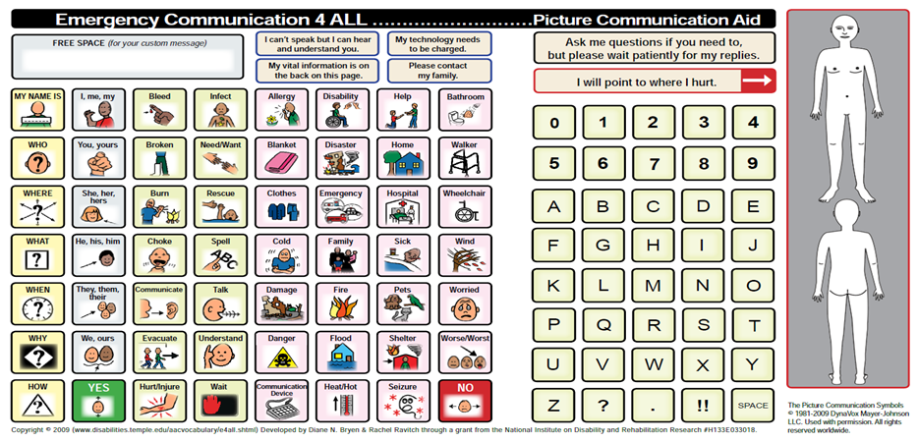
Module 2: People with Sensory Impairments
2A: d/Deaf, Hard of Hearing
Providing Assistance and Removing Barriers
  Consider the use of phone communication applications
  Ask if he or she has assistive technology
DOH 530-223 September 2018
Notes:
Consider the use of phone communication applications:
Make it Big
Show Me for Emergencies
Show ME for Emergencies Family Assistance Center
AVA 24/7 Accessible Life
Microsoft Translator
Translate Me – Live Translation (formerly Speechnotes – Speech to Text)
Ask if he or she has assistive technology (phone, hearing aid, listening device, etc.).
Stock Communication tools:
Picture communication boards (example: KwikPoint Communication Cards).
100 Signs for Emergencies (source: DawnSignPress).

Slide 16
Module 2: People with Sensory Impairments
2B: Blind, Low Vision or Visual Impairment
Definitions of Blind, Blindness, Legal Blindness, Low Vision, Visual Disorders, Visual Impairment
Examples of Possible Conditions That May Exhibit These Characteristics:
Sensory Deficits
Ocular complications of diabetes | Glaucoma
Macular degeneration | Chemical poisoning
Ocular inflammatory disease | Retinitis pigmentosa
Primary or secondary malignancies of the eye | Congenital abnormalities
Hereditary diseases of the eye | Injury
DOH 530-223 September 2018
Notes:
Blind
Person who is unable to see because of injury, disease, or a congenital condition.
Blindness
Blindness is defined as the state of being sightless. A blind person is unable to see. In a strict sense the word "blindness" denotes the inability of a person to distinguish darkness from bright light in either eye. The terms blind and blindness have been modified in our society to include a wide range of visual impairment. Blindness is frequently used today to describe severe visual decline in one or both eyes with maintenance of some residual vision.
Legal Blindness
Legal blindness is not a medical diagnosis, it is a level of vision loss that has been legally defined to determine eligibility for benefits. In the United States, this refers to a medically diagnosed central visual acuity of 20/200 or less in the better eye with the best possible correction, and/or a visual field of 20 degrees or less. Often, people who are diagnosed with legal blindness still have some usable vision.
Low Vision
A person with low vision is one who has impairment of visual functioning even after treatment and/or standard refractive correction, and has a visual acuity of less than 6/18 to light perception, or a visual field less than 10 degrees from the point of fixation, but who uses, or is potentially able to use, vision, compensatory visual strategies, low vision devices, and environmental modifications for the planning and/or execution of a task for which vision is essential.
Visual Disorders
Visual disorders are abnormalities of the eye, the optic nerve, the optic tracts, or the brain that may cause a loss of visual acuity or visual fields. A loss of visual acuity limits your ability to distinguish detail, read, or do fine work. A loss of visual fields limits your ability to perceive visual stimuli in the peripheral extent of vision.
Visual Impairment
Often defined as a best corrected visual acuity of worse than either 20/40 or 20/60. A term that encompasses both those who are blind and those with low vision. Additional factors influencing visual impairment might be contrast sensitivity, light sensitivity, glare sensitivity, and light/dark adaptation.
Vision loss
Refers to people who have trouble seeing, even when wearing glasses or contact lenses, as well as to people who are blind or unable to see at all.

Slide 17
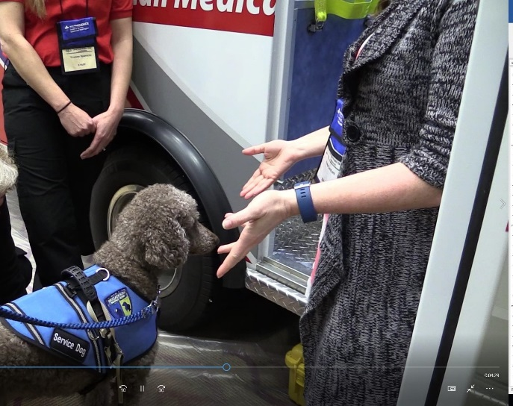
Module 2: People with Sensory Impairments
2B: Blind, Low Vision or Visual Impairment
Essential Tips / Etiquette
  Always communicate any written information orally
  Most people who are blind or have low-vision are extremely self-sufficient
  Service animals should be transported with the person
Brigadoon Dogs- Ariane & Mr.Chips
DOH 530-223 September 2018
Notes:
Essential Tips / Etiquette
Always communicate any written information orally.
Most people who are blind or have low-vision are extremely self-sufficient.
Always communicate any changes or dangers in the environment.
Service animals should be transported with the person.
After having introduced yourself (and others) initially, re-identify yourself each time you approach a person who is blind or low vision.
If providing guiding assistance, allow the person to take you by the arm.
If the person has a guide dog, walk on the side opposite the dog.
Do not touch the person’s cane or guide dog.
The dog is working and needs to concentrate.
The cane is part of the person’s personal space.
If the person puts the cane down, do not move it.
Let him or her know if it’s in the way.
When guiding, be descriptive about obstructions.
Use directions such as down, right, or left. Be sure to mention stairs, doorways, narrow passages, ramps, etc. before you come to them.
“Go to your left.”
“There is a curb here, step up.”
“We are going to go down a flight of steps.”
“We are going through a doorway, a narrow passage, a ramp, etc.”
Tell the person if you are stepping away or leaving.
If you leave a person you have been guiding who is blind, leave the person by a wall or some other landmark. The center of a room can seem like “no man’s land.”
Make the person aware of any changed conditions, temporary barriers, remodeling.
If you move any furniture to get your ambulance gurney to the patient, make sure you return the furniture to its original location. People who have low/vison or blindness often rely on the familiarity of their environment to navigate. Any change in the environment may present tripping or fall hazards for them.
Always speak directly to the person, not to his or her escort.
Do not shout. The person is blind, not deaf.
It is OK to use words such as “see,” “look,” or “blind.”
It is OK to say, “See you later” or “See you tomorrow.”

Slide 18
Module 2: People with Sensory Impairments
2B: Blind, Low Vision or Visual Impairment
Suggested Communication Techniques
  A person who is blind might communicate using written messages or pre-recorded messages
  Establish eye contact if possible and appropriate
  Ask people who are blind or have low-vision, “Where do you want me to stand?”
DOH 530-223 September 2018
Notes:
Suggested Communication Techniques
Take any card or note that is provided to you, so that the person knows you have received the message. Then hand it back, unless instructed otherwise. A person who is blind might communicate using written messages or pre-recorded messages. These are used to convey essential information about their activities.
Establish eye contact if possible and appropriate. Ask people who are blind or have low-vision, “Where do you want me to stand?” Some people may need to bring you into their line of focus. He or she may want to take your hand or shoulder and move you where it's best to see you. Do not move after establishing visual range. Once he or she has you in the field of vision, stay in the same position until you have finished the communication exchange.

Slide 19
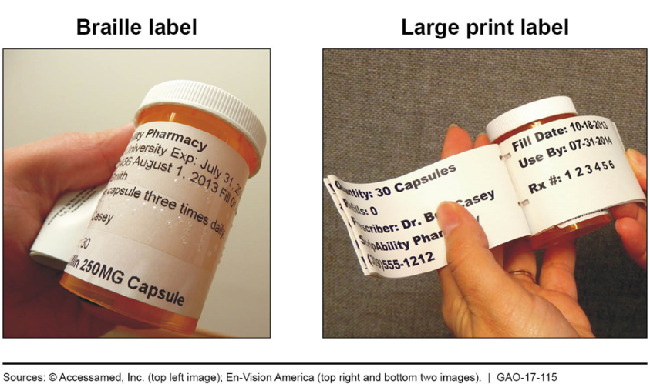
Module 2: People with Sensory Impairments
2B: Blind, Low Vision or Visual Impairment
Providing Assistance and Removing Barriers
  Offer print materials in alternate formats
  Drawing an “X” on the person’s back, or near his or her shoulder, is an indication that there is an emergency
DOH 530-223 September 2018
Notes:
Providing Assistance and Removing Barriers
EMS agencies should offer print materials in alternate formats (large print, Braille, electronic for screen reader users).
In the Deaf-Blind community, using your fingers to draw an “X” on the person’s back, or near his or her shoulder, is an indication that there is an emergency, and that he or she should trust and follow you. Note: This is used in the culturally Deaf-Blind community. People who may have vision and hearing loss but are not a part of the Deaf-Blind community will not understand this cue. (For the safety of the person, share this information only with other emergency responders.)

Slide 20
Module 2: People with Sensory Impairments
2C: Deaf-Blind
Definitions of Deaf-Blindness, Person who is Deaf-Blind
Examples of what a Person who is Deaf-Blind may Display:
Is not responding or inappropriately responds | Has a hearing aid or cochlear implant
Is asking for repetition or clarification | Is using sign language
Is staring intently at your face | Has a visual doorbell, telecom equipment, TV captioning
Seems confused | Has a visual (e.g. flashing) fire alarm system.
Is pointing to his or her ears and mouth and shaking his or her head “no”
DOH 530-223 September 2018
Notes:
Deaf-Blindness
Described as a unique and isolating sensory disability resulting from a combination of both a hearing and vision loss or impairment that significantly affects communication, socialization, mobility and daily living.
The federal definition of deaf-blindness means concomitant hearing and visual impairments, the combination of which causes severe communication and other developmental and educational needs.
Congenital Deaf-Blindness
A term used if a person is born with a sight and hearing impairment or when the combined hearing and vision impairment occurs before spoken, signed or other visual forms of language and communication have developed. This may be due to infections during pregnancy, premature birth, birth trauma and rare genetic conditions.
Acquired Deaf-Blindness
A term used if a person experiences sight and hearing loss later in life. Anyone can become deafblind at any time through illness, accident or as a result of aging.
People who are born Deaf or hard of hearing and later experience deteriorating sight. Usher syndrome, for example, causes deafness or hearing impairment at birth and vision impairment later in life.
People who are born vision impaired or blind and go on to experience hearing loss at a later stage.
People who are born with vision and hearing that deteriorates later in their life through accident, injury or disease; for significant numbers of people the aging process is a cause of dual sensory loss or deaf-blindness.
Person Who Is Deaf-Blind
The term person who is deaf-blind means any person -
who has a central visual acuity of 20/200 or less in the better eye with corrective lenses, or a field defect such that the peripheral diameter of visual field subtends an angular distance no greater than 20 degrees, or a progressive visual loss having a prognosis leading to one or both these conditions;
who has a chronic hearing impairment so severe that most speech cannot be understood with optimum amplification, or a progressive hearing loss having a prognosis leading to this condition; and
for whom the combination of impairments described above cause extreme difficulty in attaining independence in daily life activities, achieving psychosocial adjustment, or obtaining a vocation;
who, despite the inability to be measured accurately for hearing and vision loss due to cognitive or behavioral constraints, or both, can be determined through functional and performance assessment to have severe hearing and visual disabilities that cause extreme difficulty in attaining independence in daily life activities, achieving psychosocial adjustment, or obtaining vocational objectives.

Slide 21
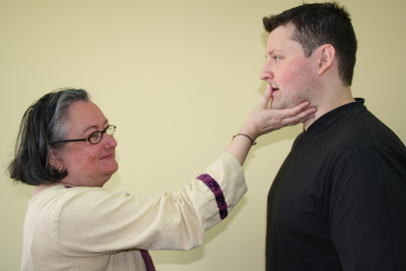
Module 2: People with Sensory Impairments
2C: Deaf-Blind
Essential Tips / Etiquette
  People who are deaf-blind may not be immediately identifiable
  Deaf-Blind does not always mean totally deaf and blind
  If someone reaches for your hands (tactile sign) or your face/lips (Tadoma – tactile lip-reading) it may be an attempt to communicate
Deafblind Perspectives CIC
DOH 530-223 September 2018
Notes:
Essential Tips / Etiquette
People who are deaf-blind may not be immediately identifiable. Due to the etiology, degree, timing of onset and level of stability of the vision and hearing loss, it is impossible to determine a specific person’s visual acuity and/or auditory acuity. He or she may or may not use canes, service animals, hearing aids, and/or cochlear implants. All information from sections 2A and 2B are also relevant to this section because of individual differences in visual and/or auditory acuity.
Deaf-Blind does not always mean totally deaf and blind. Most people may have some but very limited or poor vision. Some may be hard of hearing or profoundly deaf.
Some deaf-blind people have enough vision to be able to see writing.
If someone reaches for your hands (tactile sign) or your face/lips (Tadoma – tactile lip-reading) it may be an attempt to communicate.
Tadoma is a method of communicating with the blind and deaf whereby their hands are placed on the lips of the speaker. The person with dual-sensory loss feels out the shape of the words as you say them. This is similar to lip reading. Not all people who are deaf-blind can use Tadoma, and not everyone will be comfortable with another person placing a hand on their mouth.
If a person attempts to lead you to something or reach for something it may be an attempt to demonstrate something as a means of communication.
Exploring objects should be done in a "nondirective" way, allowing the person who is deafblind to have control.
People who are deaf-blind will often need touch in order for them to be sure their partner shares their focus of attention.

Slide 22
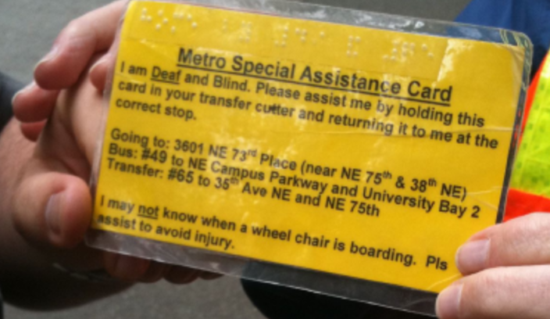
Module 2: People with Sensory Impairments
2C: Deaf-Blind
Suggested Communication Techniques
  A person who is blind might communicate using written messages or pre-recorded messages
  Establish eye contact if possible and appropriate
  Ask people who are blind or have low-vision, “Where do you want me to stand?”
DOH 530-223 September 2018
Notes:
Suggested Communication Techniques
All information from sections 2A and 2B are also relevant to this section because of individual differences in visual and/or auditory acuity.
Look for a communication partner (not the same as an interpreter).
In some cases, people with dual-sensory loss are accompanied by a partner trained to facilitate communication for the deaf-blind and they will have developed rapport with each other.
A variety of ways exist to speak to a deaf-blind person. The method of choice depends on the level of impairment of each sense. A deaf-blind person may not be profoundly deaf or completely blind.
Many deaf-blind people can use sign language if they have some vision.
The most common way for a profoundly deaf-blind person to communicate is using tactile sign language or the deaf-blind manual alphabet. Both methods rely on hand contact to communicate. If you are not certain you can be accurate with tactile sign language, do not use this method.
Some people know the tactile finger-spelling signs. If you choose to use finger spelling, place your hand under theirs and form the letters individually in the palm of the hand. The person will likely guide your hand into the correct position.
For people who do not know sign language or finger spelling, it is possible to use the Print On Palm (POP) method, by using your index finger to trace the letters on a blind and deaf person's palm. The person may also choose this method to respond to you. Do not use acronyms. Use short phrases or single words.
To get a Deaf-Blind person’s attention, gently touch on shoulder, arm or hand.
Give the deaf-blind person time to find where you are. Letting the person put their hand on yours may help. Waving hands may not help because he or she may not be able to see you. People may or may not respond to voice depending on the level of hearing loss.
Identify yourself every time. A deaf-blind person’s vision may be bad enough that he or she can’t see who you are easily nor read your name tag. Their hearing loss may prevent them from recognizing you by voice or spoken name. Print your name and role (“Judy – EMT”) in thick marker on a card to show him or her.
Always directly inform the deaf-blind person of your arrival and leaving. Do not assume that he or she knows you are there or not.
If a deaf-blind person has some sight, positioning is key. Do not stand in front of a light source or window as he or she will not be able to see your face due to backlighting. Position yourself where light falls on you and not in their eyes. Also, if he or she is sitting or lying in a bed, sit at the same level so he or she does not have to look up to see you while communicating.
Inform the deaf-blind person before you begin to do anything with or to them. For example, do not move them or grab their arm without first explaining what you are doing and why.
For brief communications, write brief to-the-point notes in thick marker (keep marker and pad of paper available). Note: Most deaf-blind people cannot read a ballpoint pen mark. Use a “20/20” pen, magic marker or Sharpie. Felt tip pens may work with some vision loss. High contrast colors work best (example: black letters on white background).

Slide 23
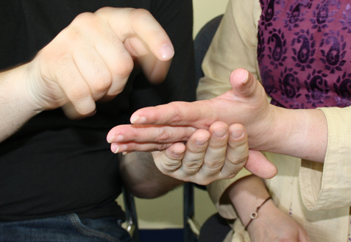
Module 2: People with Sensory Impairments
2C: Deaf-Blind
Providing Assistance and Removing Barriers
  Check frequently for understanding
  Drawing an “X” on the person’s back, or near his or her shoulder, is an indication that there is an emergency
DOH 530-223 September 2018
Notes:
Providing Assistance and Removing Barriers
Check frequently for understanding.
If an emergency happens and you must exit with the deaf-blind person quickly, draw “X” on the deaf-blind person’s back with your finger and lead him or her out by the arm. “X on the back” is a universal deaf-blind sign for emergency. (If back is not available, draw X in their palm.) Note: This is used in the culturally Deaf-Blind community. People who may have vision and hearing loss but are not a part of the Deaf-Blind community will not understand this cue. (For the safety of the person, share this information only with other emergency responders.)

Slide 24
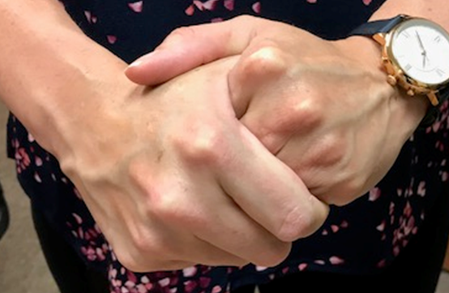
Module 3: People with
Mental Health, Cognitive, Intellectual, Developmental Impairments
Definition of Cognitive/Mental Health Conditions
General Awareness
  Behaviors that people may display
  Abilities that people may not have
  Signs of stress and/or
  confusion
DOH 530-223 September 2018
Notes:
Definition - People with cognitive/mental health issues may have sensitivities of varied abilities or inabilities to cope with common emergency scene conditions (sirens, flashing lights, lots of noise, confusion, numbers of people rushing around, etc.). People who have cognitive/mental health issues are not always easy to identify, and in many cases do not identify themselves as such. You may not be able to tell if people have cognitive/mental health issues until you are interacting and communicating with them.
Some cognitive/mental health conditions can be misinterpreted.
•Examples of possible conditions that may be easily misinterpreted will be listed in specific sections that follow.
O For example, someone might mistake cerebral palsy for drunkenness.
Military service members, veterans, and other people may have cognitive/mental health conditions due to traumatic brain injuries (TBI) or post-traumatic stress disorder (PTSD).
General Awareness
People with cognitive/mental health issues may have:
•short attention spans and the need to take more time to comprehend.
•difficulty reasoning and solving problems.
•difficulty remembering things, planning or organizing.
•pressured, halted or broken speech patterns.
•augmentative and alternative communication (AAC) devices.
•difficulty with coordination and motor functions.
•irrelevant dialogue.
•involuntary, non-aggressive or non-directed cursing.
•unusual behavior or inappropriate responses (verbal or non-verbal) Example: a building is on fire and the person is talking about the weather.
•inappropriate emotions or over-sensitivity.
People with cognitive/mental health issues may not have:
•the ability to read.
•the ability to speak and make their needs known.
People with cognitive/mental health issues may show signs of stress and/or confusion in their non-verbal body language, such as:
• confused facial expressions. • physical withdrawal from communication.
• rubbing hands together, rocking. • anxiety.
• overly friendly. • indifference.
• facial flat affect (absence of facial expressions). • agitation.
• personality changes, paranoia or hallucinations. • avoidance of eye contact or touch.
• sudden, repetitive movements or sounds that can be difficult to control (involuntary tics).
• obsessive repetition of a particular action, word or phrase.
• bewilderment indicated by the person not seeming to understand anything that is happening.

Slide 25
Module 3: People with
Mental Health, Cognitive, Intellectual, Developmental Impairments
General Etiquette
  Allow the person to complete his or her sentence or reply
  Be empathetic toward the person
  Remove a person with cognitive/mental health conditions from confusion and reduce distractions
DOH 530-223 September 2018
Notes:
General Etiquette
Do not shine flashlight in face/eyes (use of penlights for diagnostic information is acceptable).
Point to any objects as you speak about them.
Use pictures or objects to illustrate your words.
Demonstrate what you mean.
Showing someone can be more effective than telling.
Allow the person to complete his or her sentence or reply.
Do not assume the person is unintelligent.
Finishing his or her sentence or reply will only frustrate the person and serve to “highlight” the condition.
Avoid interrupting people who might be disoriented or rambling.
Be empathetic toward the person.
Show that you have heard him or her and care about what he or she has told you.
Be reassuring.
Rephrase or restate if the person does not understand.
Sometimes only one word is causing the confusion.
If the person is delusional, just let him or her know you are there to help.
Remove a person with cognitive/mental health conditions from confusion and reduce distractions.
Example: lower volume of radio, use flashing-lights on vehicle only when necessary.
Consider noise-cancelling devices if available (headphones) for the person with great sensitivities or confusion. Ask the person if he or she is willing to put them on. Explain what you are doing.

Slide 26
Module 3A: Mental Health
(Psychiatric, Behavioral, Emotional)
Definitions
  Mental Illness
  Anxiety Disorders
  Schizophrenia Disorders
  Psychiatric Disability
  Mood Disorders
Examples of Possible Conditions That May Mimic Mental Health Disorders:
Learning disability | Developmental disability
Intellectual disability | Autism
Cognitive disability | Traumatic brain injury
DOH 530-223 September 2018
Notes:
Mental Illness
A term that describes a broad range of mental and emotional conditions. Mental illness also refers to one portion of the broader ADA term mental impairment, and is different from other covered mental impairments such as mental retardation, organic brain damage, and learning disabilities.
Psychiatric Disability
Used when mental illness significantly interferes with the performance of major life activities, such as learning, working, and communicating, among others.
Someone can experience a mental illness over many years. The type, intensity, and duration of symptoms vary from person to person. They come and go and do not always follow a regular pattern, making it difficult to predict when symptoms and functioning will flare up, even if treatment recommendations are followed.
The symptoms of mental illness often are effectively controlled through medication and/or psychotherapy, and may even go into remission. For some people, the illness continues to cause periodic episodes that require treatment. Consequently, some people with mental illness will need no support, others may need only occasional support, and still others may require more substantial, ongoing support to maintain their productivity.
The most common forms of mental illness are anxiety disorders, mood disorders, and schizophrenia disorders.
Anxiety Disorders
Anxiety disorders, the most common group of mental illnesses, are characterized by severe fear or anxiety associated with particular objects and situations. Most people with anxiety disorders try to avoid exposure to the situation that causes anxiety.
Panic Disorder is the sudden onset of paralyzing terror or feeling of impending doom with symptoms that closely resemble a heart attack.
Phobias are excessive fears of particular objects (simple phobias), situations that expose a person to the possible judgment of others (social phobias), or situations where escape might be difficult (agoraphobia).
Obsessive-Compulsive Disorder is having persistent distressing thoughts (obsessions) that a person attempts to alleviate by performing repetitive, intentional acts (compulsions) such as hand washing.
Post-Traumatic Stress Disorder (PTSD) is a psychological syndrome characterized by specific symptoms that result from exposure to terrifying, life-threatening trauma, such as an act of violence, war, or a natural disaster.
The person has been exposed to a traumatic event in which both of the following have been present:
The person experienced, witnessed, or was confronted with an event or events that involved actual or threatened death or serious injury, or a threat to the physical integrity of self or others.
The person’s response involved intense fear, helplessness, or horror.
The traumatic event is persistently re-experienced in one (or more) of the following five ways:
Recurrent and intrusive distressing recollections of the event, including images, thoughts, or perceptions.
Recurrent distressing dreams of the event.
Acting or feeling as if the traumatic event were recurring (includes a sense of reliving the experience, illusions, hallucinations, and dissociative flashback episodes, including those that occur upon awakening or when intoxicated).
Intense psychological distress at exposure to internal or external cues that symbolize or resemble an aspect of the traumatic event.
Physiological reactivity on exposure to internal or external cues that symbolize or resemble an aspect of the traumatic event.
Avoidance behavior represents an effort to withdraw from certain situations that bring about body-level distress of trauma-related symptoms. Here are some examples:
Efforts to avoid thoughts, feelings, or conversations associated with the trauma.
Efforts to avoid activities, places, or people that arouse recollections of the trauma.
Inability to recall an important aspect of the trauma.
Markedly diminished interest or participation in significant activities.
Feeling of detachment or estrangement from others.
Restricted range of affect (e.g., unable to have loving feelings).
Sense of a foreshortened future (e.g., does not expect to have a career, marriage, children, or a normal life span).
Increased arousal may be demonstrated by the person as well. Here are some examples:
Difficulty falling or staying asleep.
Irritability or outbursts of anger.
Difficulty concentrating.
Hyper vigilance.
Exaggerated startle response.
Agitation.
Mood Disorders
Mood disorders are also known as affective disorders or depressive disorders. These illnesses share disturbances or changes in mood, usually involving either depression or mania (elation). With appropriate treatment, more than 80 percent of people with depressive disorders improve substantially.
Major depression is an extreme or prolonged episode of sadness in which a person loses interest or pleasure in previously enjoyed activities.
Bipolar disorder (also referred to as manic-depressive illness) is alternating episodes of mania (“highs”) and depression (“lows”) occurring over weeks at a time not suddenly.
Dysthymia is continuous low-grade symptoms of major depression and anxiety.
Seasonal affective disorder (SAD) is a form of major depression that occurs in the fall or winter and may be related to shortened periods of daylight.
Schizophrenia Disorders
Research has not yet determined whether schizophrenia is a single disorder or a group of related illnesses. The illness is highly complex, and few generalizations hold true for all people diagnosed with schizophrenia disorders. However, most people initially develop the symptoms between the ages of 15 and 25. Typically, the illness is characterized by thoughts that seem fragmented and difficulty processing information.
Symptoms of schizophrenia disorders are categorized as either “negative” or “positive.” Negative symptoms include social isolation or withdrawal, loss of motivation, and a flat or inappropriate affect (mood or disposition). Positive symptoms include hallucinations, delusions, and thought disorders.

Slide 27
Module 3A: Mental Health
(Psychiatric, Behavioral, Emotional)
Essential Tips / Etiquette
  Most people who are mentally ill are no more likely to be dangerous than the general population
  Respect personal space, and do not touch the person, or his or her belongings
  Consider differential diagnosis – do not get tunnel vision
  Do not give multiple commands – ask or state one thing at a time
DOH 530-223 September 2018
Notes:
Essential Tips / Etiquette
Media fuels misconceptions about mental illness. Fear of people who are mentally ill often stems from inability to communicate and lack of knowledge about mental illness.
In our society there is a powerful negative stigma attached to mental illness, especially the more severe forms, such as schizophrenia. Most people who are mentally ill are no more likely to be dangerous than the general population, but because of their bizarre and unpredictable behavior they often frighten people.
o Mental illness can affect behavior and communication skills.
Respect personal space, and do not touch the person, or his or her belongings.
o If touching becomes necessary, explain the process step by step.
o Some people with paranoia may be frightened, so be aware that they may need more
personal space than you may usually give.
o A touch on the shoulder can be comforting to some, but anxiety provoking to others.
Just ask; for example, “May I touch your arm?” or “May I look in your eyes?”
Do not assume that they are not smart and will believe anything you tell them.
Do not lie to them, as it will usually break any rapport you might want to establish.
Consider differential diagnosis – do not get tunnel vision.
Do not give multiple commands – ask or state one thing at a time.
If they are experiencing events such as hallucinations, be aware that the hallucinations or the delusions they experience are their reality. You will not be able to talk them out of their reality. They experience the hallucinations or delusional thoughts as real and are motivated by them.
o Find out what reality-based needs you can meet.
o Look for common ground.
o Focus on observable facts.
o Emphasize “we are all here for your safety.”
Remove yourself from the situation if you think you are getting agitated with the person; hand off to a partner.
o Know what “pushes your buttons.”

Slide 28
Module 3A: Mental Health
(Psychiatric, Behavioral, Emotional)
Suggested Communication Techniques
  Relax, stay calm and present an open stance
  Listen to the person and try to understand what he or she is communicating
  Watch out for contradictory messages between verbal and non-verbal messages
DOH 530-223 September 2018
Notes:
Suggested Communication Techniques
Relax, stay calm and present an open stance.
Start a conversation with the expectation that things will go smoothly.
Listen to the person and try to understand what he or she is communicating.
Speak in a normal, calm tone.
Listen and make eye contact (unless this is threatening).
Use “I-statements” not “you-statements,” such as “I understand you aren’t feeling well.”
Acknowledge what the other person says and how he or she feels, even if you do not agree.
Paraphrase; “If I understand you correctly, you and I…” “Is that what you’re saying?”
Engage the person in the process by asking for opinions and suggestions.
Watch out for contradictory messages between verbal and non-verbal messages.
Stick to present issues.
If needed, set limits with the person as you would others.
Example, "We have only five minutes before we must go" or "If you scream, I will not be able to talk to you."
Avoid general and loaded words such as “always” or “never.” Use specific words instead.
Ask “yes” or “no” questions and repeat them if necessary.

Slide 29


Module 3A: Mental Health
(Psychiatric, Behavioral, Emotional)
Providing Assistance and Removing Barriers
  Turn off emergency lights and sirens if possible
  Maintain continuity of care and avoid transferring the person from one responder to another if possible
  Call for help from mental health professionals if needed
DOH 530-223 September 2018
Notes:
Providing Assistance and Removing Barriers
Turn off emergency lights and sirens if possible.
Minimize environmental noise, flashing lights and confusion.
Reassure the person often and do not assume the person does not understand because he or she does not use words.
To maintain continuity of care with the person with whom you have developed a rapport, if at all possible, avoid unnecessarily transferring care from one person to another. Multiple interactions with new people may cause the person to become angry or violent. Refer the patient to someone else only if it is an appropriate referral.
Keep a current list of community resources, such as shelters, food programs, and mental health services that you can suggest (as needed).
Call for help from mental health professionals or colleagues if you need help de-escalating the person. Call for help from police or security if you feel physically threatened.

Slide 30
Module 3B: Cognitive
(Learning, Intellectual, Developmental, TBI)
Definitions
  Cognitive Disability
  Developmental Disabilities
  Traumatic Brain Injury (TBI)
  Learning Disabilities
  Dementia
Examples of Possible Conditions That May Exhibit These Characteristics:
Auditory processing disorder | Visual processing disorder
Aphasia | Cerebral palsy
Dyscalculia | Spina bifida
Dysgraphia | Brain aneurysm
Dyspraxia | Subdural hematoma
Sensory processing disorder | Concussion
Short- and long-term memory problems | Attention-deficit / hyperactivity disorder (ADHD)
Fragile X | Traumatic brain injury
Down syndrome | Autism spectrum disorders
Other intellectual disabilities | Visual processing disorder
DOH 530-223 September 2018
Notes:
Cognitive Disability
Refers to disturbances in brain functions, such as: memory loss, problems with orientation, distractibility, perception problems, and difficulty thinking logically.
• These disabilities may have their origins in physiological or biological processes within the person, such as a genetic disorder or a traumatic brain injury.
• Other cognitive disabilities may be based in the chemistry or structure of the person's brain.
Learning Disabilities
Lifelong disorders that interfere with a person’s ability to receive, express, or process information.
Developmental Disabilities
Lifelong disabilities resulting from physical or intellectual impairments, or a combination of both. These disabilities present themselves before the age of 22 and affect daily functioning in three or more of the following areas:
• Ability to support oneself economically. • Ability to live independently.
• Mobility. • Learning.
• Receptive and expressive language. • Self-care.
• Self-direction.
The disability can be severe, moderate, or mild, depending on a person’s support needs. People with intellectual disabilities, cerebral palsy, autism spectrum disorders, or genetic disorders such as Down syndrome are said to have developmental disabilities.
Dementia
This is not a specific disease. Instead, it describes a group of symptoms affecting intellectual and social abilities severely enough to interfere with daily functioning. It is caused by conditions or changes in the brain. Different types of dementia exist depending on the cause. Alzheimer's disease is the most common type.
Alzheimer's disease is a type of progressive dementia caused by the destruction of brain cells.
Although the exact cause is not known, two types of brain cell damage are common in people who have
Alzheimer's disease.
Alzheimer's disease usually progresses slowly, over seven to 10 years, causing a gradual decline in cognitive abilities. Eventually, the affected part of the brain is not able to work properly because of limited functions, including those involving memory, movement, language, judgment, behavior and abstract thinking.
Alzheimer's disease is the most common cause of dementia in people age 65 and older. Symptoms usually appear after age 60, although early-onset forms of the disease can occur, usually as the result of a defective gene.
Traumatic Brain Injury (TBI)
Traumatic brain injury can result from blunt or penetrating causes. Mild traumatic brain injury may cause temporary dysfunction of brain cells. More serious traumatic brain injury can result in bruising, torn tissues, bleeding and other physical damage to the brain that can result in long-term complications or death.

Slide 31
Module 3B: Cognitive
(Learning, Intellectual, Developmental, TBI)
Essential Tips / Etiquette
  Be patient, allow the person time to think, and answer any questions independently
  Ask about the best way to relay information
  Use clear sentences and concrete concepts
  If you are not sure whether you have understood, you can repeat for verification
DOH 530-223 September 2018
Notes:
Cognitive Disabilities
Some people with a cognitive disability may have above-average intelligence, but may have difficulty receiving, expressing, or processing information.
Other people with more profound cognitive disabilities often need assistance with simple tasks.
Ask the person if he or she prefers verbal or written communication, or some combination. For example, if providing verbal instructions, it may be helpful to give written material.
Be patient, allow the person time to think, and answer any questions independently.
Do not take lack of response personally; the person may be processing what was just asked, or discussed. Be aware that direct eye contact can be intimidating.
Learning Disabilities (LD)
Learning disabilities are lifelong disorders that interfere with a person’s ability to receive, express or process information.
•Most people with LD have average or above-average IQs.
• Allow extra time for reading, writing, response, etc. •Ask best way to relay information.
• Provide written instructions and information.
• Provide technologies that support learning strengths.
Developmental Disabilities
• Use clear sentences and concrete concepts. • Treat as adult and allow to make decisions.
• Allow adequate time to complete tasks and make decisions.
• Provide pictograms. • Allow time to adjust to change in environment or routine.
Dementia and Memory Loss
• Ask yes or no questions: repeat them if necessary. •Maintain eye contact.
Disabilities Impacting Speech
Give the person your full attention.
A person who has had a stroke, is deaf, uses a voice prosthesis or has a stammer or other type of speech disability may be difficult to understand.
Do not pretend to understand what he or she are saying if you really do not. Ask him or her to repeat it.
• If you are not sure whether you have understood, you can repeat for verification.
• If you still do not understand what someone is saying, consider asking the person to write it down.
Nodding heads does not mean the person understands. It is OK to ask the person to repeat what you said or if he or she understood.

Slide 32
Module 3B: Cognitive
(Learning, Intellectual, Developmental, TBI)
Suggested Communication Techniques
  Establish Rapport
  Choose the Appropriate Language
  Listening
  Explaining Clearly
  Communicating without Words
DOH 530-223 September 2018
Notes:
Establishing Rapport
• Consider that uniforms may be intimidating. • Speak directly to the person, not to his or her caregiver(s).
• Ask the person: “Do you want your support worker/caregiver to stay with us?”
• Ask simple introductory questions (e.g., name, reason for EMS visit).
• Explain the process and purpose of the EMS interaction in simple terms.
• Gain the person’s attention and eye contact, if possible, by using his or her name, or by touching his or her arm before speaking.
• Determine how the person communicates: “How do you say Yes? No?” “Do you use a device? Can you show me how to use this book/machine?”
•If the person uses a communication technique or device, involve a caregiver who is familiar with it.
• Show warmth and a positive regard.
• Encourage the use of “comforters” (e.g., favorite item the person likes to carry, or a preference for standing and pacing rather than sitting).
• For people with autism and related disorders, respect the preference to avoid eye contact.
• Use positive comments and positive reinforcement. •Focus on the person’s abilities rather than disabilities.
Choosing Appropriate Language
• Use concrete language.
• Use concrete as opposed to abstract language, for example: “Show me”; “Tell me”; “Do this” with gesture; “Come with me”; “I’m going to…” • Say “Put your coat on” instead of “get ready.”
• Say “Are you upset? Are you sad? Are you happy?” instead of “What are you feeling?”
• To make the concept of time more concrete, use examples from daily and familiar routines (e.g., breakfast-time, lunchtime, bedtime).
Listening
• Listen to what the person says. • Let the person know when you do and do not understand.
• Be sensitive to tone of voice and nonverbal cues.
• Differences in muscle tone for some people may complicate reading their facial expressions or body language. Check and validate your perceptions.
• Be aware that the interaction will likely take more time than usual.
Explaining clearly
• Explain what will happen before you begin. • Tell and show what you are going to do and why.
• Rephrase and repeat questions, if necessary, or write them out, if the person is able to read.
• Checking for understanding is essential. For people who can speak in sentences, ask questions such as: “Can you tell me what I just said?” “Can you tell me what I am going to do and why?”
Communicating without words
• Use visual aids. • Act or demonstrate.
• People with limited language ability and understanding rely on familiar routines and environmental cues to understand or anticipate what will happen next.
• Use simple diagrams and gestures. • Use pictures when communicating; find signs in the person’s communication
book or point to familiar objects (e.g., “It looks like…”).
• Some people may express themselves only in writing.
• When possible and safe, allow the person to handle and explore equipment.
• Point to body parts and act out actions or procedures (e.g., checking ears).

Slide 33

Module 3C: Autism
Definitions of Autism Spectrum Disorder (ASD)
Examples of Possible Conditions That May Exhibit Similar Characteristics:
DOH 530-223 September 2018
Notes:
This is Travis King, whose parents spearheaded the Travis Alert Act to help educate responders.
Autism spectrum disorder (ASD) is a range of complex neurodevelopment disorders, characterized by social impairments, communication difficulties, and restricted, repetitive, and stereotyped patterns of behavior.
Autistic disorder, sometimes called autism or classical ASD, is the most severe form of ASD, while other conditions along the spectrum include a milder form known as Asperger syndrome, the rare condition called Rett syndrome, and childhood disintegrative disorder and pervasive developmental disorder not otherwise specified (usually referred to as PDD-NOS).
Although ASD varies significantly in character and severity, it occurs in all ethnic and socioeconomic groups, and affects every age group. Some characteristic difficulties in behavior, social interaction, communication are common among people on the spectrum; others are typical of the disability but not necessarily exhibited by all people on the autism spectrum.
Behavior displayed by the person is due to the difficulties he or she has responding to the environment. Their behavior is generally an attempt by them to communicate their feelings or to cope with a situation. Behavior problems may occur as the result of their heightened sensitivity to a sound or something he or she may have seen or felt.
For people on the spectrum, rigidly sticking to routines and spending their time in repetitive behaviors are ways for them to reduce uncertainty and to maintain the predictability of their environment.
Other behaviors may include: • unusually intense or focused interests.
• stereotyped and repetitive body movements such as hand flapping and spinning.
• repetitive use of objects such as repeatedly switching lights on and off or lining up toys.
• insistence on sticking to routines such as traveling the same route home each day and doing things in exactly the same order every time.
• unusual sensory interests such as sniffing objects or staring intently at moving objects.
• sensory sensitivities including avoidance of everyday sounds and textures such as hair dryers, vacuum cleaners and sand.
Social interaction is poor with people who have autism as they have difficulty establishing and maintaining relationships. They do not respond to many of the non-verbal forms of communication that many of us take for granted, such as facial expressions, physical gestures and eye contact. They are often unable to understand and express their needs, just as they are unable to interpret and understand the needs of others. This impairs their ability to share interests and activities with other people. For this reason they may appear distant and aloof. Because they are often delayed in their speech and struggle to make sense of other non-verbal forms of communication, they may withdraw into repetitive play and behavior, and avoid interaction.
Their difficulties with social interaction may manifest in the following ways:
• limited use and understanding of non-verbal communication such as eye gaze, facial expression and gesture
• difficulties with social and emotional responsiveness. • difficulties forming and sustaining friendships.
• lack of seeking to share enjoyment, interests and activities with other people.
.
Communication difficulties, in one form or another, are common for people who have autism. Some people with autism speak fluently, others are speech impaired to varying degrees, and others still are unable to speak at all. Those who can speak will often use language in a very limited or unusual way. Their line of conversation may involve repeating your phrases or words back to you or asking the same questions over and over. People with autism will usually talk about only topics that are of interest to them, which makes the give and take in communication difficult. They have difficulty interpreting non-verbal forms of communication such as facial expressions, hand gestures and other body language.
Impaired communication is characterized by: • delayed language development. • difficulties initiating and sustaining
conversations. • stereotyped and repetitive use of language such as repeating phrases from television.

Slide 34
Module 3C: Autism
Essential Tips / Etiquette
  When interacting with people with autism:
    Be clear and direct, avoid figurative language
    Approach the person in a quiet, non-threatening manner, giving them plenty of space and time to respond
    Do not threaten the person with punishment
  When interacting with caregivers and parents:
    Allow them to explain the situation before reacting
DOH 530-223 September 2018
Notes:
When interacting with EMS and police, people with autism might:
• not respond to their name or verbal commands such as “stop.” It may appear that the person is ignoring you when the person is overwhelmed or fixated on an interest.
• repeat exactly what you say back to you without any appearance of understanding the question due to underdeveloped communication skills (also called echolalia).
• avoiding eye contact or reacting with discomfort when eye contract is attempted.
• ignore warnings of entering dangerous situations due to an impaired sense of danger, i.e. wandering to bodies of water, traffic or other dangers and not stopping when asked.
• be overwhelmed by EMS or police presence; exhibiting fear or distress to raised voices or uniform.
• reach for police equipment due to a decreased understanding of boundaries, social rules and danger.
• engage in repetitive behavior: repeating the same noise or phrase repeatedly, rocking, biting their hands, scratching themselves, rocking, spinning ext.
• have impaired sensory perception, which may present as being under or overdressed for the weather, being obviously injured but not showing any pain or asking for help.
• not speak or make eye contact. • become distracted by smells.
• become excited, frightened or distracted by noise and lights around them. Try to minimize these environmental conditions.
• experience a “meltdown”:
When a person with autism becomes overstimulated or anxious, he or she may lose control and melt down, start yelling, screaming, throwing or breaking objects, hitting themselves or those around them.
Meltdowns and tantrums appear similar, but tantrums are manipulative in nature and end when the demand is met.
Meltdowns are a loss of control and generally have to run their course.
The person experiencing the meltdown may attempt to remove themselves from the meltdown trigger by walking or running away. As long as he or she are removing themselves to a safe location, allow them to do so and follow at a safe distance. Do not physically intervene unless there is a safety risk, instead try to reduce stimuli: Reduce flashing lights, sirens, crowds, loud voices.
Follow the guidance of the guardian; he or she likely have extensive experience in managing the behavior.
Unless absolutely necessary, do not touch a person with autism without his or her permission. People with autism are often sensitive to touch, and touch can be painful.
If a person with autism begins to waves arms around, do not try to hold the person’s arms. Usually within a short period of time this will stop. It is a sign that the person is frustrated, frightened and /or experiencing something very different.
Look for signs of stress or confusion, and understand that rocking, repetitive motion and repeating words/phrases may be comforting to a person with autism.
Repeat reassurances, but do not assume the person doesn’t understand because he or she does not use words.
Remove additional stimulus if possible (in a crowded room request that the other people leave, remove barking dogs, turn off alarms, flashing lights, sirens, etc.)
Move slowly and explain calmly what you are doing.
If the person does not appear to understand request a social worker come to assist, if possible.
Be aware that people with autism may agree to questions due to lack of understanding, desire to please you, or desire to escape your questions or presence (they may say they did something in the hopes you will stop asking). This will lead people with autism to confess to crimes they did not commit or describe inaccurate medical symptoms & history. Do not question the person without first speaking with their caregiver. Be careful to ask questions that do not suggest the answer (I think you did X because of X, didn’t you? Instead ask; what were you doing at 8 am this morning?)
If the person is alone, attempt to locate the caregiver by looking for medical IDs, asking to see the person’s wallet, keys, and communication-devices or to look in their backpacks or other places a caregiver might write their contact information.
When interacting with people with autism:
Be clear and direct, avoid figurative language.
Approach the person in a quiet, non-threatening manner, giving them plenty of space and time to respond.
Do not threaten the person with punishment.
When interacting with caregivers and parents:
Allow them to explain the situation before reacting (e.g. why the parent is restraining the child).

Slide 35
Module 3C: Autism
Suggested Communication Techniques
  Use a calm voice, simplistic and short sentences
  Sensory overload is the major barrier to communication and compliance
  Be clear and direct, avoid figurative language
  Create a calm, quiet space
DOH 530-223 September 2018
Notes:
Use a calm voice, simplistic and short sentences.
Give at least two minutes for person to process and respond to a question or command. Delayed processing means that the person may need additional time to respond. If he or she do not respond repeat the question or command slowly and calmly.
Avoid using figurative language.
If the person has an iPad or other Assistive Technology Devise with them do not remove it.
The person may use this to communicate with you.
Avoid asking questions that suggest the answer when seeking information or questioning a person with ASD suspected of a crime.
If the person’s interests are obvious (the person is wearing a lot of Mario clothes or has a toy with them) attempt to engage the person in talking about it or bring up a related YouTube video on a phone to distract them.
Sensory overload is the major barrier to communication and compliance.
Turn off flashing lights, sirens, remove K-9 officers and create a calm, quiet space.
If the caregiver is present, ask them how to communicate with the person.

Slide 36
Module 3C: Autism
Providing Assistance and Removing Barriers
  Remind Search & Rescue personnel to consider looking in and around nearby bodies of water when searching for a missing child with ASD, under the age of 14
  Step back and consider what behavior is necessitating EMS response
  Identify resources that can be used to stabilize the person/situation
DOH 530-223 September 2018
Notes:
Remind Search & Rescue personnel to consider looking in and around nearby bodies of water when searching for a missing child with ASD, under the age of 14.
Step back and consider what the function of the behavior necessitating EMS/police response is (i.e. the person is repeatedly trying to get into a house he or she do not live in, did he or she live there before)? If you can discover the function of the behavior you can use this to help calm the person (the person is “stealing” food from the store-he or she may live nearby and be out of their favorite food and have simply gone to where he or she know it is without understanding the consequences).
Help identify resources the caregiver can use to stabilize the person.
It is recommended that regional police/EMS agencies develop and maintain a list of crisis and support services for people with autism and their families.
Provide prevention and safety resources to the family.
It is recommended that first responders develop a local database of “at risk people” for caregivers to provide information too.

Slide 37
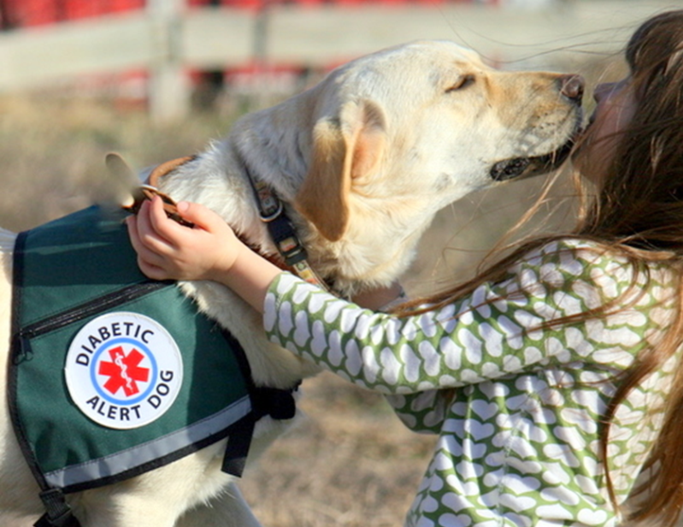
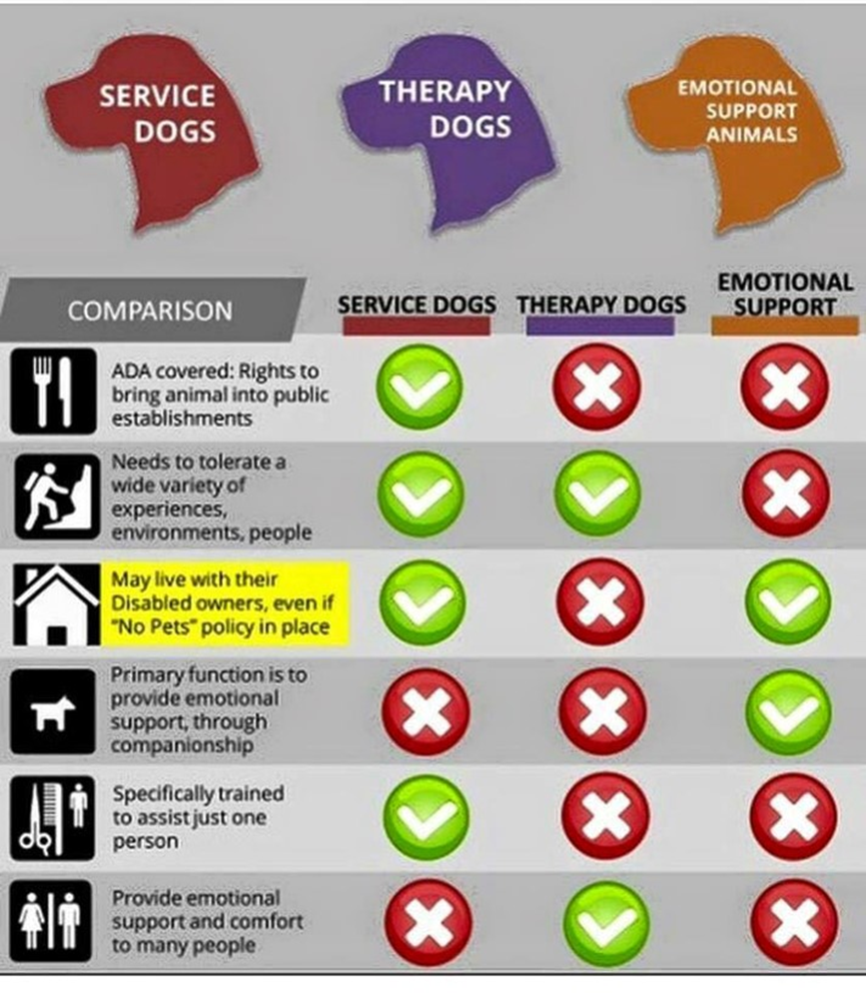
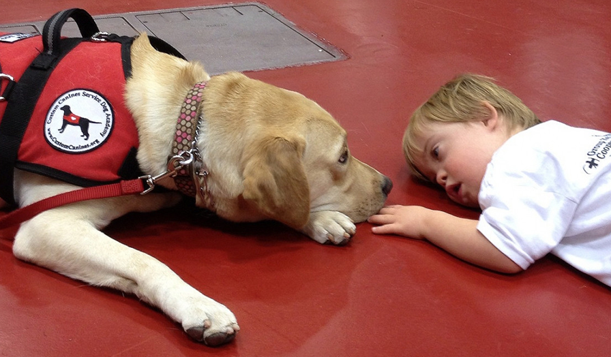
Module 4: People with Service Animals
Definitions of Dog Guide & Service Animal
  To include miniature horses
Courtesy: Custom Canines.org
Courtesy: Custom Canines.org
Notes:
Dog Guide (as defined in RCW 49.60.040(8))
A dog that is trained for the purpose of guiding blind people or a dog that is trained for the purpose of assisting hearing impaired people.
Service Animal (as defined in RCW 49.60.040(24))
An animal that is trained for the purpose of assisting or accommodating a disabled person’s sensory, mental, or physical disability.
Service Animals
Only dogs are recognized as service animals under titles II and III of the ADA. Generally, title II and title III entities must permit service animals to accompany people with disabilities in all areas where members of the public are allowed to go. A service animal is a dog that is individually trained to do work or perform tasks for a person with a disability. Dogs whose sole function is to provide comfort or emotional support do not qualify as service animals under the ADA. Service animals are working animals, not pets.
• Examples of such work or tasks include: ▫ guiding people who are blind.
▫ alerting people who are deaf. ▫ pulling a wheelchair.
▫ alerting and protecting a person who is having a seizure.
▫ reminding a person with mental illness to take prescribed medications.
▫ calming a person with post-traumatic stress disorder (PTSD) during an anxiety attack.
▫ performing other duties.
The practice of non-disabled people passing off pet dogs as different types of service dogs has eroded the rights of real assistance dog handlers, especially those with invisible disabilities.
Do not make assumptions. If you see a person who can walk and talk, and he or she is sighted, and he or she is hearing, the dog may be alerting to diabetes or seizures. Those tasks may be done by a breed that doesn’t fit the popular image of a service dog as a retriever or a German shepherd. As the list of jobs for service dogs grows, so does the diversity of service dog breeds helping people with disabilities.
Miniature Horses In addition to the provisions about service dogs, the department’s revised ADA regulations have a separate provision about miniature horses that have been individually trained to do work or perform tasks for people with disabilities.
Generally such horses range in height from 24 “ -34”measured to the shoulders, and weigh between 70 and 100 pounds.
Entities covered by the ADA must modify their policies to permit miniature horses where reasonable. The regulations set out four assessment factors to assist entities in determining whether miniature horses can be accommodated in their facility.
The assessment factors are:
Whether the miniature horse is housebroken;
Whether the miniature horse is under the owner’s control;
Whether the facility can accommodate the miniature horse’s type, size, and weight;
Whether the miniature horse’s presence will not compromise legitimate safety requirements necessary for safe operation of the facility.

Slide 38
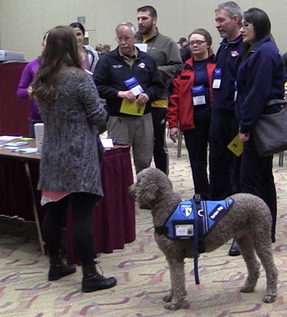

Module 4: People with Service Animals
Examples of Types of Service Animals:
Guide Dogs | Hearing Dogs
Mobility Assistance Dogs | Diabetic Alert Dogs (DAD)
Seizure Alert Dogs | Seizure Response Dogs
Psychiatric Service Dogs | Autism Support Dogs
Fetal Alcohol Spectrum Disorder (FASD) Service Dogs | Allergy Detection Dogs
DOH 530-223 September 2018
Notes:
Types of Service Animals
Guide Dogs
Guide dogs have been helping visually impaired people for centuries. While people often expect guide dogs and other assistance dogs to wear vests, the Americans with Disabilities Act does not require a vest, although the dogs will often be wearing a special harness with a handle on it.
Assistance dogs that lead visually impaired and blind people around obstacles are one of the most commonly known types of service dogs. Labrador retrievers, golden retrievers, and Lab-golden hybrids are often dog breeds chosen as guide dogs, although other breeds, such as poodles, can also be well suited to be this type of service dog.
Hearing Dogs
For people with hearing impairments, these types of service dogs assist by alerting their human to noises such as alarms, doorbells, or crying babies. When the dog hears the sound, it will touch the human and lead toward the noise.
Labradors and golden retrievers are dog breeds that are often selected as hearing dogs, but other breeds, including cocker spaniels and miniature poodles, have been successfully trained to alert as a hearing dog. Terrier mixes, poodles, cockers, Lhasa apsos, shihtzus and even Chihuahuas are being selected for personality and temperament, and are trained to alert as a hearing dog.
Mobility Assistance Dogs
These types of service dogs can perform a wide range of tasks for people with a wide range of mobility issues. According to Service Dogs of America, mobility assistance dogs can bring objects to people, press buttons on automatic doors, serve as a brace for people who are ambulatory, or even help pull a wheelchair up a ramp. These dogs help people increase their independence and confidence.
People with spinal cord injuries, brain injuries, muscular dystrophy, and arthritis are among those who benefit from being partnered with a mobility assistance dog. Different breeds are selected depending on the handler’s size, but the dogs must be large enough to support their human partner.
Diabetic Alert Dogs (DAD)
Also known as DADs, these types of service dogs can provide independence and security by alerting to chemical changes in their handler’s blood sugar. The scent changes associated with hyperglycemic or hypoglycemic events in diabetics are imperceptible to humans, but dogs can pick up on them and alert their people to blood sugar highs and lows before the levels become dangerous.
When a diabetic alert dog alerts, its human then knows to test his or her blood, then inject insulin or ingest a dose of glucose before the blood level gets dangerous. Many of these dogs are trained to go alert others in the household or set off an alarm system if their human needs medical help.
Seizure Alert Dogs
Seizure alert dogs are a controversial type of service dog that react with a specific type of behavior right before his or her human has a seizure. The ability to alert to seizures seems to be a natural ability for a small number of dogs, although some neurology experts say no reliable evidence suggests dogs can reliably predict seizures.
More next page >>
Seizure Response Dogs
Not to be confused with seizure alert dogs, seizure response dogs are trained to provide help to a person experiencing an epileptic seizure, not to predict the seizure. These dogs can be trained to bark for help or to press an alarm system during a person’s seizure. They can also get a person out of an unsafe place during a seizure and help the handler to come around when the seizure ends. These dogs may also bring medicine or a phone to a person who is coming out of a seizure.
Psychiatric Service Dogs
This versatile category of service dog assists people who are suffering from issues such as depression, anxiety and most often post-traumatic stress disorder.
Human handlers in this category can feel hyper-vigilant about their safety, and service dogs can make them feel safer by doing things such as entering the home before the human, and turning on the lights with a foot pedal. These dogs can also help PTSD sufferers who feel overwhelmed in public places by creating a physical barrier between the handler and others, giving the handler more personal space. Many PTSD sufferers find that having a service dog to care for forces the human to also take care of themselves, by getting out into the world and getting exercise with the dog.
Autism Support Dogs
For children on the autism spectrum, these types of service dogs help provide a sense of predictability as the children navigate social settings, including school. The dogs can be a big help for children who have trouble connecting with classmates, as the canine acts as an icebreaker in social situations. In addition to improving the child’s quality of life by reducing isolation and comforting the child in stressful times, these dogs are also trained to keep children from running away and can often track children if they do run off.
Fetal Alcohol Spectrum Disorder (FASD) Service Dogs
An emerging category of service dog, these dogs support children who were exposed to alcohol prenatally, and have been diagnosed with fetal alcohol spectrum disorders. These children may have physical and mental difficulties, as well as behavioral problems and learning disabilities. FASD dogs are trained similarly to autism service dogs and can be trained to interrupt a repetitive behavior.
Allergy Detection Dogs
With the rise in food allergies has come another type of medical service dog. Allergy detection dogs are trained to sniff out and alert to the odor of things such as peanuts or gluten. Often partnered with children, allergy detection dogs can be trained to alert to allergy-inducing smells at school, providing the kids with a greater sense of independence and giving their parents

Slide 39
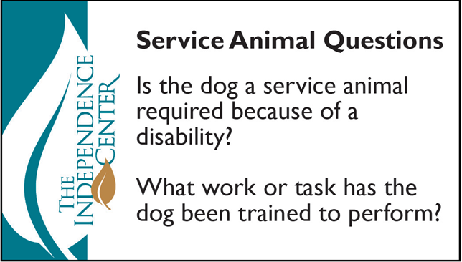
Module 4: People with Service Animals
Essential Tips / Etiquette
  Recognize the service animal as medical equipment that should accompany the person
  When it is not obvious what service an animal provides, staff members may ask two questions
  Service animals must
  be harnessed, leashed,
  or tethered, unless controlled
  by voice or signal commands
DOH 530-223 September 2018
Notes:
Under the ADA, service animals must be harnessed, leashed, or tethered, unless these devices interfere with the service animal’s work or the person’s disability prevents using these devices. In that case, the person must maintain control of the animal through voice, signal, or other effective controls.
• When it is not obvious what service an animal provides, staff members may ask two questions:
▪ Is the dog a service animal required because of a disability? ▪ What work or task has the dog been trained to perform?
Staff members may not ask about the person’s disability, require medical documentation, require a special identification card or training documentation for the dog, or ask that the dog demonstrate its ability to perform the work or task.
• Allergies and fear of dogs are not valid reasons for denying access or refusing service to people using service animals.
• A person with a disability may not be asked to remove his service animal from the premises unless:
O The dog is out of control and the handler does not take effective action to control it. O The dog is not housebroken.
O When there is a legitimate reason to ask that a service animal be removed, staff members must offer the person with the disability the opportunity to obtain services without the animal’s presence.
• Staff members are not required to provide care or food for a service animal.
• If you have doubts, wait until you arrive at your destination and address the issue with the supervisor in charge.
•Other kinds of working dogs, including therapy dogs and emotional support dogs, are not classified as service animals as they’re not trained to perform a specific task to help their handlers. In most jurisdictions, these kinds of dogs are not afforded the same privileges as service dogs.
• Many service animals such as guide dogs are very expensive to train, and trying to treat them like pets is likely to break the training regime. Remember, that dog is that user’s eyes, ears or otherwise.
• Recognize the service animal as medical equipment.
• In the event you are asked to take the dog while assisting the person, hold the leash and not the harness.
• Service animals are generally loved by their handlers, and the two share a unique bond. Keep in mind, though, that these animals are not pets. Service animals provide essential assistance to their handlers and are medically necessary.
• Avoid distracting the service animal.
O Keep in mind that service animals have a specific job to do, and that their handlers rely on them for safety and
protection in public. Feeding, playing with, talking to, or otherwise engaging the animal can be distracting for it. You
should avoid distracting the animal in any way unless you have permission from the handler.
▪ Keep in mind that some handlers have disabilities that cause anxiety or social difficulties, so they may not be able to
say "no" to you.
O A service animal may wear a patch such as "ask before petting" or "do not distract." If you do not see a patch, play it
safe and do not interact.
O If the handler is open to letting you interact with the animal, he or she will tell you. Some animals, such as emotional
support animals, can sometimes interact with you if it is OK with the handler. Other animals, such as seizure alert dogs,
need to stay focused at all times to keep the handler safe.
O Do not ask the animal to do tricks or to perform tasks.
O Do not call attention to the animal or take pictures without clear permission from the handler.
O Avoid getting in the way of the animal. Just as you would not forcibly move someone's arm or block their leg, give the
animal space to do its job.
O Making eye contact with the animal could distract it from its work, which could be dangerous to the handler.
O Teach children not to interact with a service animal, because it's busy working.
O If it appears that the handler needs help with the animal, you may politely offer assistance. For example, if the
handler cannot access an area where the dog may relieve itself, you could say something such as, “Would you like me
to walk your dog over to the grass?”

Slide 40
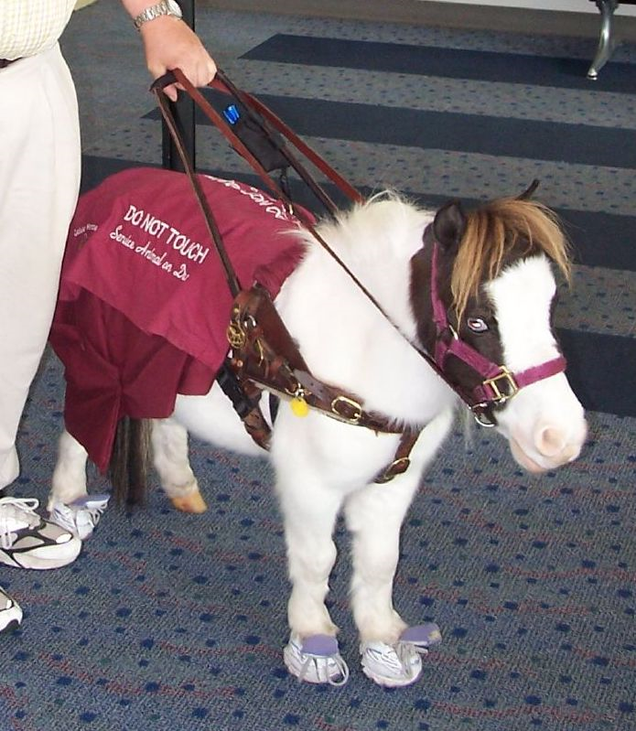
Module 4: People with Service Animals
Suggested Communication Techniques
  Talk to the handler normally and leave the animal alone
  Avoid saying insensitive things
  It is impolite, and in some cases illegal, to ask a person with a service animal what his or her disability is
Courtesy-DanDee Shots- ‘Scout’
DOH 530-223 September 2018
Notes:
Talk to the handler normally and leave the animal alone.
There is no need to ask about their disability or their service animal.
This person has a service animal because of a disability, so avoid saying insensitive things such as “That dog is really nice. I wish I had a service dog.”
If a patron, coworker, or employee brings a service animal into your establishment, you might want to ask questions.
Keep in mind that medical privacy comes into play when discussing a service animal. While you are not banned entirely from asking questions, you are allowed to ask only two under federal law.
It is impolite, and in some cases illegal, to ask a person with a service animal what his or her disability is. He or she has the right to medical privacy just like any other person.

Slide 41
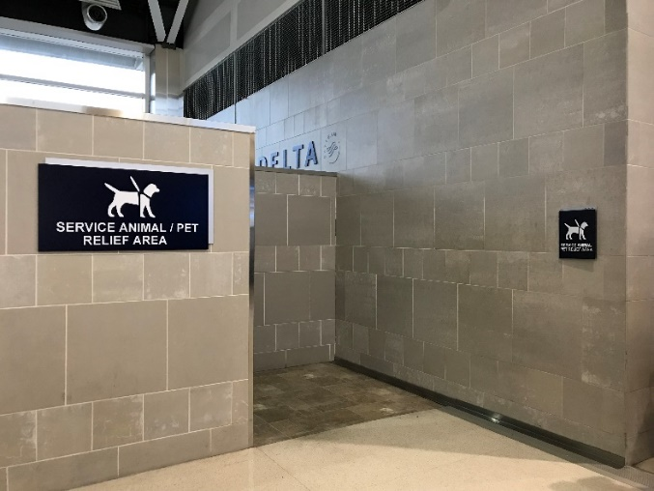
Module 4: People with Service Animals
Providing Assistance and Removing Barriers
  Know the federal law protecting service animals
  Service animals are allowed anywhere that the public is allowed
  Public transportation systems must allow service animals to travel with their handlers, this includes ambulances
DOH 530-223 September 2018
Notes:
Know the federal law protecting service animals.
Under the ADA, only dogs and miniature horses are considered service animals.
The animals are allowed anywhere that the public is allowed, and no proof must be carried to verify the animal’s training or the handler’s disability.
The ADA requires that public transportation systems allow service animals to travel with their handlers. This includes ambulances. The animal will often lie at the handler’s feet, or remain in the handler’s lap.

Slide 42
Summary
General Overall Tips / Etiquette
  Put the person first and his or her disability second
  Do not make assumptions about needs, abilities, or limitations
  If the person needs help, he or she likely will instruct you on how best to give assistance
  Be sensitive about physical contact
  Always speak to people with a disability directly
DOH 530-223 September 2018
Notes:
•Put the person first and his or her disability second.
•Use common sense.
•Do not make assumptions about needs, abilities, or limitations.
•Disability comes with varying levels of limitations.
•Do not get tunnel vision.
•Create an environment that permits people with non-visible disabilities to disclose if necessary.
•If you want to help someone, ask first.
•If the person needs help, he or she likely will instruct you on how best to give assistance.
•Treat adults as adults.
•Apply basic courtesies to all people.
•Do not be condescending, or treat people with any type of disability as if he or she were a child, unless he or she
is a child.
•Be sensitive about physical contact.
•Always speak to people with a disability directly when they present themselves to you.
•Try to include the person in conversations with other people; do not talk about a person in front of that person.
•Do not assume that people do not understand just because they do not use words to communicate.
•It is OK to use phrases such as “walk with me,” “see you later,” or “did you hear about that?” People with
disabilities will do so, too.
•Do not ask personal questions you would not ask of a person who is not disabled.
•Ask for and look for:
o An identification bracelet with special health information.
o Emergency contact information to reach the person's family.
o Essential equipment and supplies (for example: wheelchair, walker, oxygen, batteries, communication devices
[head pointers, alphabet boards, speech synthesizers, etc.]).
o Medication.
o Mobility aids (for example, wheelchair, cane, walker or an assistance or service animal).
o Specific health instructions (for example: allergies).
o Specific communication information (for example: is the person using sign language?).
o Signs of stress and/or confusion (for example, the person might say he or she is stressed, look confused,
withdraw, start rubbing the hands together).
o Conditions that people might misinterpret (for example, someone might mistake cerebral palsy for
drunkenness).

Slide 43
Summary
General Overall Communication
  Put the person first and his or her disability second
  Do not make assumptions about needs, abilities, or limitations
  If the person needs help, he or she likely will instruct you on how best to give assistance
  Be sensitive about physical contact
  Always speak to people with a disability directly
DOH 530-223 September 2018
Notes:
People with speech disabilities, people with cognitive difficulties, people with significant hearing loss or anyone with limited English proficiency may not be able to use audible and/or intelligible speech to communicate.
People who have difficulty speaking may also have difficulty understanding what other people are saying.
People with communication limitations are a vulnerable population in any emergency or disaster.
If the person does not use words to speak, look for gestures or other behaviors that communicate what the person is wanting to express.
Begin by identifying basic communication methods (pay attention to pointing, gestures, nods, sounds, eye gaze and eye blinks).
Example questions to establish good communication could include:
"Show me how you say yes."
"Show me how you say no."
"Show me how you point to something or someone you want."
After communication methods have been identified, ask a few basic questions.
"Is someone here who can help me communicate with you?"
"Do you have a communication board, communication book, or a speech generating device?"
"Did you bring it with you?" If the person indicates yes, ask where it is and help retrieve it. If the person indicates no, go to the Picture Cues tab.
Present paper and writing utensil or a communication board if possible.
Use pointing and gestures to show what you want the person to do.
Watch for signs that the person is deaf or hard of hearing.
Ask questions that can easily be answered with a yes or no response.
Ask questions one at a time and slowly.
Give the person extra time to respond.
Take time to listen carefully.
Maintain eye contact if possible and appropriate.
Maintain appropriate facial expressions.
If you look angry or annoyed, the person may be less cooperative.
• Do not pretend to understand when you do not – repeat what you do understand, and ask for the
part you didn’t understand to be repeated

Slide 44
Ability Checklist
General - Immediate Actions Items:
  Safety of EMS personnel and bystanders
  Respect personal space
  Use calm tone
  Include the patient in planning and decision making
  Assess and treat immediate life threats
  What physical barriers need to be removed
  Consider the need for outside resources
DOH 530-223 September 2018
Notes:
Part of the legislation called for EMS providers to have a checklist of Key Considerations to think about when interacting with People with Access and Functional Needs.
These are general considerations, and specific considerations are listed in the following slides relative to the topic.

Slide 45
Ability Checklist- Mobility / Physical Impairments
• Key Considerations
  Transport assistive devices used by patient should accompany the patient when possible
  Arrange for alternative transport for the device or find a method of securing the device if it is not possible to transport the device
  Consider using the same method patient was transported in past
  Request other resources if special considerations in handling and transport are needed
DOH 530-223 September 2018

Slide 46
Ability Checklist - Sensory Impairment - Vision
• Key Considerations
  Determine the degree of vision deficit
  Speak directly to the patient; do not shout or use non-specifics e.g. “Watch out”
  Determine if assist devices or service animals are used
DOH 530-223 September 2018

Slide 47
Ability Checklist - Sensory Impairment - Hearing
• Key Considerations
  Determine the degree of hearing deficit
  Determine which communication techniques are best to use, such as lip reading, signing, or the use of written language
  Look for someone to help you to communicate, or use a family member or other resource immediately available who is able to assist if appropriate
DOH 530-223 September 2018

Slide 48
Ability Checklist - Mental Health / Cognitive
• Key Considerations
  Check blood sugar
  Consider the differential diagnosis (consider medical, traumatic conditions)
  Avoid sensory overload or triggering actions when interacting with the patient.
  Use calm voice, avoid escalation
  Use open posture, avoid prolonged eye contact
  Consider other resources for safety
DOH 530-223 September 2018

Slide 49
Ability Checklist - Autism
• Key Considerations
  Avoid sensory overload and triggering actions such as sounds or bright light when interacting with the patient
  Discuss requirements for successful interaction with caregiver
  Use calm tone, acknowledge and validate emotions
DOH 530-223 September 2018

Slide 50
Ability Checklist – Service Animals
• Key Considerations
  Assure the service animal is transported with the patient
  Request additional assistance should the animal not be able to accompany the patient
DOH 530-223 September 2018

Slide 51
Resources for Information
Related to Different Disabilities
Community Resources
  https://www.doh.wa.gov/YouandYourFamily/DisabilityOrganizations/
Provider Tools
  http://cdd.unm.edu/dhpd/pdfs/FifthEditionTipsSheet.pdf
  https://www.ada.gov/service_animals_2010.htm
  http://terrorism.spcollege.edu/SPAWARAFN/index.html
  http://www.readysandiego.org/training/first-responder-access-functional-needs-training-series/
Training Resources
  https://www.doh.wa.gov/ForPublicHealthandHealthcareProviders/EmergencyMedicalServicesEMSSystems/EMSProviderEducation/EMSTrainingApplicationsAndDocuments
DOH 530-223 September 2018
Notes:
DOH includes on its website a list of public and private nonprofit disability related agencies and organizations, and the contact information of each agency and organization.

Slide 52

Conclusion
Thank you for the privilege of your time!
Thank you for all you do for People with Access and Functional Needs!
Travis and his family thank you as well.
DOH 530-223 September 2018

