Slide 1

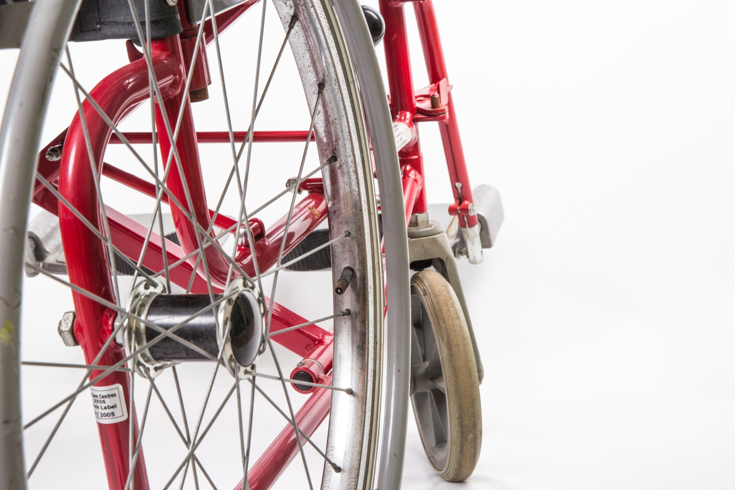
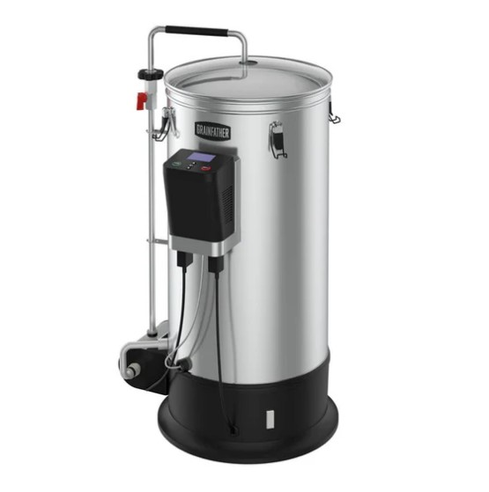
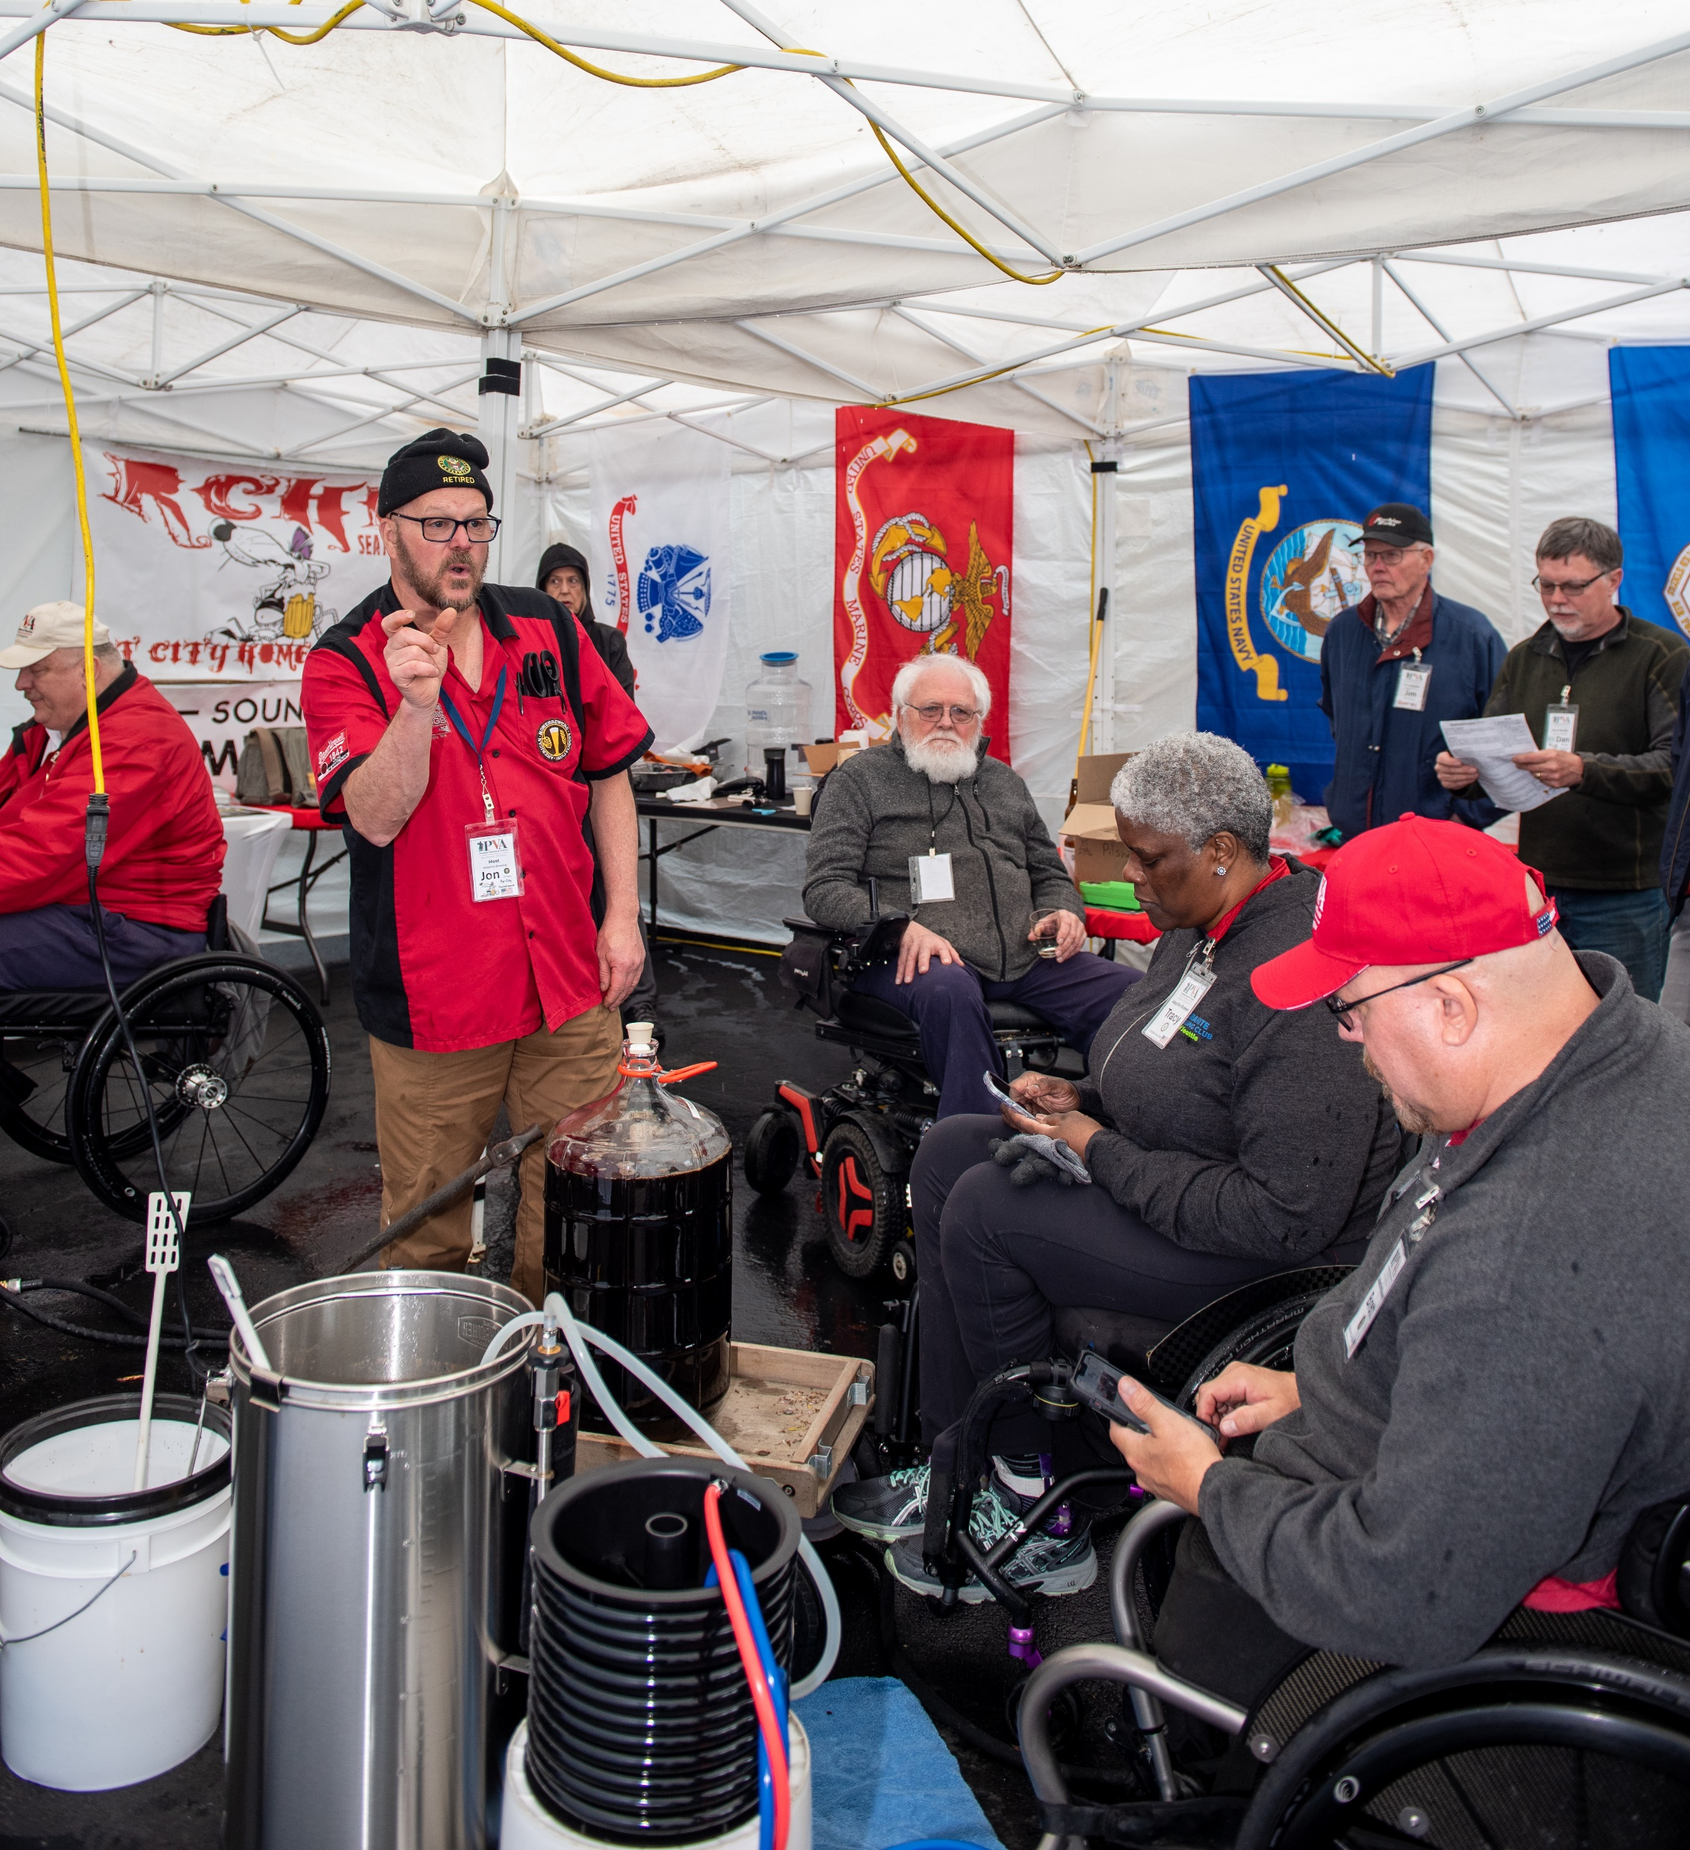

Adaptive Brewing
Program
Part 3 of 3
Jon M Newton
4 Barking Dogs Brewery & Tap House
24 Aug 2024

Slide 2
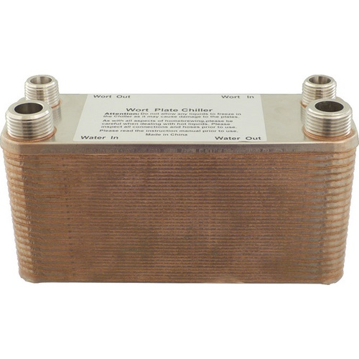
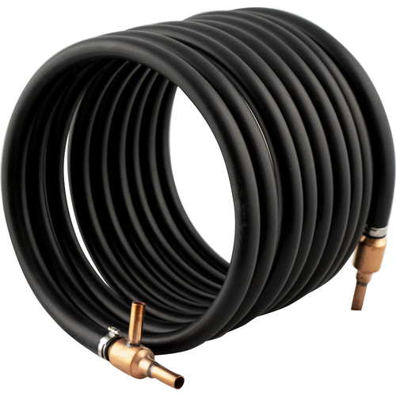
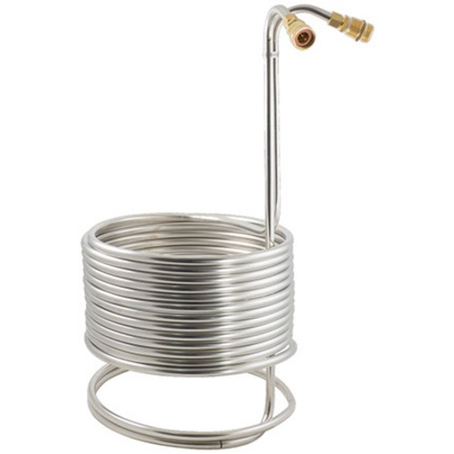
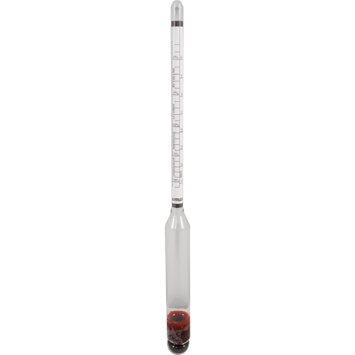
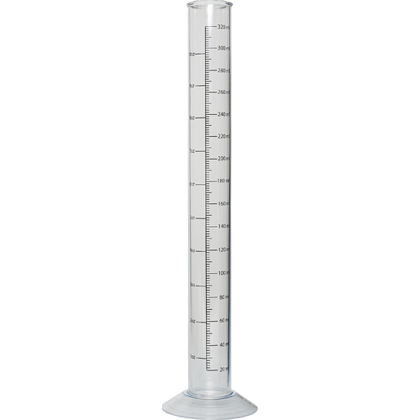
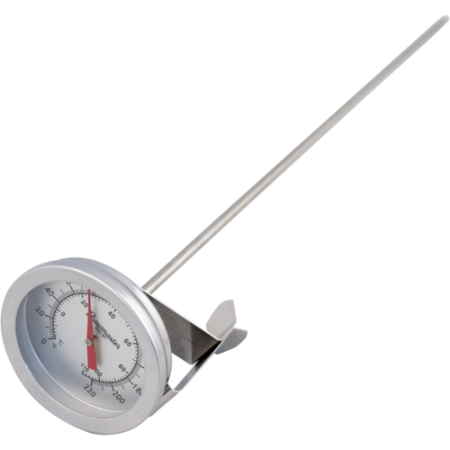

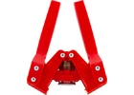
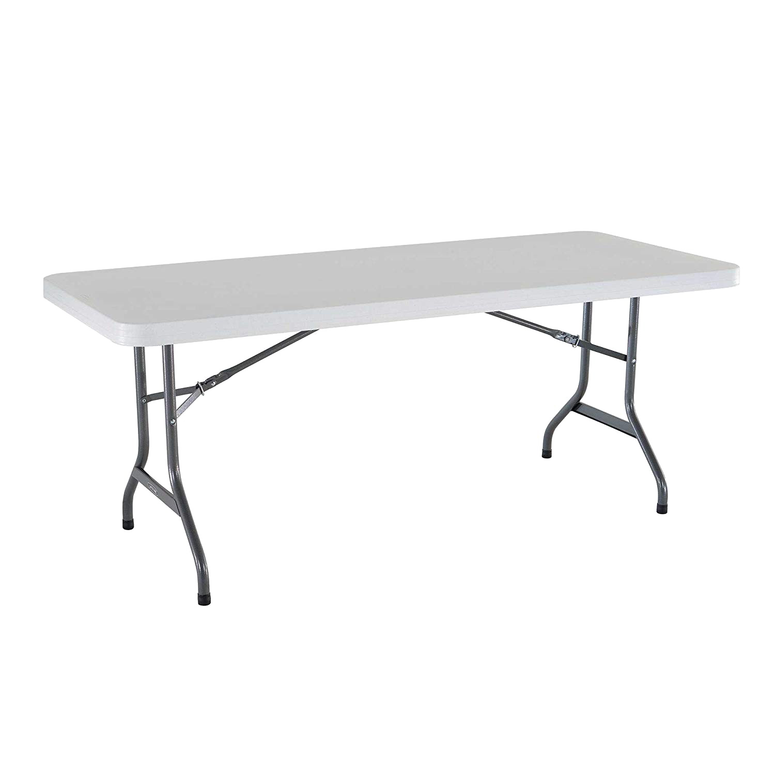
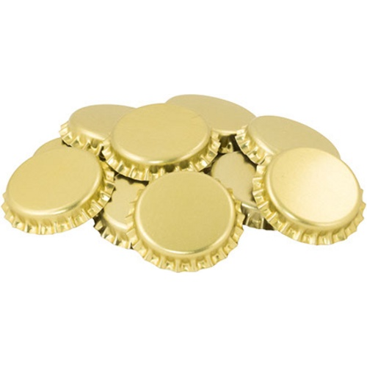

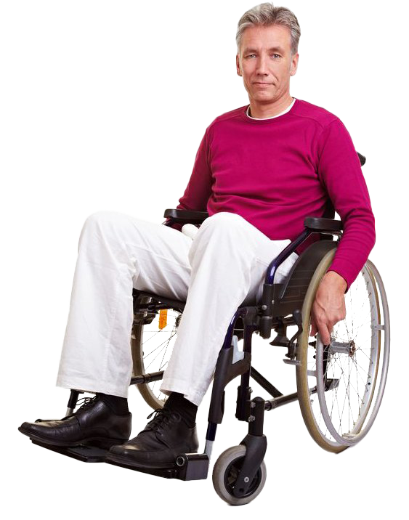
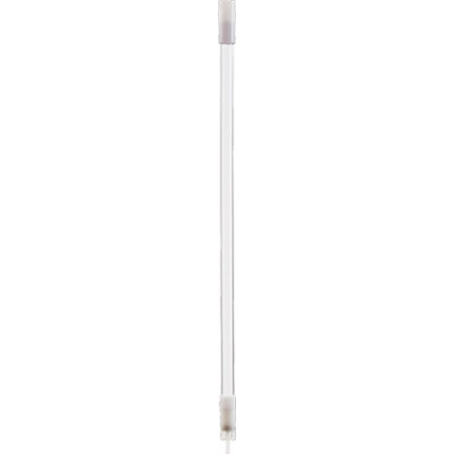
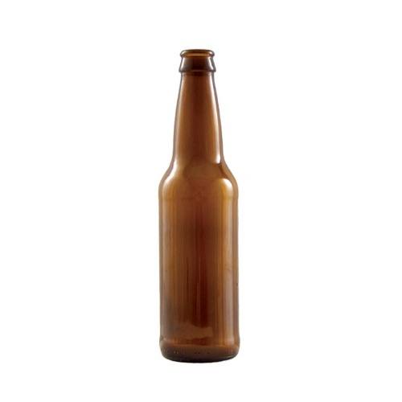
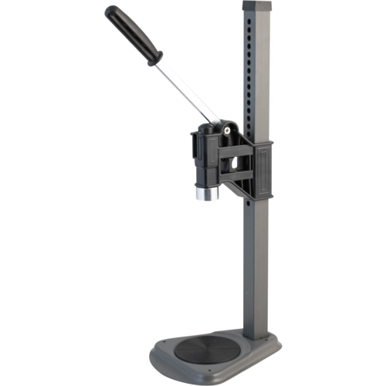
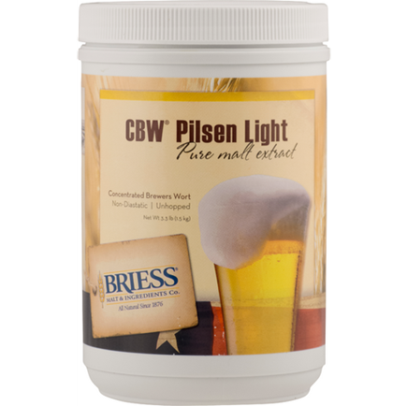
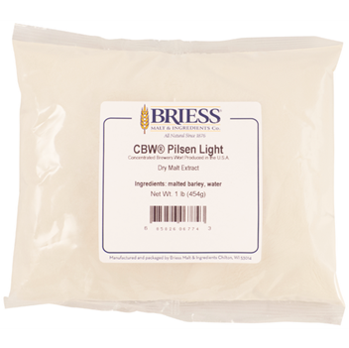
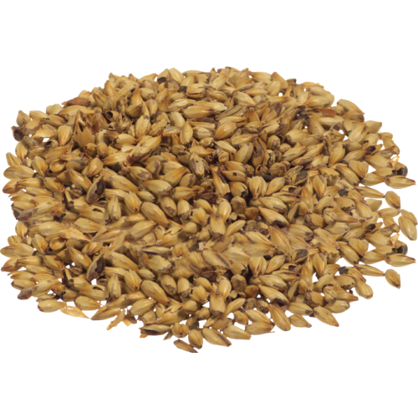
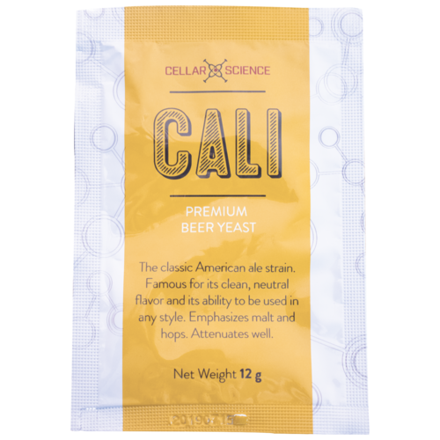
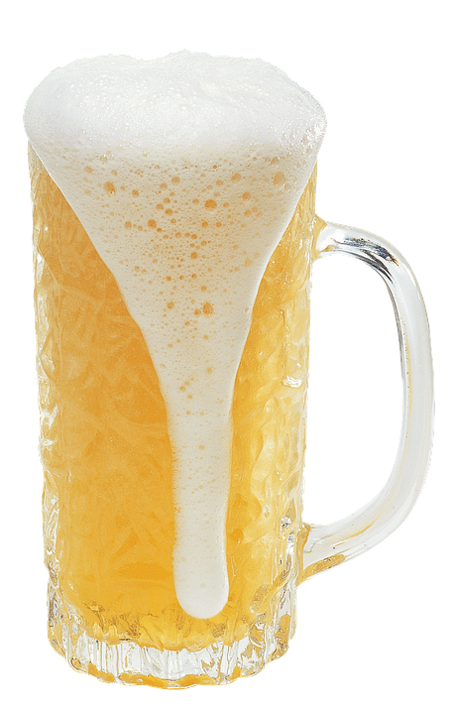
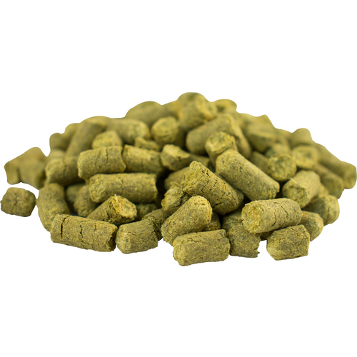
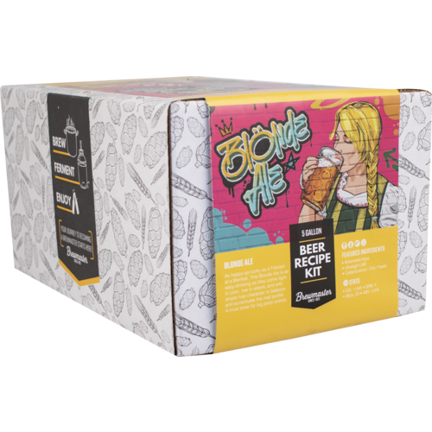
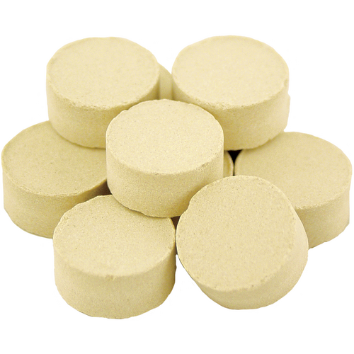
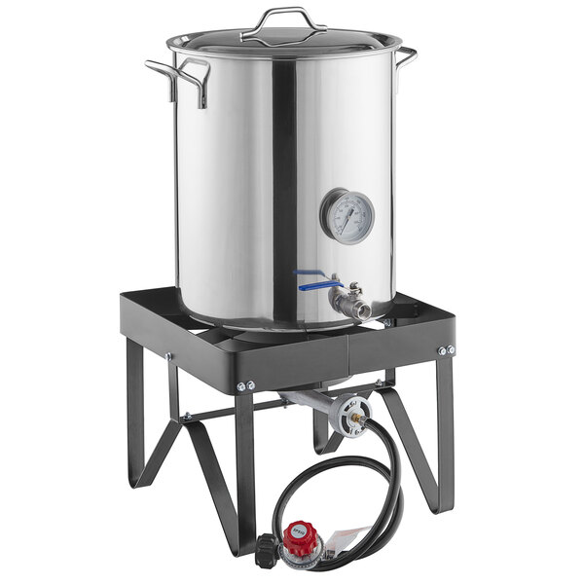
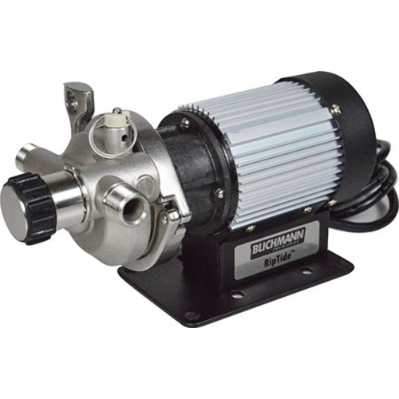
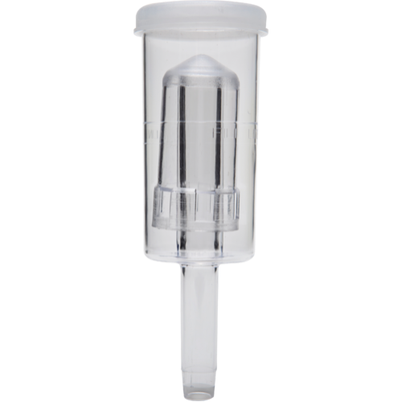
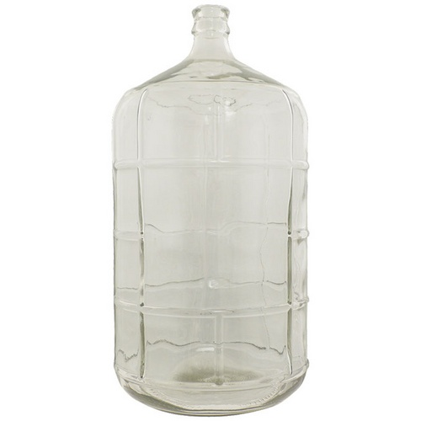
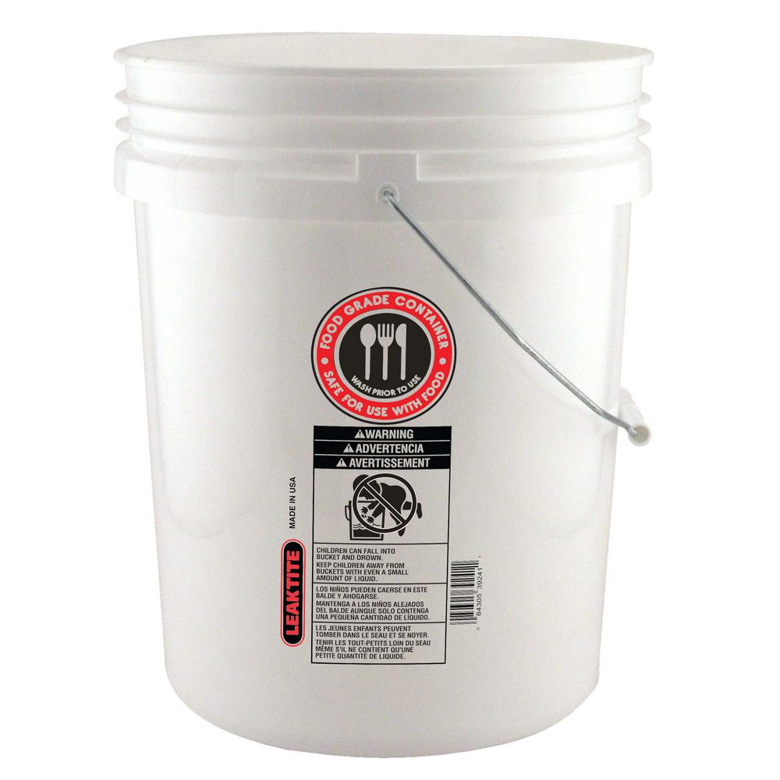
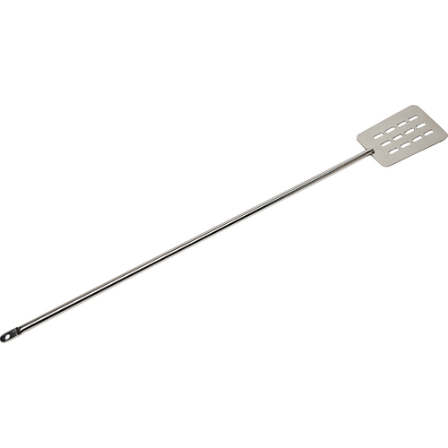
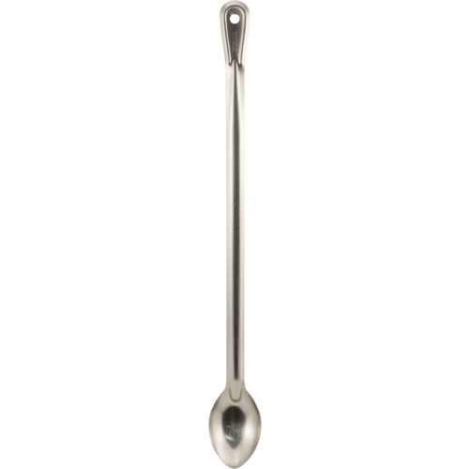
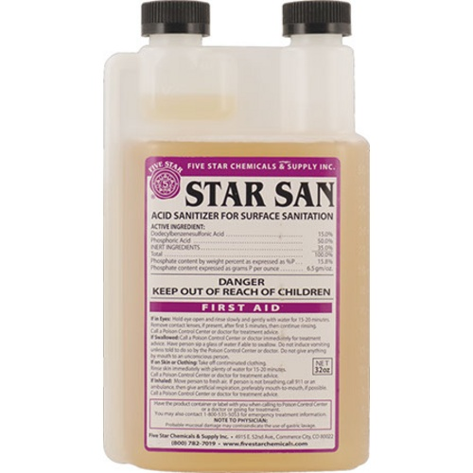
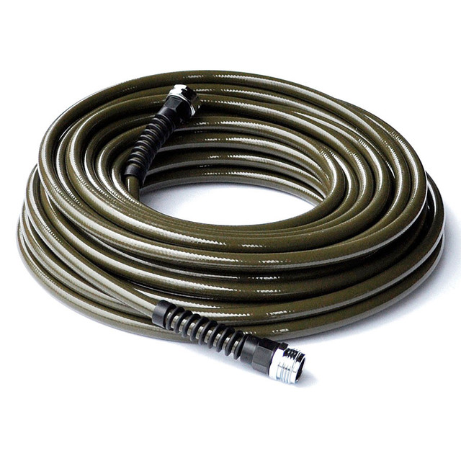
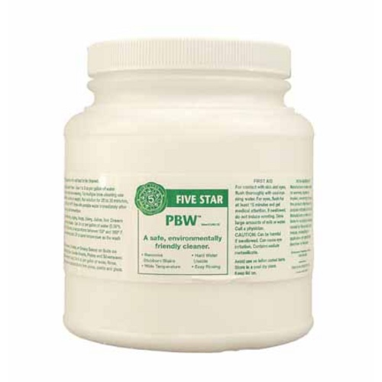
Continued from Part 2 of 3
Wort Chillers
Hydrometer
Thermometer
Bottling
Brew Buddy
Bottle
Filler
Caps
Extract Kit
Adaptive Brewer
Capper
Bottle
Propane System
Table
Pump
Fermenter
Clean & Sanitize
Food Grade
Water Hose
6.5 gal
Carboy
Stopper
Air Lock
All-in-one
Brew
System
Paddle
Spoon
Pail
5 Gallon
Bucket
Rinse
Sanitize
Clean

Slide 3
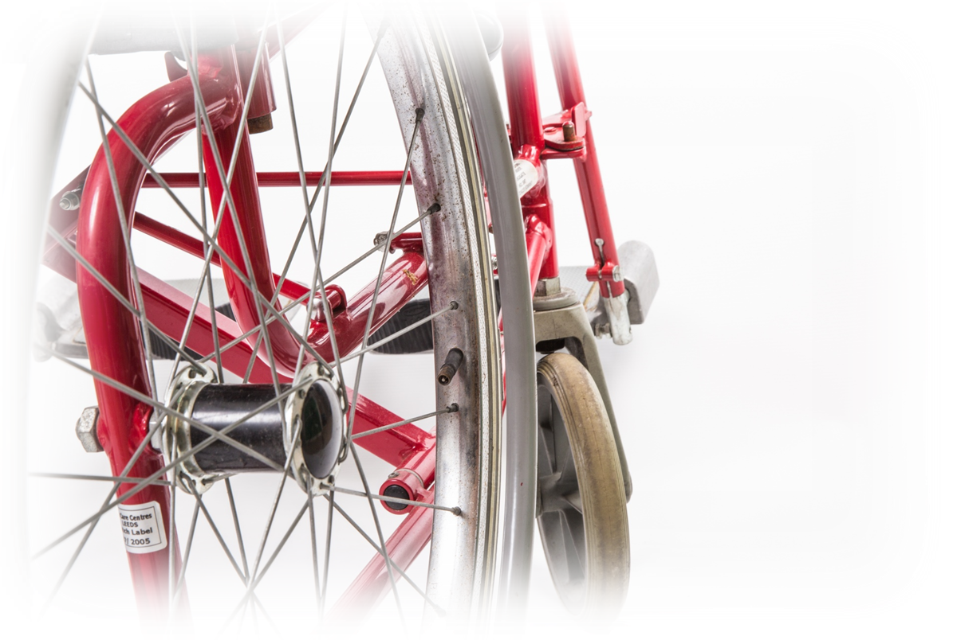
What’s the Process?
Milling
  Beer making starts with the milling of brewing grains
Mashing
  Mashing looks like porridge making, converting starch to simple sugars
Lautering
  Extracting the sugar water (wort) from the mash, sparging (rinsing)
Boiling
  Converts sugars and hops into flavors
Fermentation
  Yeast use aerobic and anerobic processes to multiply and convert sugars into CO₂ and ethyl alcohol
Filtration and Conditioning
Packaging
Extract

Slide 4

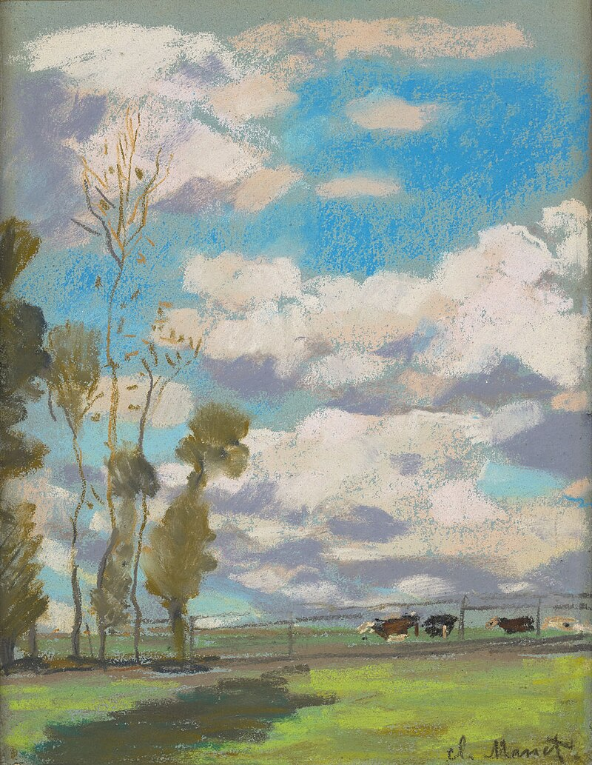
Brewing Methods
Extract
  Sugars already concentrated in liquid or dry form
  Shortest brew time
  Good beer but not “OMG WoW!”
  Paint-by-numbers, limited palette of paints
  Repeatable
All-grain
  Sugars need extraction by milling, mashing, lautering, and sparging
  Longest brew time
  Ability to make “OMG WoW!”
  Blank canvas and full pallette of paints, spatulas, brushes
  Repeatable with good process and records

Slide 5
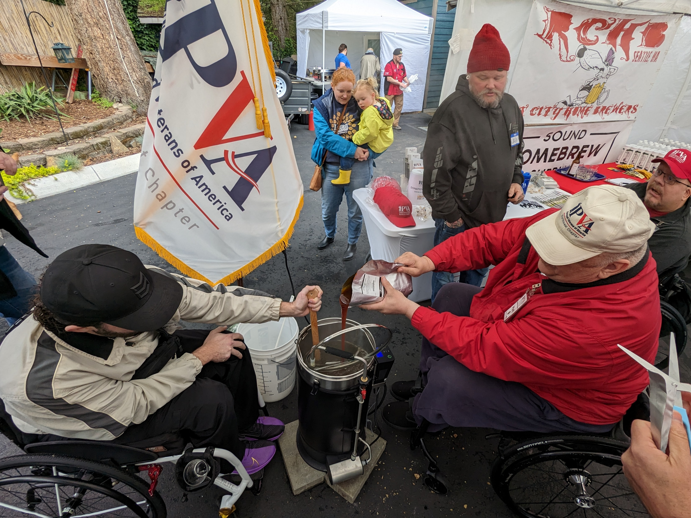
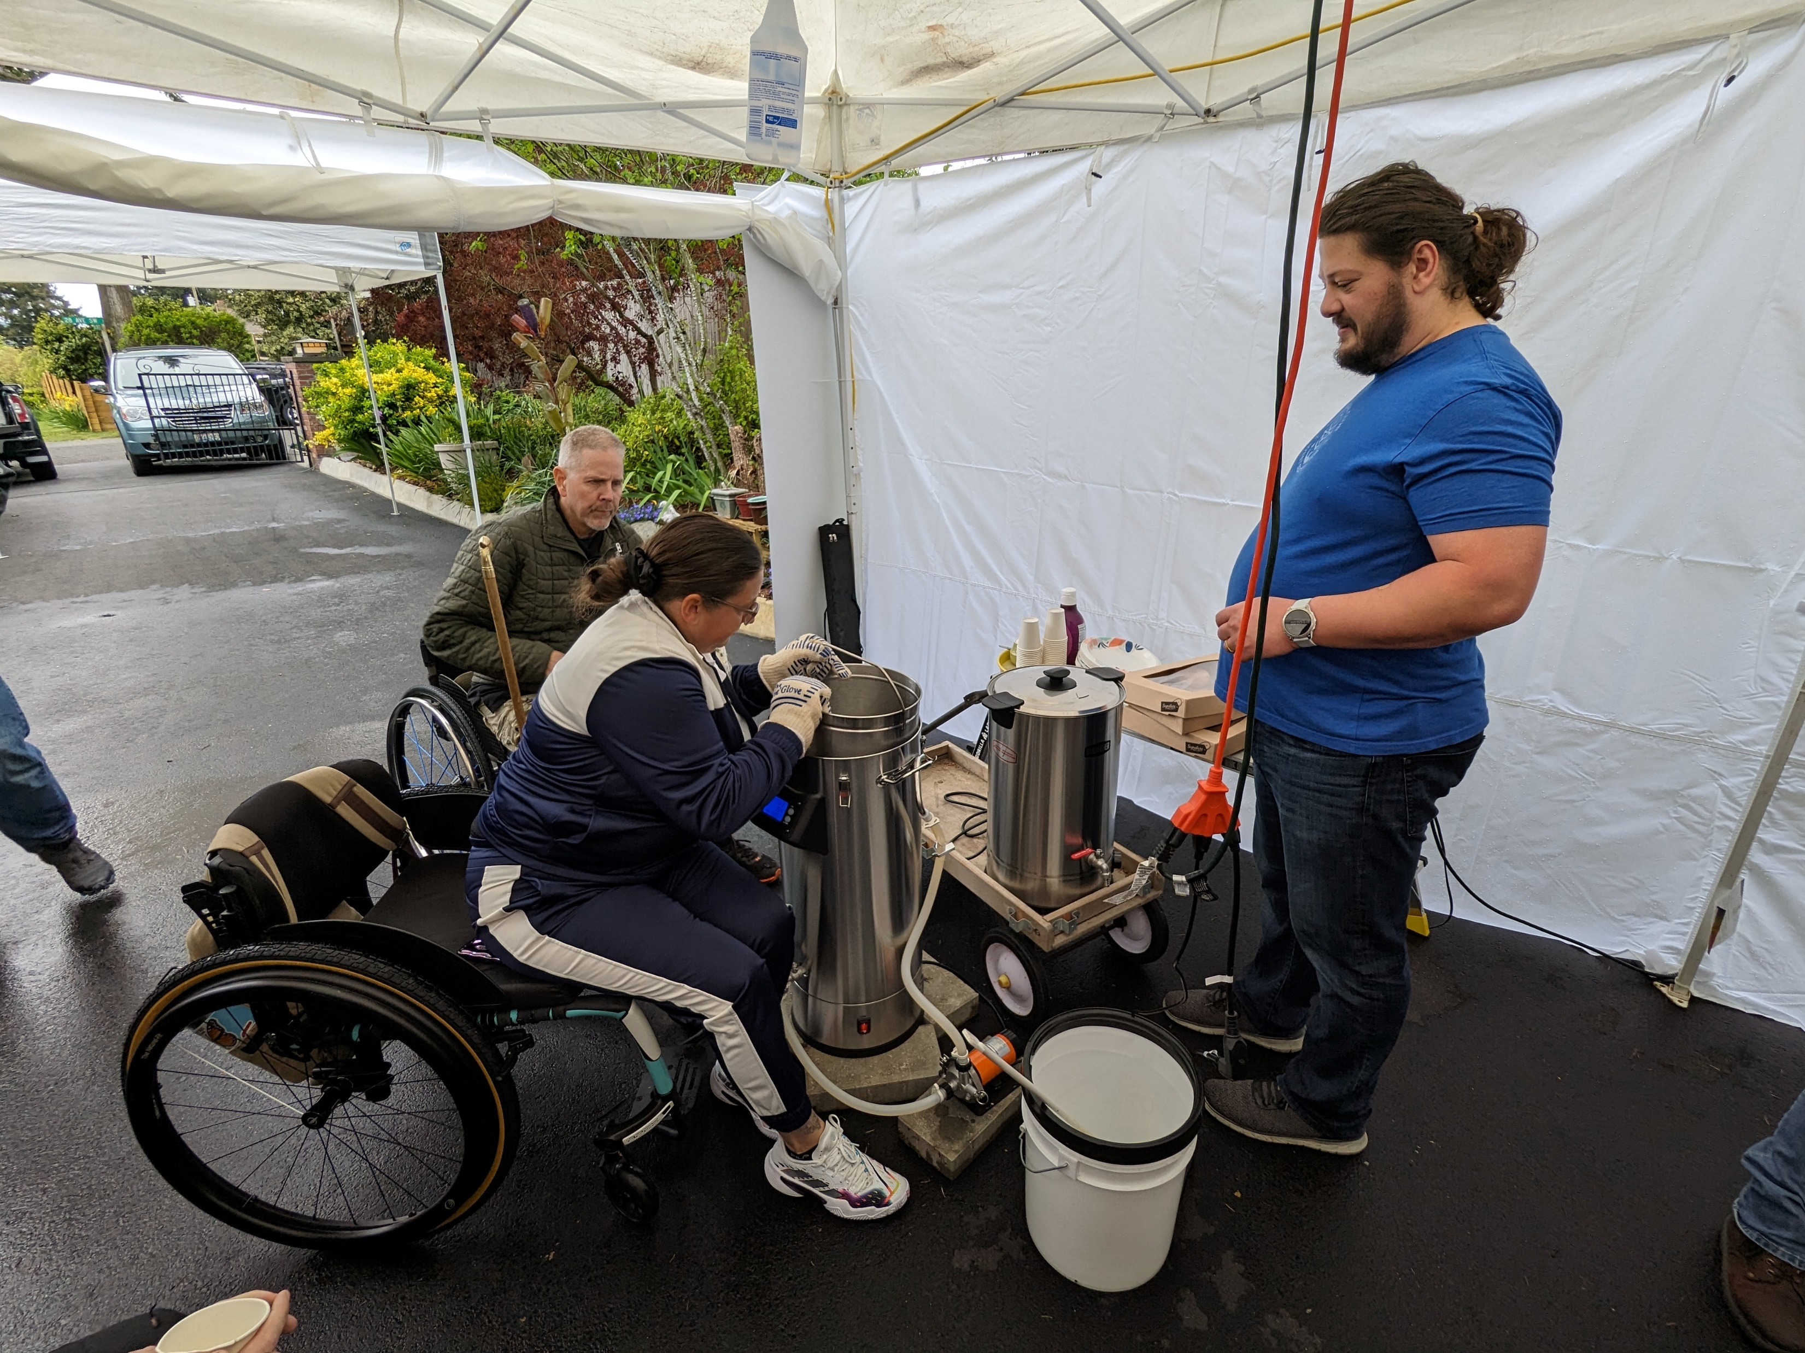
Brewing Methods
Preparing to hoist the 20-pound grain basket
during an all-grain brew session
Adding Liquid Malt Extract (LME)

Slide 6
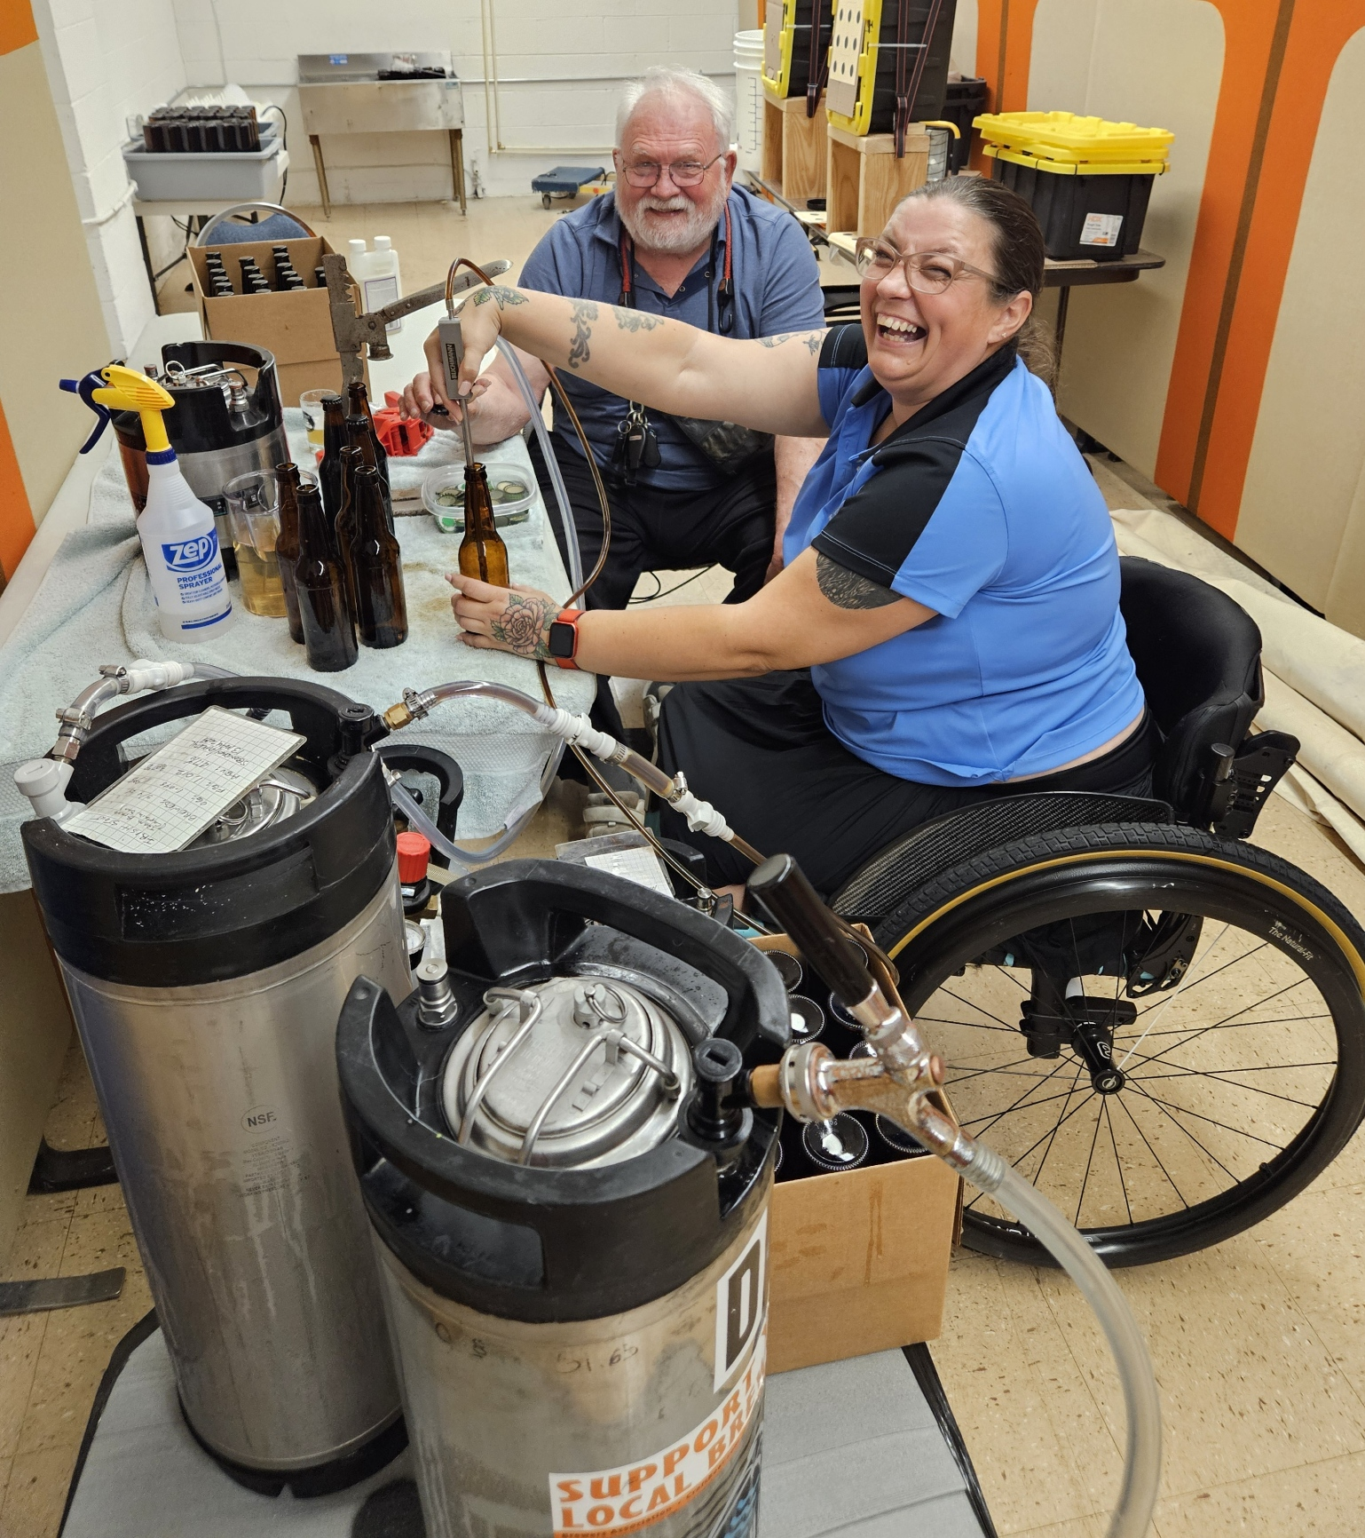
Bottling Methods
Joy is using a “beer gun” to fill cleaned and sanitized bottles
George waits for the filled bottle to do the capping with an
old-style “bandit arm” capper using sanitized caps
Capped bottles are placed in the case for storage in warm area
68-72 degrees for natural carbonation to develop
Foreground is the source keg connected to beer gun
Low level sink in back
All actions accomplished at table level.

Slide 7

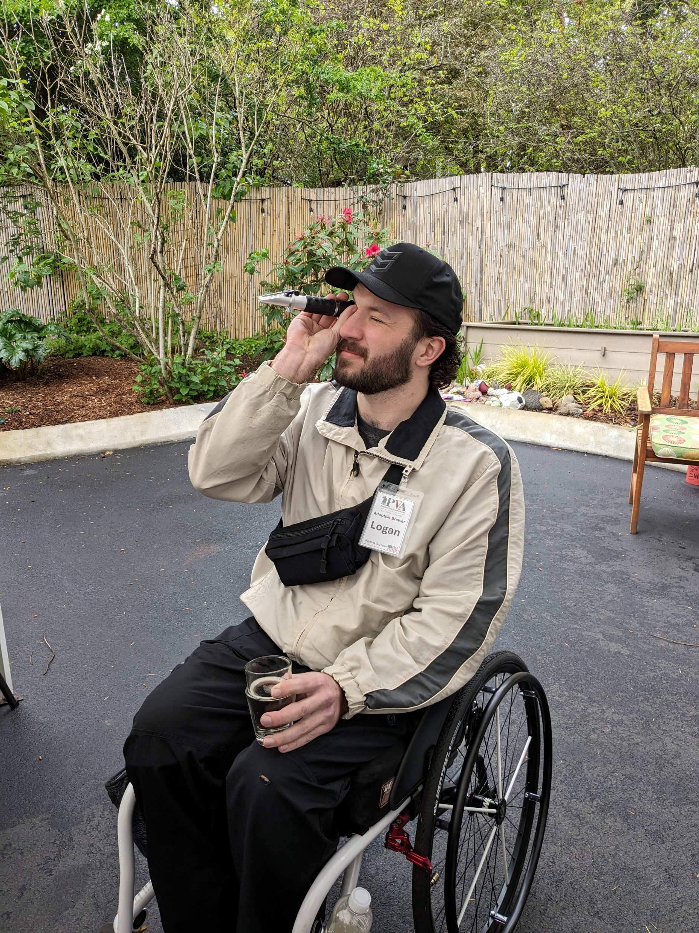
Sensory versus Physical
Sensory ability more important than physical ability
Chemistry, biology, mathematics
Right brain (artsy, creative)
Left brain (analytical, methodical, logical)
Proper process control and methods
Diacetyl (2,3-butanedione)
Mercaptan (ethanethiol)
Lightstruck (3-methyl-2-butene-1-thiol)
Hydrogen Sulphide (H2S)
Caprylic (octanoic or caprylic acid)
Butyric (butyric acid)
Grainy/Husky
Banana (Isoamyl Acetate)
Metallic (ferrous sulphate)
Sour
Catty (p-menthane-8-thiol-3-one)
Cheesy (isovaleric acid)
Sweet
Dimethyl Sulfide (DMS)
Acetaldehyde
Oxidation
Phenolic
Musty (2,4,6-tricholoroanisole)(TCA)
Checking the Specific Gravity (SG) using a refractometer

Slide 8
Physical Tasks
Opening packages
  Use scissors
  Unscrew lids
Lifting up to 35 lbs
  Gallon of water 8.345 lbs 3.78 kg
  Grain absorbs 0.125 gal/lb or 1.043 lbs
  15 lbs grain = 15_{dry} + 15.65_{saturated} = 30.65 lbs plus weight of basket
Moving equipment up to 30 lbs horizontally and vertically short distances
Dexterity
  Grasping
  Stirring
  Turning
  Pushing
  Pulling
Mobility
  Around brewing space
  Bending at waist

Slide 9
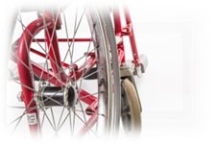

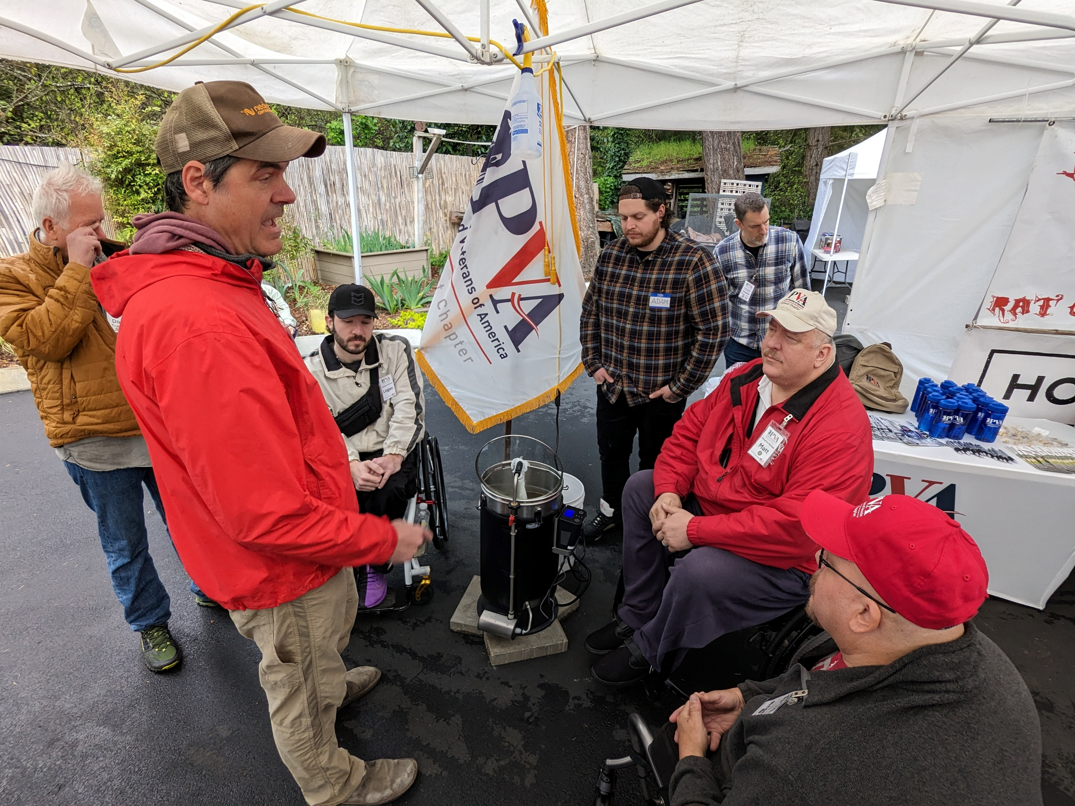
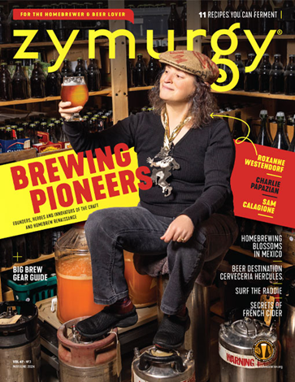
AHA Clubs
Over 1,600 registered homebrewing clubs in USA
263 homebrewing clubs in California
Brew Buddies

Slide 10
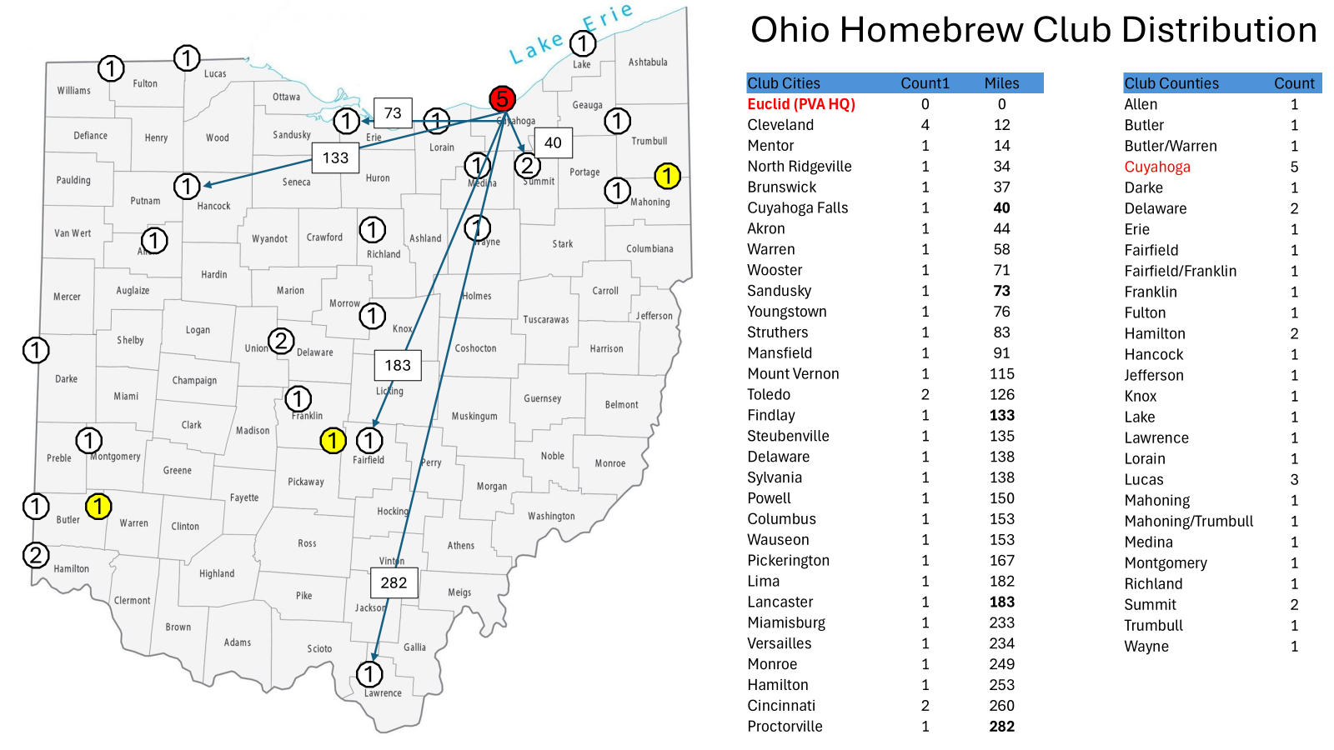
AHA Clubs in Ohio

Slide 12

Next Steps
Gauge interest within PVA membership
Connect with local brew clubs and suppliers
Visit local homebrewing stores
Encourage store and brewery accessibility standards
Form your own club
Join American Homebrewers Association (AHA)
Brew, learn, compete, enjoy
Relax, have a homebrew!

Slide 13
Summary
Brewing has been a human activity since time immemorial
All that is needed is desire to learn, equipment and a glass to enjoy your own homebrew with friends and family
Good brewing is more sensory than physical
Adaptive Brewing provides access to all who want to learn to brew, builds community, enriches lives, creates relationships, engenders a sense of pride in accomplishment

Slide 14

Adaptive Brewing
Program
Part 3 of 3
Jon M Newton
206-660-5902
4barkingdogsbrewery@gmail.com
4 Barking Dogs Brewery & Tap House
24 Aug 2024

