Slide 1
Neonatal Emergencies:
HoW to Host a Neonatal Rodeo!
Cristina Zeretzke-Bien, MD FAAP FACEP

Slide 2
We are Big
People:
The Little People Need Us-
So Saddle up!

Slide 3
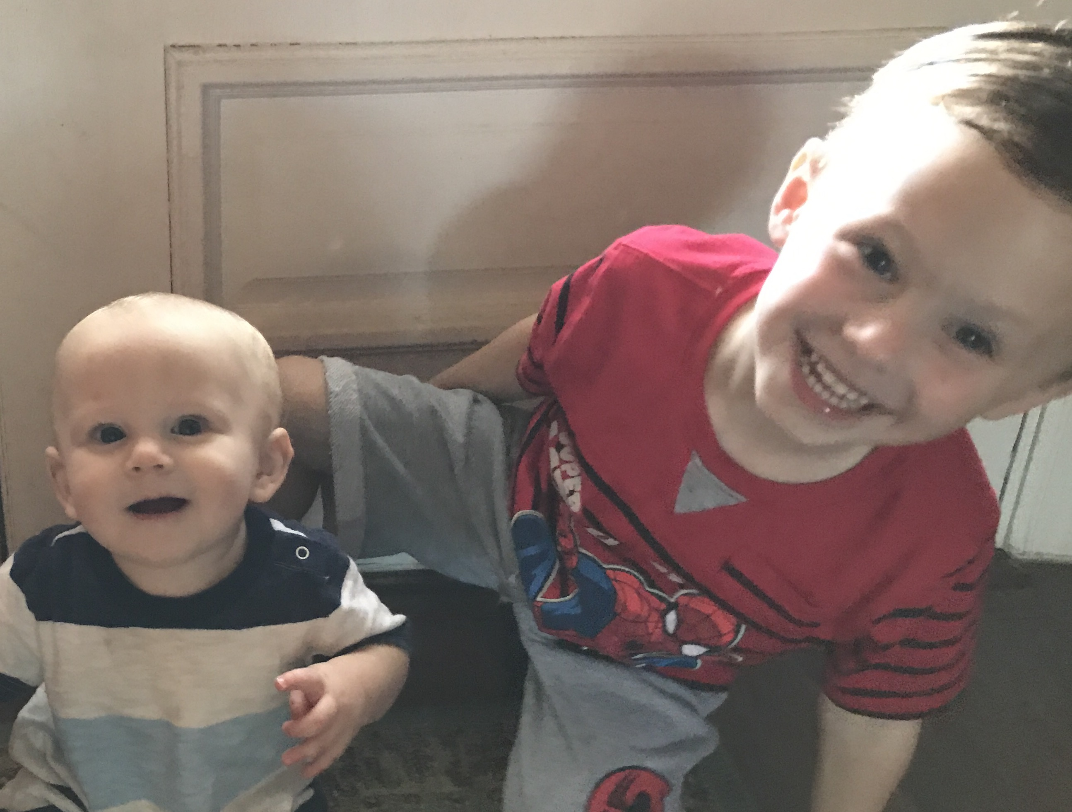
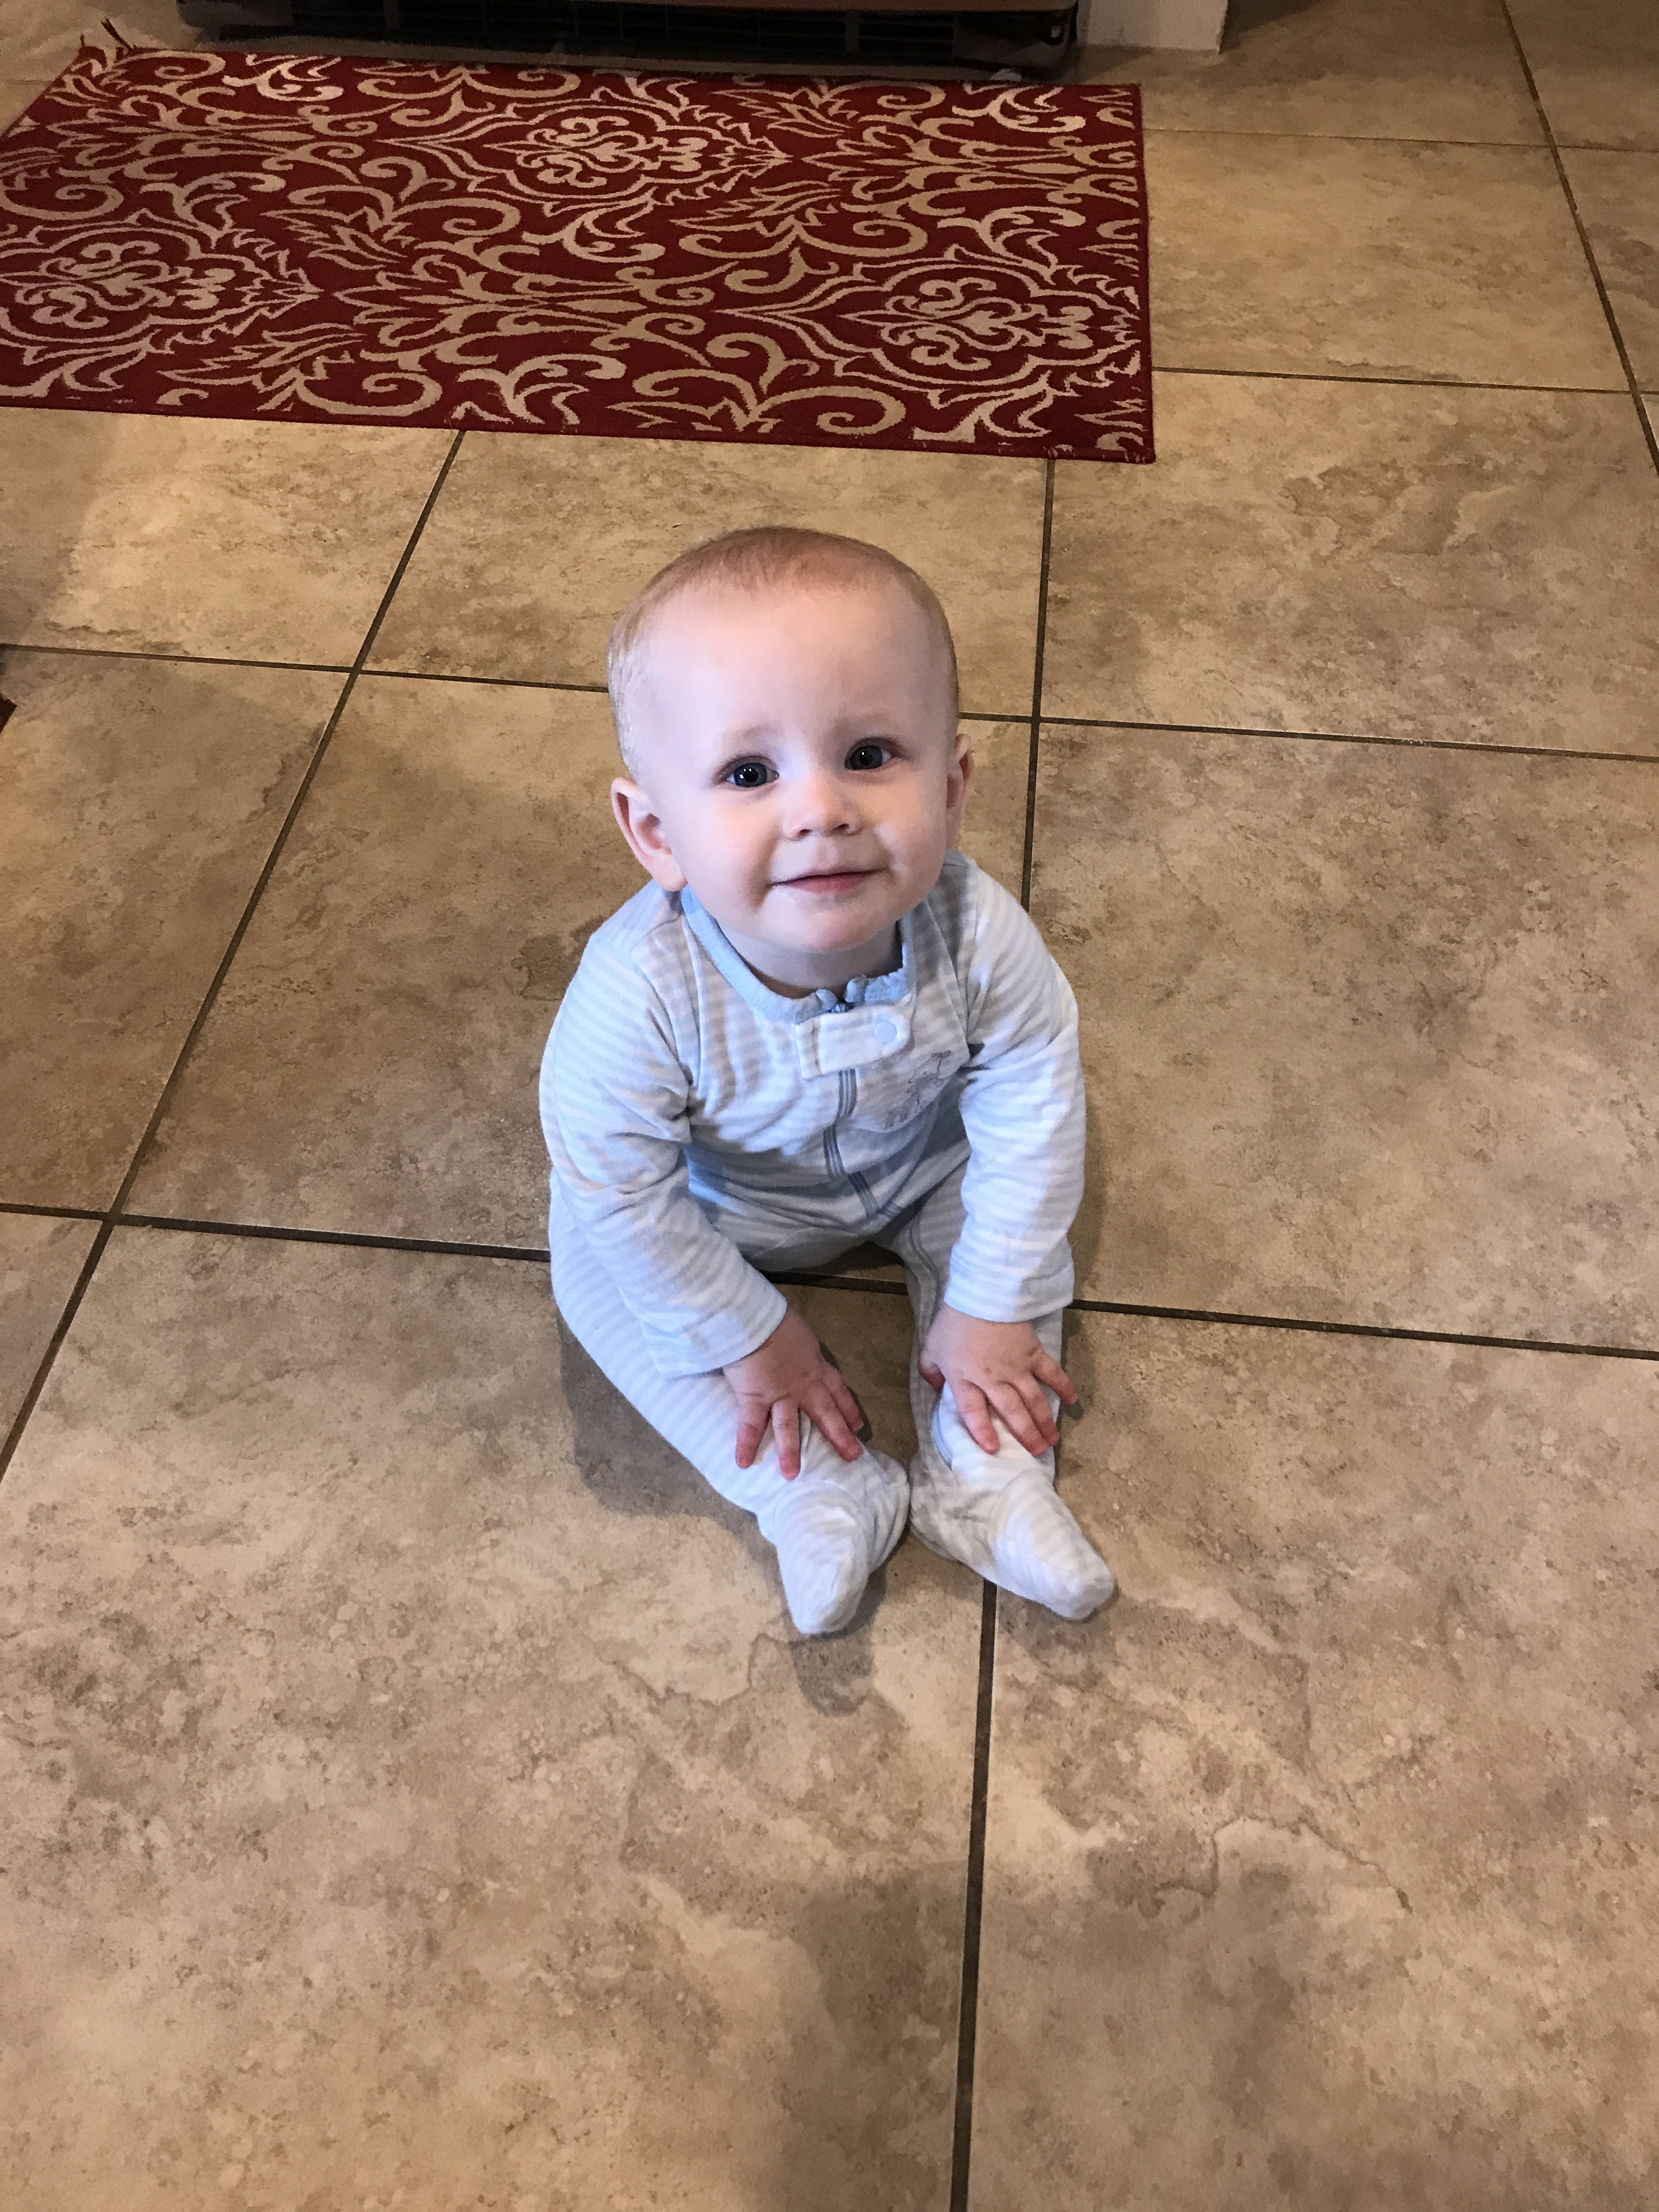
Why Do We Care??

Slide 4
We need to know the Medicine, but we need to know the Equipment!
ABC’s – Always!
KNOW THE NUMBER 60
  HR less than 60
  BP less than 60
  Requires intervention!

Slide 5
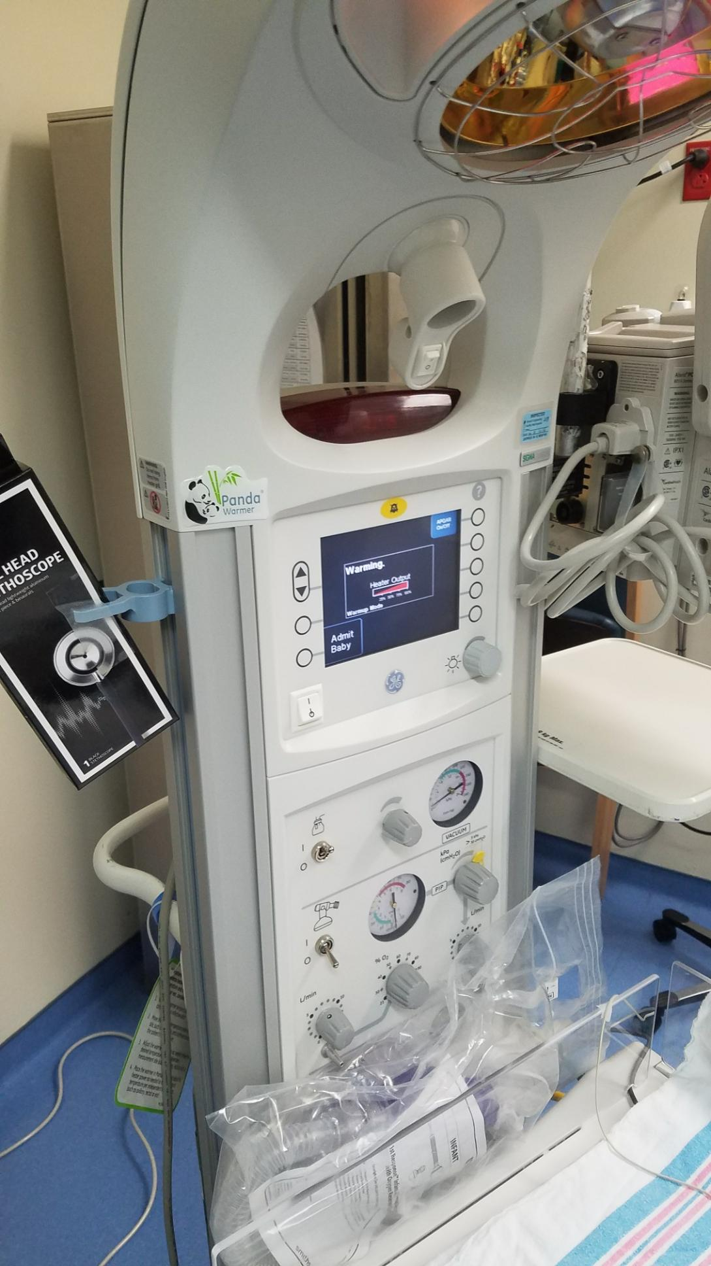

Slide 6
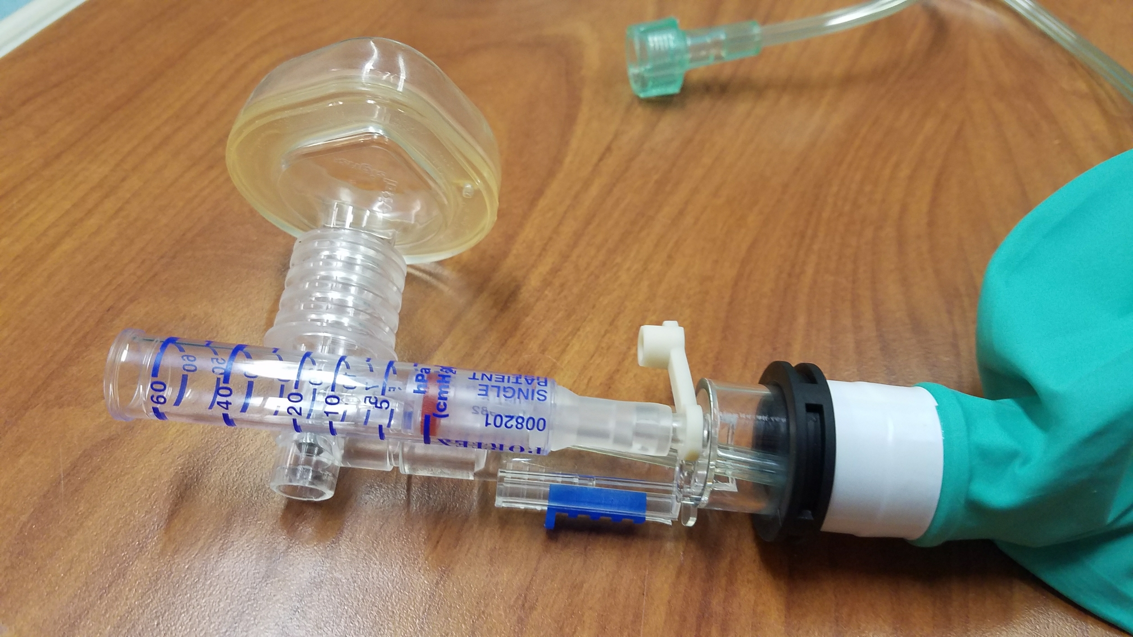

Slide 7
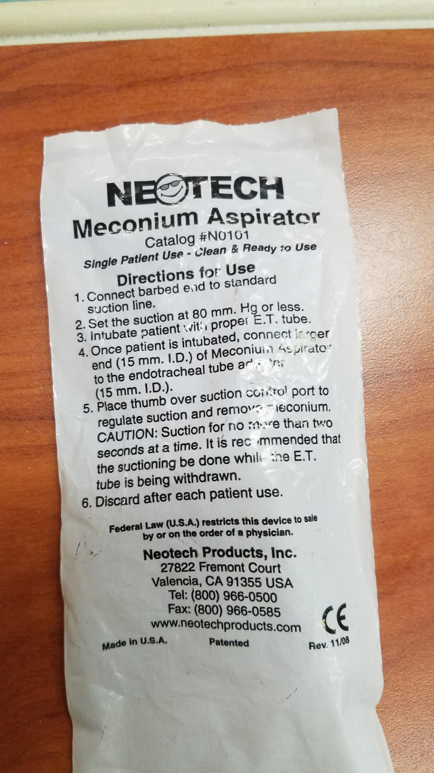

Slide 8
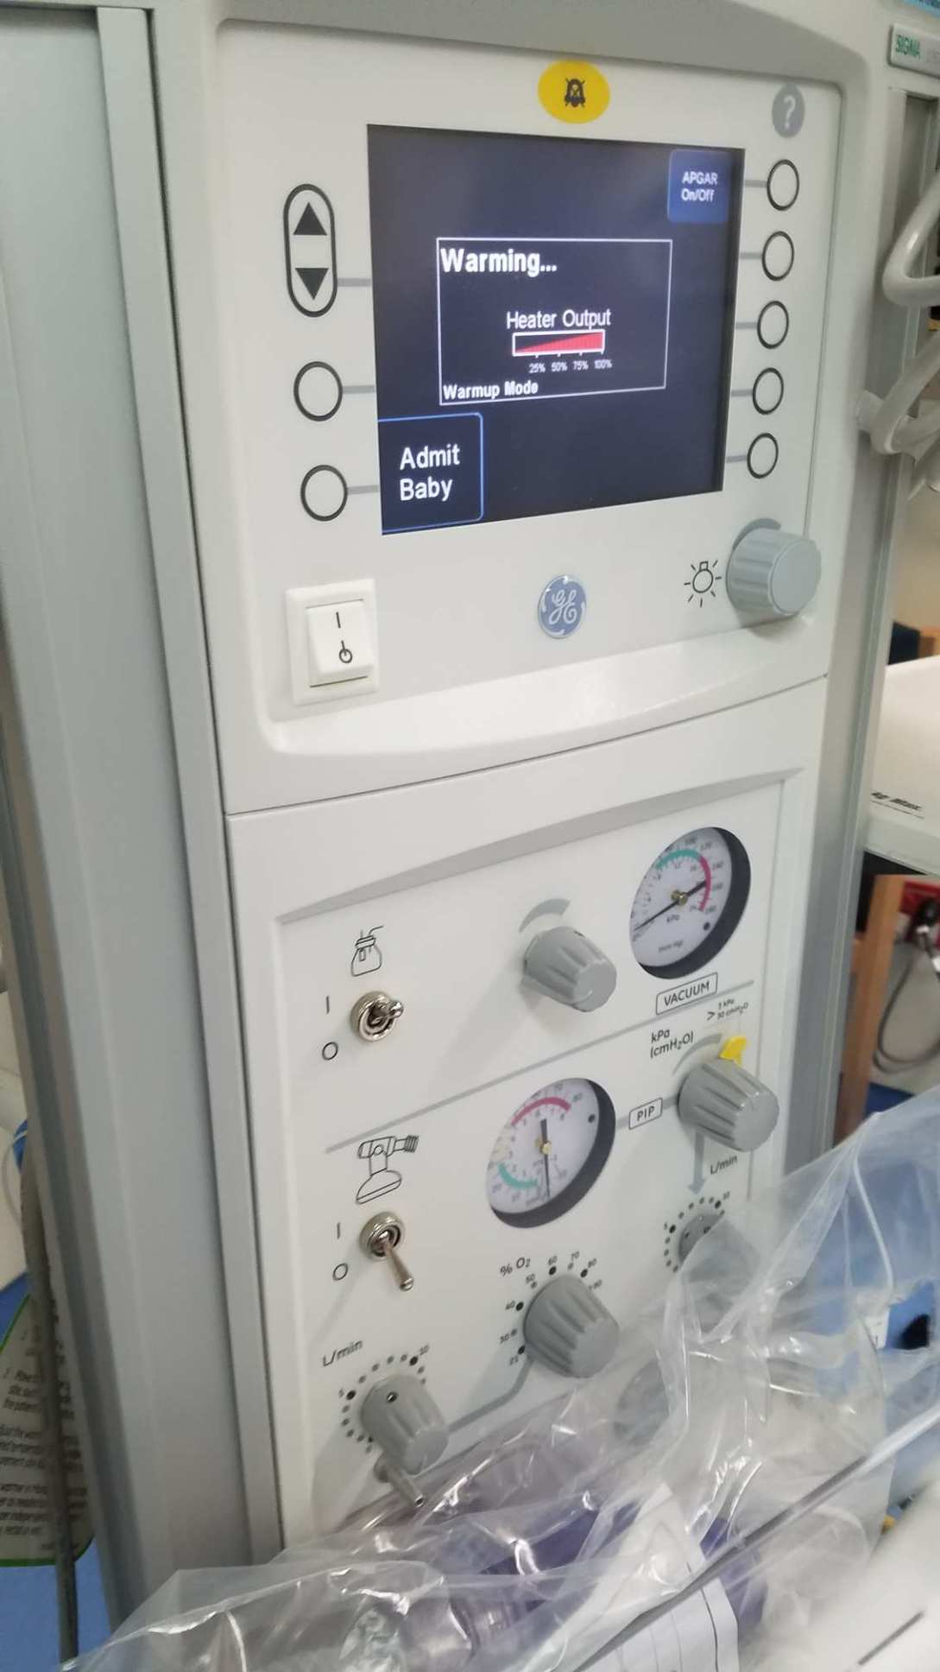

Slide 9
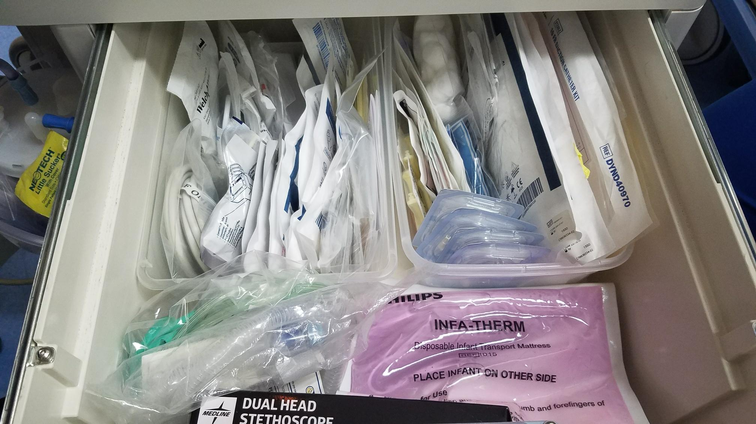

Slide 10
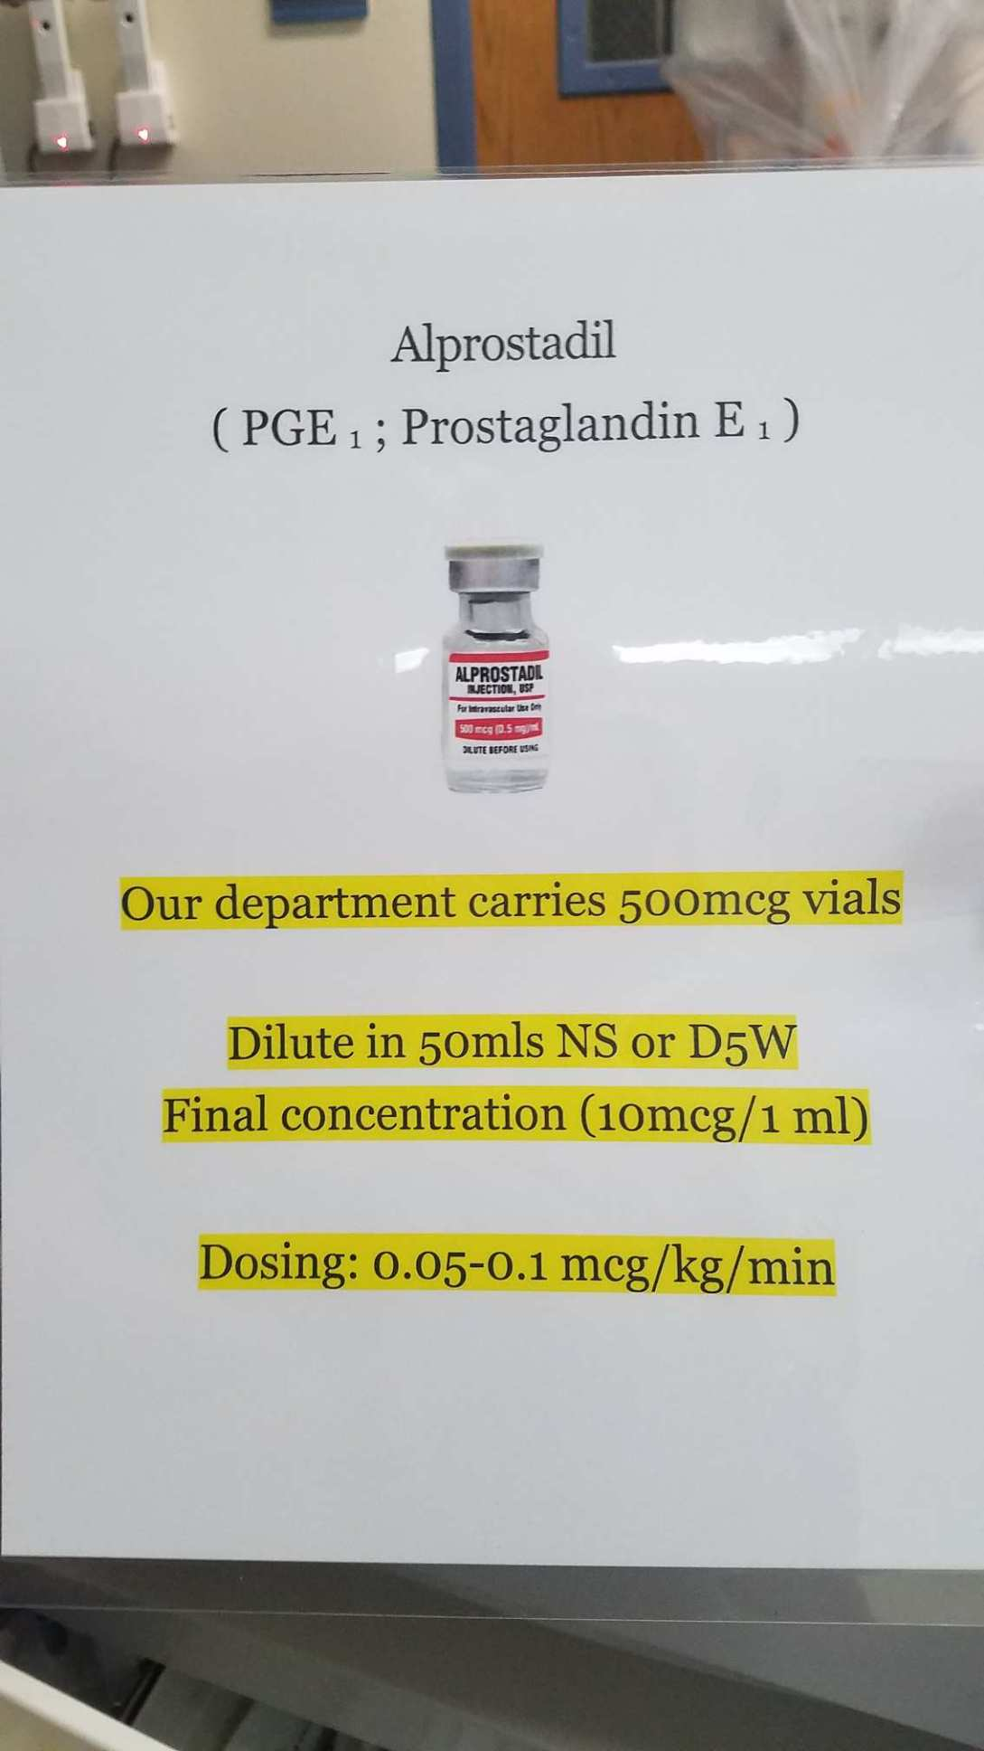

Slide 12
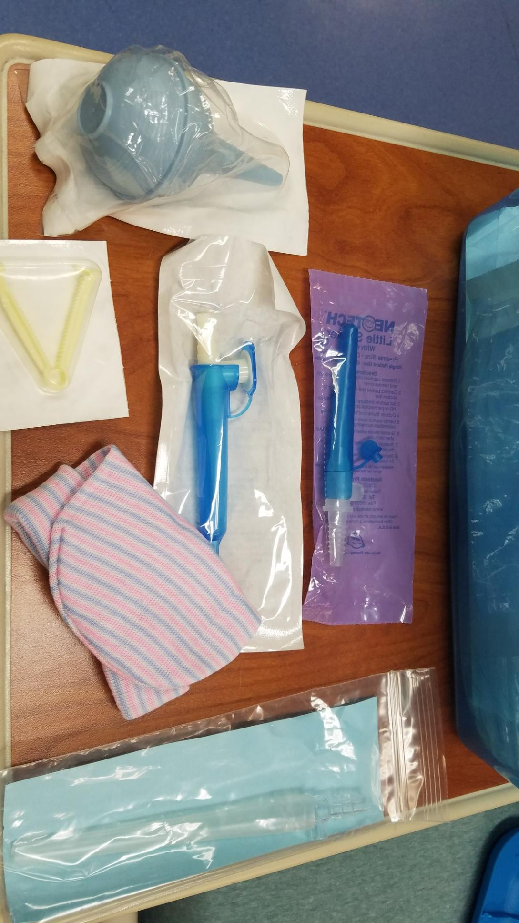

Slide 13
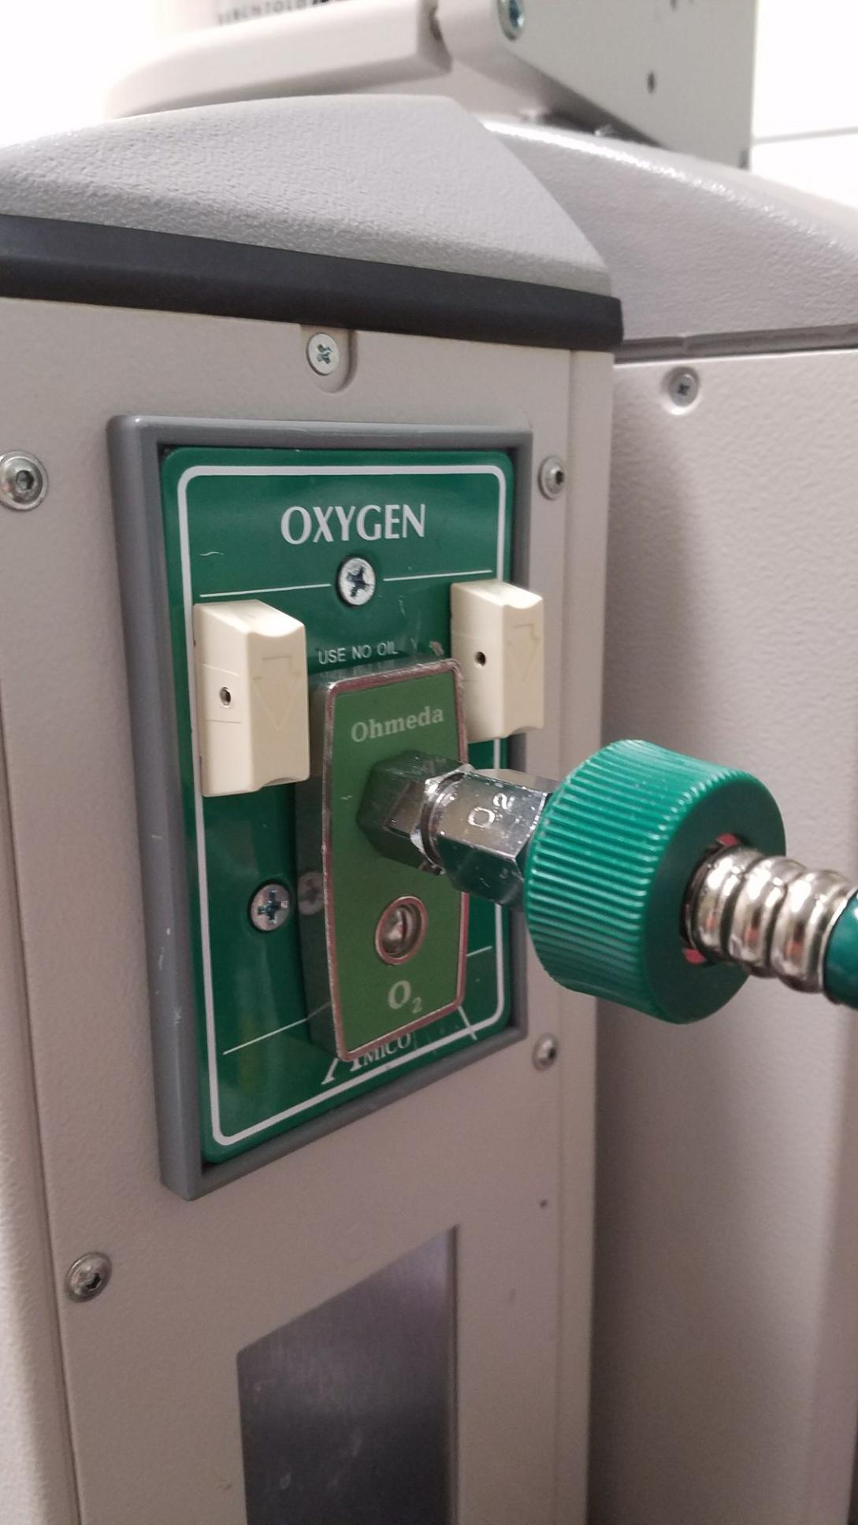

Slide 14
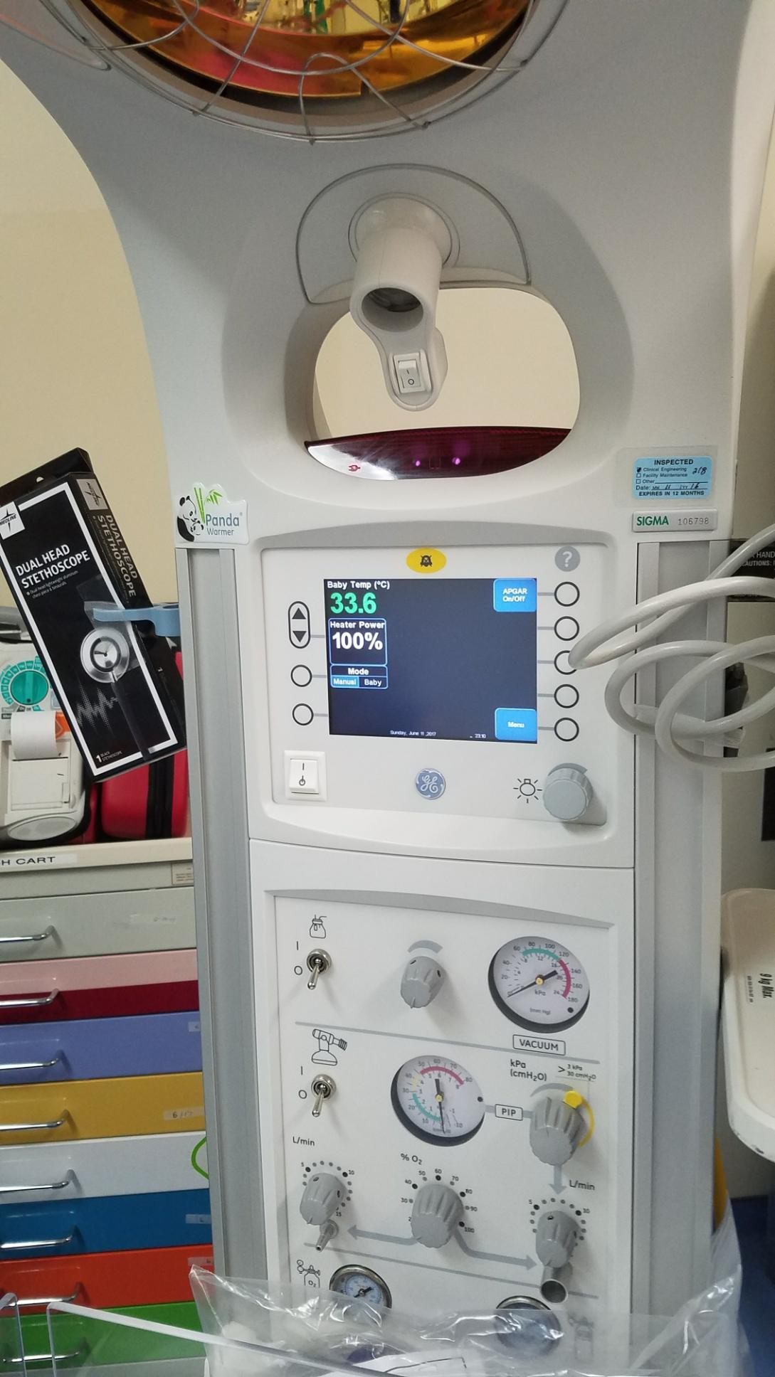

Slide 15
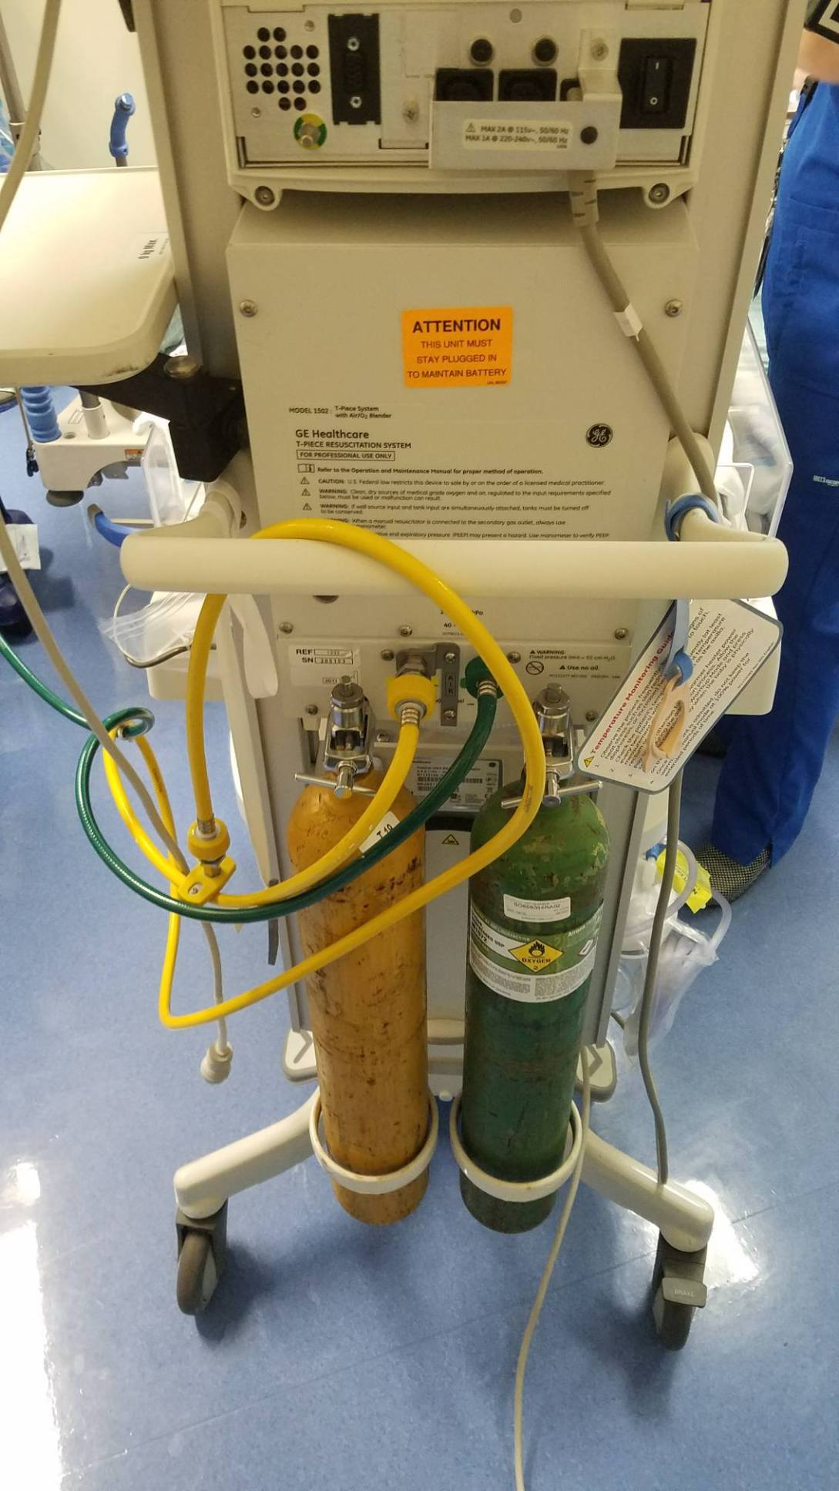

Slide 16
