Slide 1
BRUE
Cristina M. Zeretzke MD FAAP FACEP Pediatric Emergency Medicine
Notes:
Brief Resolved Unexplained Event

Slide 2
Disclosures
No disclosures

Slide 3
Objectives
Define BRUE
BRUE vs ALTE
Discuss epidemiology
BRUE vs SIDS
Evaluation in the PED
Association with comorbid conditions
Management: to hospitalize or not?

Slide 4
Definition
1986 National Institute of Health consensus panel:
  “an episode that is frightening to the observer that is characterized by some combination of apnea, color change, a marked change in muscle tone, choking or gagging.”
Notes:
ALTE

Slide 5
Definition
2016 AAP Clinical Practice Guidelines:
  “An event in an infant <1 year of age when the observer reports a sudden, brief and now resolved episode of 1 or more of the following:
    Cyanosis or pallor
    Absent, decreased or irregular breathing
    Marked changes in tone
    Altered level of responsiveness”
Notes:
*Brief Resolved Unexplained Event
*Only if there is no explanation for a qualifying event after Hx and PE
New terminology is intended to reflect that the event is TRANSIENT and remove the “life threatening” label
New guidelines came from previous ALTE literature, so many stats will still be based on ALTE’s, not just BRUE

Slide 6
BRUE vs ALTE
Strict age limit
No other likely explanation
Diagnosis based on clinician’s characterization of event
Cyanosis or pallor
Apnea, absent breathing or irregular breathing
Significant change in tone
Does not include choking or gagging
Altered level of responsiveness
Notes:
- Characteristics that differentiate BRUE from ALTE
Under the new clinical guidelines for BRUE
Clinician’s characterization: i.e. – was event life threatening/resolved; not parents reaction
Color change: not just any (rubor does not count)
For ALTE, only apnea needed in dx
Tone: hypertonia, hypotonia
Choking or gagging considered a possible dx – thus not a BRUE
No mention of responsiveness in previous ALTE def

Slide 7
Epidemiology
0.6 – 2 per 1000 live births
0.6% - 0.8% of all emergency visits (children less than 1 year old)
2% of pediatric hospitalizations
Male = Female
0% - 6% mortality rate
Notes:
ALTE epidemiology

Slide 8

SIDS
Unexpected, sudden death in a child < 1 year old
  No explainable cause by autopsy, history or crime scene investigation
Risk factors:
  Prone and side sleeping
  Environmental smoking
  Overheating
Notes:
Sudden Infant Death Syndrome

Slide 9
Why BRUE ≠ SIDS
SIDS
80% deaths between midnight and 6 am
Peak incidence 2-4 mo
“Back to sleep” has reduced incidence
BRUE
82% of episodes between 8 am - 8 pm
Peak incidence 1st two months of life
No reduction in incidence

Slide 10
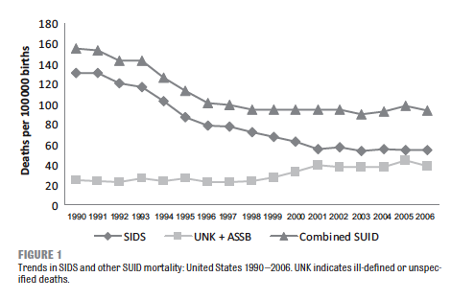
Notes:
Back to sleep campaign in 1994 – most significant decline in SIDS rates since then

Slide 11
Case 1
1 month old female brought into the PED due to an episode of choking and gagging at home today. Mom turned her on her side and patted her back until it resolved.
Notes:
What is this? ALTE/reflux
Is this a BRUE?
What would you like to know?
- turned red, no cyanosis, was just waking up from sleeping post eating 20 min ago; no hx of similar events in the past; health infant
- Bhx: full term, SVD,

Slide 12
Evaluation
History is key

Slide 13
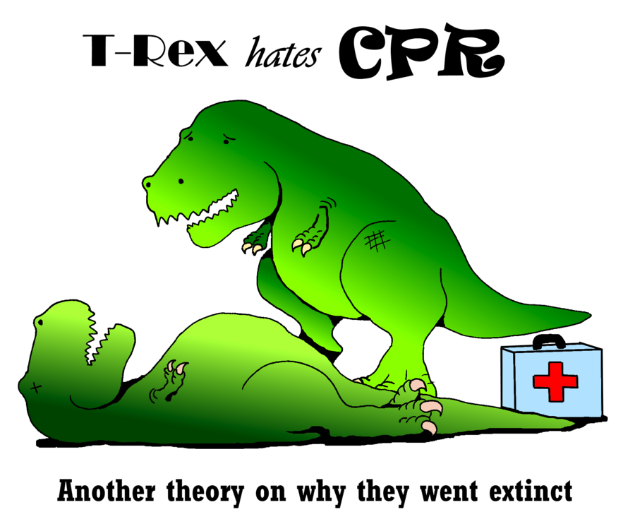
Assess Severity
Notes:
Was a significant intervention required? Or was it self resolving?
If there was CPR, who preformed it? - Difference between lay person and someone trained in CPR

Slide 14
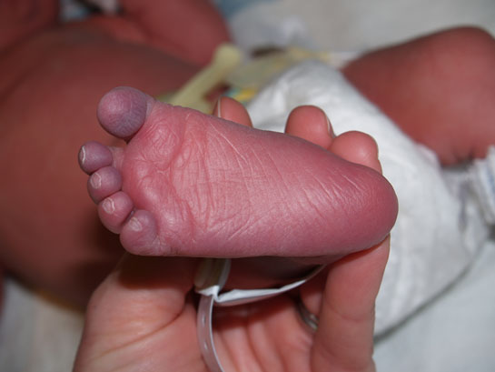
Color change?
Notes:
Central cyanosis, acrocyanosis, flushing?

Slide 15
Color change?
Apnea?
Notes:
Periodic breathing? Shallow breathing? Pause lasting less than 30 sec?

Slide 16

Color change?
Apnea?
Current illness?
Notes:
URI sx? Fever? GI sx?

Slide 17
Evaluation
More Key History
  Past hx of similar episode
  Birth hx
  Feeding hx
  Medical hx
  Family hx
Notes:
- Family hx specifically hx of SIDS, unexplained deaths, metabolic or cardiac hx

Slide 18
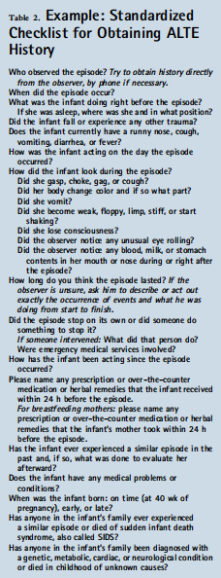
*Fu, L.; Moon, R. Apparent Life-Threatening Events: An Update. Pediatrics in Review. Aug 2012;33(8):361.
Notes:
Hx directly from observer
What happened right before, what was infant doing?
Any trauma?
Length?
Did it stop on its own?
Meds?
Past episodes?

Slide 19
Evaluation
Physical exam
  Initial eval: ABC and vitals
  Complete exam with close attention:
    Dysmorphic features
    Changes in tone
    Bruising
    Color change
    Respiratory symptoms
    Lethargy

Slide 20

Warning!
Notes:
Biggest thing with BRUE/ALTE will be to look for the warning signs

Slide 21
Concerns?
Symptoms on presentation
  Toxic appearing
  Lethargy
  Recurrent vomiting
  Respiratory distress
Bruising/trauma signs
Dysmorphic features
Congenital abnormalities

Slide 22
Oh no!
Hx of prior ALTE
  Especially in last 24 hours
Hx of significant ALTE or unexpected death in siblings
Required resuscitation
Significant physiological component during ALTE
Notes:
*Hx of SIDS
- Physiological components: sustained cyanosis, loss of consciousness, need for CPR

Slide 23
Management

Slide 24
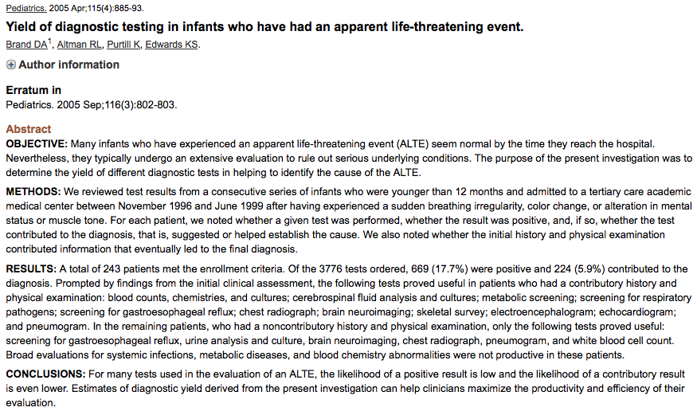
Notes:
2005 Pediatrics, New York Medical College and Westchester Medical Center, Valhalla, New York,

Slide 25
< 12 mo old and admitted with + ALTE

Slide 26
Looking for tests performed and if they contributed to the dx

Slide 27
If initial hx and PE contributed to the final dx

Slide 28
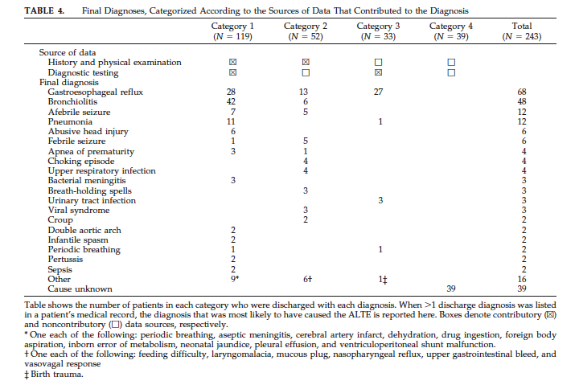
Notes:
Enrolled 243 patients: 3776 tests ordered of which 17.7% were positive and 5.9% aided in final dx
Those with contributory hx & PE had the greatest amount of dx testing(49%)
21% had a dx based on hx&PE with no usefull dx testing

Slide 29
The normal child
Most ALTE episodes have completely resolved by evaluation of a provider
What to do with normal findings?

Slide 30
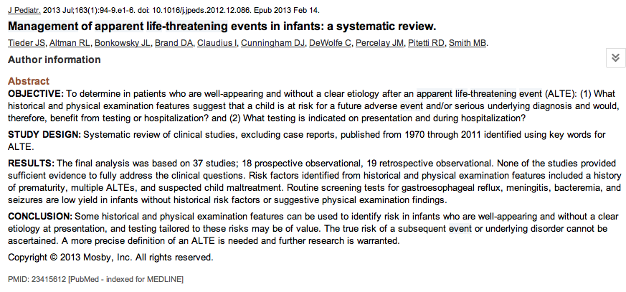

Slide 31
history of prematurity, multiple ALTEs, and suspected child maltreatment

Slide 32
No evidence to recommend routine screening tests without supportive hx/PE

Slide 33
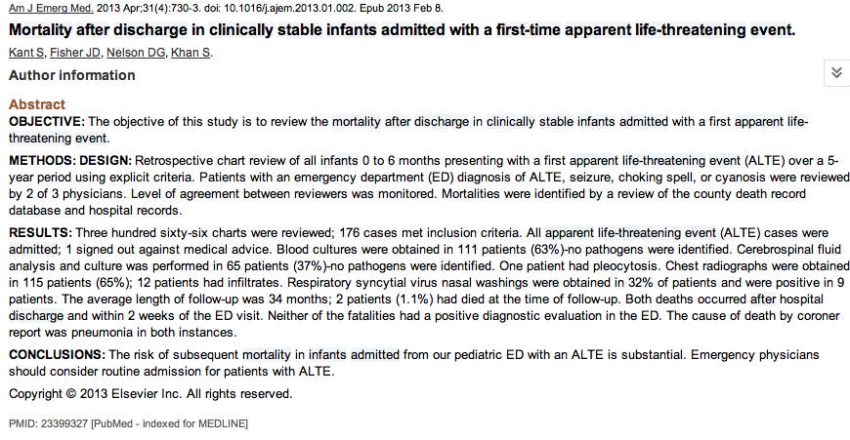
Notes:
Retrospective chart review; infants 0-6 months
Reviewing mortality after discharge for clinically stable infants with 1st ALTE
366 charts; 176 cases met criteria; all admitted
CXR 115 pts
F/u 34 months

Slide 34
Emergency physicians should consider routine admission for patients with ALTE.

Slide 35
To Consider
Study looked at:
ED dx of ALTE, seizure, choking spell, or cyanosis
Admitted cases
2 deaths:
1st with hx of URI + mild tachypnea at ED
2nd an ex 34 wk with ? Infiltrate on CXR
Notes:
Deaths were after discharge from hospital admission, within 2 weeks of ED visit
Both dx with PNA by coroner

Slide 36
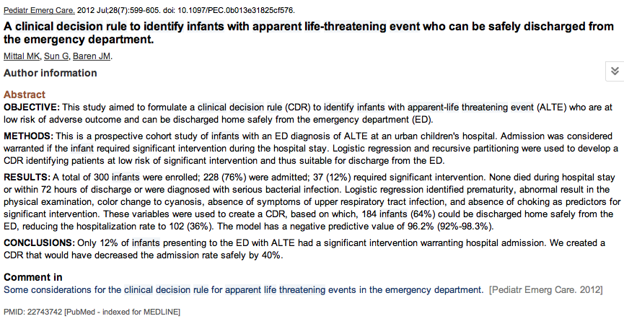
Notes:
Prospective cohort looking to identify a clinical decision rule for safe d/c of ALTE from ED
Infants dx in ED with ALTE
300 infants enrolled, 228 admitted, 37 with significant intervention. No deaths

Slide 37
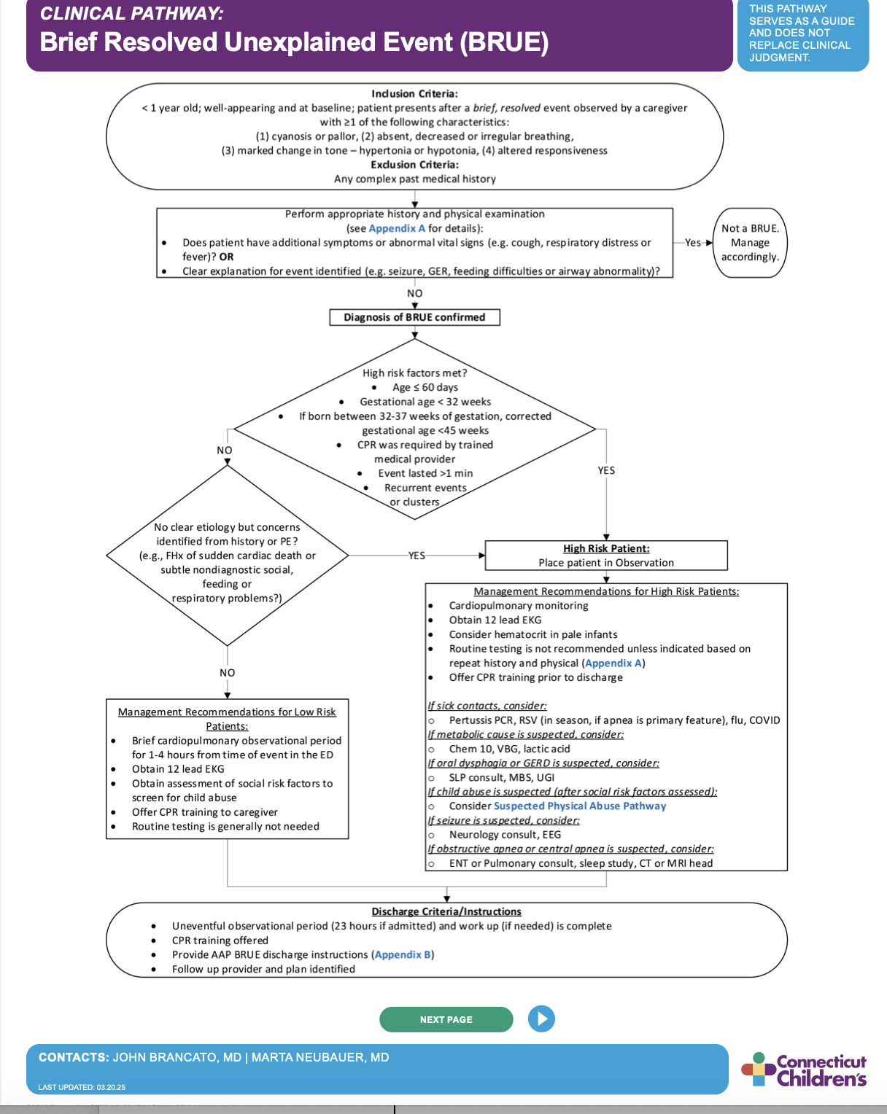

Slide 38
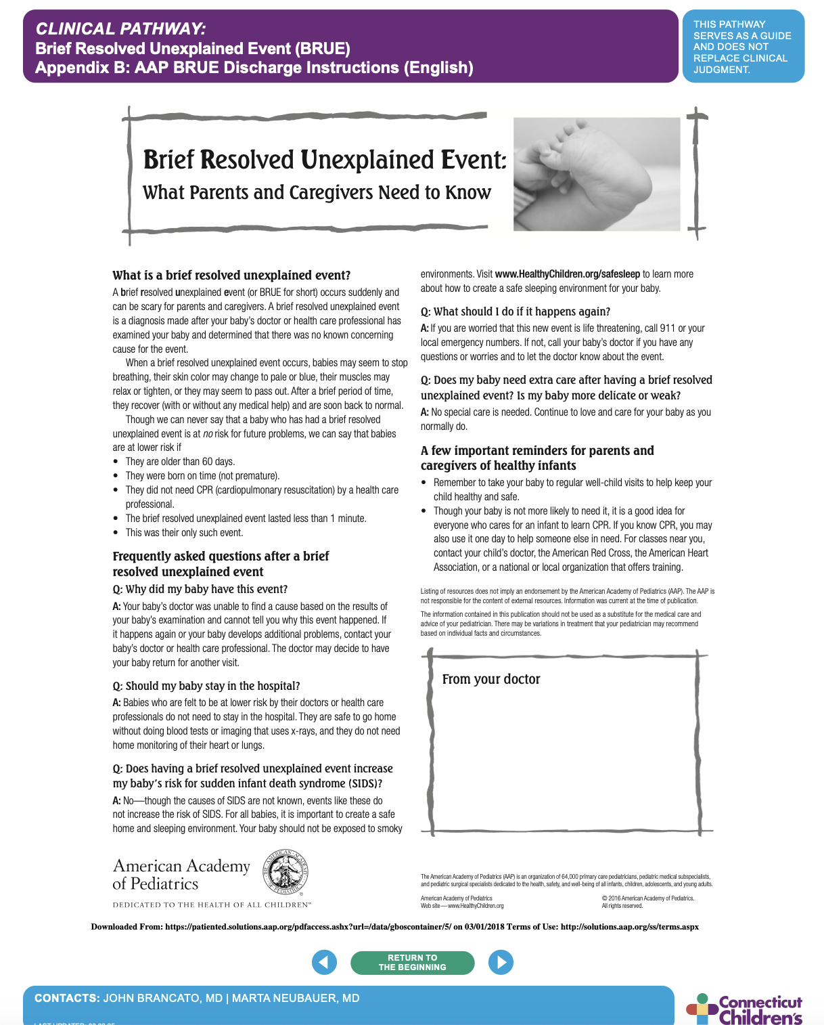
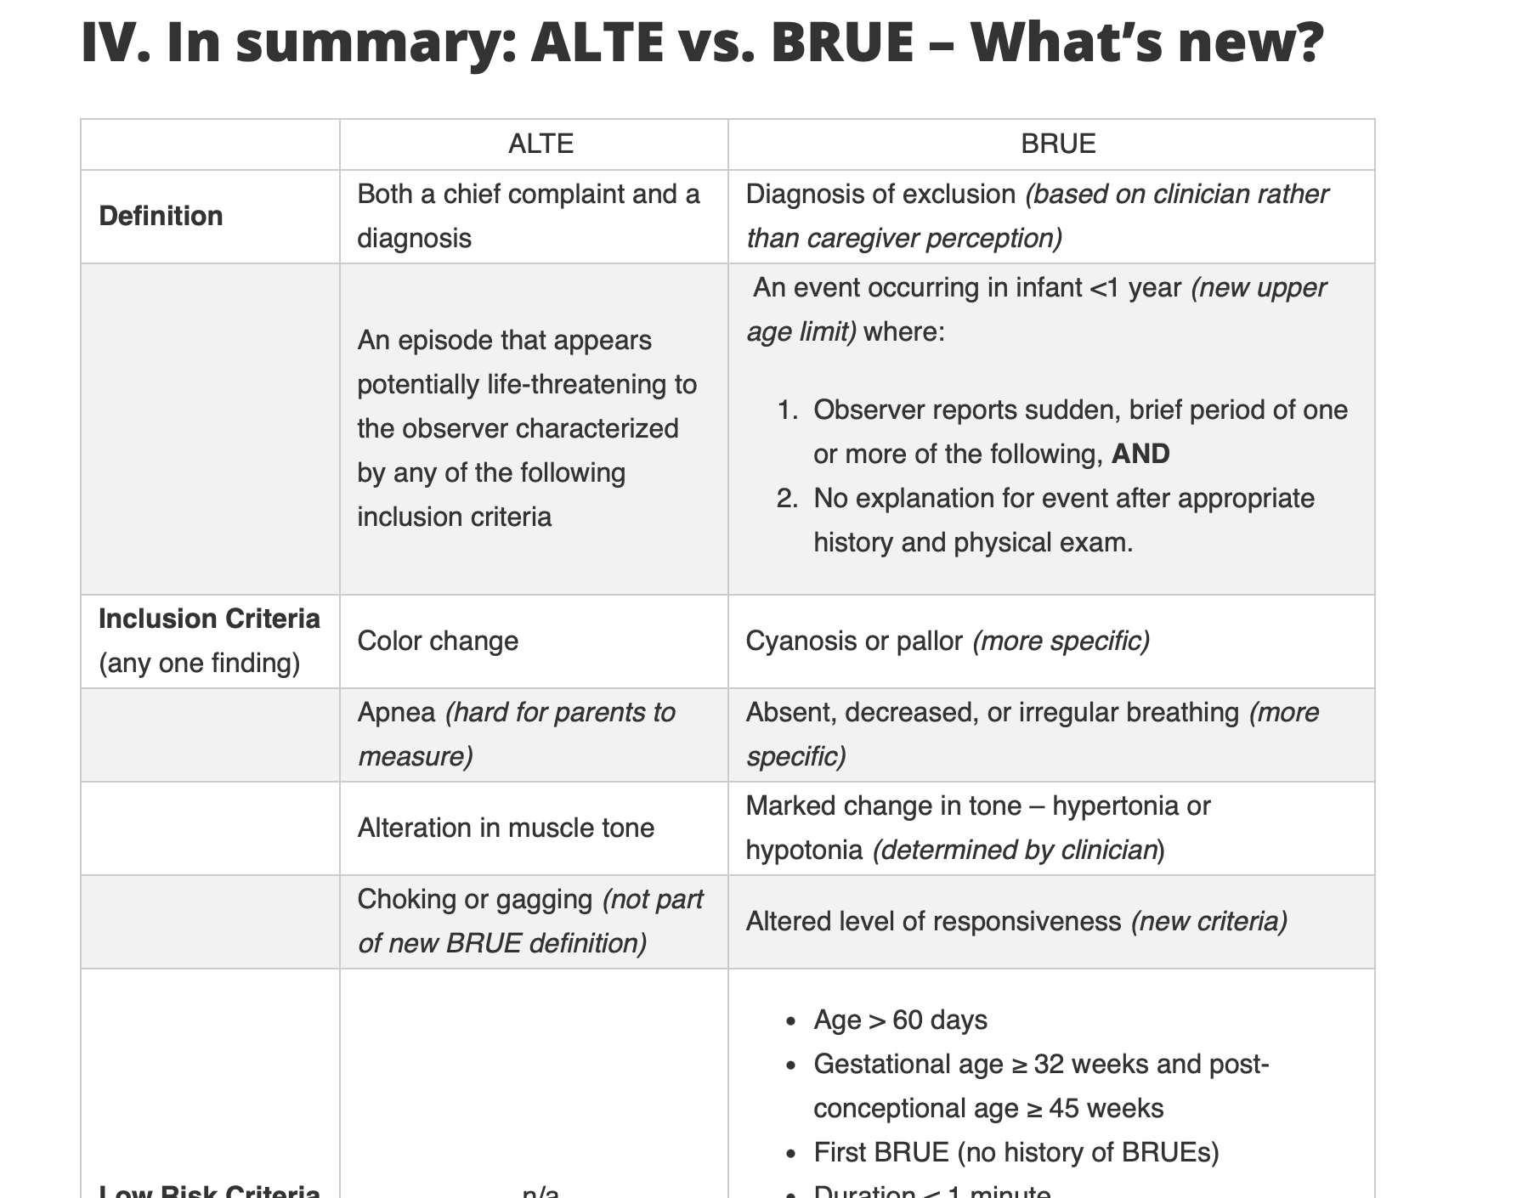

Slide 39
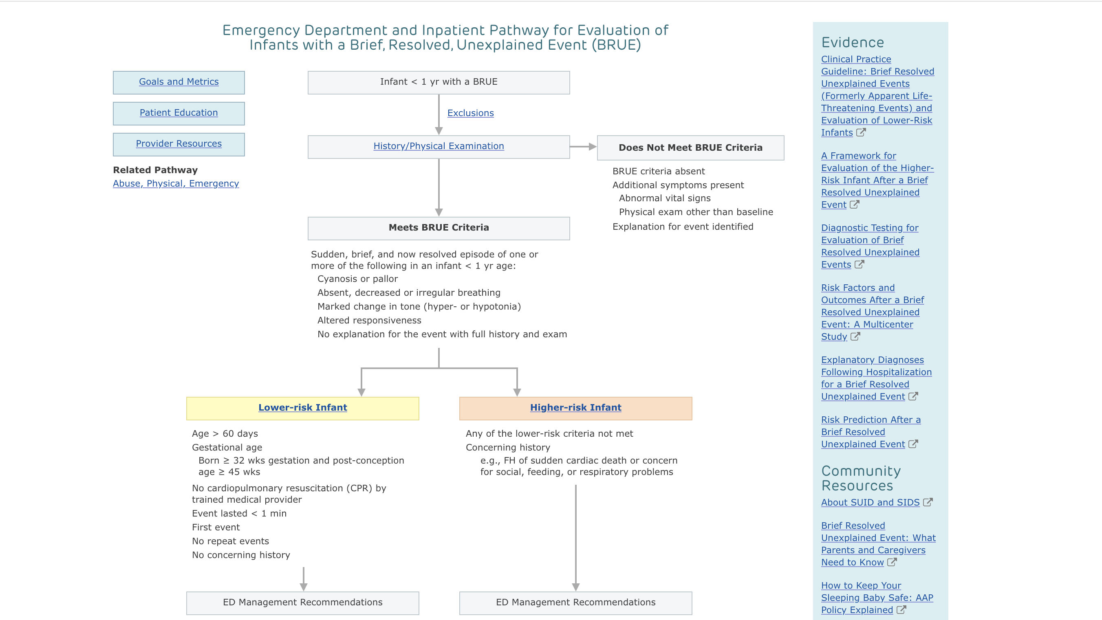

Slide 40
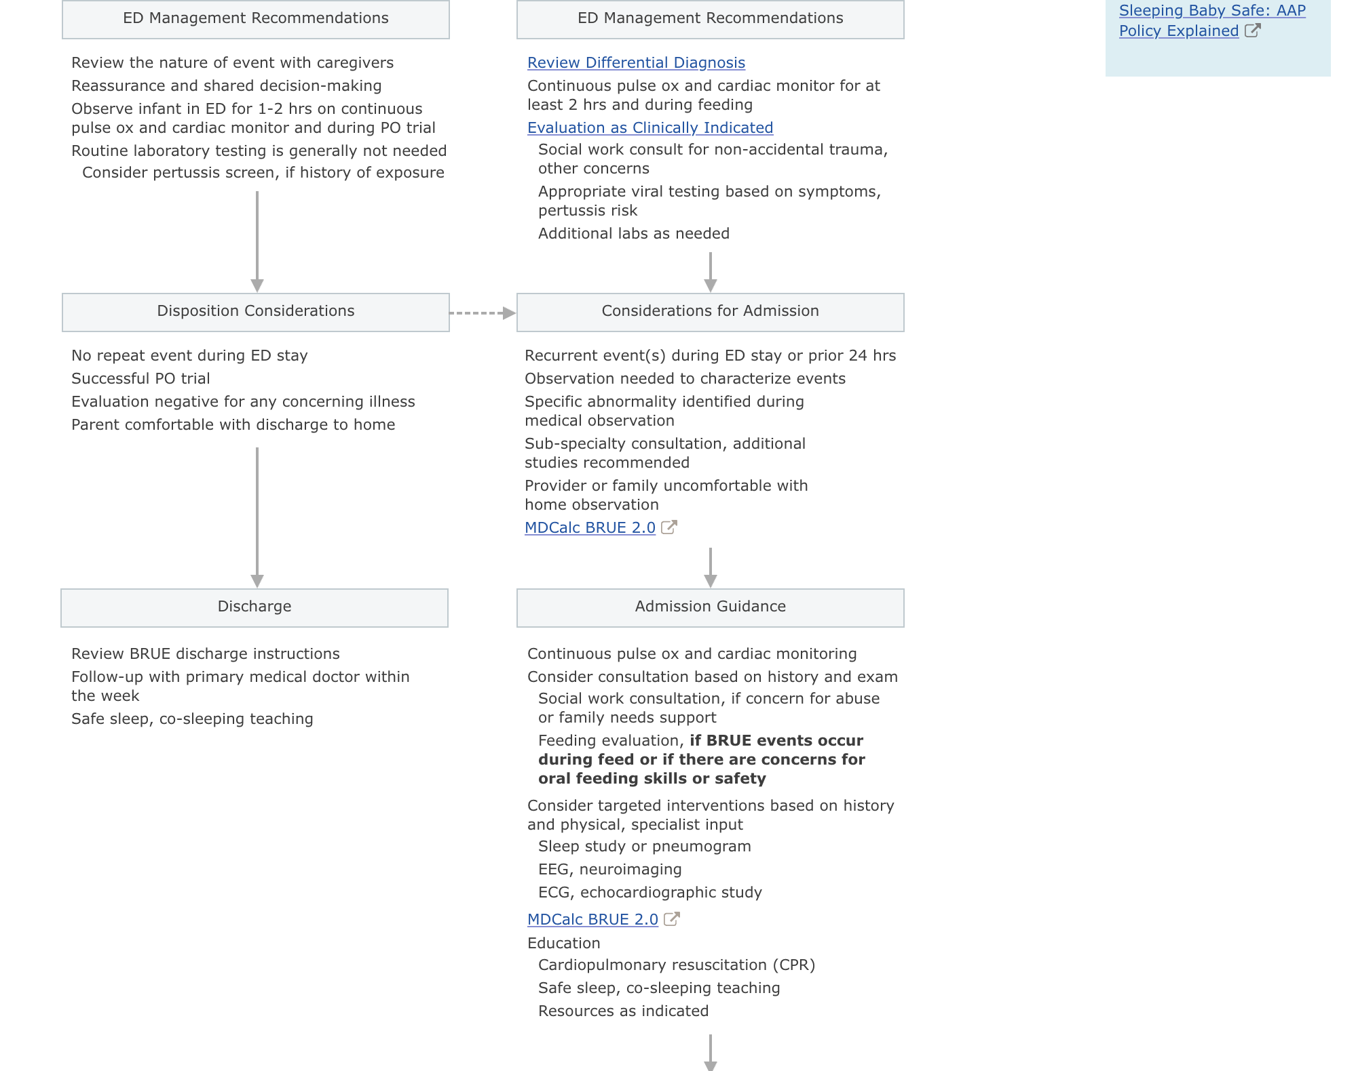

Slide 41
Predictors for significant intervention: prematurity, abnormal PE, cyanosis, absence of URI sx, absence of choking

Slide 42
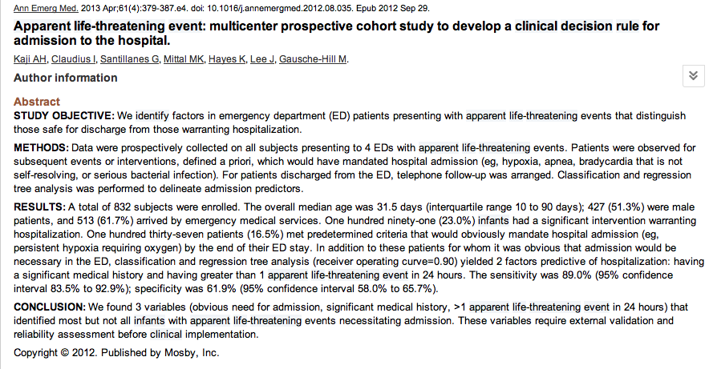
Notes:
- multicenter study of 832 infants with apparent life-threatening events, the presence of any of 3 factors (obvious reasons for admit, significant medical history, 1 apparent life-threatening event
in 24 hours) identified most (89%) of the 191infants who ultimately had justification for hospitalization.
- LA, CHOP, UCLA

Slide 43
Identify predictors for admission
Notes:
- multicenter study of 832 infants with apparent life-threatening events, the presence of any of 3 factors (obvious reasons for admit, significant medical history, 1 apparent life-threatening event
in 24 hours) identified most (89%) of the 191infants who ultimately had justification for hospitalization.
- LA, CHOP, UCLA

Slide 44
3 factors: obvious reasons for admission, significant medical history, more than 1 ALTE in 24 hours
Notes:
- multicenter study of 832 infants with apparent life-threatening events, the presence of any of 3 factors (obvious reasons for admit, significant medical history, 1 apparent life-threatening event
in 24 hours) identified most (89%) of the 191infants who ultimately had justification for hospitalization.
- LA, CHOP, UCLA

Slide 45
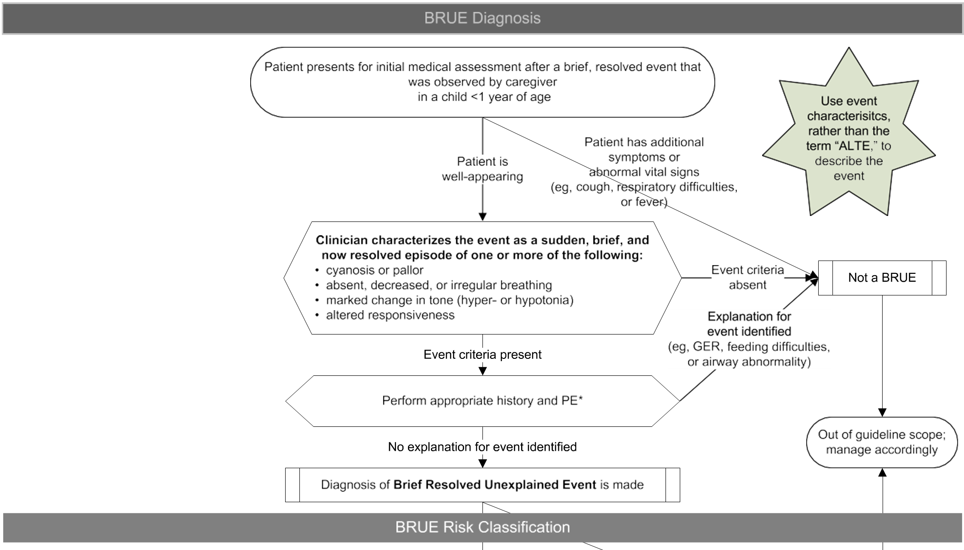
Notes:
2016 AAP Clinical Guidelines

Slide 46
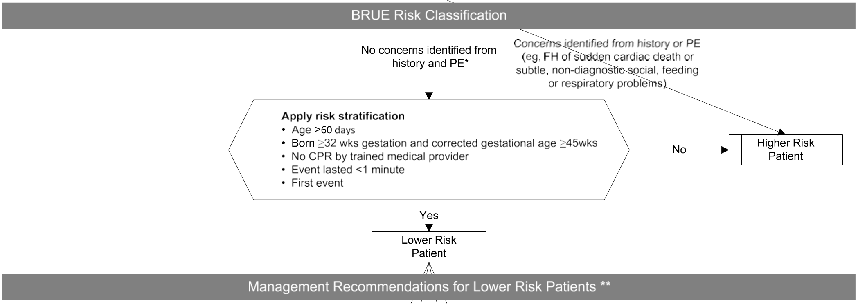
Notes:
High risk pts – which BRUE guideline do not apply:
Less than 2 months old
Premature (< 32 weeks GA or <45 wks corrected age)
CPR preformed by trained professional
> 1 event
>1 min event

Slide 47
Causes
50% of cases have no diagnosis
Most common comorbid conditions:
  Gastroesophageal reflux
  Respiratory infection
  CNS

Slide 48
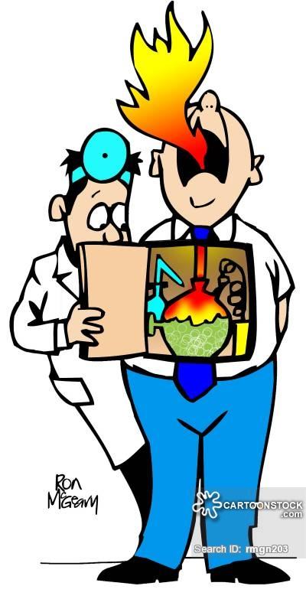
Gastroesophageal Reflux
Dx in approximately 30% of ALTEs
Most likely transient laryngospasm
No clear association with GER and apnea/brady
Notes:
Most likely when hx of gross emesis/oral regurge; episodes while awake and supine; obstructive apnea description
No definitive association with apnea/brady, has shown some airway obstruction laryngospasm or aspiration
For BRUE: excludes from dx; no routine testing shown to be beneficial; no acid suppression needed

Slide 49
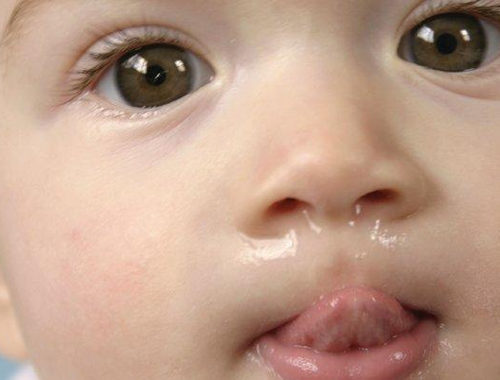
Respiratory Infection
Dx in approximately 20% of ALTE cases
Pertusis in 6-9%
RSV
Notes:
- RSV cases presenting with apnea/ALTE: 9-82%
- mostly under 2 mo of age or premature (excluded from new BRUE guidelines)
CXR not needed unless HX/PE indicative of it; need 24 hour follow up
Can get Pertussis
- can present afebrile and with no resp sx
Consider if + exposure, not vaccinated or increased in community

Slide 50

CNS
Dx in approximately 3-11%
Most common: seizure
Most likely with description of decreased muscle tone and unresponsive
Notes:
Dx by hx; usually neg EEG
No neuro imagining recommended

Slide 51
Case 2
14 day old female is brought into the PED by her grandparents due to an episode of “weird” breathing at home.
Notes:
They where laying with her in the sofa when they noticed that she seemed to breathing strangely: it seemed very shallow and then it looked like she stopped breathing
Lasted about 30 seconds and she turned blue around the lips and on them;
Increased sleeping all day and when awake irritable
Parents were called and they said that she does that; they told their PCP and said it was normal;
No abnormalities on exam but she does appear irritable and hard to console
What do you want to do? - full work up, head CT
What do you think? – NAT, sepsis

Slide 52
NAT?
0.4% - 11% well appearing ALTE associated with child abuse
Suspicious findings:
  Recurrent ALTE
  Family hx of unexplained sudden death or ALTE
  Unexplained facial bruising or bleeding
  Presence of vomiting or irritability at presentation
  Historical discrepancies
Consider standardized questions with multiple personnel
Notes:
Neuro imagining low yield in low risk/BRUE, although head trauma most common
Also in worrisome PE:
Subconjunctival hemorrhage
Rapid head enlargement
Hx issues:
Hx discrepencies
Developmental discrepencies
Previous ALTE
Recent 911 call

Slide 53
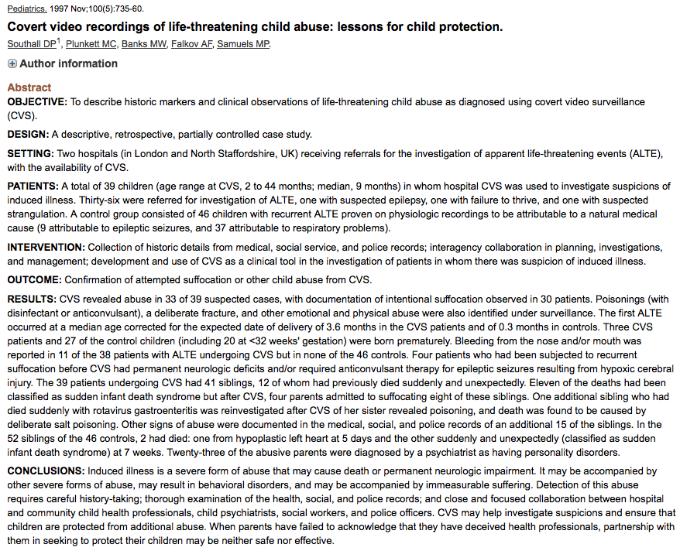
39 children using covert video recordings to investigate possible abuse
33 of 39 suspected cases revealed abuse
Observation of parents with children under covert video recordings
Notes:
Retrospective, Partially controlled case study, North Staffordshire Hospital, Stoke-on-Trent, United Kingdom
36 referred for investigation of ALTE, 1 epiliepsy, 1 FTT, 1 suspected strangulation
control: 46 children with recurrent ALTE by natural medical cause
Abuse cases: 30 with intentional suffocation
Also found: poisonings, fractures and physical/emotional abuse

Slide 54
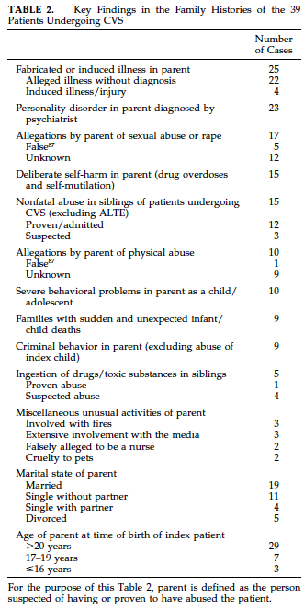
Notes:
Key findings in the history initiating the CVS

Slide 55
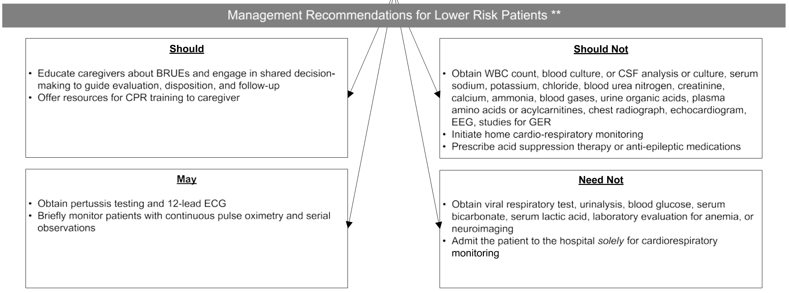
Notes:
Cardiopulmonary recs:
ECG, can consider:
low positive predictive value, but 100% neg predictive value
No need for ECHO after that
Obs for 1-4 hours with serial exams for cardiopulmonary issues (weak recommendation)

Slide 56
The work up
Labs:
  CBC
  CMP
  Glucose
  Blood cx
  UA/Urine cx
  Urine drug screen
  Blood gas
  Lactate
  Pyruvate
  Pertussis
  RSV
Imaging/Diagnostics
  CXR
  Head CT
  ECG
  EEG
- Guided by history and physical -
Notes:
For BRUE:
Not recommended:
CBC, CMP, Bcx, LP, ammonia, inborn errors work up
urine

Slide 57
The work up
Likelihood of positive test low
  Results may be confounding
    Ex: ph probe

Slide 58
Summary
Testing:
  Based on Hx and PE
Hospitalize:
  Abnormal findings
  Intervention required
  Multiple ALTE events

Slide 59
Summary
High Risk BRUE patients:
  Less than 2 months old
  Premature (< 32 weeks GA or <45 wks corrected age)
  CPR preformed by trained professional
  > 1 event
  >1 min event

Slide 60
Questions

Slide 61
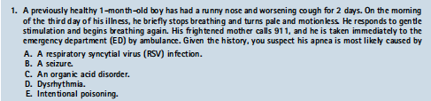
Notes:
A

Slide 62
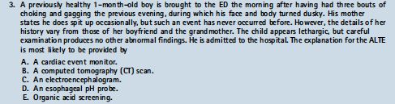
Notes:
B

Slide 63
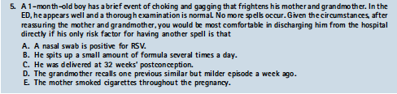
Notes:
E

Slide 64



Slide 65
Refs and credit to Dr. Maritza Plaza
Fu, L.; Moon, R. Apparent Life-Threatening Events: An Update. Pediatrics in Review. Aug 2012;33(8):361.
Kaji, A., et al. Apparent Life-Threatening Event: Multicenter Prospective Cohort Study to Develop a Clinical Decision Rule for Admission to the Hospital. Ann Emerg Med. 2013;61:379-387.
Kant, S; Fisher, JD; Nelson, DG; Khan, S. Mortality after discharge in clinically stable infants admitted with a first-time apparent life-threatening event. Am J Emerg Med. Apr 2013; 31(4):730-3.
Mittal, MK; Sun, G; Baren, JM. A clinical decision rule to identify infants with apparent life-threatening event who can be safely discharged from the emergency department. Pediatric Emergency Care. Jul 2012;28(7):599-605.
Southall, D., et al. Covert Video Recordings of Life-threatening Child Abuse: Lessons for Child Protection. Pediatrics. Nov 1987:100(5)
Task Force on SIDS. SIDS and Other Sleep-Related Infant Deaths: Expansion of Recommendations for Safe Infant Sleeping Environment. Pediatrics. 2011:128;e1341.
Tieder, et al. Management of Apparent Life-Threatening Events in Infants: A Systematic Review. The Journal of Pediatrics. 2013;163:94-9.
www.uptodate.com Apparent-Life Threatening Events in infants.
Tieder JS, Bonkowsky JL, Etzel RA, et al. Brief Resolved Unexplained Events (Formerly Apparent Life-Threatening Events) and Evaluation of Lower-Risk Infants. Pediatrics. 2016; 136(5):e20160590.

