Slide 1


Shock: What YOU Need To Know
Maureen LaTour, MSN,RN,CNL
Kaitlin Mauch, UF Health Education Intern
Spring 2012
Reviewed 2015

Slide 2
Shock Defined:
A critical condition in which the tissues do not receive enough oxygen to meet metabolic demand.
Shock may occur with:
  Normal blood pressure
  Increased blood pressure
  Decreased blood pressure
All forms of shock can impair vital organ function:
  The brain: decreased level of consciousness
  The kidneys: low urine output and decreased kidney function

Slide 3
Causes of Shock
The following will cause the tissues in the body to require more oxygen:
  Fever, infection, injury, respiratory distress, and pain
  Then, cell and organ damage may occur
The treatment goal is to restore blood flow to the tissues and prevent organ injury.
If this is not accomplished quickly, damage may become irreversible and progress into cardiopulmonary failure and cardiac arrest

Slide 4
Shock Types
Hypovolemic:
  Results from inadequate blood volume
  Most common shock in the the pediatric patient population
Distributive or Septic:
  May be caused by bacteria and viruses circulating in the body
  In turn, the inflammatory cascade starts
Cardiogenic:
  Results from poor circulation from decreased cardiac function. The patient may have other comorbidities or previous illness.
Obstructive:
  Results from low blood flow as a result of blocked blood flow pathways

Slide 5
Shock
Types of Shock | Causes
Hypovolemic shock, including hemorrhage | Inadequate blood volume
Distributive/septic shock | Inappropriate distribution of blood flow
Cardiogenic shock | Impaired pumping of the heart
Obstructive shock | Obstructed blood flow
In shock, tissues do not receive enough oxygen because of:
  Insufficient oxygen delivery to the tissues
  Increased demand of cells/tissues for oxygen

Slide 6
Signs of Shock
Area | Sign
Heart | Tachycardia for age of the patient
Skin | Cold, pale, mottled; delayed capillary refill; sweating In septic shock, the child may be red and warm, or may have petechiae
Pulses | Weak peripheral pulses-- compare central pulses to distal pulses with every re-assessment
Kidney | Decreased urine output for age of the patient
Brain | Decreased verbal response, agitation, confusion, and/or anxiety

Slide 7
Severity of Shock
Uncompensated Shock
Compensated Shock
Normal blood pressure
Capillary refill may be prolonged
Urine output stable
Mentation stable
Normal skin color and temperature
ALTERED blood pressure (a late sign)
Delayed over 3 second capillary refill
Agitation/confusion
Cool, pale, sweaty, or flushed skin
Note:
In compensated shock the SYSTOLIC B/P IS NORMAL but the DIASTOLIC B/P IS ABNORMAL (either low or high)

Slide 8
Progression of Shock
Assessment includes:
Signs of Hypotension:
Check capillary refill time
Level of consciousness
Check for skin color and temperature
Urine output-- Is it appropriate for child’s age?
If the patient’s HR is outside the normal range, obtain assistance(PEWS)
Irritability
Tachycardia
Confusion
Decreased muscle tone
Lethargy
Seizures
Pupil dilation
Weak pulses
Mottling of the skin

Slide 9
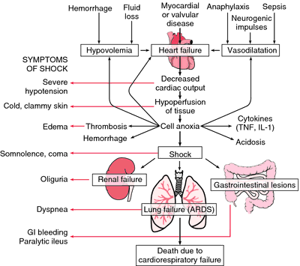

Slide 10
Hypovolemic Shock
Causes:
  Water loss
    Diarrhea, vomiting with poor PO intake, diabetes, high urine output, and major burns
  Blood loss
    Obvious trauma; occult bleeding from pelvic fractures, blunt abdominal trauma; “shaken baby”
  Low preload leads to decreased SV and decreased CO
  Compensation occurs with increase in HR and SVR

Slide 11
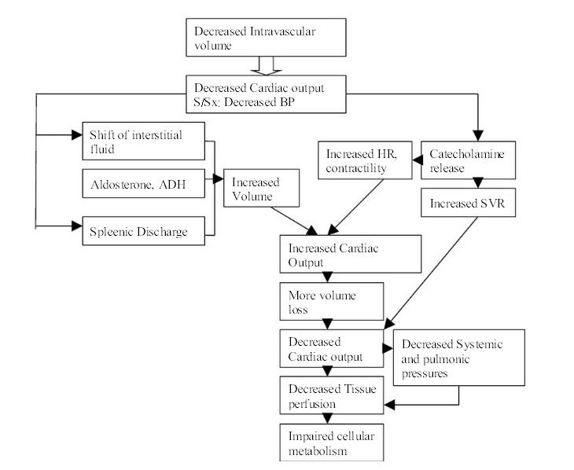
Hypovolemic shock

Slide 12
Hypovolemic Shock
Primary Assessment | Sign
A | Maintainable airway?
B | Increased respiratory rate Normal or increased respiratory effort
C | Tachycardia Weak or absent peripheral pulses Normal or weak central pulses Delayed capillary refill Cool to cold, pale, mottled, sweaty skin Normal systolic blood pressure or hypotension Decreased urine output
D | Changes in level of consciousness
E | Exposure to toxins or well water?

Slide 13
Distributive/Septic Shock
Most common forms:
  Septic: caused by body’s response to infectious organisms or their by products; this triggers inflammation.
    SIRS SEPSIS SEPTIC SHOCK
  Anaphylactic: results from a severe reaction to a drug, vaccine, food, toxin, plant, venom, or other pathogen. Blood vessels relax, causing fluid to leak into tissues.
  Neurogenic: results from head or cervical spine injury; disrupts the nerve supply to the blood vessels and heart.

Slide 14
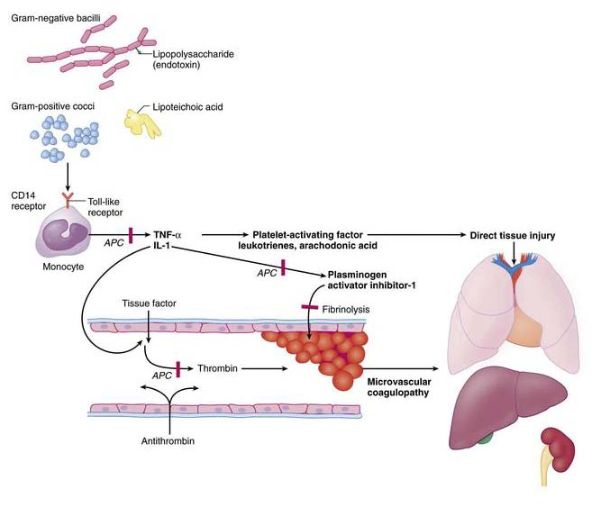
Causes of Sepsis

Slide 15
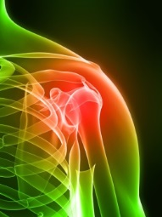
Septic Cascade
Inflammatory response of the body to an infectious agent
Cytokines (inflammatory substances) are activated and cause blood vessel walls to relax, making blood vessels wider and causing fluids to leak from the cells to the tissues
Cytokines may impair the pumping of the heart as the inflammatory cascade continues

Slide 16
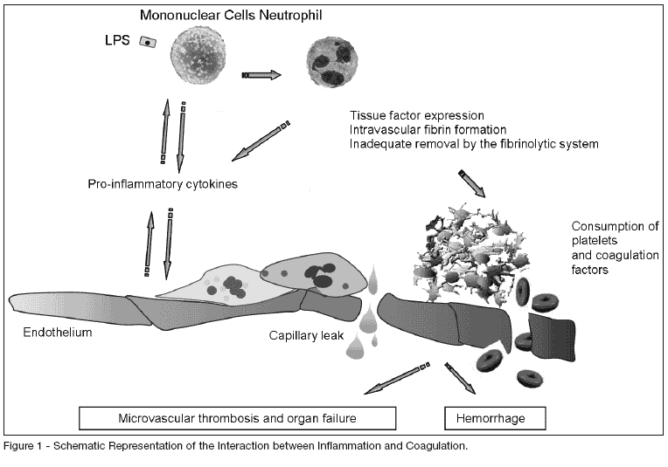
This inflammation may lead to :
Hypotension (a late sign in pediatrics; wide blood vessels and decreased heart pumping)
Respiratory failure
Abnormal blood clot formation or bleeding resulting in DIC
Decreased production of stress hormone

Slide 17
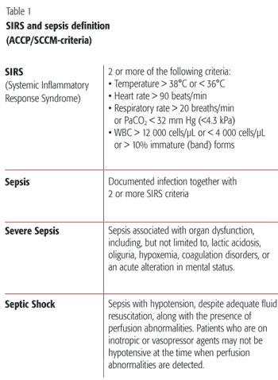
Septic Guidelines:
In Pediatrics; we need to remember age appropriate vital signs prior to diagnosis of SIRS, Sepsis, or Septic Shock

Slide 18
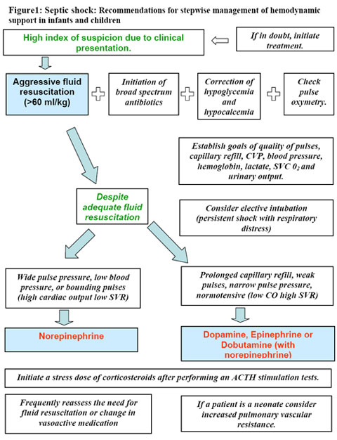

Slide 19
Septic or Distributive Shock
Primary Assessment | Finding
A | Usually patent unless level of consciousness is significantly impaired
B | Fast respiratory rate Normal respiratory effort or increased effort if the child has pneumonia, lung injury, or heart failure Normal breath sounds or crackles
C | Tachycardia Very strong peripheral pulses (bounding) Warm flushed skin with brisk capillary refill (warm shock) or cool skin with delayed capillary refill (cold shock) Systolic and diastolic blood pressures may be normal, low, or high
D | Changes in level of consciousness (agitation, confusion, or decreased responsiveness in late shock)
E | Variable temperature (in sepsis, may have low or increased temperature) Petechial or purpuric rash (septic shock)

Slide 20
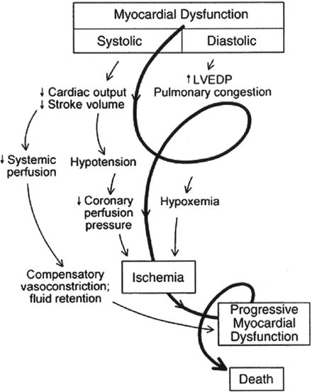
Cardiogenic Shock
Causes:
Congenital or genetic heart disease
Inflammation of the heart muscle
Abnormality of pumping function
Arrhythmias
Sepsis
Poisoning or drug toxicity
Injury to the heart (e.g. trauma)

Slide 21
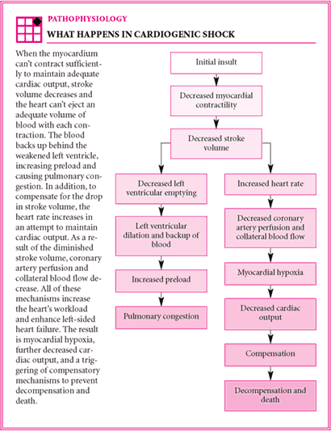
Cardiogenic Shock

Slide 22
Cardiogenic Shock
Primary Assessment | Finding
A
B | Fast respiratory rate Increased respiratory effort (chest retractions, nasal flaring) resulting from fluid in the lungs
C | Tachycardia Weak or absent peripheral pulses Normal and then weak central pulses Delayed capillary refill with cool arms and legs Cold, pale, mottled, sweaty skin Cyanosis Normal or low blood pressure Decreased urine output Signs of congestive heart failure (e.g. fluid in the lungs, liver enlargement, distended neck veins)
D | Change in level of consciousness (agitation or anxiety early, reduced responsiveness later)
E | Variable temperature

Slide 23
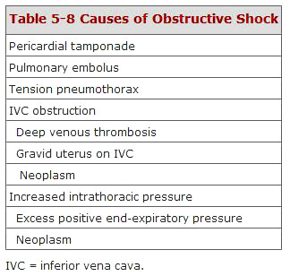
Obstructive Shock
Obstruction of blood flow; results in decreased blood flow to the tissues
As the condition progresses, increased respiratory effort, cyanosis, and signs of poor circulation become more apparent

Slide 24
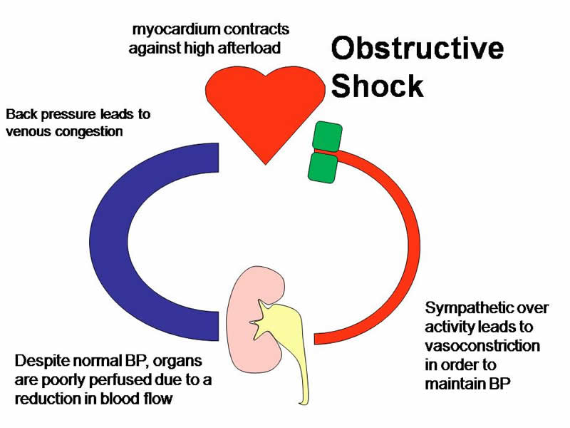
Obstructive Shock

Slide 25
Obstructive Shock
Cause | Type of Obstructive Shock
Accumulation of fluid in the sac around the heart | Cardiac tamponade
Accumulation of air outside the lungs in the chest cavity | Tension pneumothorax
Obstruction of normal blood flow from the heart as a result of congenital heart disease | Ductal-dependent lesions
Blood clot to the lungs | Pulmonary embolism

Slide 26
Interventions for Shock
Hypovolemic
  Fluid resuscitation
  Goals:
    Restore intravascular volume
    Correct metabolic acidosis- -look at the lactic acid in an ABG, what is the PH in a Blood gas?
    Treat the cause
  Degree of dehydration is underestimated
    Reassess perfusion, urine output, vital signs…
  Isotonic crystalloid is always a good choice
    20 to 50 cc/kg rapidly if cardiac function is normal
      ALWAYS REASSESS THE PATIENT AFTER BOLUS IS ADMINSITERED

Slide 27
Interventions for Shock (continued)
Distributive
  Give adequate fluid to restore blood flow (septic shock)
  Look for signs of respiratory distress (septic shock)
  Identify the signs of shock before hypotension develops
Cardiogenic
  Do not give large or rapid fluid boluses– can worsen fluid in lungs, as well as worsen heart function
  Give small isotonic fluid boluses (5 to 10 mL/kg)
  Give fluid boluses over longer periods of time (e.g. 20 minutes instead of 5-10 minutes)
  Monitor patient closely during fluid infusion

Slide 28
Interventions for Shock (continued)
Obstructive
  Immediate action is required when you recognize obstructive shock– failure to correct the cause will often result in rapid progression to cardiopulmonary failure and cardiac arrest
  Initial therapy is always a fluid challenge
  Treating the cause:
    Pericardial drain, chest tube, surgical intervention, order labs for evaluation of status
    If the patient is a neonate with a ductal dependent lesion than give PGE
  Further evaluation includes invasive monitoring, pharmacologic therapy, and appropriate consults

Slide 29
Summary of Shock:
Seek expert consultation as needed for the child or infant in shock
Open and support the airway
Position the child for comfort as able to depending on level of stability
Provide oxygen therapy
Ensure IV access
IV fluid therapy is essential
  Provide boluses as needed and indicated for patients vital signs and perfusion

Slide 30
Summary of Shock
Use isotonic crystalloid for fluid replacement
Correct metabolic imbalances(decreased or increased Na, K+ etc.)
Monitor:
  Heart rate
  Pulses, capillary refill
  Urine output-- (increase in UOP is a + sign)
  Blood pressure
  Respiratory rate
  Level of consciousness
  Temperature
  Glucose
Perform FREQUENT REASSESSMENT to determine response to therapy

Slide 31
Shock Therapeutic Endpoints:
Urine output >1ml/kgm per hour
Normal heart rate and blood pressure for age
Normal pulses
Capillary refill < 2 seconds
Warm extremities
Normal mental status (return to patient's baseline)
Decreased serum lactate
Reduced base deficit in ABG or VBG
Central venous oxygen saturation >70%

Slide 32
Medications used in Shock: Normotensive
Drug | Why used | Dose | Monitor
Dobutamine | Increases contractility and HR, vasodilatation | 2- 20 mcg/kg per minute infusion. Onset: 1-2 min, Peak: in 10 min. | Vital signs, HR, UOP.
Dopamine | Cardiogenic and distributive shock . Increase HR, beta adrenergic receptors, decreases SVR | 2 to 20 mcg/kg/min, titrate to desired vital sign results Onset: 1-2 min.; Peak: in 10 min. | UOP, Vital signs. Central line administration preferred, IV sites
Epinephrine | Anaphylaxis, croup, bradycardia, cardiac arrest, shock, increases heart contractility & vasoconstriction | 0.1mg/kg 0f 1:10,000 every 3 to 5 minutes in an arrest. Infusion:0.1to1mcg/kg/min Onset: immediate Peak: within 1 minute | Oxygen requirements increase, increases serum lactate, for arrhythmias
Milrinone | Myocardial dysfunction in shock, increases contractility , reduces preload and afterload | Loading dose: 50mcg/kgm IV or IO over 10 to 60 min. Infusion: 0.25 t0 0.75 mcg/kg per min. | Hypotension, arrhythmias, do not use in patients with Ventricular outflow defects

Slide 33
Medications used in Hypotensive Shock
Drug | Why used | Dose | Monitor
Norepinephrine | Vasopressor, hypotensive shock, increases contractility and HR | 0.1-2 mcg/kgm per minute- titrate to change in BP and perfusion | B/P, Renal function, rhythm, perfusion
Dopamine | Cardiogenic and distributive shock . Increase HR, beta adrenergic receptors, decreases SVR | 2 to 20 mcg/kg/min, titrate to desired vital sign results Onset: 1-2 min.; Peak: in 10 min. | UOP, Vital signs. Central line administration preferred, IV sites
Epinephrine | Anaphylaxis, croup, bradycardia, cardiac arrest, shock, increases heart contractility & vasoconstriction | 0.1mg/kg 0f 1:10,000 every 3 to 5 minutes in an arrest. Infusion:0.1to1mcg/kg/min Onset: immediate Peak: within 1 minute | Oxygen requirements increase, increases serum lactate, for arrhythmias

Slide 34
Medication used for Shock
Drug | Why Used | Dose | Monitor
Vasopressin | Shock states to increase cardiac contractility and vasoconstriction | Shock: 0.00017-0.010 units/kg/min IV, titrate to B/P and perfusion | B/P, UOP, perfusion, & lactate.
Warning! Vasopressin is also used in the treatment for patients with Diabetes Insipidus.
The dosing is usually milliunits/kg/hour.
Please take extra caution when starting any vasopressin infusion!!!!

Slide 35
Maintenance Fluid Requirements:
For Infants under 10 kgm:
    4ml/kg/hour=
    Example: 8 kgm infant:
    10x4=40ml hour
For children10-20 kgm:
    (4ml/kg/hour for the first 10 kgm)+ (2ml/kg per hour above 10 kgm)=
    Example: 15kgm child:
    4 x10 +2ml/kg x5kg=50ml/hour
Children above 20 kg:
    (4ml/kg/hour for the first 10kgm)+(2ml/per kgm for kgm11-20 kgm) +(1 ml/kgm/hour for each kgm above 20kgm)=
    Example: 27 kilogram child:
    4ml/kg/hour for the first 10kgm +2ml/kg/per hourx10 kgm +1ml/kgm/hour x7 kgm = 67 ml hour
PALS, 2010

Slide 36
International Consensus Pediatric Sepsis Criteria:
Recommended updates in the hemodynamic
support guidelines for pediatric and neonatal septic shock, include
continuous ScvO2 monitoring.
International Consensus Pediatric Sepsis Criteria:
• Hypotension >40 mL/Kg isotonic fluid bolus
• Vasoactive medications to maintain BP
• 2 or more of the following:
– Base deficit >5 meq/L
– arterial lactate > twice normal
– oliguria (UOP* <0.5 mL/Kg/hr)
– CRT+ >5 sec
– core to peripheral temperature gap > 3°C
Severe Sepsis Criteria
• GCS** <15 without CNS++ disease
• Lactate >1.6 mmol (arterial) or >2.2 mmol (venous)
• Measured UOP <1 mL/Kg for 2 hrs
Criteria for Septic Shock
• Hypotension after 20 mL/Kg fluid bolus
• Needs inotrope or vasopressor besides dopamine
SEPSIS
  • Hypotension >40 mL/Kg isotonic fluid bolus
  • Vasoactive medications to maintain BP
  • 2 or more of the following:
  – Base deficit >5 meq/L
  – arterial lactate > twice normal
  – oliguria (UOP* <0.5 mL/Kg/hr)
  – CRT+ >5 sec
  – core to peripheral temperature gap > 3°C
SEVERE SEPSIS Criteria
  • GCS** <15 without CNS++ disease
  • Lactate >1.6 mmol (arterial) or >2.2 mmol (venous)
  • Measured UOP <1 mL/Kg for 2 hrs
Criteria for SEPTIC SHOCK
  • Hypotension after 20 mL/Kg fluid bolus
  • Needs inotrope or vasopressor besides dopamine
  • Any criteria from severe sepsis
EDWARDS LIFE SCIENCE REFERENCE MATERIAL

Slide 37
Information from Edwards Critical Care Education
Please go to this web site fro more information:
http://ht.edwards.com/sci/edwards/sitecollectionimages/products/mininvasive/7266pedquickguide.pdf
Site provides information related to critically and acutely ill children

Slide 38
Other ways to Differentiate Shock States
Cold or Warm | Fluid Refractory | Catecholamine resistant | Refractory
↓Mental status, perfusion CRT* >2 sec (cold) Flash CRT* (warm) Diminished pulses (cold) Bounding pulses (warm) Mottled extremities (cold) ↓UOP+ (<1mL/Kg/h) | Shock despite fluid bolus >60 mL/Kg and dopamine infusion 10μ/Kg/min | Shock despite epinephrine (cold shock) or norepinephrine (warm shock) | Shock despite goal directed therapy: inotropes, vasopressors, vasodilators, metabolic agents (glucose, calcium) and hormonal homeostasis therapy (insulin, thyroid, hydrocortisone)
)

Slide 39
Table of Shock Types
Hypovolemic | Cardiogenic | Obstructive | Endocrine
Decreased intravascular volume • Internal/external bleeding • Burns, capillary leak syndrome, • Vomiting, diarrhea, diuretics Endocrine | Congenital heart disease, arrhythmias • Cardiomyopathy • Infections, toxic disorders • Metabolic disorders • Neuromuscular disorders • Connective tissue diseases • Hypoxia, trauma | Cardiac tamponade • Hemothorax or pneumothorax • Coarctation, IAA | Vasodilatory shock • Vasopressin deficiency • Thyroid storm • Adrenal insufficiencies
Septic |  | Distributive
Infections • Inflammatory response |  | Anaphylaxis • Spinal cord injuries

Slide 40
Shock Stages
Compensated | Uncompensated | Irreversible
Compensatory mechanisms to maintain BP • Increase HR and myocardial contractility • Systemic venous constriction • Systemic arterial constriction – Cool, pale skin – Muscle weakness – Restlessness, irritability – Decrease UOP – GI dysfunction* – BP normal | Local tissue hypoxia • Beginning lactic acidosis • Intense sympathetic Vasoconstriction Mental deterioration Cold, clammy skin Pale mucus membranes and nail beds Hypotensive S-T changes → myocardial ischemia Oliguria | Profound tissue hypoxia Profound organ damage Severe hypo-perfusion Anaerobic metabolism Stiff lungs Inadequate cardiac output Leaky capillary syndrome Anuria GI tract necrosis* • Death

Slide 41
SIRS
Temperature | Heart Rate | Respiratory | WBC
>38˚C or <36˚C (rectal) >37.8˚C or <35.8˚C (oral) >37.2˚C or <35.2˚C (axillary | > 90th percentile for age | > 90th percentile for age PaCO2 <32 mmHg | > 12,000 <4,000

Slide 42
References
AHA, (2011), PEARS: Pediatric Emergency Assessment Recognition and Stabilization
AHA, (2011), PALS: Pediatric Advanced Life Support.
Slota, M.C. (2006) AACN Core Curriculum for pediatric Critical Care Nursing.
Hazinski, M.F. ( 2006). Manual of Pediatric Critical Care Handbook.
Hazinski, M.F. (2013) Nursing Care of the Critically Ill child.
Pub Med literature searches for pediatric sepsis conducted prior to every course

