Slide 1

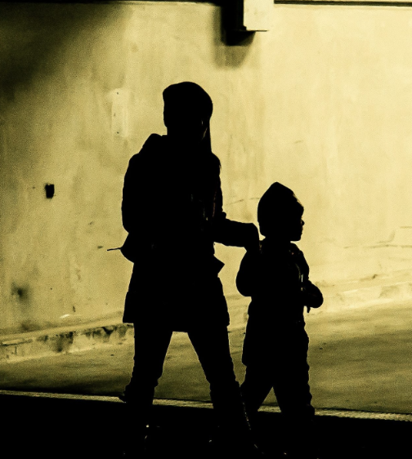



Unseen Dangers: Identifying and Addressing Covert Exploitation in the ED
Cristina Zeretzke-Bien MD FAAP FACEP

Slide 2

A little about me:
Advocate & Ally
Not an Expert- but I have worn some hats (SANE med director, worked for CPT, HT coalition, Child abuse teams, & DCF med director.
Passionate about education with Child Abuse, HT, and Domestic Violence
I am a PEM trained pediatrician– open to being educated/double-boarded PEM/Peds
Notes:
Bio and intro

Slide 3
Objectives
Define vulnerable populations: Human Trafficking/Labor Trafficking /IPV/abuse
How to Identify Victims & Why A Concern for Health Care/Screening
Physical Exam Findings
What to Do once you have Identified
Literature
Resources- National and Local

Slide 4

What is Human Trafficking? What is Labor Trafficking?
What is Human Trafficking? the act of coercion, fraud, or forcing a person into leaving their home to work for little or no payment.
What is Labor Trafficking? the recruitment, harboring, transportation, provision, or obtaining of a person for labor or services through force, coercion, or fraud.
Notes:
-A basic definition of Human Trafficking is the act of tricking, luring, or forcing a person into leaving their home to work for little or no payment.
-The capturer has power and ownership over the victim.
-In the simplest form, it is slavery, only a modern day and more advanced form.
-The victims are treated as commodities, void of any right or dignity.
-Though the Civil War was supposed to abolish slavery in the US in 1865, and the Slavery Convention of the League of Nations was supposed to put an end to it worldwide in 1926, it is still an enormous issue.
-Because this is an underground operation, most people are not aware that this is going on, or of the magnitude of the problem.

Slide 5

Let’s start Here… Labor Trafficking:
Labor trafficking is often absent from discussions of human trafficking
LIMITED DISCUSSIONS: Many are limited to sex trafficking
BUT, the legal definition of human trafficking includes both sex trafficking and labor trafficking.

Slide 6
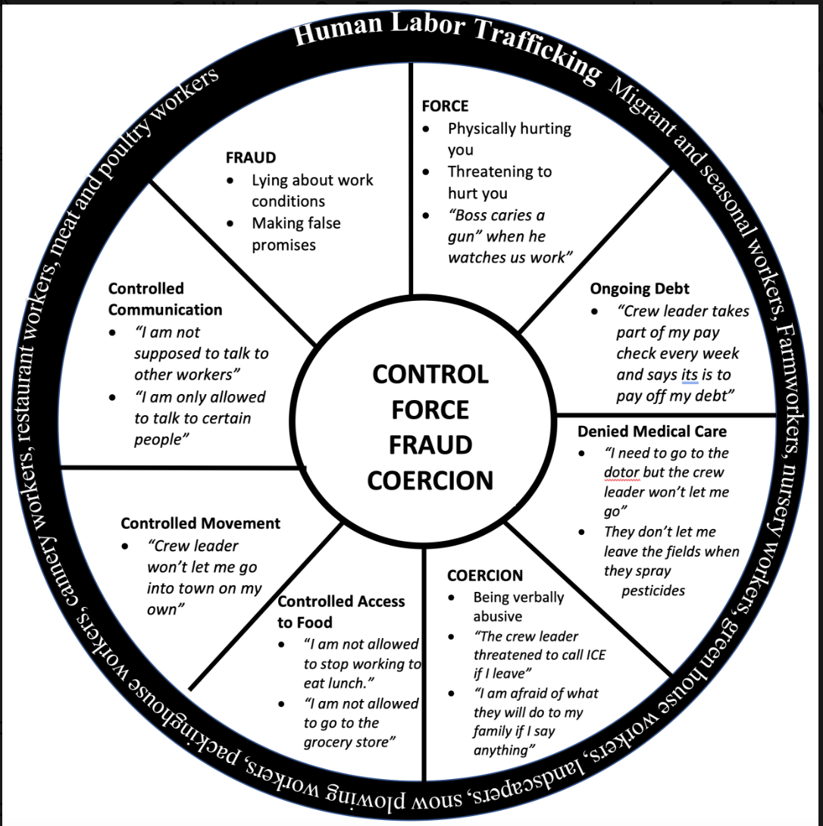

Slide 7

Labor Trafficking IS a Health Care Issue!
Labor trafficking is a pervasive issue globally
In the US the National Human Trafficking Hotline calculates that 16% of labor trafficking cases reported to them involved children
Where are people trafficked?
in agriculture
construction
domestic labor
commission-based sales
the drug trade

Slide 8

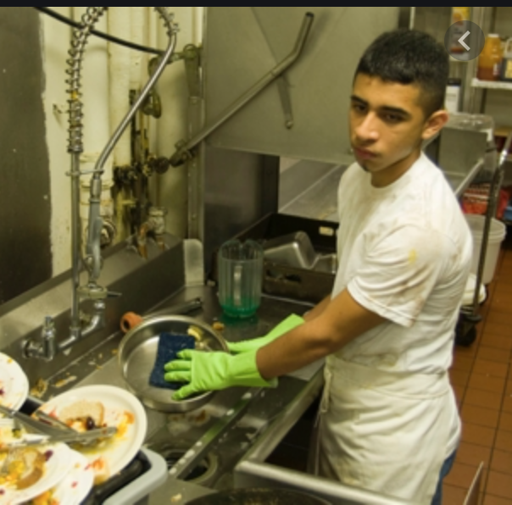

Who is Vulnerable?
Among the most vulnerable groups of children
the homeless
those in foster care
unaccompanied migrants

Slide 9
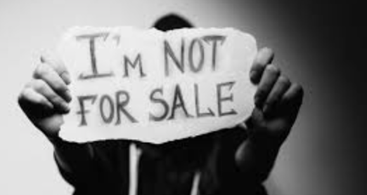
How Will They Present to Your ED?
Victims often present with complaints related to their experience trafficking
These include:
work-related injuries
exposure to toxins
bruises and scars
exhaustion
malnutrition

Slide 10
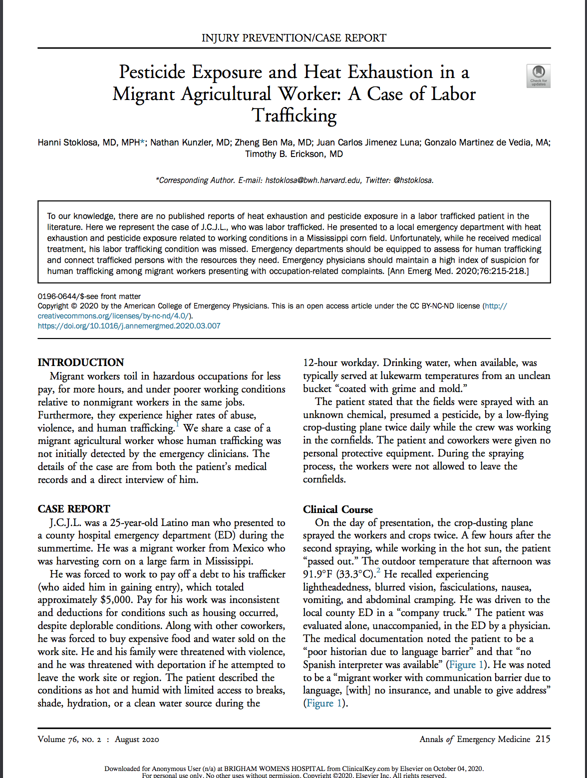

Slide 11
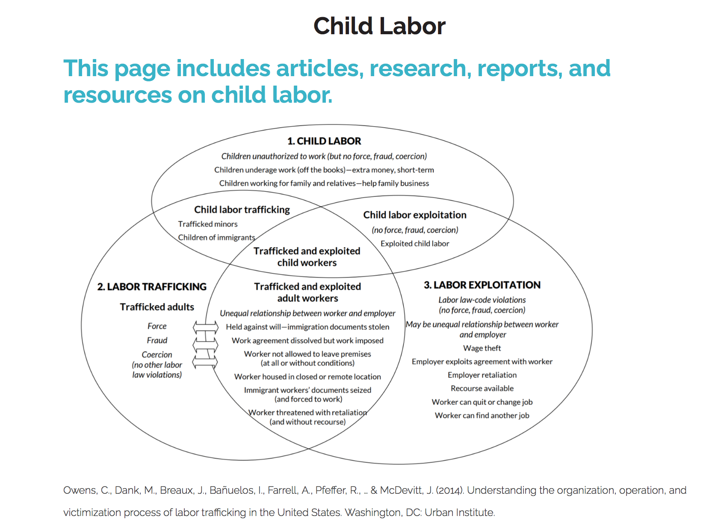
What Must We Do?
PRACTICE with Vigilance!

Slide 12
How to Help?
If people do not disclose, those who are suspected victims should be provided referrals
Use of trauma-informed healthcare that reflects an awareness of the harms
Provide information that could help prevent further victimization.

Slide 13
A Word on Trauma Informed Care:
Keep the survivor on the forefront of our interactions- Victim Centered
Safe Space
Traumas create triggers (sights, sounds, emotions)
Send an authentic message
Realizes the widespread impact of trauma
Responds by integrating knowledge
Seeks to resist re-traumatization

Slide 14


How to Connect?
All health systems should include labor trafficking responses in their trafficking policies and procedures
Resources available to healthcare workers include:
HEAL Trafficking Toolkit
National Human Trafficking Resource Center Assessment Tool
CDC’s guide to trauma-informed care

Slide 15
Where is trafficking happening?
Notes:
-This is going on even in the United States.
-As we said before, most people are unaware of just how close to home this issue really is. The following video demonstrates how common this is in our own country.

Slide 16
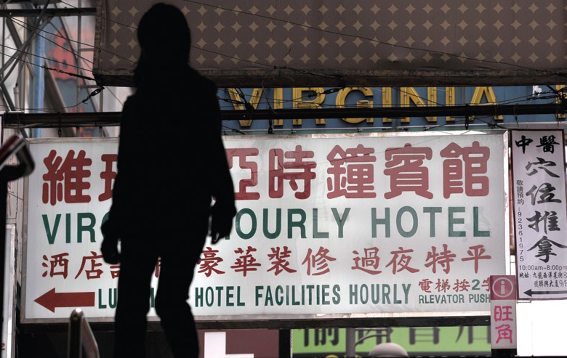



Slide 17
Are the numbers accurate???
The FBI estimates that well over 100,000 women and children are trafficked into the U.S. every year. They generally range in age from 9 to 19, with the average age being 11.
Although almost 50% of trafficking victims are sold into prostitution, the other half are forced to work in factories, harvest crops, wash dishes in restaurants and clean in motels and offices
WE DO NOT HAVE ACCURATE NUMBERS!

Slide 18

How To Identify Who Are HT Victims:
Victim:
Is not free to leave or come and go
Is in the commercial sex industry and has a pimp/manager
Is unpaid, paid very little, or paid only through tips
Notes:
Is not allowed breaks or suffers restrictions at work
Owes a large debt and is unable to pay it off
Recruited through false promises concerning the nature of his/her work
High security measures exist in the work or living locations (bars, cameras, etc)

Slide 19

RED FLAGS:
Physical Exam:
General Appearance: Appears malnourished, limping /Pain
Skin: trauma, scars, rashes, sunburn, track marks, branding
Gyn/GU: STI, trauma, Foreign bodies, unknown pregnancy

Slide 20


RED FLAGS: Identification
Lack of Control
Minor Not in School
Does not speak English
Alcohol/Drugs
Trauma
Unfamiliar with Surroundings

Slide 21
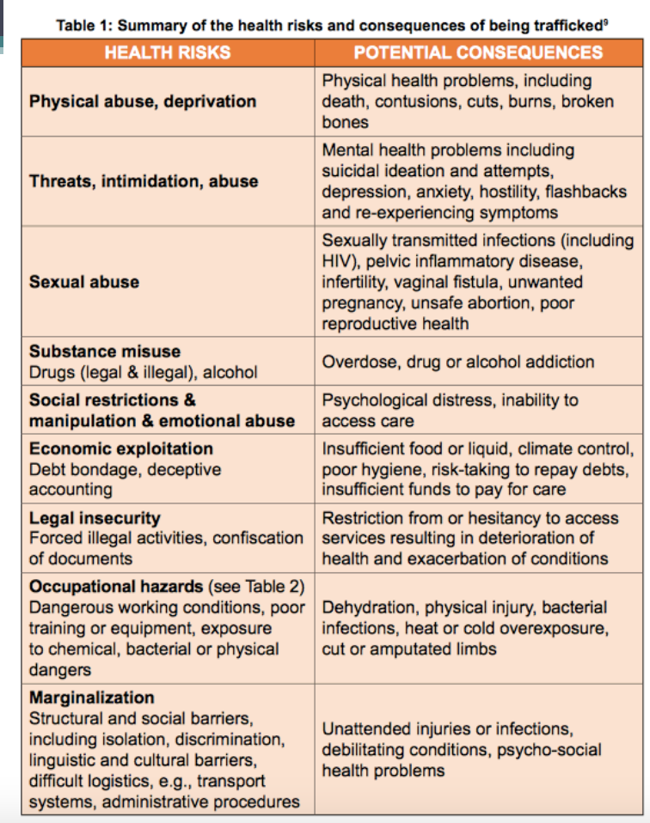

Slide 22
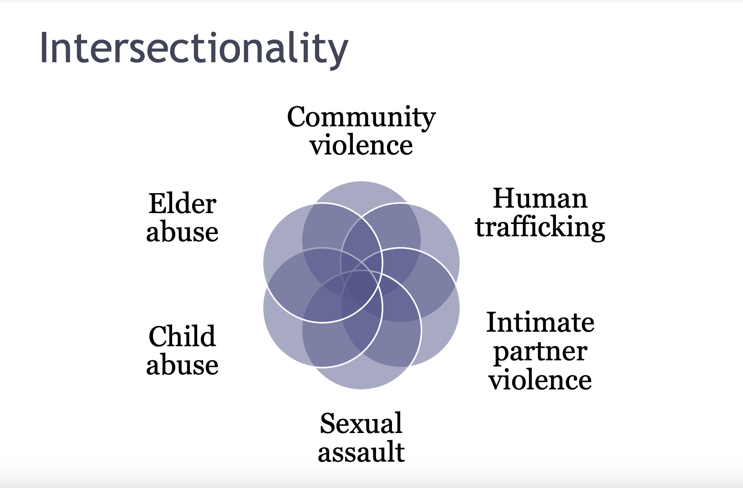

Slide 23


Slide 24
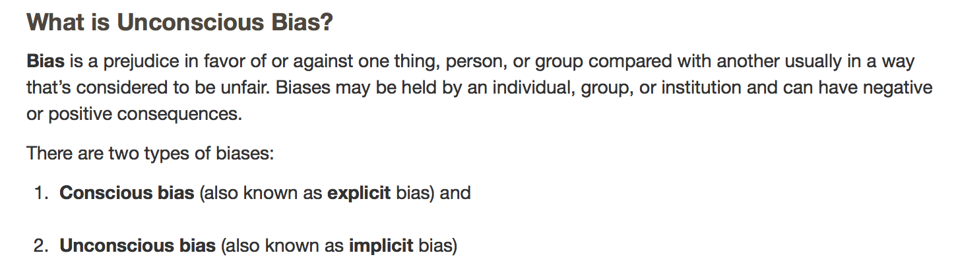
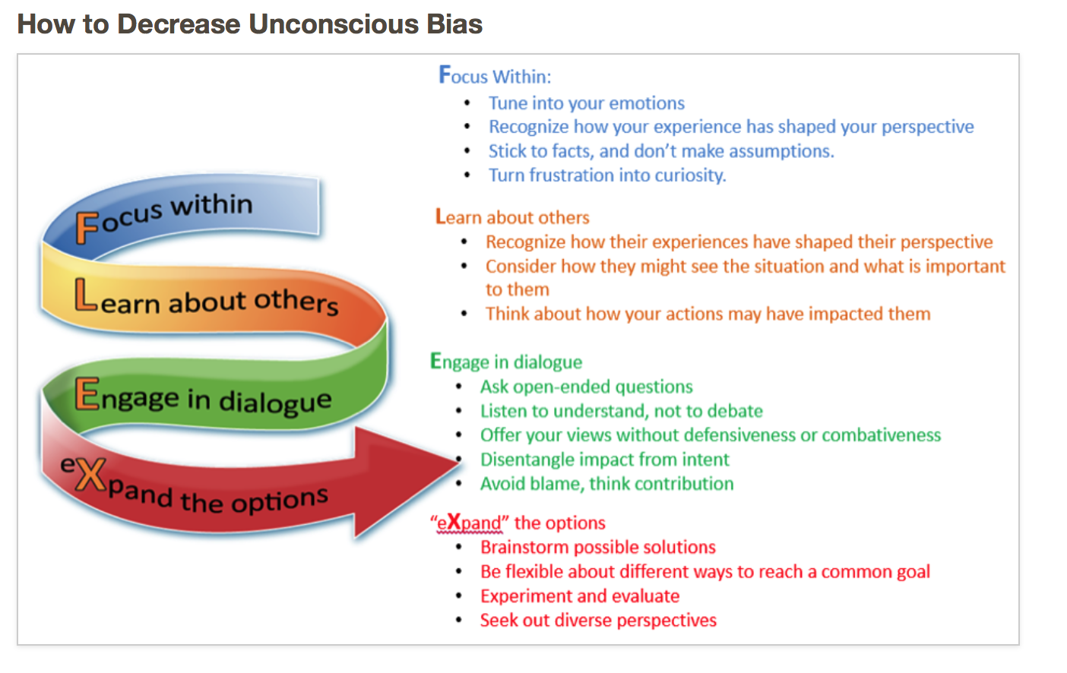
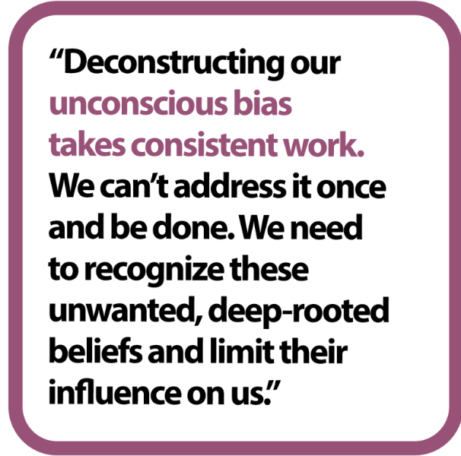
BEFORE WE CAN REACH THE PATIENT: WE MUST ADDRESS OUR OWN BIASES

Slide 25
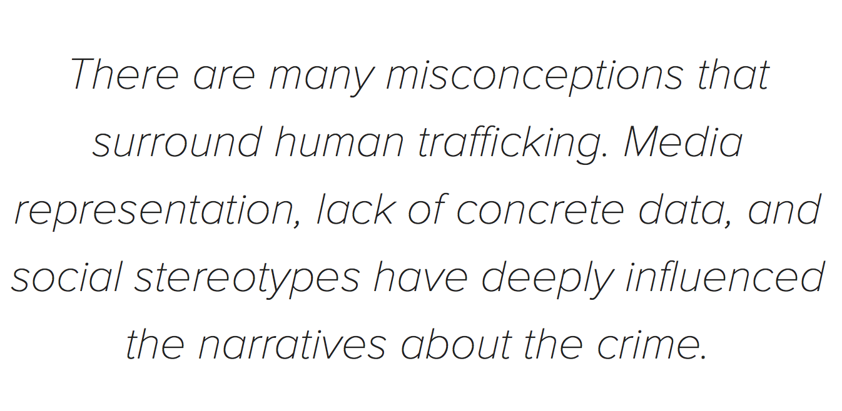
Let’s Re-think the Narrative:
Notes:
This slide aims to highlight common myths and misconceptions in the dominant narratives about human trafficking. Narratives help our brains contextualize and humanize experiences that we may not have ourselves. Despite the narrowness of the discourse surrounding trafficking, victims and survivors have a wide variety of experiences. This section seeks to highlight the diversity of identities and experiences, and to address misconceptions about the crime of human trafficking.

Slide 26

WHERE HAVE YOU SEEN EXAMPLES OF HUMAN TRAFFICKING? This is a misconception
Very Rare- the actual case
If we believe that all trafficking victims are only women, only kidnapped, or only foreign nationals, we will fail to see the victims who fall outside of those narratives
Sensationalism is a journalistic approach that uses shocking stories, images, and language that grab public attention at the expense of accuracy
Notes:
26
This is the Hollywood version

Slide 27
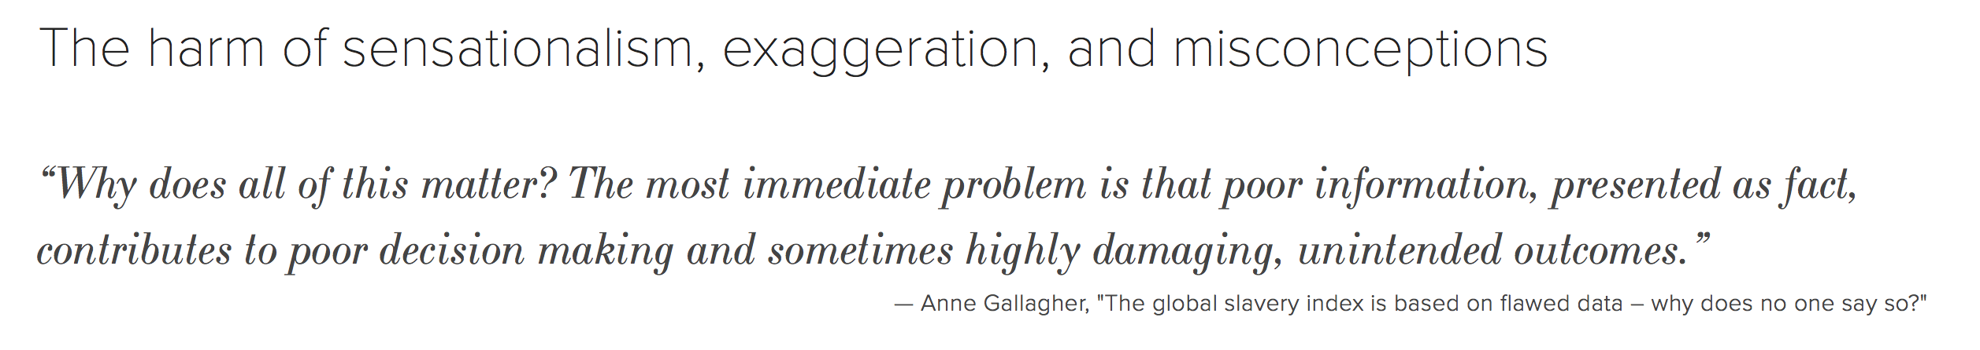
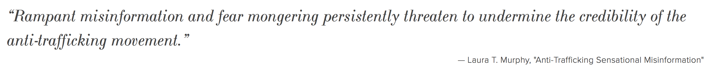
Lets demystify the myths!

Slide 28
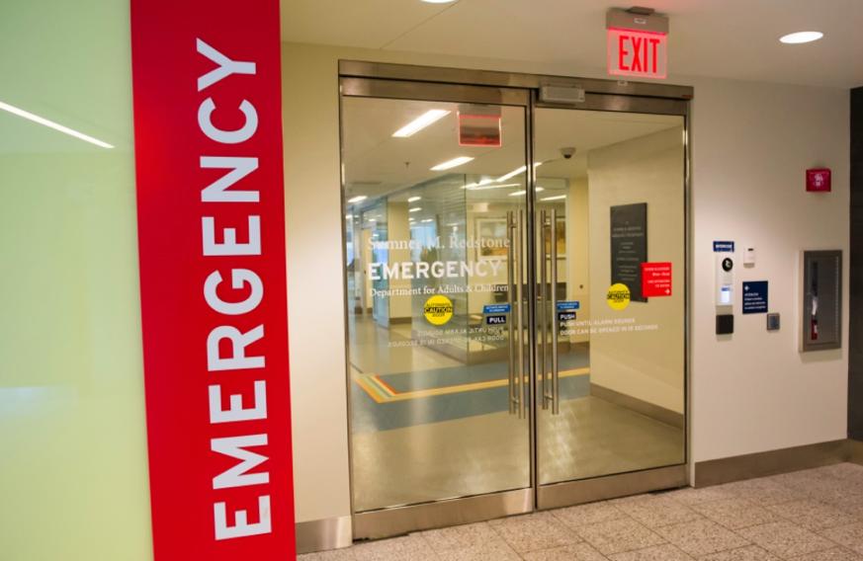
HOW TO ADDRESS THE PATIENT: THE ED IS THE FRONT LINE!

Slide 29
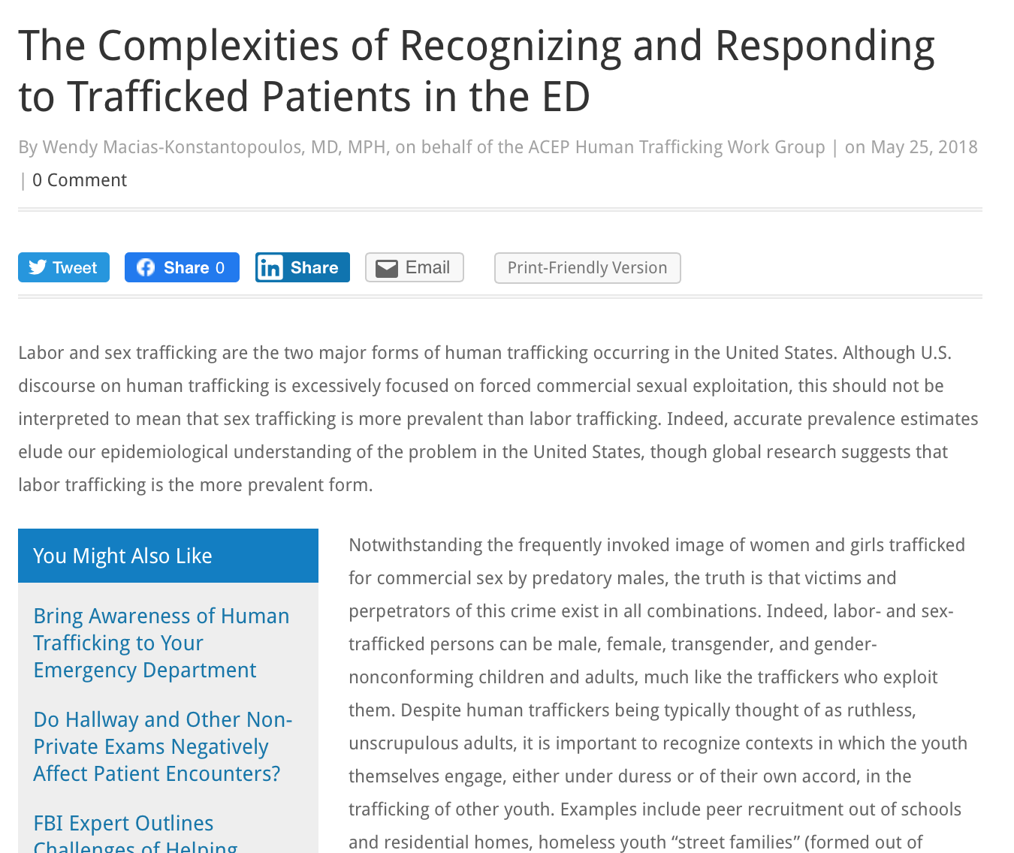

Slide 30
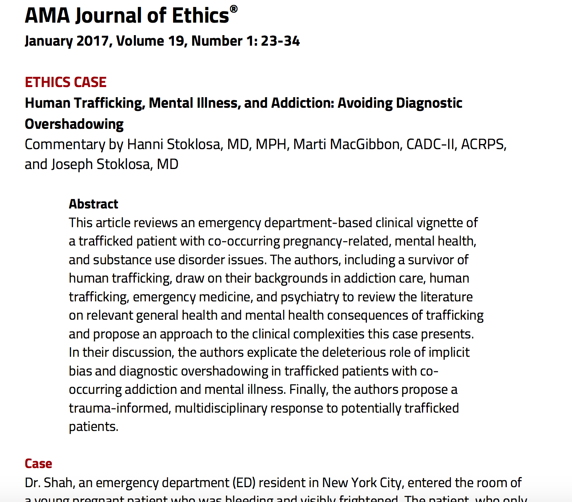

Slide 31
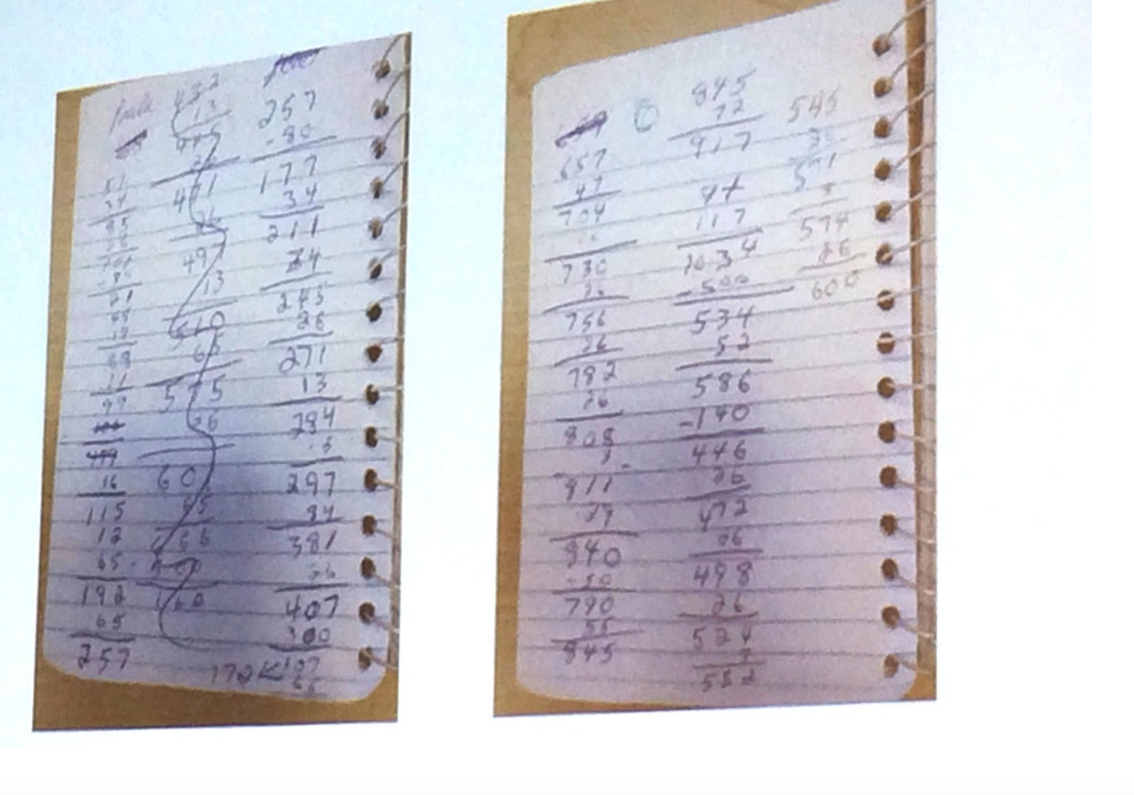

It is about Survival: Based on Basic Need

Slide 32
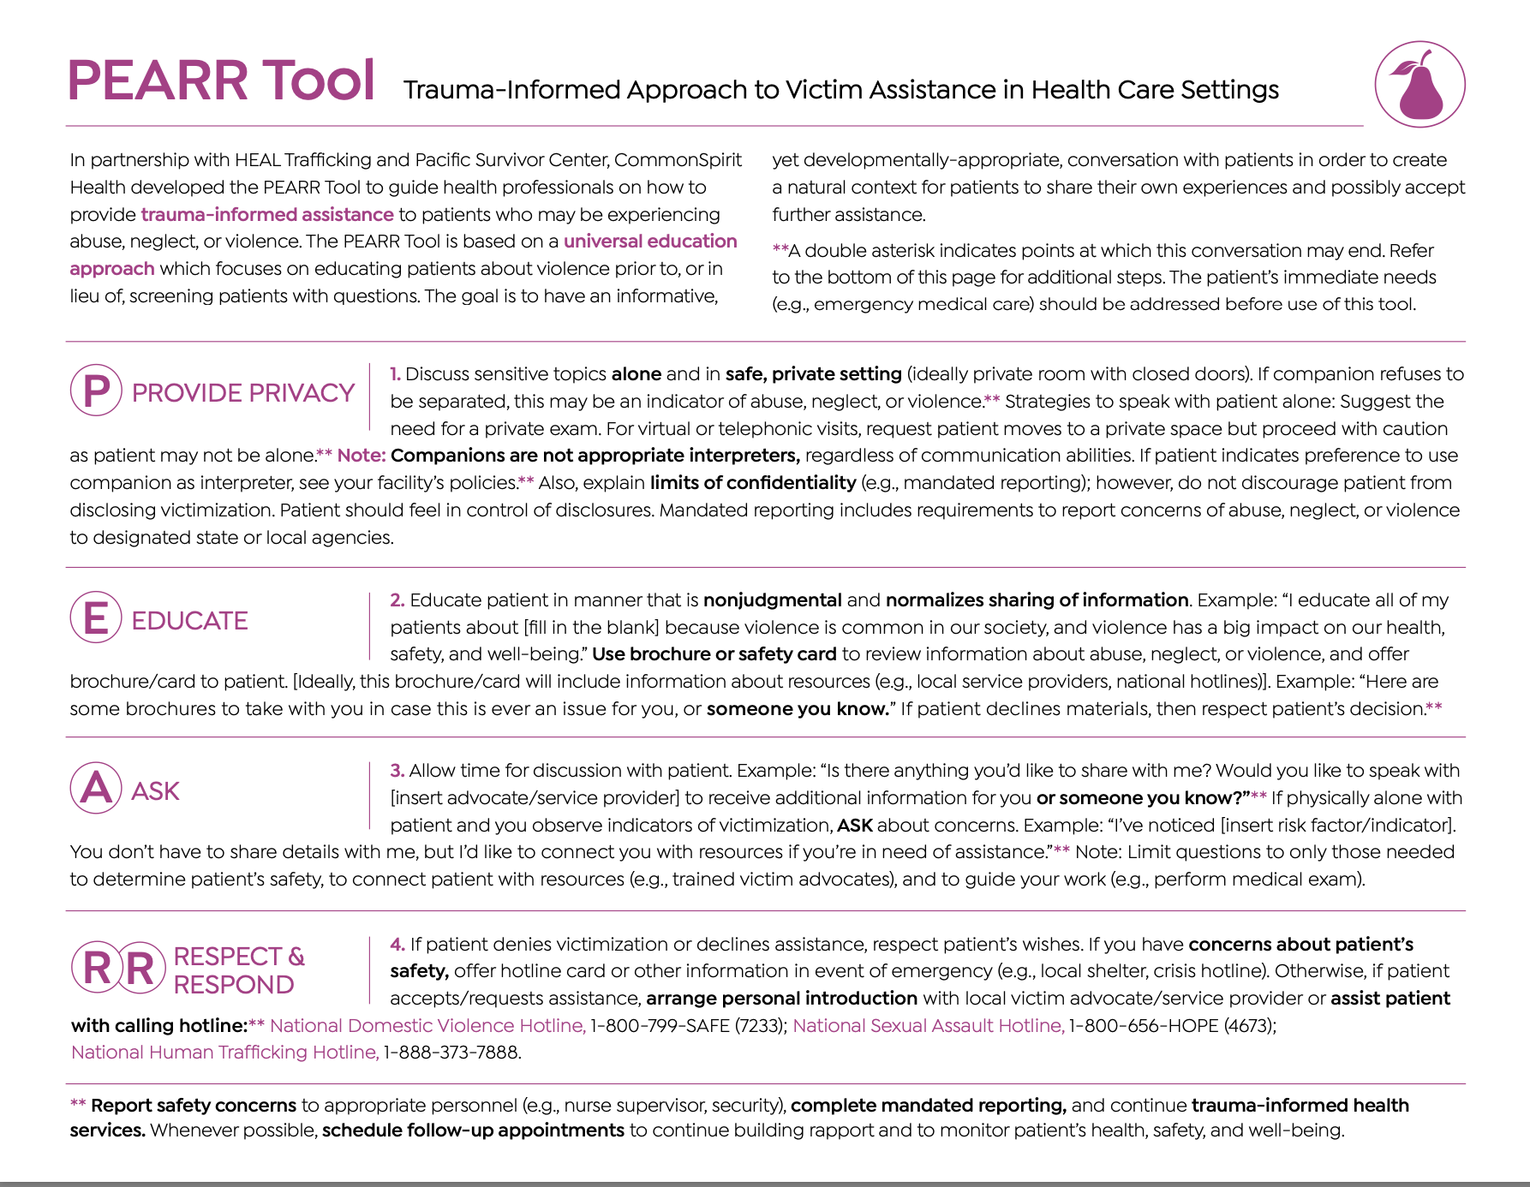

Slide 33


Human Trafficking and Health Care:
68% of Human Trafficking victims access Healthcare while being trafficked

Slide 34


The goal it to create an open door…
Notes:
Build trust, educate and provide resources

Slide 35
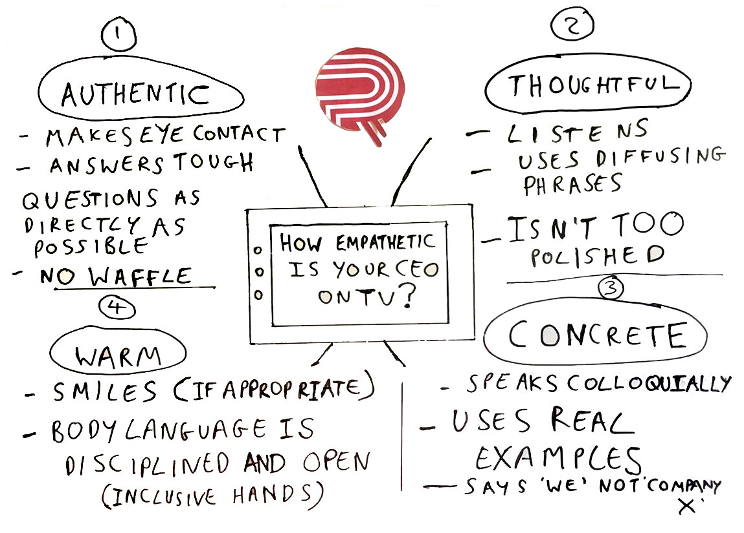

Slide 36
Help to provide a Tool: Educate, Build Trust, and Empower

Slide 37
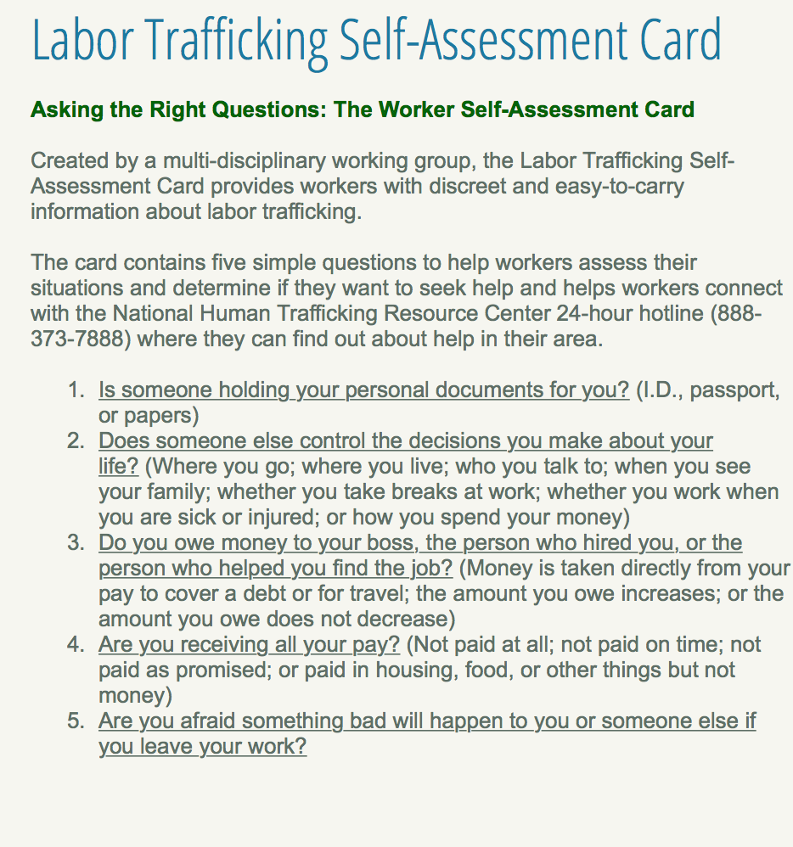
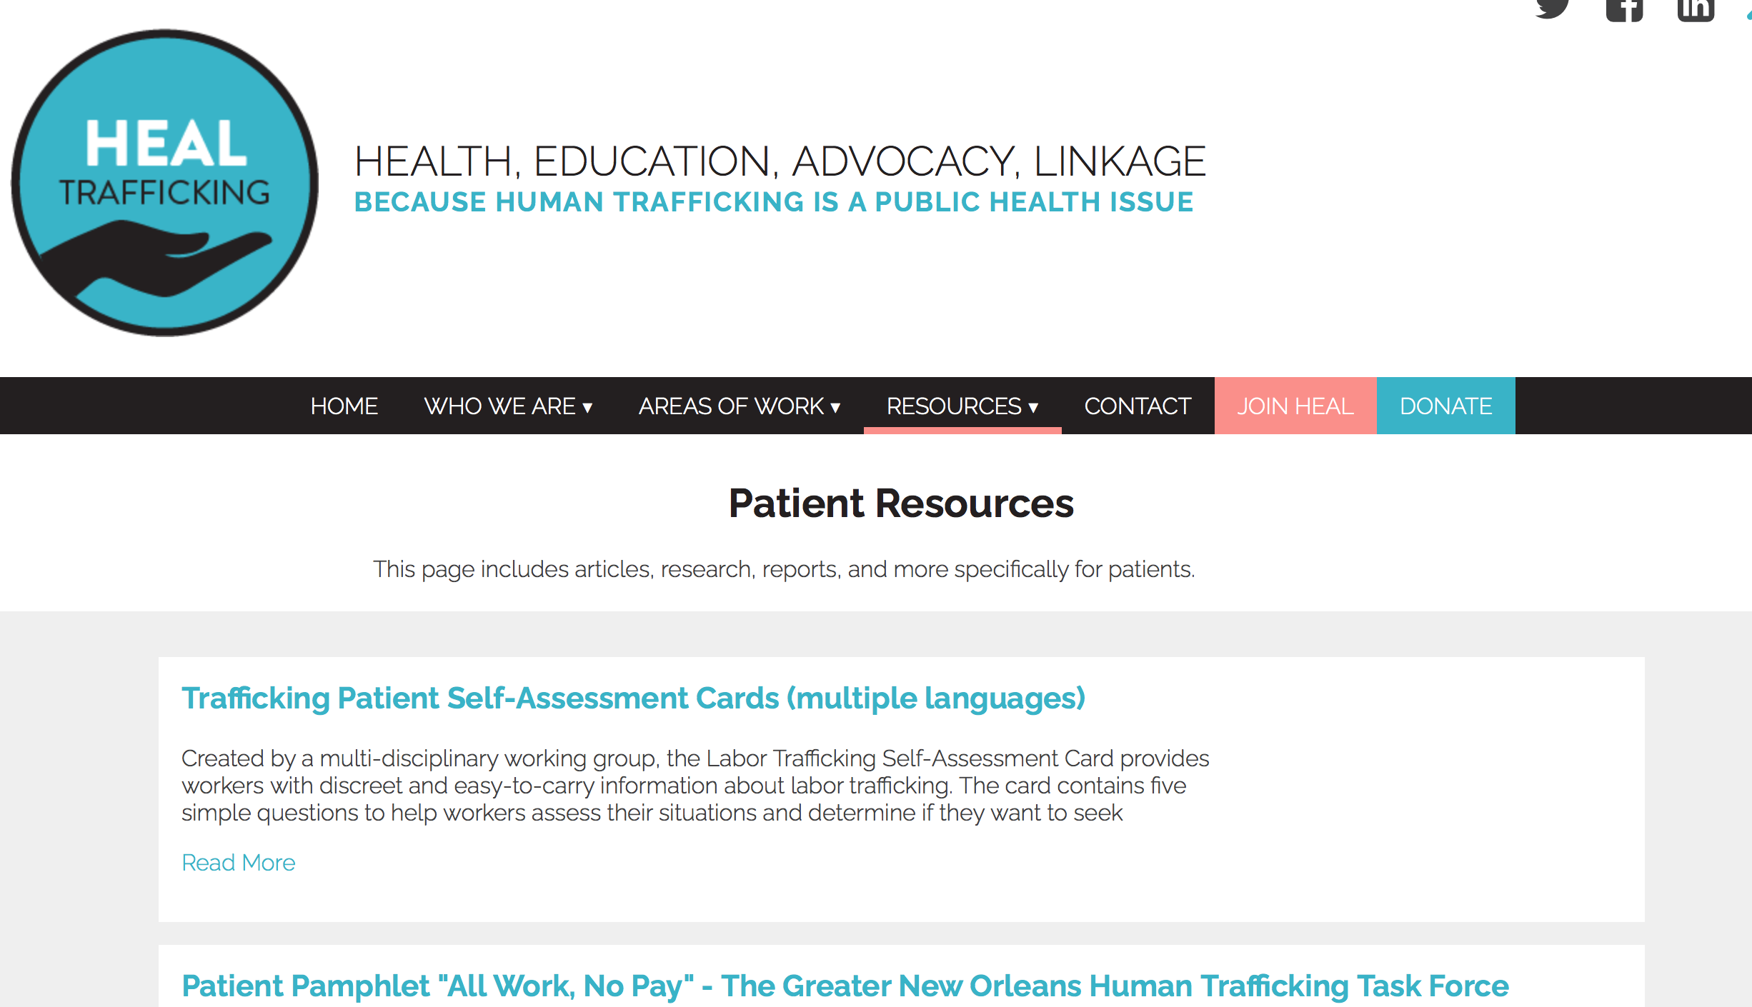
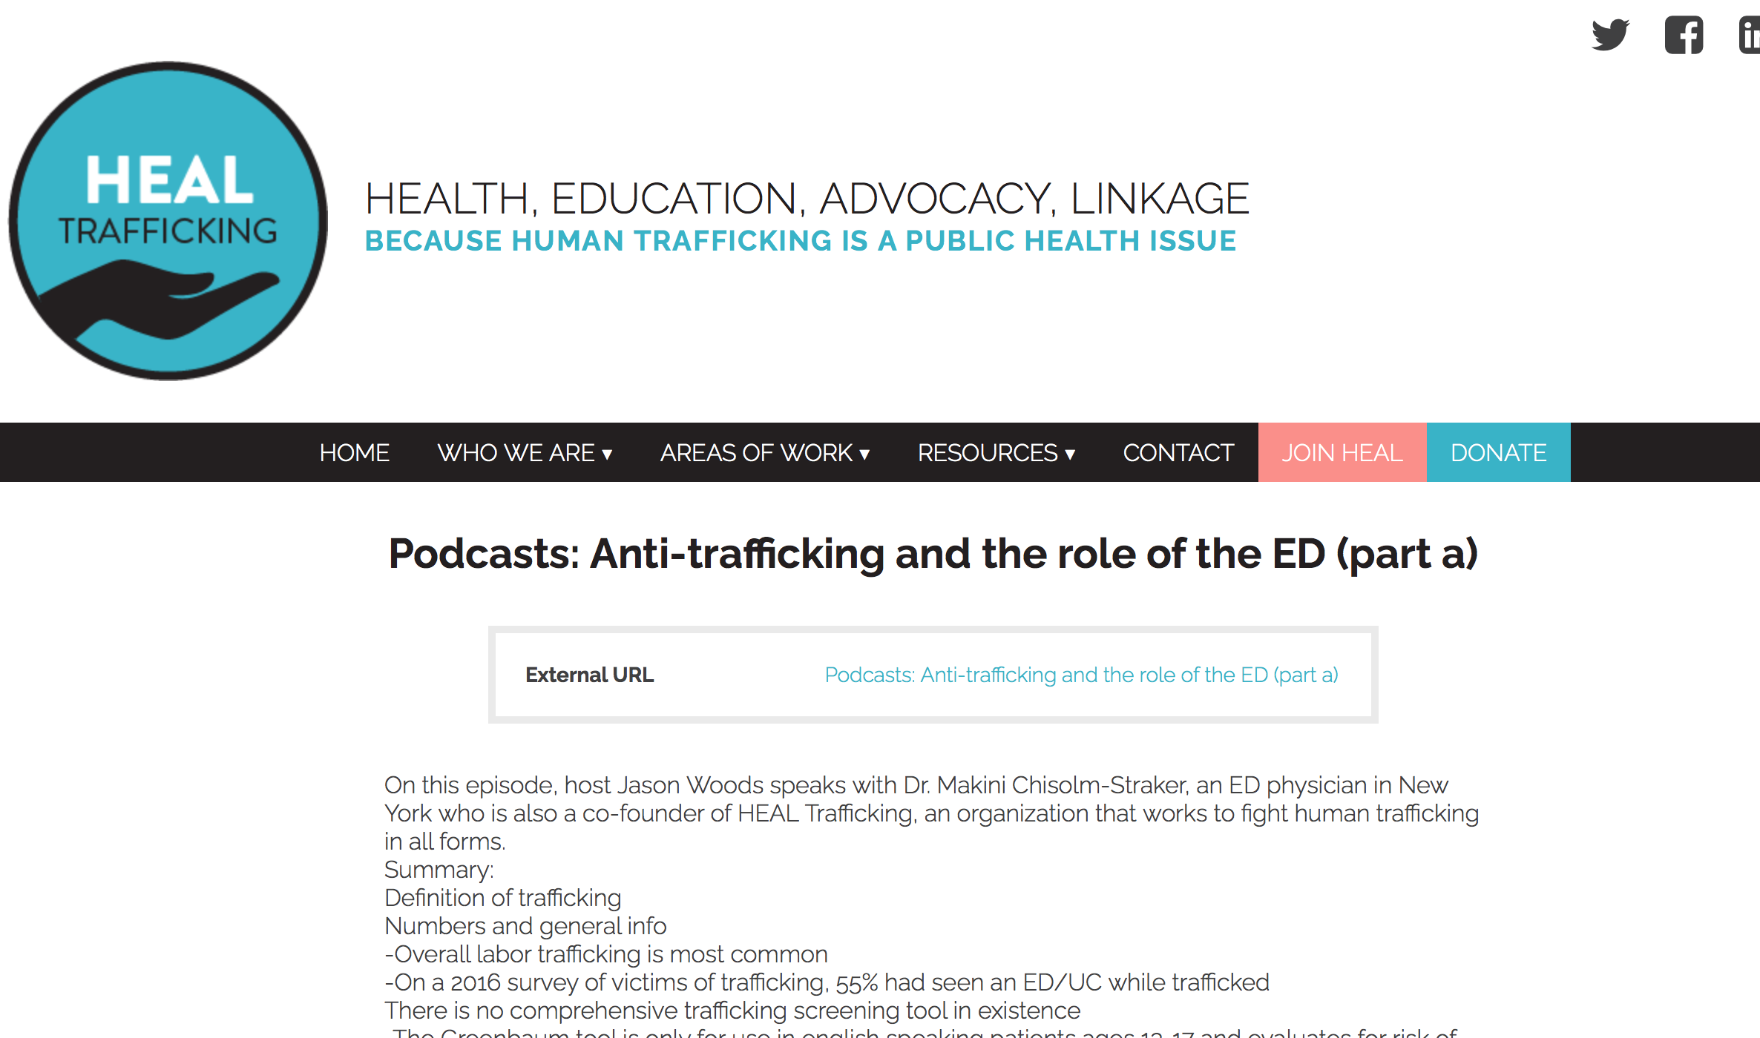
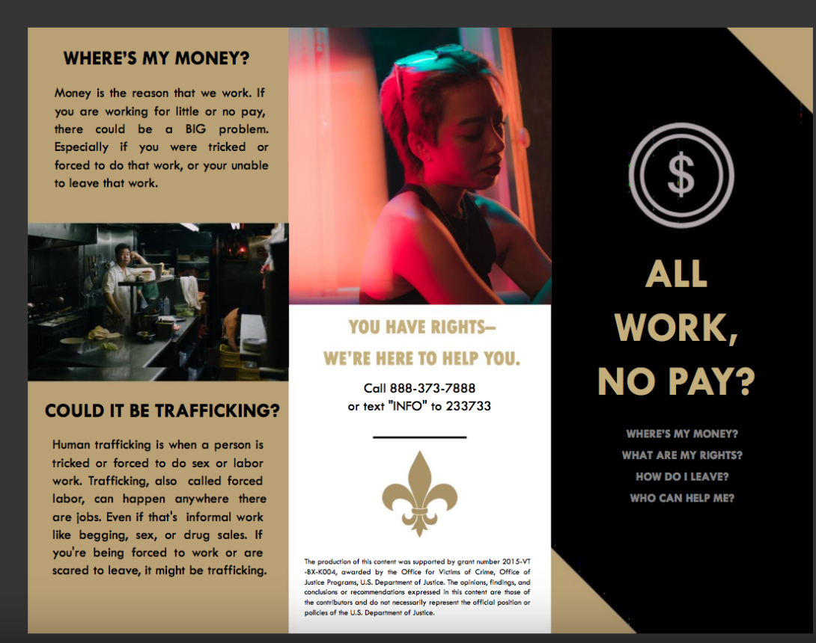

LITERATURE TO REVIEW: EDUCATE YOURSELF!

Slide 38
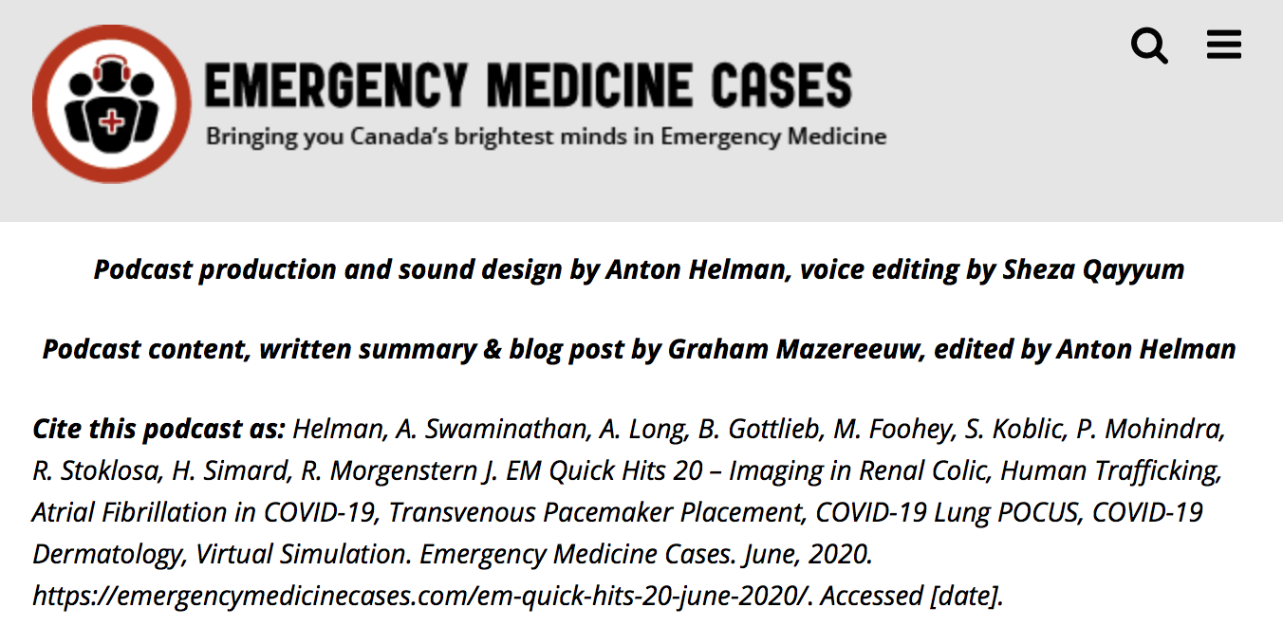
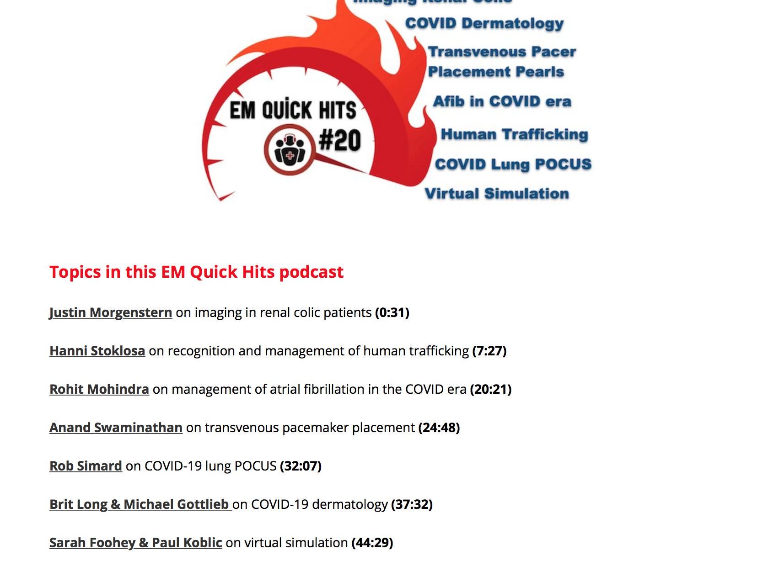
Recent podcast: 7 min!

Slide 39
RESOURCES:
https://healtrafficking.org/patient-resources/
https://healtrafficking.org/resources/pearr-tool/
http://www.nolatrafficking.org/myths-and-misconceptions
The National Human Trafficking Resource Hotline – 888.373.7888
If you suspect human trafficking or are a victim you should contact the hotline for assistance

Slide 40
Open the Door
Read the room!!!!!!!
Find your own way of phrasing questions.
Be prepared to hear your patient’s answer.
Face-to-face talk is more effective than written patient questionnaires.
Caring, empathetic questions may open the door for later disclosure.
Notes:
The point of asking questions directly is to open the door of communication. You will find your own way of phrasing questions. The key is to to convey to the patient that you are prepared to hear her answer—no matter what that answer is.
Research has shown that asking women direct questions in a face-to-face assessment is more effective than asking women about violence in a written questionnaire.¹⁸ One recent study of physicians indicates that although disclosure may not occur at the time of screening, caring and empathetic questioning may open the door for later disclosure.⁷

Slide 41


Thank You For What You Do!
Questions?
zeretzke@ufl.edu
drzeretzke@gmail.com
Notes:
41

Slide 42

A Special Thanks!
Hanni M. Stoklosa, MD, MPH
Instructor, Department of Emergency Medicine, Harvard Medical School Emergency Medicine, Women's Health
Executive Director at Heal Trafficking
My Human trafficking mentor

