Slide 1

Fever Protocols: QI for fever in under 60 days
Cristina M. Zeretzke-Bien MD Issa Hanna, MD

Slide 2
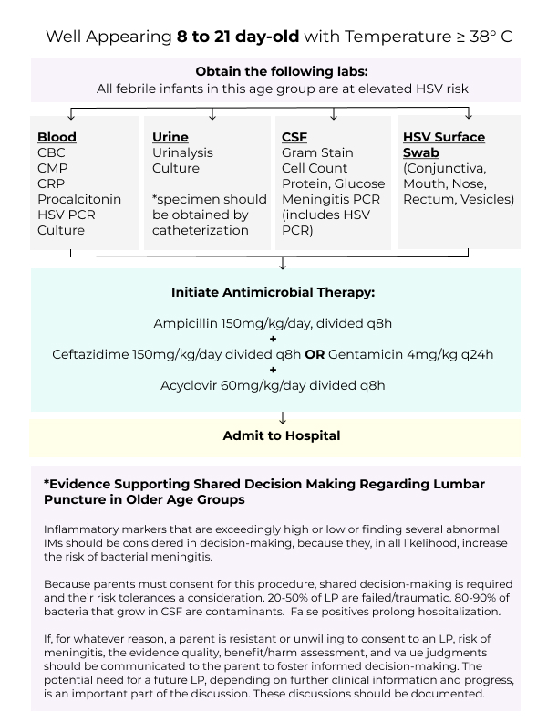

Slide 4
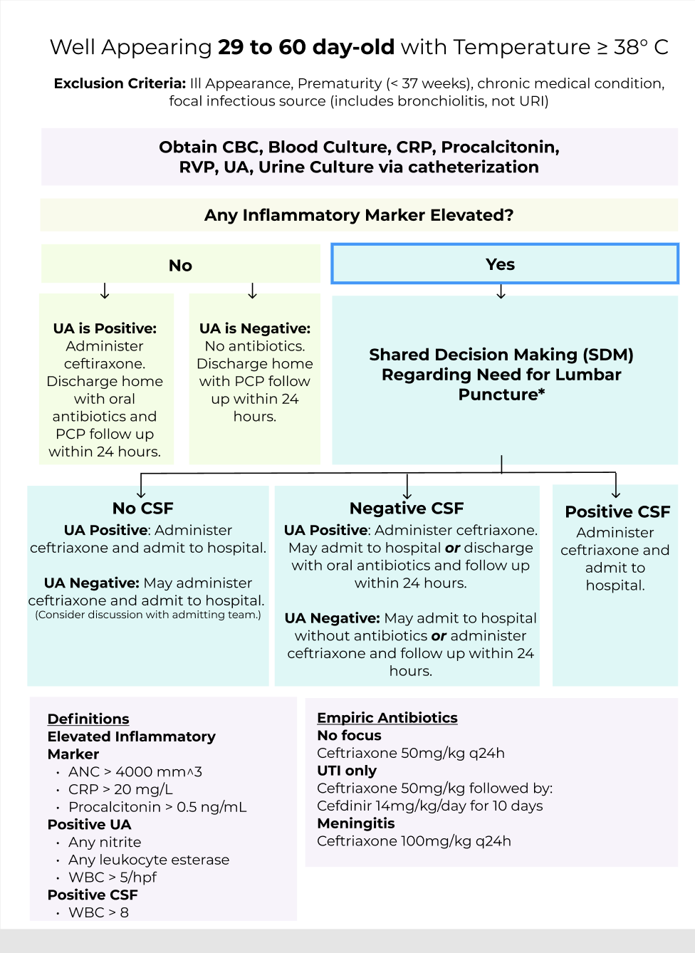

Slide 5
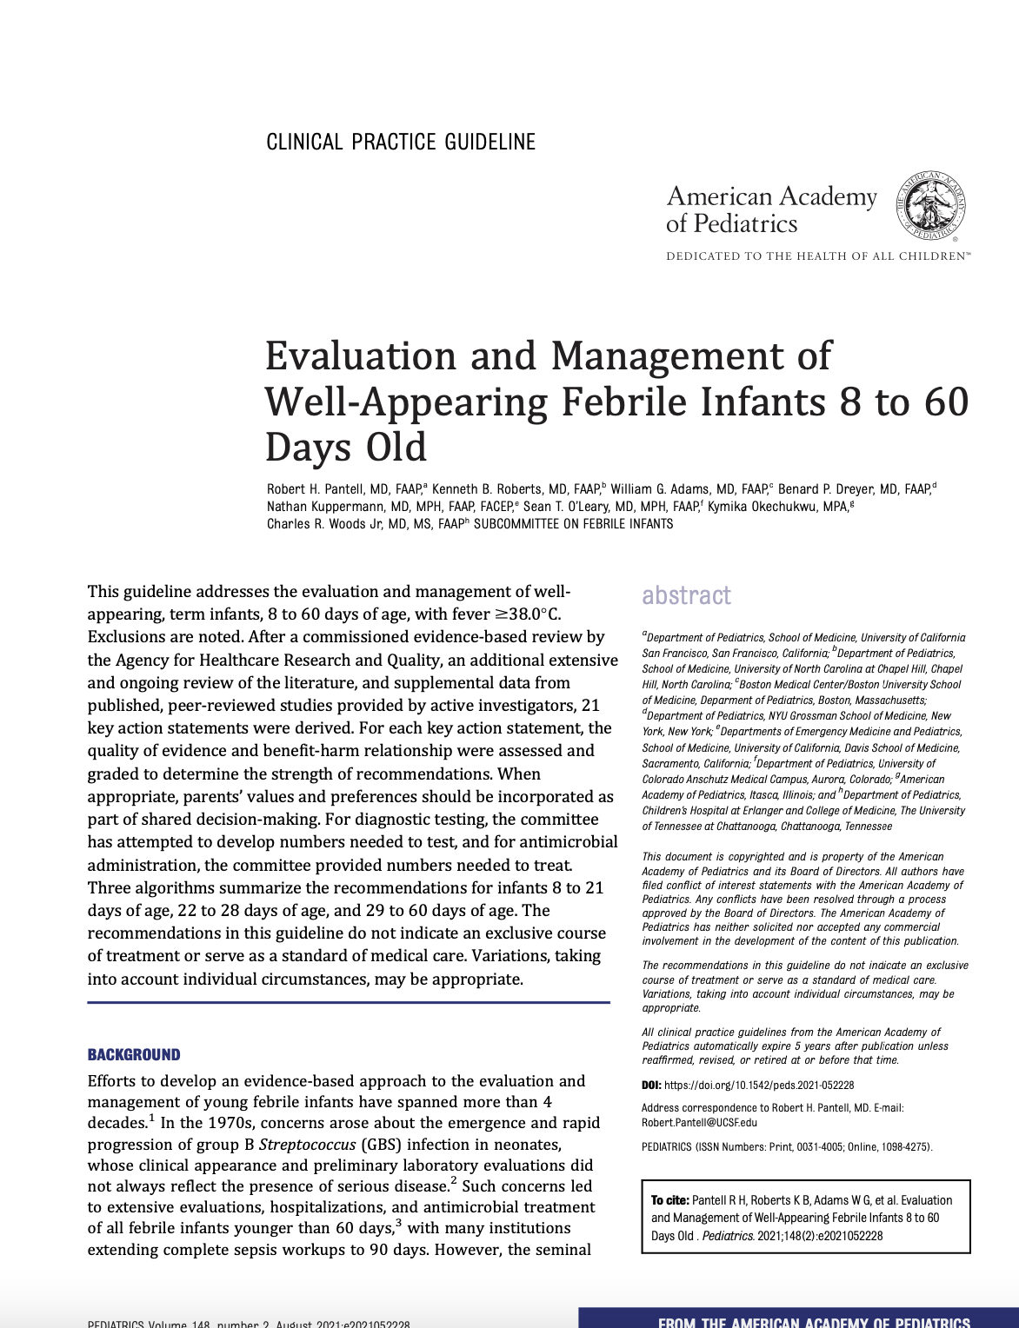

Slide 6
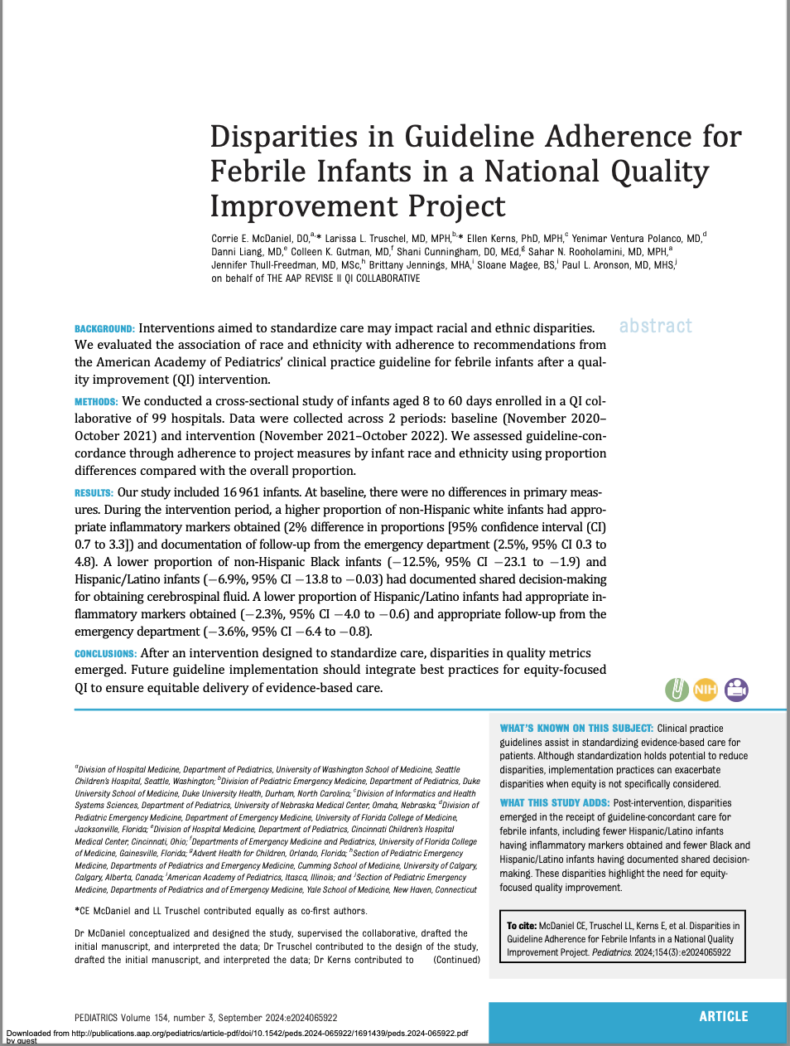

Slide 7
Thank you!

