Slide 1
Welcome
To The 2025 Legislative Leaders’ Forum
Uniting Voices for Meaningful Advocacy
Featuring
Rep. Lauren Carson, House Deputy Majority Leader
Sen. Jacob Bissaillon,
Chair, Senate Housing & Municipal Government Committee

Slide 2
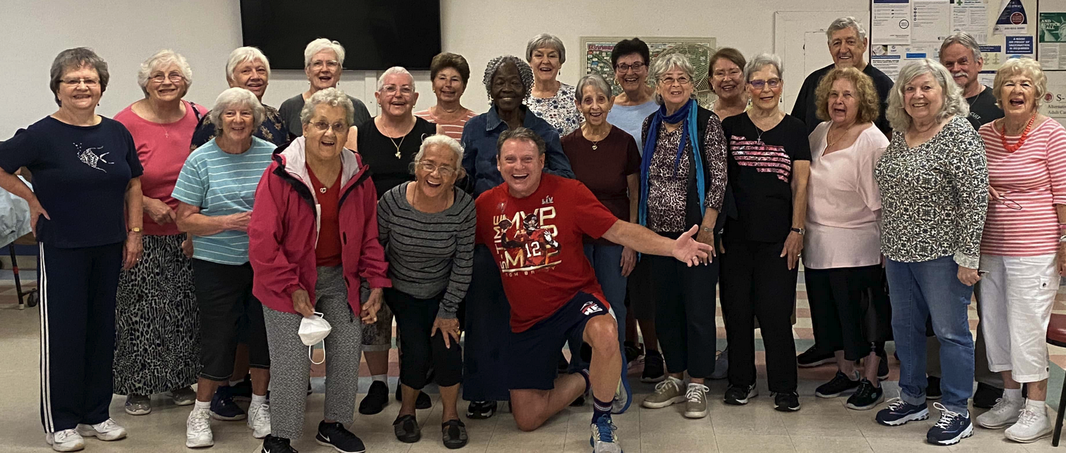
200,000 RI’ers Age 65+ (and our numbers are growing!)
In 2030, 1 in 4 persons in RI will be 65+
In 21 RI Communities persons 65+ now comprise
20% or more of the population

Slide 3
Older R.I.ers all have their own story! “If you have seen one older adult, you have seen one older adult” Dr.Phillip Clark, URI Gerontology Director
We are Workers
We are Caregivers
We are Voters
We are Veterans
We are Volunteers
We are Volunteers
We are Taxpayers
We contribute to the R.I. Economy
(50+yrs=40%GDP)

Slide 4
Let’s Play SACRI TRIVIA
Which U.S. State is the Oldest?
Which U.S. State is the Youngest?
Which R.I. Community is the Oldest?
Which R.I. Community is the Youngest?

Slide 5
Many Older RIers Have Limited Incomes “The Forgotten Middle”
1 out of 4 RI 65+ Households = Less Than $25,000 a year*
Almost half of RI 65+ Households = LESS Than $50,000 a year
Average 65+ Household Soc.Sec. Income: $23,995
Average Man’s Social Security Benefit: $26,372 **
Average Woman’s Social Security Benefit: $23,565 **
*US Census ACS table B19037 2023 5 Year Estimate; **2024 Social Security Statistical Report

Slide 6
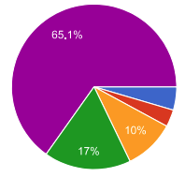
What Concerns Older Rhode Islanders?
Healthcare: (think about costs & access)
Economic & Financial Security (think about Social Security, retirement planning, employment

Slide 7
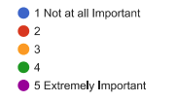
Housing: (think about affordability, access to options & security
Supports for Independent Living: think about homecare, transportation, senior centers

Slide 8
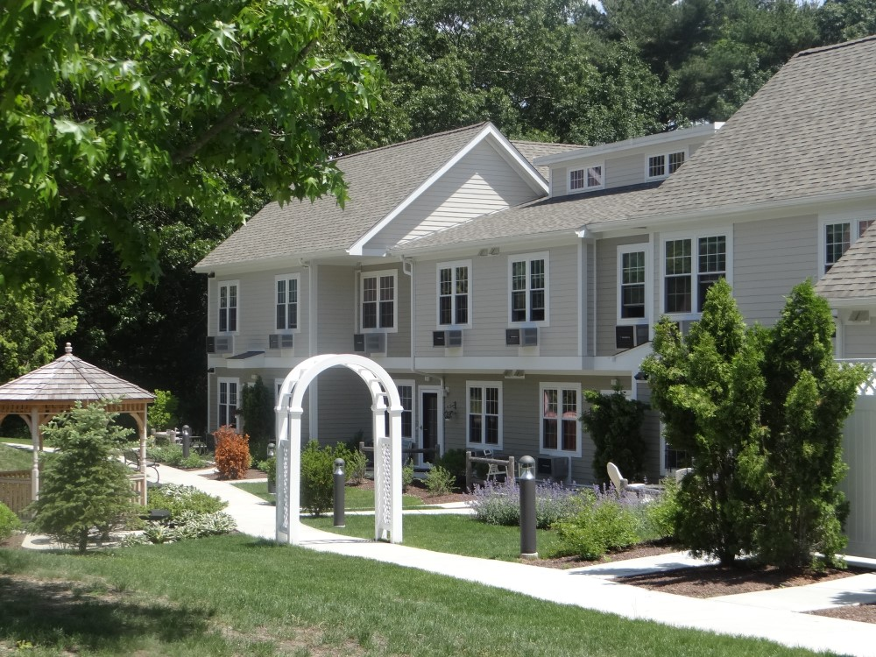
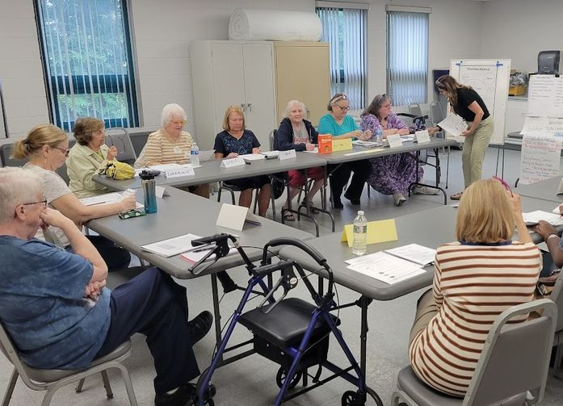
Senior Agenda Coalition of RI 2025 Advocacy Priorities
Health & Long Term Care
Economic Security
Housing
Community Supports

Slide 9
Healthcare – Costs & Access
Medicare Gaps
Out-of-Pocket Costs
Avg $6,663 year*
Premiums - Co-pays – Deductibles
Primary Care Crisis
We Support
Expand Medicare Savings Program Eligibility(MSP)
Cover Part B Premiums
Save $185/month
No Asset Limit
Helps R.I. Economy
Incentives for Primary Care
Rate Review
Prohibit Prior Authorization
*Beneficiaries in Traditional Medicare: Out-of-Pocket Spending for Health Care. AARP March 2023Analysis
Medicare Advantage Plans 2024 out-of-pocket covered services cannot exceed $8,850 in-network; $13,300 our of network

Slide 10
Long Term Care
Nursing Homes
Closures
Staffing shortages
Increased substandard care
High Private Pay Costs
We Support
Direct Care Staff Wage increases
Quality Incentives
Financial Transparency
ØMedicaid Cuts

Slide 11
Housing Affordability & Access
Older population growing
Low housing production
Inaccessible Older Homes
Rents Increasing
High Property Taxes
Subsidized Hsg Wait List
Fair Share of Housing Funds for Older Adults
Accessibility Features in New Developments
Expand Property Tax Relief Program

Slide 12
Community Supports
Older adults overwhelming
prefer to remain living at home!!!
Senior Centers - Increase Funding to $10/65+
Caregivers - Enact Caregiver Tax Credit
Home Care – Increase Asset Limit to Stay @ Home
Volunteer Programs Age in Place” - Support
Transportation – Continue “Ride to Anywhere Pilot”

Slide 13
On Behalf of 200,000 RI’ers Age 65+ (and our numbers are growing!)
Thank You for Joining Us

