Slide 1
What’s ROMA got to do with it?
May 15, 2019

Slide 2
NCRPs ask: What is my job?
What am I supposed to be doing?
Notes:
We know that many ROMA professionals, especially those newly certified, are often anxious to “start doing ROMA”! That enthusiasm is appreciated!
There is a wealth of material available to help you implement ROMA in your agency. However, in true ROMA fashion, we want to be sure that that before we implement strategies to “bring ROMA to life”, we understand what is needed.
One part of that material is the Results Oriented Management and Accountability (ROMA) IMPLEMENTATION CHECKLIST. It is not recommended to use this checklist as a ‘stand alone’, but to instead consider it as one of many tools in your tool kit that will help you to assess your agency’s level of results orientation.
While yes, we need to develop indicators of agency level change to demonstrate our agency is results oriented, we must first have clear need and outcome statements. In order to do this, we have to establish a baseline and determine the need.

Slide 3
What do we want to know?
“Has being an NCRI increased your agency’s continuous use of the full ROMA Cycle?”

Slide 4
Where do we start?
If we are going to use the ROMA Cycle, we start with identifying the need.

Slide 5
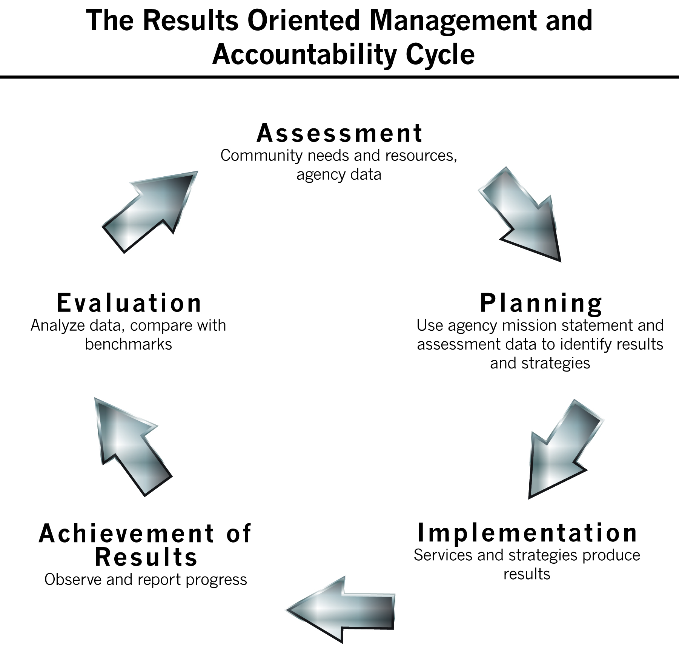
Using the ROMA checklist to conduct a ROMA audit can help us to:
Determine a baseline, to see areas where we have gaps and need to improve (Assess), so we can
Determine the change we want to see and the strategies we will employ and what we will measure (Plan), and then
Notes:
Using the ROMA checklist to conduct a ROMA audit can help us to do these things:
help us to determine a baseline, to see areas where we have gaps and need to improve (Assess).
Once we know our baseline, we can determine the change we want to see and the strategies we will employ (plan then implement),
determine how we will record our progress (Achievement of Results), and
then evaluate the impact of our strategies (evaluation).
AND THEN WE CONTINUE WITH ASSESSING…

Slide 6
Using the ROMA checklist to conduct a ROMA audit can help us to:
Put the plan into action (Implement)
Observe and record our progress (Achievement of Results), and
Determine the impact of our strategies (Evaluation).
Notes:
Using the ROMA checklist to conduct a ROMA audit can help us to do these things:
help us to determine a baseline, to see areas where we have gaps and need to improve (Assess).
Once we know our baseline, we can determine the change we want to see and the strategies we will employ (plan then implement),
determine how we will record our progress (Achievement of Results), and
then evaluate the impact of our strategies (evaluation).
AND THEN WE CONTINUE WITH ASSESSING…

Slide 7
Consider Creating an Agency Level Logic Model
Need:
The national Community Action network has demonstrated an uneven understanding of the principles and practices related to ROMA.
A network focused on delivery of services has a limited capacity to achieve results.
Outcome:
Increased standardization of the understanding of ROMA
Increased capacity of agencies to achieve results
Indicator:
The number of individuals who have become certified
Notes:
Lets consider the information on this slide as an example.
In some ways, our evidence of need is only anecdotal -- we hear from NCRPs that they are facing barriers because our network’s organizational culture is still not focused on outcomes.
One of the barriers identified over and over is a statement that is something like this:
“My agency is focused on provision of services and does not have many customers who are moving out of poverty.”
Because agencies are not seeing their customers move out of poverty, they do not see the value of using the ROMA principles.
This kind of input leads us to identify the second need statement, that a network focused on services is limiting its capacity to achieve results.
What do people think about this?
If those are indeed the needs, The outcomes, then, could be that we increase understanding of the principles and practices related to ROMA.
and increase capacity to achieve results.
Now to the indicator:
Is this a sufficient response?
We have a lot more certified ROMA Professionals across the country than we did 3 years ago.
How many of you would “pass” this start of a logic model?
We are saying that just having more people who have demonstrated specific competencies related to ROMA principles and practices means that agencies have more capacity to achieve results. A “proxy” if you will.
What do we know about proxies? They have to have research basis – meaning someone has done follow up to see that the treatment (service, strategy, program, etc.) has lead to a change in the situation that caused the need for the treatment. And it is about an identified population – consider the difference between a random person getting a food box, or a senior getting home delivered meals – in our case the particular focus is on CAA network.
** Proxy’s are not used just because we don’t have the follow up in place.
As one ROMA professional said, we have increased capacity – but what do we do with the capacity? So what?

Slide 8
What do we know?
How have we increased a standardized understanding of ROMA?
What is the agency doing to implement the full ROMA Cycle?
How does ROMA increase agency capacity?
Notes:
Why does your local agency need ROMA?
As a ROMA professional and member of the ROMA Task Group, what do you want to know?
What do you think other people want to know?

Slide 9
If we don’t know where we started, we cannot identify what has changed
Establish a baseline

Slide 10
If we can’t identify the change, we can’t acknowledge success!!!
Establish a baseline and then measure progress.

Slide 11
CONDUCTING A ROMA AUDIT Using a Checklist for Implementation
Helps you identify:
-- What are you doing now that would demonstrate each of the items on the checklist
-- What could be done differently to include the ROMA element
Notes:
Hand out Results Oriented Management and Accountability (ROMA) IMPLEMENTATION CHECKLIST
This checklist is a tool for conducting a ROMA audit in order to establish a baseline.
Find out what is current status -- this is how we actually determine what our needs are, then we can identify what we want to see change, and from there make a plan.

Slide 12
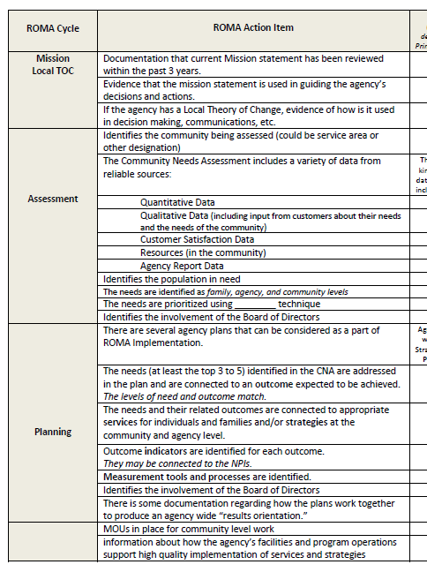

Slide 13
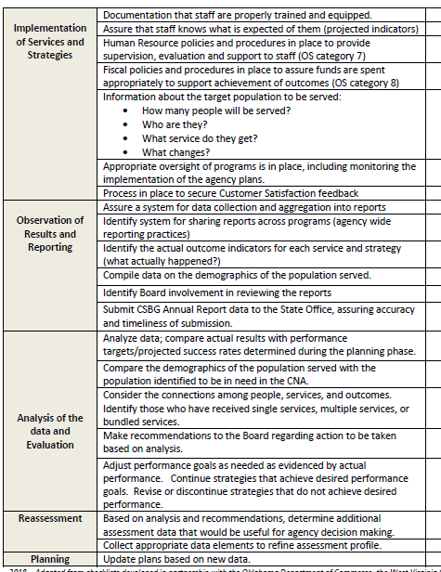

Slide 14
When completing the checklist, consider:
What can you identify right now and what do you need to find out more about?
Who do you need to talk to
(to find out what is happening in other departments)?
Notes:
Activity -- Give the group time (in pairs or small groups) to talk to each other about what is currently done.
There is a list of guiding questions on the next page. 10 min at most for this.

Slide 15
In each phase of the ROMA Cycle, consider:
Who is involved and what do they do?
What is expected to be achieved in this phase?
How will you know if it is done well or is successful?
How do you collect, aggregate and analyze the data in each section?
What makes the process useful?

Slide 16
Once you have a baseline you will have a better understanding of:
what is happening right now
what is not happening
The next step is to consider exactly what you think could change.
Notes:
This can lead into another discussion about assessing the organizational culture, as the culture of the organization can impact how change is viewed, implemented, etc.

Slide 17
RESULTS FROM THE FIELD
SOME THINGS WE KNOW HAVE CHANGED
(OR ARE CHANGING)
Notes:
When we just had NCRTs, the response was an increase in knowledge.
The NCRTs provided the standard information about basic ROMA principles and the knowledge in the network increased.
Much of the data we collected about NCRTs were outputs.
How many trainings the NCRTs did.
How many agency staff and partners were trained on the Intro to ROMA curriculum.
Back in 2004 and again in 2010 we did surveys asking NCRTs to identify what they saw that had changed.
Those things are similar to what the NCRIs are saying now.
For the NCRIs, we’ve recently (2017 and 18) been engaged in follow up surveys
One of the guiding ideas is the frame of meeting Org Standard 4.3: The agency demonstrates the implementation of the full ROMA cycle.

Slide 18
What changed or is in process of changing?
Made sure (or have plans to make sure) that there are explicit connections between the CNA and Strategic Plan (and Community Action Plan)
Added customer satisfaction survey (or changed content or delivery or other part of existing survey)
Notes:
These are observed changes or potential changes.

Slide 19
What changed or is in process of changing?
Added (or plan to add) explicit need statements – including level of need
Identified outcomes (not just outputs) the agency expects to achieve/is tracking

Slide 20
What changed or is in process of changing?
Increase the agency staff’s general understanding of ROMA
Created (or began to create) local Theory of Change

Slide 21
What kinds of Changes are you seeing?
As a result of increased focus on ROMA….
Notes:
evaluate how are things going,
Ask who is doing what work, what’s going well / not well.
Is there a way to talk about this: How committed are staff and leadership to ROMA?

Slide 22
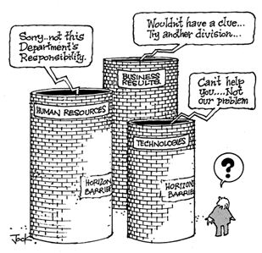
Two Most Often Mentioned Changes
from NCRI reports:
#1 Movement to break down silos
Notes:
1 -- The change represented by a movement away from silos is part of a big change across the CAA network.
One aspect of this is a commonly mentioned improvement: more complete understanding across all staff of the relationship between their various program outcomes and the more general agency (and national) outcomes. Front line staff can put their work in the context of agency goals.
This is part of understanding ROMA principles, but also of understanding the Whole Family approach and of engaging in the “Whole Agency/local TOC” movement.

Slide 23
#2 -- Acknowledgment of the real need to do community level work
Notes:
2 – in looking at the whole agency, and considering the agency’s local theory of change, a second big change surfaced.
Agencies with a improved “results orientation” have increased engagement in community initiatives
NCRIs report that they understand community work (not working in the community but doing community change work)
And acknowledge that focus only on family level work can produce limited long term impact

Slide 24
Most often repeated strategy
Sharing key elements of ROMA with peers and colleagues in the agency.
Notes:
various kinds of training are cited.
One recurring example is “on boarding” of new employees, providing a ROMA orientation as part of the first days on the job.
It is important to talk to the rest of the agency staff!!!!!!!!!!

Slide 25
Bringing the ROMA Cycle to Life
In Head Start and Weatherization

Slide 28
Some thoughts ROMA will be defined by what it delivers: We need to show results that enrich the organization’s value to customers, funders, community stakeholders and employees.
What will YOU do next?
Notes:
ROMA cannot be defined by what it does but by what it delivers —results that enrich the organization’s value to customers, funders, community stakeholders and employees.
Does your agency have a service focus or a results focus?
What if you had only one thing you can share about your agency. What would it be?
Was it the results your agency helps to accomplish? Or the services you provide?

Slide 29
NEXT STEPS
CONCUCT A ROMA AUDIT
Share experiences with ROMA Audit
(help improve the use of the checklist)
Help to identify the opportunities for sharing within the agency
Notes:
, what do staff need to do their work better;

Slide 30
Lots of resources to help you:
www.ancrt.org
www.communityactionpartnership.com
www.NASCSP.org

