Slide 1
Bear River High School
Rehearsal / Safety Brief

Slide 2
Purpose
Provide Outside Agencies with essential information to
Timeline
Identify entry exit points
Designated parking locations
Emergency procedures on site
Emergency egress (i.e., CalFire)
Commo Plan (Calfire/CHP Valley Air)

Slide 3
Timeline
DATE: 10/28/2022, Friday
TIME:
530 - 600 pm, outside agency vehicles arrival/setup static displays
600 – 700 pm, static displays, and community interaction
700 - 730 pm, Ceremony (be flexible)
Student Body President, Liam Marchi makes remarks about the purpose of Heroes Night
Introduces Congressman LaMalfa to make remarks
Liam identifies each outside agency and asks everyone to stand and recognize them

Slide 4
Timeline (Continued)
-Band Plays the National Anthem!
-CHP Valley Air Flyover
-Coin Toss by Congressman LaMalfa / BRHS / CHS
-Game Starts

Slide 5
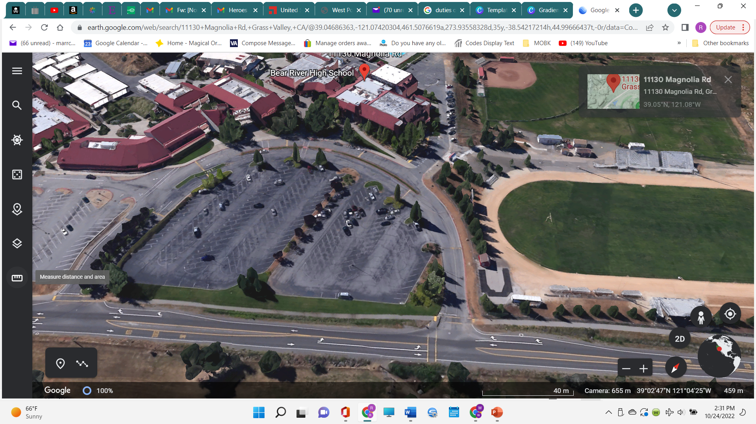
Entry /Egress Points
Entry Point will be the Eastern driveway nearest the track/Stadium
Egress will be the Western driveway

Slide 6
Outside Agency Vehicle Locations

Slide 7
Emergency procedures on site
Emergency egress (i.e., CalFire)
Medical Emergency on site per normal 911 dispatch protocol
Offsite emergency call egress out through western driveway

Slide 8
Commo Plan (Calfire/CHP Valley Air)
CalFire will coordinate with CHP Valley Air when aircraft is requested to be onsite 5 minutes out and 1 minute out.
CHP Valley Air will circle stadium with lights and sirens. Three blasts of siren will indicate they are departing.
Football game will Kick off immediately after.

