Slide 1
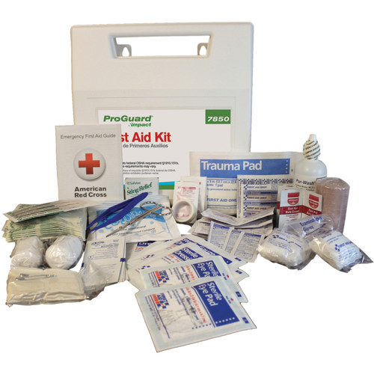
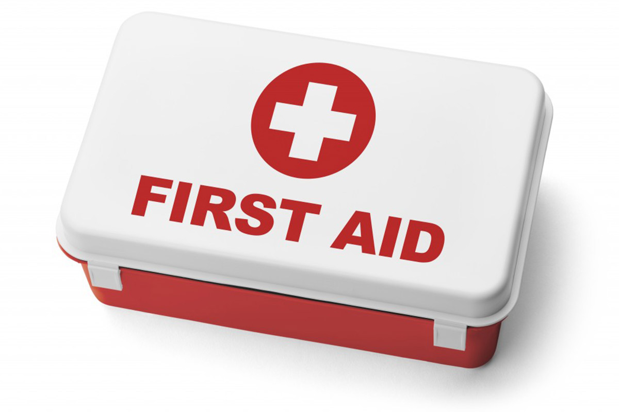
RECOGNIZING EMERGENCIES BASIC FIRST AID AND/OR CPR
EUROPEAN SERVICE AT HOME
YULIYA STASYUK, RN BSN
NURSING SUPERVISOR

Slide 2
FUNDAMNETAL OF FIRST AID AND CPR
CALL 911 IN CRITICAL EMERGENCIES, UNRESPONSIVENESS, COLLAPSE OR SUDDEN CHANGE IN CONDITION OF CLIENT AND REPORT TO SUPERVISOR
ALWAYS BE AWARE OF YOUR SURROUNDINGS IN CASES OF EMERGENCY
REMEMBER:
ABC (AIRWAY → BREATHING → CIRCULATION)
CONTROL BLEEDING
TREAT FOR SHOCK (MEDICAL EMEERGENCIES)
DISCUSSION POINTS:
OPEN WOUNDS AND BURNS
FRACTURES OR DISLOCATIONS
EMERGENCY PREPARDNESS PLAN
SUDDEN OR ACUTE CHANGES IN CLIENT CONDITION
ALWAYS PERFORM HAND HYGIENE BEFORE AND AFTER ASSISTING CLIENTS AND WEAR GLOVES WHEN IN CONTACT WITH OPEN WOUNDS

Slide 3
WHAT IS AN EMERGENCY?
An emergency is a situation demanding an immediate response or action
An emergency can happen at any times or at any place. It is not a clear-cut situation
Your response may be the difference between:
Life or death
Temporary or permanent disability
Short or long term recovery

Slide 4
WHAT CAUSES AN EMERGENCY RESPONSE?
Many events can cause the activation of an Emergency Preparedness Plan to minimize negative impacts and save lives
Each client has an individual Emergency Preparedness Plan which you, as a caregiver, should familiarize self in case of emergency situations
Some examples of Emergency Situation include sudden injury such as falls, acute changes in health condition such as stroke or heart attack
Other examples of Emergency Situation may include outside factors, such as:

Slide 5
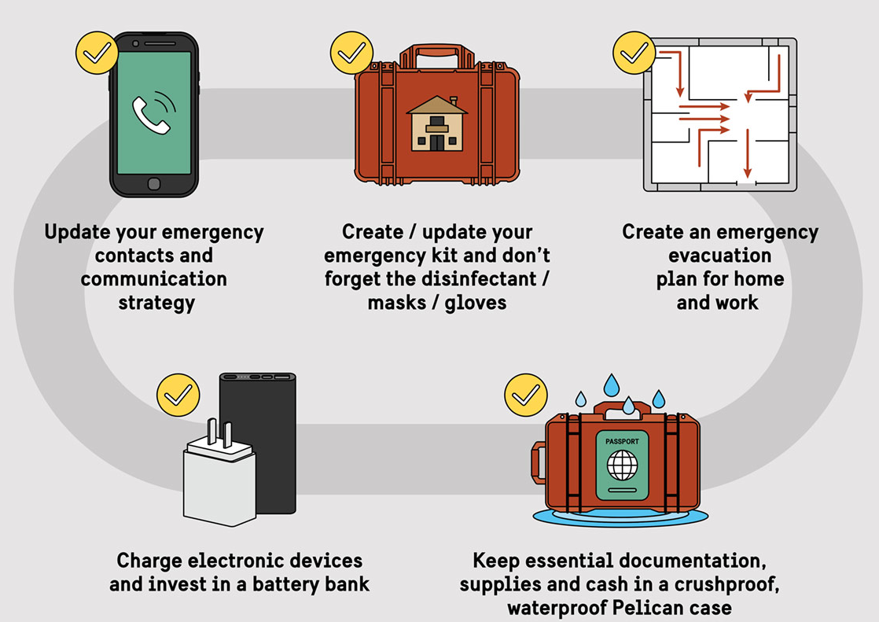
EMERGENCY PREPAREDNESS TIPS

Slide 6
EMERGENCY PREPAREDNESS TIPS FOR EVERYONE
Where are the safe areas in your home, workplace, and other places you visit often?
How will you get emergency information?
How will you communicate with your support network?
What items will you need in order to stay safe and healthy if you cannot leave your home for hours or days?
What items will you need in order to stay safe and healthy if you have to go to a shelter?
How will you evacuate if you need to?

Slide 8
EMERGENCY PREPARDNES TIPS FOR PEOPLE WITH MOBILITY DISABILITIES
Where are the safe areas in your home, workplace, and other places you visit often?
Are these areas, and the routes to these areas, accessible for you?
If you have to leave your home, do you have accessible transportation?
Do you have equipment, medications or Assistive Technology that you would need in a shelter?
Backup equipment

Slide 9
EMERGENCY PREPAREDNESS TIPS FOR PEOPLE WITH SENSORY DISABILITIES
What is the best way for you to receive emergency information?
How will you communicate with others?
Do you have equipment, medications or Assistive Technology that you would need in a shelter?
Backup equipment?

Slide 10
EMERGENCY PREPAREDNESS TIPS FOR PEOPLE WITH COGNITIVE OR INTELECTUAL DISABILITIES
What is the best way for you to receive emergency information?
How will you communicate with others?
Do you have equipment, medications or Assistive Technology that you would need in a shelter?
Backup equipment?
Items that will help you to reduce stress?

Slide 11
DISASTER EMERGENCY KIT
STATE OF ILLINOIS
https://ready.illinois.gov/plan/emergencykit.html

Slide 12
EMERGENCY PREPARDENESS

Slide 13
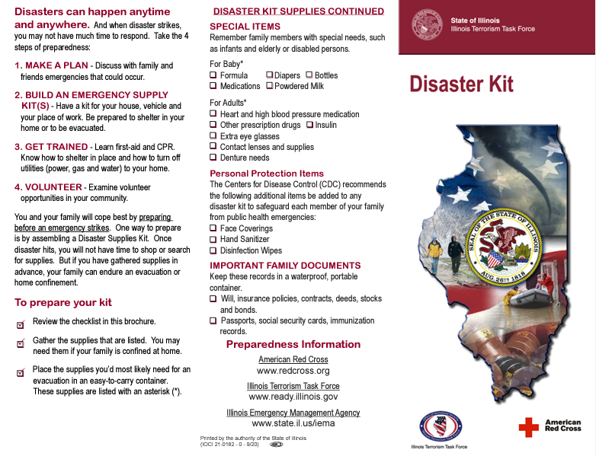

Slide 14
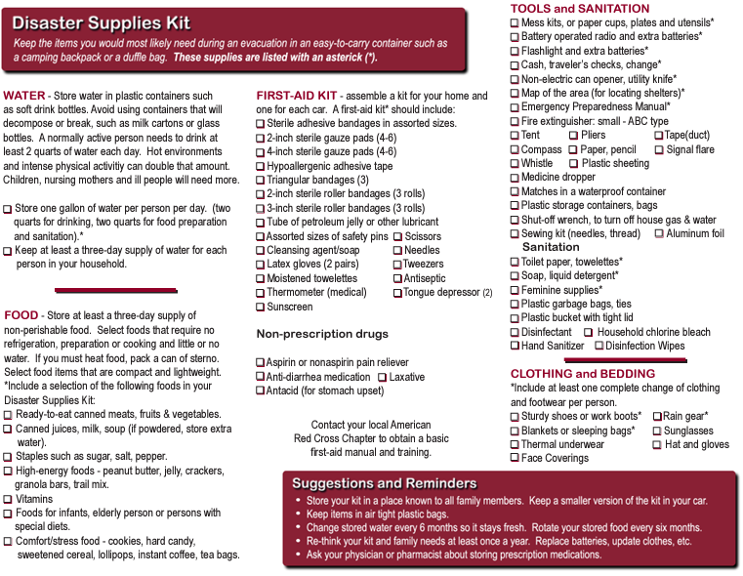

Slide 15
RECEIVING ALERTS AND WARNINGS
Plan ahead to determine the best option for you. May try out different services and ensure to have one or more back-up options. Some alert services include:
Weather radios
Email alerts
Text alerts
Reverse 911 systems
Smartphone applications
Television, radio and internet sources
Emergency alert systems

Slide 16
EVACUATION
Know your transportation needs
Make a plan in advance, if possible
Take equipment and service animals with you
Have back-up options
Communicate with first responders
DISABILITY SERVICES
Coordinate disability specific resources
Disseminate information about evacuation
Health and safety checks
Work with emergency management

Slide 17
SHELTERING
Plan in advance
take service animals, loved once and care recipients with you
Utilize your support network
Plan for support services
Practice telling shelter workers what your needs are
DISABILITY SERVICES
Plan with emergency managers
Review shelter sites
Plan for continuation of services
Communicate within the shelter

Slide 18
CLIENT EMERGENCIES
AND FIRST AID

Slide 19
CLIENT FALLS AND IS INJURED
Do not move them unless they are in serious and immediate danger
Call “911” following procedures outlined in “Guidelines”
Make them as comfortable as possible
Stay with them until assistance arrives
Report and record the following:
• How the fall occurred
• How far the person walked
• How activity was tolerated before the fall
• Complaints before the fall
• How much help the person needed while walking
Complete the ADSC’s Incident Report, as soon as possible

Slide 20
CLIENT FALLS AND IS NOT INJURED
You may need to let the person move for his or her safety and your own
Stay calm, and protect the person from injury
Call for help if needed
Stay with the person
Provide for comfort
Report and record the following:
• How the fall occurred
• How far the person walked
• How activity was tolerated before the fall
• Complaints before the fall
• How much help the person needed while walking
Complete an Incident Report

Slide 21
CLIENT COLLAPSE OR IS SERIOUSLY ILL
Call “911”!
Make them as comfortable as possible
Call the office to report the incident await further instructions
Stay with them until assistance arrives
Ensure the home is secure when leaving
Complete the Agency’s Incident Report as soon as possible

Slide 22
SIGNS AND SYMPTOMS WHICH MAY INDICATE EMERGENCY SITUATION AND REQUIRE TO CALL “911” IMMEDIATELY:
Difficulty breathing or no breathing
No pulse
Bleeding severely
Chest/neck/jaw/arm pain
Losing consciousness or are unconscious
Suspected fracture
Badly burned
Inability to move one or more limbs
Seizure
Suffering from
Hypothermia (below normal body temperature)
Hyperthermia (well above normal body temperature)
Poisoning
Diabetic emergency
Stroke
Doubt exists as to the seriousness of the situation or client condition rapid deterioration
Sudden onset of confusion or trouble speaking or understanding speech
Sudden inability to ambulate, dizziness, or problems with balance
Sudden changes in vision
Severe headache with no known cause, especially accompany with light sensitivity, nausea/vomiting, collapse

Slide 23
STROKE SIGNS – CALL 911!

Slide 24
HEART ATTACK SIGNS CALL 911!

Slide 25
SEIZURE SIGNS – CALL 911!

Slide 26
SEIZURE FIRST AID

Slide 27
HYPOTHERMIA
Occurs when bodies lose more head than they produce
Temperature of body falls below 95F
Risk factors: cold, alcohol, fatigue, open wounds
UNTREATED HYPOTHERMIA BECOMES A MEDICAL EMERGENCY

Slide 28
HYPOTHERMIA FIRST AID
Move person to a warm place
Remove wet clothing
Warm center of the body first – chest, head, neck and groin
Give warm beverages if conscious
Wrap body and head in a warm blanket
Administer CPR if unconscious and trained. Always call 911, ESPECIALLY if no improvement notes or individual collapses!

Slide 29
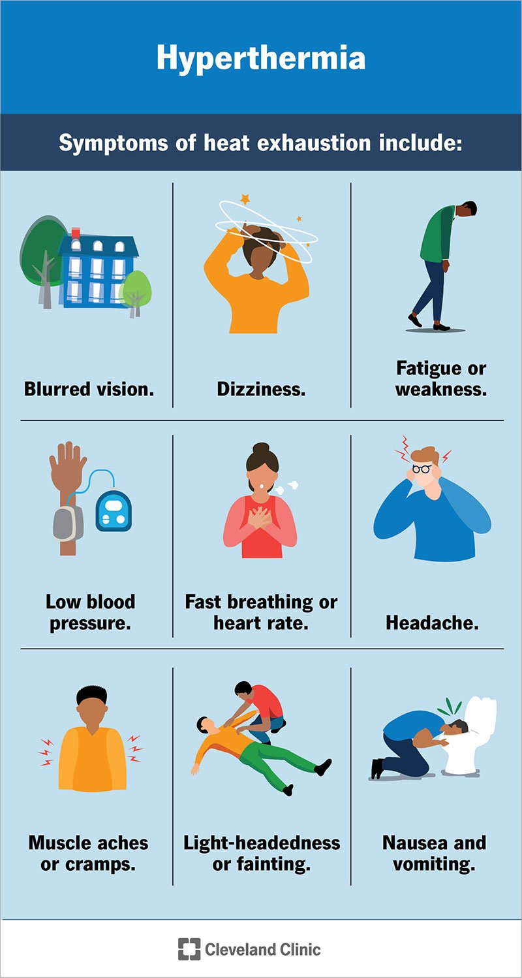
HYPERTHERMIA
Hyperthermia can be due to outside forces, such as heat exhaustion during hot weather or being in hot tub for too long
Other factors contributing to hyperthermia are during periods of infection when core temperature exceeds normal range of 98F, or in individuals who are unable to regulate their core temperature due to chronic and/or acute conditions
There are two forms of hyperthermia
Heat exhaustion
Heat stroke
NOTE: HEAT STROKE IS A MEDICAL EMERGENCY AND REQUIRES IMMEDIATE AND AGGRESSIVE TREATMENT – CALL 911!!

Slide 30
HEAT EXHASTION VS HEAT STROKE

Slide 31
HYPERTHERMIA TREATMENT
Move to cooler environment
Place in shock position – lying on back with feet elevated
Remove excess clothing
Cool by fanning or apply cool water/ice to central body (chest, behind neck, groin, armpits, head)
Hydration; offer water to drink every 15 minutes
Call 911 if no improvement, person collapsed, or Heat Stroke suspected
HEAT STROKE
During heat stroke, body heat regulating mechanism fails. The rise in temperature causes brain damage and death.
It requires IMMIDATE INTERVENTION AND COOLING OF BODY
The body temperature can rise up to 105F!
CALL 911 IMMIDIATELY
Cool environment
Try to cool as quickly as possible in any manner possible
E.g. - cool water bath, wrap in wet sheets, place in air conditioned room
DO NOT GIVE ANYTHING BY MOUTH
Place in shock position

Slide 32
SEVERE BURNS
Call 911!
Cool the burn area with water for 10-20 minutes
Protect burn area from ground contact. May cover the injured area loosely with sterile unmedicated dressing or similar non-fluffy material and bandage
Don’t remove anything that is sticking to the burn
Don't apply lotions, ointments, butter or fat to the injury
Don't break blisters or otherwise interfere with the injured area
Don't over-cool the patient and cause shivering
If breathing and heartbeat stop, call 911 and begin resuscitation immediately
If client is unconscious but breathing normally, place in the recovery position.
Treat for shock
Send for medical attention and prep for transport.

Slide 33
MINOR BURNS
Place the injured part under slowly running water, or soak in cold water for 10 minutes or as long as pain persists
Gently remove any rings, watches, belts, and shoes from the injured area before it starts to swell
Dress with clean, sterile, non fluffy material
Don't use adhesive dressings
Don't apply lotions, ointments or fat to burn/ scald
Don't break blisters or otherwise interfere
If in doubt, seek medical aid and call 911

Slide 34
FIRST AID FOR BURNS AND CUTS

Slide 35
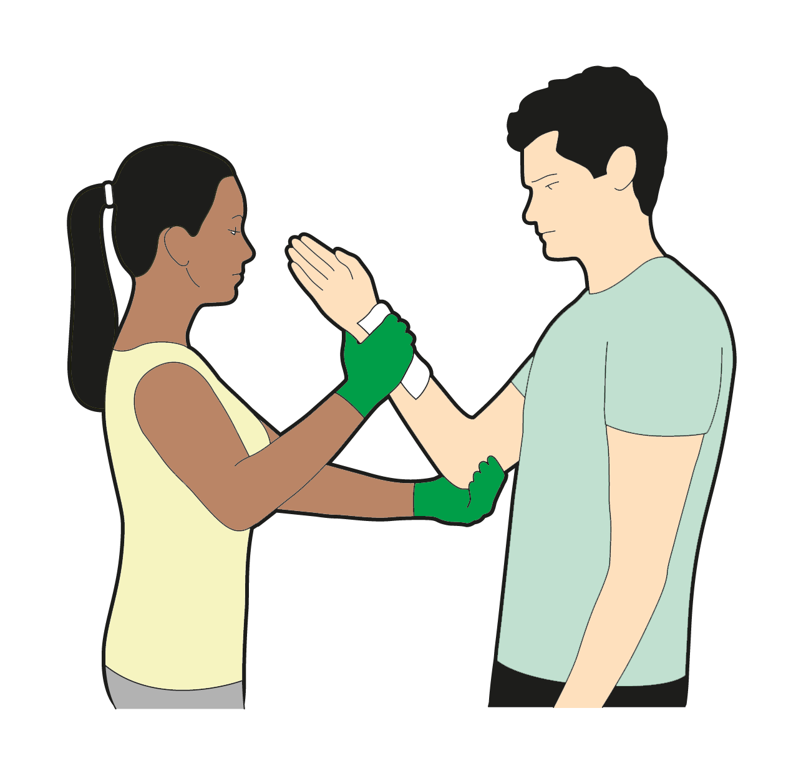
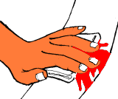
FRACTURES AND BLEEDING
If open fracture noted (bone sticking out of body) NEVER PUSH THE BONE BACK INTO PLACE
DO NOT straighten breaks or broken bones
DO NOT attempt to fix a dislocation of bones – call 911, only doctors can do this!
ALWAYS TREAT FOR BLEEDING FIRST – APPLY PRESSURE TO STOP THE BLEED!
CALL 911 IMMIDIATELY!
CONTROL OF BLEEDING
Direct pressure
Elevation
Cold application
Pressure bandage

Slide 36
HEIMLICH MANEUVER DURING CHOCKING

Slide 37
CARDIAC ARREST
CALL 911 IMMIDIATELY!!!
MAY BE DIRECTED TO PERFORM CPR BY 911 DISPATCHER
CPR CERTIFICATE CAN BE OBTAINED AND RENEWED EVERY 2 YEARS INDEPENDENTLY – ENSURE A COPY IS IN YOUR FILE BY HR DEPARTMENT.

Slide 38
CARDIO PULMONARY RESSUSCITATION CALL 911 – MEDICAL EMERGENCY!
Should be trained to perform this procedure and have a valid CPR or BLS license
If done improperly, could harm the individual
ALWAYS CALL 911 IF CLIENT IS NOT BREATHING OR HAS NO PULSE
State: “THIS IS AN EMERGENCY!”
Describe what has happened; give facts and describe what you observed
Provide number you’re calling from, your name, location
Remain calm
Follow the 911 dispatcher’s direction
Advise dispatched immediately if you are not trained in CPR
Do NOT hang up before the dispatcher hangs up
Reassure the client and/or family
Always notify the supervisor of what has transpired and 911 after assisting the client or EMT arrival

Slide 39
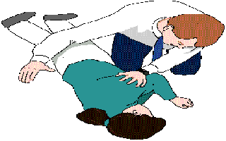
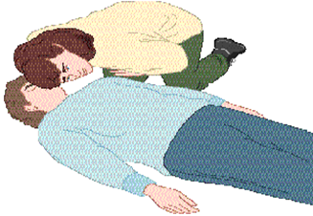
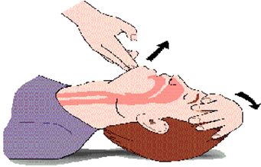
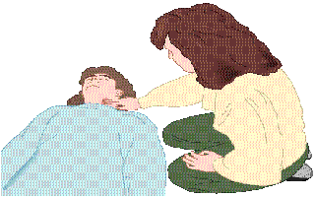
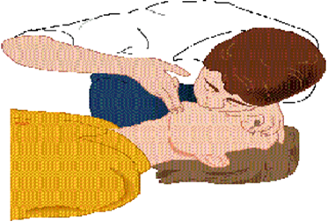
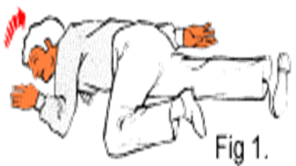
CALL 911 IMMIDIATELY AND FOLLOW THEIR DIRECTIONS, WHICH MAY INCLUDE
A → B → C AIRWAY → BREATHING → CIRCULATION
1. Establish responsiveness – “are you okay?”
2. Look and listen/feel for breathing – rise in chest
3. Use chin lift or tilt head upwards
4. Check pulse
5. Attempt to Ventilate if no breathing observed
6. Recovery position

Slide 41
POST TEST
TEST YOUR UNDERSTADNING

Slide 42
QUESTION 1
Everyone, including family members, clients and caregivers, should be familiar with emergency plan since they each play an important role.
TRUE
FALSE
Notes:
Answer is True

Slide 43
QUESTION 2
You are carrying for your client at their home and received a notification on your smartphone from local authorities to evacuate to a safe area due to tornado warning in your area. You should:
A) Refuse to leave. Most “emergencies” don’t turn out to be a big deal.
B) Wait to see if the situation worsened, then decide.
C) Follow the advice of local authorities to ensure you and your client is safe.
D) Call your neighbor and see what she thinks you should do.
Notes:
Answer is C.

Slide 44
QUESTION 3
You are assisting your client during transfer from a chair to standing position. Suddenly, the client screams “My legs are giving out!”. You tried to hold the client and assist them back to the chair but they still fell to the ground and hit their head, where you noted an open wound and bleeding. What should you do next?
A) Apply pressure to the wound to stop the bleeding and move the client to the chair.
B) Call 911 immediately, assess the client to ensure they are safe in the position they are in and follow 911 dispatcher instructions. Notify supervisor once EMT arrives for the client.
C) Assist the client to the chair but to not touch the wound and do not call 911, per client request.
D) Lie the client on the ground to ensure they do not fall and call your supervisor.
Notes:
Answer is B.

Slide 45
QUESTION 4
It is a hot summer day and you are enjoying the weather outside with your client. Suddenly, your client complains of feeling thirsty and having a throbbing headache. You do not note any shivering but their skin feels hot to touch and appears very red and dry. Client starts vomiting and collapses. What should you do?
A) Call 911 as this is a medical emergency. Attempt to cool the client with cool wraps from cold water and follow 911 dispatcher instructions.
B) Apply ice compress to client head and skin to help cool them down.
C) Call your supervisor on direction of what to do now.
Notes:
Answer is A.

Slide 46
QUESTION 5
You were assisting your client in preparing a meal. You noted the water in the pot started to boil excessively and the client reached out to turn down the heat, but a small amount of the boiling water splashed on the client hand causing a minor burn. What should you do?
A) Evaluate the area to ensure no skin break occurred. Rinse the hand under cool water for 10-20 minutes to reduce discomfort. Apply loose sterile/clean dressing around the hand. Notify supervisor of the incident to complete an Incident Report.
B) Put the hand into an ice bath for 20 minutes and apply antibacterial ointment on the area once it is dry.
C) Call 911 stating “THIS IS AN EMERGENCY!”
D) Yell at the client for being so clumsy and not careful. Report to your supervisor on what transpired.
Notes:
Answer is A.

Slide 47
QUESTIONS?
THANK YOU FOR PARTICIPATING!

