Slide 1



iNaturewatch Foundation
Our Offerings

Slide 2
Contents
1. | About iNaturewatch Genesis Goals & Objectives
2. | Target Audience
3 | What we do Programmes Projects Online Courses

Slide 3
About iNaturewatch
iNaturewatch Foundation is a charitable trust (reg. E-1074 dt. 13 May 2016) working in the field of urban biodiversity across the country since 2014.
It aims at developing environmentally sensitive citizens by engaging them with environment through our various innovative initiatives.
Mission
To build capacities of local communities for nature conservation and climate change through citizen science in India.

Slide 4
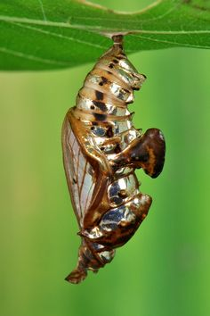
Genesis
iNaturewatch began with the implementation of the project - Mobile Apps 4 Climate Change.
This project was partnered with NGOs such as WWF-India and Greenline

Slide 5
Goals & Objectives
Building field-oriented environmentally resilient communities.
To conduct environmental awareness programmes
To conduct citizen science projects
To undertake habitat creation and restoration CSR projects
To collaborate with like-minded institutions
To develop educational modules on urban biodiversity
To promote lesser fauna research

Slide 6
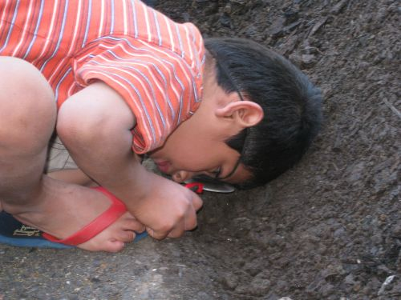
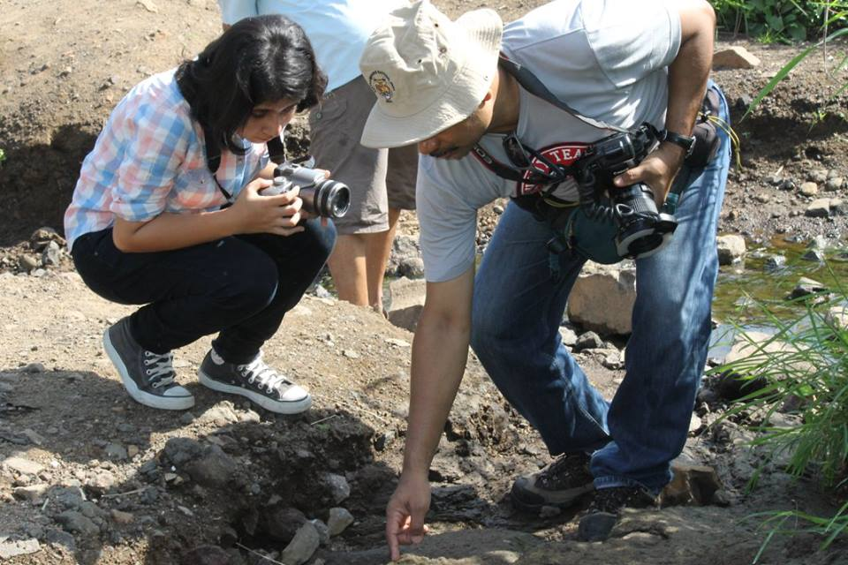
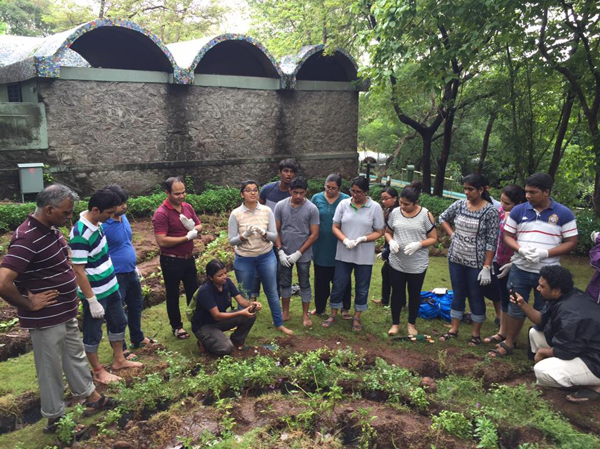
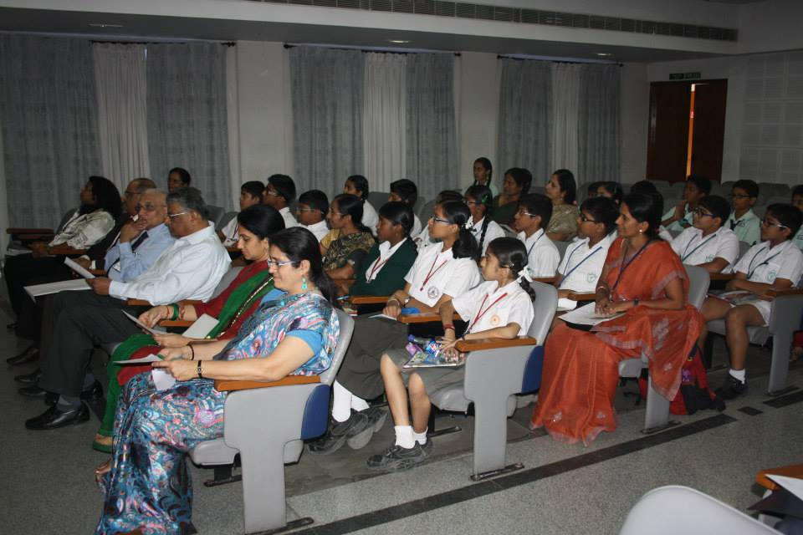
Target Audience
Students
Teachers
Nature Enthusiasts
Corporates

Slide 7
What We Do
Conduct free nature appreciation walks in Navi Mumbai
Hold annual Urban iNaturewatch Challenge
Create and Restore wildlife habitats in urban areas
Develop entomological projects
Conduct workshops and camps under Insect Tourism

Slide 8
Programmes
Projects
Online Courses
Outreach
Training Courses
Insect Tourism

Slide 9
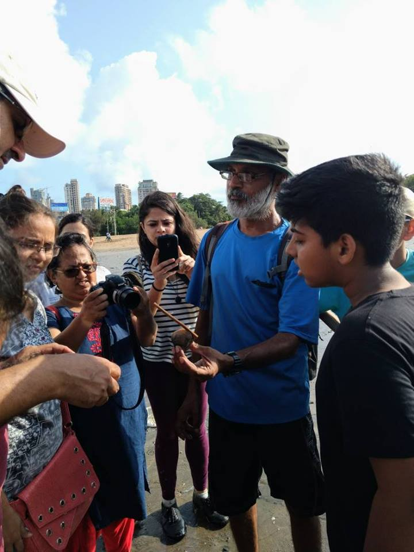
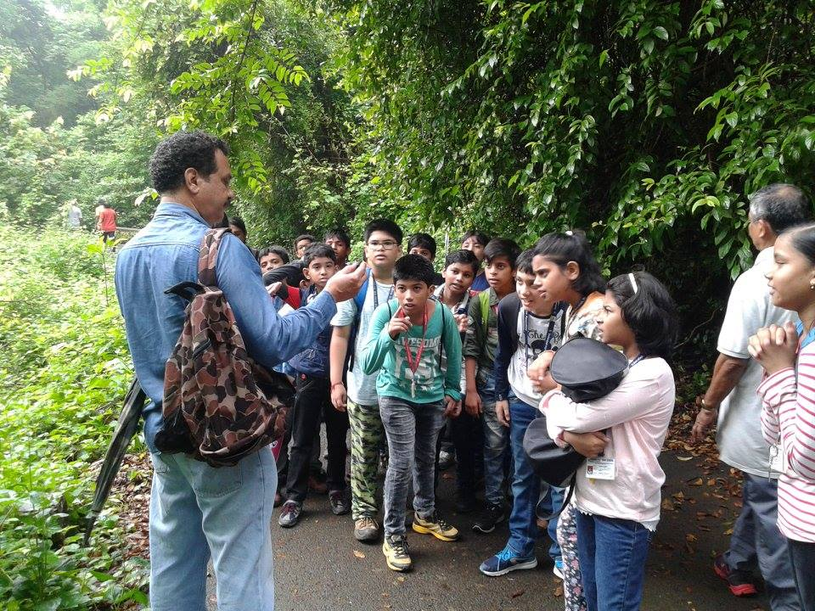
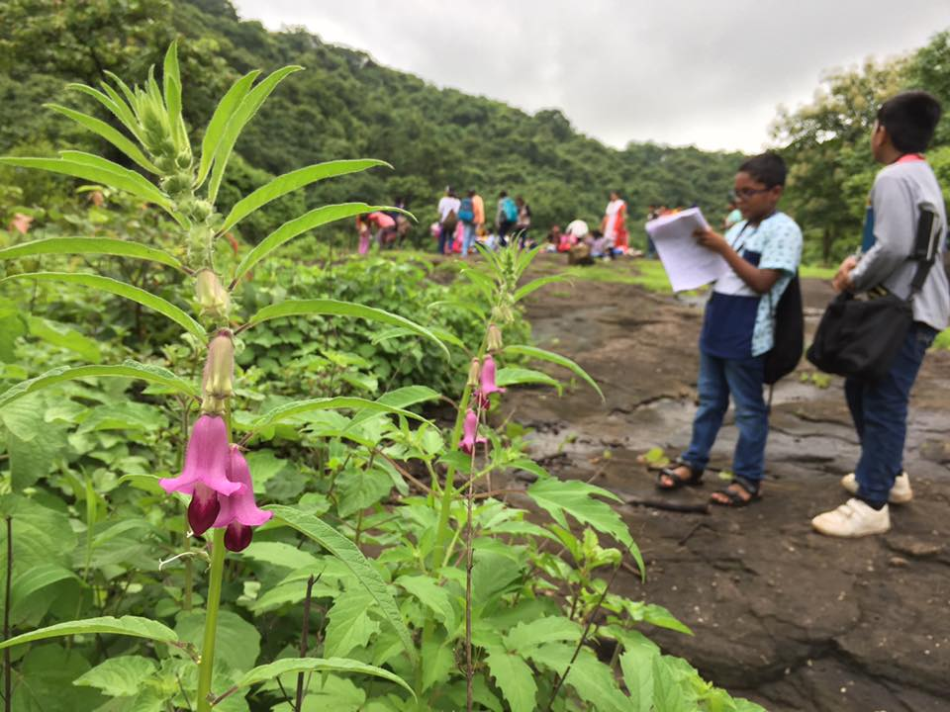
Programme
Outreach
Nature walks
Marine biodiversity walk
To study and observe urban biodiversity including birds, insects and flora we conduct monthly walks in around Navi Mumbai, Mumbai and Thane
Wildflower trail
Nature trail for Schools

Slide 10
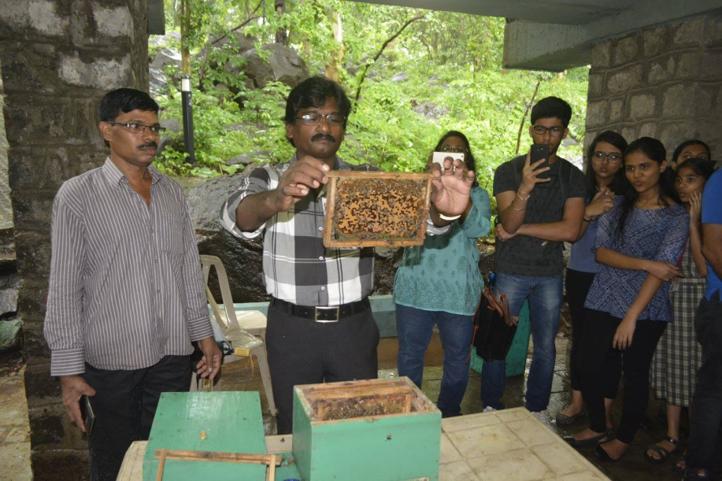
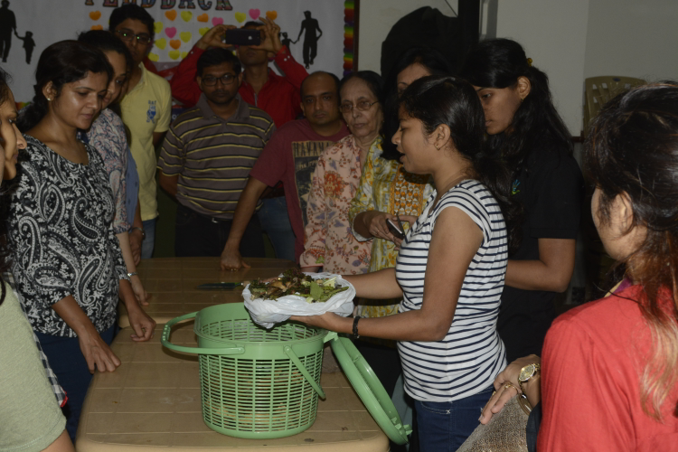
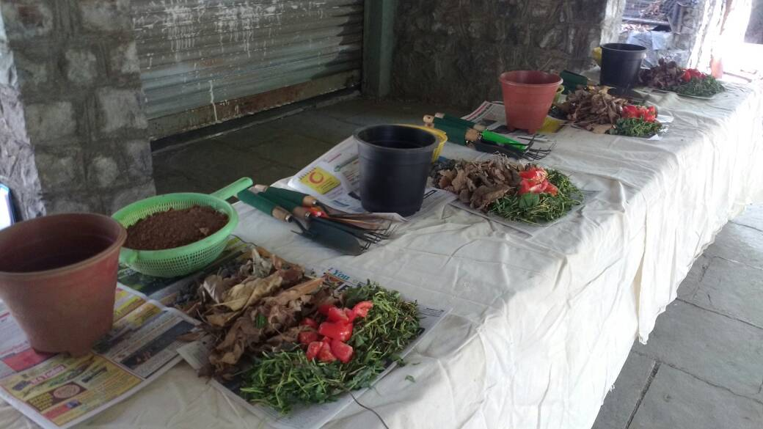
Programme
Outreach
Workshops
To study and observe urban biodiversity including birds, insects and flora we conduct monthly walks in around Navi Mumbai, Mumbai and Thane
Bee workshop
Kitchen gardening workshop

Slide 11
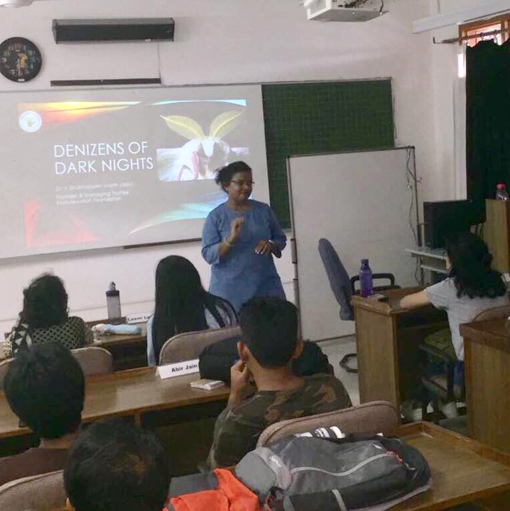
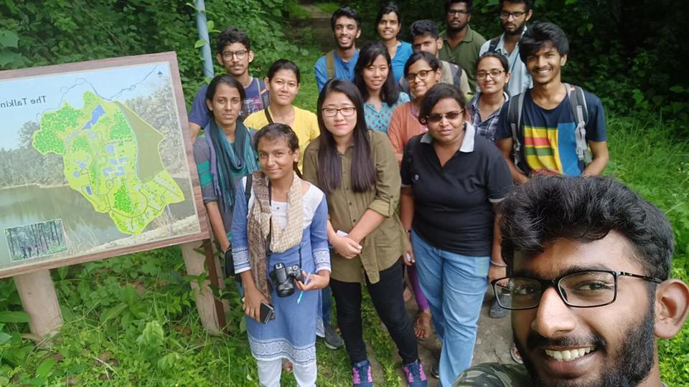
Programme
Outreach
Green Talks
National moth week at WII, Dehradoon

Slide 12
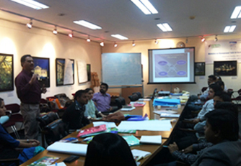
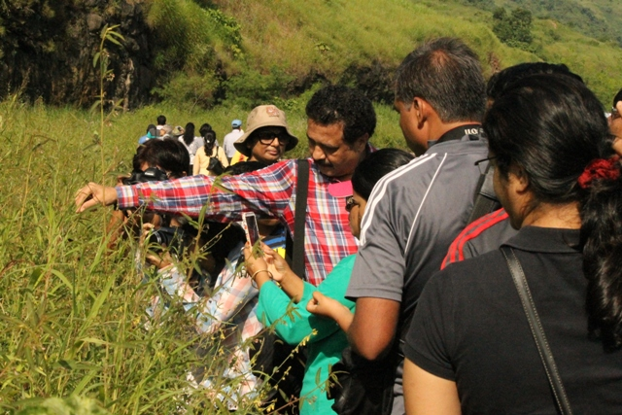
Programmes
Training Courses
Naturalist training
Lepidoptera training

Slide 13
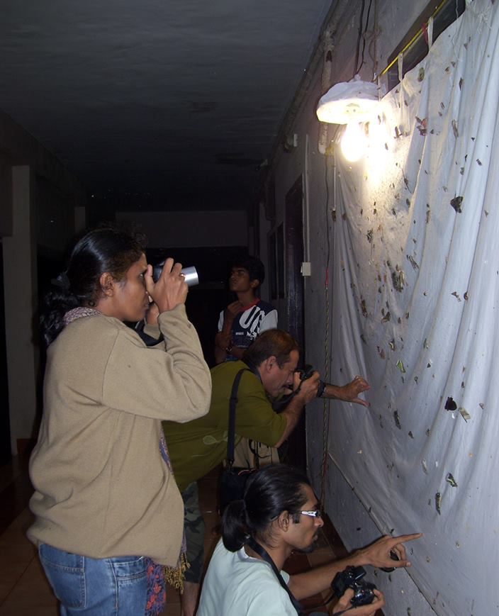

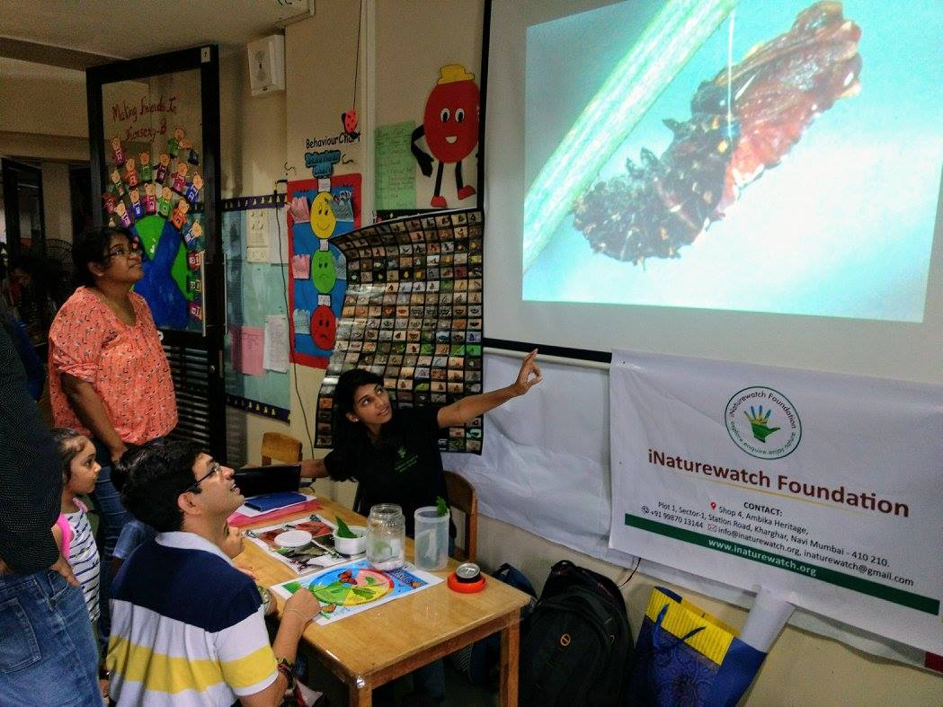
Programmes
Insect Tourism Camps
Insect Appreciation Talks
Insect Explorer’s Guide
Our insect stall at Somaiya school Science Fair

Slide 14
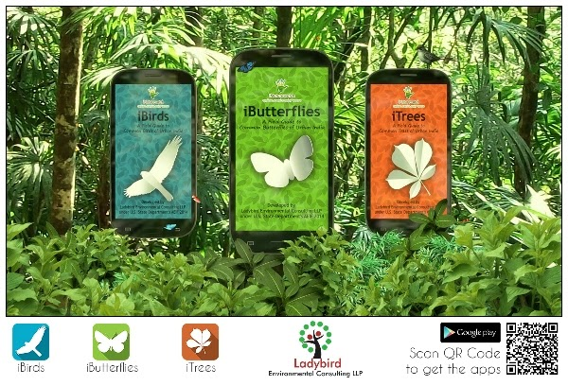
Projects
Urban iNaturewatch
Urban Wildlife Habitats
Urban iNaturewatch is a citizen science initiative which encourages urban citizens to appreciate and document their local biodiversity with the help of three mobile apps - iNaturewatch Birds, iButterflies and iTrees.

Slide 15
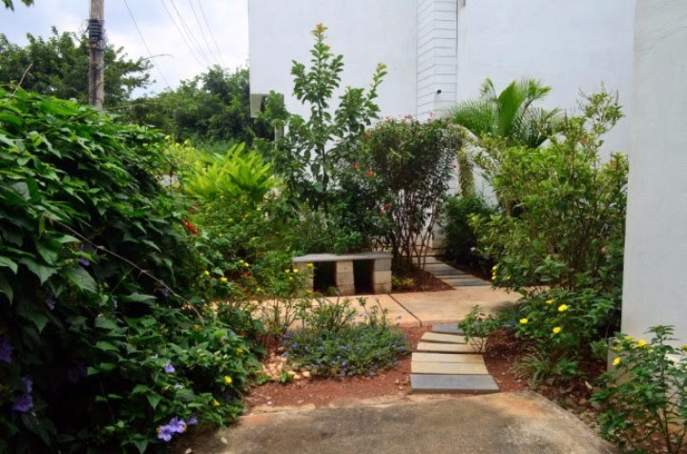
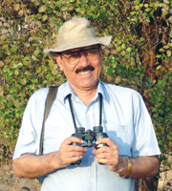
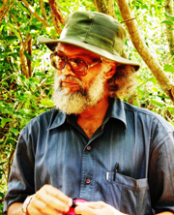
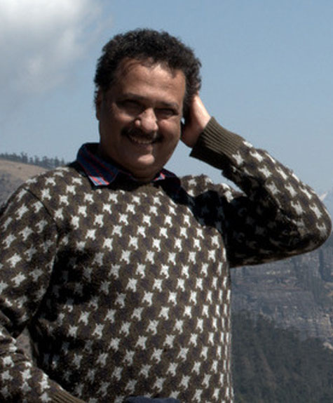
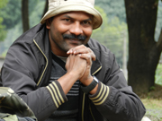
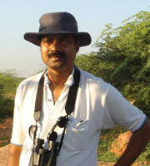
Projects
Urban Wildlife Habitats
Urban wildlife habitat recognition
Programme where individuals, institutions and companies could get their wildlife habitats recognized under this programme. Depending on the features, you could choose any of the following plans for your habitat:
Herb Plan
Shrub Plan
Tree Plan
Our Wild-life expert panelists
Dr. Asad Rahmani Dr. P.A Azeez, Mr. Isaac Kehimkar, Dr. Ramesh Krishnamurthy, Dr. M.Shah Hussain.
First certified wildlife habitat created by Mr.Madhusudahn Shukla, Bangalore

Slide 16
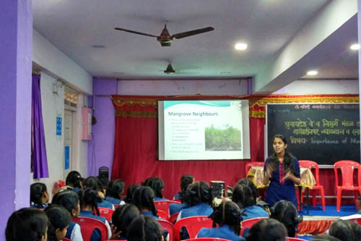
Projects
Shorekeepers of Mumbai
In collaboration with United Way Mumbai, the iNaturewatch Foundation is happy to launch its unique mangrove awareness programme- Shorekeepers of Mumbai. The programme includes talks and quiz based on mangroves :
So far we have held 26 sessions for more than 1000 audience including school, college students and general public

Slide 17
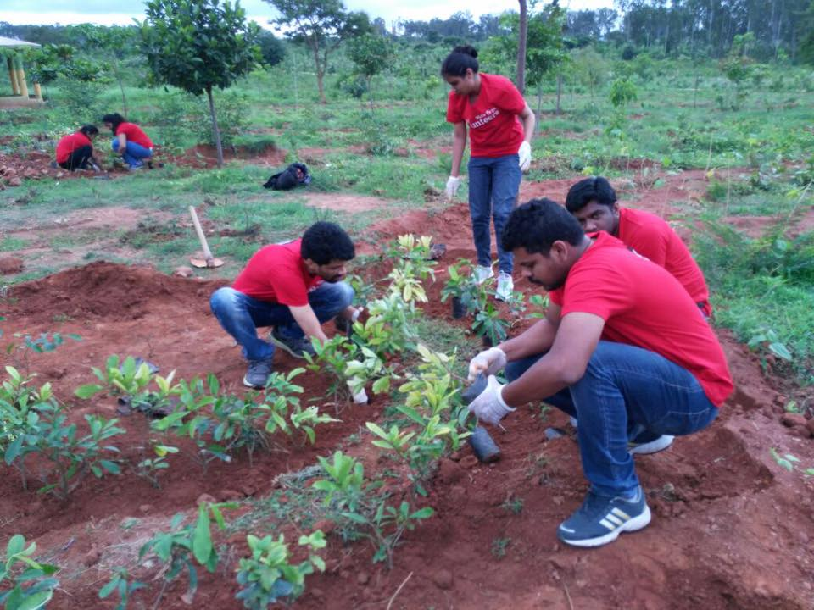
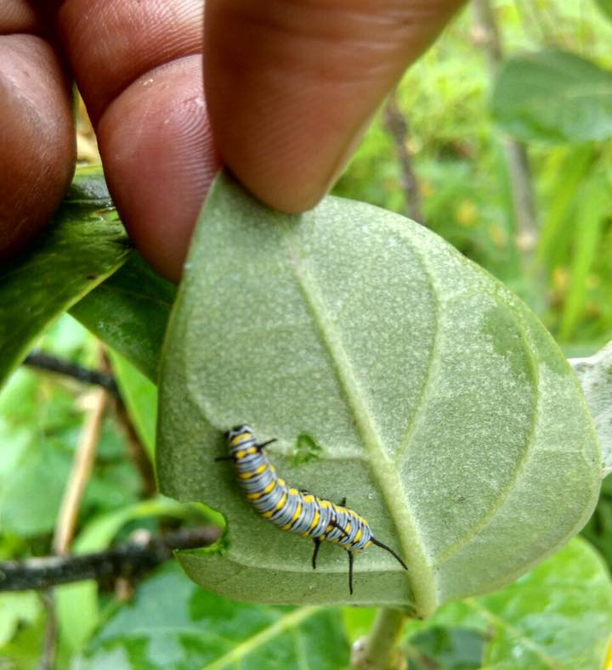
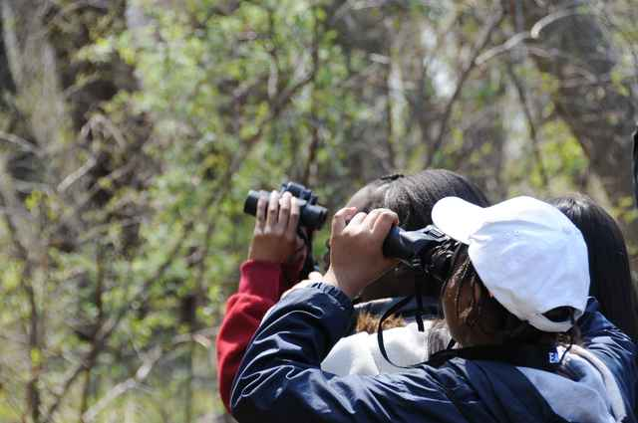
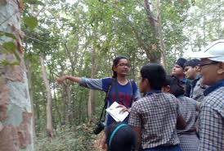
3. Online Courses
Gardening for life
Birds for beginners
Botany for beginners
Bugs for beginners
4 batches
2 batches 15 participants
2 batches
Two batches 10 participants

Slide 18


Jungle Guru
Our Whatsapp group which forms a platform to involve nature enthusiasts, to discuss their doubts and queries with nature experts.
+91 - 9987013144

Slide 19
Thank you
ADDRESS
iNaturewatch Foundation,
Shop no. 4, Ambika Heritage,
Plot - 1, Sector-1,
Station Road, Kharghar,
Navi Mumbai- 410210
EMAIL ADDRESS
inaturewatch@gmail.com
GIVE US A CALL
+91 - 9987013144
+91 - 9820165525

