Slide 1
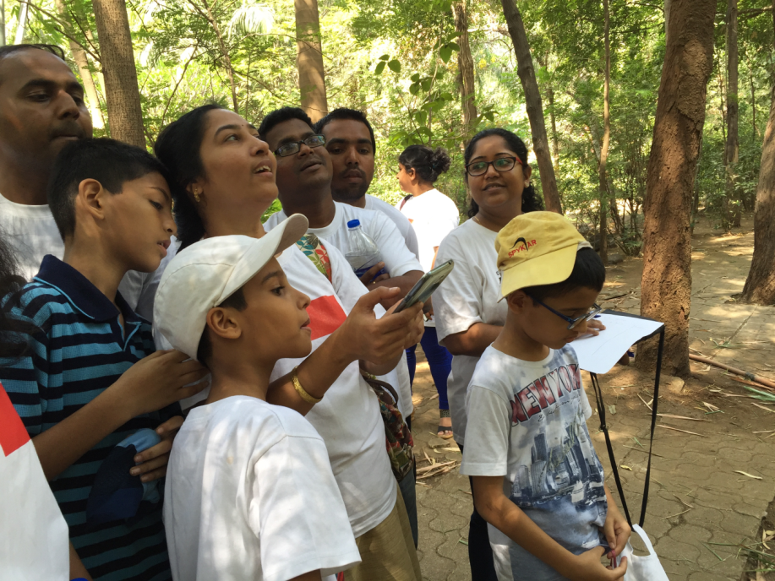
Mobile Apps for Recording Climate Change: A Case Study of Mobile Learning through Citizen Science in Four Urban Secondary Schools in India
Presented by Dr. V. Shubhalaxmi
Founder & Director
Ladybird Environmental Consulting LLP

Slide 2
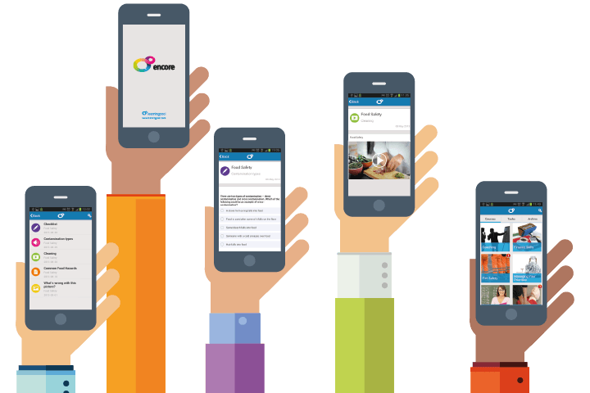
Why m-education for education
m-learning (use of mobile devices to deliver education anytime anywhere)
India has the second largest mobile phone users in the world – 900 million mobile phone users
Use of mobile technology provides an opportunity to remodel and upgrade current education delivery system
Environment education being handson and field oriented will benefit inclusion of mobile technology as one of the tools.
Notes:
SLIDE 1: FOUNDATION OF THE PROJECT
The seed for this project began with the promotion of Digital India – which is a programme launched by Government of India to transform India into a digitally empowered society.
We felt mobile technology recently advancing in such a rapid speed, can be used as a tool for empowering the society and transforming India.
India being the second largest mobile phone users in the world of around 900 million users (almost every single person in urban areas would have a mobile phone; professionals, students, childrens, labourers, etc everyone are obsessed with mobile phones now a days) This proved to be most important resource for our project.
We thought we could use this mobile technology to remodel and upgrade education delivery system.
There has also been a recent introduction of m-learning especially in rural areas which is use of mobile devices to deliver education anytime anywhere for adult learning.

Slide 3
Mobile apps for climate change (2014-15)
In July 2014, a team of alumni of International Exchange Programme won a global grant competition of 25000 USD by U.S. State Departments – Alumni Innovation Engagement Fund (AEIF 2014)
Three Android mobile apps for 50 commonly found species of birds, butterflies and trees in urban areas were developed namely iTrees, iButterflies and iNaturewatch Birds.
A citizen science programme was launched among secondary schools of four metros; Mumbai, New Delhi, Hyderabad and Kolkatta to collect data on the impact of climate change on urban biodiversity with the help of these mobile apps
These mobile apps fits the definition of m-learning (as this was the first project in India where schools allowed use of mobile phones for a project)

Slide 4
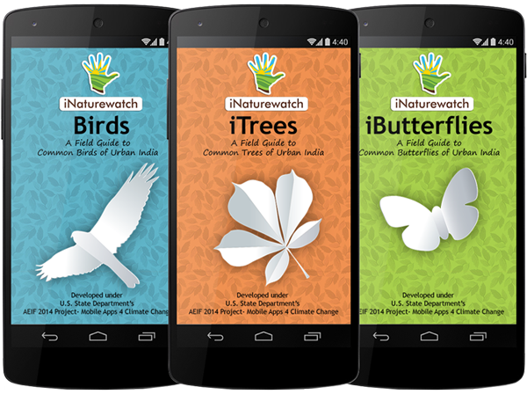
Purpose of the project
Can mobile apps be used for documenting climate change impact on urban biodiversity????
two major questions
Would mobile apps help school students in outdoor learning?????

Slide 5
process

Slide 6
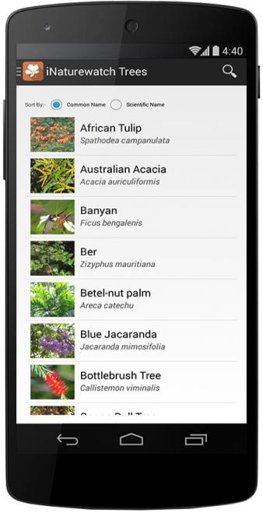
Highlights of apps & website
APPs
Inspired from Audobon e-guides
50 species of birds, butterflies and trees
Total of 447 photographs used
Features male/female birds/butterflies, life cycles of butterflies, tree leaves, fruit and flowers
Bird calls included
WEBSITE
Citizen science could register on the website
Approach to report sightings
Collects and presents data
Contains guidelines for study
Supportive datasheets available for download
Tutorial video on YouTube:

Slide 7
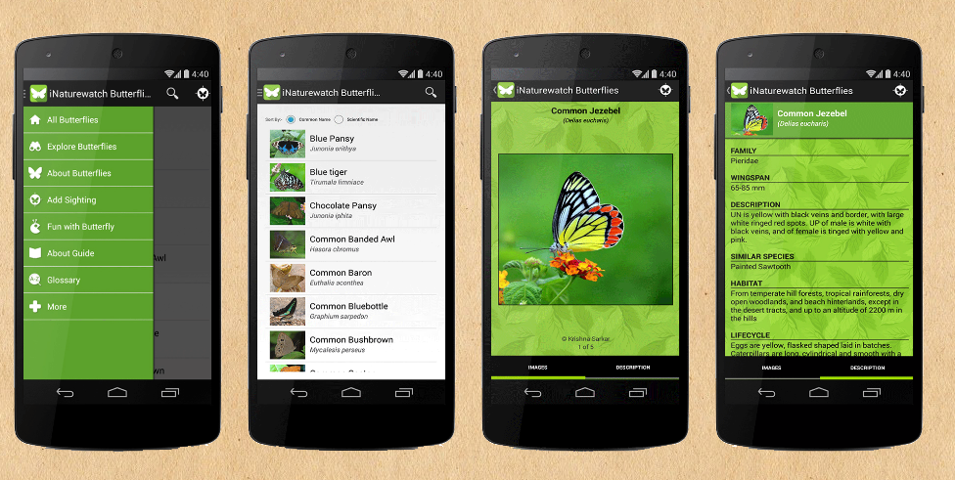
ibutterflies

Slide 8
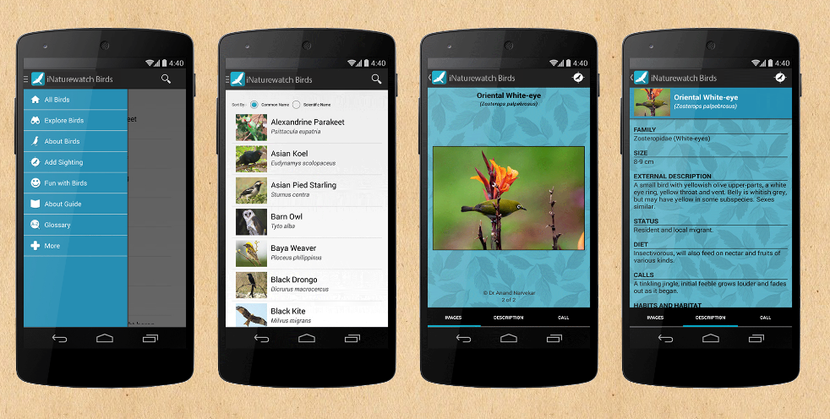
Inaturewatch birds

Slide 9
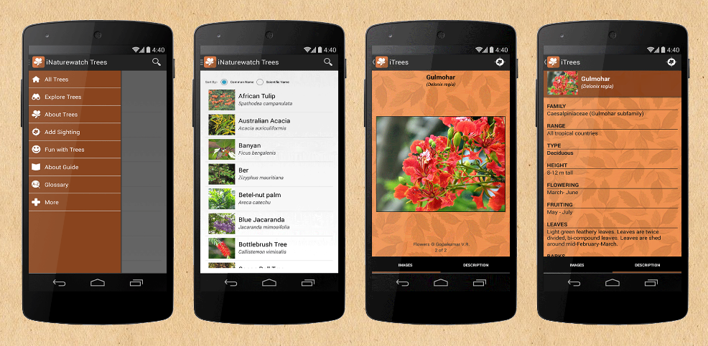
itrees

Slide 11
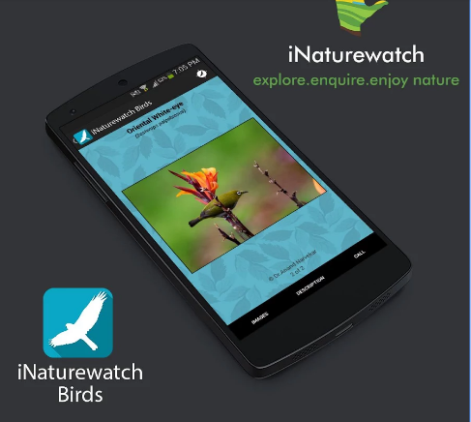

Slide 12
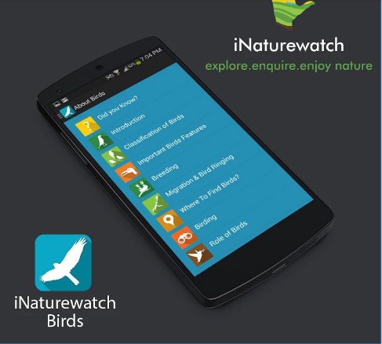

Slide 13
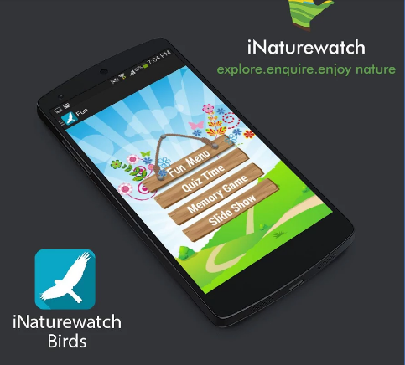

Slide 14
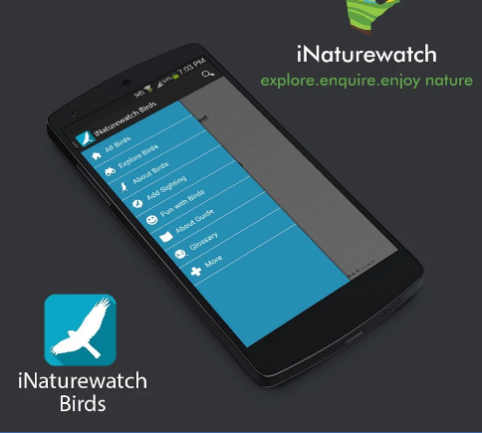

Slide 15
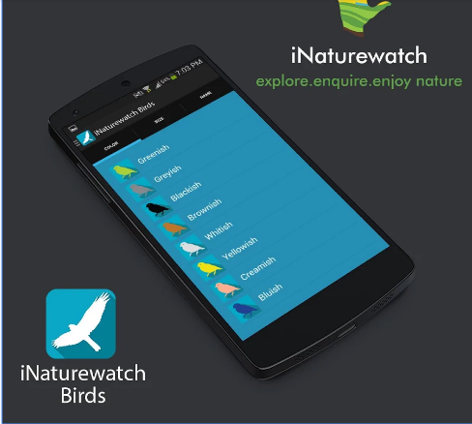

Slide 16
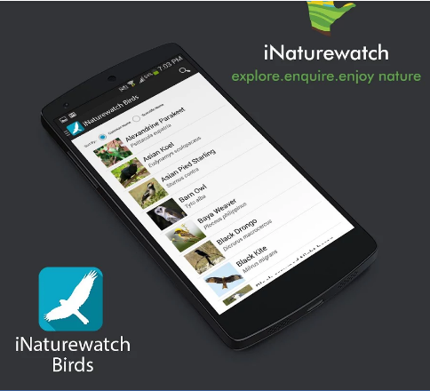

Slide 18
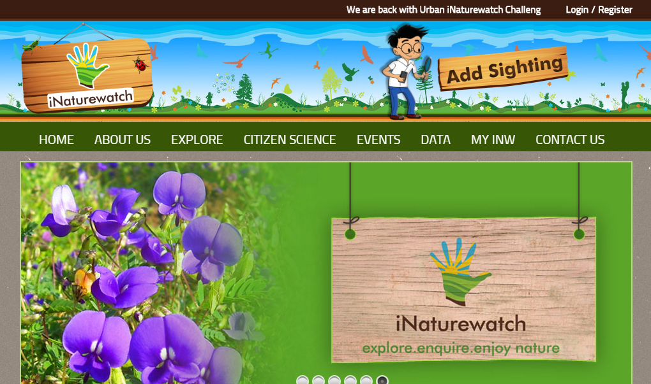
Project website

Slide 19
Project partners
New Delhi, Kolkatta, Hyderabad
Mumbai

Slide 20
Launch of Mobile Apps
12 December 2014
Launched on
Available for free download on
DOWNLOAD RANGE : 1000 -5000 ALL OVER THE WORLD (AROUND 11 COUNTRIES)

Slide 21
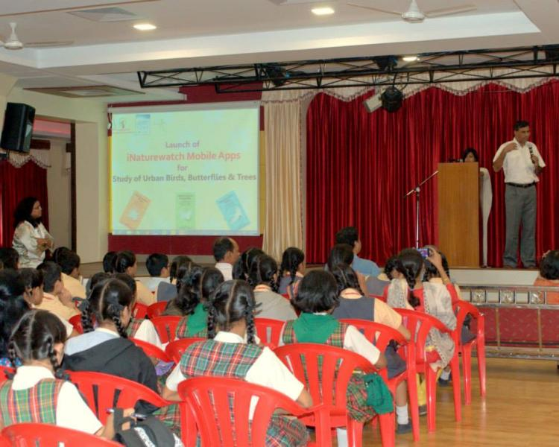
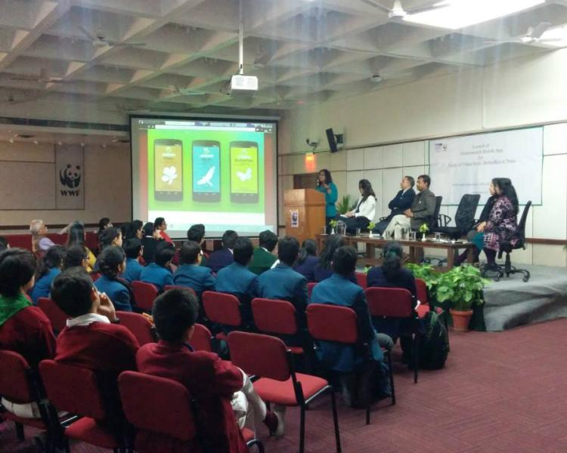
Launch Programmes
Launched in four metros; Mumbai, New Delhi, Hyderabad, Kolkatta
Orientation to participating students were provided

Slide 22
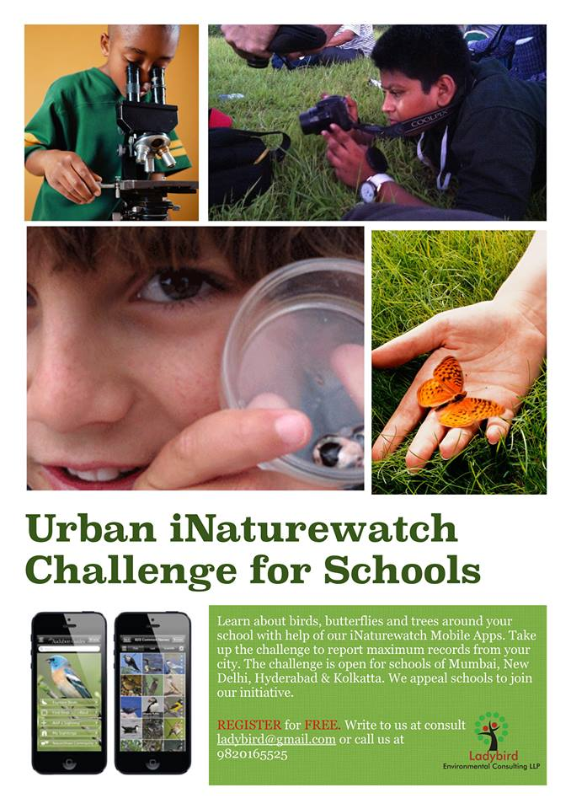
Urban inaturewatch challenge
In order to incentivize the students a competition on data collection was launched.
The challenge was part of the student project

Slide 23
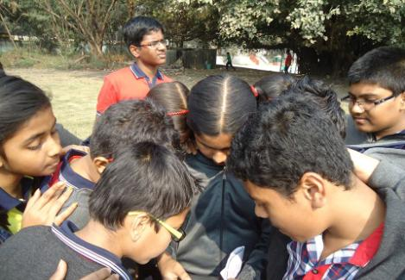
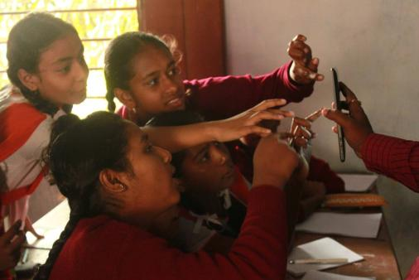
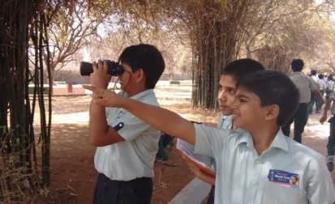
Data Collection
DATA COLLECTION:
JAN 2015 – APR 2015
COLLECTED THROUGH ECO CLUBS, NATURE WALKS
TEACHERS SUPERVISION OF THE WORK
47 TREE SPECIES
50 BUTTERFLY SPECIES
48 BIRD SPECIES

Slide 24
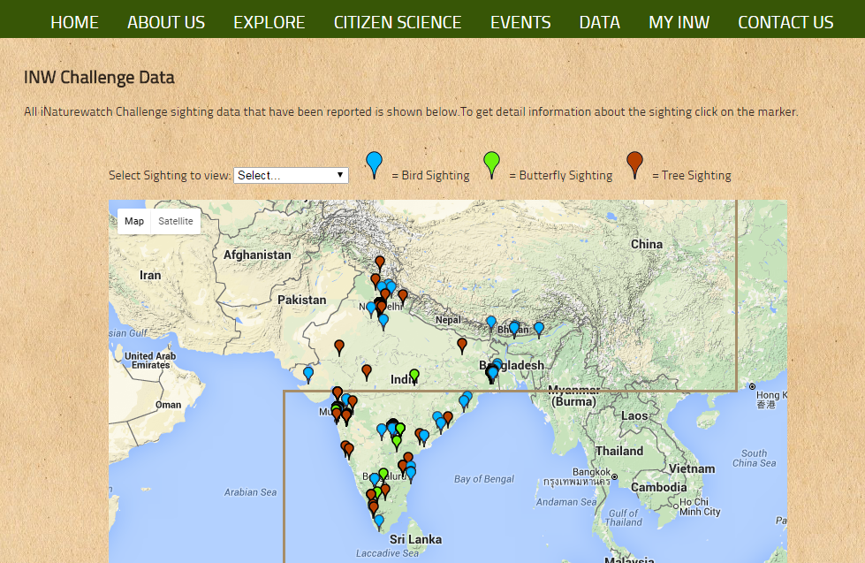
DATA DISPLAY

Slide 25
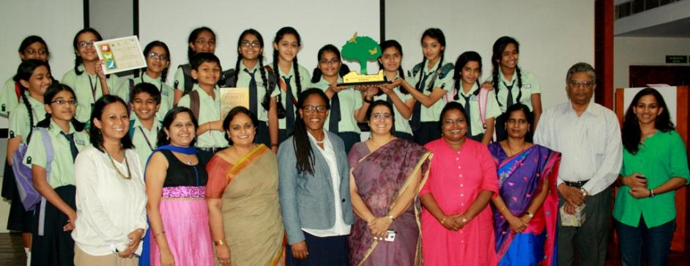
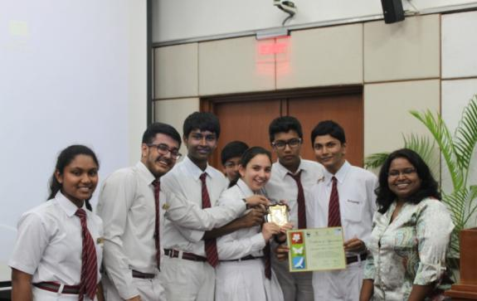
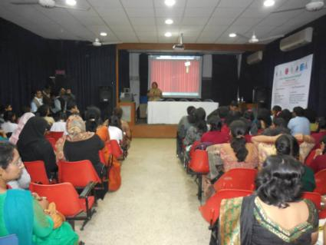
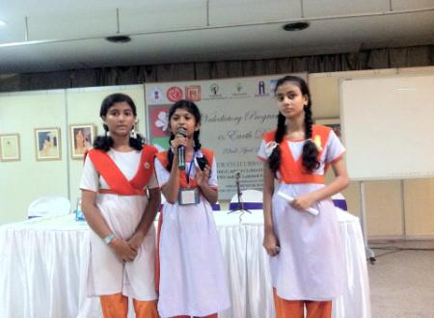
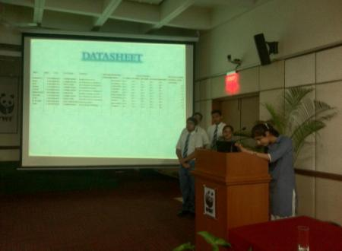
Conclusion
Urban iNaturewatch Challenge concluded in April 2015
Total of 2227 records were sighted
DELHI VALEDICTORY FUNCTION
WINNER SCHOOL - SPRINGDALES
KOLKATA EVENT
PRESENTATION BY STUDENTS

Slide 26
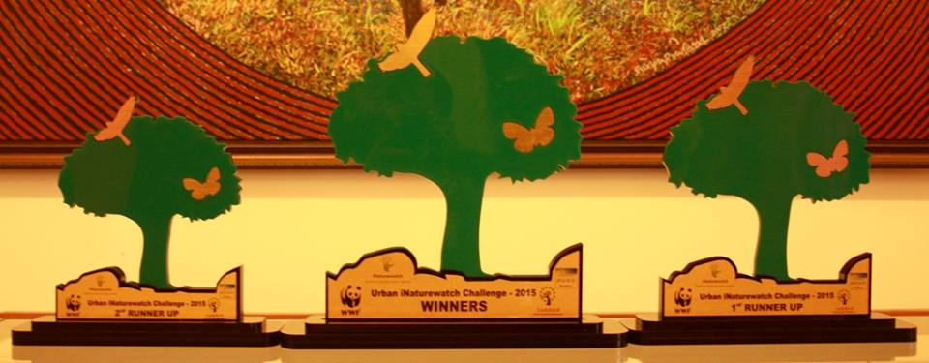
Urban iNaturewatch Challenge
CHALLENGE TO RECORD HIGHEST NUMBER OF SIGHTINGS
City | No. of Schools | No. of Students | No. of Records
Hyderbad | 7 | 603 | 1068
Kolkatta | 10 | 708 | 855
New Delhi | 6 | 96 | 166
Mumbai | 9 | 192 | 138
TOTAL | 32 | 1599 | 2227

Slide 27
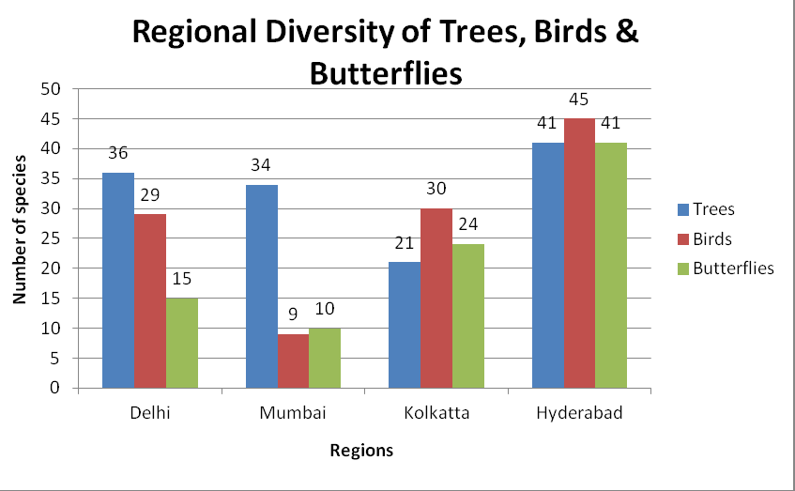
Data Interpretation

Slide 28
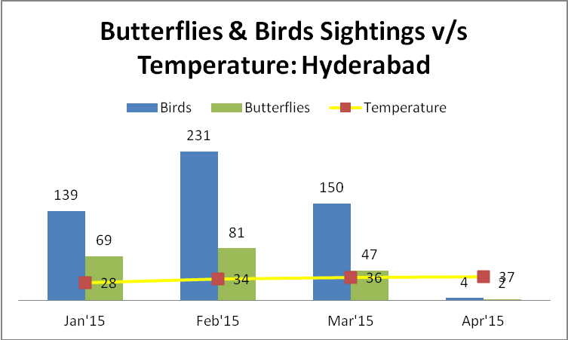
A sample data set- FLIGHT PERIOD OF BUTTERFLIES AND BIRDS

Slide 29
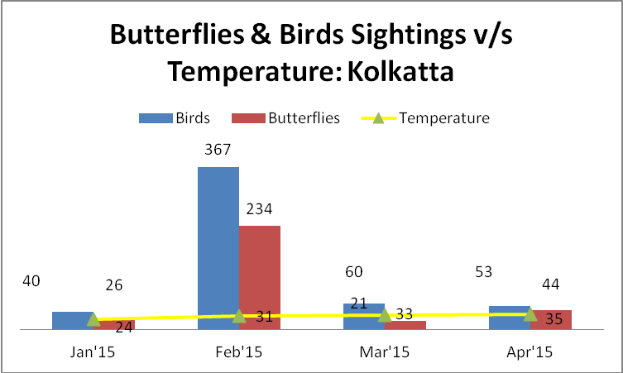
FLIGHT PERIOD OF BUTTERFLIES AND BIRDS

Slide 30
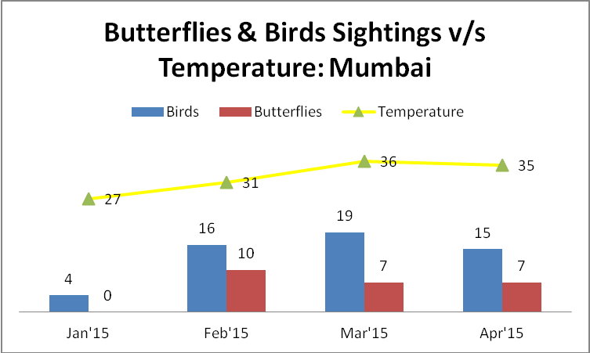
FLIGHT PERIOD OF BUTTERFLIES AND BIRDS

Slide 31
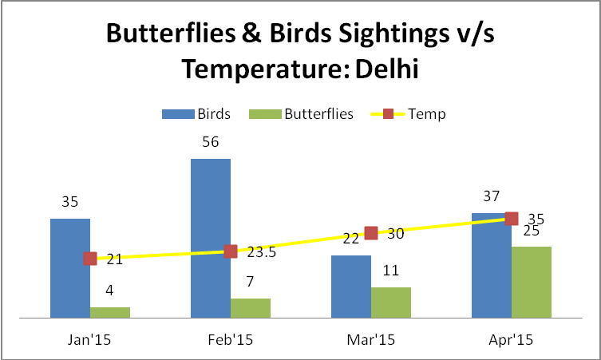
FLIGHT PERIOD OF BUTTERFLIES AND BIRDS

Slide 32
Pedagogical Analysis
Complexity
Trialability
Observability
Compatibility
Relative Advantage
Analysis of Theoretical Framework

Slide 33
Pedagogical Analysis
Adoption of Innovation theory by users
Knowledge
Thoroughly promoted in print and social media
Generated curiosity about mobile apps
Persuasion
NGO Partners and schools – project adopters
Provided free educational resource
Decision
Persuasion factors were successful
Decision was taken to use mobile apps
Implementation
Confirmation
Schools participated in the challenge
Students collected data from respective cities and won challenge

Slide 34
Pedagogical Analysis
Analysis of General Characteristics
AVAILABILITY
SCIENCE CONTENT
APP TYPE
MOBILE APP DESIGN FEATURES
STUDENT OUTCOME MEASURE
Freely available on Google Play Store
Loaded with natural history information
Includes general topic on climate change impact
Place-based data collection tools
Users collect data from their respective location
Technology-based scaffolding
Location-aware
Visual-audio representation
Low level – Understanding
High level – presentation and analysis
Cognitive load

Slide 35
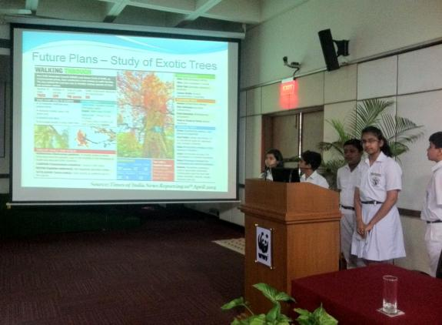
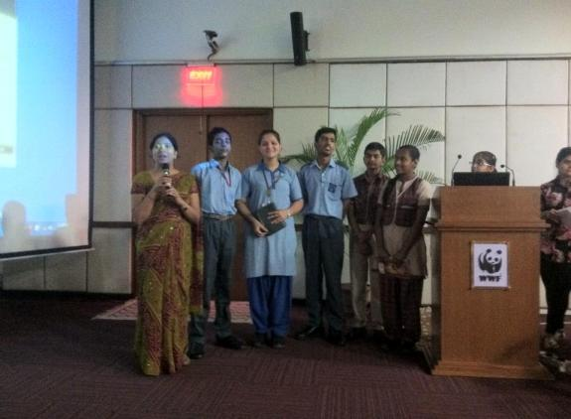
Discussion & Feedback
FEEDBACK
Teachers : very useful; modern technology put to a good use
Students: Exciting way of learning; increased interest about environment; bird call feature very cool
DISCUSSION
Use of the App was successful in collecting urban biodiversity data
Could correlate with weather parameters
Students ventured out to collect data
Mobile apps can actually be used as a too for engaging school students with outdoor activity

Slide 36
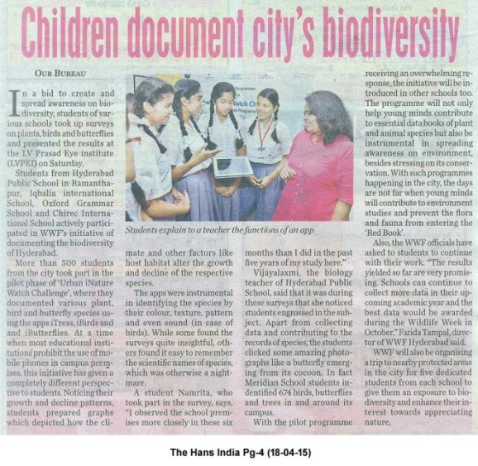
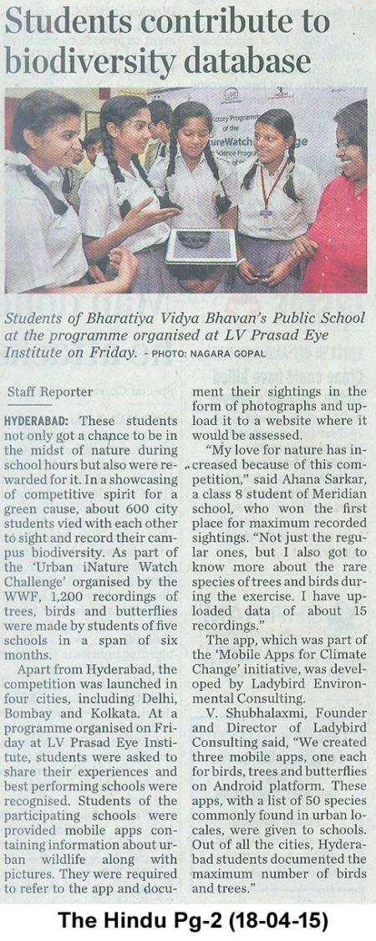
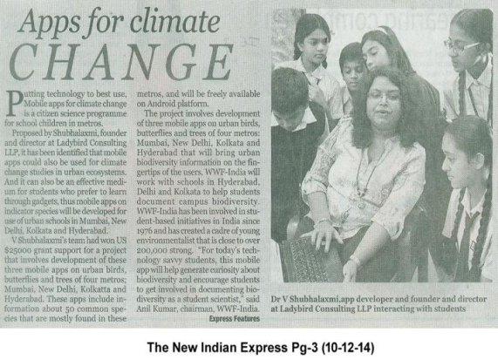
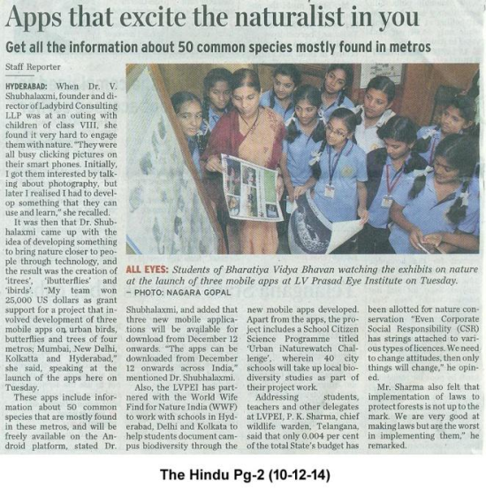
Media reports

Slide 37
Acknowledgements
U.S. State Department’s Alumni Innovation Engagement fund for financial assistance and U.S. Consulate General, India for extending support to the project
WWF-India and Greenline for partnering with the project
LINC 2016 for accepting the paper and providing travel grant
5 Authors of the paper

Slide 38
Post project updates
iNaturewatch Foundation has been formed as a nonprofit entity which will promote citizen science in urban India using the mobile apps
Mobile apps will be upgraded for additional 25 species
iNaturewatch Newsletter will be sent to all dataloggers

Slide 39
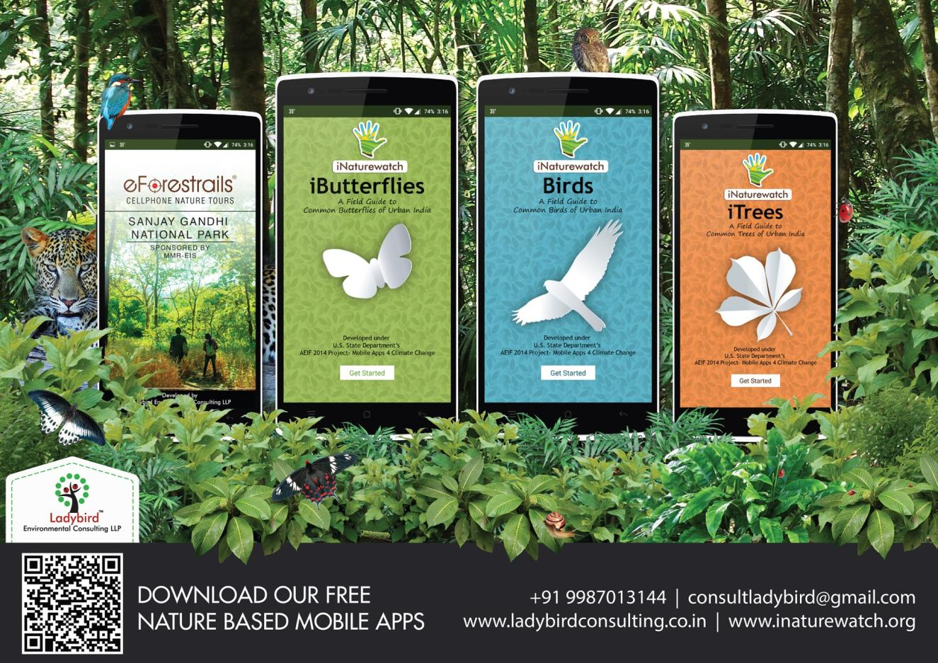
Thank you for your time

