Slide 1
Sunsync Vista Energy For Sustainable Future
Technical Presentation

Slide 2
INTRODUCTION
Sunsync Vista Energy Pvt Limited is a leader in renewable energy solutions, dedicated to promoting sustainability through innovative solar power systems. Our mission is to accelerate the transition to clean energy by providing advanced, efficient, and cost-effective solar solutions for diverse sectors. We specialize in photovoltaic systems, energy storage, solar water pumping, and large-scale solar park development. Our achievements include successful installations across residential, commercial, and industrial projects, contributing significantly to reducing carbon footprints and promoting energy independence. Sunsync Vista continues to push boundaries in renewable technology, delivering reliable and environmentally friendly energy solutions.

Slide 3
OUR EXPERTISE
Photovoltaic System
EV Chargers
Energy Storage
Sunsync Vista Energy
Performance Analysis, Operations & Maintenance
Solar Water Pumping System
Solar Park Development

Slide 4
SOLAR PV SYSTEMS
Photovoltaic (PV) systems use solar panels to capture sunlight and convert it into electricity through the photovoltaic effect. These systems are versatile and can be implemented across various settings:
Residential Use: Provides homeowners with sustainable, cost-effective power for daily energy needs, potentially lowering electricity bills.
Commercial Use: Businesses can reduce operating costs and enhance their green credentials by installing PV systems on rooftops or dedicated solar farms.
Industrial Use: Large-scale PV systems help industries meet significant energy demands sustainably, often integrating with on-grid or hybrid systems for reliability.

Slide 5
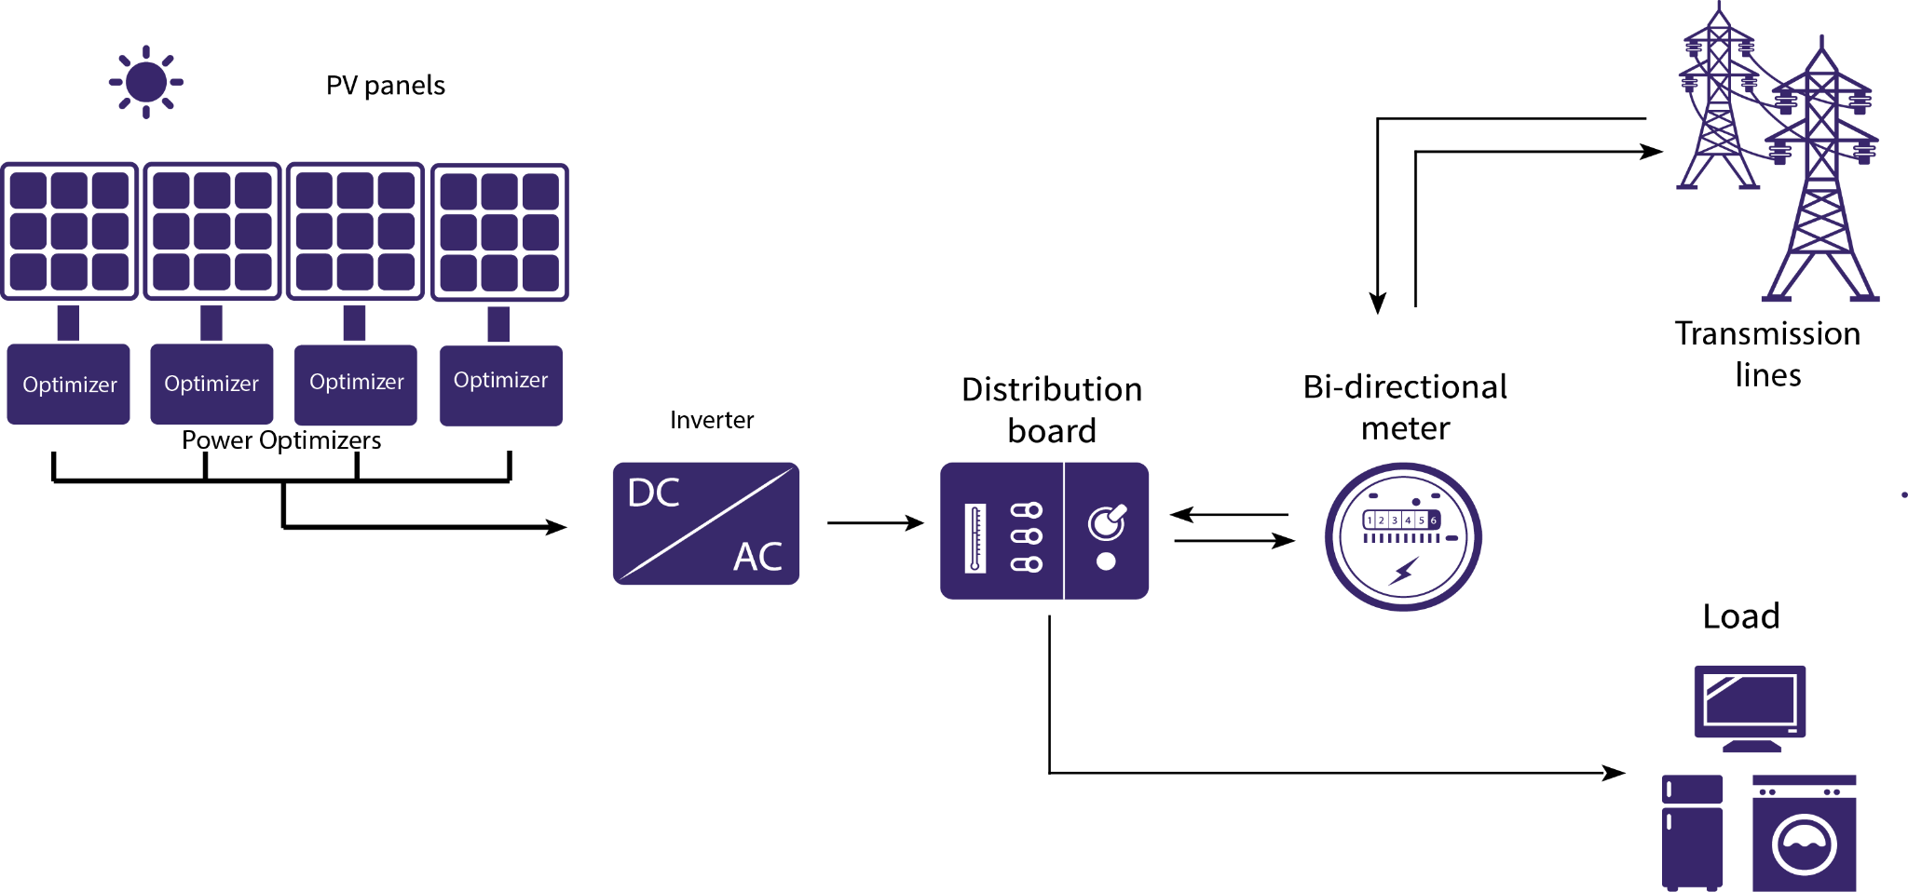
SOLAR ON-GRID SYSTEMS
On-grid solar photovoltaic (PV) systems are directly connected to the electrical grid, allowing for efficient energy use and management. These systems generate electricity from sunlight, which is converted from DC (direct current) to AC (alternating current) by an inverter, making it compatible with standard grid power.
Key Features:
Energy Flow: Excess energy produced by the system is fed back into the grid, often resulting in credits or incentives for the user, known as net metering.
Reliability: During times of low solar generation (e.g., cloudy days or nighttime), the system automatically draws power from the grid to ensure a continuous energy supply.
Cost Savings: Reduces electricity bills by offsetting the amount of power drawn from the grid, with long-term savings on energy costs.
Environmental Impact: By generating renewable energy, on-grid systems help decrease reliance on fossil fuels, supporting cleaner energy consumption.

Slide 6
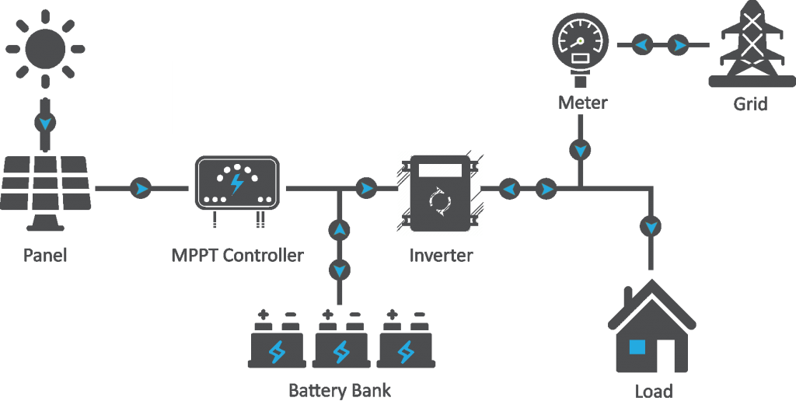
SOLAR HYBRID SYSTEMS
Solar Hybrid Systems combine solar power with battery storage and the electrical grid to ensure a continuous power supply, even when sunlight is unavailable or limited. They offer flexibility and reliability by storing excess solar energy for later use and drawing from the grid when needed.
Key components and benefits of solar hybrid systems:
Solar Panels: Capture sunlight to generate DC electricity.
Battery Storage: Stores excess energy generated during sunny periods, providing backup during nighttime or cloudy days.
Grid Connection: Supplies additional power when battery storage is low or during high energy demand, while also allowing surplus energy to be fed back to the grid.
Applications:
Residential: Provides homes with a reliable power source, minimizing grid dependency.
Commercial & Industrial: Supports businesses with consistent energy, reduces peak demand charges, and enhances energy security.

Slide 7
ENERGY STORAGE
At Sunsync Vista, our energy storage solutions are designed to enhance energy reliability, reduce costs, and support sustainable practices across sectors. Here’s how energy storage plays a critical role in modern energy systems:
Backup Power: Our storage systems provide essential backup power during grid outages, ensuring homes, businesses, and facilities remain operational without interruption.
Uninterrupted Operations: By storing excess energy, Sunsync Vista enables businesses and critical infrastructures to maintain seamless operations even during power fluctuations, protecting productivity and safety.
Enhanced Energy Security: Energy storage supports greater independence from the grid, making it especially valuable in remote areas or industries with high energy demands, reducing reliance on external power.
Renewable Energy Optimization: Our systems store surplus renewable energy, allowing customers to use clean power around the clock, reducing carbon footprints and lowering energy costs.
Sunsync Vista’s energy storage solutions are tailored to provide reliable, efficient power management that aligns with the future of sustainable energy.

Slide 8
SOLAR OFF-GRID SYSTEMS
Sunsync Vista’s solar off-grid systems provide a complete, self-sustaining energy solution for areas with limited or no grid access. Designed to operate independently, our off-grid systems offer reliable power by combining solar energy with advanced battery storage, delivering a consistent energy supply regardless of location.
Why Choose Sunsync Vista’s Off-Grid Solutions?
Reliable Power in Remote Areas: Ideal for rural communities, isolated homes, and agricultural setups where traditional grid access is unavailable or unreliable.
Energy Independence: Off-grid systems allow users to generate and store their own energy, reducing dependency on the grid and fuel-based generators.
Cost-Effective and Eco-Friendly: By harnessing renewable solar energy, our systems lower long-term energy costs and reduce environmental impact.
Customizable for Varied Needs: Our off-grid systems can be scaled to fit diverse energy demands, from basic residential setups to larger commercial installations.

Slide 9
SOLAR WATER PUMPING SYSTEM
Sunsync Vista’s Solar Water Pumping Systems provide efficient, eco-friendly solutions for agriculture, water management, and rural development. Powered by solar energy, these systems eliminate fuel costs and reduce dependence on unreliable power sources, making them ideal for areas with limited grid access.
Advantages of Sunsync Vista’s Solar Water Pumping Systems:
Cost Savings: By utilizing solar energy, our systems significantly reduce electricity and fuel expenses, offering long-term savings for agricultural and rural applications.
Environmental Impact: Emitting zero carbon, solar pumps support sustainable agriculture and water conservation efforts, aligning with green energy goals.
Reliable Water Supply: Ensures a consistent water source, vital for crop irrigation, livestock, and rural water needs, without the risk of power shortages.
Ease of Installation and Maintenance: Our solar pumps are easy to install and require minimal maintenance, providing dependable operation with little upkeep.

Slide 10
Dynamic delivery
Solar Panel Installation:
Solar panels are installed in a location with optimal sunlight exposure. These panels convert sunlight into direct current (DC) electricity.
Energy Conversion:
The DC electricity generated by the solar panels is sent to a solar inverter, which converts it into alternating current (AC) electricity if required by the pump. Some systems may utilize DC pumps directly.
Pump Activation:
When sunlight is available, the inverter sends power to the water pump, activating it. The pump begins drawing water from a source (such as a well, borehole, or surface water).
Water Pumping:
The pump moves water through a piping system to the designated storage tanks or irrigation systems. The pumping rate is dependent on the solar energy available and the specifications of the pump.
Water Storage:
The pumped water is directed into storage tanks or reservoirs. This ensures a reliable supply of water for later use, particularly beneficial for irrigation during non-sunny hours.
Automated Controls:
Many solar water pumping systems include automated controls that monitor water levels and solar energy availability. These controls optimize the pump’s operation, ensuring it runs efficiently and only when needed.
Continuous Operation:
The system operates during daylight hours, taking advantage of peak sunlight. With sufficient solar energy, the pump can function continuously or at intervals as needed.
Backup Options:
Some systems may include battery storage or a grid connection to ensure water pumping can continue during cloudy days or after sunset, providing uninterrupted water supply.

Slide 11
SOLAR PARK DEVELOPMENT
At Sunsync Vista, we specialize in the design and development of solar parks, which are large-scale solar power installations designed to generate significant renewable energy efficiently. Our approach to solar park development focuses on sustainability, land optimization, and seamless grid integration.
Key Aspects of Sunsync Vista’s Solar Park Development:
Large-Scale Energy Generation: Our solar parks harness the power of sunlight to produce substantial amounts of electricity, contributing to the renewable energy supply and reducing reliance on fossil fuels.
Land Optimization: We strategically select and optimize land use for solar installations, ensuring minimal environmental impact while maximizing energy production. This includes utilizing underutilized or degraded land for solar parks.
Grid Integration: Sunsync Vista ensures that solar parks are designed for effective integration with existing electrical grids, facilitating smooth energy distribution and enhancing grid stability.
Economic Benefits: Our solar parks create job opportunities during construction and operation, stimulate local economies, and provide clean energy solutions that can lower electricity costs for communities.
Environmental Impact: By promoting renewable energy generation, our solar parks contribute to reducing greenhouse gas emissions and mitigating climate change, supporting a sustainable future for all.

Slide 12
PERFORMANCE ANALYSIS, OPERATIONS & MAINTENANCE
At Sunsync Vista, we prioritize the efficiency and longevity of solar energy systems through our comprehensive performance analysis and maintenance services.
Key Aspects of Our Approach:
Continuous Monitoring: We employ advanced monitoring systems to track performance metrics in real-time, ensuring optimal operation of solar installations.
Proactive Maintenance: Regular maintenance checks and proactive interventions prevent potential issues, extending the lifespan of solar systems and maximizing energy production.
Data-Driven Insights: Our performance analysis provides actionable insights to improve efficiency, enabling clients to make informed decisions about their energy systems.
Expert Support: Our skilled technicians offer prompt support and solutions to any operational challenges, ensuring minimal downtime and reliable energy supply.

Slide 13
PERFORMANCE ANALYSIS, OPERATIONS & MAINTENANCE
SCADA
Remote monitoring and control of solar power systems
Real-time data collection and analysis
Fault detection and diagnosis
DG- Sync
Synchronization of multiple distributed generators (e.g., solar inverters)
Grid stability and reliability
Integration of renewable energy sources
Drone Thermography Audit
Efficient inspection of large solar arrays
Detection of faults, shading, and performance issues
Cost-effective and time-saving
Performance Analysis
Energy production
System efficiency
Return on investment (ROI)
Carbon footprint reduction

Slide 14
PV-DG OPERATION WHEN GRID AND SOLAR AVAILABLE
Grid Priority: When the grid is available alongside solar power, the system prioritizes grid and solar sources to power the load, reducing dependency on the diesel generator (DG) and saving fuel costs.
Seamless Switching: In cases where additional power is needed, the PV-DG system seamlessly integrates solar energy with grid supply, maintaining a steady and efficient power flow.
Fuel Savings and Efficiency: This setup maximizes solar utilization and minimizes DG usage, ensuring both cost efficiency and environmental benefits by reducing emissions and fuel consumption.

Slide 15
PV-DG OPERATION CASE 1 -PLANT LOAD LESS THAN 30% OF DG CAPACITY
When the plant load is below 30% of the Diesel Generator (DG) capacity, the DG operates inefficiently, resulting in higher fuel consumption and maintenance costs. In this scenario, solar photovoltaic (PV) systems can supplement power, reducing DG runtime and improving overall fuel efficiency.

Slide 16
EV CHARGERS

Slide 17
EV CHARGERS
Environmental Impact: Reducing greenhouse gas emissions and promoting cleaner transportation.
Economic Benefits: Creating new jobs in the electric vehicle industry and stimulating local economies.
Convenience: Providing charging options for EV owners, making electric vehicles more accessible and practical for daily use.

Slide 18
Thank you !

