Slide 1
UNRAVELLING THE MYSTERIES OF THE PCI-DSS STANDARDS
And make your organizations compliant
Ralph Villanueva PCI-ISA PCIP CISA CISM ITIL CIA CRMA CFE CPA (Phil) MBA
IT Security and Compliance Analyst
Diamond Resorts International
NCPACA & PASCPA 32nd Annual Professional Convention 2018

Slide 2
Objectives
Provide an overview of the PCI-DSS standards
Explain the importance of complying with the PCI-DSS standards
Point out how accounting and finance professionals can help make their organizations compliant
NCPACA & PASCPA 32nd Annual Professional Convention 2018

Slide 3
About Ralph Villanueva
IT compliance professional since 2010
Payment Card Industry – Internal Security Assessor (PCI-ISA), Payment Card Industry Professional (PCIP), Certified Information Systems Auditor (CISA), Certified Information Security Manager (CISM), IT Infrastructure Library (ITIL), Certified Internal Auditor (CIA), Certification in Risk Management Assurance (CRMA), Certified Fraud Examiner (CFE) and CPA (Phil)
BSBA from UPV and MBA from Ateneo de Manila University
Believes that Filipino accounting professionals are among the best in the world
NCPACA & PASCPA 32nd Annual Professional Convention 2018

Slide 4
POLLING QUESTION
How many of you use at least one credit or debit card?
How many of you work for organizations that accept credit or debit cards?
NCPACA & PASCPA 32nd Annual Professional Convention 2018

Slide 5
Why is the PCI-DSS important?
NCPACA & PASCPA 32nd Annual Professional Convention 2018

Slide 6
Why this is important to you?
Savings for your organization - less audit fees paid if you can do some of the work
Better appreciation of interconnectedness of all controls – more meaningful recommendations
IKAW AY MAGIGING SIKAT – Your career will get a substantial boost, you’re more likely to get that promotion, that salary increase and even your boss’ daughter (if you’re single)
NCPACA & PASCPA 32nd Annual Professional Convention 2018

Slide 7
Why you can do it?
Similar to accounting, more work, less pay
Compare accounting entry to GAAP
Compare IT observation to IT compliance framework
Prepare report of observations, impact and recommendations
NCPACA & PASCPA 32nd Annual Professional Convention 2018

Slide 8
What is PCI-SSC?
NCPACA & PASCPA 32nd Annual Professional Convention 2018

Slide 9
What is PCI-DSS
Payment Card Industry – Data Security Standards
Systems that store, process or transmit card holder data
Systems that provide security services or may impact security of cardholder data environment (CDE)
Any other component or device located within or connected to the CDE
NCPACA & PASCPA 32nd Annual Professional Convention 2018

Slide 10
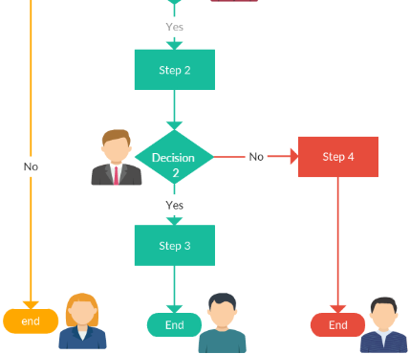
PCI-DSS covers
People
Process
Technology
NCPACA & PASCPA 32nd Annual Professional Convention 2018

Slide 11
Parties to a payment card transaction
NCPACA & PASCPA 32nd Annual Professional Convention 2018

Slide 12
Six main categories
Build and maintain a secure network and systems
Protect card holder data
Maintain a vulnerability management program
Implement strong access control measures
Regularly monitor and test networks
Maintain an information security policy
NCPACA & PASCPA 32nd Annual Professional Convention 2018

Slide 13
Twelve requirements
NCPACA & PASCPA 32nd Annual Professional Convention 2018

Slide 14
How can you help your organization be compliant?
Leverage your position within the organization as trusted and competent management advisers
Communicate the PCI-DSS requirements to everyone who processes, stores and transmits card holder data
Be familiar with the PCI-DSS requirements
NCPACA & PASCPA 32nd Annual Professional Convention 2018

Slide 15
Requirement#01: Install and maintain a firewall configuration to protect card holder data
Latest software version and updated patches
Implicit deny all
Access control list
Reviewed every six months
Security policies & operational procedures for managing firewalls are documented, in use and known to all affected parties
NCPACA & PASCPA 32nd Annual Professional Convention 2018

Slide 16
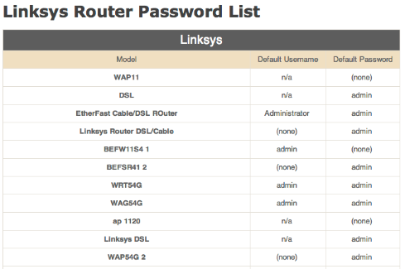
Requirement#02:Do not use vendor-supplied defaults for system passwords and other security parameters
Shoulder surf with your IT admins
No default passwords
Encrypted non-console access
Security policies & operational procedures for managing vendor defaults are documented, in use and known to all affected parties
NCPACA & PASCPA 32nd Annual Professional Convention 2018

Slide 17
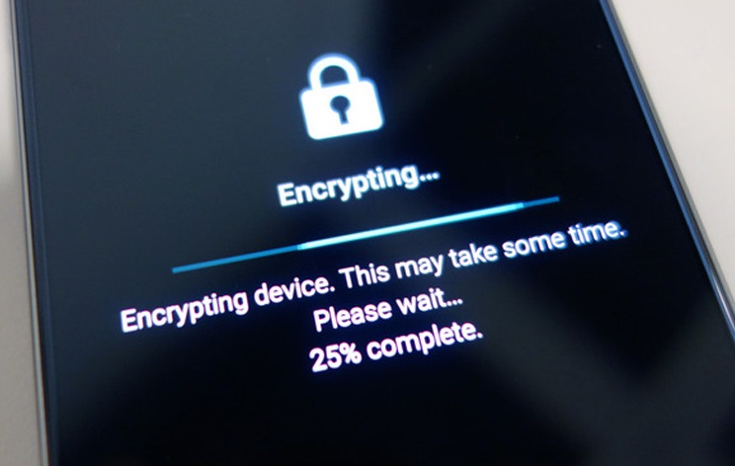
Requirement#03: Protect stored card holder data
Encryption
Data retention and disposal policies and procedures
Mask card account number when displayed
Security policies & operational procedures for protecting stored card holder data are documented, in use and known to all affected parties
NCPACA & PASCPA 32nd Annual Professional Convention 2018

Slide 18
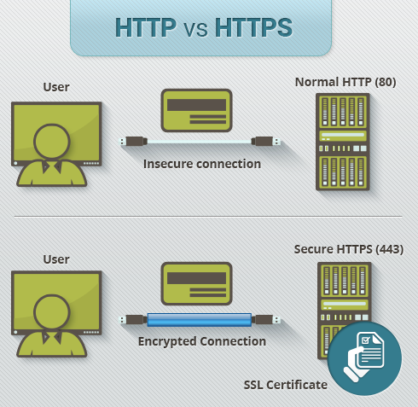
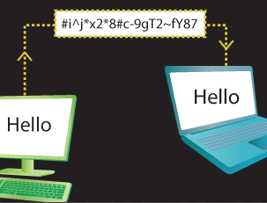
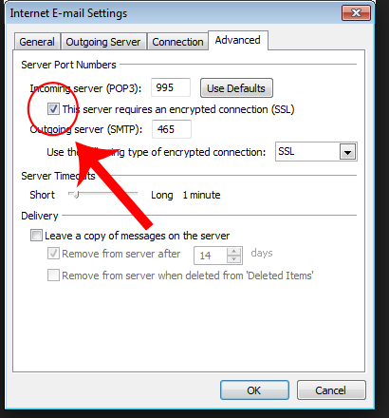
Requirement#04: Encrypt transmission of cardholder data across open public networks
NCPACA & PASCPA 32nd Annual Professional Convention 2018

Slide 19
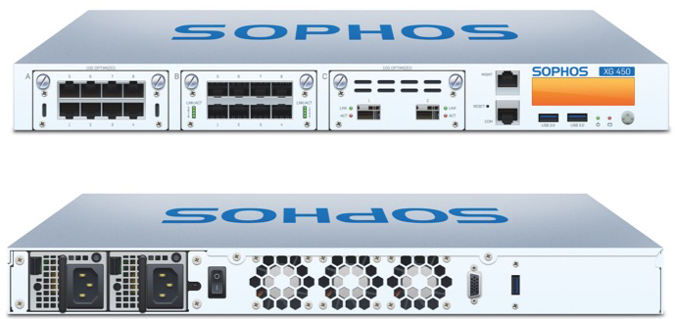
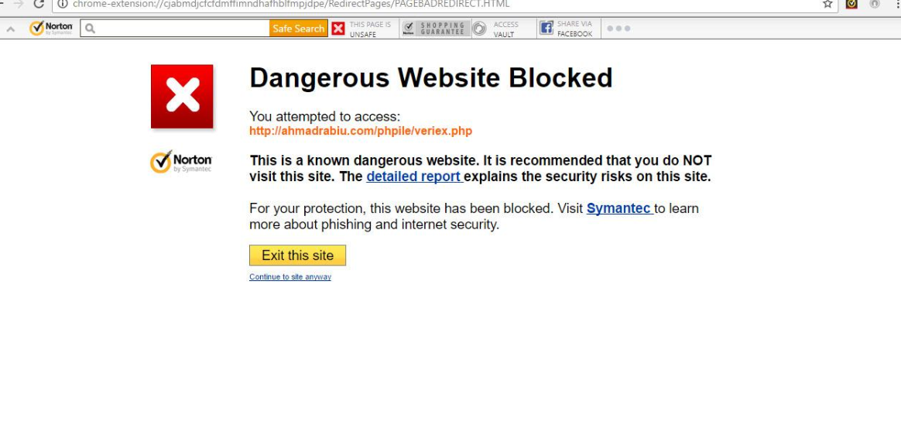
Requirement#05: Protect all systems against malware and regularly update anti-virus systems and programs
Latest version and patches
Deployed to all computers susceptible to malware
Users cannot be admins; cannot disable anti-virus
Security policies & operational procedures for protecting systems against malware are documented, in use and known to all affected parties
NCPACA & PASCPA 32nd Annual Professional Convention 2018

Slide 20
Requirement#06: Develop and maintain secure systems and applications
Security vulnerability analysis & risk ranking
Incorporate information security during development
Change control processes
Segregation of duties between development & production teams
Functionality testing and back-out procedures
Security policies & operational procedures for developing secure systems and applications are documented, in use & known to all affected parties
NCPACA & PASCPA 32nd Annual Professional Convention 2018

Slide 21
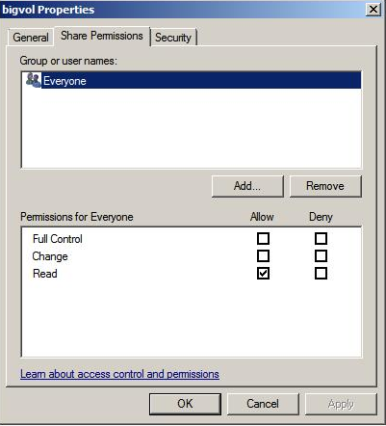
Requirement#07: Restrict access to card holder data by business need to know
Least privilege
Access after management approval
Access based on job classification & function
Security policies & operational procedures for restricting access to cardholder data are documented, in use & known to all affected parties
NCPACA & PASCPA 32nd Annual Professional Convention 2018

Slide 22
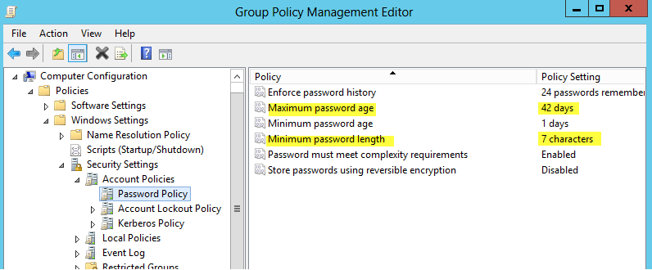
Requirement#08: Identify and authenticate access to system components
Unique user names and passwords
Password at least 7 alpha, numeric and special characters, change every 90 days
Lockout after 6 attempts
Multi factor non-console access
Security policies & operational procedures to identify and authenticate are documented, in use and known to all affected parties
NCPACA & PASCPA 32nd Annual Professional Convention 2018

Slide 23
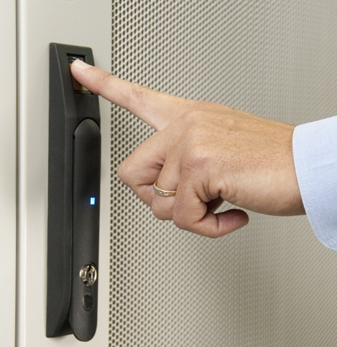
Requirement#09: Restrict physical access to card holder data
Facility entry controls
Restrict physical access to wireless access points, network and telecom equipment
Control physical access to sensitive areas and strict control over storage and access to media
Updated list of computers
Inspect devices to detect tampering
Policies & procedures documented, in use & known to all
NCPACA & PASCPA 32nd Annual Professional Convention 2018

Slide 24
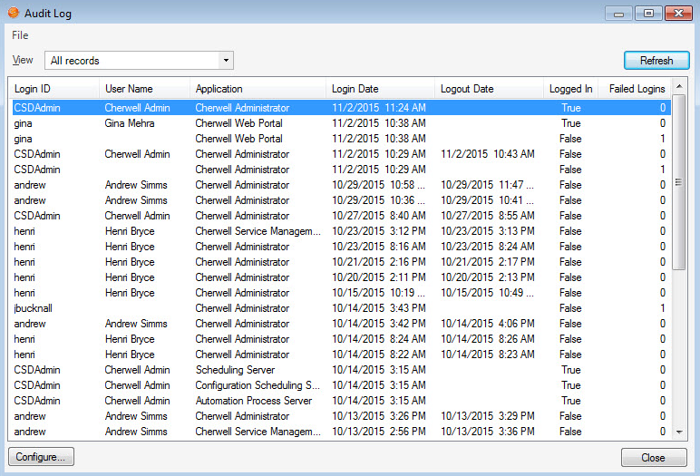
Requirement#10: Track and monitor all access to network resources and card holder data
Computer activity logs & audit trails
Invalid logical access
Changes to system – level objects
Someone reviews logs & security events
Retention of audit trails for one year, with 3 months ready for analysis
Policies & operational procedures documented, in use and known to all affected parties
NCPACA & PASCPA 32nd Annual Professional Convention 2018

Slide 25
Requirement#11:Regularly test security systems and processes
Incident response procedures
Quarterly internal and external vulnerability scans
Annual internal and external penetration tests
Presence of intrusion detection and prevention systems
Policies & operational procedures documented, in use & known to all affected parties
NCPACA & PASCPA 32nd Annual Professional Convention 2018

Slide 26
Requirement#12: Maintain a policy that addresses security for all personnel
Establish, publish, maintain and disseminate a security policy
Annual risk assessment process
Inventory of critical technologies, owners and access
Defined information security management responsibilities
Formal security awareness program
Employees to acknowledge annually security policy and procedures
Screen employees prior to hire
NCPACA & PASCPA 32nd Annual Professional Convention 2018

Slide 27
Some aspects of IT security policies
Acceptable Use Policy
Information Security Awareness & Training
BYOD Policy
Data Storage Retention & Disposal Policy
Data Classification Policy
Internet Security Policy
IT Security Roles Policy
NCPACA & PASCPA 32nd Annual Professional Convention 2018

Slide 28
Some tips on PCI-DSS compliance work
N - Never stop pestering IT with answers
C - Collaborate with stakeholders
P - PCI-DSS
A - Auditor mindset
C - Consult with peers and industry contacts
A - Attitude
NCPACA & PASCPA 32nd Annual Professional Convention 2018

Slide 29
Bonus round
What is the happiest place on earth in California?
Who founded Disneyland?
What is the latest newly opened attraction? (Hint: Two words both starts with P)
NCPACA & PASCPA 32nd Annual Professional Convention 2018

Slide 30
Thank you Here are some online resources
www.pcisecuritystandards.org
www.isaca.org
www.us-cert.gov
www.iapp.org
www.coso.org
For more info, my email is:
rvsvillanueva@yahoo.com
NCPACA & PASCPA 32nd Annual Professional Convention 2018

