Slide 1
How Much Is Your Client’s Business Worth?
September 2, 2018
John Misuraca
Avalon Advisors, Inc.
Avalon Advisors, Inc.

Slide 2
Why Do People Go Into Business?
.
Avalon Advisors, Inc.

Slide 3
Why Do People Go Into Business?
Create Current
Cash Flow
Create Future Value
Avalon Advisors, Inc.

Slide 4
Reasons For A Business Valuation
Mergers & Acquistions
Sale of Stock (Private Company)
Gifting of Stock
Buy/Sell Agreements
Fairness Opinions
Avalon Advisors, Inc.

Slide 5
Reasons For A Business Valuation
Litigation
Partner disputes
Divorce
Bankruptcy
ESOP
Business in Estate
Avalon Advisors, Inc.

Slide 6
Who Are The Business Owners?
31% over age 55
60% over age 45
In the next 5 to 10 years there will continue to be a huge transfer of business ownership
SOURCE: US Census Bureau
Avalon Advisors, Inc.

Slide 7
Steps to Valuing A Business
Gather Information
Financial Statements / Tax Returns
Balance Sheet & Income Statements
Last 3 to 5 years
Avalon Advisors, Inc.

Slide 8
Steps to Valuing A Business
Gather Information
Forecasts
Next 3 to 5 years
Why was the forecast created?
How accurate have they been on past forecasts?
Growth Company – future cash issues?
Avalon Advisors, Inc.

Slide 9
Steps to Valuing A Business
Gather Information
Intangibles
Patents / Technology
Management knowledge / experience
Location
Brand Name
Avalon Advisors, Inc.

Slide 10
Steps to Valuing A Business
Gather Information
Intangibles
Customer List
Workforce – Knowledge / Experience
Recipes
Goodwill (Personal????)
Avalon Advisors, Inc.

Slide 11
Steps to Valuing A Business
Gather Informaton
SWOT Analysis
Strengths
Weaknesses
Opportunities
Threats
Avalon Advisors, Inc.

Slide 12
Steps to Valuing A Business
Site Visit
Interview key personnel
Observations
Neat & Orderly or
Disorganized & Messy
Processes
Data recording
Avalon Advisors, Inc.

Slide 13
Steps to Valuing A Business
Compare this Business to Others of Same Size and Industry
Ratios
Growth
Avalon Advisors, Inc.

Slide 14
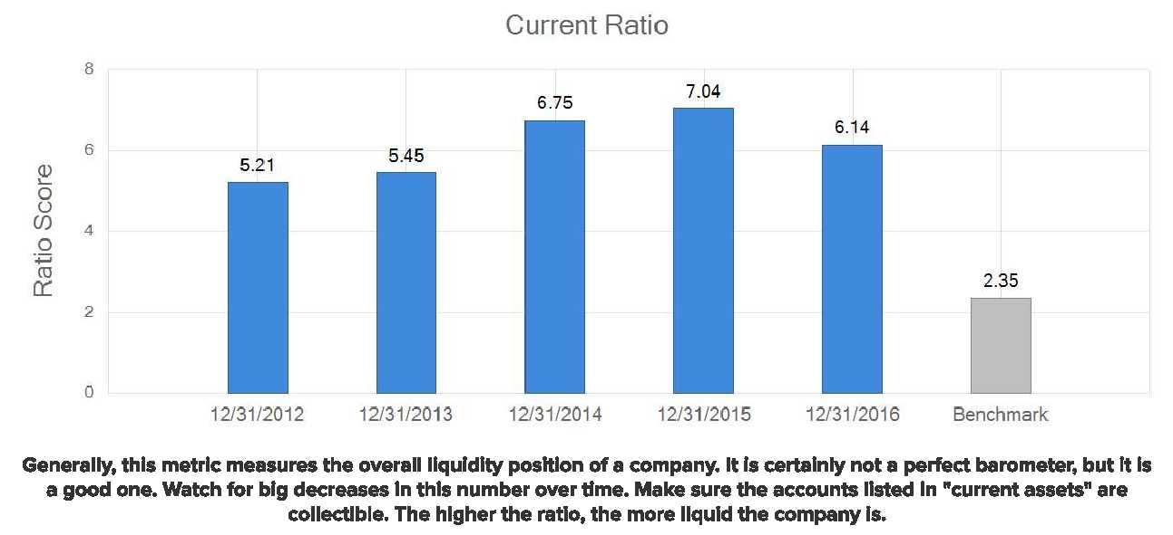
Steps to Valuing A Business
Avalon Advisors, Inc.

Slide 15
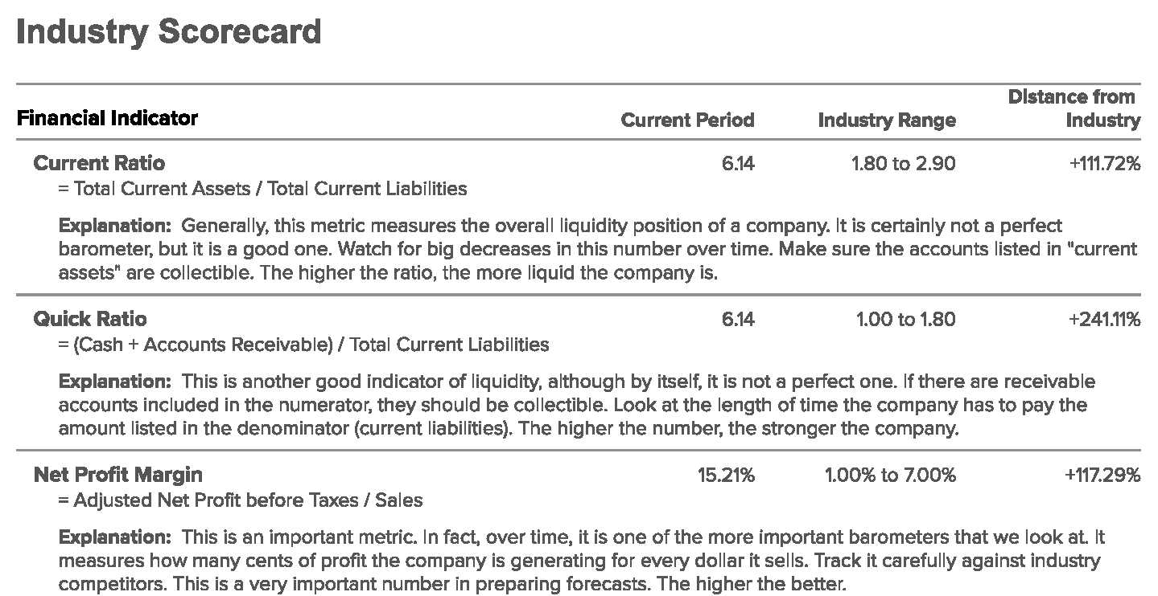
Steps to Valuing A Business
Avalon Advisors, Inc.

Slide 16
Steps to Valuing A Business
Normalize Financials
Add back non-cash expenses - depreciation / amortization
Adjust for fixed asset purchases
Avalon Advisors, Inc.

Slide 17
Steps to Valuing A Business
Normalize Financials
Owner Expenses
Salaries
Meals & Entertainment
Travel
Auto
Health Insurance
Avalon Advisors, Inc.

Slide 18
Steps to Valuing A Business
Gather Information
Ownership breakdown
Lawsuits
Business Evolution
Avalon Advisors, Inc.

Slide 19
Where Are You In The Evolution Of Your Business?
Avalon Advisors, Inc.

Slide 20
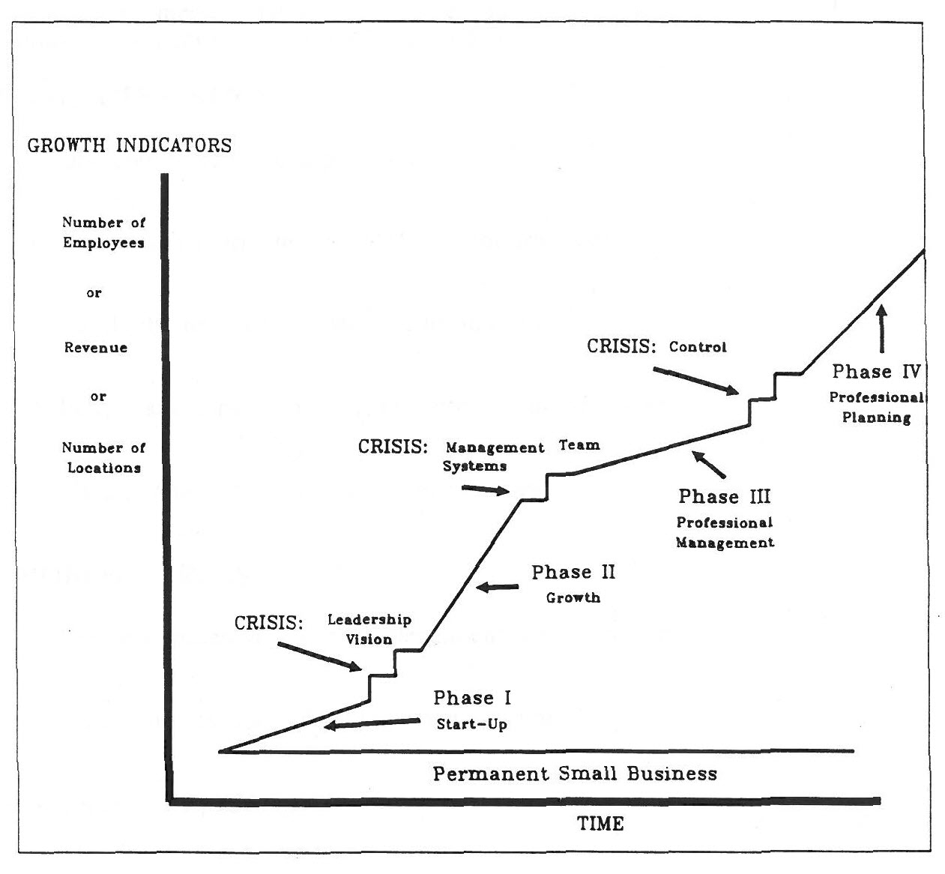
Avalon Advisors, Inc.

Slide 21
Permanent Small Business
Businesses that will always be considered a small business.
Characteristics:
Operated in effect as a proprietorship
Owner is task-oriented (vs. management oriented)
Rarely the need for formal systems and procedures
Few, if any, long-term employees other than the owner
Avalon Advisors, Inc.

Slide 22
Permanent Small Business
Characteristics (continued)
Usually retail, service, or brokerage business
Avalon Advisors, Inc.

Slide 23
Phase I – Start-Up Phase
Characteristics:
Founder(s) often still there and running the business
Founder(s) are technical or entrepreneurial; they dislike management functions
Emphasis is on creativity producing products or services and selling them
Minimal emphasis on management, systems, planning, etc.
Avalon Advisors, Inc.

Slide 24
Phase I – Start-Up Phase
Characteristics (continued)
Organization and communication informal
Long work hours – modest salaries
Management reacts mostly to customers rather than employees
Growth greater than inflation but moderate
Avalon Advisors, Inc.

Slide 25
Phase II – Growth Phase
Characteristics:
Faster growth experienced
Often multiple locations such as sales branches or warehouses
More attention given to areas other than producing and selling
Marketing
Personnel
Accounting, budgeting, and finance
Avalon Advisors, Inc.

Slide 26
Phase II – Growth Phase
Characteristics (continued)
Employee duties become more specialized and formally defined
Business becomes more impersonal
Avalon Advisors, Inc.

Slide 27
Phase III – Professional Management
Characteristics:
Organization begins to decentralize by:
Function
Product or service
Geographic location
Management by exception
Managers do more managing than technical work
Avalon Advisors, Inc.

Slide 28
Phase III – Professional Management
Characteristics (continued)
Profit centers established
Growth rate is moderate – usually slower than Phase II
Avalon Advisors, Inc.

Slide 29
Phase IV – Professional Planning Phase
Characteristics:
Business has a well-defined mission and long-range strategy
Formal business planning procedures are in place
Line and staff balance is achieved
Employees have a strong identification with the business
Operations are decentralized
Avalon Advisors, Inc.

Slide 30
Phase IV – Professional Planning Phase
Characteristics (continued)
Support functions are centralized
Managerial accountability is strongly emphasized
Growth rate is usually faster than in Phase III
Avalon Advisors, Inc.

Slide 31
Why Is Understanding the Phase Your Business Is In Important To Its Value?
It can help you to identify factors
contributing to increased and
decreased value of your business!
Avalon Advisors, Inc.

Slide 32
How Is A Business Valued?
An appraiser will analyze the
business from three approaches
using various methods:
Asset Approach
Market Approach
Income Approach
Avalon Advisors, Inc.

Slide 33
How Is A Business Valued?
Asset Approach:
Essentially the fair market value of all the company assets reduced for all it’s debts
Often the liquidation value
Some exceptions – particularly if the company has intangible assets
Avalon Advisors, Inc.

Slide 34
How Is A Business Valued?
Market Approach:
What have companies in similar industries, similar size and/or similar sales sold for recently?
Uses ratios or “multiples”
Information from various data bases
Public companies are used too – but their size makes comparison difficult
Avalon Advisors, Inc.

Slide 35
How Is A Business Valued?
Avalon Advisors, Inc.

Slide 36
How Is A Business Valued?
Income Approach:
Investors buy into companies based on their expectations of returns vs. risk
Cash flows (potential dividends) projected using historical data (usually established companies) or future forecasts (usually startup companies)
Avalon Advisors, Inc.

Slide 37
How Is A Business Valued?
Some approaches will not produce a result
Company may be specialized and finding comparable companies may be difficult
Company may have had recent losses, so an income approach using historical data may not provide a value
Avalon Advisors, Inc.

Slide 38
How Is A Business Valued?
Appraisers makes judgments on the resulting data using their knowledge and experience:
Weighting of approaches
Reconciling differences – why are the values different?
What is going on with the industry?
Avalon Advisors, Inc.

Slide 39
How Is A Business Valued?
As one would expect, the effects of crash of the national economy from 2008 to 2010 wrecked havoc with valuations and created greater difficulties and challenges for both appraisers and investors.
Avalon Advisors, Inc.

Slide 40
How Is A Business Valued?
Valuing businesses has always been an art and a science. The introduction of new data bases and models are always moving appraisals closer to a science.
However, since there is no one correct value, there will always be some subjectivity involved.
Avalon Advisors, Inc.

Slide 41
What Is Your Business Worth?
Personal Goodwill:
Often a business loses value because the owner is such an intricate part of the business that separating him/her from it will be detrimental to it’s performance, and as a result, it’s value.
Avalon Advisors, Inc.

Slide 42
What Is Your Business Worth?
Using An Income Approach:
Determine the cash flows of your business:
Starting with net income, add back non-cash expenses such as depreciation
Determine if there are overly high owner salaries and/or expenses and adjust
Avalon Advisors, Inc.

Slide 43
What Is Your Business Worth?
Determine the capitalization rate (expected rate of return an investor would expect based for your business)
Large profitable public company: 5 to 10%
Other profitable public company:
9 to 14%
Unprofitable public company: 12%+
Avalon Advisors, Inc.

Slide 44
What Is Your Business Worth?
Healthy private company: 8 to 16%
Typical private company: 14 to 24%
Start-up (VC-type investment): 35 to 60%
Really risky company: the sky’s the limit!
Avalon Advisors, Inc.

Slide 45
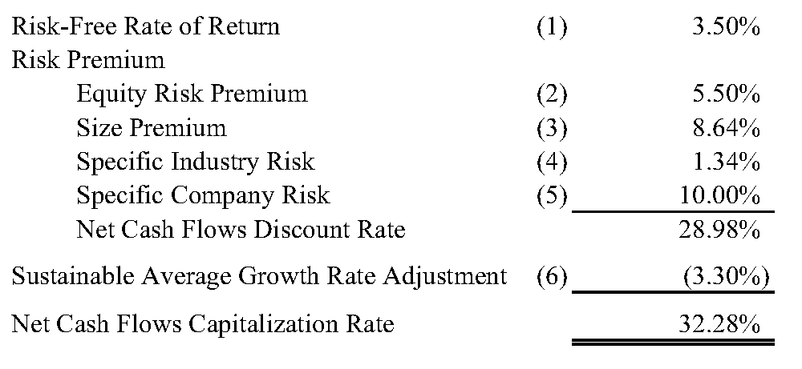
What Is Your Business Worth?
Avalon Advisors, Inc.

Slide 46
What Is Your Business Worth?
Divide the cash flows by the capitalization rate:
Annual cash flows - $100,000
Capitalization rate – 20%
$100,000 / .20 = $500,000 value
Avalon Advisors, Inc.

Slide 47
What Is Your Business Worth?
Is this a controlling (50% or more) or non-controlling interest?
Income Approach calculates a minority interest
Controlling – take value and multiply by 1.10 to 1.50% (average is 1.35%) - Premium
Avalon Advisors, Inc.

Slide 48
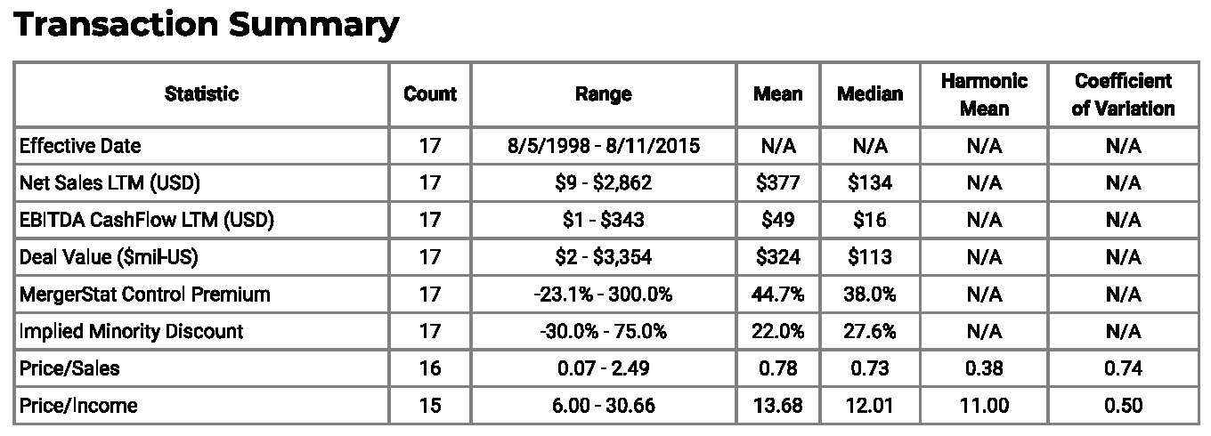
What Is Your Business Worth?
Avalon Advisors, Inc.

Slide 49
What Is Your Business Worth?
Controlling –
$500,000 x 1.35 = $675,000
Non-controlling – $500,000
Avalon Advisors, Inc.

Slide 50
What Is Your Business Worth?
Take value from #4 and multiply by Marketability/Liquidity Discount (typically 15 to 45 percent – average is 30%)
Avalon Advisors, Inc.

Slide 51
What Is Your Business Worth?
Controlling –
$675,000 x (1 - .35 = .65) = $438,750
Non-controlling –
$500,000 x (1 - .35 = .65) = $325,000
Avalon Advisors, Inc.

Slide 52
Importance of Knowing the Value of Your Business
Exit Planning should begin with a Business Valuation
If your plan assumes the business is worth $1,000,000, but it is actually only worth $500,000, it’s better to know now then when you are ready to exit
Ideally, an exit plan should be made and started at least 5 years before you plan to do so
If you need to increase the value of your business, starting early gives you time to do so
Avalon Advisors, Inc.

Slide 53
What Is Your Business Worth?
There are several Valuation Credentials in the United States:
ABV (AICPA)
CVA (NACVA)
ASA (ASA)
Avalon Advisors, Inc.

Slide 54
What Is Your Business Worth?
Disclaimer:
The examples shown in this presentation are to provide the viewers with some very general guidelines as to how a business is valued. It is not meant to be used to determine the actual value of a specific business or what a buyer would pay for it
Avalon Advisors, Inc.

Slide 55
Contact me if I can help:
John Misuraca
Avalon Advisors, Inc.
Laguna Hills, CA
Email- jmisuraca@avalonadvisorsinc.com
Web- www.avalonadvisorsinc.com
Twitter- AvalonBusVal
LinkedIn – John Misuraca, Orange County
Avalon Advisors, Inc.

