Slide 1

The Bottom Line:
How Human Capital Management (HCM)
Impacts P&L and Margins

Slide 2


Agenda
Trends in Human Capital Management (HCM)
How HCM Impacts the P&L
Solutions to Address HCM Challenges
What Better Looks Like on the Bottom Line
Benchmarking
Copyright © 2016 ADP, LLC. Proprietary and Confidential.

Slide 3
Trends in Human Capital Management (HCM)

Slide 4
A Closer Look: HCM Trends
Talent
Compensation & Benefits
Risk Management
Millennials will make up 75% of the workforce by 2025
-INC
74% of employees want better benefits and 62% would leave their employer for better benefits.
–Access Development
1 in 5 small businesses will face employment related charges and the average cost and defense for a claim is 125K.
-Hiscox & Lexis Nexis
Copyright © 2016 ADP, LLC. Proprietary and Confidential.
Notes:
You have probably heard your clients state that they started their business because they had passion and an innovative idea and that helped them attain the success they have today.
However, as their business grew, they added employees and it became more complicated to run their business. The cost of doing business increased and they no longer have just themselves to manage and now deal with the added cost and administration of having employees- which is arguably a company’s greatest asset but also their greatest risk. Each of your clients have goals for their organization that they want to achieve and the ability to minimize distractions and focus on strategic initiatives is critical for success.
With unemployment at its lowest level in decades, companies have to aggressively compete for top talent to stay competitive. According to INC, millennials will make up 75% of the workforce by 2025, that’s only a short time from now, so today’s employers must provide a radically different approach aimed to attract, retain and engage employees, or they risk losing in this war for talent. The problem is, Gallup recently found that 60% of millennials say they are open to different job opportunities and turnover is expensive- a bad hire can cost you 5x that individual’s salary. Getting it right and maximizing their potential is extremely important to hitting your goals and also protecting your profitability.
Once you’ve found the right employee, you have to work today to keep them. Employers must offer a variety of compensation and benefit programs that align with the different generations in their workforce to draw in key players and keep them engaged and loyal. However, due to lack of time and resources, less than 60% of companies today conduct regular examinations of their wages, salary and benefits. This is more important now than ever before because a recent survey conducted by Access Development found that 74% of employees stated they wanted better benefits and 62% would leave their employer for better benefits.
And last, but perhaps most important, the ability to adapt to changing regulatory trends and mitigate employer related risks can help companies control unexpected costs and maintain profitability. According to recent claims data provided by Hiscox, 1 in 5 small and mid-sized businesses will face employment related charges. The cost to litigate or settle can be expensive, in fact according to Lexis Nexis the average cost and defense for an employment claim is $125k. The blind side, or unexpected costs associated with non compliance can prevent businesses from investing in key initiatives necessary to meet goals, and can drastically impact profits.

Slide 5
A Closer Look: HCM Trends
Tools
Insights
Strategies
Copyright © 2016 ADP, LLC. Proprietary and Confidential.
Notes:
In order to effectively compete in today’s market the most successful companies need access to innovative tools, insights and strategies to maximize their most valuable asset and offer a fair and equitable compensation program while protecting the investment they’ve made in their company.
Tools that provide access to innovative tools that help your clients attract, retain and motivate the changing workforce without adding additional time to their day or headcount to their organization.
Insights from customized workforce data and analytics to help your clients make better business decisions. And not just data on their own organization, your clients need to understand what is happening with their competition, the market and regulatory landscape as a whole so they can make better proactive business decisions.
And Strategies that align with their goals to help hire and retain the right people, provide the right compensation and benefit package, and helps them navigate the ever-changing waters of regulatory compliance.

Slide 6
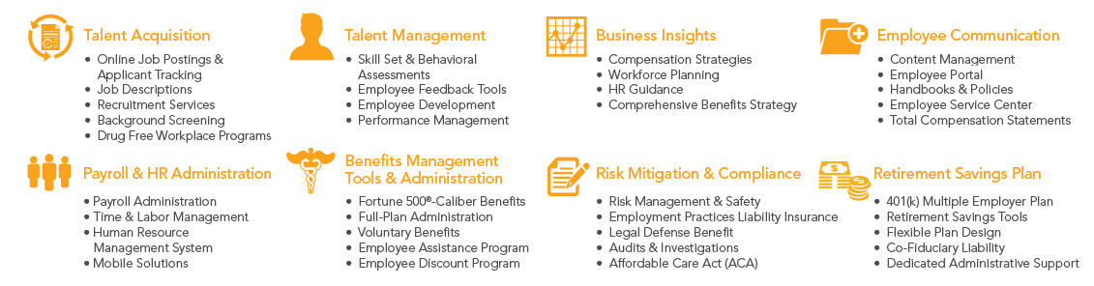
Best In Class HCM Solutions
Solutions that help drive results across the HCM pillars of:
Talent, Benefits & Compensation, and Risk
Copyright © 2016 ADP, LLC. Proprietary and Confidential.
Notes:
So before diving into the P&L impact, lets get a broad overview of the HCM tool and technology solutions that can help drive HCM results around Talent, Compensation & Benefits, and Risk Management.

Slide 7
How HCM Impacts the P&L

Slide 8


A Closer Look: Talent
Recruitment
Associate Development
Performance Management
Demographic & Culture
Productivity & Engagement
Leadership & Succession Planning
Copyright © 2016 ADP, LLC. Proprietary and Confidential.
Notes:
The business environment is rapidly evolving. With ever-changing challenges and opportunities. But there's one constant that doesn't change: the importance people play in the ongoing success of an organization. What does it take to keep your people motivated and performing at their peak? It starts with a company’s reputation, culture, benefits, and career growth opportunities and the ability to adapt to whatever comes next makes all the difference.
Talent management within an organization is broad and complex and many companies say the talent gap in the workforce today is the most significant obstacle they face in meeting business objectives. The unemployment rate is at its lowest level in nearly a decade. Historically, employers have leveraged traditional methods of attracting new employees but the changing demographics of today’s employees demand that employers adapt to the new realities of the workforce.

Slide 9
A Closer Look: Talent
75% higher revenue growth¹
77% better strategy implementation²
85% stronger financial performance overall³
1 Source: PWC, 2014
2 Source: PWC, 2014
3 Source: PWC, 2014
Copyright © 2016 ADP, LLC. Proprietary and Confidential.
Notes:
PWC has stated that: Executives who boldly transform their company’s talent operations to be as innovative as their business strategy see dramatic, measurable improvements in their company’s performance and ability to accelerate growth. By viewing their people as assets on their balance sheet, and by aligning business goals with the talent strategy needed to achieve them, companies can see 75% higher revenue growth, 77% better strategy implementation and 85% stronger financial performance overall (PwC, Project Management Institute, Talent Management - State of the Market, Nov. 2014). They also attract and retain employees not just as bright new hires but as future leaders.
Source: http://www.pwc.com/us/en/hr-management/talent-innovation.html

Slide 10
The Impact of Talent on the P&L
REVENUE
COGs
−
$ GROSS MARGIN
=
OPERATING
EXPENSE
−
$ OPERATING INCOME
=
NON-OPERATING
EXPENSE
−
$ NET INCOME
=
Copyright © 2016 ADP, LLC. Proprietary and Confidential.
Notes:
Click each arrow to review how the P&L is impacted.

Slide 11
The Impact of Talent on the P&L
REVENUE
COGs
An organization can increase revenue by recruiting top talent to sell their product or service. Less turnover and more tenured and knowledgeable employees lead to greater client satisfaction and repeat business.
−
$ GROSS MARGIN
=
OPERATING
EXPENSE
−
$ OPERATING INCOME
=
NON-OPERATING
EXPENSE
−
$ NET INCOME
=
Copyright © 2016 ADP, LLC. Proprietary and Confidential.
Notes:
Click each arrow to review how the P&L is impacted.

Slide 12
The Impact of Talent on the P&L
REVENUE
COGs
When organizations have happy, engaged employees for their direct labor force, they can increase productivity and quality, thereby reducing cost of goods sold.
−
$ GROSS MARGIN
=
OPERATING
EXPENSE
−
$ OPERATING INCOME
=
NON-OPERATING
EXPENSE
−
$ NET INCOME
=
Copyright © 2016 ADP, LLC. Proprietary and Confidential.
Notes:
Click each arrow to review how the P&L is impacted.

Slide 13
The Impact of Talent on the P&L
REVENUE
COGs
Operating Expenses cover the costs associated with recruiting, onboarding and training. Companies can reduce Operating Expenses when they use the most cost-effective methods of recruiting, and when they get those hiring decisions right the first time.
−
$ GROSS MARGIN
=
OPERATING
EXPENSE
−
$ OPERATING INCOME
=
NON-OPERATING
EXPENSE
−
$ NET INCOME
=
Copyright © 2016 ADP, LLC. Proprietary and Confidential.
Notes:
Click each arrow to review how the P&L is impacted.

Slide 14
The Impact of Talent on the P&L
REVENUE
COGs
Non-Operating Expenses are those unpredictable costs such as lawsuits, fines, etc. Making a bad hire can increase the risk of experiencing these unexpected non-operating costs.
−
$ GROSS MARGIN
=
OPERATING
EXPENSE
−
$ OPERATING INCOME
=
NON-OPERATING
EXPENSE
−
$ NET INCOME
=
Copyright © 2016 ADP, LLC. Proprietary and Confidential.
Notes:
Click each arrow to review how the P&L is impacted.

Slide 15


A Closer Look:
Compensation & Benefits
Compensation Management
Employer of Choice Benefits
Benefits Strategy
Benefits Administration
Retirement Plans
Copyright © 2016 ADP, LLC. Proprietary and Confidential.
Notes:
We just reviewed how talent impacts the P&L. But in order to attract, engage and motivate the entire workforce, employers must offer a variety of compensation and benefit programs that align with the different generations in their workforce and that helps meet their overall business goals.

Slide 16
A Closer Look:
Compensation & Benefits
2.5 times more engaged¹
Less than 60% have reviewed programs²
32.7% lower operating income³
1 Source: AON Hewitt.
2 Source: AON Hewitt.
3 Source: AON Hewitt 2015.
Copyright © 2016 ADP, LLC. Proprietary and Confidential.
Notes:
This is important because as we discussed on our HCM trend overview employees who view their total rewards program (pay, benefits, PTO) as competitive are 2.5 times more engaged than other employees. And, due to lack of time and resources, less than 60% of companies today conduct regular examinations of their wages, salary and benefits.
This is important because Companies with low engagement scores can earn an operating income 32.7% lower than companies with more engaged Ees (AON Hewitt 2015)
An effective compensation and benefit strategy will draw in team players and keep them engaged and loyal.

Slide 17
The Impact of Compensation
& Benefits on the P&L
REVENUE
COGs
−
$ GROSS MARGIN
=
OPERATING
EXPENSE
−
$ OPERATING INCOME
=
NON-OPERATING
EXPENSE
−
$ NET INCOME
=
Copyright © 2016 ADP, LLC. Proprietary and Confidential.
Notes:
Click each arrow to review how the P&L is impacted.

Slide 18
The Impact of Compensation
& Benefits on the P&L
REVENUE
COGs
A strong compensation and benefit strategy that will attract top talent has the ability to greatly impact Revenue. An effective compensation and benefit strategy will draw in team players and keep them engaged and loyal. These key employees will provide more innovation and better sales and customer service to drive the company toward its goals.
−
$ GROSS MARGIN
=
OPERATING
EXPENSE
−
$ OPERATING INCOME
=
NON-OPERATING
EXPENSE
−
$ NET INCOME
=
Copyright © 2016 ADP, LLC. Proprietary and Confidential.
Notes:
Click each arrow to review how the P&L is impacted.

Slide 19
The Impact of Compensation
& Benefits on the P&L
REVENUE
COGs
Company sponsored benefits for the direct labor force have a huge impact on COGS. While a worthy investment that can show a large ROI, a strong strategy around what types of benefits to offer in order to align with the expectations of the workforce is key.
−
$ GROSS MARGIN
=
OPERATING
EXPENSE
−
$ OPERATING INCOME
=
NON-OPERATING
EXPENSE
−
$ NET INCOME
=
Copyright © 2016 ADP, LLC. Proprietary and Confidential.
Notes:
Click each arrow to review how the P&L is impacted.

Slide 20
The Impact of Compensation
& Benefits on the P&L
REVENUE
COGs
Technology to manage compensation and benefits as well as benchmarking salaries and benefit plans can be costly and is sometimes cost-prohibitive to many companies. Companies with a strong compensation and benefits strategy can expect lower turnover, reducing the need for recruiting, onboarding and training which helps control Operating Expenses.
−
$ GROSS MARGIN
=
OPERATING
EXPENSE
−
$ OPERATING INCOME
=
NON-OPERATING
EXPENSE
−
$ NET INCOME
=
Copyright © 2016 ADP, LLC. Proprietary and Confidential.
Notes:
Click each arrow to review how the P&L is impacted.

Slide 21
The Impact of Compensation
& Benefits on the P&L
REVENUE
COGs
A focus on compensation management, specifically as it relates to non-discriminatory pay and practices can help you avoid expensive litigation and fines. The best way to control Non-Operating Expense through benefits administration is to put in place safeguards and tools to ensure compliance with the regulations impacting benefits administration including HIPAA, ACA, COBRA, Section 125, and more.
−
$ GROSS MARGIN
=
OPERATING
EXPENSE
−
$ OPERATING INCOME
=
NON-OPERATING
EXPENSE
−
$ NET INCOME
=
Copyright © 2016 ADP, LLC. Proprietary and Confidential.
Notes:
Click each arrow to review how the P&L is impacted.

Slide 22


A Closer Look: Risk
Employment Laws
Workplace Safety
Affordable Care Act (ACA)
Copyright © 2016 ADP, LLC. Proprietary and Confidential.
Notes:
Risk is everywhere and regulations are ever changing - as we have seen with changing times and administrations. What’s more, there are likely risks that your clients are not aware of.
OSHA, FLSA and ACA are just a few of the major changes that took place this past year and compliance costs continue to rise.

Slide 23
A Closer Look: Risk
Violations nearly 80% of time¹
2-6x return to bottom line²
Approximately 40% did not meet ACA deadline³
1 Source: DOL: 2015.
2 Source: National Safety Council.
3 Source: ADP Study; Four ACA Compliance Challenges Still Impacting Employers.
Copyright © 2016 ADP, LLC. Proprietary and Confidential.
Notes:
The DOL reports that an investigation leads to a violation nearly 80% of the time 1
Yet, according to the National Safety Council, every single dollar spent on prevention can return between $2-6 to the bottom line of an organization. 2
And on the ACA front, an ADP Study found that about 40% of employers handling ACA internally did not meet the original deadline for distributing Form 1095-C to their employees.3

Slide 24
The Impact of Risk on the P&L
REVENUE
COGs
−
$ GROSS MARGIN
=
OPERATING
EXPENSE
−
$ OPERATING INCOME
=
NON-OPERATING
EXPENSE
−
$ NET INCOME
=
Copyright © 2016 ADP, LLC. Proprietary and Confidential.
Notes:
Click each arrow to review how the P&L is impacted.

Slide 25
The Impact of Risk on the P&L
REVENUE
COGs
Leveraging an experienced partner for risk management, such as ACA compliance and Workplace safety, provides more time for strategic planning and focus which can impact Revenues.
−
$ GROSS MARGIN
=
OPERATING
EXPENSE
−
$ OPERATING INCOME
=
NON-OPERATING
EXPENSE
−
$ NET INCOME
=
Copyright © 2016 ADP, LLC. Proprietary and Confidential.
Notes:
Click each arrow to review how the P&L is impacted.

Slide 26
The Impact of Risk on the P&L
REVENUE
COGs
Employment litigation and claims of non-compliance can negatively impact employee engagement and therefore productivity, driving up Cost of Goods Sold. Workplace injuries can significantly impact COGS when employees miss work due to injuries. Injuries resulting in Workers’ Compensation claims by the direct labor force cause the employer’s Workers’ Comp rates to increase which is a direct hit COGS.
−
$ GROSS MARGIN
=
OPERATING
EXPENSE
−
$ OPERATING INCOME
=
NON-OPERATING
EXPENSE
−
$ NET INCOME
=
Copyright © 2016 ADP, LLC. Proprietary and Confidential.
Notes:
Click each arrow to review how the P&L is impacted.

Slide 27
The Impact of Risk on the P&L
REVENUE
COGs
Managing compliance with employment laws and workplace safety requires resources and expertise. Employing this kind of expertise can be costly to Operating Expense, which is why world class organizations leverage strategic partnerships and outsourcing to help them meet their compliance obligations while controlling costs.
−
$ GROSS MARGIN
=
OPERATING
EXPENSE
−
$ OPERATING INCOME
=
NON-OPERATING
EXPENSE
−
$ NET INCOME
=
Copyright © 2016 ADP, LLC. Proprietary and Confidential.
Notes:
Click each arrow to review how the P&L is impacted.

Slide 28
The Impact of Risk on the P&L
REVENUE
COGs
The cost of OSHA fines, and any litigation resulting from workplace injury or illness, hits Non-Operating Expense. Employers can help control Non-Operating Expenses by maintaining compliance with OSHA and driving a culture of safety within the organization.
−
$ GROSS MARGIN
=
OPERATING
EXPENSE
−
$ OPERATING INCOME
=
NON-OPERATING
EXPENSE
−
$ NET INCOME
=
Copyright © 2016 ADP, LLC. Proprietary and Confidential.
Notes:
Click each arrow to review how the P&L is impacted.

Slide 29
Solutions to Address HCM Challenges

Slide 30
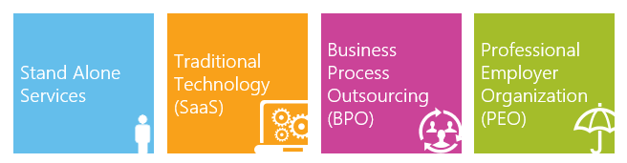
HCM Service Type Continuum
Technology Only
HR BPO Solutions
*Additional Fees May Apply
Copyright © 2016 ADP, LLC. Proprietary and Confidential.
Notes:
Businesses leverage one of 4 distinct options to handle their human capital yet there are thousands of vendors, service providers, consultants they could work with. The mistake many businesses make is thinking technology alone is what they need. Without Assessing the entire organizational challenges, current systems, processes and resources in place, they risk wasting time and money.
In addition to missing out on critical HR expertise.
HR Business Process Outsourcing (HRBPO) solution types generally provide this expanded HR expertise.

Slide 31
A Closer Look: Best Practice
HR BPO Solutions Continuum
PEO/
Co-Employer
Extend In-House
HR Capabilities
Fortune 500©-Caliber Benefits
Full Service 401(k)
Benefits Administration and Support
HR Expertise with Dedicated HR Support
Legal Defense Benefit and EPLI Policy
Talent Management
and Acquisition
Employee Development
Proactive HR with Business Insights
Employee Portal with Mobile Solutions
Dedicated Risk and Safety Support
Workers’ Compensation Coverage
ACA Compliance
Time and Attendance
Hands On HR
Guidance and Tools
HR Expertise with Dedicated HR Support
Talent Management and Acquisition
Job Posting Interface and Applicant Tracking
Employee Development
Proactive HR with Business Insights
Employee Portal
with Mobile Solutions
ACA Compliance
Risk and Safety Guidance
Risk Mitigation and Compliance
Employee Discount Program
Work/Life Services
Time and Attendance
Recruitment Services
Employee Development
Proactive HR Guidance
Handbooks and Policies
Employee Portal with Mobile Solutions
Payroll and HR Administration
Employee Discount Program
Risk Management and Safety
HR Expertise with Dedicated HR support
Copyright © 2016 ADP, LLC. Proprietary and Confidential.
Notes:
There is a spectrum of HCM solutions that can help drive your clients’ results depending on their current HR needs.
Some Best Practice HRBPO Offering Types Include:
Hands On HR Guidance and Tools – This combines HR technology and one-on-one guidance for your client without them having to hire an in-house HR professional. This model helps guide your clients through everyday HR, compliance, and payroll and tax challenges.
Extended In-House HR Capabilities - This model connects technology and extends your clients in-house HR team’s capabilities. Service choices vary between basic or comprehensive administrative support for payroll, human resources, and/or benefit administration.
HR Co-Pilot or PEO / Co-Employer – The most comprehensive solution of the spectrum is the Professional Employer Organization or PEO model. This model allows your clients to gain the hands-on support of experienced professionals and technology that’s built to manage every aspect of human resources. Through a co-employment relationship, clients access Fortune 500-caliber benefits, HR, payroll, compliance, risk management, safety, recruiting, and more to help them make sure their Human Resources bases are covered – without adding headcount.

Slide 32
What Better Looks Like on the
Bottom Line

Slide 33


Margin Impact with a Best Practice
HR BPO Solution
REVENUE
COGs
−
$ GROSS MARGIN
=
OPERATING
EXPENSE
−
$ OPERATING INCOME
=
NON-OPERATING
EXPENSE
−
$ NET INCOME
=
Copyright © 2016 ADP, LLC. Proprietary and Confidential.
Notes:
As a CPA, you and your firm succeed when your client is able to grow revenues and maintain a healthy net income. The right HR BPO solutions can proactively impact your clients’ margins in a number of ways. Human Capital Management solutions can help drive revenues, reduce operating expenses, and help protect them from unexpected non-operating expenses.

Slide 34
Margin Impact with a Best Practice
HR BPO Solution
REVENUE
New Sales
HR BPO solutions can help increase revenue per employee by helping clients hire the best talent, improve employee engagement, and increase employee retention.
Repeat Business
Clients that can attract and retain top talent may be better positioned to service clients. With training and development programs organizations can improve the customer service skills of their team to promote customer loyalty.
COGs
−
$ GROSS MARGIN
=
OPERATING
EXPENSE
−
$ OPERATING INCOME
=
NON-OPERATING
EXPENSE
−
$ NET INCOME
=
Copyright © 2016 ADP, LLC. Proprietary and Confidential.
Notes:
Click each arrow to review how the P&L is impacted.

Slide 35
Margin Impact with a Best Practice
HR BPO Solution
REVENUE
Wages
A best practice HR BPO solution can provide industry benchmarks and compensation analysis to help ensure clients are paying the right wage for the right job.
Benefits
Look for a variety of benefits programs and tools to help your clients expand their employee offering, while controlling costs.
Workers’ Compensation
Risk Management and Safety support will help make the workplace safer and control Workers’ Compensation costs.
Employer Taxes
Look for an HR BPO provider with SUI expertise and proactive HR support to help your clients contain their only controllable tax rate.
COGs
−
$ GROSS MARGIN
=
OPERATING
EXPENSE
−
$ OPERATING INCOME
=
NON-OPERATING
EXPENSE
−
$ NET INCOME
=
Copyright © 2016 ADP, LLC. Proprietary and Confidential.
Notes:
Click each arrow to review how the P&L is impacted.

Slide 36
Margin Impact with a Best Practice
HR BPO Solution
REVENUE
Indirect Labor and Burden
HR BPO providers can help alleviate the administrative burdens of human capital management.
Vendors
A full-service HR outsourcing solution can help your clients consolidate your vendor relationships into a streamlined and strategic partnership.
Technology
Trade expensive maintenance and upgrade costs for a dynamic cloud-based Human Capital Management system that comes with the support your clients need.
Materials
Your clients can go paperless with electronic pay statements, online employee and manager self-service, and mobile access.
COGs
−
$ GROSS MARGIN
=
OPERATING
EXPENSE
−
$ OPERATING INCOME
=
NON-OPERATING
EXPENSE
−
$ NET INCOME
=
Copyright © 2016 ADP, LLC. Proprietary and Confidential.
Notes:
Click each arrow to review how the P&L is impacted.

Slide 37
Margin Impact with a Best Practice
HR BPO Solution
REVENUE
Taxes
Depending on the size, industry, and location of your client, a best practice HR BPO provider may be able to help reduce tax liabilities by helping them take advantage of tax credits available to employers.
Penalties
Leveraging an HR BPO’s expertise and proactive approach will help your clients accurately manage their payroll and HR processes to avoid costly and unexpected penalties.
Litigation
A best practice HR BPO will help implement the tools, processes and best practices your clients need to avoid costly litigation and settlements related to discrimination, wrongful termination, negligent hiring, and more.
COGs
−
$ GROSS MARGIN
=
OPERATING
EXPENSE
−
$ OPERATING INCOME
=
NON-OPERATING
EXPENSE
−
$ NET INCOME
=
Copyright © 2016 ADP, LLC. Proprietary and Confidential.
Notes:
Click each arrow to review how the P&L is impacted.

Slide 38
HCM Benchmarking
86%
of companies do not have any analytic capabilities in HR*
Identify strengths and weakness through data analytics
Most companies have no way to measure how they stack up in areas such as talent, compensation & benefits and risk.
HCM Benchmarking provides data and analytics on how a business compares with their peers in the same industry and geographic area. The data will help them determine how they stack up in the areas of talent, compensation & benefits, and risk. These insights will highlight areas of strength as well as gaps which could be significantly impacting the bottom line.
Copyright © 2016 ADP, LLC. Proprietary and Confidential.

Slide 39
53
HCM Benchmarking
3 Easy Steps to Improve HCM Effectiveness*
1.
Assess
Take a look at the things you can control. Poll employees to see if their opinions sync up with the employer’s perspective.
Compare
Benchmarking compares the operation of a business with similar businesses and establishes a performance level to shoot for. It starts with identifying measurable business processes that exist in other businesses.
  Do you know how you stack up against other employers in your industry or area?
  Is the salary you’re offering competitive enough to entice new employees to join and current workers to stay?
  Are your benefits in line with those offered by other employers?
  Could you provide perks such as flexible hours, virtual work options, paid volunteer hours, or employee discount programs?
Plan
So you’ve assessed the business and performed benchmarking. Now it’s time to analyze the data.
Use the information you’ve gathered to find the gaps. Where are results low when they should be high? Where possible, bring numbers in line with companies that are having greater success with hiring and retention. See what benefits are valued most, how compensation compares, and which voluntary benefits are trending.
2.
3.
Copyright © 2016 ADP, LLC. Proprietary and Confidential.
Notes:
These are key points from the “Bottom Line Magazine – Find your Sweet Spot” article
Questions you can ask in the “assess stage”
• What’s the average age and tenure of our workforce?
• What is our turnover rate?
• What’s our average pay increase schedule and how often do we evaluate performance?
• What benefits do we offer?
• Do employees have a career path and opportunities for advancement?
• Do we communicate regularly with our workers?

Slide 40
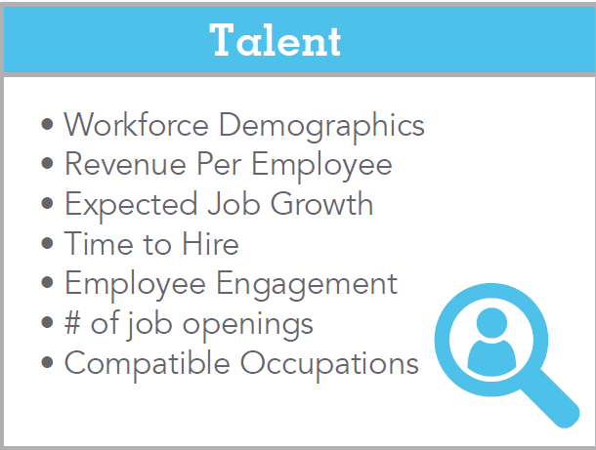
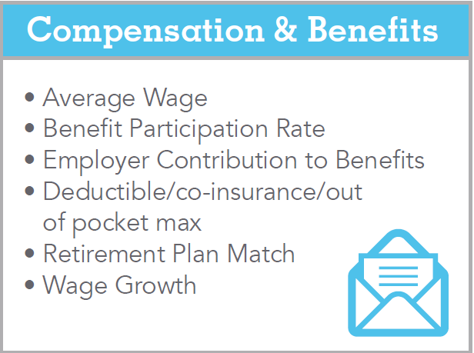
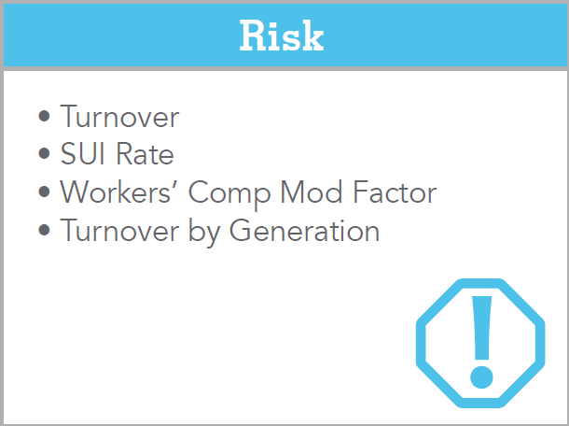
Knowing beats guessing.
But knowing is only half the battle. How do you interpret the analytics? How do you take meaningful action with it? How can the information
propel your business forward?
ADP® knows.
We’ll help you uncover insights from the start – even before you become a client – so you can see how you stack up against your peers. After an initial consultation with ADP you’ll know how your company compares to others in your industry and location in a wide variety of areas:
Top Opportunities for HCM Benchmarking
53% of employer say retaining talent is a top priority
Are your clients struggling with attracting top talent, or the rising labor and benefits costs? By benchmarking these top areas, your clients can gain insights and opportunities to increase their competitive advantage.
Copyright © 2016 ADP, LLC. Proprietary and Confidential.
Notes:
*According to Xerox HR Services (now Conduent), 53% of employers say retaining talent is a top priority.

Slide 41
The Value of HCM Benchmarking
How Benchmarking Can Enhance your
Client Relationships
Provide data analytics and insight that will identify strengths and gaps related to Talent, Compensation/Benefits and Risk that will impact their bottom line.
Elevate yourself as a strategic advisor by providing recommendations that will help your client navigate a competitive landscape.
Attract & retain new clients by offering a more strategic approach that will lead them to greater success.
Copyright © 2016 ADP, LLC. Proprietary and Confidential.

Slide 42

Which of Your Clients Would Benefit?
Real Estate &
Property Management
Technology
Companies
Engineering & Architecture Firms
Medical/Dental Offices
Plumbing &
HVAC Contractors
Electrical
Contractors
Insurance Agents
& Brokers
Wholesale Companies
Legal
Offices
Management Consulting Services
Business
Services
Accounting Practices
Manufacturing
Copyright © 2016 ADP, LLC. Proprietary and Confidential.
Notes:
There are many industries that tend be perfect fits for HR outsourcing, for a variety of reasons. These industries tend to be a few of the best fits.
Real Estate & Property Management
Technology companies
Engineering and architecture firms
Medical/dental offices
Plumbing & HVAC contractors
Electrical contractors
Insurance agents and brokers
Wholesale companies
Legal offices
Management consulting services
Business Services
Accounting practices
Manufacturing

Slide 43

Business Triggers and Signals
Business Growth
Downsizing / Reorganization
Spinoffs / Mergers / Acquisitions
Changes in Key Staff
Employment Litigation
Multi-Location / Business Expansion
Fiscal Year Budgeting
Competitive Slippage
Business Conflict
Economic Market Shifts
Medical or Workers’ Compensation Renewal
Copyright © 2016 ADP, LLC. Proprietary and Confidential.
Notes:
There are several business triggers that signal the need for HR outsourcing consideration.
Growth, downsizing, spinoffs, acquisitions, changes in key staff, employment litigation, multi-location, etc.

Slide 44
Thank you.
To learn why accountants recommend ADP® for HR BPO solutions,
call 800-447-3237 or visit adp.com/PEOforAccountants.
Hands On HR Guidance and Tools
ADP Resource®: Modern HR software + dedicated professionals who provide hands-on guidance to help manage Payroll, Talent, Compensation, and Risk with confidence.
Extended In-House HR Capabilities
ADP Workforce Now® Comprehensive Services: Comprehensive HR software + dedicated professionals to complement an in-house HR team who provide the level of support needed to help with Payroll, Talent, Compensation & Benefits Administration, and Risk.
PEO / Co-Employment
ADP TotalSource®: All-in HR with software + dedicated professionals + a co-employment partnership to help manage a company’s Talent, Compensation & Benefits, and Risk for maximum impact.
Copyright © 2016 ADP, LLC. Proprietary and Confidential.
Notes:
ADP, is one of the world’s largest providers of business outsourcing and human capital management solutions and serves more than 625,000 businesses of all types and sizes in over 100 countries.
We welcome you to contact us today at 800-447-3237 or www.adp.com/PEOforAccountants to discuss how ADP’s HRBPO flexible HRBPO options can help you and your clients maximize the impact of HR investments.

Slide 45
CPE Logistics
Before leaving today’s program be sure that you have noted your attendance on the Sign-In Sheet
CPE Certificates can be found on the “My CPE” page within the ADP® CPE Link Center at: cpelink.com/adp
CPE Certificates are typically posted within 3-5 business days
Copyright © 2016 ADP, LLC. Proprietary and Confidential.

