Slide 1
Financial Markets review and outlook
GE-110757 (REV 6/18) (Exp. 6/20)

Slide 2
AXA Equitable Funds Management Group, LLC
Est1999
70
approx.
professionals
17 years avg. exp.
75 designations
and degrees
to manage investment portfolios and underlying separate accounts
40+
$109.4B
subadvised partners
assets under management
Information as of 6/30/18. Partnership and AUM statistics refer to FMG LLC’s EQAT and VIP Trust portfolios (aka proprietary portfolios) available within AXA Equitable variable products as well as offshore and mutual funds, AXA Equitable Funds Management Group, LLC is a wholly owned subsidiary of AXA Equitable Life Insurance Company.
Notes:
Read Slide

Slide 3








Industry Rankings
Based on assets under management, AXA Equitable ranks within the top 15% of all U.S. fund firms
Many of the subadvisers used in our portfolios appear within the top 10% of firms
*Source: Investment Company Institute, www.ici.org as of 5/31/2018, based on AuM of 314 mutual fund companies that report statistical information to the Institute. Assets of these companies represent 98 percent of investor assets.
Notes:
Read Slide

Slide 4
Diversification and the Average Investor
Source: J.P. Morgan Asset Management; (Top) Barclays, Bloomberg, FactSet, Standard & Poor’s; (Bottom) Dalbar Inc.
Indexes used are as follows: REITS: NAREIT Equity REIT Index, EAFE: MSCI EAFE, Oil: WTI Index, Bonds: Bloomberg Barclays U.S. Aggregate Index, Homes: median sale price of existing single-family homes, Gold: USD/troy oz., Inflation: CPI. 60/40: A balanced portfolio with 60% invested in S&P 500 Index and 40% invested in high quality U.S. fixed income, represented by the Bloomberg Barclays U.S. Aggregate Index. The portfolio is rebalanced annually. Average asset allocation investor return is based on an analysis by Dalbar Inc., which utilizes the net of aggregate mutual fund sales, redemptions and exchanges each month as a measure of investor behavior. Returns are annualized (and total return where applicable) and represent the 20-year period ending 12/31/17 to match Dalbar’s most recent analysis.
Guide to the Markets – U.S. Data are as of June 30, 2018.
Notes:
The top chart shows the powerful effects of portfolio diversification. It illustrates the difference in movements between the S&P 500, a 60/40 portfolio and a 40/60 portfolio indicating when each respective portfolio would have recovered its original value at the peak of the market in 2007 from the market bottom in 2009. It shows that the S&P 500 fell far more than either of the two diversified portfolio and also took two or more years longer to recover its value. The bottom chart shows 20-year annualized returns by asset class, as well as how an "average investor" would have fared. The average investor asset allocation return is based on an analysis by Dalbar, which utilizes the net of aggregate mutual fund sales, redemptions and exchanges each month as a measure of investor behavior.

Slide 5
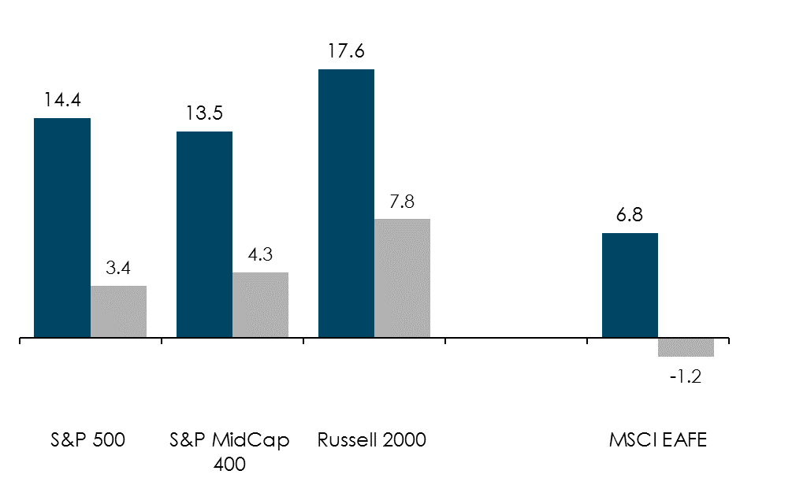
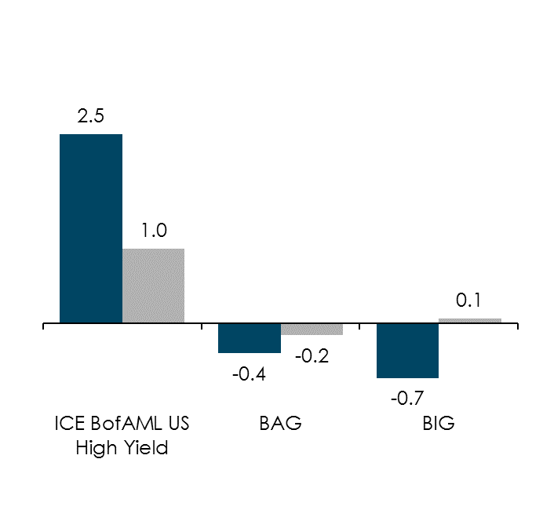
Broad Market Asset Class Returns
1-Yr and 3mo Returns (%) as of 6/30/18
Equities
Equities improved from the first quarter with small cap exhibiting the strongest performance
Fixed Income
Bonds performance improved from the previous quarter though still muted
Past performance is no guarantee of future results. Individuals cannot invest directly in an index. Please see the important information pages for index definitions and risks.
Notes:
This page shows returns of various equity and fixed income indices for 1 year period ended 3/31/18 in green and for the 3 month period ended 3/31/18 in gray.

Slide 6
Returns and Valuation by Style
Returns as of 6/30/18
Source: FactSet, Russell Investment Group, Standard & Poor’s, J.P. Morgan Asset Management.
All calculations are cumulative total return, including dividends reinvested for the stated period. Since Market Peak represents period 10/9/07 –6/30/18, illustrating market returns since the S&P 500 Index high on 10/9/07. Since Market Low represents period 3/9/09 – 6/30/18, illustrating market returns since the S&P 500 Index low on 3/9/09. Returns are cumulative returns, not annualized. For all time periods, total return is based on Russell style indices with the exception of the large blend category, which is based on the S&P 500 Index. Past performance is not indicative of future returns. The price to earnings is a bottom-up calculation based on the most recent index price, divided by consensus estimates for earnings in the next 12 months (NTM), and is provided by FactSet Market Aggregates.
Guide to the Markets – U.S. Data are as of June 30, 2018..
Notes:
This page shows returns and valuations by investment style for the U.S. equity market, and leverages the "style box" framework pioneered by Morningstar. Return periods include the most recent quarter, year-to-date returns, returns since the 2007 peak and returns since the 2009 low. To the right, valuations depict which areas of the U.S. equity markets are trading at a deeper discount or premium, relative to their own 15-year average.

Slide 7

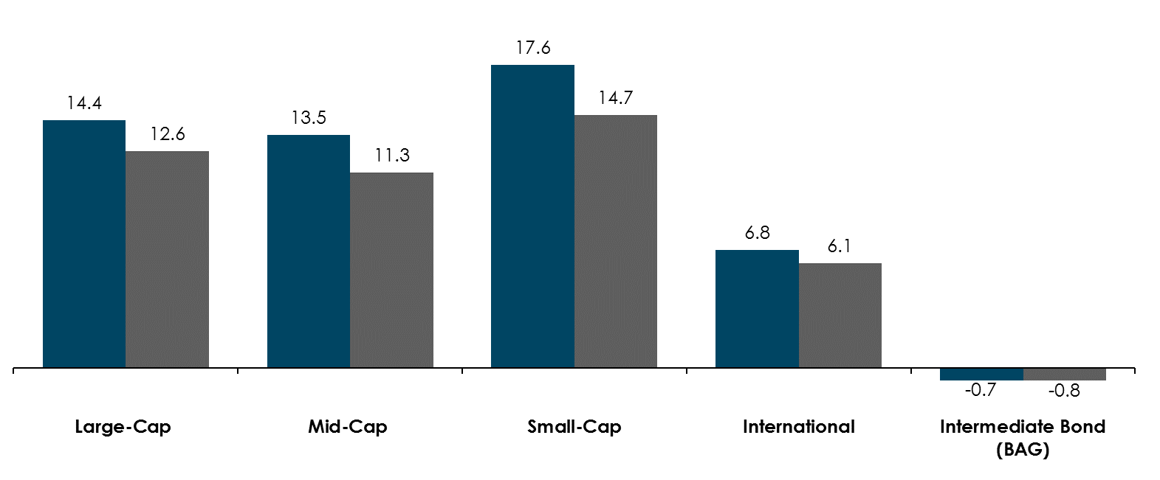
Active vs. Passive Performance
1-Year Returns (%) as of 6/30/18
Past performance is no guarantee of future results. Data as of 6/30/18. The market index for Large Blend is the S&P 500 Index; Mid Cap is the S&P Mid Cap 400 Index, Small Cap is the Russell 2000 Index, International is the MSCI EAFE; Intermediate-Term Bond is the Bloomberg Barclays Capital US Government Intermediate Bond Index; Active managers are represented by the median performance of the various Morningstar categories shown. It is not possible to invest directly in an index. Refer to the important information slides for benchmark definitions and for specific risk disclosures.
Notes:
For the one year ended 3/31/2018 passively managed funds generally outperformed actively managed funds except in the international and intermediate government bond asset classes. For this we look at various indices (passive management) compared to the Morningstar category average (active management).

Slide 8
Market Volatility
Sources: CBOE, FactSet, J.P. Morgan Asset Management.
Stock market returns are based on calendar year peak to trough declines experienced during VIX spike, except for J.P. Morgan acquires Bear Stearns, which is based on the calendar year peak to the acquisition date. Average is based on the period shown from 12/31/2006-3/31/2018.
Guide to the Markets – U.S. Data are as of March 31, 2018..
Notes:
This slide looks at the VIX, a measure of S&P 500 volatility, along with market returns for times when volatility spiked.

Slide 9
Annual returns and intra-year declines
Source: FactSet, Standard & Poor’s, J.P. Morgan Asset Management.
Returns are based on price index only and do not include dividends. Intra-year drops refers to the largest market drops from a peak to a trough during the year. For illustrative purposes only. Returns shown are calendar year returns from 1980 to 2017, over which time period the average annual return was 8.8%.
Guide to the Markets – U.S. Data are as of June 30, 2018.
Notes:
This chart shows intra-year stock market declines (red dot and number), as well as the market's return for the full year (gray bar). What is clear is that the market is capable of recovering from intra-year drops and finishing the year in positive territory, which should encourage investors to stay the course when markets get choppy.

Slide 10
S&P 500 Index at Inflection Points
Source: Compustat, FactSet, Federal Reserve, Standard & Poor’s, Thomson Reuters, J.P. Morgan Asset Management.
Dividend yield is calculated as consensus estimates of dividends for the next 12 months, divided by most recent price, as provided by Compustat. Forward price to earnings ratio is a bottom-up calculation based on the most recent S&P 500 Index price, divided by consensus estimates for earnings in the next 12 months (NTM), and is provided by FactSet Market Aggregates. Returns are cumulative and based on S&P 500 Index price movement only, and do not include the reinvestment of dividends. Past performance is not indicative of future returns.
Guide to the Markets – U.S. Data are as of June 30, 2018.
Notes:
This chart shows the past two market cycles in the S&P 500, highlighting peak and trough valuations, as well as index levels, dividend yields and the 10-year U.S. Treasury yield.

Slide 11
S&P 500 Valuation Measures
Source: FactSet, FRB, Robert Shiller, Standard & Poor’s, Thomson Reuters, J.P. Morgan Asset Management.
Price to earnings is price divided by consensus analyst estimates of earnings per share for the next 12 months as provided by IBES since December 1989, and FactSet for March 31, 2018. Average P/E and standard deviations are calculated using 25 years of FactSet history. Shiller’s P/E uses trailing 10-years of inflation-adjusted earnings as reported by companies. Dividend yield is calculated as the next 12-month consensus dividend divided by most recent price. Price to book ratio is the price divided by book value per share. Price to cash flow is price divided by NTM cash flow. EY minus Baa yield is the forward earnings yield (consensus analyst estimates of EPS over the next 12 months divided by price) minus the Moody’s Baa seasoned corporate bond yield. Std. dev. over-/under-valued is calculated using the average and standard deviation over 25 years for each measure. *P/CF is a 20-year average due to cash flow data availability.
Guide to the Markets – U.S. Data are as of June 30, 2018.
Notes:
This slide shows various valuation metrics for the S&P 500 in the top right box, while the main chart shows the forward P/E over a 25-year history. The purpose of this slide is to evaluate whether or not the equity market appears overvalued, and if so, by how much, measured in standard deviations from their 25-year average.

Slide 12
P/E Ratios and Equity Returns
Source: FactSet, Standard & Poor’s, Thomson Reuters, J.P. Morgan Asset Management.
Returns are 12-month and 60-month annualized total returns, measured monthly, beginning June 30, 1993. R² represents the percent of total variation in total returns that can be explained by forward P/E ratios.
Guide to the Markets – U.S. Data are as of June 30, 2018.
Notes:
These charts demonstrate the historical relationship between forward P/E levels and subsequent 1 and 5 year returns. This slide shows that while valuation measures, such as the forward P/E, do not necessarily have predicative power in terms of returns over a short time period (1 year), there is a much tighter correlation when using longer return periods, such as 5 years.

Slide 13
Corporate Profits
Source: Compustat, FactSet, Standard & Poor’s, J.P. Morgan Asset Management; (Top right) Federal Reserve, S&P 500 individual company 10k filings, S&P Index Alert.
EPS levels are based on operating earnings per share. Earnings estimates are Standard & Poor’s consensus analyst expectations. Past performance is not indicative of future returns. Currencies in the Trade Weighted U.S. Dollar Major Currencies Index are: Australian dollar, British pound, Canadian dollar, euro, Japanese yen, Swedish krona and Swiss franc. *Year-over-year change is calculated using the quarterly average for each period. USD forecast assumes no change in the U.S. dollar from its June 30, 2018 level. S&P 500 revenue breakdown comes from Standard & Poor’s S&P 500 2016: Global Sales report as of June 2017.
Guide to the Markets – U.S. Data are as of June 30, 2018.
Notes:
The slide looks at corporate profits. The left chart shows operating earnings for the S&P 500 as well as consensus analyst expectations for earnings through the next 4 quarters. It is becoming clear that the pullback in earnings was due to transitory factors, as earnings have begun to rebound as these headwinds subside. The charts on the right side show two facts that are major drivers for earnings in the U.S. dollar and margins. Headwinds from a stronger dollar have dissipated this year as the dollar has weakened, and more revenue is making its way to the bottom line as margins are at all-time highs.

Slide 14
Trade and the U.S. Dollar
Source: J.P. Morgan Asset Management; (Left) BEA; (Right) Federal Reserve, FactSet.
Currencies in the Trade Weighted U.S. Dollar Major Currencies Index are: British pound, euro, Swedish kroner, Australian dollar, Canadian dollar, Japanese yen and Swiss franc. *2Q17 figure is a J.P. Morgan Asset Management estimate.
Guide to the Markets – U.S. Data are as of June 30, 2017.
Notes:
This chart looks at the Current Account Balance of the U.S. as a percent of GDP and the value of the U.S. dollar. As this page shows, a stronger U.S. dollar tends to lead a larger current account deficit as a percent of GDP

Slide 15
Global Equity Markets
Source: FactSet, MSCI, Standard & Poor’s, J.P. Morgan Asset Management.
All return values are MSCI Gross Index (official) data. 15-year history based on U.S. dollar returns. 15-year return and beta figures are calculated for the time period 12/31/02-12/31/17. Beta is for monthly returns relative to the MSCI AC World Index. Chart is for illustrative purposes only. Please see disclosure page for index definitions. Countries included in global correlations include Argentina, Australia, Austria, Brazil, Canada, China, Colombia, Denmark, Finland, France, Germany, Hong Kong, India, Italy, Japan, Korea, Malaysia, Mexico, Netherlands, New Zealand, Peru, Philippines, Portugal, Spain, South Africa, Taiwan, Thailand, Turkey, UK and the U.S. Past performance is not a reliable indicator of current and future results.
Guide to the Markets – U.S. Data are as of June 30, 2018.
Notes:
This page looks at international equity markets and the opportunity set for global investing. The right side makes the case for investing internationally, as almost half of the equity market opportunity set is found outside of the U.S. (top right). The bottom right graph illustrates why now is a particularly attractive time to invest internationally, as correlations between different global equity markets have been falling (increasing the diversification benefit). The table on the left shows USD and local currency returns for various international indices. The difference between the two highlights the role that currencies play in international investing: sometimes they add to returns and sometimes they can detract from returns once converted back to USD. On the far right hand columns of the table we show 15 year annualized returns and a 15 year beta, which is a measure of volatility.

Slide 16
Local investing and global opportunities
Source: IMF, Openfolio, Strategic Insight Simfund, J.P. Morgan Asset Management.
*Global stock and bond markets data are as of 2013. U.S. investor allocation is the total value of investments in global or domestic equity mutual funds and ETFs as of 2017. **Investor allocation by region is based on data collected by Openfolio. Average sector allocations at the national level are determined by looking at the sector allocations of over 20,000 brokerage accounts, and taking a simple average. Portfolio allocations are then evaluated on a regional basis, and the regional averages are compared to the national average to highlight any investor biases. Further details can be found on openfolio.com.
Guide to the Markets – U.S. Data are as of June 30, 2018.
Notes:
A heavier weight to assets in an investors country of domicile is a common investment behavior known as home-country bias. The chart on the left shows the U.S. as a percent of global GDP and U.S. stocks and bonds as a percent of global capital markets. Those proportions are much smaller compared to the average U.S. investor's allocation to U.S. assets, which suggests that U.S. investors may be underinvested in international assets. The right side of the page shows that investors may invest with bias regionally as well. For example, the chart shows that investors in the northeast are more likely to own financials stocks. These investors may be biased toward the sector because of the investors' proximity to New York City, a global financial hub. In the same vein, investors in the west are more likely to own technology stocks because they feel familiar with Silicon Valley-based firms. Industrials and energy are the key economies of the Midwest and the southeast, respectively, and investors in each region tend to overweight those sectors.

Slide 17
International Equity Earnings and Valuations
Source: FactSet, MSCI, Standard & Poor’s, Thomson Reuters, J.P. Morgan Asset Management.
*Valuations refer to NTMA P/E for Europe, U.S., Japan and developed markets and P/B for emerging markets. Valuation and earnings charts use MSCI indices for all regions/countries, except for the U.S., which is the S&P 500. All indices use IBES aggregate earnings estimates, which may differ from earnings estimates used elsewhere in the book. MSCI Europe includes the eurozone as well as countries not in the currency bloc, such as Norway, Sweden, Switzerland and the UK (which collectively make up 46% of the overall index). Past performance is not a reliable indicator of current and future results.
Guide to the Markets – U.S. Data are as of June 30, 2018.
Notes:
This page looks at different measures of equity earnings and valuations across four areas of the world: The U.S., Europe, Japan, and emerging markets. The left side of the page shows next twelve month earnings estimates in U.S. dollar terms. This illustrates the recovery some regions have made since the financial crisis and which regions may have more room to run in the future. We can see that the U.S. and Japan have had strong earnings growth for a while now, while EM and Europe have only recently started to see earnings improvements. The right side of the page compares each region’s current valuation to its 25-year history.

Slide 18
Oil Markets
Source: J.P. Morgan Asset Management; (Top and bottom left) EIA; (Right) FactSet; (Bottom left) Baker Hughes.
*Forecasts are from the June 2018 EIA Short-Term Energy Outlook and start in 2018. **U.S. crude oil inventories include the Strategic Petroleum Reserve (SPR). Active rig count includes both natural gas and oil rigs. WTI crude prices are monthly averages in USD using continuous contract NYM prices.
Guide to the Markets – U.S. Data are as of June 30, 2018.
Notes:
The table on the top left hand side shows the growth in supply and demand for petroleum over the past few years, which highlights that while demand has not increased much globally, supply has. The increase in supply has mainly come from the U.S., due to the shale oil revolution, shown by the steady increase in inventories on the bottom left chart, while the number of active rigs producing this supply has fallen with prices. This increase in supply is one of the drivers of the recent downturn in oil prices, which can be seen on the right side of the page.

Slide 19
The Fed and Interest Rates
Source: Bloomberg, FactSet, Federal Reserve, J.P. Morgan Asset Management.
Market expectations are the federal funds rates priced into the fed futures market as of the date of the June 2018 FOMC meeting.
Guide to the Markets – U.S. Data are as of June 30, 2018.
Notes:
This page shows the differences in rate expectations between the FOMC and market participants. Market participants expect the federal funds rate to be much lower than what is being projected by the FOMC, meaning large and unexpected rate hikes could disrupt the market.

Slide 20
Yield Curve
Source: FactSet, Federal Reserve, J.P. Morgan Asset Management.
Guide to the Markets – U.S. Data are as of June 30, 2018.
Notes:
This page shows the U.S. Treasury yield curve as of the most recent date and as of December 31, 2013. As the Federal Reserve has risen rates, the yield curve has become much flatter now than it was in the past.

Slide 21
Bond Market Duration and Yield
Source: Barclays, Bloomberg, FactSet, J.P. Morgan Asset Management.
Duration measures the sensitivity of the price of a bond to a change in interest rates. The higher the duration the greater the sensitivity of the bond is to movements in the interest rate. Yield is yield to worst.
Guide to the Markets – U.S. Data are as of June 30, 2018.
Notes:
This page shows the duration and yield of the Bloomberg Barclays U.S. Aggregate index. Duration is a measure of sensitivity toward interest rates, so as duration increases, so too does sensitivity.

Slide 22
Fixed Income Yields and Returns
Source: Barclays, Bloomberg, FactSet, Standard & Poor’s, U.S. Treasury, J.P. Morgan Asset Management. Sectors shown above are provided by Bloomberg and are represented by – Broad Market: U.S. Aggregate; MBS: U.S. Aggregate Securitized - MBS; Corporate: U.S. Corporates; Municipals: Muni Bond 10-year; High Yield: Corporate High Yield; TIPS: Treasury Inflation Protection Securities (TIPS); Floating Rate: FRN (BBB); Convertibles: U.S. Convertibles Composite. Yield and return information based on bellwethers for Treasury securities. Sector yields reflect yield to worst. Convertibles yield is based on US portion of Bloomberg Barclays Global Convertibles. Correlations are based on 10-years of monthly returns for all sectors. Change in bond price is calculated using both duration and convexity according to the following formula: New Price = (Price + (Price * - Duration * Change in Interest Rates))+(0.5 * Price * Convexity * (Change in Interest Rates)^2). Chart is for illustrative purposes only. Past performance is not indicative of future results.
Guide to the Markets – U.S. Data are as of June 30, 2018.
Notes:
This chart shows some basic metrics for the different areas of the fixed income market (yields, returns, etc.) as well as the sensitivity of each sector to movements in interest rates. Bond prices fall when interest rates rise, but different types of bonds will rise/fall in price by different amounts.

Slide 23
High Yield Bonds
Source: J.P. Morgan Global Economic Research, J.P. Morgan Asset Management.
Default rates are defined as the par value percentage of the total market trading at or below 50% of par value and include any Chapter 11 filing, prepackaged filing or missed interest payments. Spreads indicated are benchmark yield to worst less comparable maturity Treasury yields. Yield to worst is defined as the lowest potential yield that can be received on a bond without the issuer actually defaulting and reflects the possibility of the bond being called at an unfavorable time for the holder. High yield is represented by the J.P. Morgan Domestic High Yield Index.
Guide to the Markets – U.S. Data are as of June 30, 2018.
Notes:
This chart shows the spread between the yield of the J.P. Morgan Domestic High Yield Index and the yield on comparable maturity Treasury bonds in gray and the default rate in blue. Both metrics remain at or near cycle lows.

Slide 24
Global Fixed Income
Source: J.P. Morgan Asset Management; (Left) Barclays, Bloomberg, FactSet; (Right) BIS.
Fixed income sectors shown above are provided by Bloomberg and are represented by the global aggregate for each country except where noted. EMD sectors are represented by the J.P. Morgan EMBIG Diversified Index (USD), the J.P. Morgan GBI EM Global Diversified Index (LCL) and the J.P. Morgan CEMBI Broad Diversified Index (Corp). European Corporates are represented by the Bloomberg Barclays Euro Aggregate Corporate Index and the Bloomberg Barclays Pan-European High Yield index. Sector yields reflect yield to worst. Correlations are based on 10 years of monthly returns for all sectors. Past performance is not indicative of future results. Global bond market regional breakdown may not sum to 100% due to rounding.
Guide to the Markets – U.S. Data are as of June 30, 2018.
Notes:
This page highlights the growth in the fixed income markets outside of the U.S. and provides some data points to highlight some of the diversification benefits of different markets.

Slide 25
Emerging Market Debt
Source: J.P. Morgan Global Economic Research, J.P. Morgan Asset Management.
EM sovereigns: J.P. Morgan EMBIG Diversified Index; EM corporates: J.P. Morgan CEMBI Broad Diversified Index. *Lat Am index excludes Argentina, Ecuador and Venezuela.
Guide to the Markets – U.S. Data are as of June 30, 2018.
Notes:
The left chart shows the spread over Treasuries of U.S. dollar denominated emerging markets sovereign and corporate debt. The top right side of the page shows the regional weights in the J.P. Morgan Emerging Market Global Bond index and the J.P. Morgan Corporate Emerging Market Bond index. The bottom right charts look at inflation in Latin America and Asia and it is important to note that in these two regions is quite different.

Slide 26
Asset Class Returns
Source: Barclays, Bloomberg, FactSet, MSCI, NAREIT, Russell, Standard & Poor’s, J.P. Morgan Asset Management.
Large cap: S&P 500, Small cap: Russell 2000, EM Equity: MSCI EME, DM Equity: MSCI EAFE, Comdty: Bloomberg Commodity Index, High Yield: Bloomberg Barclays Global HY Index, Fixed Income: Bloomberg Barclays US Aggregate, REITs: NAREIT Equity REIT Index. The “Asset Allocation” portfolio assumes the following weights: 25% in the S&P 500, 10% in the Russell 2000, 15% in the MSCI EAFE, 5% in the MSCI EME, 25% in the Bloomberg Barclays US Aggregate, 5% in the Bloomberg Barclays 1-3m Treasury, 5% in the Bloomberg Barclays Global High Yield Index, 5% in the Bloomberg Commodity Index and 5% in the NAREIT Equity REIT Index. Balanced portfolio assumes annual rebalancing. Annualized (Ann.) return and volatility (Vol.) represents period of 12/31/02 – 12/31/17. Please see disclosure page at end for index definitions. All data represents total return
for stated period. Past performance is not indicative of future returns.
Guide to the Markets – U.S. Data are as of June 30, 2018.
Notes:
This chart shows the historical performance and volatility of different asset classes, as well as an annually rebalanced asset allocation portfolio. The asset allocation portfolio incorporates the various asset classes shown in the chart and highlights that balance and diversification can help reduce volatility and enhance returns.

Slide 27
Understanding Alternatives
Source: Cambridge Associates, HFRI, J.P. Morgan Asset Management; (Left) Barclays, FactSet, NCREIF, Standard & Poor’s; (Right) Lipper.
The portfolios that do not contain alternatives are a mix of the S&P 500 and the Barclays U.S. Aggregate. The 20% allocation to alternatives shown on the left reflects the following: 10% in hedge funds (HFR FW Comp.), 5% in private equity and 5% in private real estate. The volatility and returns are based on data from 3Q92 to 3Q17, encompassing 25 years of data. *Manager dispersion is based on: 2006 – 2015 annual returns for large cap core, Core Bond; 2006 – 2015 monthly returns for hedge funds; 2006 – 2014 annual returns for private equity, venture capital, and buyout & growth; and 2009 – 2015 quarterly returns for U.S. real estate.
Guide to the Markets – U.S. Data are as of December 31, 2017.
Notes:
The left hand chart shows the efficient frontier for portfolios with and without an allocation to alternatives. An allocation to alternative asset classes can both enhance return and reduce volatility compared to purely stock and bond portfolios. The right hand chart shows the wide dispersion of returns from managers within different alternative asset classes. Manager selection is especially important in the alternatives space.

Slide 28
Diversification and the Average Investor
Source: J.P. Morgan Asset Management; (Top) Barclays, Bloomberg, FactSet, Standard & Poor’s; (Bottom) Dalbar Inc.
Indexes used are as follows: REITS: NAREIT Equity REIT Index, EAFE: MSCI EAFE, Oil: WTI Index, Bonds: Bloomberg Barclays U.S. Aggregate Index, Homes: median sale price of existing single-family homes, Gold: USD/troy oz., Inflation: CPI. 60/40: A balanced portfolio with 60% invested in S&P 500 Index and 40% invested in high quality U.S. fixed income, represented by the Bloomberg Barclays U.S. Aggregate Index. The portfolio is rebalanced annually. Average asset allocation investor return is based on an analysis by Dalbar Inc., which utilizes the net of aggregate mutual fund sales, redemptions and exchanges each month as a measure of investor behavior. Returns are annualized (and total return where applicable) and represent the 20-year period ending 12/31/17 to match Dalbar’s most recent analysis.
Guide to the Markets – U.S. Data are as of June 30, 2018.
Notes:
The top chart shows the powerful effects of portfolio diversification. It illustrates the difference in movements between the S&P 500, a 60/40 portfolio and a 40/60 portfolio indicating when each respective portfolio would have recovered its original value at the peak of the market in 2007 from the market bottom in 2009. It shows that the S&P 500 fell far more than either of the two diversified portfolio and also took two or more years longer to recover its value. The bottom chart shows 20-year annualized returns by asset class, as well as how an "average investor" would have fared. The average investor asset allocation return is based on an analysis by Dalbar, which utilizes the net of aggregate mutual fund sales, redemptions and exchanges each month as a measure of investor behavior.

Slide 29
Important Information
Information provided in this presentation is general in nature, is provided for informational purposes only, and should not be construed as investment advice. The views and opinions expressed are those of the authors as of the date of their contribution and do not necessarily represent the views of their affiliated investment advisors, AXA Equitable Funds Management Group, LLC or its affiliates. Any such views and opinions are subject to change at any time based on market or other conditions and are not intended to be a forecast of future events, a guarantee of future results, or investment advice. Securities and sectors referenced should not be construed as a solicitation or recommendation or be used as the sole basis for any investment decision. It is not possible to invest directly in an index.
Past performance is not a guide to future performance.
No guarantee or representation is made that investment objectives and/or opinion stated will be achieved. Each specific client or investor's experience may vary.
The information has been established on the basis of data, projections, forecasts, anticipations and hypothesis which are subjective. This analysis and conclusions are the expression of an opinion, based on available data at a specific date. Due to the subjective aspect of these analyses, the effective evolution of the economic variables and values of the financial markets could be significantly different for the projections, forecast, anticipations and hypothesis which are communicated in this material.
Portfolio Risks. There are specific risks associated with the investment options available within AXA Equitable’s variable life insurance and variable annuity products: In general, stocks and other equity security values fluctuate, and sometimes widely fluctuate, in response to changes in a company’s financial condition as well as general market, economic, and political conditions and other factors. Commodity-linked investments face increased price volatility and liquidity, credit, and issuer risks compared with their underlying measures. There are greater risks involved in investing in emerging market countries and/or their securities markets. Developing and emerging markets tend to develop unevenly and may never fully develop. Investments in these countries and/or markets may present market, credit, currency, liquidity, legal, political, technical and other risks different from, or greater than, the risks of investing in developed countries.
This presentation and Take Five Views features commentary from individuals who are affiliated with investment portfolios that are available through AXA Equitable variable life insurance and variable annuity portfolios.
Variable life insurance and variable annuities are issued by AXA Equitable Life Insurance Company and are co-distributed by AXA Advisors, LLC (member FINRA, SIPC) and AXA Distributors, LLC (member FINRA, SIPC). AXA Equitable Funds Management Group, LLC is a wholly owned subsidiary of AXA Equitable. All companies are affiliated and are located at 1290 Avenue of the Americas, NY, NY 10104, (212) 554-1234.
Please consider the charges, risks, expenses, and investment objectives carefully before purchasing a variable life insurance policy or variable annuity. For a prospectus containing this and other information, please contact a financial professional. Read it carefully before you invest or send money.
Investments in variable investment portfolios are subject to market risk including loss of principal.
“AXA” is the brand name of AXA Equitable Financial Services, LLC and its family of companies, including AXA Equitable Life Insurance Company (NY, NY), AXA Advisors, LLC, and AXA Distributors, LLC AXA S.A is a French holding company for a group of international insurance and financial service companies, including AXA Equitable Financial Services, LLC. The obligations of AXA Equitable Life Insurance Company are backed solely by their claims-paying ability.
Notes:
Thank you for your time. Please take a moment to read the important information included in the following pages.

