Slide 1
Crea DEEP DIVE ON SEC 199A
PASCPA November 10, 2018
Presented by: Marissa Bueno and Adeline Barnuevo

Slide 2
QBI Acronyms:
TCJA – Tax Cuts and Jobs Act
QBI – Qualified Business Income
QRD – Qualified REIT Dividend
QPTPI – Qualified Publicly Traded Partnership Income
QPAI – Qualified Production Activity Income
SSTB – Specified Service Trade or Business
COBIA – Combined QBI Amount
UBIA – Unadjusted Basis Immediately after Acquisition
TI – Taxable Income

Slide 3
Timeline:
December 22, 2017 – Passage of P.L 115-97, Known as Tax Cuts and Jobs Act ( TCJA). One of the important provisions of this act is the new Sec. 199A which is the deduction for Qualified Business Income (QBI).
August 8 ,2018 – the IRS issued the widely anticipated proposed regulations ( REG 107892-18) concerning the deduction for QBI.

Slide 4
What is Sec199A Qualified Business Income (QBI)Deduction?
Allows a deduction for up to 20% of QBI starting after December 31, 2017.
Trade or Business of:
Partnerships ( applied at partner level)
S Corporations ( applied at S Shareholder level)
Sole Proprietorships
Eligible Taxpayers:
Individuals
Trusts
Estates
Agricultural Cooperatives.

Slide 5
What is Qualified Business Income?
Must be a Section 162 TB
Ordinary income
Cannot be capital gain
Cannot be a dividend
Can be negative

Slide 6
Maximum §199A Deduction
Start with:
20% x QBI ( Qualified Business Income)
+ 20% x QRD ( Qualified REIT Dividend)
+ 20% x QPTI ( Qualified Publicly Traded Partnerships)
Plus:
9% x Qualified Production Activity Income ( QPAI) from agricultural cooperatives

Slide 7
Sec 199A Threshold Amount
Taxable Income of ( inflation adjusted after 2018):
$315,000 for MFJ
$157,500 for all other filers
Taxable Income means income without regard to Sec 199A deduction.
When taxable income is BELOW the threshold:
No need to pay W-2 wages
No need for unadjusted basis
No difference between specified service trade or business ( SSTB) and any other trade or business.
Irrelevant whether to aggregate trade or businesses or not.

Slide 8
Sec 199A Threshold amount (continued):
When taxable income is ABOVE the threshold:
Sec 199A deduction phases –out for SSTBs.
The W-2 + UBIA limit applies. Note that aggregation of trade or business may be available to minimize the W2 + UBIA limit. This aggregation option is not available for SSTBs.
The overall TI limit still applies.

Slide 9
Specified Service Trade or Business (SSTBs):
SSTBs- any trade or business involving the performance of services in the field of:
Health
Law
Accounting
Actuarial Science
Performing Arts
Consulting
Athletics
Financial Services
Brokerage Services
OR any trade or business where the principal asset of such trade or business is the reputation or skill of 1 or more of its employees or owners;
OR which involves the performance of services that consist of:
Investing and investment management, trading or,
Dealing in securities
Partnership interests, or commodities.

Slide 10
SSTBs – continued:
Is like any other business if TI is:
≤ $315,000 for MFJ
≤ $157,500 for all other filers
No §199A deduction if TI:
≥ $415,000 for MFJ
≥ $207,500 for all other filers
§199A deduction phase-out :
$100,000 for MFJ
$50,000 for all other filers

Slide 11
W2+UBIA Limit:
Fully phased-in If TI exceeds the threshold amounts, §199A deduction is limited to the greater of:
50% of wages paid, or
25% of W-2 wages + 2.5% if UBIA
Complete taxpayer relief from W2+UBIA limit if TI is at or below the threshold amount.
Fully-phased in W2+UBIA limit applies if the taxpayer’s TI is above the threshold.
Taxpayer is allowed to phase-in the W2+UBIA limit over a $100K or $50k ranges for MFJ and other filers respectively.

Slide 12
Draft 2018 1040 with §199A Deduction

Slide 13
Self Employment tax – the §199A deduction is not allowed for SE tax purposes.
Negative Taxable Income – the §199A deduction will never generate an NOL due to the overall TI limit.
NOL Deduction – the §199A deduction must be removed from an NOL deduction.
AMT - §199A deduction is allowed for AMT purposes.

Slide 14
PASSIVE LOSS RULES OF SEC 469
Can take §199A deduction on Passive income
Suspended passive losses under §469 does not reduce QBI.
§469 PAL grouping rules do not apply to §199A.
Previously disallowed §469 passive losses, §465 at-risk losses, §704(d) partner outside basis and §1366(d) S Shareholder stock and debt basis – when freed-up, reduce QBI unless disallowed before 2018. ( Tracking/ordering rules will be needed.

Slide 15
Net Investment Income Tax (NIIT)
§199A deduction does not reduce the Net Investment Income.
§199A deduction is not for AGI deduction, hence, does not reduce MAGI.
A profitable rental, if a trade or business, will generally be subject to the NIIT and eligible for §199A deduction.

Slide 16
Proposed Regulations

Slide 17
Proposed Regulations - continued
Overall TI Limit – for all taxpayers, the 199A deduction cannot exceed 20% of T.I. in excess of net capital gain. Net capital gain is capital gain + Qualified dividend income.
Formula:
20% x total QBI, plus
20% x Qualified REIT dividend, plus
20% x QPTPI
= tentative §199A deduction
Note : §199A deduction is the lesser of:
the tentative §199A deduction or
20% of taxable income minus net capital gain

Slide 18
Proposed Regulations - continued
While significant questions may have been answered with the release of the proposed guidance, it appears that many still remained and IRS spokesperson, just before this release admitted that the guidance would not cover every questions taxpayers have.
Below is a three-part series interview of Wolters Kluwer with IRS Joshua Wu:
PART 1:
QBI and activities – what is the effect of the proposed regulations requiring that qualified business activities meet the Code Sec 162 trade or business standard? And what industries might be problematic? The positive aspect of incorporating Sec 162 is that there is an established body of case law and administrative guidance with respect to what activities will qualify. Aside from gambling industry, the real estate industry will continue to face some uncertainty. The proposed regulation provide a helpful rule, where the rental or licensing of tangible or intangible property to a related trade or business is treated as a trade or business if the rental or licensing and other trade or business are commonly controlled. But that rule does not help taxpayers in the rental industry with no ties to another trade or business. The question remains whether a taxpayer renting out a single-family home or a small group of apartments is engaged in a trade or business for purposes of Sec 162 or 199A.
QBI definition - how does the IRS define QBI? QBI is the net amount of effectively connected qualified items of income, gain, deduction and loss form any qualified trade or business. Certain items are excluded from QBI, such as capital gains/losses, certain dividends, and interest income. The Proposed Reg. §1.199A-3(b) , provides further qualify on QBI. Most importantly, they provide that a passthrough with multiple trades or business must allocate items of QBI to such trades or businesses based on reasonable method for different items of income, gain, deduction and loss, but the overall combination of methods must also be reasonable based on all facts and circumstances.

Slide 19
Proposed Regulations - continued
While significant questions may have been answered with the release of the proposed guidance, it appears that many still remained and IRS spokesperson, just before this release admitted that the guidance would not cover every questions taxpayers have.
Below is a three-part series interview of Wolters Kluwer with IRS Joshua Wu:
PART 1(continued ):
3. Unadjusted Basis Immediately After Acquisition – what effect does the unadjusted basis immediately after acquisition ( UBIA) of qualified property attributable to a trade or business have on determining QBI? This is applicable for taxpayers above the taxable income threshold amounts. The code limits 199A deduction based on (i) the amount of W-2 wages paid with respect to the trade or business, and/or (ii) the unadjusted basis immediately after acquisition ( UBIA) of qualified property held for use in the trade or business.
4. De Minimis Exception – How is the specified service trade or business ( SSTB) limitation clarified under the proposed regulations? And how does the deminimis exception apply? The proposed regulations provide helpful guidance on the definition of a SSTB. Under the statute, if a trade or business is and SSTB, its items are not taken into account for the 199A computation. Thus , the performance of services in the fields of health, law, accounting, actuarial science, performing arts, consulting, athletics, financial and brokerage services, investment management, trading, dealing in securities, and any trade or business where the principal asset of such is the reputation or skill of one or more of its employees or owners, do not result in a 199A deduction. There is a deminimis exception to the general rule for taxpayes with taxable income below threshold. Once those thresholds are hit, the 199A deduction phases –out until it is fully eliminated.

Slide 20
Proposed Regulations - continued
PART II
1. How do the proposed regulations provide both limitations and flexibility regarding the available election to aggregate trades or businesses? Treasury agreed with various comments that some level of aggregation should be permitted to account for the legal, economic and other non-tax reasons that taxpayers operate a single business across multiple entities. Permissive aggregation allows taxpayers the benefit of combining trades or businesses for applying the W-2 wage limitation, potentially resulting in higher limit.
To use this method, the business must:
a. Qualify as a trade or business
b. Must have common ownership
c. Not be a SSTB
d. Demonstrate that the businesses are part of a larger, integrated trade or business ( for individuals and trusts).
2. How does notice 2018-64 Methods of Calculating W-2 Wages for Purposes o Section 199A, which accompanied the release of the proposed regulations, coordinate with aggregation? Guidance on three methods for calculating W-2 wages for purposes of Sec 199A.
a. Unmodified Box Method
b. Modified Box 1 method
c. Tracking wages method

Slide 21
Proposed Regulations - continued
PART II ( continued)
3. Crack and Pack . What noteworthy anti-abuse safeguards did the proposed regulations seek to establish? Treasury included some anti-abuse provisions in the proposed regulations.
a. Us of multiple non-grantor trust to avoid the income threshold limitations on the 199A deduction.
b. Crack and pack strategies – spinning off some of business entities assets to an entity that is not an SSTB and could claim the 199A deduction.
Winners & Losers. Generally, what industries can be seen as “winners” and “losers” in light of the proposed regulations? Most obvious losers are the SSTBs. On the other hand, certain specific service providers benefit from the proposed regulations, like health clubs and spas. Additionally, broadcasters of performing arts, real estate agents and brokers, loan officers, ticket brokers and art brokers are also exempt from the SSTB limitation.
What areas of 199A provision stand out as most complex when calculating the deduction, and how does this complexity vary among taxpayers? One complex area is planning to maximize the W-2 wages limitation. Determining the equilibrium point between having enough W-2 wages to limit the impact of the wage limitation, while preserving QBI, will be a fact-driven complex planning issue that must be determined by each taxpayer. Another complex area will be how taxpayers track losses which may reduce future QBI, and thus the 199A deduction.

Slide 22
Proposed Regulations - continued
PART III – Looking ahead….
On the whole, the proposed regulation did a good job addressing the most important areas of Sec 199A. However, there are many areas where additional guidance would be helpful. Such guidance may be in the form of additional regulations or other administrative pathways. For example, the proposed regulations did not address the differing treatment between a taxpayer operating as a sole proprietor versus an S corporation. Wages paid to an S corporation shareholder boosts the W-2 limitation but are not considered QBI. Thus, with the same underlying facts, the 199A deduction may vary between taxpayers operating as a sole proprietor versus those operating as an S Corporation.

Slide 23
Proposed Regulations - continued
SEC 199A DEDUCTION COMPUTATION:
( c ) Computation of the §199A deduction for individuals with TI NOT exceeding threshold amount.
In general. The §199A deduction is determined for individuals with taxable income for the taxable year that does not exceed the threshold amount by adding 20% of the combined amount of the qualified REIT dividends and qualified PTP income. That sum is then compared to 20% of the amount by which the individual’s taxable income exceeds capital gain. The lesser of these two amounts is the individual’s section 199A deduction.

Slide 24
Proposed Regulations - continued
Total QBI amount is negative = §199A deduction for QBI is zero
The net negative total QBI amount carries over to the following year and is treated as negative QBI from a separate trade or business.
If the combined amount of qualified REIT dividends and QPTPI is negative, then §199A deduction for that combined portion ( QRD and QPTPI) is zero for the tax year.
The net negative carries over to the following year and offsets the combined QRD and QPTPI in the following year.

Slide 25
Proposed Regulations - continued

Slide 26
Proposed Regulations - continued

Slide 27
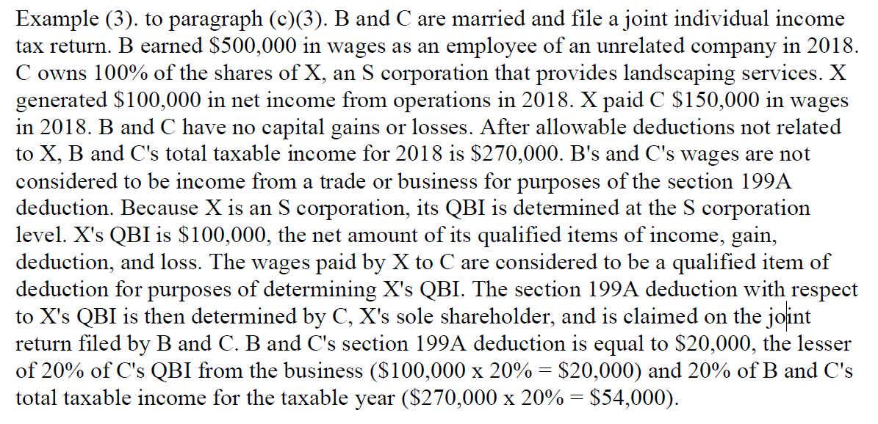
Proposed Regulations - continued

Slide 28
Proposed Regulations - continued

Slide 29
Proposed Regulations - continued

Slide 30
Proposed Regulations - continued
(d) Computation of the §199A deduction for individuals with TI ABOVE threshold amount.
In general. The §199A deduction is determined for individuals with taxable income for the taxable year that exceeds the threshold amount by adding the QBI component and 20% of the combined amount of qualified REIT dividends and qualified PTP income. That sum is then compared to 20% of the amount by which the individual’s taxable income exceeds net capital gain. The lesser of these two amounts is the individual’s §199A deduction.
QBI component. Individuals with taxable income for the taxable year that exceeds the threshold amount determine the QBI component using the following computational rules:
SSTB exclusion
Aggregated trade or business
Netting and carryover
QBI component calculation

Slide 31
Proposed Regulations - continued

Slide 32
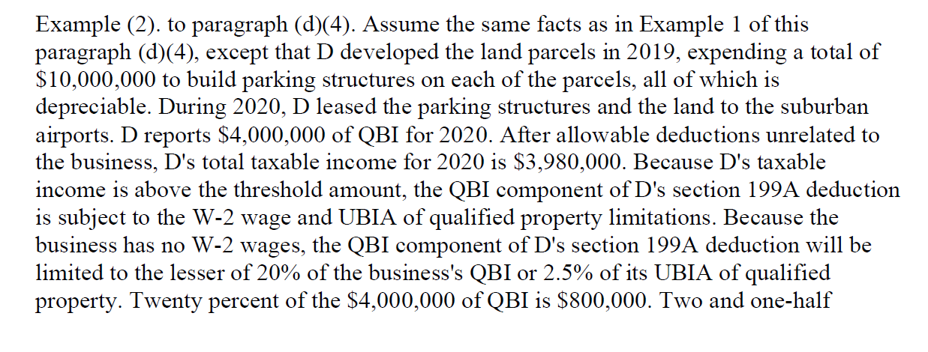
Proposed Regulations - continued

Slide 33
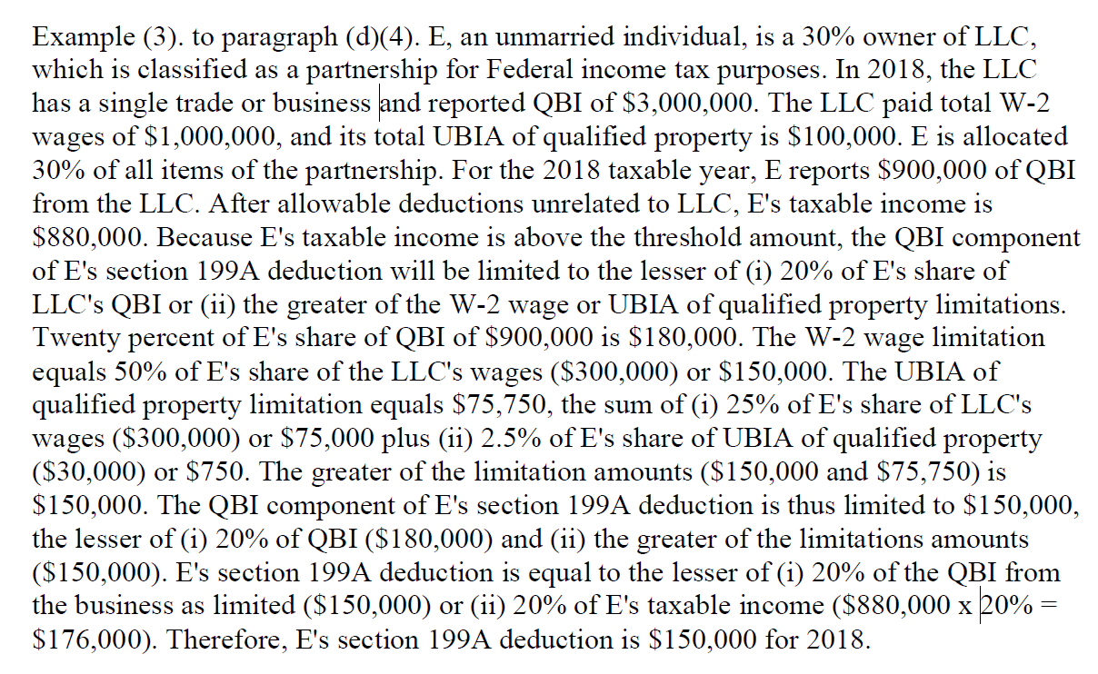
Proposed Regulations - continued

Slide 34
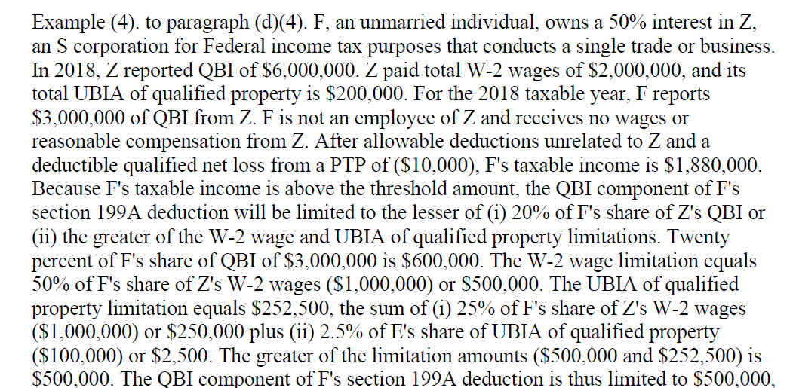
Proposed Regulations - continued

Slide 35
Proposed Regulations - continued

Slide 36
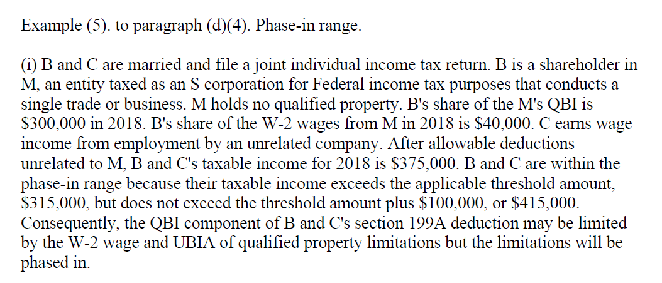
Proposed Regulations - continued

Slide 37
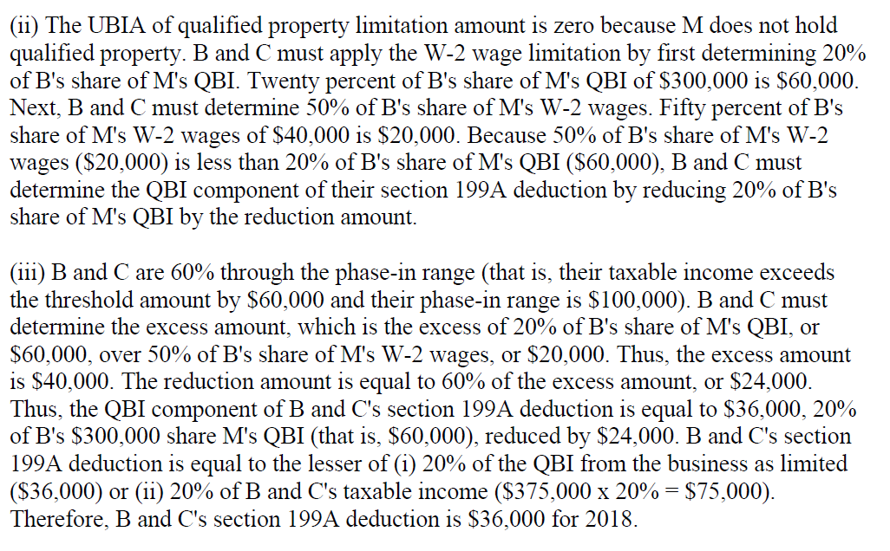
Proposed Regulations - continued

Slide 38
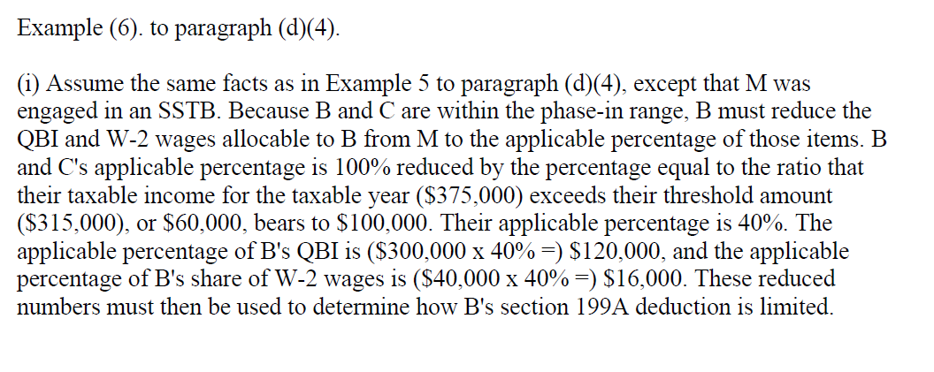
Proposed Regulations - continued

Slide 39
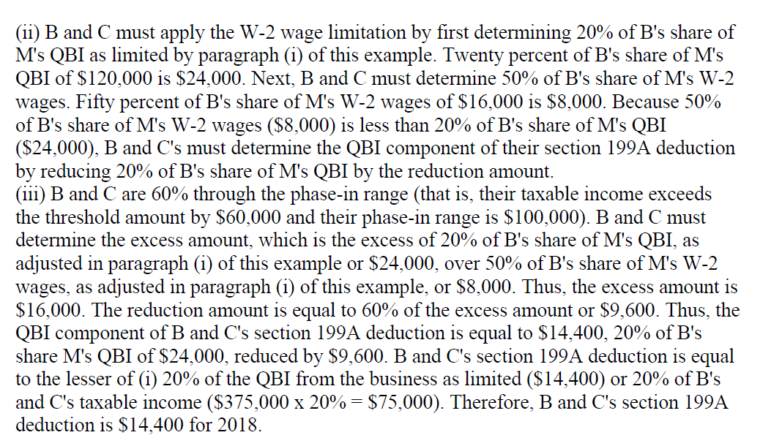
Proposed Regulations - continued

Slide 40
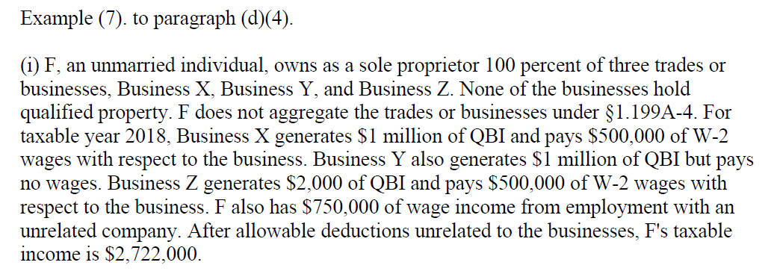
Proposed Regulations - continued

Slide 41
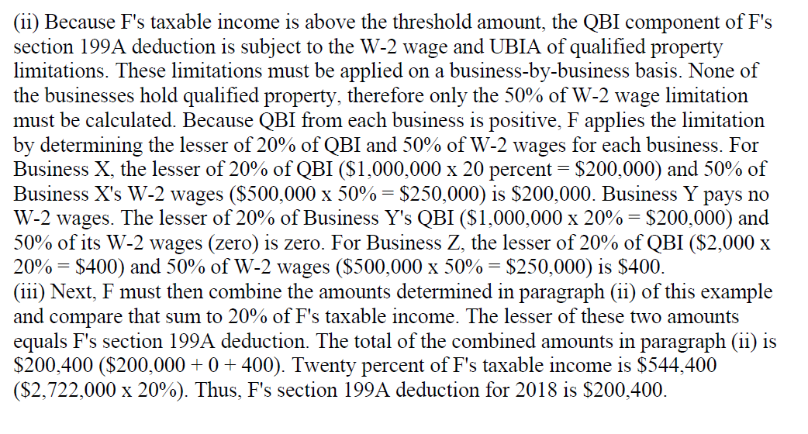
Proposed Regulations - continued

Slide 42
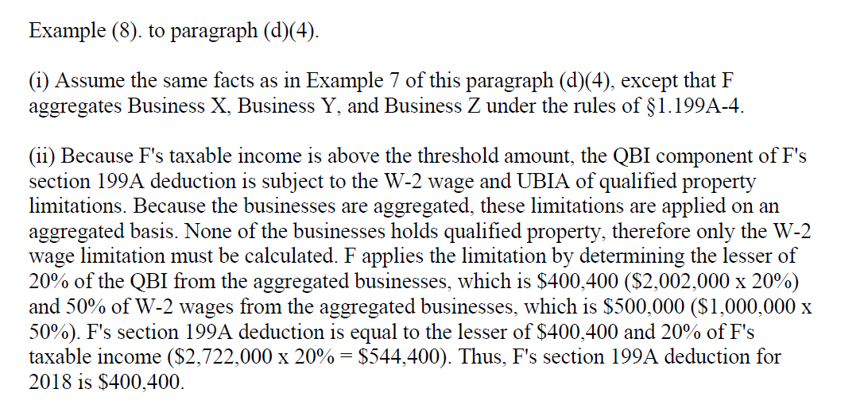
Proposed Regulations - continued

Slide 43
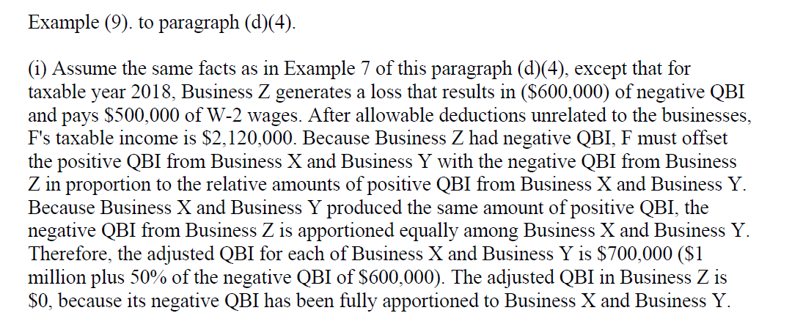
Proposed Regulations - continued

Slide 44
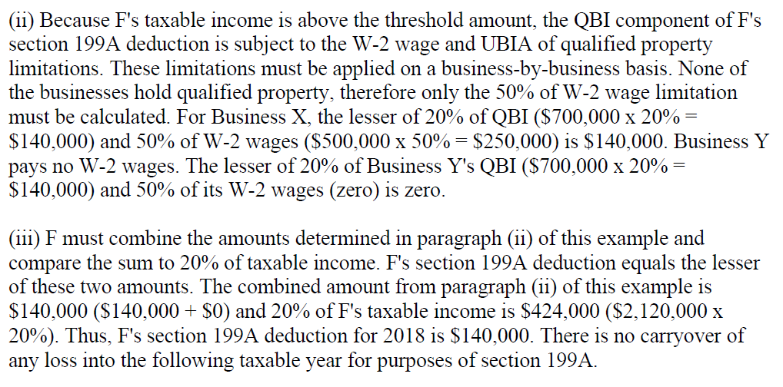
Proposed Regulations - continued

Slide 45
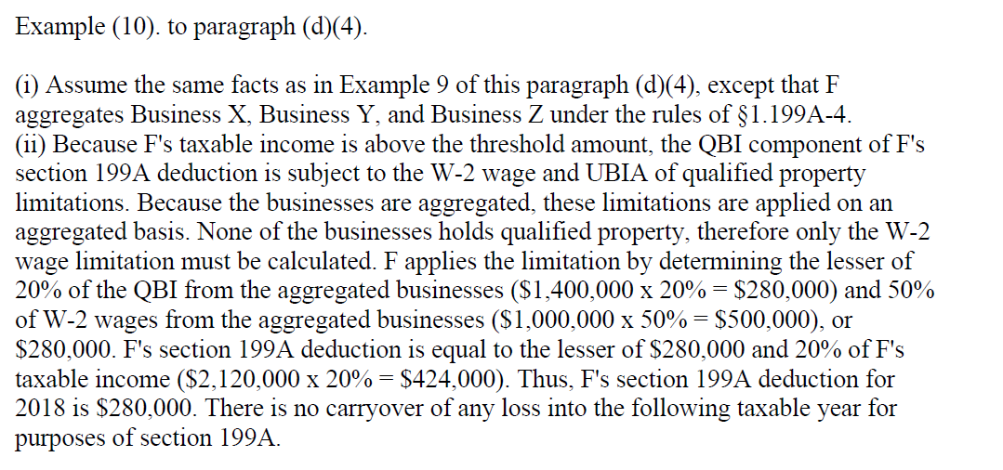
Proposed Regulations - continued

Slide 46
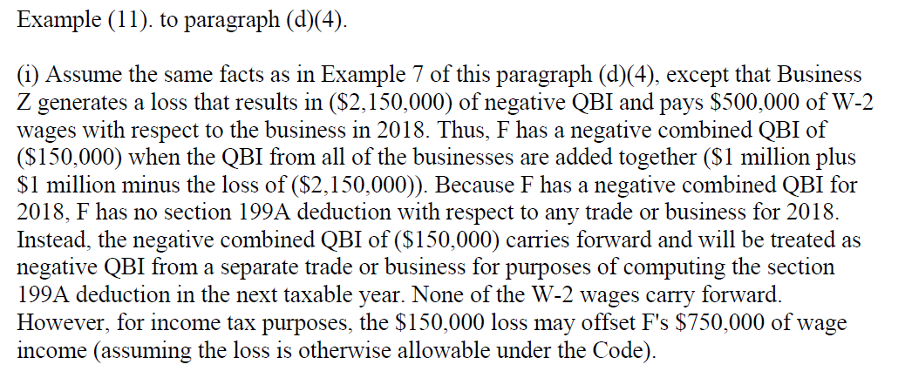
Proposed Regulations - continued

Slide 47
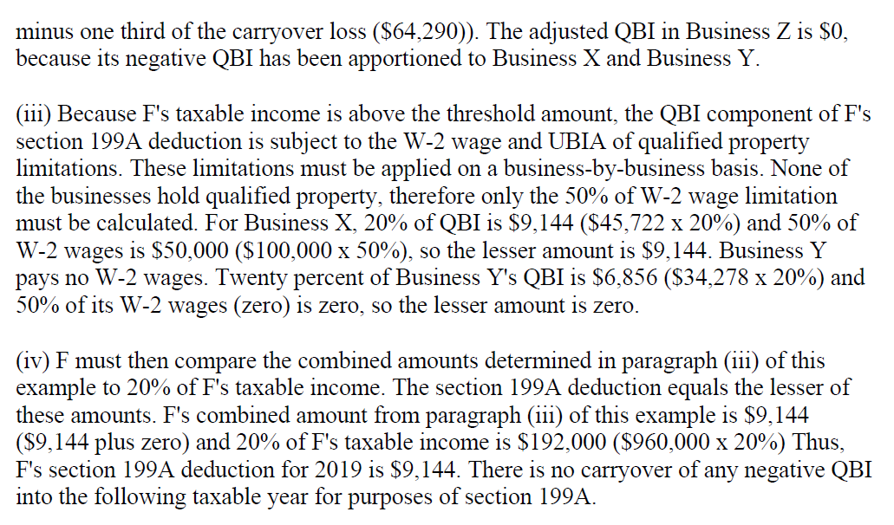
Proposed Regulations - continued

Slide 48
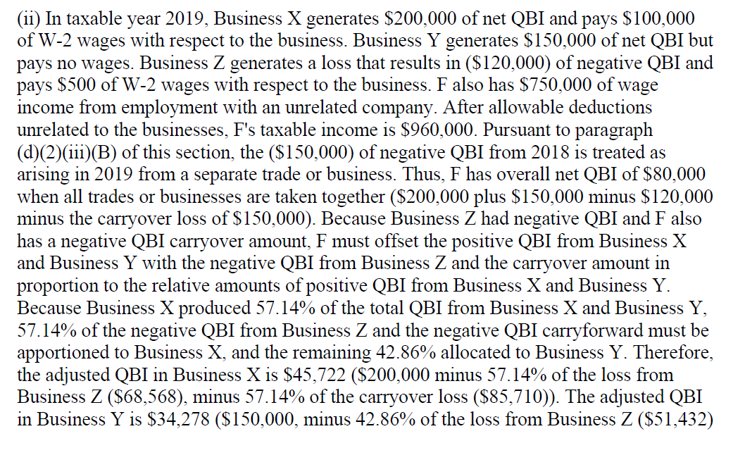
Proposed Regulations - continued

Slide 49
Proposed Regulations - continued

Slide 50
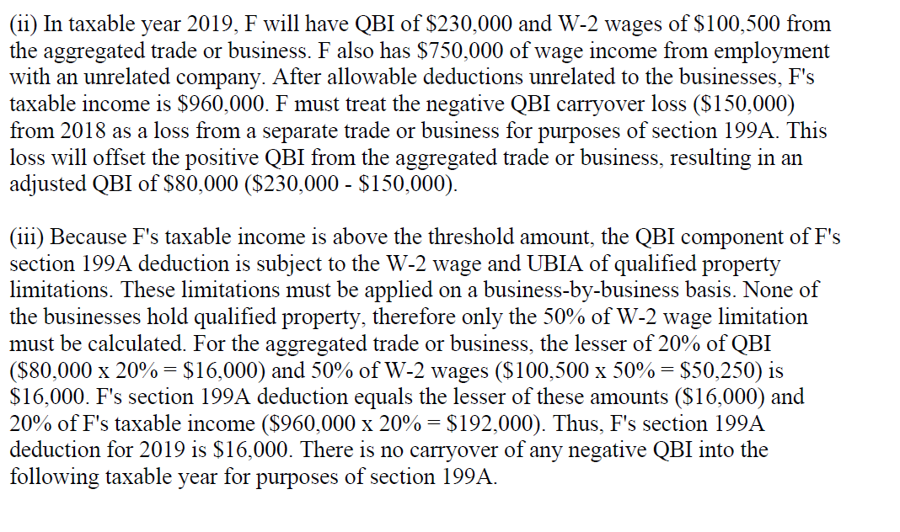
Proposed Regulations - continued

Slide 51
Proposed Regulations - continued
(e) Special rules.
Effect of deduction. In the case of a partnership or S corporation, §199A is applied at the partner or shareholder level. The §199A deduction has no effect on the adjusted basis of a partner’s interest in the partnership, the adjusted basis of a shareholder’s stock in a S corporation , or an S corporation’s accumulated adjustments account.
Self-employment tax and net investment income tax. The deduction under §199A does not reduce net earnings from self-employment under section 1402 or net investment income under section 1411.
Commonwealth of Puerto Rico. If all of an individual’s QBI from sources within the Commonwealth of Puerto Rico is taxable under section 1 of the Code for the taxable year, then for purposes of determining the QBI of such individual for such taxable year, the term “ United States” includes the Commonwealth of Puerto Rico.
Coordination with alternative minimum tax. For purposes of determining alternative minimum taxable income under section 55, the deduction allowed under section199A(a) for a taxable year is equal in amount to the deduction allowed under section 199A(a) in determining taxable income for that taxable year ( that is, without regard to any adjustments under section 56 through 59).
Imposition of accuracy-related penalty on underpayments. For rules related to the imposition of the accuracy-related penalty on underpayments for taxpayers who claim the deduction allowed under section 199A.
Reduction for income received from cooperative. In the case of any trade or business of a patron of a specified agricultural or horticultural cooperative, as defined in section 199A(g)(4), the amount of section 199A deduction determined under paragraphs ( c ) or (d) of this section with respect to such trade or business must be reduced by the lesser of:
Nine percent of the QBI with respect to such trade or business as is properly allocable to qualified payments received from such cooperative, or
50% of the W-2 wages with respect to such trade or business as are so allocable as determined under §1.199A-2.

Slide 52
CANNABIS BUSINESS:
No §199A Deduction on Cannabis Business regardless of all other qualifications ( income threshold, qualified trade or business).
Per §280E – no deduction or credit shall be allowed for any amount paid or incurred during the taxable year in carrying on any trade or business if such trade or business consists of trafficking in controlled substances.
The TCJA did not modify §280E .

