Slide 1


Simplified-Issue/Individually-Owned
Cash-Benefit Programs – Hawai’i (updated May’25)

Slide 2


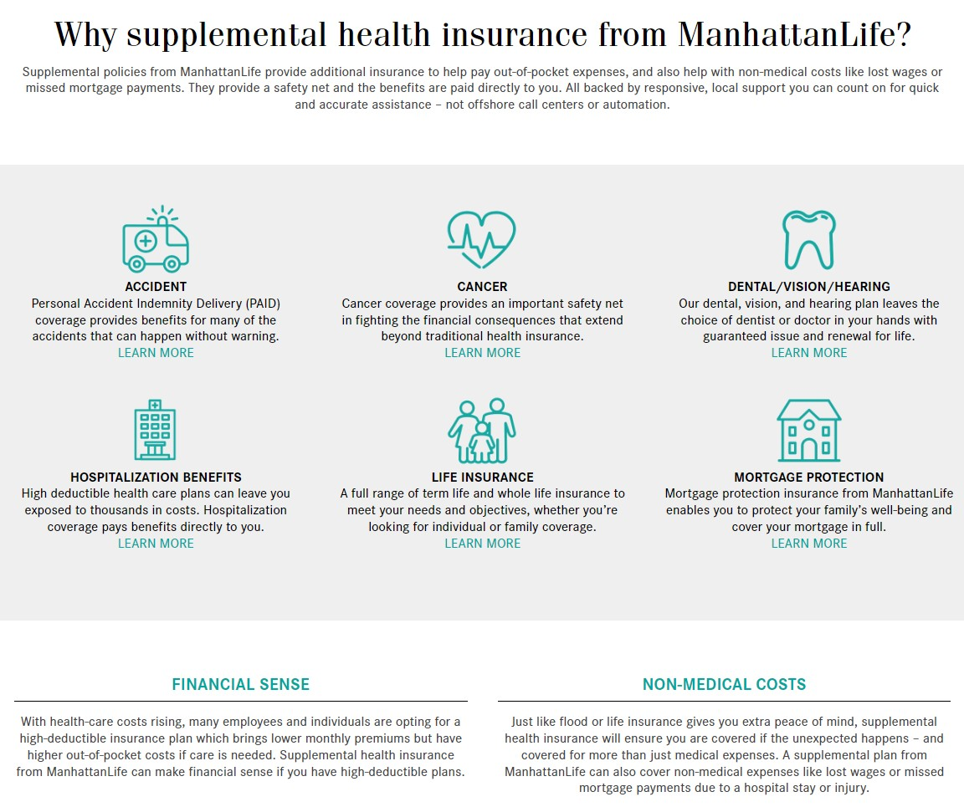
ManhattanLife Overview

Slide 3
Why do people sign up for Cash-Benefit programs?
We all own insurance for specific reasons:
  Car Insurance is purchased to pay the auto mechanic, so that we don’t have to pay for all the expenses.
  Home Owners/Renters Insurance is purchased to pay for repairs or replacements to our property & effected items.
  Health/Dental/Vision Insurance is purchased to pay the hospitals & medical providers, so that we don’t have to pay for all the expenses.
  Life Insurance is purchased to pay off debts & provide additional financial support for living loved ones.
Unfortunately, most families do NOT have insurance that will pay them cash to help pay their monthly bills, help replace lost income and/or help them pay for all the leftover medical bills. Making sure that we have money coming in to pay our bills & support our family SHOULD BE our highest priority, but most people don’t know (until now) that there are insurance programs that do just that!
ManhattanLife benefits PAY CASH DIRECTLY TO YOU, & the programs typically cost $2-$8/week for Individuals & just a few dollars more to cover the entire family!

Slide 4







Simplified-Issue/Individual Benefits – Hawai’i (May ‘25)
Accident/Injury Policy
(includes AD&D & Wellness)
Signup Ages 18-84
Affordable Choice
(Fixed-Indemnity Health Plan)
Signup Ages 18-64
Hospital Indemnity Select
(Gap – Lump Sum Benefits)
Signup Ages 18-89
Cancer Plus
(Ongoing Payout Plan)
Signup Ages 18-69
Cancer, Heart & Stroke (CHAS)
(Lump-Sum Cash Payout)
Signup Ages 20-84
Short-Term Care
(Rehabilitation & Therapy Care)
Signup Ages 45-89
Home Health Care Select
(Benefits for Recovery at Home)
Signup Ages 45-89

Slide 5
Which plans may be best for you?
Are you or your family active, in sports, manual labor, traveling, and/or likely to experience even the smallest of injuries?
  If so, you’ll probably make money owning the PAID Enhanced Accident plan.
Are you or your family looking to save money on health insurance and/or own something that pays YOU, not the doctors/hospitals?
  If so, we highly recommend looking into the Affordable Choice plan as a standalone policy OR in addition to what you have.
Are you or your spouse looking for an affordable way to cover copays & deductibles?
  If so, you may want to investigate the Hospital Indemnity plan (guaranteed-issue for individuals 64.5-70).
Are you or your family concerned about the diagnosis of Cancer or experiencing a heart condition, based on lifestyle and/or family history?
  If so, the CHAS Lump-sum plan is definitely something to look into.
Are you or your spouse between the ages of 45-89 & looking for a very affordable way to receive benefits for care at home or in a facility?
  If so, please check out the Home Health Care and the Omni-Flex Short-Term Care plans.
If you don’t see a need for all of the plans, that’s perfectly fine. Most people feel comfortable initially participating in 1-3 plans, & adding on as needed. If your situation and needs change down the road changes, at least you know which policies are available. Our #1 priority is to educate you on the options available, and if 1 or more of the policies make sense for you & your family, we’re here to help enroll & support you after your coverages are in force. It’s a quick & easy enrollment process, & our only suggestion is that coverage must be in place before something happens. We can’t cover a situation that has already happened.

Slide 6

CHAS (Cancer Heart and Stroke) Plan
Cancer, Heart and Stroke Policy
This may be the most important policy available through Manhattan Life, since more people are experiencing serious medical events at younger ages, regardless of family history. Cancer illnesses & heart-related medical events typically generate huge medical & non-medical costs, and usually effect the income of 1 or both providers in the home. This policy provides lump-sum benefits that help the family focus on recovery.
Product Features
Lump-sum benefit payouts from $5,000-$75,000
Coverage available for Cancer, Heart & Stroke or All
Issue Ages: 20-84
30-day waiting period before benefits become active
2 additional riders available

Slide 7

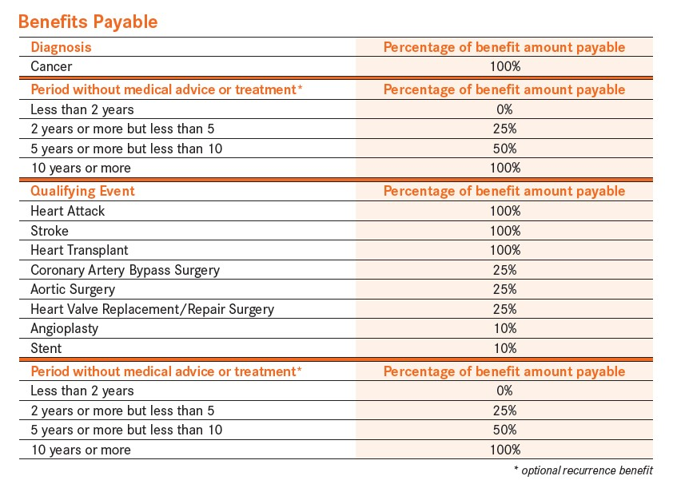
Policy Benefits
You Choose the Benefit Amount
Benefits range from $5,000 to $75,000, in $5,000 increments
Benefits are available for Cancer, Heart & Stroke OR Both Plans
Lump-sum benefits will pay out up to 100% of the selected benefit amount, based on the medical event
Cancer Recurrence Rider (optional)
Heart & Stroke Restoration Rider (Optional)
See policy for full details

Slide 8

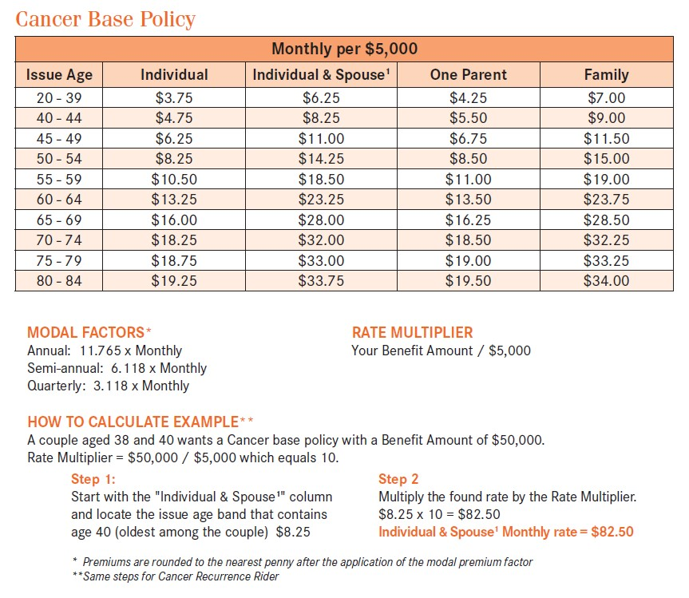
CHAS (Cancer only) Rates – Hawai’i

Slide 9
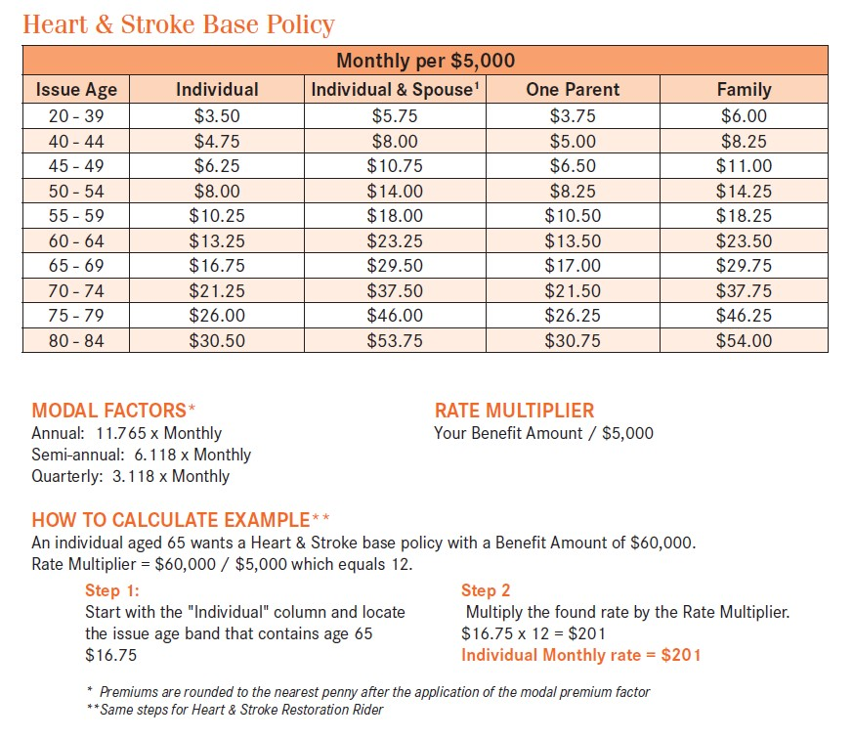
CHAS (Heart & Stroke only) Rates – Hawai’i

Slide 10
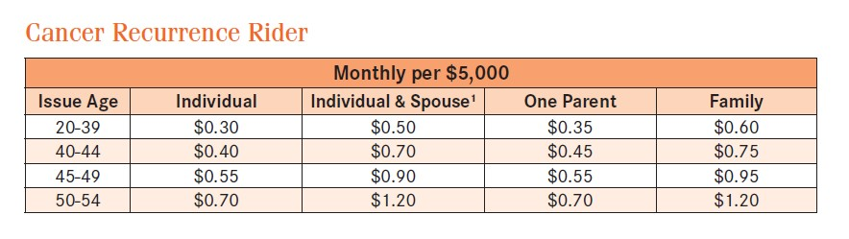
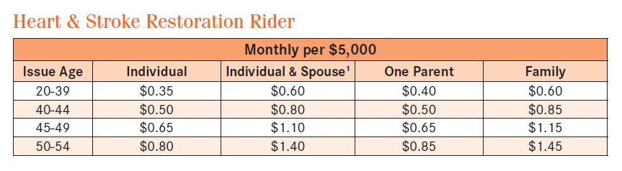
CHAS (Optional Recurrence Riders) Rates – Hawai’i

Slide 11

What’s Next?
Quoting & Enrollment Process
Decide which plan(s) you’re interested in
Quote each plan with me (or through my self-enrollment site)
Provide information for enrollment
Select beneficiaries
Select benefit effective date & bank draft date
(suggested date of 10 days after application date)
Input bank account information (from a check or bank login)
Signature process is completed with mother’s maiden name
(in-person or remote)
You will receive electronic & paper copies of your policies
If you know 1 or more people in your network that would benefit from these policies, I would love to help them out!
Claims/Servicing
If you have a claimable situation, please make sure to grab paperwork as your leaving the doctor (not a copay receipt – paperwork that includes your name, facility name & treatment)
Call me & I will help you file your 1st claim!

