Slide 1


Simplified-Issue/Individually-Owned
Cash-Benefit Programs – Hawai’i (updated March’26)

Slide 2


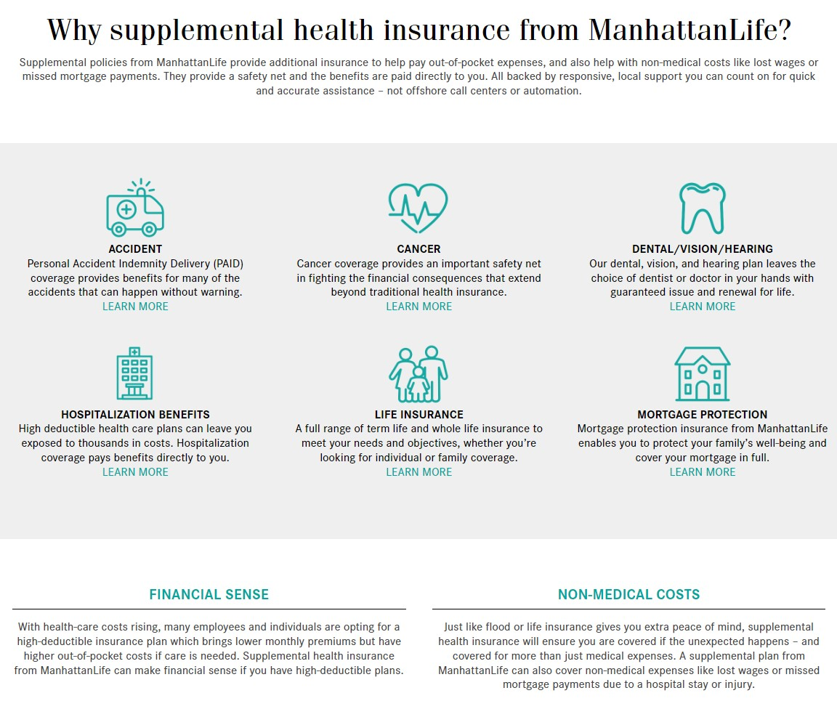
ManhattanLife Overview

Slide 3
Why do people sign up for Cash-Benefit programs?
We all own insurance for specific reasons:
  Car Insurance is purchased to pay the auto mechanic, so that we don’t have to pay for all the expenses.
  Home Owners/Renters Insurance is purchased to pay for repairs or replacements to our property & effected items.
  Health/Dental/Vision Insurance is purchased to pay the hospitals & medical providers, so that we don’t have to pay for all the expenses.
  Life Insurance is purchased to pay off debts & provide additional financial support for living loved ones.
Unfortunately, most families do NOT have insurance that will pay them cash to help pay their monthly bills, help replace lost income and/or help them pay for all the leftover medical bills. Making sure that we have money coming in to pay our bills & support our family SHOULD BE our highest priority, but most people don’t know (until now) that there are insurance programs that do just that!
ManhattanLife benefits PAY CASH DIRECTLY TO YOU, & the programs typically cost $2-$8/week for Individuals & just a few dollars more to cover the entire family!

Slide 4







Simplified-Issue/Individual Benefits – Hawai’i (Dec ‘25)
Affordable Choice Enhanced
(Fixed-Indemnity Health Plan)
Signup Ages 18-64
Accident/Injury Policy
(includes AD&D & Wellness)
Signup Ages 18-84
Hospital Indemnity Select
(Gap – Lump Sum Benefits)
Signup Ages 18-89
Cancer Plus
(Ongoing Payout Plan)
Signup Ages 18-69
Cancer, Heart & Stroke (CHAS)
(Lump-Sum Cash Payout)
Signup Ages 20-84
Short-Term Care
(Rehabilitation & Therapy Care)
Signup Ages 45-89
Home Health Care Select
(Benefits for Recovery at Home)
Signup Ages 45-89

Slide 5
Which plans may be best for you?
Are you or your family active, in sports, manual labor, traveling, and/or likely to experience even the smallest of injuries?
  If so, you’ll probably make money owning the PAID Enhanced Accident plan.
Are you or your family looking to save money on health insurance, with no deductibles and benefits that can be used anywhere?
  If so, we highly recommend looking into the Affordable Choice Enhanced plan as a standalone policy OR in addition to what you have.
Are you or your spouse looking for an affordable way to cover copays, deductibles & other out-of-pocket expenses?
  If so, you may want to investigate the Hospital Indemnity plan (guaranteed-issue for individuals 64.5-70).
Are you or your family concerned about the diagnosis of Cancer or experiencing a heart condition, based on lifestyle and/or family history?
  If so, the CHAS Lump-sum plan is definitely something to look into.
Are you or your spouse between the ages of 45-89 & looking for a very affordable way to receive benefits for care at home or in a facility?
  If so, please check out the Home Health Care and the Omni-Flex Short-Term Care plans.
If you don’t see a need for all of the plans, we understand. Most people feel comfortable initially participating in 1-3 plans, & adding on as needed. If your needs change down the road changes, at least you know which policies are available. Our #1 priority is to educate you on the options available, and if 1 or more of the policies make sense for you & your family, we’re here to help enroll & support you after your coverages are in force. It’s a quick & easy enrollment process, & it’s important to know that coverage must be in place before something happens. We can’t cover a situation that has already happened.

Slide 6

Affordable Choice Enhanced Plan
Affordable Choice Enhanced
This policy is unique to Manhattan Life & provides a strong yet affordable alternative to traditional health insurance plans. This plan is perfect for anyone who wants to own a health insurance plan that pays YOU (the policyholder), NOT the doctor or hospital (unless you assign payments to them). Ideal for self-employed, part-time and/or anyone wanting to supplement their current coverage.
Product Features
Four plan choices to choose from:
  Elite Plus (richest benefits & could be standalone coverage)
  Elite (standalone or partnered with high-deductible plan)
  Classic Plus (usually complements current coverage)
  Classic (most affordable compliment to current coverage)
Issue Ages: 18-64
Cancer benefit & 6 ancillary services included!
Notable Exclusion: Pregnancy is not covered

Slide 7

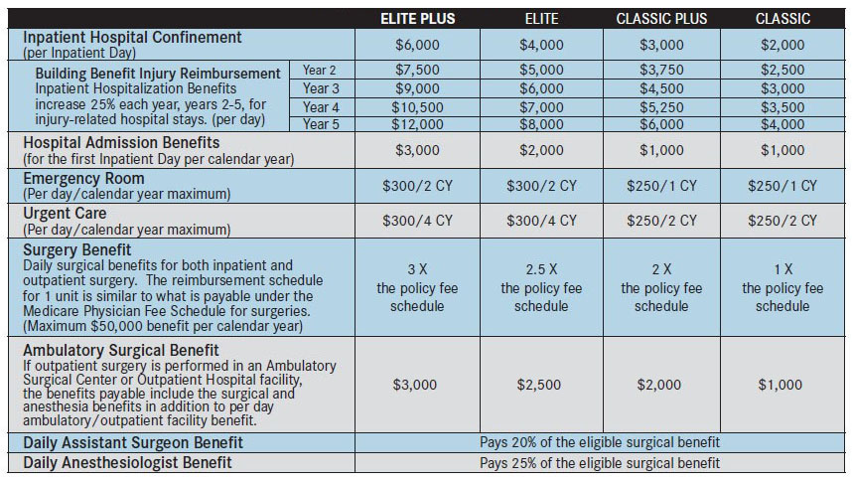
Policy Benefits
Elite Plus Example (highest tier)
Admission Benefit = $3,000
Hospital Confinement = $6,000/day
Emergency Room/Urgent Care = $300
4 benefits related to Surgeries
Classic Example (lowest tier)
Admission Benefit = $1,000
Hospital Confinement = $2,000/day
Emergency Room/Urgent Care = $250
4 benefits related to Surgeries
See policy for full details

Slide 8
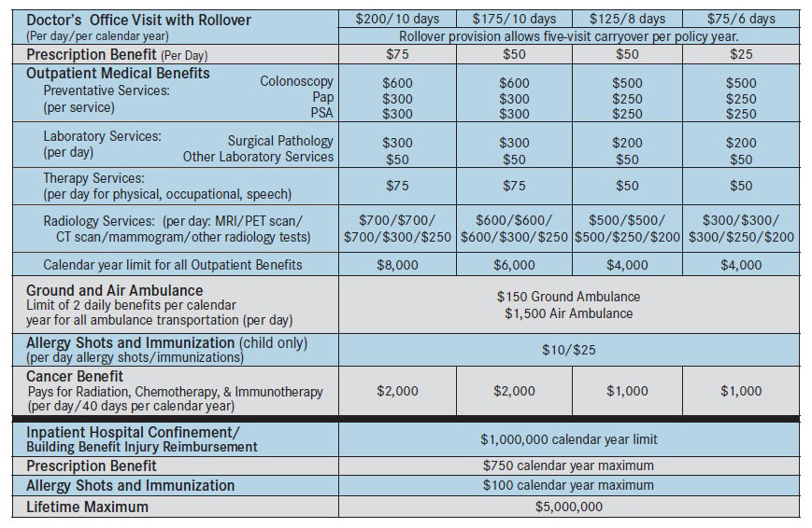
Policy Benefits (continued)
Elite Plus Example (highest tier)
Doctor’s Office Visits = $200 (x10)
  Unused benefits rollover
Prescription Benefit = $75/day
Preventive Services = Up to $600
Lab Services = Up to $300/day
Therapy/Chiropractic Services = $75/day
Radiology Services = Up to $700/day
Ground/Air Ambulance = Up to $1,500
Allergy Shots & Immunizations Benefits
Cancer Benefit = $2,000/day
Policy Limits
Outpatient Benefits = $8,000/cal. year
Inpatient Hospital Confinement =
$1,000,000/calendar year
Prescription Benefit = $750/cal. year
Allergy Shots/Immunizations = $100/y
Lifetime Maximum = $5,000,000
See policy for full details

Slide 9
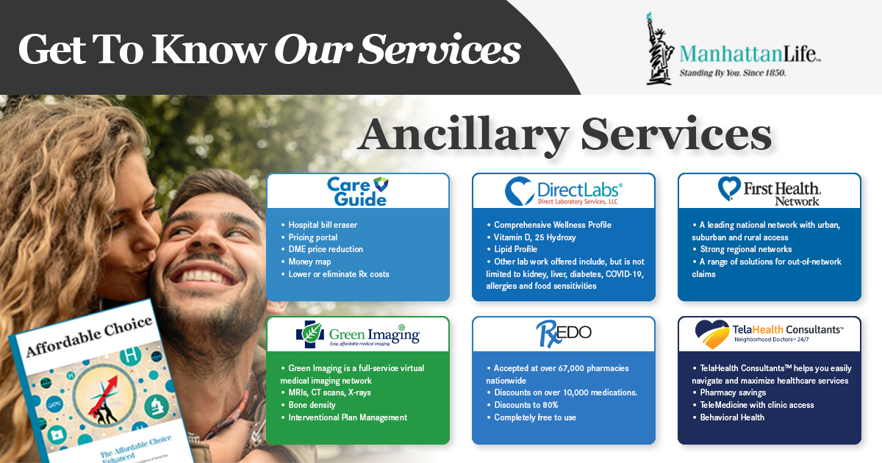
6 Ancillary Benefits (included at no cost)

Slide 10

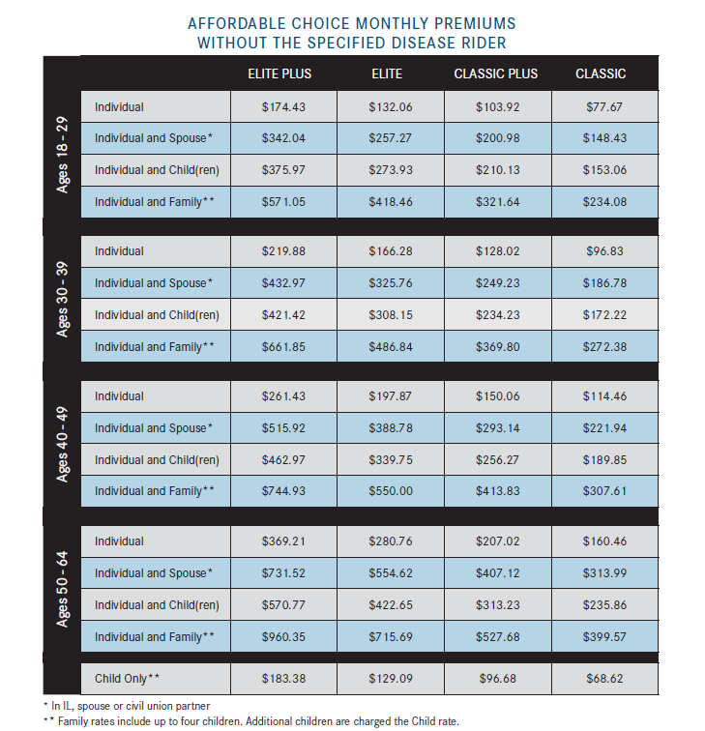
Affordable Choice Base Policy Rates – Hawai’i

Slide 11

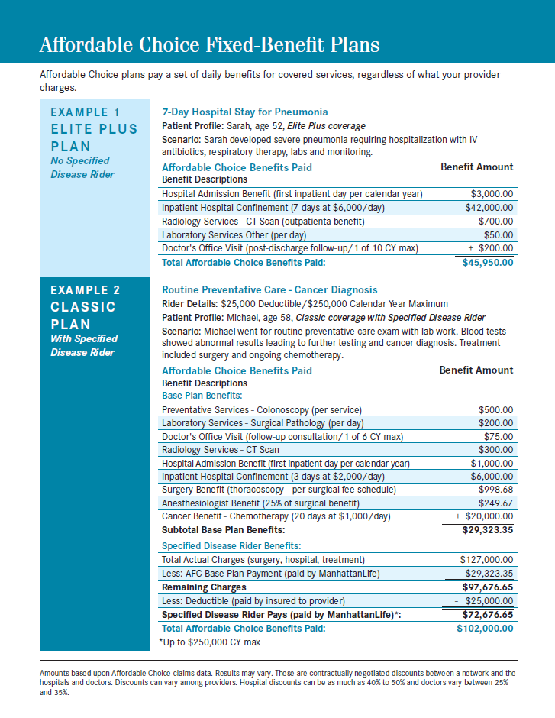
New Specified Disease Rider (add-on to base policy)

Slide 12
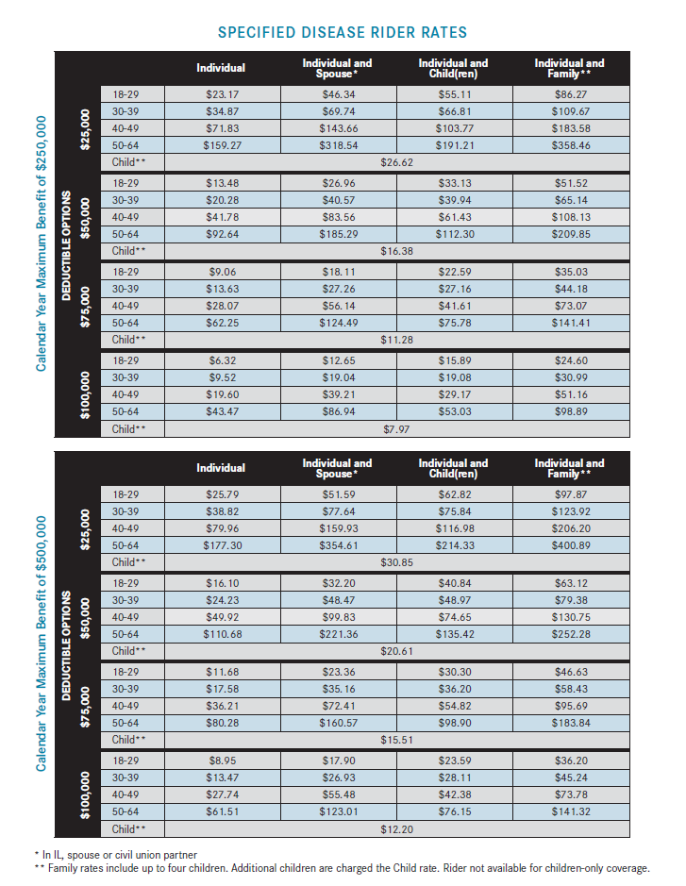
Specified Disease Rider Rates (additional to base plan)

Slide 13
Accident/Injury Plan (recommended for all coverages)
PAID Enhanced Accident Policy
This is our most popular plan, because it pays you cash the next time someone gets injured & goes to seek medical treatment! Injuries are the main reason most of us go to the doctor, so wouldn’t it be nice to receive a few hundred dollars or a few thousand dollars the next time it happens?
Product Features
Helps you pay for out-of-pocket expenses
Pays for injuries, big or small
2 options: 24-hour or off-the-job only
Issue Ages: 18-84
Guaranteed renewable for life, subject to our right to change premium rates
Choose one or two units
AD&D Included

Slide 14
Accident/Injury Policy Benefits
Money for the 1st Treatment Visit
Physicians Office - $150
Emergency Room - $200
Urgent Care - $225
Emergency Dental - $100-$300
Money for Follow-up Visits
Physicians Office (x8) - $50
Physical Therapy (x10) - $70
Chiropractor (x5) - $70
Wellness Visits - $60*
Tests & Supplies
X-Rays - $100
Crutches/Braces - $150
MRIs, CT Scans, etc - $200
Blood/Plasma - Up to $300
Money for the Types of Injuries
Cuts/Lacerations - Up to $800
Tendon/Ligament/Rotator Cuff - $1,000
Dislocations - Up to $4,000
Fractures - Up to $5,000
Burns - Up to $20,000
Pays out for several types of Injuries
Accidental Death
Policyholder - $50,000
Spouse - $20,000
Child - $10,000
All amounts x2 for
Common-Carrier Incidents
Hospitalization, Surgeries & Services
Hospital Confinement - $300/day
ICU Confinement - $600/day
Surgeries - Up to $2,000
Ambulances - Up to $2,000
See policy for full details - *optional rider

Slide 15
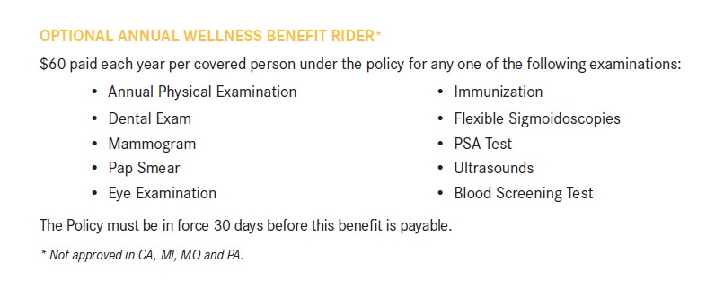
Optional Wellness Rider (recommended)

Slide 16
PAID Enhanced Accident Policy Rates – Hawai’i
Monthly Rates (24/7 coverage that includes $60/wellness per person per year & $50,000/$20,000/$10,000 AD&D)
Individual: $25/month
Employee + Spouse: $38/month
Employee + Children: $38/month
Family: $51/month

Slide 17

What’s Next?
Quoting & Enrollment Process
Decide which plan(s) you’re interested in
Quote each plan with me (or through my self-enrollment site)
Provide information for enrollment
Select beneficiaries
Select benefit effective date & bank draft date
(suggested date of 10 days after application date)
Input bank account information (from a check or bank login)
Signature process is completed with mother’s maiden name
(in-person or remote)
You will receive electronic & paper copies of your policies
If you know 1 or more people in your network that would benefit from these policies, I would love to help them out!
Claims/Servicing
If you have a claimable situation, please make sure to grab paperwork as your leaving the doctor (not a copay receipt – paperwork that includes your name, facility name & treatment)
Call me & I will help you file your 1st claim!

