Slide 1

Hampshire Fire Protection District
Full Time Testing Orientation
2022

Slide 2

Fire Chief – Trevor Herrmann
Deputy Fire Chief – Eric Larson

Slide 3
Hampshire Fire Protection District
Overview of the District
The District encompasses 42 square miles plus 9 miles of Interstate 90 in Kane, DeKalb and McHenry Counties.
Currently One fire station located downtown, a second fire station will be built and opened by 2024.
The District is made up of residential, commercial, industrial and agriculture
Major Roadways: Rt. 72, Rt. 20, I-90
Population: 10,000 (Fire District)

Slide 4
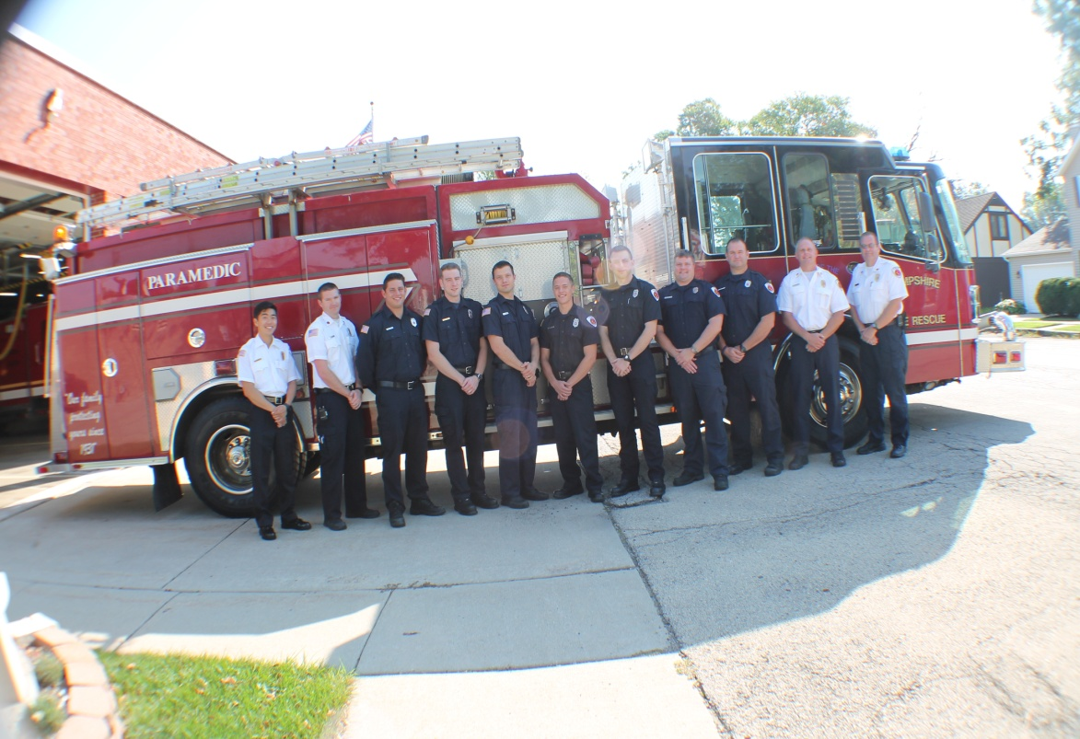
Personnel
31 Personnel
Full-time Fire Chief
Full-time Deputy Chief
Full-time EMS Captain
3-Full-time shift Lieutenants
3-Full-time firefighters
20 Part time firefighters
Full-time Fire Inspector
Part time Financial Director
Staffed with 5 personnel
(3 Engine / 2 Ambulance

Slide 5
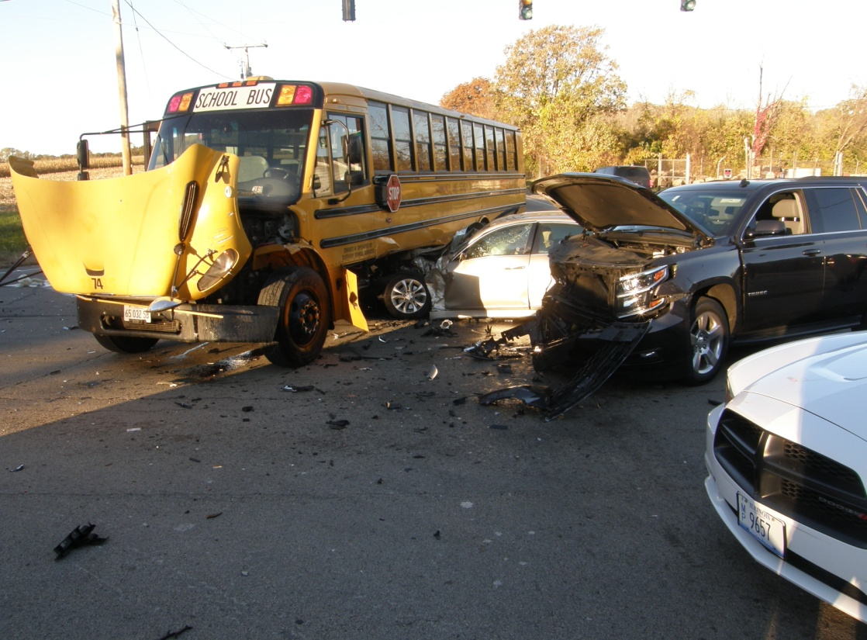
Call Volume History

Slide 6
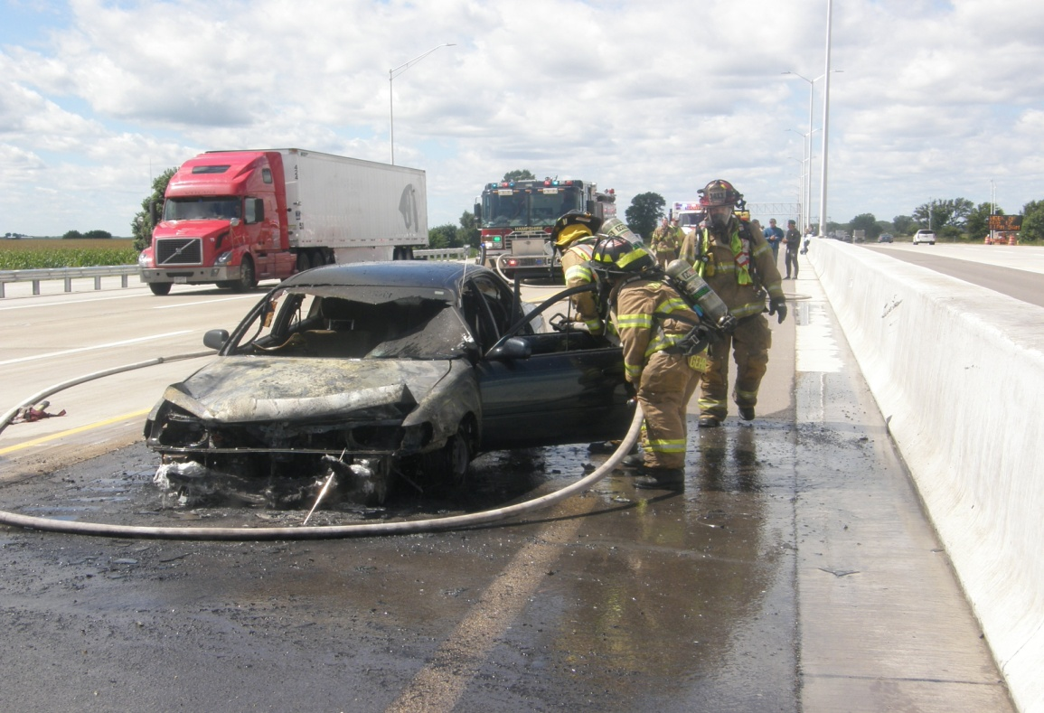
2021 Call Volume
Total Calls – 1,460
Fire Calls – 492
EMS Calls - 968

Slide 7
Job Requirements
US Citizenship
No Felony Convictions
Valid Driver’s License
21 to 35 years of age by date of hire unless exempt by statute
OSFM Illinois Firefighter II or Basic Operations Firefighter
IDPH Paramedic License at the time of Hire, EMT-B may be hired based on Paramedic depletion
CPAT and Ladder Climb verification (no more than one year old).

Slide 8
Salary and Benefits
Starting Salary : $57,800
Collective Bargaining Agreement: Yes
IAFF Local 4782
24/48 hour work schedule
Vacation : Year one = 2 days
Years 2-6 = 7 days
Years 7-11 = 9 days
Years 12 – 16 = 12 days
Years 17-21 = 13 days
Years 22 and beyond = 16 days
6 FLSA Days Annually
Nine Paid Holidays if you work the Holiday

Slide 9
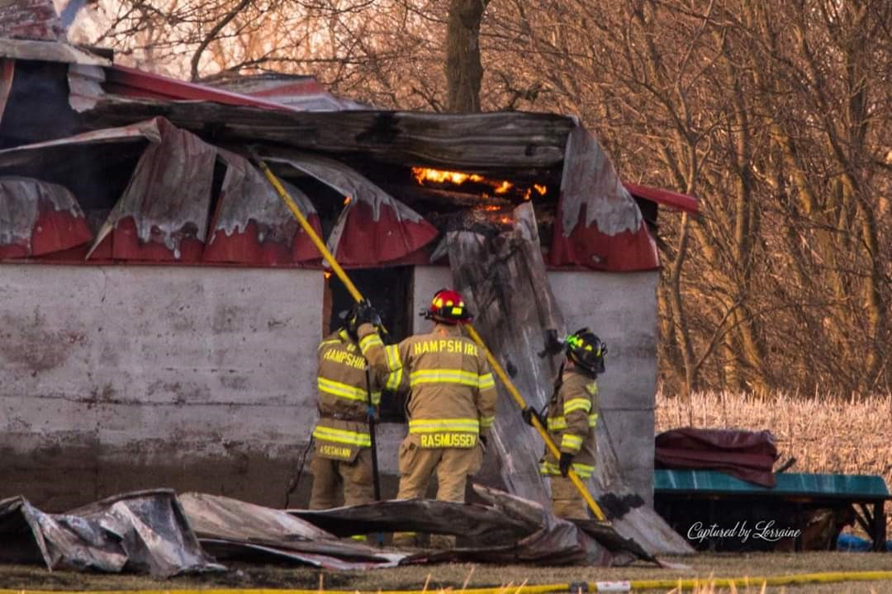
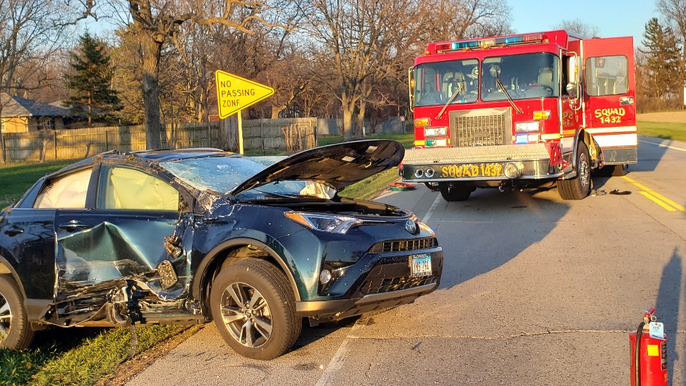

Slide 10
Salary and Benefits Continued
168 Sick Hours Annually
Paid Associate Degree Classes with a B or Higher
$25,000 Life Insurance Policy for Employee
$600 Uniform Allowance Annually
Insurance – Currently Blue Cross Blue Shield Blue Choice Options High Deductible Plan with District Contributing 100% to an HRA In Network.
Standard Dental Coverage

Slide 11
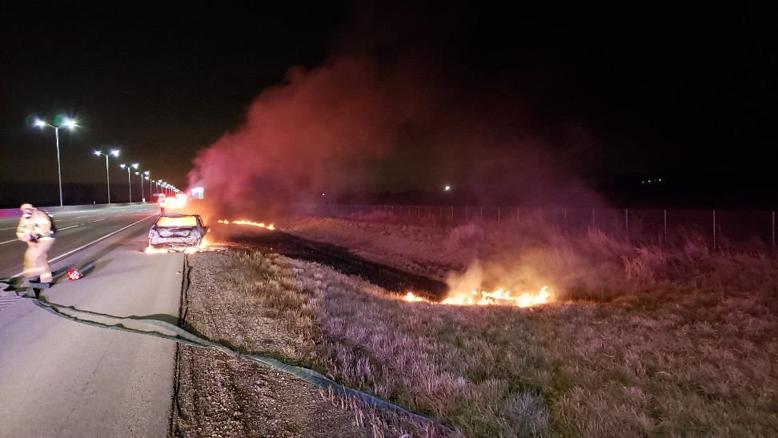
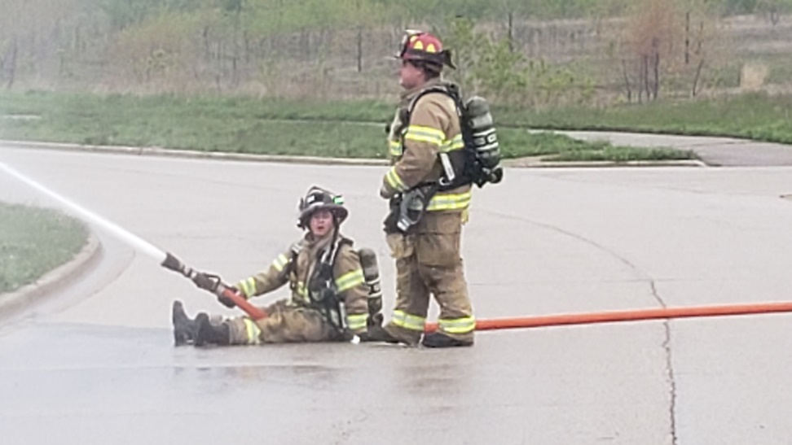

Slide 12
Department Testing Process
Orientation / Written exam - Those who pass the written exam will move on to the:
Oral Interview
Initial Eligibility list Established after Oral interview
Preference Points
Final Eligibility List
Conditional Offer of hire will require – background check, medical exam, Psychological exam

Slide 13
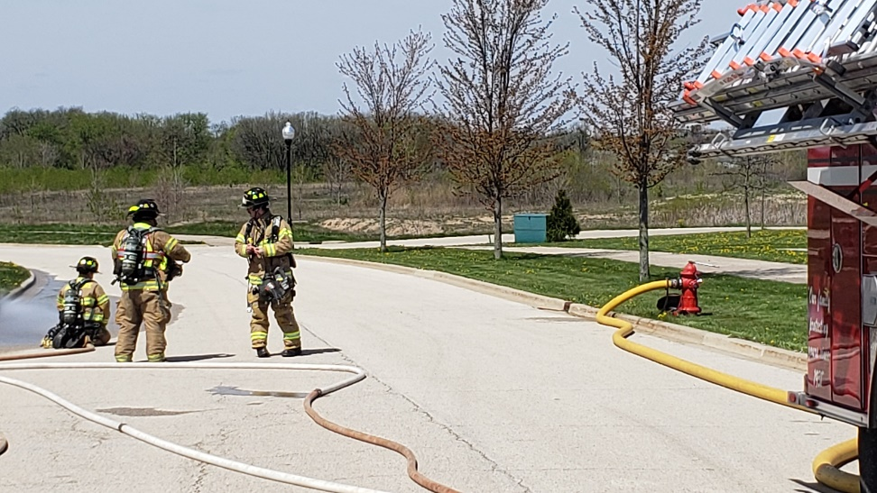
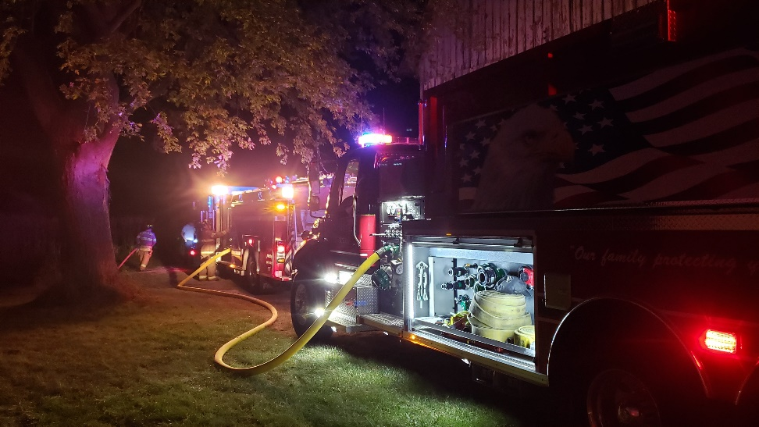

Slide 14
Preference Points
Veterans (5 Points) – Per Fire District Act
Experience (1/2 point per year to 5 points maximum)– POC / Part time employees of the District
Full time Firefighters outside of the District (1/2 point per year to 5 points maximum)
Education (2 points for Associates Degree in Fire Service, 3 points for Bachelors Degree in related field)

Slide 15
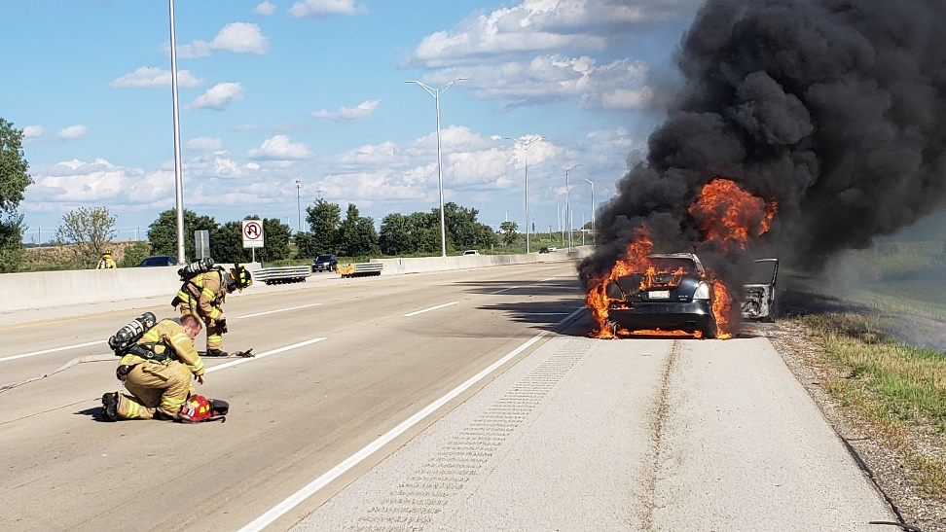
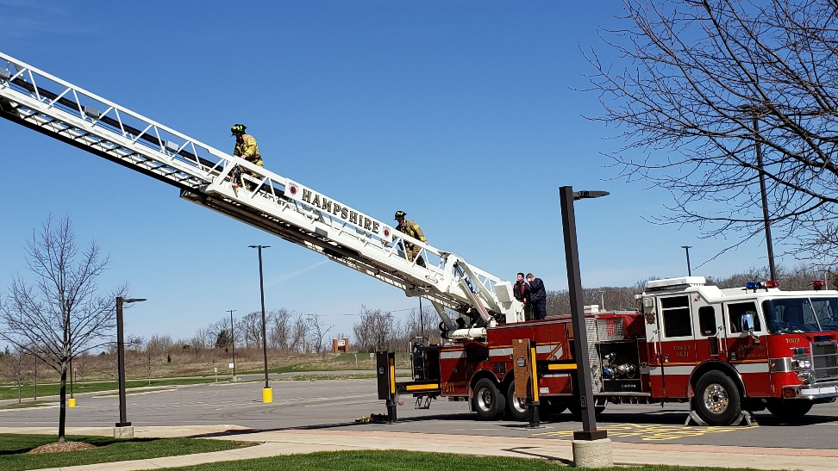

Slide 16
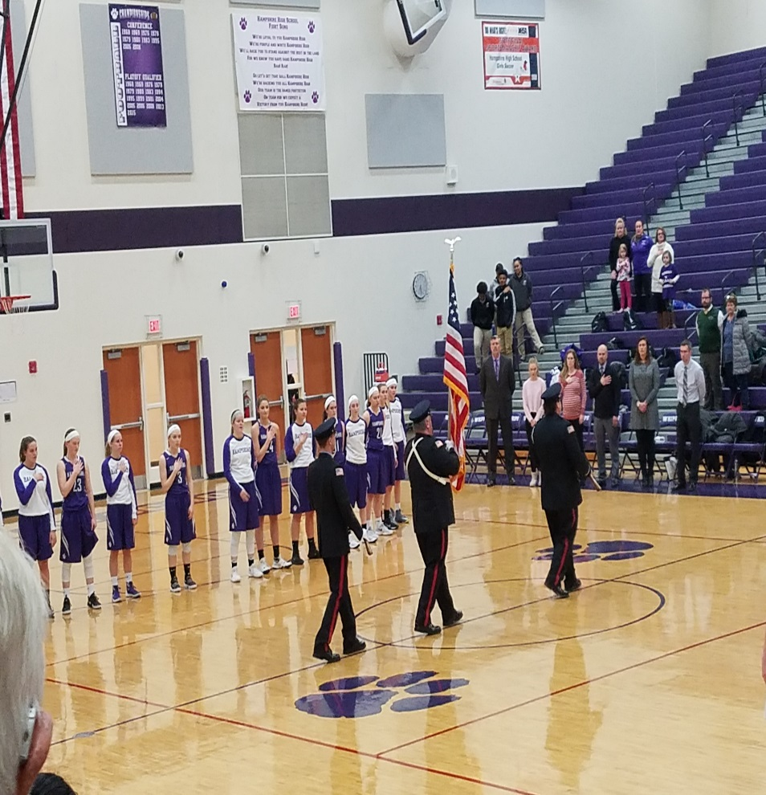
We are Very Community Involved!
The Future looks promising for our District!
We have an Outstanding Public Education Program!
We have a Proud Department History and we look to continue that Tradition!

Slide 17
The Future
Several Residential Subdivisions totally 3,000 plus homes are currently under construction.
There are several Business / Industrial Parks currently being developed or in the planning stages.
Second station to be built and staffed with additional full time hires.

Slide 18
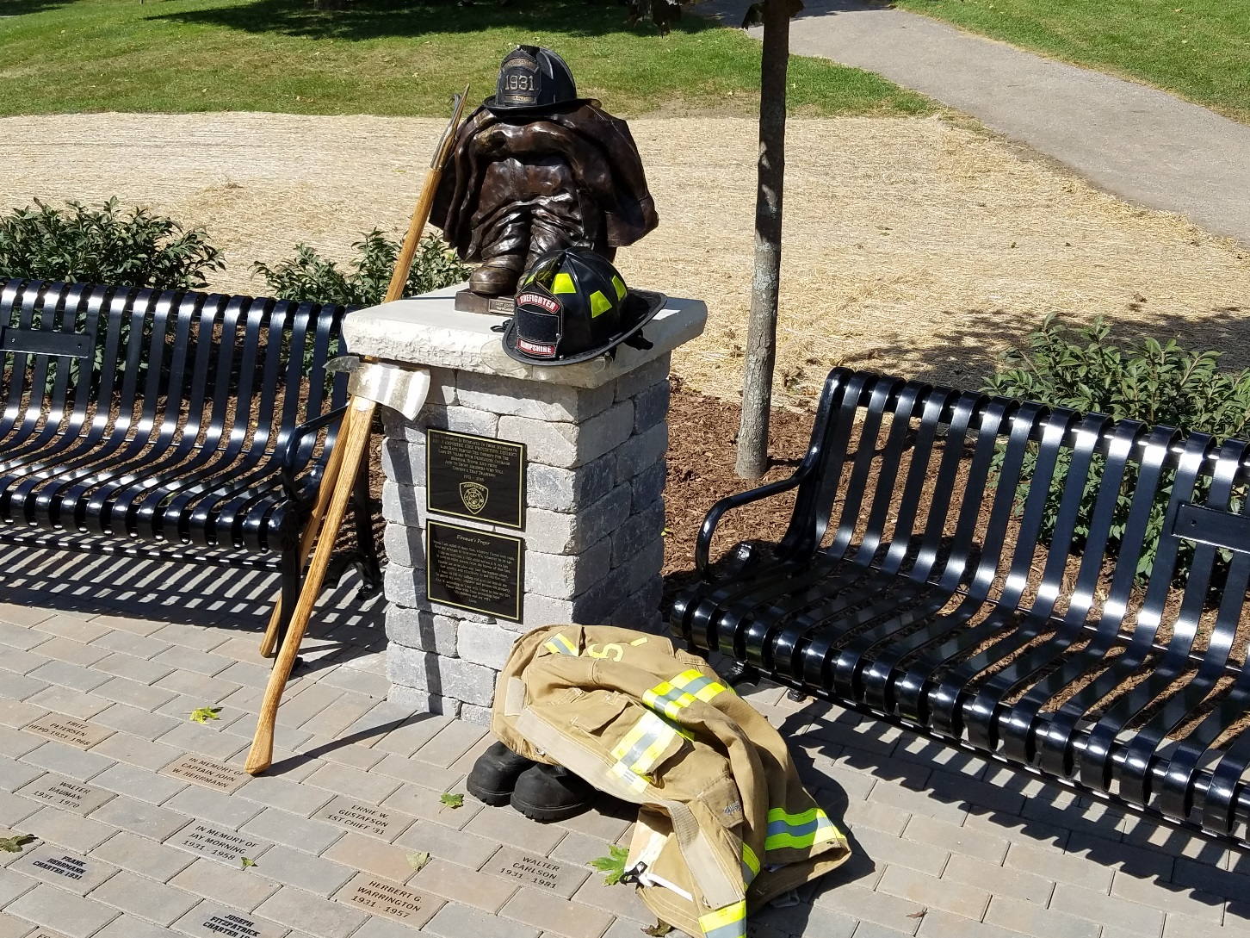
Good Luck!

