Slide 1
Philosophy for Happiness, Joy and Wisdom
BUT WHAT IS HAPPINESS, JOY, WISDOM???

Slide 2
Human Beings Began to Ask Fundamental Life Questions
“I wonder…”
3 paths for answering
1. Does God exist?
2. Are we free?
3. Is the soul immortal?
4. How should we act?
5. Who are we?
6. Where are we?
7. How did we get here?
8. What are we doing here?
9. What is the nature of reality?
10. Is there a purpose to life?
Happiness?
1. Myths/poetry/stories/culture
2. Faith
Religion/Theology
Prayer
Liturgy
Enlightenment
3. Reason
Philosophy/Science
Wonder
Thinking
Demonstration

Slide 3
Ancient Philosophers Appeared
Thales – 624-546 BC [Greece]
‘Pre-Socratic philosophers’
Siddhartha Gautama (Buddha) – 563-480 BC [India]
Lao Tzu – 601 BC [China]
Socrates – 469-399 BC
Plato – 427-347 BC
Aristotle – 384-322 BC

Slide 4
Plato’s influence on Christianity/Theology
Justin Martyr: Christian apologist and philosopher whose work often focused on the doctrine of the Logos and argued that many Stoic and Platonic philosophical ideas were similar to ideas in the Old Testament
Origen: Origen was influential in integrating elements of Platonism into Christianity. He incorporated Platonic idealism into his conceptions of the Logos, and the two churches, one ideal and one real. He also held a strongly Platonic view of God, describing him as the perfect, incorporeal ideal.
Augustine of Hippo: Augustine developed classical Christian philosophy, and the whole of Western thought, largely by synthesizing Hebrew and Greek thought. He drew particularly from Plato, the Neoplatonism of Plotinus, and Stoicism, which he altered and refined in light of divine revelation of Christian teaching and the Scriptures.

Slide 5
Plato: the allegory of the cave A story about achieving true knowledge

Slide 6
Plato: the Theory of Forms

Slide 7
Platonic philosophy (highlights)
Emphasis on use of reason (rather than mythology) to explain
Dialectical philosophical method
Learned from Socrates
Conversational method of inquiry
Two-world view
World perceived by the senses
World understood by the rational mind
Theory of forms (ideas/ideal)
Problem of universals & one/many problem (ship example)
Hierarchchy of forms (lower to higher)
Good as highest form (beyond being)
Immortality of the soul (Body-soul dualism)
Ethics: to know the Good is to do the good
Happiness achieved through practice of VIRTUE
Happiness = knowledge of the Good [Go(o)d]

Slide 9
Aristotle: practical philosophy

Slide 10
Virtue Ethics (Aristotle 384-322 B.C.E.)
Basic Structures
Everyone has a natural end or purpose (telos) in this life
Practicing the virtues actualizes this potential.
Happiness (flourishing, thriving) (Eudaimonia) = goal of Ethics
Virtue (Arête) = excellence
Different types of Greek virtues: intellectual, moral, practical, athletic, etc.
Virtues are created in us by repetitive practice; habit; mindless, sort of…
Moral Virtue = excellence of character
Embodied or actualized virtues are character traits
Individual citizen needs state/nation to achieve, thus closeness of morality & politics and society
Main Greek moral virtues: wisdom, courage, justice, temperance, piety plus (Aristotle believed) many others
Aristotle: Virtue understood as mean between two extremes (vices)
Virtue = process of Self-actualization

Slide 11
Different Cultures, Different Virtues

Slide 12
Virtue Ethics has some similarity to
SELF-ACTUALIZATION THEORY

Slide 13
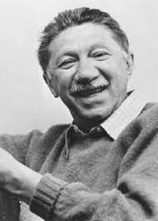
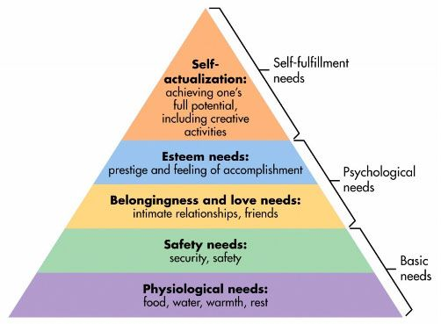
Abraham Maslow 1908-1970
Self-actualization theory

Slide 14
Do psychologists still use Maslow’s hierarchy of needs? (4:31) required

Slide 15
Expanded hierarchy of needs

Slide 16
STOIC PHILOSOPHERS
Zeno of Citium – 3rd century bc [Greek/Stoic]
Chrysippus – 279-206 bc [Greek/Stoic]
Seneca – 3-65 AD [Roman stoic]
Marcus Aurelius – 121-180 AD [Roman]
Epictetus – 1st century AD [Rome]
DAILYSTOIC.COM

Slide 17
Saint Thomas Aquinas

Slide 18
René Descartes

Slide 19
Immanuel Kant

Slide 20
Phenomenology and Existentialism

