Slide 1
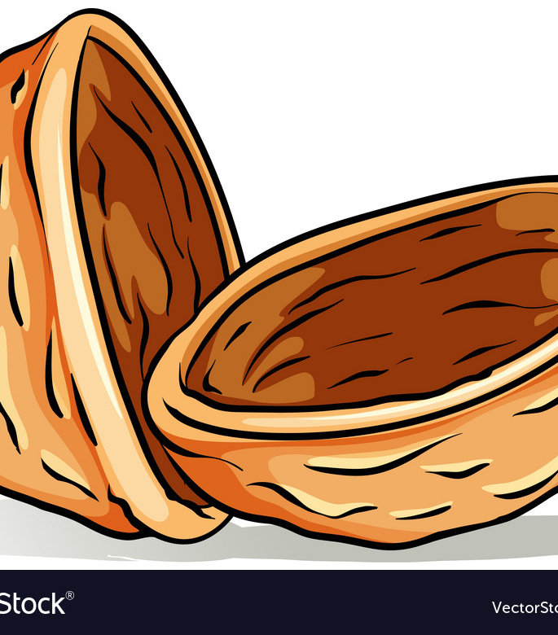
From Greek World to the Modern World
IN A NUTSHELL

Slide 2
European history
1^{st/}2nd cen CE – Neoplatonism
  Plotinus 204-270 CE
2nd century CE – Stoicism
  Marcus Aurelius 121-180 CE
  Constantine 272-337 CE
  St. Augustine 354-430
Fall of Rome – 476 CE
Middle Ages 5th c – 15th c
  Holy Roman Empire – Charlemagne 800; ends 1806
  St. Thomas Aquinas 1225-1274
    works
  St. Bonaventure 1221 – 1274
  Roger Bacon 1214-1292
Renaissance 1300-1600
Ignatius of Loyola 1491-1556
Age of Science 16/17th c – 19th c
  René Descartes 1596-1650
    Meditations of First Philosophy
Modern era 1500-1800+
  Edmund Husserl 1859-1938

Slide 3
Stoic reflection exercises/meditations/practices
Focus on what’s under your control / Let-go of what’s not
  Amor fati
It’s not what happens that harms you but your interpretation of it
Take the view from above (the big picture/universal view)
  What is ultimately most important to you?
Memento mori/think about your death (today could be the day you die)
Examine your life/goals/actions etc. (ruthless housecleaning)
Imagine the worse that could happen
Find a model to emulate
Remember: Success is never final; failure never fatal

Slide 4
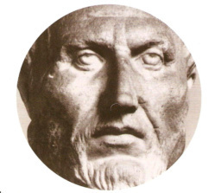



Plotinus (204-270)
Neoplatonism (follower of Plato)
Wrote the Enneads (six groups of nine)
  Edited by Porphry (student)
Main tenets (Emanation/Contemplation)
  The One (God, the Good)
  Nous (Intellect, Spirit – locus of the Forms/Ideas)
  Soul
    Higher part; divine, purely contemplative)
    Lower part (mixed w matter; personality, passions, etc.)
  Matter (pure potentiality; chaos)

Slide 5

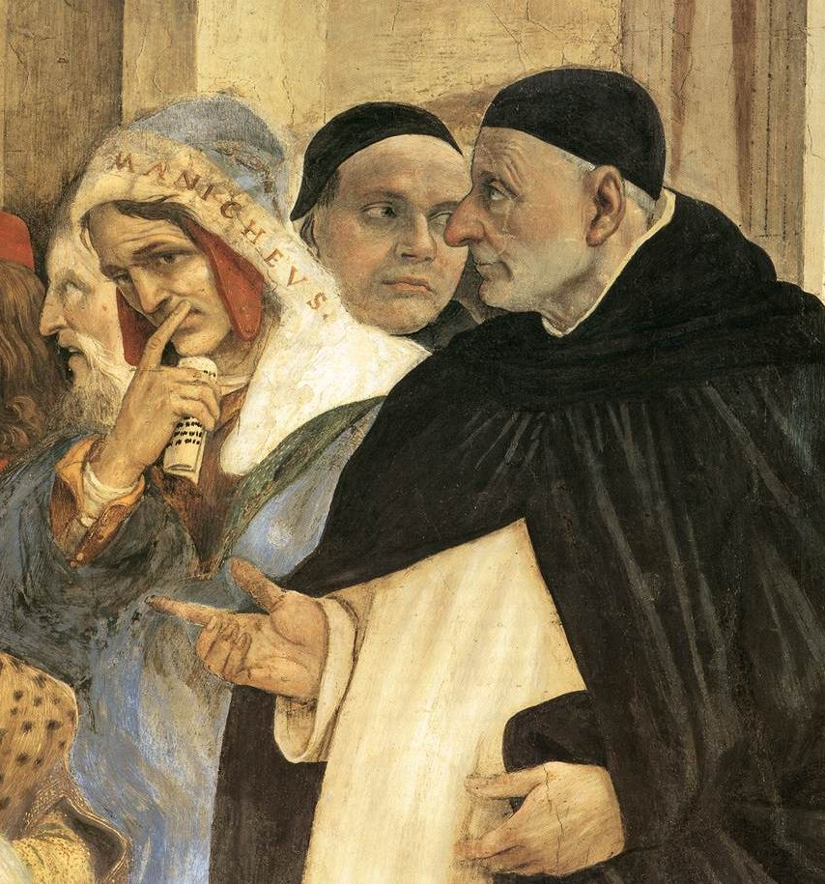
Thomas Aquinas 1225-1274
Faith & Reason
  Natural law (derived from nature by reason/argument/thinking)
  Divine law (God’s revelation); faith
Historically, natural law refers to the use of reason to analyze the meaning and purpose of human being and to logically deduce binding rules of moral behavior from God's creation of the natural world. The concept of natural law was articulated in ancient Greek philosophy, including Aristotle & the Stoics, and was referred to in Roman philosophy by Cicero.

Slide 6

Scholasticism/dominated Medieval education
Scholasticism was a tool and method for learning which places emphasis on dialectical reasoning (the exchange of argument, or thesis, and counter argument, or antithesis, in pursuit of a conclusion, or synthesis), directed at answering questions or resolving contradictions. In medieval Europe, dialectics (or logic) was one of the three original liberal arts (the "trivium"), in addition to rhetoric and grammar.

Slide 7
Scholasticism, main tenets
An acceptance of the prevailing Catholic orthodoxy.
Within this orthodoxy, an acceptance of Aristotle as a greater thinker than Plato.
The recognition that Aristotle and Plato disagreed about the notion of universals, and that this was a vital question to resolve.
Giving prominence to dialectical thinking and syllogistic reasoning.
An acceptance of the distinction between "natural" and "revealed" theology.
A tendency to dispute everything at great length and in minute detail, often involving subtle word-play.

Slide 8
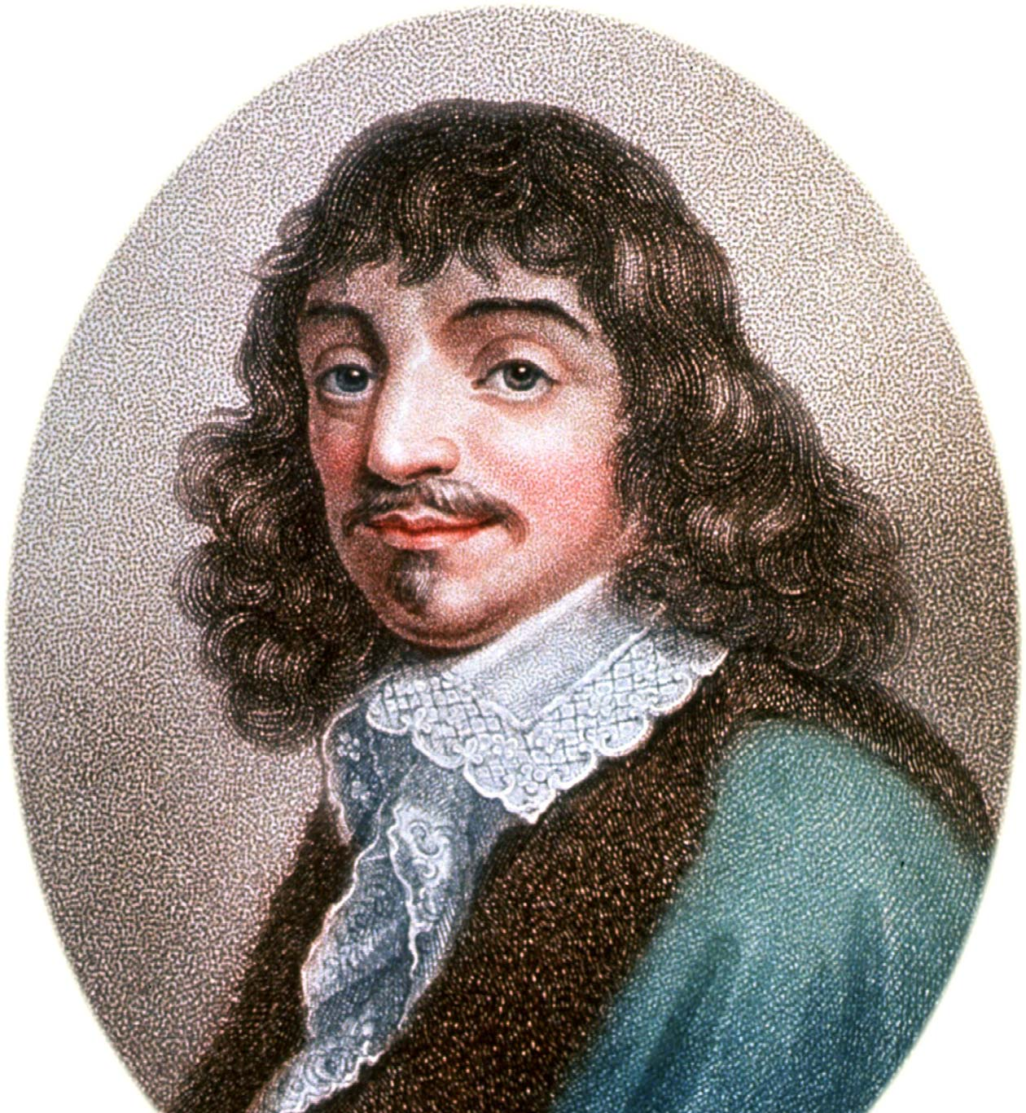
René Descartes 1596-1650
Renaissance 14th – 17th
Beginning of modern era (Modern Philosophy)
D’s interests: Mathematics, natural science, metaphysics
Rationalism / dualism
Method of Doubt
Reasoning from self-evident first principles v God/revelation/authority/tradition/ natural law
I think therefore I am

Slide 9
Descartes 1596-1650
D’s interests: Mathematics, natural science, metaphysics
1614 – leaves La Flèche
1618 – law degree; joins army in Netherlands
1619 – Ulm - three dreams
  New philosophy; apply math model to philosophy; find single truth & all else will follow
1619-1628 – travels in Europe; ends up in Netherlands
1633 – The World (suppressed by D → [Galileo])
  Copernican heliocentrism v Aristotelian geocentrism
    Giordano Bruno: executed 1600
    Galileo Galilei: house arrest for life 1633
Criticizes Scholasticism
  Aristotle’s (prime matter) final cause theory; hylomorphism (matter/form); substantial form theory (tells us nothing new about the thing…thus no new knowledge)
  Induction from sensory data (= probabilism); mechanistic model better (+ mind/body dualism)
  Syllogistic logic ineffective in science
1635 – daughter (with servant girl Helena Jans van der Strom; Francine dies at 5)
1637 – Discourse on Method (“Rules for Direction of Mind”)
1639 – Meditations on First Philosophy
1649 – Passions of the Soul (Princess Elisabeth of Bohemia); moves to Sweden (Queen Christina)
1650 – dies in Sweden

Slide 10


Slide 11
Meditations on First Philosophy
1639 – Meditations on First Philosophy
Med 1
  Hyperbolic (methodical) doubt of sense impressions as knowledge source
  Untrustworthy / madness? / dreaming? / (God) evil demon?
    [Cf. Ignatius of Loyola – Spiritual Exercises; P. Hadot]
Med 2
  “I am, I exist” (True whenever conceived by my mind) [in Discourse: “I think, therefore I am”]
  Piece of wax: how know? Senses? No. Mind yes. / clear and distinct knowledge from mind alone
Med 3
  Theory of ideas: innate, invented, adventitious
  Mechanistic determinism
  Innate ideas / formal & objective reality
  The idea of a perfect God (must come from a God who actually exists)

Slide 12
Meditations continued
Med 4
  God is not a deceiver.
  Will, intellect and the possibility of error
Med 5
  God exists because existence is part of His perfection
  Essence determined by intellect, not empirical observation
Med 6
  Body: extension (must exist because God is not a deceiver)
  Body / mind dualism

Slide 13
After Descartes (Modern Philosophy – 17th to early 20th)
The ‘Age of Reason’ (17th & 18th)
Rationalism
  Gottfried Leibniz (1646–1716)
  Baruch Spinoza (1632–1677)
Empiricism
  John Locke (1632-1704)
  George Berkeley (1685-1753)
  David Hume (1711-1776)
Immanuel Kant (1724-1804) (Transcendental Idealism)
  Johann Gottlieb Fichte (1762-1814)
  Friedrich Schelling (1775-1854)
  Georg Wilhelm Friedrich Hegel (1770-1831)
Edmund Husserl (1859-1938)

Slide 14
Phenomenology
Edmund Husserl (1859-1938)
Martin Heidegger
Maurice Merleau-Ponty
Emmanuel Levinas

Slide 15
Existentialism
Søren Kierkegaard 1813-1855
Friedrich Nietzsche 1844-1900
Jean-Paul Sartre 1905-1980

