Slide 1
ENTREPRENEURIAL ETHICS
Chapter 4- Personal Moral Development:
Creating and Configuring Your Moral Self

Slide 2
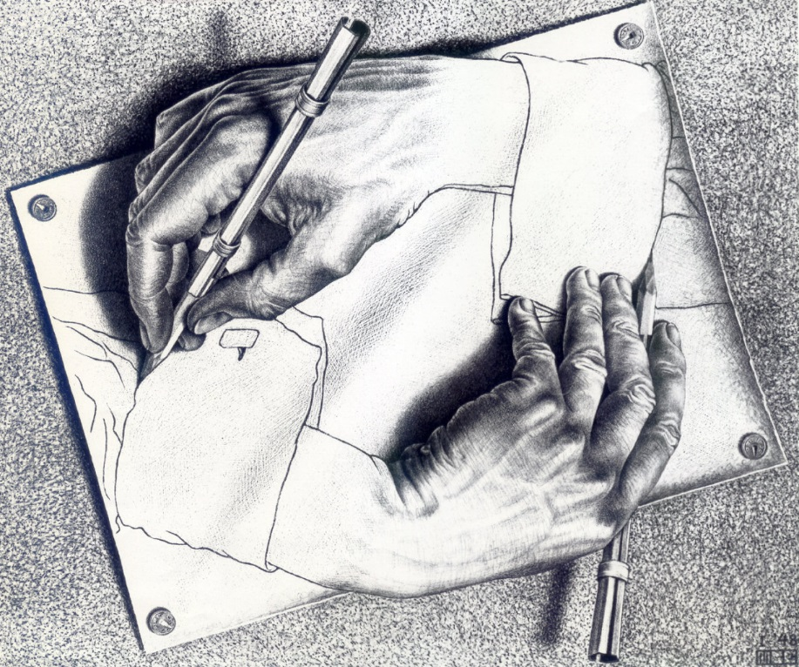
Personal Moral Development

Slide 3
Virtue ethics
Building Character | Pursuing Excellence

Slide 4
Virtue Ethics (Aristotle 384-322 B.C.E.)
Basic Structures
Everyone has a natural end or purpose (telos) in this life
Practicing the virtues actualizes this potential.
Happiness (flourishing, thriving) (Eudaimonia) = goal of Ethics
Virtue (Arête) = excellence
Different types of Greek virtues: intellectual, moral, practical, athletic, etc.
Virtues are created in us by repetitive practice; habit; mindless, sort of…
Moral Virtue = excellence of character
Embodied or actualized virtues are character traits
Individual citizen needs state/nation to achieve, thus closeness of morality & politics and society
Main Greek moral virtues: wisdom, courage, justice, temperance, piety plus many others
Aristotle: Virtue understood as mean between two extremes (vices)
Self-actualization

Slide 5
Different Cultures, Different Virtues

Slide 6
Virtue Ethics: General Moral Principle
You should always act in such a way that your actions aim at producing a virtuous character in yourself.
Be all you can be.

Slide 7
List of virtues/personal values (as part of the Self) List of virtues (2) Ten Essential Virtues
Wisdom
Justice
Piety
Fortitude (Courage)
Self-control (Temperance)
Love
Positive Attitude
Hard working
Integrity
Gratitude
Humility

Slide 8
Virtue Ethics: General Moral Principle
You should always act in such a way that your actions aim at producing a virtuous character in yourself.
Be all you can be.

Slide 9
Virtue Ethics: Pros & Cons
Pros:
Widespread & perennial; holistic view of human nature / character development; cross-cultural; developmental; self-creation; responsibility for self; virtuous way of life;
Cons:
somewhat relativistic (virtues differ arbitrarily); bourgeois (Greek citizens, male-oriented); individualistic; conflicts difficult to resolve; self-focused (anti-social?)

Slide 10
What is the difference between Virtue Ethics, Deontology, and Utilitarianism? Required Reading
Virtue Ethics (a detailed overview of virtue theory, Internet Encyclopedia of Philosophy)
Virtue Ethics Commentary (an overview, Stanford Encyclopedia of Philosophy)
The Greek Word "Arete" Means "Virtue" "Virtue Ethics Without Character Traits" by Gilbert Harman (This paper looks at linking virtues with actions rather than with traits as a way of getting passed the whole debate about character.)

Slide 11
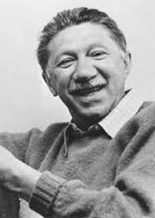
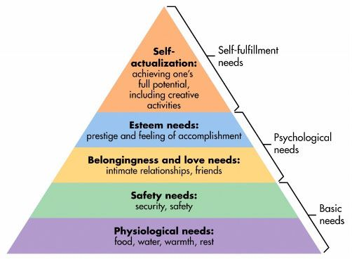
Abraham Maslow 1908-1970
Self-actualization theory

Slide 12
Do psychologists still use Maslow’s hierarchy of needs? (4:31) required

Slide 13
Expanded hierarchy of needs

Slide 14
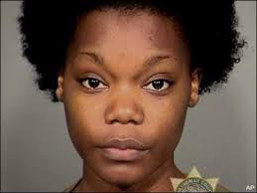
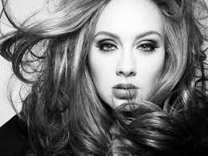
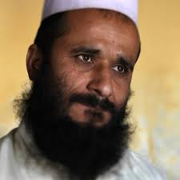
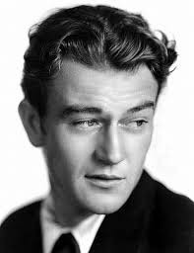
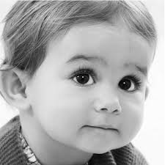
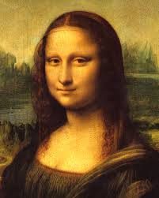
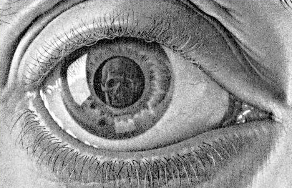
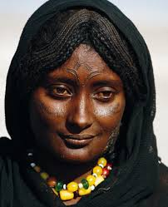
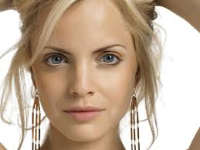
Phenomenology &Existentialism

Slide 15
Phenomenology Edmund Husserl 1859 -1938
Phenomena (Greek: phainomenona = “that which appears”)
Focus on first-person description of subjective experience
Husserl sought apodicticity (scientific certitude) - Existentialists rejected this idea - Used Phenomenology to see/investigate human condition
Existential Phenomenology
Practicing the Phenomenological ‘Reductions’
3 steps
Epochæ (suspension of judgment re what is not certain; bias, etc.)
Reduction of objective world (natural attitude) to phenomena
Reduction of phenomena to essences (that without which X could not be X)

Slide 16
Existentialism (Great resource page) Some prominent Existentialist thinkers
Soren Kierkegaard 1813 – 1855 Friedrich Nietzsche 1844 – 1900 Miguel de Unamuno 1864 – 1936 Martin Heidegger 1889 – 1976 Gabriel Marcel 1889 – 1973 Jean-Paul Sartre 1905 – 1980 Simone de Beauvoir 1908 - 1986 Hannah Arendt 1906 – 1975 Emmanuel Levinas 1906 - 1995 Etc., etc., etc.
Society for Phenomenology and Existential Philosophy

Slide 17
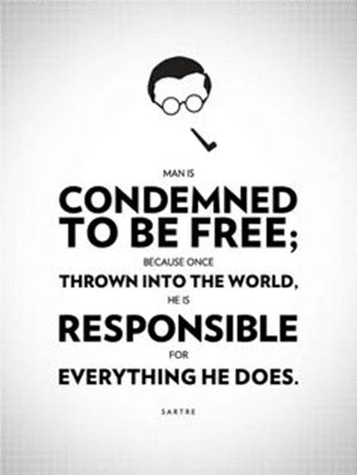
“condemned to be free”
Jean-Paul Sartre
Responsibility for self

Slide 18
Existentialism: We MUST make moral judgments
Existential human situation - Life is absurd; must create meaning
Sartre: “existence precedes essence”
Thrown into world
No escape
Self = essential freedom
Confronted by moral choices
Must choose (no escape)
Authenticity
“bad faith”
Our choices create us
Anxiety / despair
Must be responsible for my choices
Blaming is bad faith

Slide 19
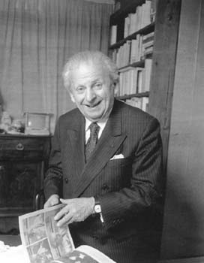
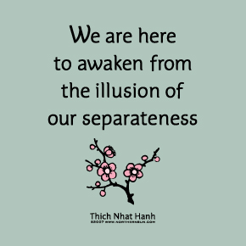
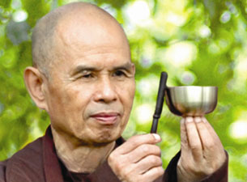
Responsibility for the Other: face-to-face with the Other
Emmanuel Levinas (906 – 1995)

Slide 20
Current Levinas recognition
North American Levinas Society
Emmanuel Levinas: New World Encyclopedia
Levinas Studies – An Annual Review
Société Internationale de Recherche Emmanuel Levinas.
Institut D’Etudes Levinassiennes
Levinas Studies | Facebook
Walsh Ph.D. dissertation: “The Priority of Responsibility in the Ethical Philosophy of Emmanuel Levinas”

Slide 21
Face-to-face with the Other

Slide 22
Levinasian Themes
Face-to-face relation
The other and the Other
The widow, the orphan & the stranger
The call/claim of the Other over me
Sociality
The one-for-the-other
For-the-Other
Ethics prior to metaphysics
Priority of response-ability

Slide 23
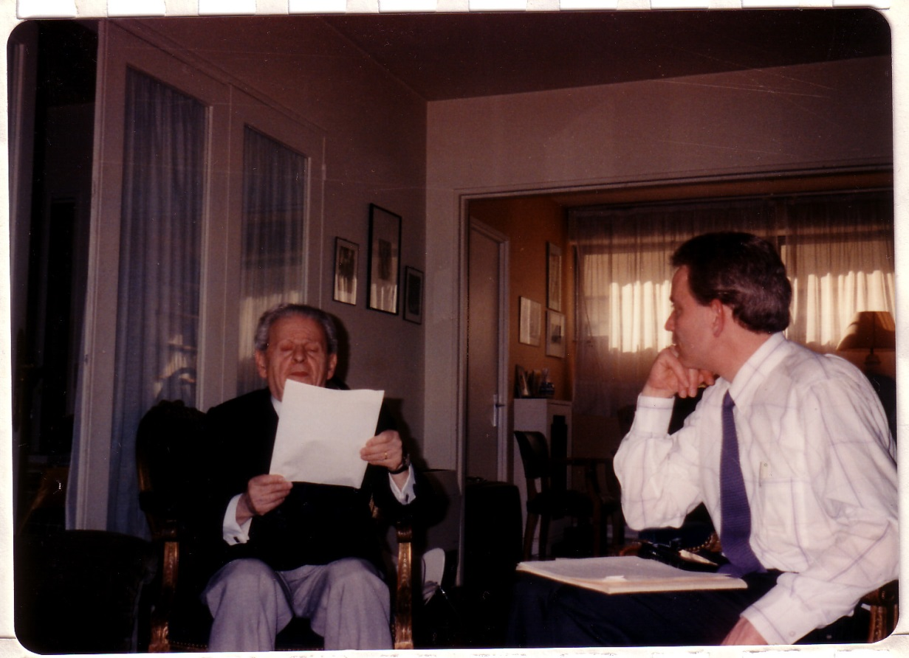

Slide 24
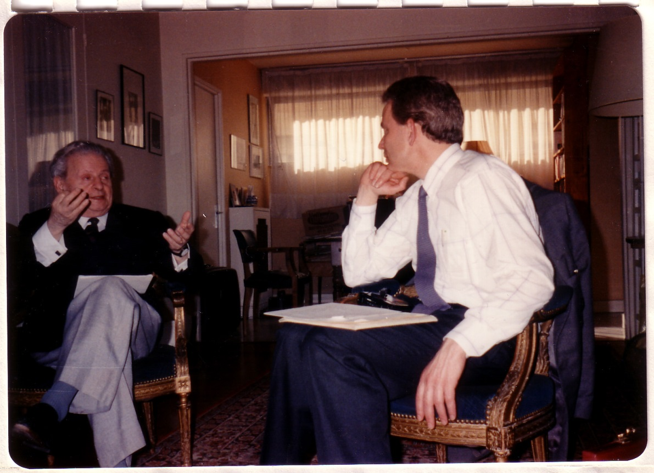

Slide 25
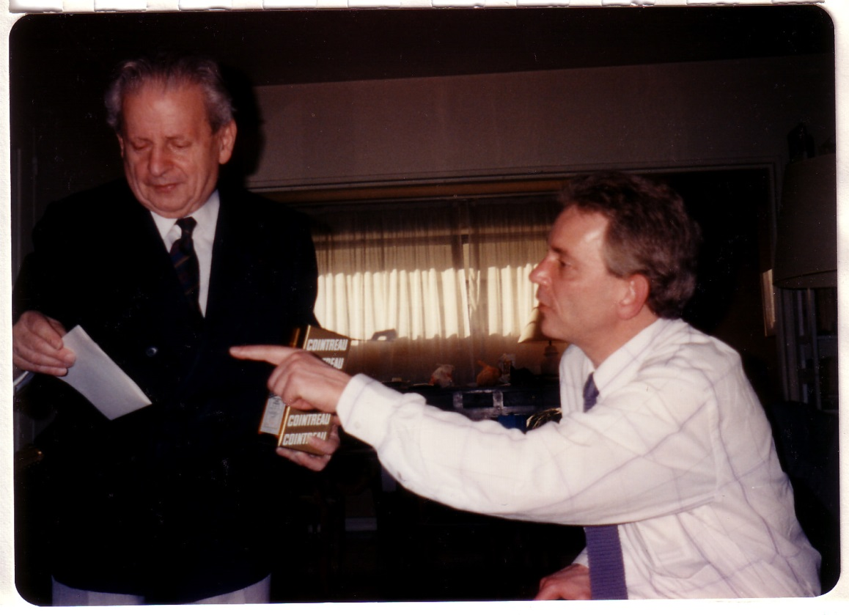
Booze

Slide 26
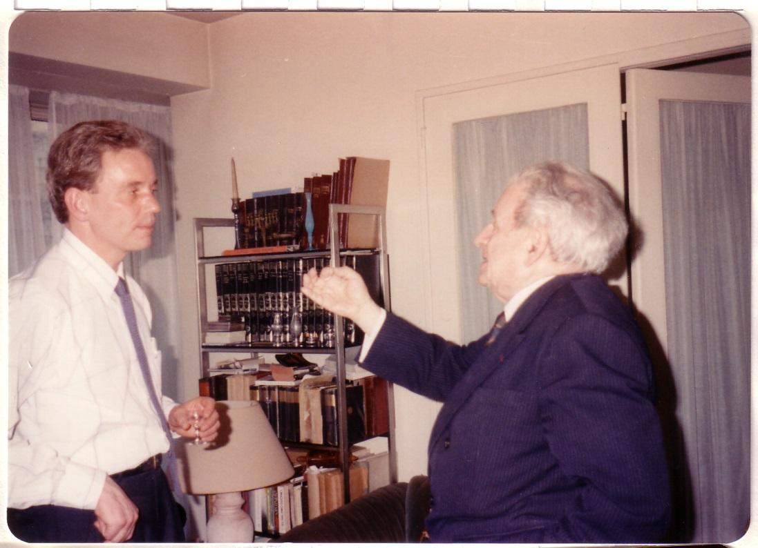

Slide 27
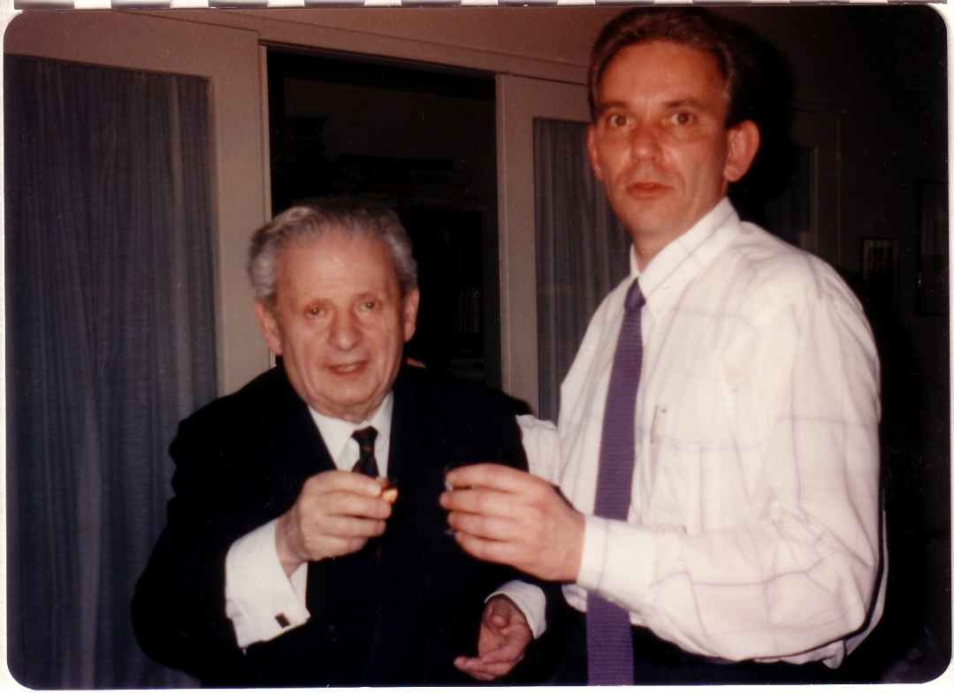

Slide 28
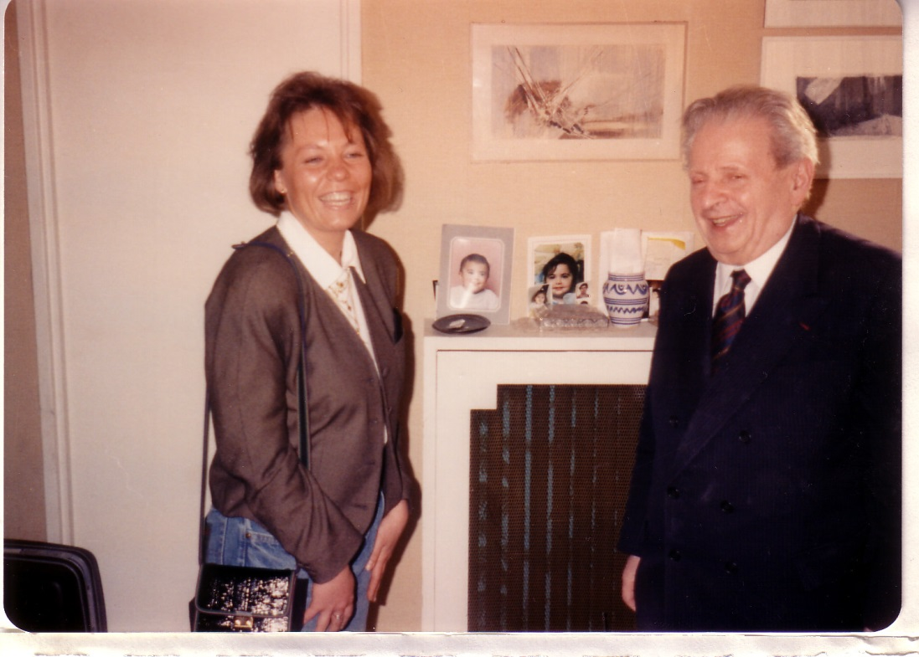

Slide 29
American Pragmatism
Main developments between 1850-1950
William James
Charles Sanders Peirce
John Dewey
Richard Rorty
an approach to understanding that
assesses the truth
of the meaning of theories or beliefs
in terms of the success of
their practical application
Practical configuration of Self/Society/World from experience
Try it on; see if it fits

Slide 30
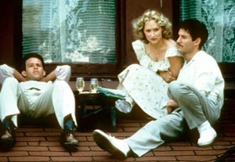
We MUST make moral judgments
Sophie’s Choice

