Slide 1
Chapter 6: Stoicism and personal moral power
How to Achieve Success in Your
Personal and Professional Life

Slide 2
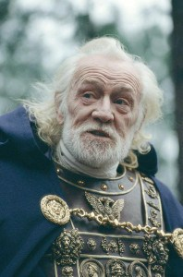
Stoicism, Entrepreneurs, and Emperors
9 Stoic Principles to Live by
(Recommended)
Want an Unconquerable Mind?
Try Stoic Philosophy (Carrie Sheffield / Forbes - Recommended)
Stoicism 101: A Practical Guide
for Entrepreneurs
A Few Words About Stoicism
(in depth article)

Slide 3
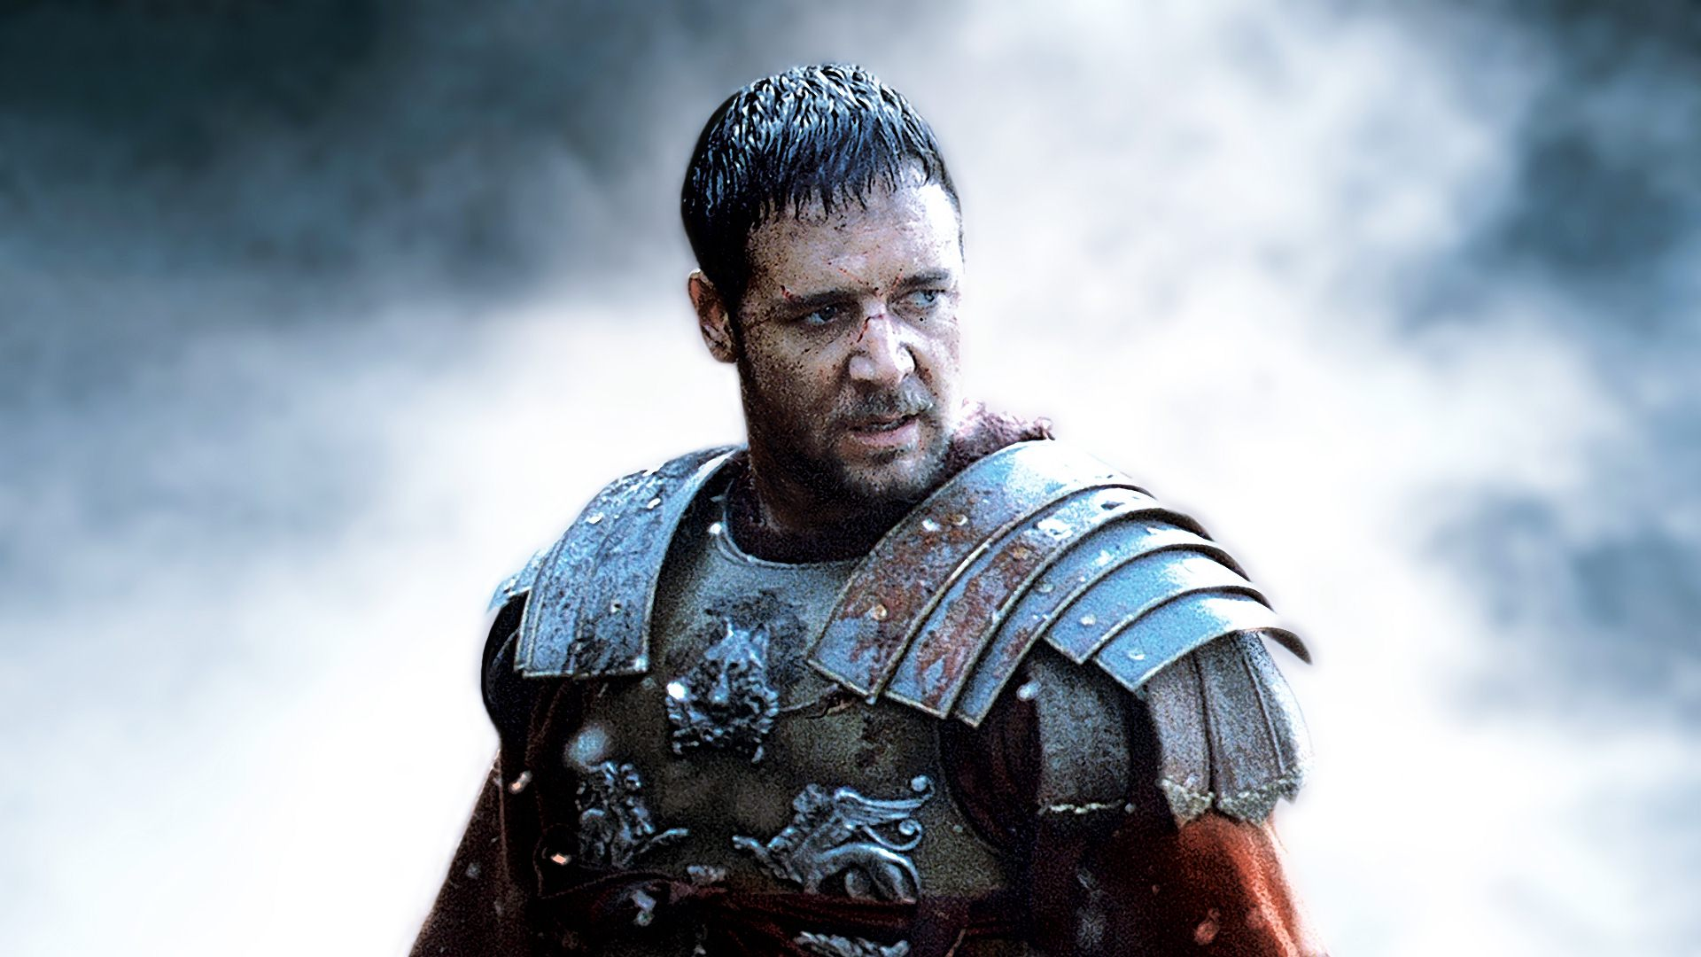
Gladiator trailer

Slide 4
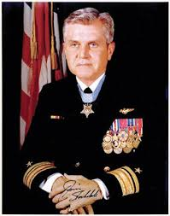
James Stockdale
“So what Epictetus was telling his students was that there can be no such thing as being the "victim" of another. You can only be a "victim" of yourself. It's all in how you discipline your mind. Who”
― James B. Stockdale, Courage Under Fire: Testing Epictetus's Doctrines in a Laboratory of Human Behavior

Slide 5
Stoicism and Resilience
The test of a philosophy is simple: does it lead people to live better lives? If not, the philosophy fails.
If so, it succeeds….

Slide 6
Jonathon Newhouse, CEO Conde Nast Int’l.
“If someone is behaving in a rude way, step back and say ‘OK that’s their problem. What’s my responsibility? Mine is to follow the precepts of truth, justice, courage and self-control’ … nothing can prevent you from living according to the precepts of Stoicism.”

Slide 7
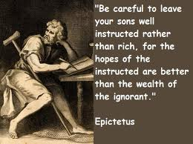
Epictetus ~ Stoic Teacher / Philosopher
Ἐπίκτητος AD 55 – AD 135

Slide 8
A Few Words About Stoicism from Epictetus, on the purpose of life Epictetus

Slide 9
How to Achieve Happiness?
Practice virtue
Live in accord with reason
Caution about passion
Get some ethical and philosophical
training for life
Practice self-reflection
Make careful judgments
Develop inner calm. How?
Focus on what is under your control
Let go of what is not under your control

Slide 14
Ask Epictetus

Slide 15
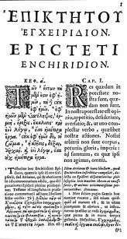
Epictetus: NO Nobody can cause you to get angry.
The Enchiridion By Epictetus Written 135 C.E. Translated by Elizabeth Carter
“1. Some things are in our control and others not. Some things in our control are opinion, pursuit, desire, aversion, and, in a word, whatever are our own actions. Things not in our control are body, property, reputation, command, and, in one word, whatever are not our own actions.”

Slide 16
“The things in our control are by nature free, unrestrained, unhindered; but those not in our control are weak, slavish, restrained, belonging to others.
Remember, then, that if you suppose that things which are slavish by nature are also free, and that what belongs to others is your own, then you will be hindered. You will lament, you will be disturbed, and you will find fault both with gods and men.
But if you suppose that only to be your own which is your own, and what belongs to others such as it really is, then no one will ever compel you or restrain you. Further, you will find fault with no one or accuse no one. You will do nothing against your will.
No one will hurt you, you will have no enemies, and you will not be harmed.”

Slide 17
So…What do you think?

Slide 18
Personal Power
PERSONAL POWER is your ability to get what you want, and to live the life you want, as far as this is possible.

Slide 19
Creating Personal Power: 4 tips
1. Perpetually focus on determining what is under your control and what is not; act on what is, let go of what is not
Marks the limit of your personal power
2. Taking responsibility for what is under your control
No blaming; living by principles
3. Indifference to what is not under your control
Let it go
4. The more responsibility you take for what is truly under your control (while letting go of what is not), the greater your Personal Power
Lifelong practice
START RIGHT NOW!

Slide 20
Stoicism Influenced Contemporary Psychotherapy
Albert Ellis

Slide 21
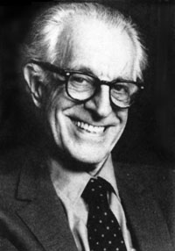
Rational Emotive Behavior Therapy (REBT) also called Cognitive Behavioral Therapy (CBT)
Albert Ellis
1913-2007 Books by Albert Ellis

Slide 22
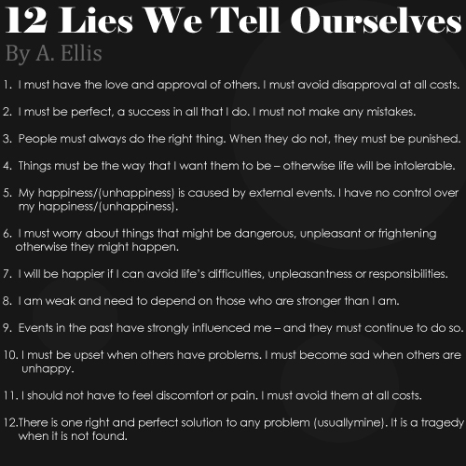

Slide 24
Jules Evans
How Stoic philosophy saved my life

