Slide 1
Fainting, Flirting, & Fighting: Nonverbal Communication and the Art of Storytelling
Karen Stewart
CNYRW ● September 7, 2019

Slide 2
What do communication scholars research?
Human Communication
Interpersonal Communication
Nonverbal Communication

Slide 3
How important is Nonverbal Communication?
In 1967, the Journal of Consulting Psychology published a study conducted by two researchers that would eventually shape the way we understand the importance of nonverbal communication. Written by UCLA professor Albert Mehrabian and Susan R. Ferris, the piece described the relative importance of words, tone of voice and body language in understanding an underlying emotional message…

Slide 4
How important is Nonverbal Communication? 93% of meaning is conveyed through nonverbal cues!
Notes:
What does this mean for writers??

Slide 5
World of Time written by Robert Jordan, Brandon Sanderson
Notes:
https://www.reddit.com/r/WoT/comments/60t4n8/stats_for_braids_tugged_skirts_smoothed/

Slide 6
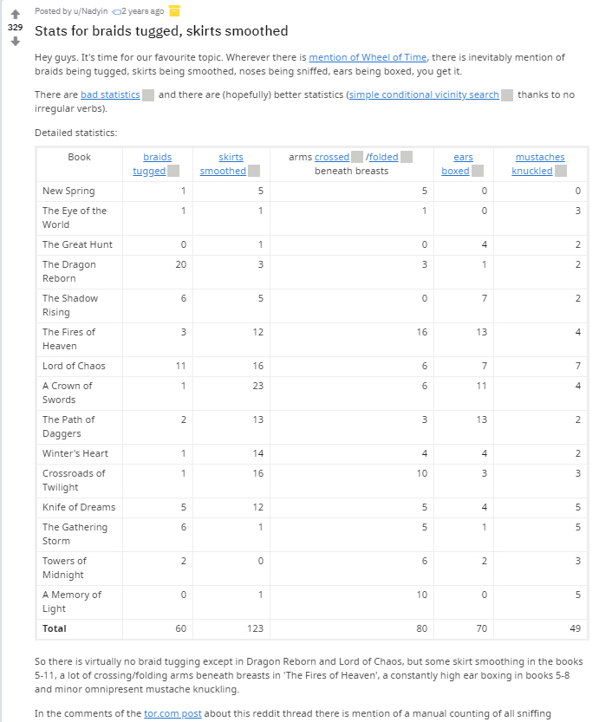
Notes:
https://www.reddit.com/r/WoT/comments/60t4n8/stats_for_braids_tugged_skirts_smoothed/

Slide 7
Let’s Make a List…

Slide 8
What exactly is nonverbal communication?
Facial expressions
Gestures (emblems, illustrators, regulators, adaptors)
Body movements
Eye contact
Use of personal space (intimate = 1ft, personal = 3 ft, social = 6 ft)
Use of paralanguage (voice qualities like pitch, rate, fillers)
Use of silence
Use of time

Slide 9
The Dark Side of NV Communication
Hard to LIE with your non-verbals
Some non-verbal behaviors appear prejudicial:
Not looking at someone when talking with them
Not acknowledging someone’s presence
Staring as if to say “Why are you here?”
Not listening or responding to what they say
Avoid touching their skin when giving/taking something
Watching closely to see what they are up to
Avoiding someone walking near you

Slide 10
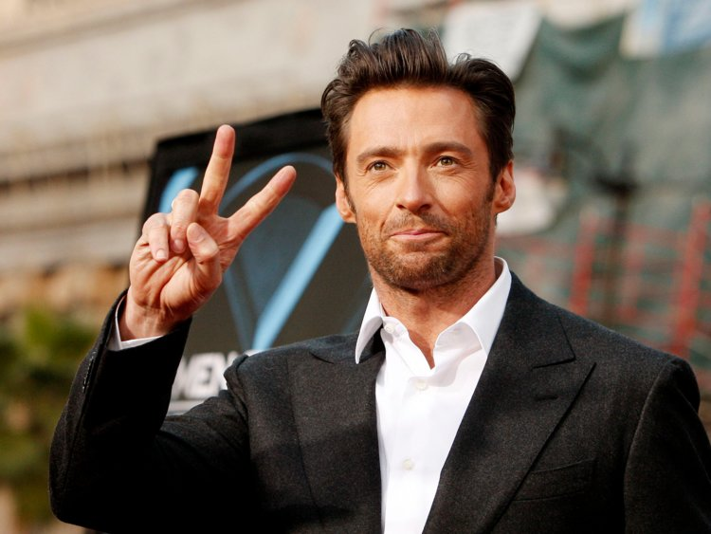
Nonverbal Communication varies by culture. if you get it wrong, people from that culture will know. #ownvoice Sensitivity Readers
Notes:
https://www.yahoo.com/lifestyle/18-gestures-that-can-cause-offense-around-the-114150011797.html
https://hopscotchtheglobe.com/10-obscene-hand-gestures-around-the-world/

Slide 11
How can we use this info to enhance our stories?

Slide 12
1. Think Variety
People in the United States engage 54 nonverbal actions when flirting…
Let’s name as many as we can!

Slide 13
2. Think Cultural Differences
Characters with different cultural backgrounds will need to learn how to interpret each other’s nonverbal messages.
Notes:
The New York flat smile / PHX no smile
High vs. Low flirting cultures
Loud vs. quiet cultures
Stranger engagement
Shifter vs. Human cultures (Silver Silence by Nalini Singh)

Slide 14
2. Think Miscommunication!
Nonverbals are pretty easy to misunderstand even between people who share a cultural nonverbal vocabulary.
Notes:
Dollar exchange
IR Book signing

Slide 15
Three Examples to Consider

Slide 16
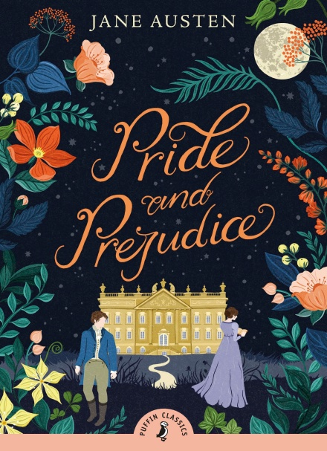
Notes:
Lizzie / Elizabeth and Mr. Darcy

Slide 17
Notes:
Greta Helsing and Varney

Slide 18
Notes:
Sophie – believes the oldest of three sisters will never be successful

Slide 19
Thank you!

Slide 20
Gestures
Arm and hand movements
Emblems = have specific meaning (thumbs up!)
Illustrators = flow with spoken words for reinforcement or emphasis (measurements, spinning around)
Regulators = regulate dialog (shhh! Hurry up!)
Adaptors = help us manage our emotions (covering mouth, clinching nails into palm)

Slide 21
