Slide 1
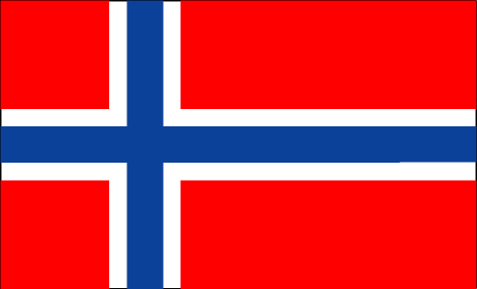

Norwegian Buhund
Club of America
NBCA
Breed Presentation

Slide 2
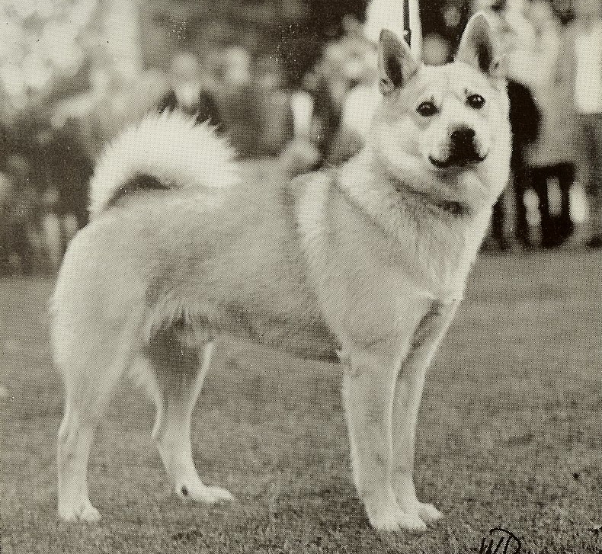
Norwegian Buhund Club of America
Introduction to the Breed

Slide 3
History in Norway
The ancient Gokstad ship (900 AD) had 6 dog skeletons, 2 are similar to the modern day Norwegian Buhund.
A number of ship graves at a rock called Bikjholberg from the Viking Age city, Kaupang in Norway contain the remains of a spitz dog similar to the modern Norwegian Buhund.
As the custom was that only the most precious belongings should accompany the master into the grave and to Valhalla, it is quite clear that the ancestors of the Buhund were highly prized.

Slide 4
History in Norway
The word “Buhund” was documented by 1698, when it was written in the “Ordsamling frå Norderhov” ; I.J. Rasmus, 1698: Buhund, faehund, canis pecuaris.
The dog was present on nearly every farm. “Bu” means home or farm.
The Buhund was so often seen near the Norwegian chalets, where the women lived while watching their herds grazing in the summer, that it was eventually considered the “women’s dog.”

Slide 5
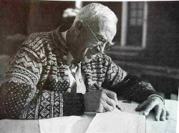
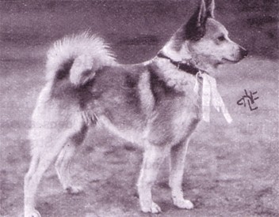
History in Norway
1920 the breed was threatened with extinction. Jon Saeland, the Norwegian State Counsel, organized an inventory and analysis of the state of the Norwegian Buhund.
1926, a breed description was written in collaboration with Carl Omsted, who was the expert on Spitzdogs in the Norwegian kennel club (NKK).
1926 first exhibition and registry .
1936 first Buhund Club.
Notes:
The Buhund is Norway’s national dog.
In the 1920’s Buhund shows were commonly held in connection with state-run goat and sheep shows.
Saved by the active breeders in the “sheep country” Rogaland in south-western Norway.
It has been threatened with extinction several times in its history, and is currently on the NKK’s “in danger of extinction” list.

Slide 6
History in the United States
1983: Aud-Marie Ferstad Maroni founded the Norwegian Buhund Club of America as a Specialty Club.
1989: Mrs. Maroni returned to Norway to live and asked Mrs. Jan Barringer to replace her as President.
1990: The first Specialty as a non-AKC club. 19 Specialties were held before the breed was accepted into the AKC.
Notes:
There are currently about 550 registered Buhunds on the North American Continent, and about the same in Europe.
About 90 puppies were born in the US in 2010, about 1/3 of that to date (July 2011).
160th breed to enter AKC
In the Herding Group in AKC and CKC. In the Primitive-Spitz Group in FCI

Slide 7
History in the United States
1996: The Club's registry was accepted into the AKC's Foundation Stock Service.
2006: Norwegian Buhunds accepted into AKC’s Miscellaneous Class.
2009: Norwegian Buhunds accepted into the Herding Group with the NBCA as the Parent Club.
2010: NBCA’s First AKC National Specialty in Springfield, MA
Notes:
Our membership is scattered widely, with the main groups of showing and breeding Buhunds in Oregon, Colorado, the Upper Midwest, and the New Jersey/New York area (in order of smallest to largest groups).
There are currently 21 Buhunds on the list of “Top 25 Buhunds”.
There are currently 8 Grand Champion Norwegian Buhunds.
The NBCA’s 2011 AKC National Specialty will be held in Lancaster, OH (just southeast of Columbus, OH) on September 18, with a supported entry on September 17.
The Specialty is in conjunction with the Licking River Kennel Club events

Slide 8
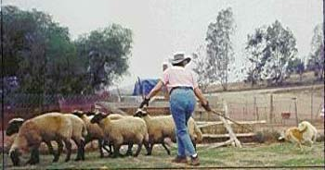
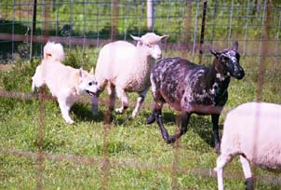
Function of the Breed:
Sheep Herding
Buhunds were often sent up into the Mountains on their own to gather and fetch the sheep.
Notes:
The breed was used to herd mainly sheep, sometimes other livestock, and to watch the farm.
Buhunds will “alert” to any movement, and thus make good guardians of home and stock.
Large enough to handle all types of livestock but small enough to be economical and easy to keep.
In the Spring sheep were driven onto the mountains – looked after by a couple of shepherds and their dogs.
In the Fall, would send the dogs up the mountain to work on their own initiative to gather in and drive the sheep down. Sometimes one or two – sometimes 20-30 sheep.
During the winter down the Buhund keeps the sheep in the unfenced pasture and guards them from predators.

Slide 9
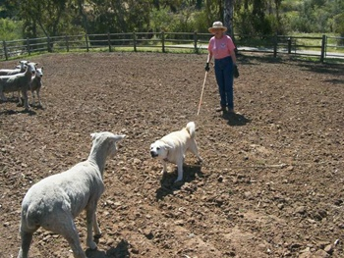
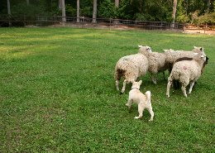
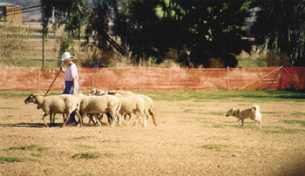
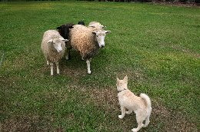
Function: Sheep Herding
Upright, loose-eyed breed that communicates with a bark
Notes:
Buhunds herd independently, in pairs, or with shepherds.
The breed uses several barks to herd: a high-pitched yip to drive the sheep out from hiding, and a lower-pitched but loud “force bark” to move the sheep. There is even a lower bark to warn of strangers
Several Buhunds in the US have AHBA herding titles.

Slide 10
General Appearance:
The Norwegian Buhund is a square, compact breed. It is a typical Northern breed, a little under medium size and squarely built, with a tightly curled tail, set high and carried over the back. The head is wedge-shaped and not too heavy, with prick ears. Broken teeth and honorable scars incurred in the line of herding duty are acceptable.
Notes:
The Buhund’s general appearance points to kinship with the Iceland Dog, to whom he is closely related.
He should not resemble the higher-stationed, lightly built Finnish Spitz, nor should he carry the substance of a Finnish Lapphund.
If a choice between a little coarse or finely built, choose a little coarse.
Not a dog of extremes – everything about the Buhund suggests moderation. This breed is built to last!

Slide 11
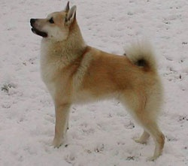

Slide 12
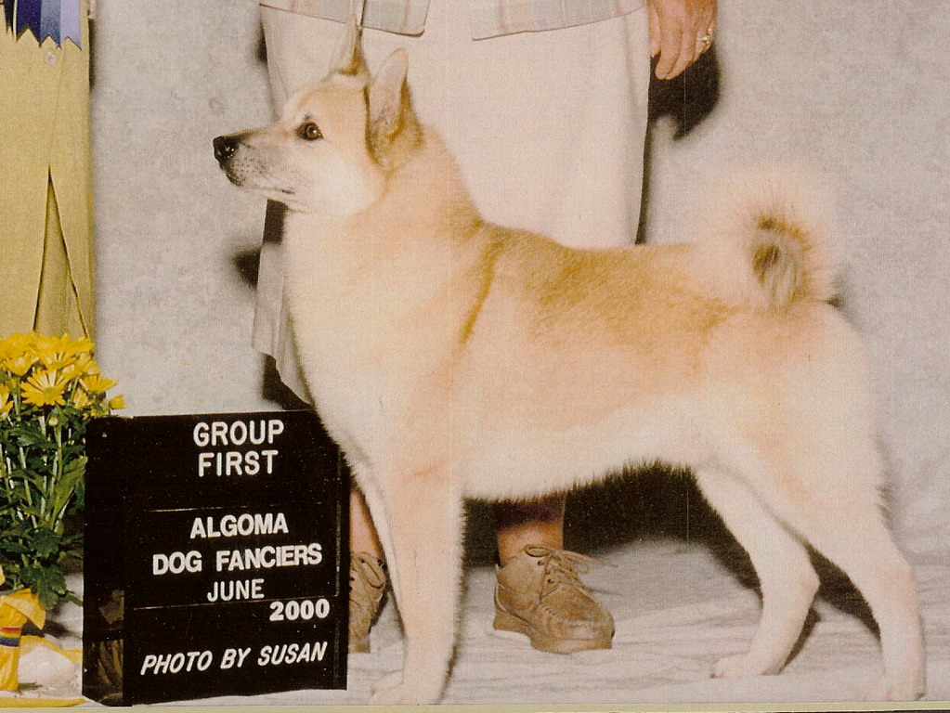
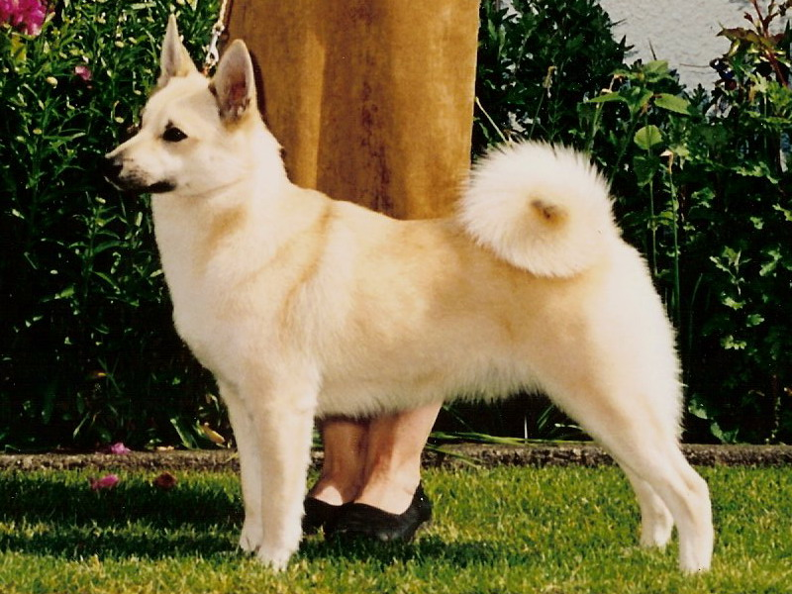
Construction of the
Norwegian Buhund

Slide 13
Proportion and Substance
Robust without being ‘heavy’ or coarse; athletic without being too finely drawn or ‘stringy’.
Proportion: Square in profile. The height, measured vertically from the ground to the highest point of the shoulder blade equals the length, measured horizontally from the prosternum to the rear projection of the upper thigh.
Coat can distort the proportion
Notes:
There is nothing ‘fancy’ or elaborate about the breeds’ construction; he has no quirks of build or other remarkable physical anomalies which might strike one as unusual or peculiar.
He is simply built and remarkably sound.

Slide 14
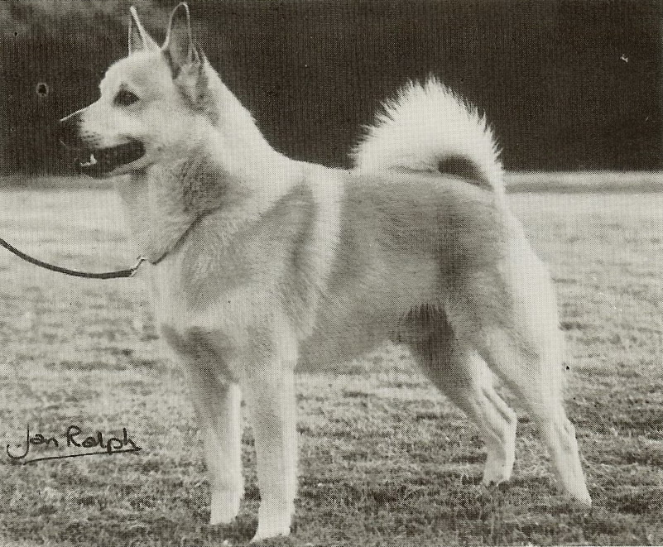

Slide 15
Size and Height
Size: Height at the highest point of the shoulder blade in dogs, 17 to 18 1⁄2 inches; in bitches, 16 to 17 1⁄2 inches.
Disqualifying faults: more than a half inch under, or one inch over the height at the highest point of the shoulder blade.
Weight: Dogs 31 to 40 pounds, Bitches, 26-35 pounds.
Notes:
Important to use a wicket.
Difference in dogs and bitches can be up to 3 inches.
Black dogs always appear smaller than Wheaton dogs, even if they are the same size.
Not a table dog.

Slide 16
Head
Head: The size of the head should be in proportion to the body and not too heavy. The skull is wedge-shaped, almost flat, and parallel with the bridge of the nose. The muzzle is about the same length as the skull, with a stop that is well defined but not too pronounced. The muzzle should be neither snipey nor too broad. The nasal bridge is straight and well filled out under the eyes. The lips should be black and tightly closed.
Notes:
If the length is off, would prefer a slightly longer muzzle to a slightly shorter muzzle.

Slide 17
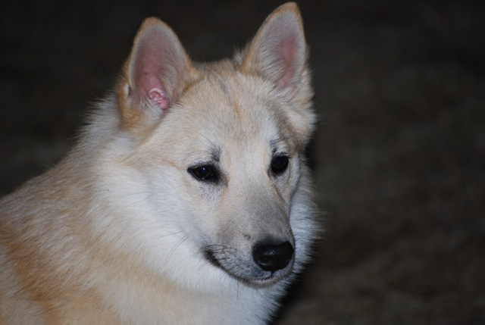
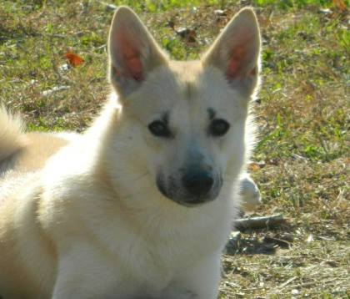

Slide 18
Teeth
The teeth should meet in a scissors bite, with complete dentition.
Disqualifying fault: overshot or undershot mouth.
Notes:
Broken teeth should not be penelized.

Slide 19
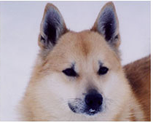
Ears, Nose, Eyes
Ears: Medium sized, prick ears with pointed tips, carried strongly erect yet very mobile. When relaxed or showing affection the ears go back, and the dog should not be penalized for doing this during the judge’s examination.
Nose: Black
.
Notes:
Eyes oval shaped, dark, with black eye rims
Well-filled under eye
Should not be round or protuberant
Whiskers should not be removed – they have an important function. – should be penalized if they are removed.

Slide 20
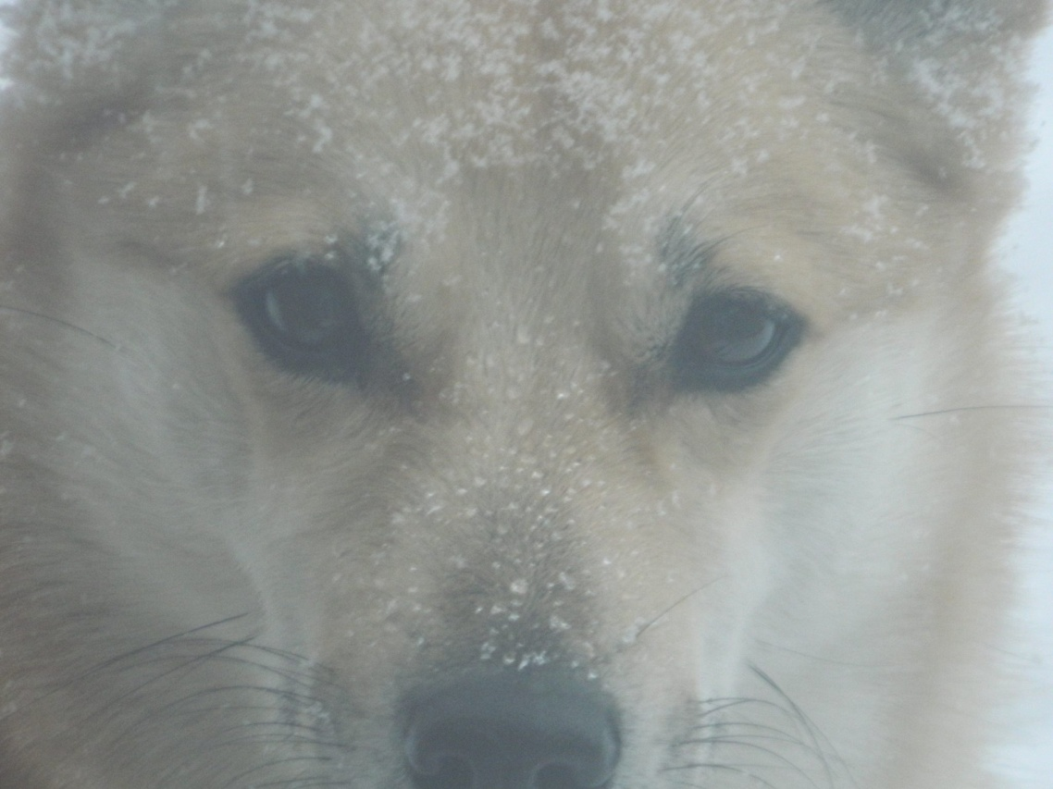
EYES:
Oval shaped, color as dark as possible, black eye rims. Good fill under the eye. Eyes must not be round or protuberant.

Slide 21
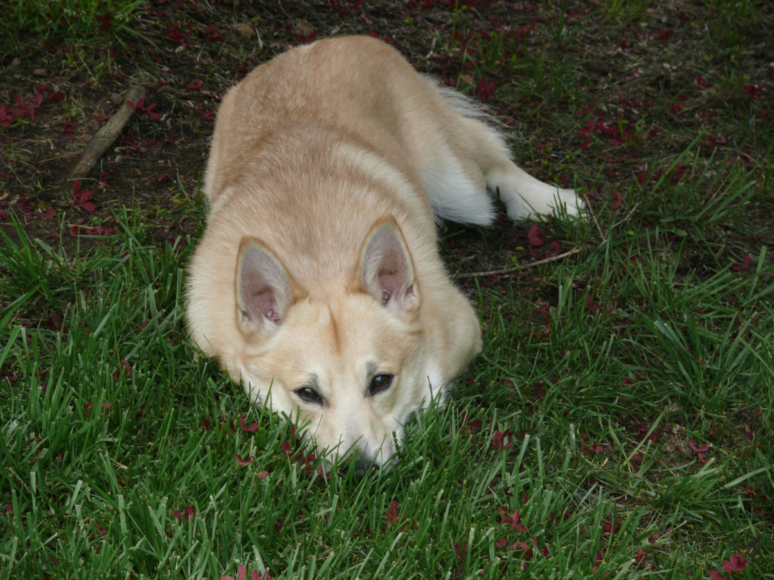
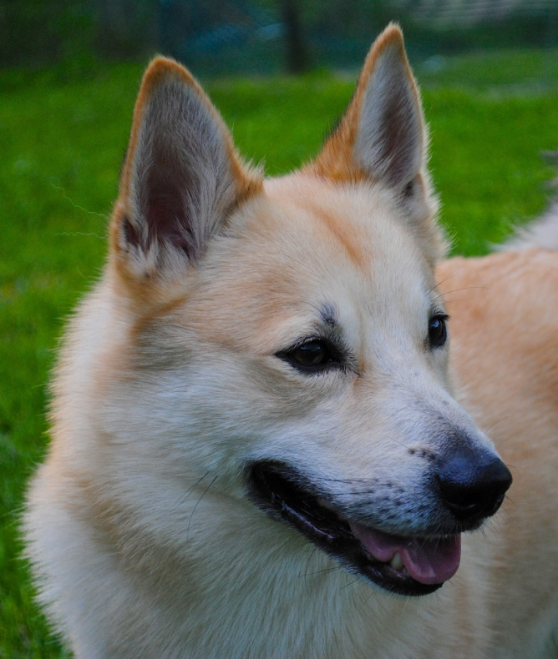

Slide 22
Neck: Of medium length, is well set on, with no loose skin on the throat. Should not be too short or too long. A neck that it too long will distort the appearance of a square, compact dog.
Topline: The back is level; croup with as little slope as possible.
Body: Chest deep, ribs well-sprung. The chest should be well-developed with good depth, with the underline moderately tucked up.
Tail set high, tightly curled and carried over the center line of the back.
Notes:
Correct proportions should be approximately ½ and ½ . Depth of chest should be approximately ½ distance from ground to withers.
Short loin.
Underline of the dog should be a smooth, slight, but slope upwards towards the rear.

Slide 23
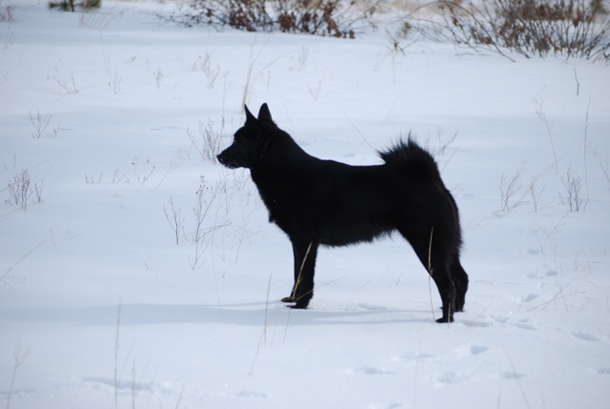
Notes:
Nice fore chest -

Slide 24

Tails should be well-curled, carried high. Looser curls are very common, and are not as serious a fault as a sloping croup with low tail set.
Tails of a Buhund should follow the “3 T’s”: Tight, Tidy and relatively Thick.

Slide 25
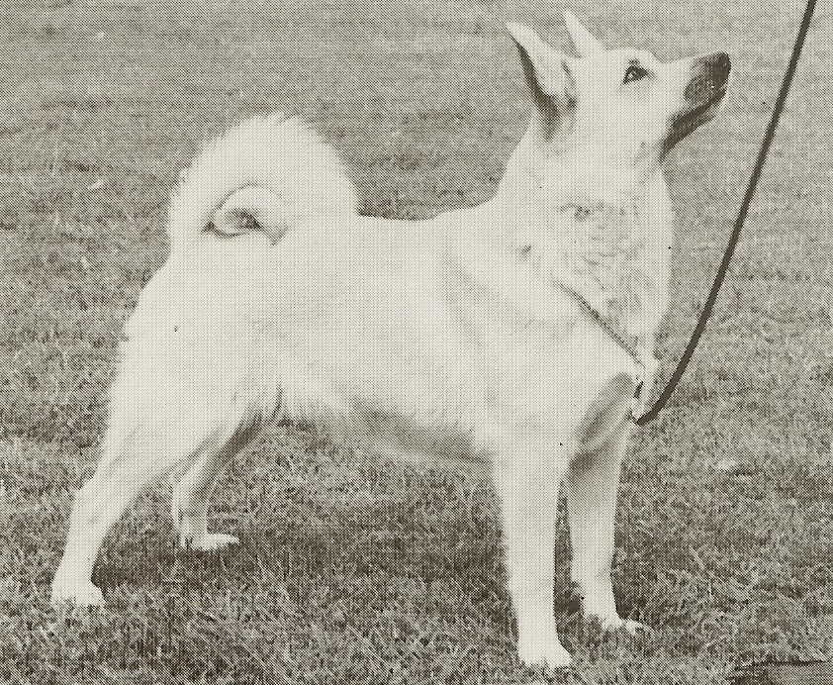
Notes:
Notice the nice tight tail and the space behind the buttocks. This is very important.
Do not worry about length of tail. Length is not a part of the standard. With the desired tightness of tail, please do not uncurl the tail.
Look for the set on and the tightness of the curl.

Slide 26
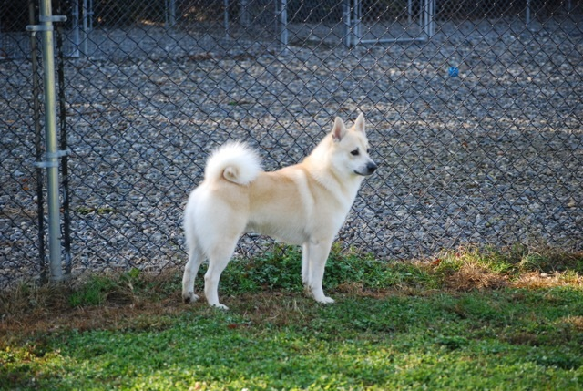
There should be plenty of butt behind the tail.
With the tail curled tightly curled over the back.

Slide 27
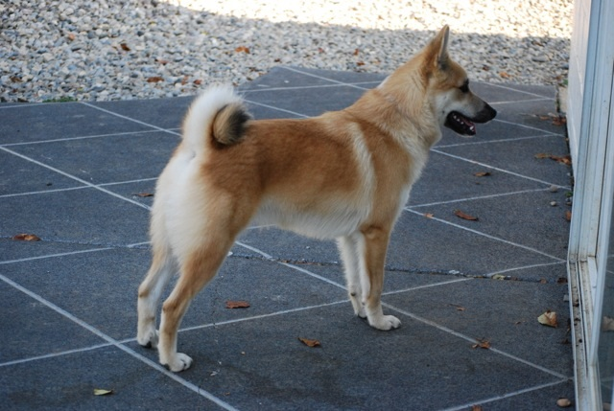

Slide 28
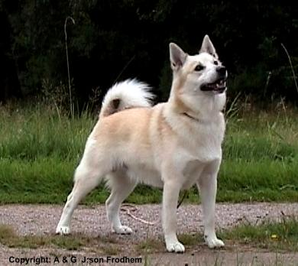
Forequarters: Shoulders moderately sloping, elbows well set, turned neither in nor out; legs substantial but not coarse in bone, legs seen from the front appear straight and parallel; pastern seen from the side moderately sloping; feet oval in shape with tightly closed toes, feet turned neither in nor out.
There should be no “paddling” in the gait.
Notes:
Topline should be level.

Slide 29
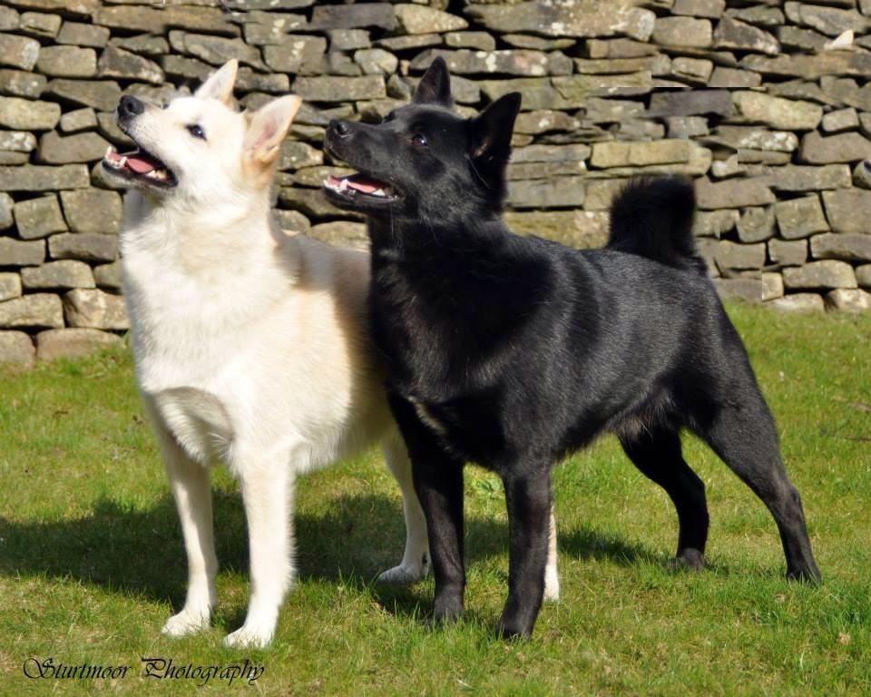

Slide 30
Keep in Mind:
Toes of a Buhund should follow the “3 T’s”: Tight, Tidy and relatively Thick.
Toes (feet) need to be compact, tight and oval in shape. Thin, splayed or ‘flat’ feet should be strongly faulted.
Notes:
Also keep in mind that a dog with a poor foot can not maintain its stamina.

Slide 31
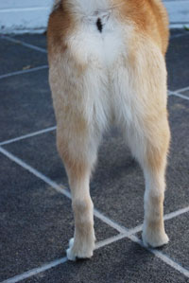
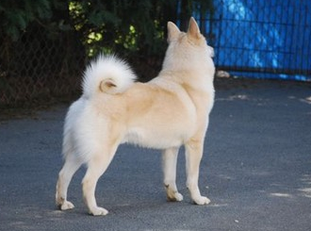
Hindquarters
Hindquarters: Moderate angulation at stifle and hock, upper thigh powerful, well muscled; lower thigh well muscled, seen from behind legs are straight and strong, feet same as above.
Notes:
A word about feet: Many Buhunds are born with double dewclaws in the rear; these are acceptable.
Dewclaws may be removed, or may be present.
Thin, splayed or flat feet should be heavily faulted.

Slide 32
Coat
The coat should be a medium length, the harsh outer coat laying relatively flat to keep the soft dense undercoat dry. The coat should never appear to be fluffy or open.
The coat on the head and front of the legs is comparatively short. The coat on the neck, chest and back of thighs is longer.
Notes:
The coat of the Norwegian Buhund is, in many ways, that of a ‘typical’ Nordic dog; it must be thick, rich and relatively hard, and should lay fairly smoothly.
Undercoat is soft, dense and somewhat water repellent. Absence of undercoat in summer months is to be expected – NOT penalized.
BEWARE a fluffy, “open” coat – a good ‘jacket’ will be readily apparent, and will NOT need ‘artificial enhancement’. Should be penalized
Trimming – does it help the dog work better? No?
Basic tidying is one thing; sculpting, chalking, dyeing, etc., should be penalized.

Slide 33
Color
Color: Wheaton: (any shade from pale cream to bright orange) With or without dark tipped hairs; as little white as possible; black mask acceptable.
Black: Preferably without too much bronzing; with as little white as possible. Areas where white is permissible: a narrow white ring around the neck, a narrow blaze on the face, a small patch of white hairs on the chest, white feet and tip of the tail.
Notes:
Color to be as clear and clean as possible
Wheaten to run the gamut of clotted cream to new penny
Black tips accepted
Black Mask accepted.
Black to be as coal, with as little bronzing as possible
White to be accepted only to the degree overall impression is not jarred.
(feet
tail tip
forechest
narrow ring around the neck
narrow blaze on face
No other colors accepted.

Slide 34
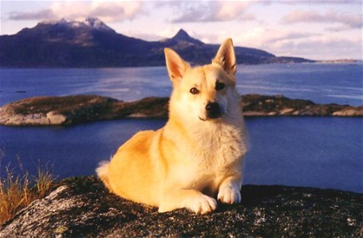
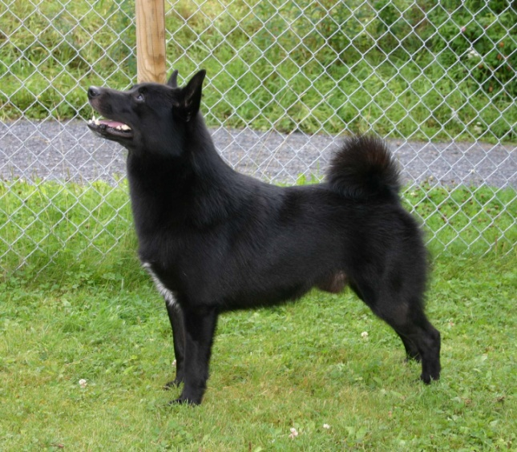
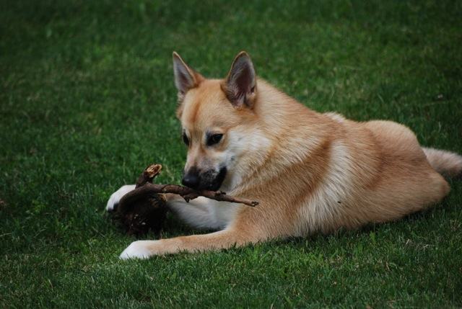
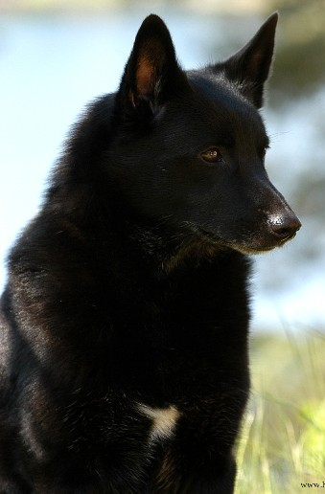
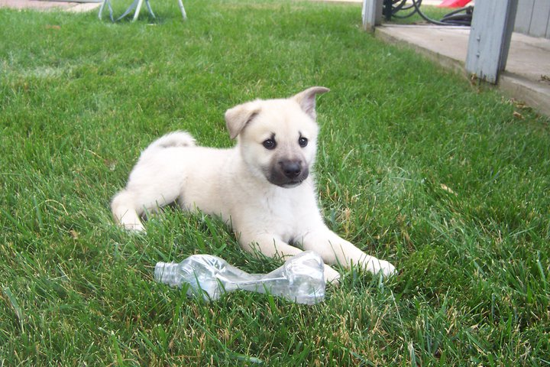
Colors

Slide 35
Gait
Gait: The action is free and effortless. The topline remains level while moving. Sound movement is essential for working ability.
Notes:
The Buhund must be agile, quick and sure-footed to work in the rugged terrain of its homeland.

Slide 36
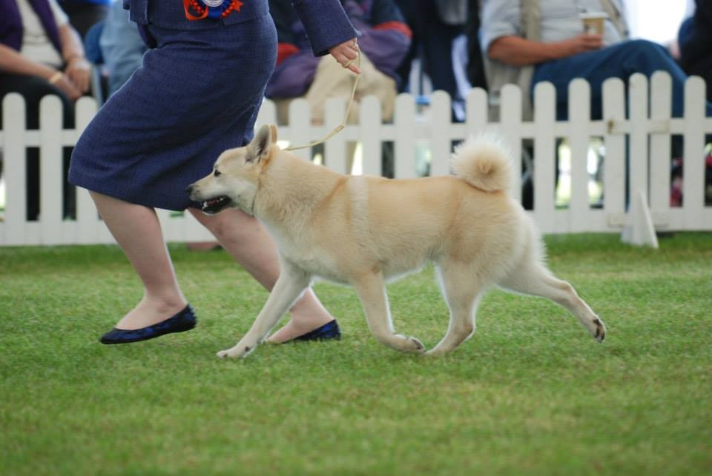
Carriage and Movement in the Norwegian Buhund

Slide 37
Carriage and Movement
“Side movement is a big focus in the breed, truly great propulsion, PRIDE and carriage, perfect coordination with one engine as opposed to one motor in each leg. We would rather give something on coming and going than sacrificing the side gait and balance.” (Espen Engh)

Slide 38
Carriage and Movement
Movement should be clean coming and going, and converging towards the centre.
This is a single-tracking dog, and wide double-tracking, though common, should be faulted.

Slide 39
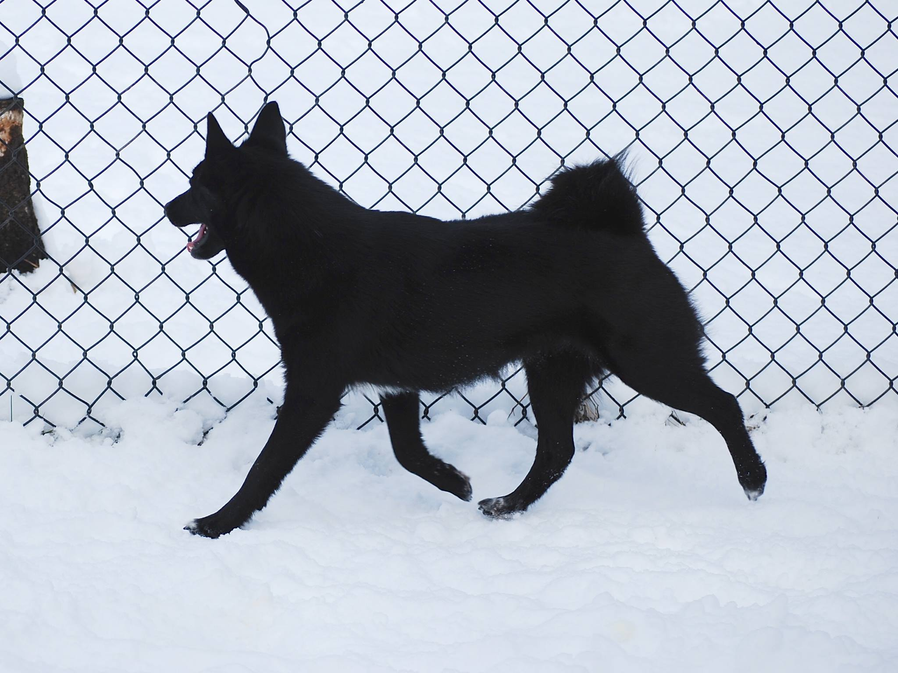
Carriage and Movement
Good Buhunds are confident and extremely self-possessed; they conduct themselves with purpose, and move in a way that shows no hesitancy.
Notes:
We do not look for Tremendous Reach and Drive in this breed, rather an economy of movement.

Slide 40
Carriage and Movement
This breed MUST be shown in working condition; judges would do well to penalize a soft, flabby or out of shape specimen.
There is little to add pertaining to this breed’s movement; those judges accustomed to watching Nordic varieties will quickly acquaint themselves with the Buhund’s straightforward manner of travel.

Slide 41
Carriage and Movement
Breed-appropriate speed is a brisk, swift trot
He must NEVER be strung up; as his rate of travel increases, the Buhund will often lower his head slightly.
Notes:
Moderate
Light on feet
Stamina as opposed to speed
Deft and athletic
Less speed and loose lead

Slide 42
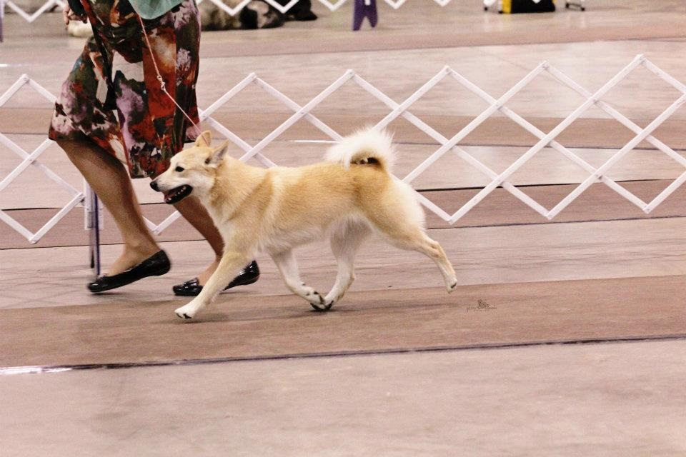
Notes:
Remember the 5 C’s:
Construction - square
Character –
Carriage – moderate, light on feet, stamina
Coat – double & thick
Color – wheaten or black

Slide 43
Disqualifying Faults
Faults: The foregoing description is that of the ideal Norwegian Buhund. Any deviation from the above described dog is to be penalized to the extent of the deviation.
TWO Disqualifying Faults:
  More than a half inch under, or one inch over the height at the highest point of the shoulder blade.
  Overshot or undershot mouth.
Notes:
Disqualifications expected for those items that are disqualified in any dog: undescended testicles, etc.

Slide 44
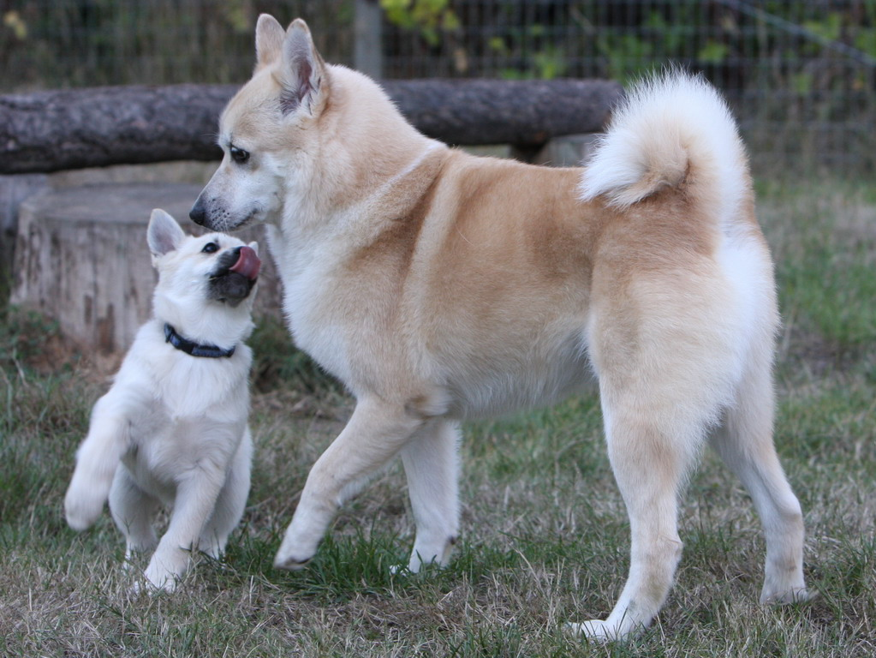
Character of the Norwegian Buhund

Slide 45
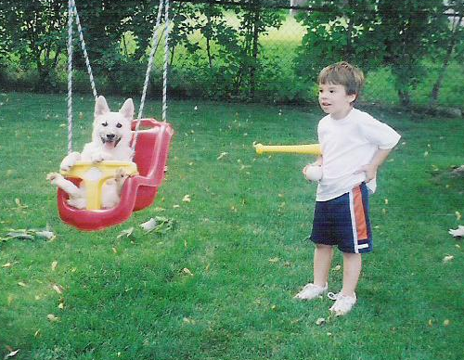
Character
Temperament: Self confident, alert, lively, and very affectionate with people.
Known as “The Friendly Spitz”

Slide 46
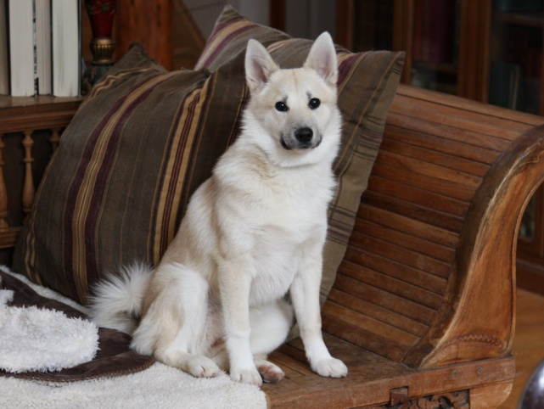
Character
His character is truly courageous, energetic and friendly – willing and amenable.
He is an absolutely honest little dog of tremendous heart, and possesses an unquenchable drive to ‘make things right’. It is no exaggeration to say he is the dog world’s best kept secret.
Notes:
Now used for many purposes. In England, they are used for guide dogs and drug detection dogs.

Slide 47
Character
Shyness, timidity, fear, dullness and aggression are enough by themselves to exclude a Buhund from being considered for any formal award.
Inter-male displays of temper should be viewed on their merit (sometimes boys will be boys), but ANY Buhund who attempts to bite a person or goes after an otherwise innocent animal bystander should be eliminated forthwith.

Slide 48
Character
The very best Norwegian Buhunds regard the show ring as a party to which all new and old friends have been invited. While handler control is, by the rules, necessary, I beg you not to penalize the entry who simply can’t stop a wagging tail, or one that stamps his feet with impatience that you haven’t made up your mind. His ears are highly mobile and it is quite common for them to be constantly swiveling, even down; you should only ‘ask’ him for them once, then it is back to work for your inquisitive little entry.

Slide 49
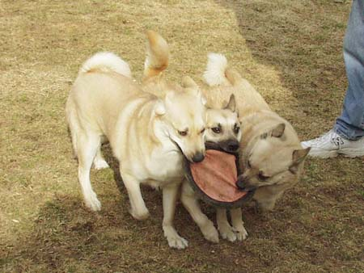
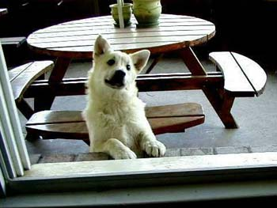
Buhund Traits
Let me in!
Teamwork - they were bred to work together with or without a human present to gather the flock. This teamwork is applied to other tasks and problem solving.
This is a social breed that prefers to be with its people. Norwegian Buhunds do not like to be alone.

Slide 50
Buhund Traits
Norwegian Buhunds are vocal and brave but not aggressive. They are excellent watchdogs.
They also have the northern traits of great energy, the desire for human companionship.
These dogs are in tune with owners, communicating with various noises and body language.
They are highly trainable.
Notes:
Their focus is generally on their handler. They may not react to your trying to get their attention.

Slide 51
Keep in Mind:
The Norwegian Buhund is an ancient, but very rare breed, and has been declared in danger of extinction by the Norwegian Kennel Club (NKK).
This breed is not a “cookie-cutter” breed. There will be some variety in size and certain characteristics—head shape, for instance may have some variability.
Moderation in all things makes a good Buhund.
Choose the best representative of the breed standard while not allowing serious faults.

Slide 52
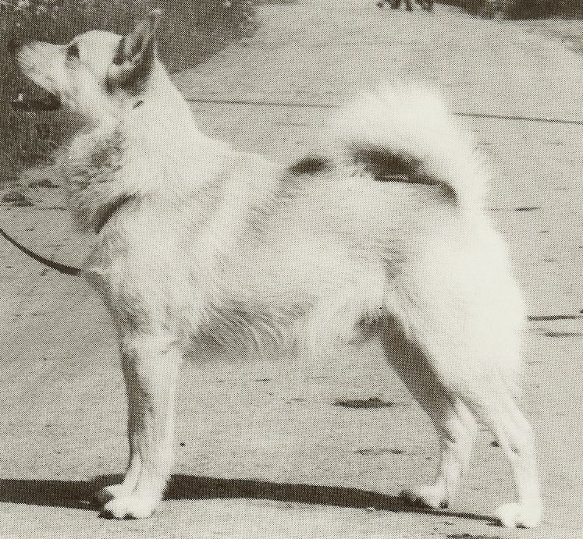

Slide 53
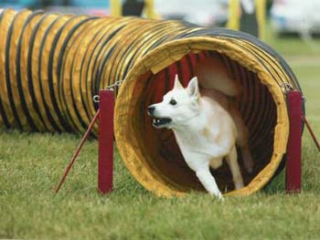
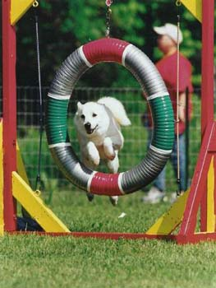
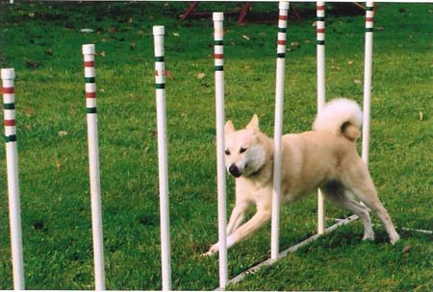
Agility
Notes:
There are several Buhunds with Rally and Agility titles.
They are good retrievers and swimmers – hunt vernim – do barn hunt and lure coursing.

Slide 54
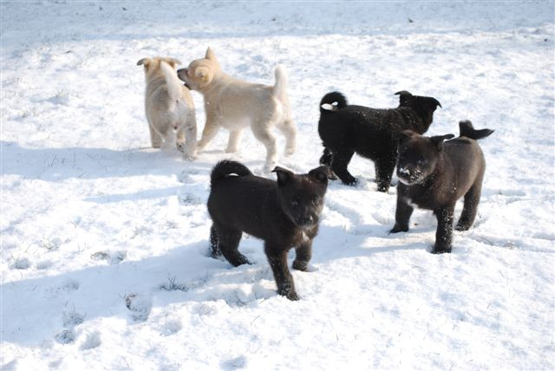
Puppies

Slide 55
Club Resources
NBCA Approved Mentors
Else Turner rob480@comcast.net
Lisa Donnelley caredig116@comcast.net
Additional Resources
NBCA Website
www.buhund.org
AKC Judge’s Guide
http://www.akc.org/judges/guides/norwegian_buhund/standard.cfm
Comparative Discussion
http://judgesl.com/Buhund/Buhund.htm
Other information:
Faye Adcox, NBCA President
corgpinmom@aol.com
302-242-8877
Notes:
Breeders OFA and Cerf
Right now the drags in the breed are
Not square
Tail too low set
Snipey heard
Undesirable color
Lack of consistency
Right now the strengths of the breed are
Good coat
Excellent temperaments

Slide 56
Our Thanks
The Norwegian Buhund Club of America thanks the following people for their assistance in this presentation.
Cindy Stansell
Else Turner
Valina Dawson
Pat Jarvis
Cheryl Loech
And the many committed Buhund owners who submitted photos, without reservation, for our use.

Slide 57
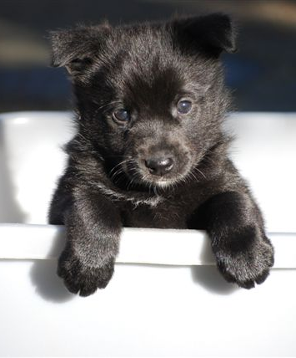
The Norwegian Buhund
Club of America
Thanks You for attending our
Judge’s Education!

