Slide 1
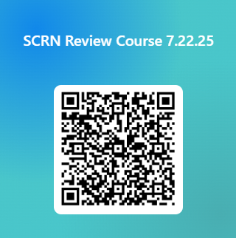
SAVE THE DATE: SCRN REVIEW COURSE 2025
Are you preparing to take the SCRN exam? Join us for our hybrid SCRN review course! The format and material are designed to help you prepare and focus your preparation for the exam. We will discuss important topics related to the care of a stroke patient and answer your questions with the goal of improving your confidence to pass the SCRN exam.
There is no fee for this class
Date: July 22, 2025
Time: 8:00 – 4:00pm
Format: Hybrid, Teams and In-person at 1800 Parkway Place, Marietta GA 30067.
River Birch Room, 2nd floor
CEUs have been requested for this course
*Registration closes July 15th, 2025
Breakfast and lunch will be provided
LINK to AANN SCRN Exam information
Questions? Email Susan.Zimmermann@wellstar.org

