Slide 1
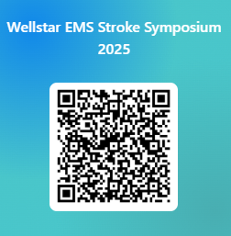
Save the Date: EMS Stroke Symposium
Emergency Medical Services play a key role in the Stroke chain of survival. Join us for our second annual Wellstar EMS Stroke Symposium! We will discuss important topics related to the emergency care of Stroke patients and answer your questions with the goal of improving your confidence in caring for Stroke patients in the field!
There is no fee for this symposium
Date: August 8th, 2025
Time: 8:00 am-4:00 pm
Format: Hybrid, Teams and In-Person at 1800 Parkway Place, Marietta, GA 30067
Dogwood-Live Oak Room, 1st Floor
CEUs are being requested for this course
*Registration closes August 1st, 2025
Breakfast and lunch will be provided
Questions? Email Kirstin.Knudson@wellstar.org
Vendors and Door Prizes!

