Slide 1
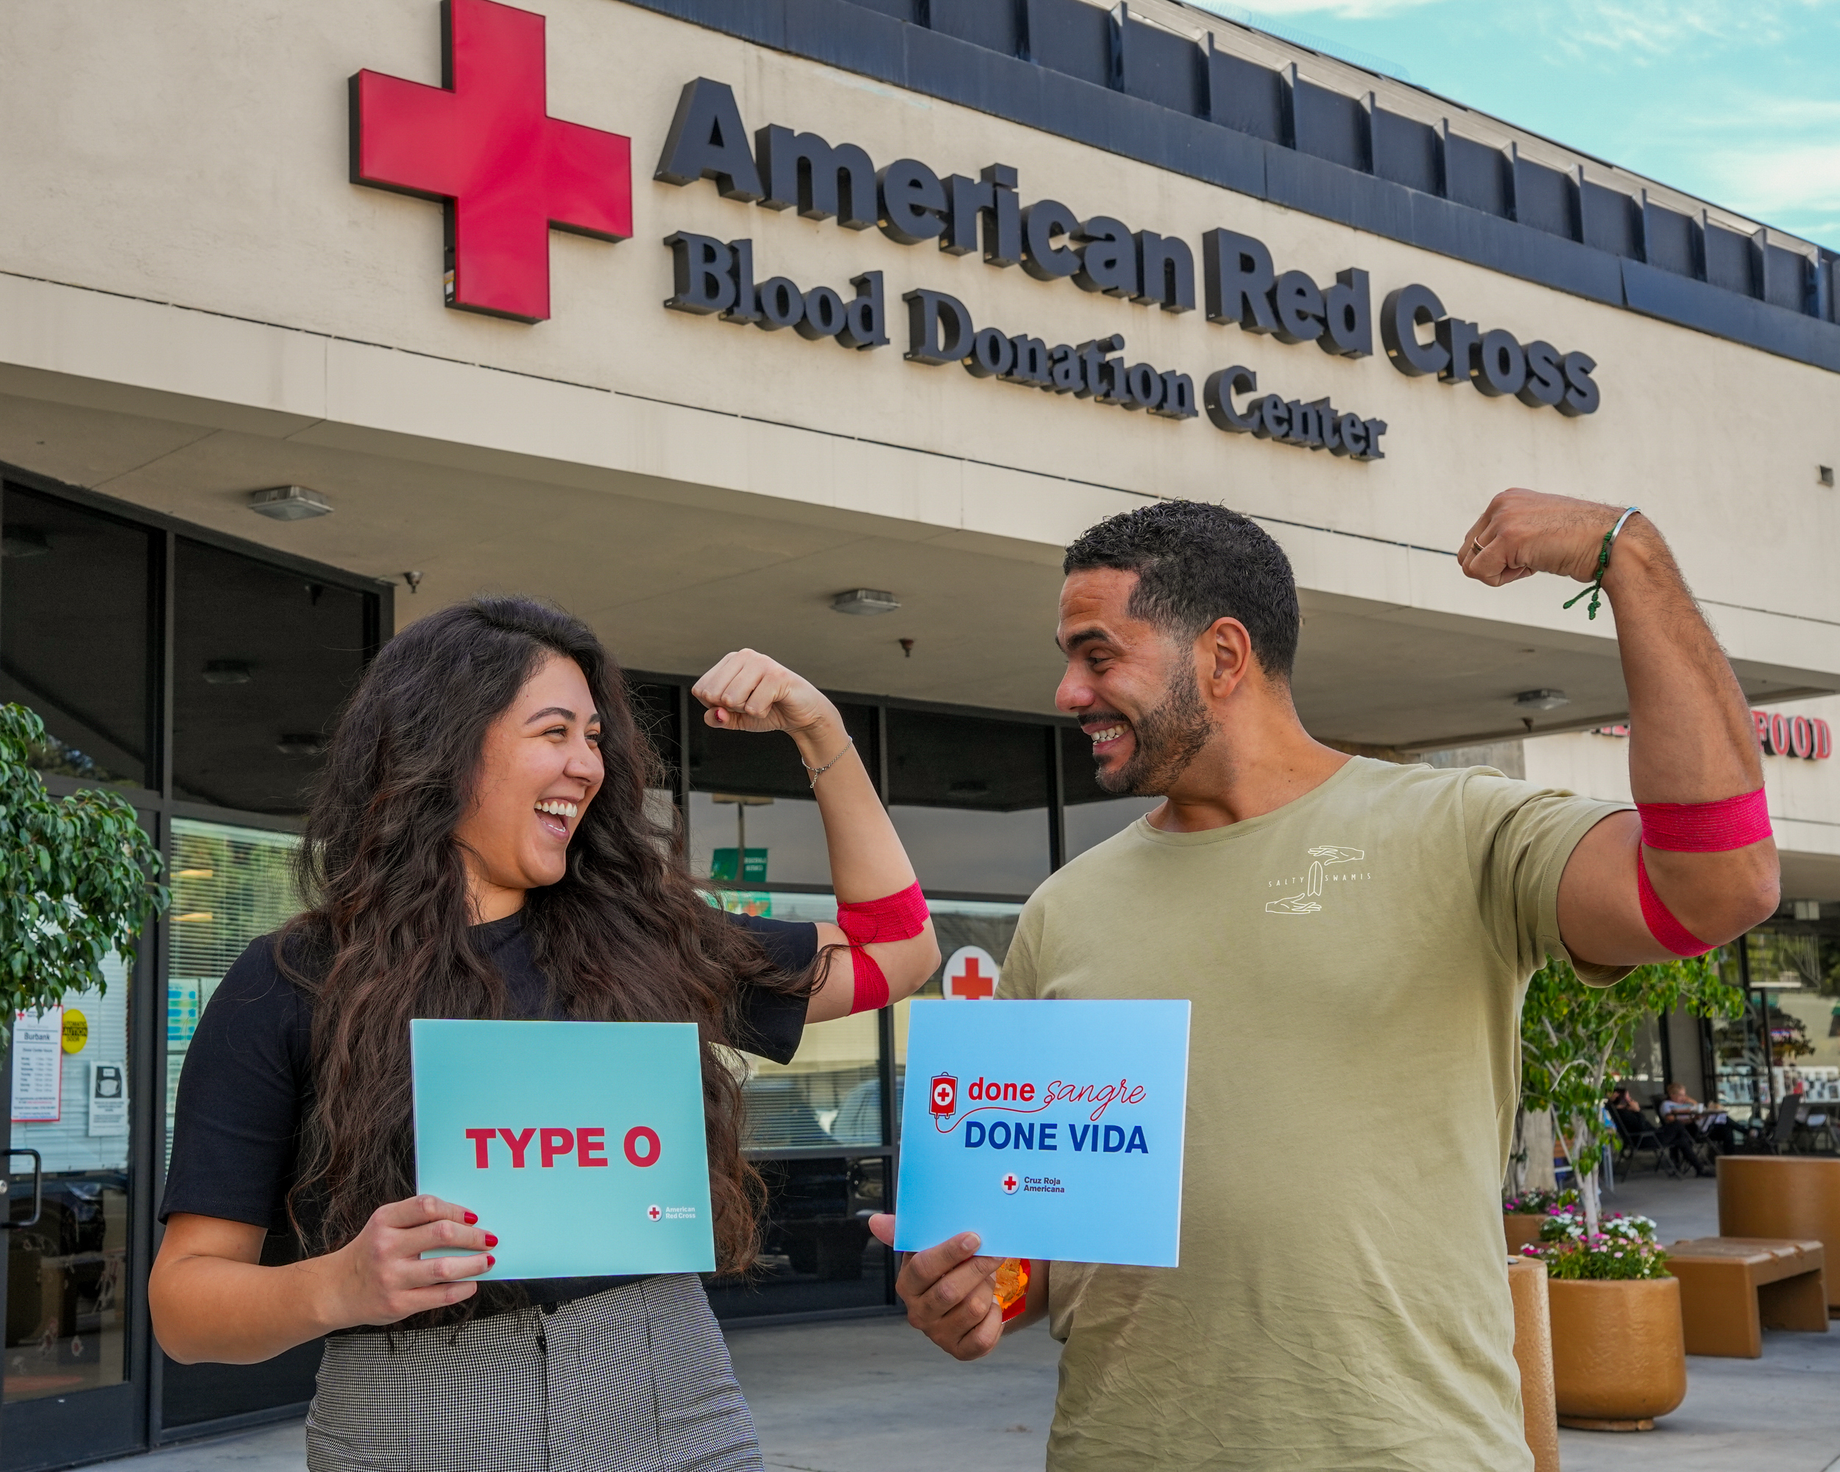

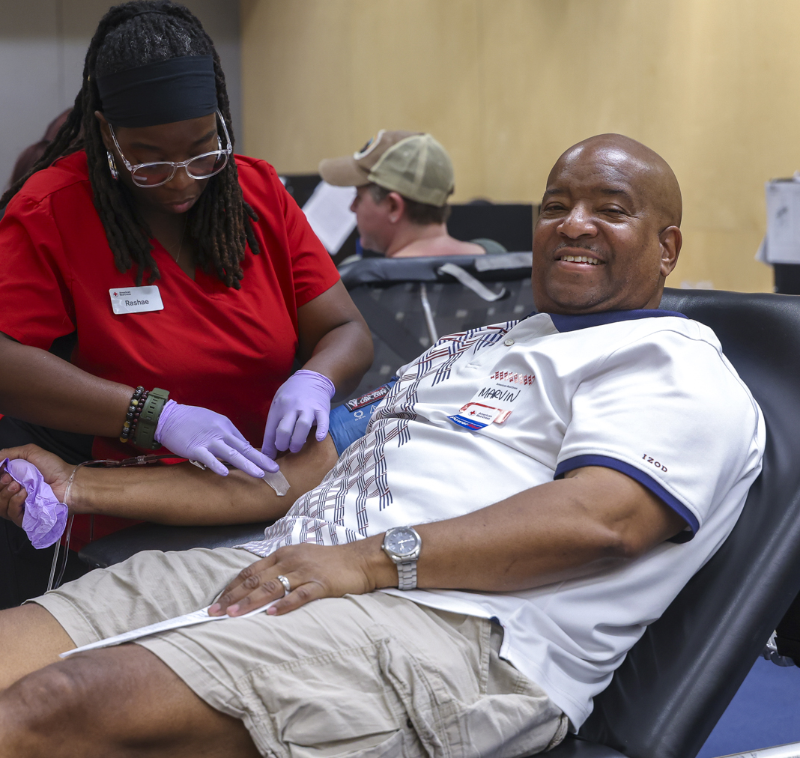
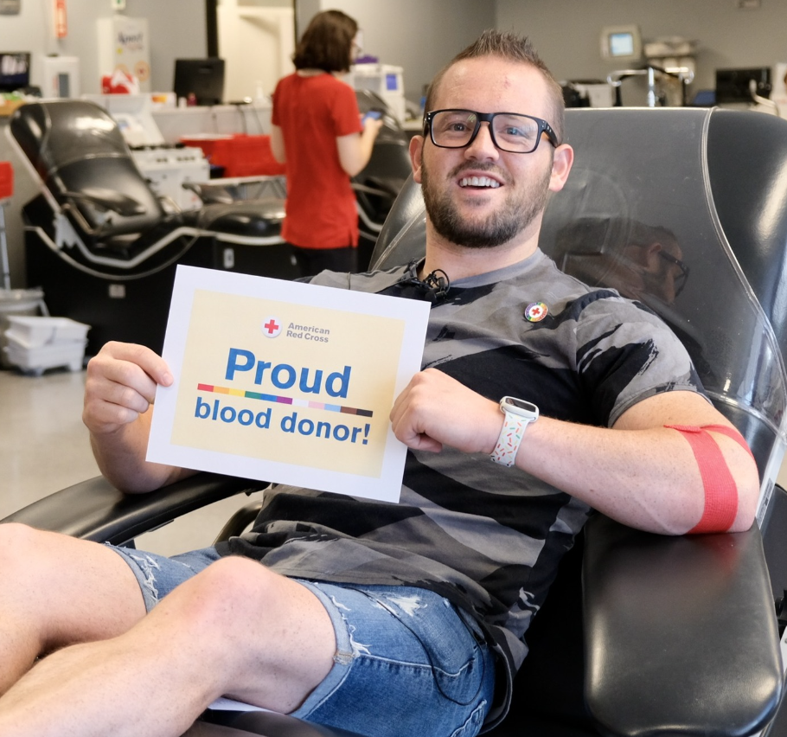
Joining
forces with
The Gaymber!

Slide 2
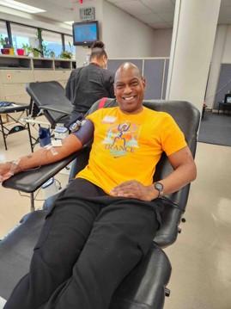
Blood Services – Meeting the Need
Every 2 seconds, someone in the U.S. needs blood
Patients battling cancer
People coping with sickle cell or
heart disease
Patients recovering from traumatic accidents
People giving birth and babies
born premature
Individuals impacted by disasters —
natural or man-made
Gary Jamison started donating blood in the 1990s and he says he was compelled to remain a committed donor for decades. But little did he know, one day being a blood donor would save his own life.
Notes:
500 blood drives daily
We collect about 40 percent of the nation’s blood supply
Annually, that adds up to: More than 4.5 million blood donations
Nearly 1 million platelet donations
From nearly 2.6 million volunteer donors

Slide 3
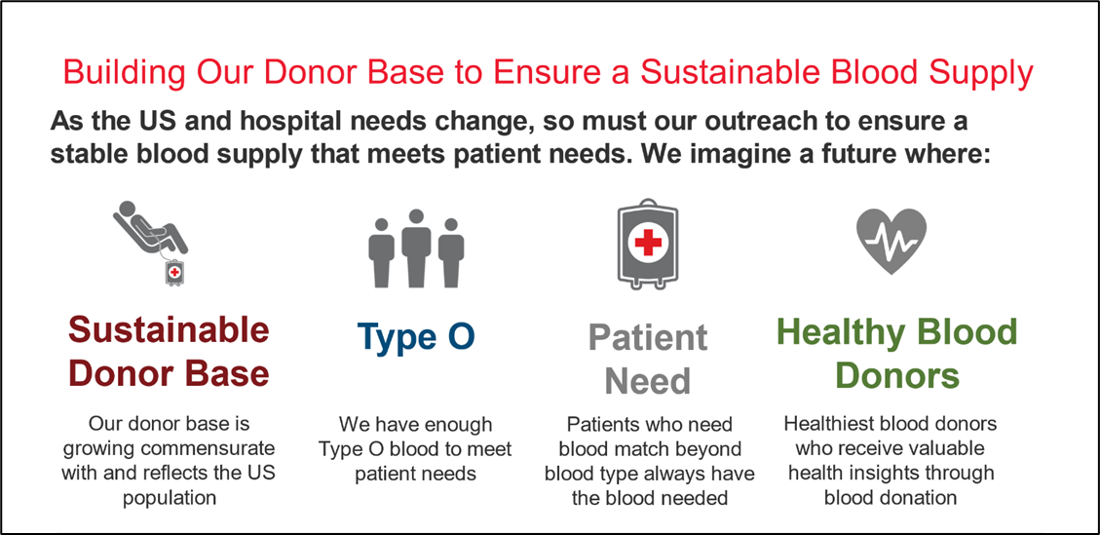
Expanding the Donor Base: Securing a Sustainable Blood Supply
Notes:
A1C testing
Blood pressure screening
Health insights

Slide 4
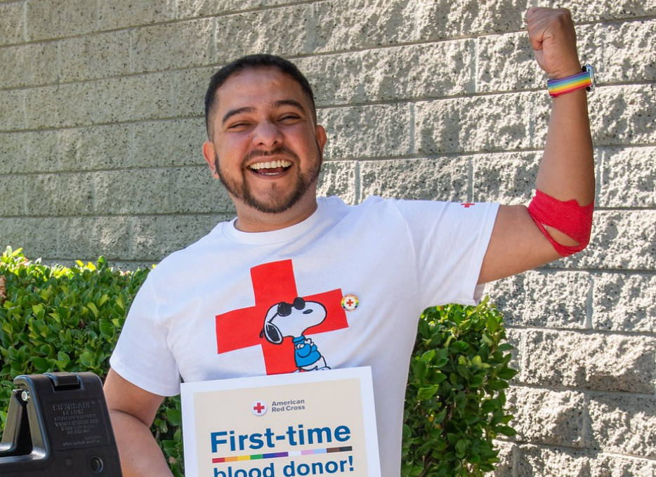
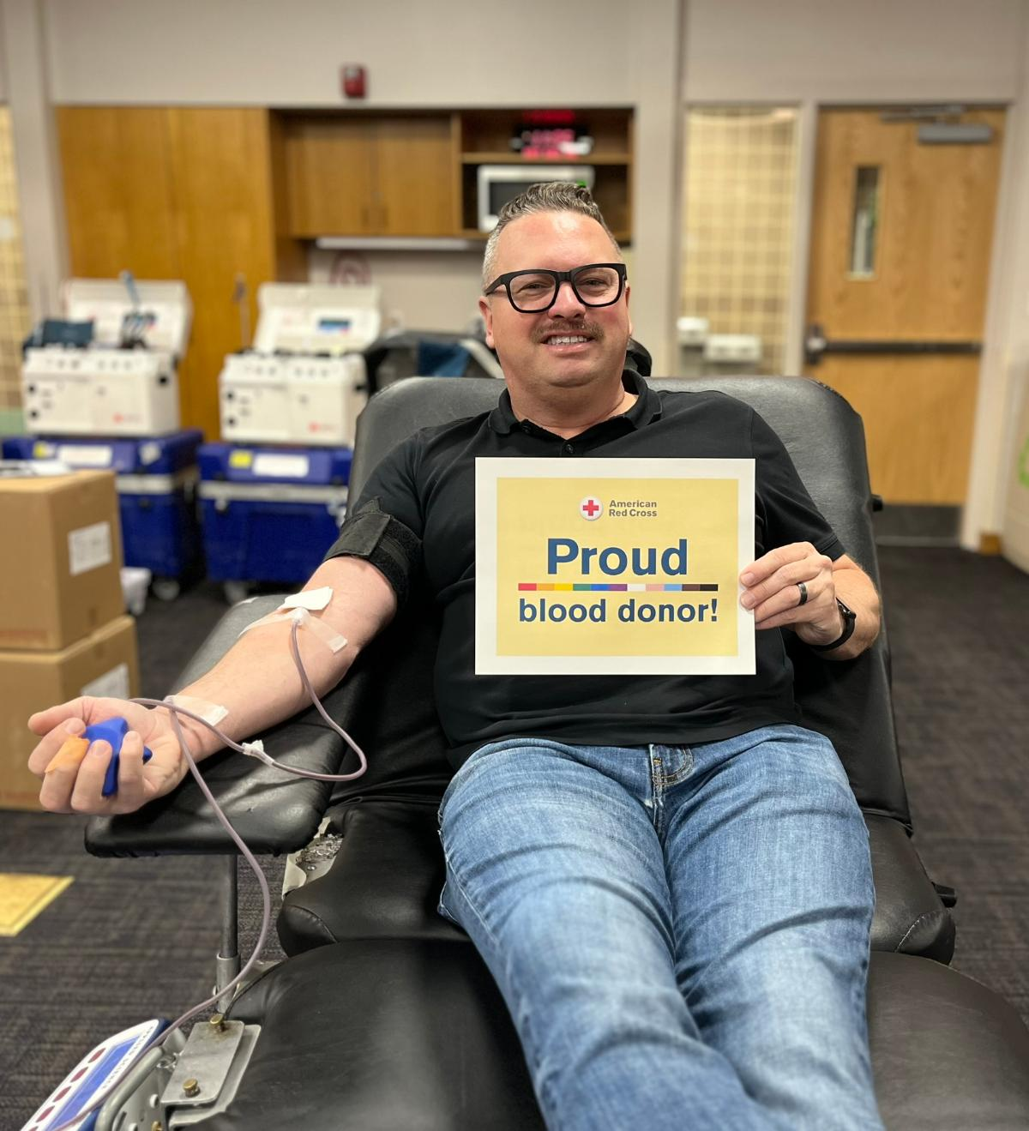
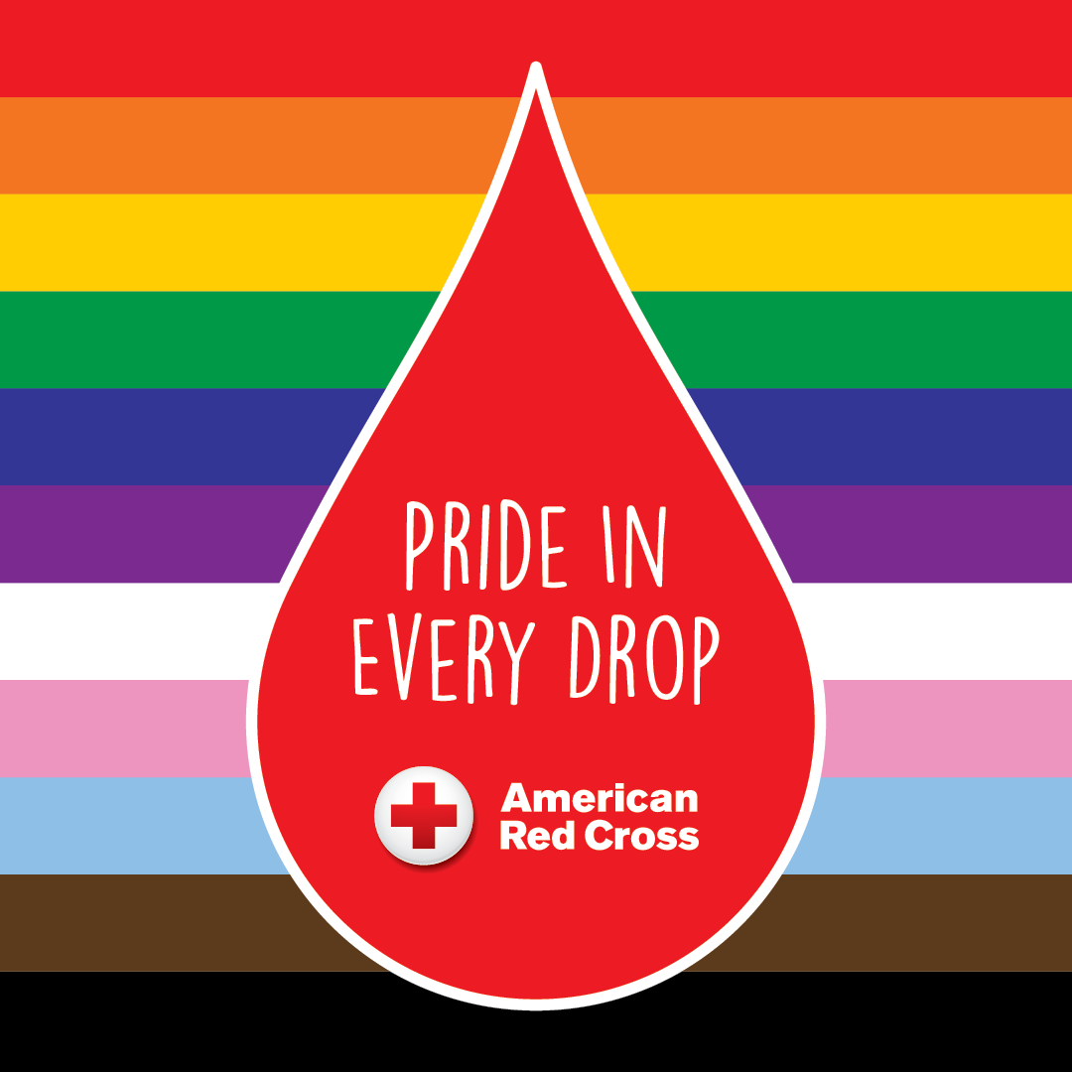
LGBTQ+ Engagement
Did You Know?
LGBTQ+ individuals have long been a part of our mission to serve the community. The Red Cross is now excited to welcome more LGBTQ+ individuals as newly eligible blood donors as well. Our LGBTQ+ engagement efforts work to share the good news of change and welcome with the LGBTQ+ community.
With the FDA change in policy in 2023 to eliminate blood donation eligibility criteria based on sexual orientation, more people are now able to donate blood.
  More than 10% of individuals who had previously been unable to give under the prior policy, and who we informed of the change, have returned to donate blood.
  About 60% of these individuals have donated more than once since the change.

