Slide 1
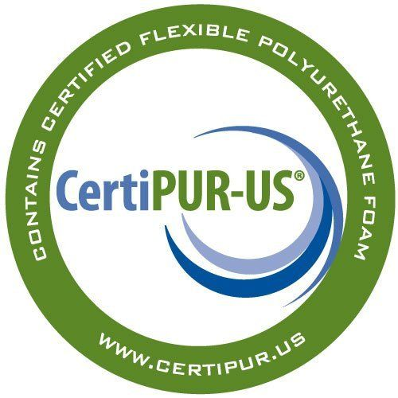
CertiPUR-US certified foams are:
✓ Made without ozone depleters
✓ Made without PBDEs, TDCPP or TCEP (”Tris”) flame retardants
✓ Made without mercury, lead, and other heavy metals
✓ Made without formaldehyde
✓ Made without phthalates regulated by the Consumer Product Safety Commission
✓ Low VOC (Volatile Organic Compound) emissions for indoor air quality (less than 0.5 parts per million)
https://certipur.us/about-the-seal/ learn more about memory foams.

