Slide 1
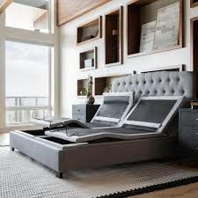
The S750 Malouf Adjustable base- Level 4
The pinnacle of relaxation and luxury, the Structures™ S750 Adjustable Bed Base gives you everything you ever wanted in a bed. Find the perfect resting position with the basic adjustable head and foot panels plus head tilt and lumbar support. The Reach Assist™ feature pulls the bed back toward the wall as you incline for easy access to your nightstand. Built-in Bluetooth® connectivity makes it easy to customize your sleep experience with the Malouf Base app. Plus, the app alarm option allows you to select a time and preset or memory position and the S750 gently raises you up every morning; available only on iOS devices.

Slide 2
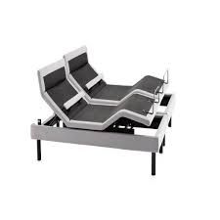
Malouf Adjustable Base Features- Level 4
Adjustable head tilt and lumbar support with Reach Assist™
Bluetooth® built-in with free Malouf Base app, available only on iOS devices
5 preset positions including Zero Gravity; including 2 memory positions
36 dual-zone luxurious massage options: 4 programs, 3 intensities, 3 timers
Motion activated LED backlit wireless remote control
2 dual USB charging ports; child-lock safety feature; under-bed LED nightlights
Headboard brackets and 3-inch leg adapters available upon request
Top-of-the-line Okin motors; 850-pound weight capacity on all sizes; 20-year warranty
. Independent head incline extends from 0 to 60 degrees, with foot incline of 0 to 45 degrees.

