Slide 1





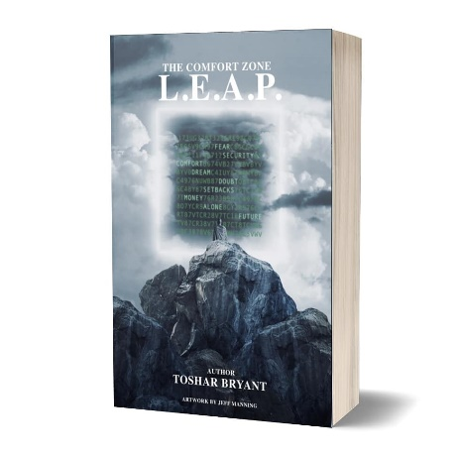
Why do we let our FEARS Disempower US? What has happened to our SUCCESS and how we can EMPOWER it NOW!
Prime Pitch: My name is Toshar, “Transformation Queen of Empowerment Strategies that Creates Success!!!” Teaching your audience techniques to “Transform their Obstacles into Opportunities!!!”
Staying stuck in what may seem like an obstacle is just an opportunity waiting to be discovered under the many layers where our Victory Awaits!!
I Will Engage Your Audience on How to Convert Obstacles into Opportunities. By applying the same techniques that Journeyed me out of Oppressive Environments, and the stigma from Social Injustices into an Empowerment Speaker | Coach | Consultant | and Trailblazer for anyone who is Ready to Transform their Obstacles into Opportunities!!!
Current Performance Topics:
Your Why…Why knowing Your Purpose in Life is key to your Success!!!
How knowing Your Value Empowers your Vision, Goals, and Direction in Life!!!
De-Stress Your Life and Live on Purpose each and every day!!!
#1 CHOICE
Toshar is a Leading expert in the field of Empowerment, Purpose, and Adding Value into Peoples Lives.
Specializing in Strategies that Creates Success, and Author of “From Welfare to Queen”, & “The Comfort Zone L.E.A.P.”
Sought after by diverse organizations to teach people how to Empower their Purpose in Life.
Did you know that the #1 cause for people not to pursue their Dreams in Life is due to FEAR?
Learn How to make the IMPOSSIBLE into the IM’POSSIBLE!
Shine the Light of Toshar’s Empowerment Expertise onto the Path of Your Audience
7 Techniques
To Create Empowerment with Your Personal & Professional Life
“Her empowerment strategies are a source of inspiration, action and reliability.”
--Kevin T. Robertson, Celebrity Insider/Consultant/Professional Speaker
“EMPOWERING YOUR PERSONAL & PROFESSIONAL SUCCESS”
Toshar@Toshar.net

