Slide 1






Empowerment Strategies
That Creates Purpose
“Turn your obstacles into opportunities”
Signature Programs
BELIEF BASED EMPOWERMENT
Learn tools to overcome obstacles and deal with challenges which builds your self-esteem along with the confidence to live your dream
Learn to recognize and reverse the illusion of your “fears”
Recreate a clear vision to achieve success you truly believe in
PERCEPTION BASED EMPOWERMENT
Recognize how to decode the messages hidden in every obstacle, and find your success
Build a bridge and go from the guessing of uncertainty to the bold hard facts
Learn to change the perception of how you view your obstacles to achieve greater results
DISCIPLINE BASED EMPOWERMENT
Establish deadlines and set up a system of accountability
Explore the art of strategic goal planning to create the structure to stay more organized
Develop your focus to maintain a habit of consistency
ACTION BASED EMPOWERMENT
Learn how great ideas mean nothing without the action called; results
Take action, attack your goals and develop the instincts to overcome and never give up
Understand Tea’s Greatest 3 Techniques that will turn your great idea into evidence-based actions
What Industry Leaders
And Top Thinkers Are
Saying About
“Toshar Bryant”
Rave
Reviews
America’s Leading
Focus
Expert
Toshar has a brand imagined by many and actually accomplished by few.
Her empowerment strategies are a source of inspiration, action and reliability.
If you or your company wants to experience directional leadership at its finest… follow her teachings and get ready to experience the path to holistic fulfillment.
She understands how to deploy techniques that advance the skillset of your actions and excite the psychology of achieving your dreams. Connect with her programs and soar.
-Kevin T. Robertson, Celebrity Insider/Consultant/Professional Speaker
Learn what Toshar teaches about EMPOWERMENT STRATEGIES THAT CREATES SUCCESS!!! Learn why successful organizations like America Works,and Visiting Nurse Services will book her again and again.
www.Toshar.net | Toshar@Toshar.net | P.O. Box 284 Palm Harbor Fl,24682 | Bookings: 646-588-0827

Slide 2




Empowerment Strategies
That Creates Purpose
“Turn your obstacles into opportunities”
Professional Biography
Toshar is a dynamic Elite Speaker recognized amongst those she speaks to as an expert in the area of Empowering others through her Journey of overcoming adversity as a teenager who faced obstacles such as rape, domestic violence, college drop-out, poverty and homelessness.
Through her Journey, she has also been able to give back by assisting others on their Journey towards Success in her How- To, Self-Help book entitled: “From Welfare to Queen”, where she shares her methods and techniques utilized to overcome obstacles, and obtain success. In her second book “The Comfort Zone; Life Experiences After Poverty” (L.E.A.P),
Toshar empowers the reader to find their Life’s Purpose by breaking the chains of complacency and comfort.
Since year 2000, Toshar began her career in the Social Services field. She had the fortune to work with various organizations, family agencies, and private programs such as the Visiting Nurse Services of New York.
Through her extensive work experience, she takes pride in working with diverse populations who are challenged by obstacles in specialized areas such as poverty, foster care system, chemical dependency, homelessness, mental illness, and recognizing the traumas of long-term incarceration.
Toshar has earned her reputation as an Empowerment Coach to those who are ready to follow their path in Life, despite the obstacles, and takes action through her tested and proven seven step process.
Toshar’s unique techniques inspires audiences from motivation towards empowerment which leaves all eager to hear more.
In 2017, Toshar was the keynote speaker at America Works Youth Mentorship program opening day in New York City. This was unprecedented due to the organization being a pivotal platform in Toshar’s journey out of poverty through this Welfare Reform Program.
Successful organizations such as American Red Cross, Visiting Nurse Services of New York (Clinical Case Management) CCM Program, and America Works have either featured Toshar in their newsletter, documentary, or archived her book in their organizations library for client to read as a reference of resource.
Toshar has been featured in American Red Cross Homeless shelter monthly newsletter “How, When, Where?” America Works featured Toshar in their documentary entitled: Toshar’s Bryant Success Story found on YouTube.
What Industry Leaders
And Top Thinkers Are
Saying About
“Toshar Bryant”
Rave
Reviews
Toshar’s resilience throughout her Life’s experiences with social injustices is a testament to her empowering others as a Speaker, Author, and Life Coach.
Finding and living her Purpose continues to allow her to inspire others to “Break Through Boundaries,” & and “Turn Their Obstacles into Opportunities!”
~Dr. Yusef Salaam
The Perfect Speaker For Anytime Of The Year!
Bookings:
646-588-0827
From homeless to professional speaker:
How Toshar used her gift to communicate and teach…
“ Empowerment Strategies
That Creates Purpose”
www.Toshar.net | Toshar@Toshar.net | P.O. Box 284 Palm Harbor Fl,24682 | Bookings: 646-588-0827

Slide 3

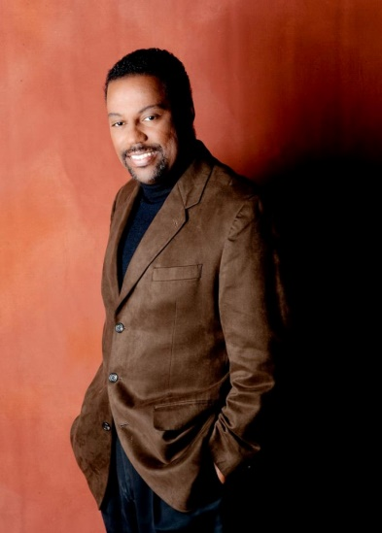
Empowerment Strategies
That Creates Purpose
“Turn your obstacles into opportunities”
BELIEF BASED EMPOWERMENT
This intense program takes an in-depth look into ourselves and how we empower fears that are acquired through learned behaviors which hinders our growth in the areas of thoughts, words, and actions.
As a result, these hindrances erode our growth, and adds difficulty to realizing our true self.
With this program, we carefully look at how we support our current belief system through our “fears” instead of facts. Once we’ve identified the origins of our “fears”, we can begin our journey of self-reflection and repairing our belief system.
Empowering us to view our situation with confidence and obstacle that we can overcome.
Formulas applied from this program, gives us the courage to move forward and create a new belief system supported by facts.
With the shadows of doubt behind us, we are free to strategically navigate towards our definition of success.
After this program, you will be able to:
Prevent self-esteem killers; “You are what you defeat”
Destroy habit forming fears that are made up of our negatively impacted beliefs
Learn how common communication filters have a positive or negative impact on your thinking
Pull the weeds out of your field of dreams
Discover confidence and self-fulfillment along your Journey
Audiences:
Organizations, Associations, small, medium and large size companies who want to increase their level of SUCCESS and attain more personal and professional FOCUS.
Also: Conference keynotes/breakouts, Association meetings, Corporate events, Banquets, Incentive Trips, Entertainment events, Stadiums and Venues, Colleges and Universities.
Customization Options: Keynote or Onsite Strategic Work Session
Alternate titles:
• 5 Keys to next level leadership
• How to listen from the front and lead from the back
Program Length:
This program can be customized from 60 minutes (keynote/breakout) to half-day, full-day, and 2-day formats.
What Industry Leaders
And Top Thinkers Are
Saying About
“Toshar Bryant”
Rave
Reviews
Winner of the
Toastmasters World Championship
of Public Speaking
Toshar’s delivery of content is amazing and unique.
She makes you believe that you can overcome tough obstacles and empowers you with the belief that you can achieve your desires.
Capture the very best quality of life by following her strategies and become inspired to have huge impact on others.
-CEO and Founder of Ed Hearn International Public Speaking & Training Company. Winner of the Toastmasters World Championship of Public Speaking
The Perfect Speaker For Anytime Of The Year!
Bookings:
646-588-0827
From homeless to professional speaker:
How Toshar used her gift to communicate and teach…
“ Empowerment Strategies
That Creates Purpose”
www.Toshar.net | Toshar@Toshar.net | P.O. Box 284 Palm Harbor Fl,24682 | Bookings: 646-588-0827

Slide 4
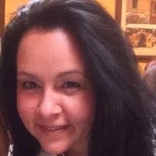

Empowerment Strategies
That Creates Purpose
“Turn your obstacles into opportunities”
PERCEPTION BASED EMPOWERMENT
This insightful based program is designed for anyone who wants to achieve SUCCESS and overcome Life’s Challenges.
In this session, you will learn to tap into the powers of your subconscious mind and stop allowing negativity to influence your perception.
Learn to reverse devastating mental patterning and turn it into positive self -reflection. Never again look at the world from a perspective of dead-end opportunity and cure possibility blindness in this life changing session.
After this program, you will be able to:
Recognize thought patterns which no longer serves your positive thinking
Replace old behaviors with new behaviors
Navigate the path to achieve success when obstacles test you
Utilize life lessons and turn adversities into teachable moments
Become precise with your thinking to achieve long-term success
Audiences:
Organizations, Associations, small, medium and large size companies who want to increase their level of SUCCESS and attain more personal and professional FOCUS.
Also: Conference keynotes/breakouts, Association meetings, Corporate events, Banquets, Incentive Trips, Entertainment events, Stadiums and Venues, Colleges and Universities.
Customization Options: Keynote or Onsite Strategic Work Session
Alternate titles:
• 5 Keys to next level leadership
• How to listen from the front and lead from the back
Program Length:
This program can be customized from 60 minutes (keynote/breakout) to half-day, full-day, and 2-day formats.
What Industry Leaders
And Top Thinkers Are
Saying About
“Toshar Bryant”
Rave
Reviews
“From Welfare to Queen”
“Toshar is someone who has demonstrated commitment towards achieving her goals, and who has used adverse expertise in her life to propel her towards a brighter future.
She is an example of someone who has put in a great deal of hard work to rise above her circumstances, and who has sound meaning in helping others find their purpose as well.
She was a wonderful asset to our program and was both a mentor and beacon of hope to clients who were struggling to find their way out of a life of reliance on public assistance and into one of greater self-sufficiency.”
-Tara Noto, Program Director VNSNY CCM Program
The Perfect Speaker For Anytime Of The Year!
Bookings:
646-588-0827
From homeless to professional speaker:
How Toshar used her gift to communicate and teach…
“ Empowerment Strategies
That Creates Purpose”
www.Toshar.net | Toshar@Toshar.net | P.O. Box 284 Palm Harbor Fl,24682 | Bookings: 646-588-0827

Slide 5
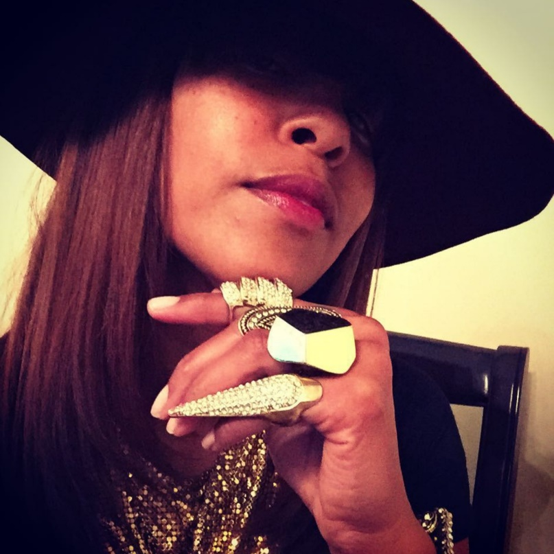
Empowerment Strategies
That Creates Purpose
“Turn your obstacles into opportunities”
ACTION BASED EMPOWERMENT
This enthusiastic based program is designed for anyone who wants put into motion the Law of Attraction to create a better picture of your Future-Self.
Never again succumb to unfocused energy, and create a new found birth of explosive actions. In this session, you will be able to operate on a different vibrational frequency which will yield much higher results.
Become the pilot of your actions instead of a passenger waiting to see where things may land.
By having a clear vision, and destination, with this program, become the leader of your future by developing a flight plan of action!
After this program, you will be able to:
Neutralize low – self-esteem, dominate with confidence, and live your dream
Explore the origins of positive thinking, and how it can guide you to achieve ultimate success
Reconstruct your actions and follow a blueprint to manifest positive results in your life
Discover the law of gratitude and create abundance in your life
Develop the endurance to go the extra mile and finish your personal and professional goals
Audiences:
Organizations, Associations, small, medium and large size companies who want to increase their level of SUCCESS and attain more personal and professional FOCUS.
Also: Conference keynotes/breakouts, Association meetings, Corporate events, Banquets, Incentive Trips, Entertainment events, Stadiums and Venues, Colleges and Universities.
Customization Options: Keynote or Onsite Strategic Work Session
Alternate titles:
• 5 Keys to next level leadership
• How to listen from the front and lead from the back
Program Length:
This program can be customized from 60 minutes (keynote/breakout) to half-day, full-day, and 2-day formats.
What Industry Leaders
And Top Thinkers Are
Saying About
“Toshar Bryant”
Rave
Reviews
The Perfect Speaker For Anytime Of The Year!
Toshar’s light (Soul) kept her going,
helped her through those dark moments of despair,
got her through school and continues to guide her.
How beautiful is that!
I’m looking forward to Toshar’s next book.”
-Kim Diva Fashion Stylist
Bookings:
646-588-0827
From homeless to professional speaker:
How Toshar used her gift to communicate and teach…
“ Empowerment Strategies
That Creates Purpose”
www.Toshar.net | Toshar@Toshar.net | P.O. Box 284 Palm Harbor Fl,24682 | Bookings: 646-588-0827

Slide 6

Empowerment Strategies
That Creates Purpose
“Turn your obstacles into opportunities”
DISCIPLINE BASED EMPOWERMENT
This structured based step-by-step educational program is designed for those who want to break free from the shackles of procrastination and many negative obstacles that extinguish the fires of productivity.
In this session, you will learn simplistic approaches and common-sense techniques to neutralize the devastating effects of negativity that prolongs success and often times rob you of your deepest ambitions and stall your dreams.
Never again be defined by lack of self-confidence and soar as the eagle you are destined to be in this life changing session.
After this program, you will be able to:
Learn how to become Laser focused to accomplish tasks consistently
Form healthy habits that will give you the confidence to create your success
Create a simplistic routine that will charge your motivation to complete your goals
Recognize things that hold you back like fear, doubt, and anxiety that blocks you from achieving your full potential
Hit the ground running and visualize your vision and mission statement
Audiences:
Organizations, Associations, small, medium and large size companies who want to increase their level of SUCCESS and attain more personal and professional FOCUS.
Also: Conference keynotes/breakouts, Association meetings, Corporate events, Banquets, Incentive Trips, Entertainment events, Stadiums and Venues, Colleges and Universities.
Customization Options: Keynote or Onsite Strategic Work Session
Alternate titles:
• 5 Keys to next level leadership
• How to listen from the front and lead from the back
Program Length:
This program can be customized from 60 minutes (keynote/breakout) to half-day, full-day, and 2-day formats.
What Industry Leaders
And Top Thinkers Are
Saying About
“Toshar Bryant”
Rave
Reviews
Empowerment Coaching with Toshar
has been so beneficial to my Life.
I never thought of having a “Life Coach,” but now that I do, I really don’t see myself not having one.
Each session is like I’m planning, preparing and bringing forth visions that used to be dreams.
Very professional, straight forward, to the point, and direct coaching. Something I definitely need.
~Patricia Woney
CEO of SoJoMiCreations
The Perfect Speaker For Anytime Of The Year!
Bookings:
646-588-0827
From homeless to professional speaker:
How Toshar used her gift to communicate and teach…
“ Empowerment Strategies
That Creates Purpose”
www.Toshar.net | Toshar@Toshar.net | P.O. Box 284 Palm Harbor Fl,24682 | Bookings: 646-588-0827

Slide 7
Empowerment Strategies
That Creates Purpose
“Turn your obstacles into opportunities”
Audio Visual Set Up
Summary:
The following professional requirements are necessary to ensure a HIGH QUALITY presentation.
Equipment:
Wireless lavaliere microphone + spare battery
Hand Held microphone + spare battery
Flipchart + fresh markers
LCD projector + screen
When videotaping, professional house lighting is required. Toshar may prefer hand held or lavaliere for presentations.
Room Setup:
Conference/Auditorium Style
Appropriate for short presentations or larger groups that do not require extensive note-taking
Classroom/Banquet Style
Appropriate for groups fewer than 40
Toshar is a high-energy speaker who utilizes a participant centered learning style to connect with the audience.
Toshar engages the audience and occasionally will move around often to keep the presentation fun and exciting.
Please keep this in mind as you prepare your audio/visual logistics for your event.
If you have any questions, please call us at:
646-588-0827
Thanks and we look forward to working with your team!
What Industry Leaders
And Top Thinkers Are
Saying About
“Toshar Bryant”
Rave
Reviews
Toshar has been a guest speaker and panelist at numerous events
including but not limited to:
Prison system
Youth market
Faith based organizations
Numerous associations
Colleges & Universities
Retreats
Corporate events
Leadership conferences
Company onsite locations
Private corporate events
Women’s empowerment conferences
Networking events
Guest panelist and host
The Perfect Speaker For Anytime Of The Year!
Bookings:
646-588-0827
From homeless to professional speaker:
How Toshar used her gift to communicate and teach…
“ Empowerment Strategies
That Creates Purpose”
www.Toshar.net | Toshar@Toshar.net | P.O. Box 284 Palm Harbor Fl,24682 | Bookings: 646-588-0827

Slide 8


Books by Toshar Bryant
“From Welfare to Queen”
Toshar shares the strategies and techniques of how she created her success and gained financial independence. Toshar’s strategies on how she was living in poverty with her four small children all while obtaining her college degree and “Turning Obstacles into Opportunities” are revealed for any reader who faces Life’s Challenges.
“The Comfort Zone L.E.A.P”
With her own life examples, Toshar challenges the reader to L.E.A.P out of their Comfort Zone and find their purpose in life. As a successful Empowerment Coach, Toshar guides the reader on a Journey of Life’s pitfalls that can keep us in a Comfort Zone we may not be aware we are in.
www.Toshar.net | Toshar@Toshar.net | P.O. Box 284 Palm Harbor Fl,24682 | Bookings: 646-588-0827

Slide 9










Seminars and Speaking Clients
Toshar Bryant has delivered
Seminars, Podcast Radio, Talk, and Keynotes for…
www.Toshar.net | Toshar@Toshar.net | P.O. Box 284 Palm Harbor Fl,24682 | Bookings: 646-588-0827

Slide 10
Clients Testimonials
Phil,
I have had the pleasure of meeting Toshar Bryant over 20 years ago.
It didn't take long for me to conclude that this shy and timid young lady would someday become a role model for other young women.
After leaving a terrible marriage and moving into a shelter with four small children, she still found a way to manage her day-to-day responsibilities and attend college and eventually graduate.
Because of her history, she can quickly relate to groups in her workshops and show them that their past does not dictate their future. As long as they work hard; stay focus and don't let their distractions get in their way, they can overcome what seems impossible.
Keep up the excellent work Toshar and keep telling your story. You never know whose life you may save.
Philip J. Jones
Senior Vice President
America Works
www.Toshar.net | Toshar@Toshar.net | P.O. Box 284 Palm Harbor Fl,24682 | Bookings: 646-588-0827

Slide 11

Clients Testimonials
Tracè Gaskin
1826 Calash Way
Virginia Beach, VA 23454
(646) 601-9644 (c) | gaskin.trace@gmail.com
September 18, 2019
TO WHOM IT MAY CONCERN:
I have had the distinct honor of having been a recipient of life coaching by Ms.Toshar Bryant.
I met her at a cultural event this past Summer and we have maintained constant contact. When the opportunity arose to discuss a business proposition for next year, I explained that I was in the process of trying to put together a proposal for spiritual development in Virginia Beach. At this time, Ms. Bryant informed me that she was a life coach as well as an entrepreneur. We set up a few sessions that were very informative.
It is very important that people dream big. It is equally important that there be people around that are capable of helping to fine tune those dreams into realistic and achievable goals. Ms. Bryant is an excellent listener and was able to ask questions that maintained the integrity of the goals and kept us both on task. This may seem like a simple idea when set on paper but in reality is a crucial skill to have. What I found to be rather impressive is that she focused more on how I was planning to approach success with this project rather than the very real possibilities of becoming too overwhelming to manage. While my impulse is to shoot forward, what I really need to do is to exercise patience as I set up the parameters for New Moon Misas & Spiritual Development.
During the sessions, it became evident that I needed to create a strategic plan as well as a rubric to indicate the levels of success for each facet of the business. Toshar was excellent in pushing me to set intentions so that I could clearly state my objectives. Part of the plan requires that I present the proposal for approval to a group of Elders. Without this approval, starting this business is going to be extremely difficult. It can be done, and it will be, by creating a mission statement and the timeline for the actual workshops. Being coached enabled me to see just how prepared I was and how much more work needed to be accomplished before opening day. I thoroughly enjoyed my coaching sessions and understand the need for objectivity. I highly commend the skills and talents of Ms. Bryant and strongly recommend the discipline that professional coaching affords the new entrepreneur.
Empowering the future,
Tracè Gaskin, MS
www.Toshar.net | Toshar@Toshar.net | P.O. Box 284 Palm Harbor Fl,24682 | Bookings: 646-588-0827

Slide 12
Press & Media
www.Toshar.net | Toshar@Toshar.net | P.O. Box 284 Palm Harbor Fl,24682 | Bookings: 646-588-0827

Slide 13
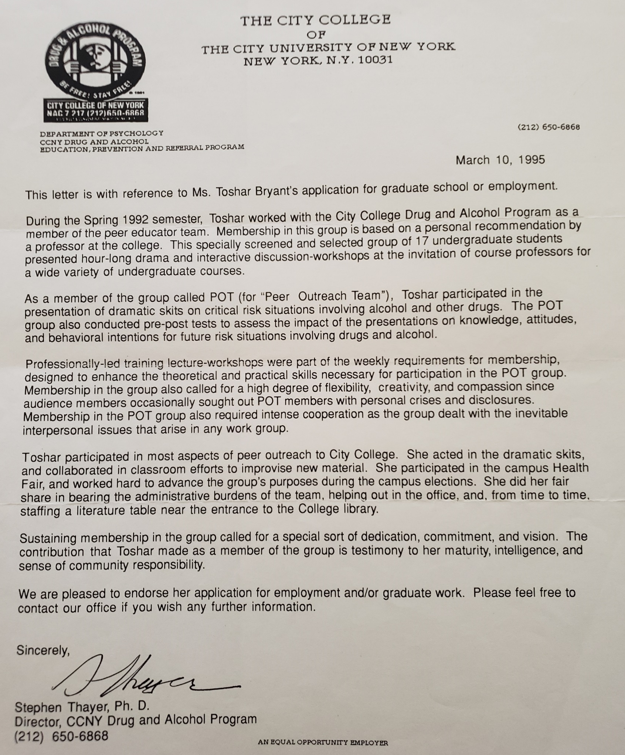
Accolades
www.Toshar.net | Toshar@Toshar.net | P.O. Box 284 Palm Harbor Fl,24682 | Bookings: 646-588-0827

Slide 14
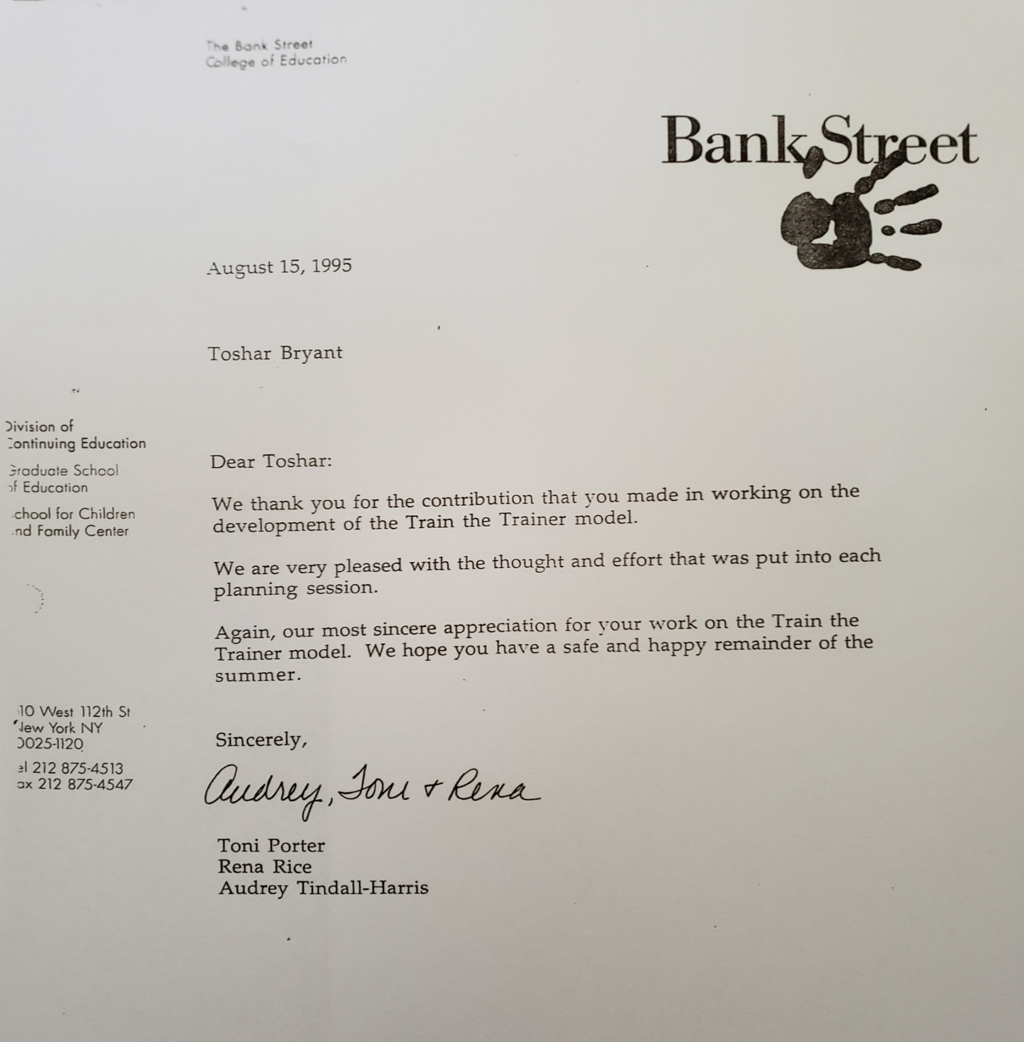
Accolades
www.Toshar.net | Toshar@Toshar.net | P.O. Box 284 Palm Harbor Fl,24682 | Bookings: 646-588-0827

Slide 15
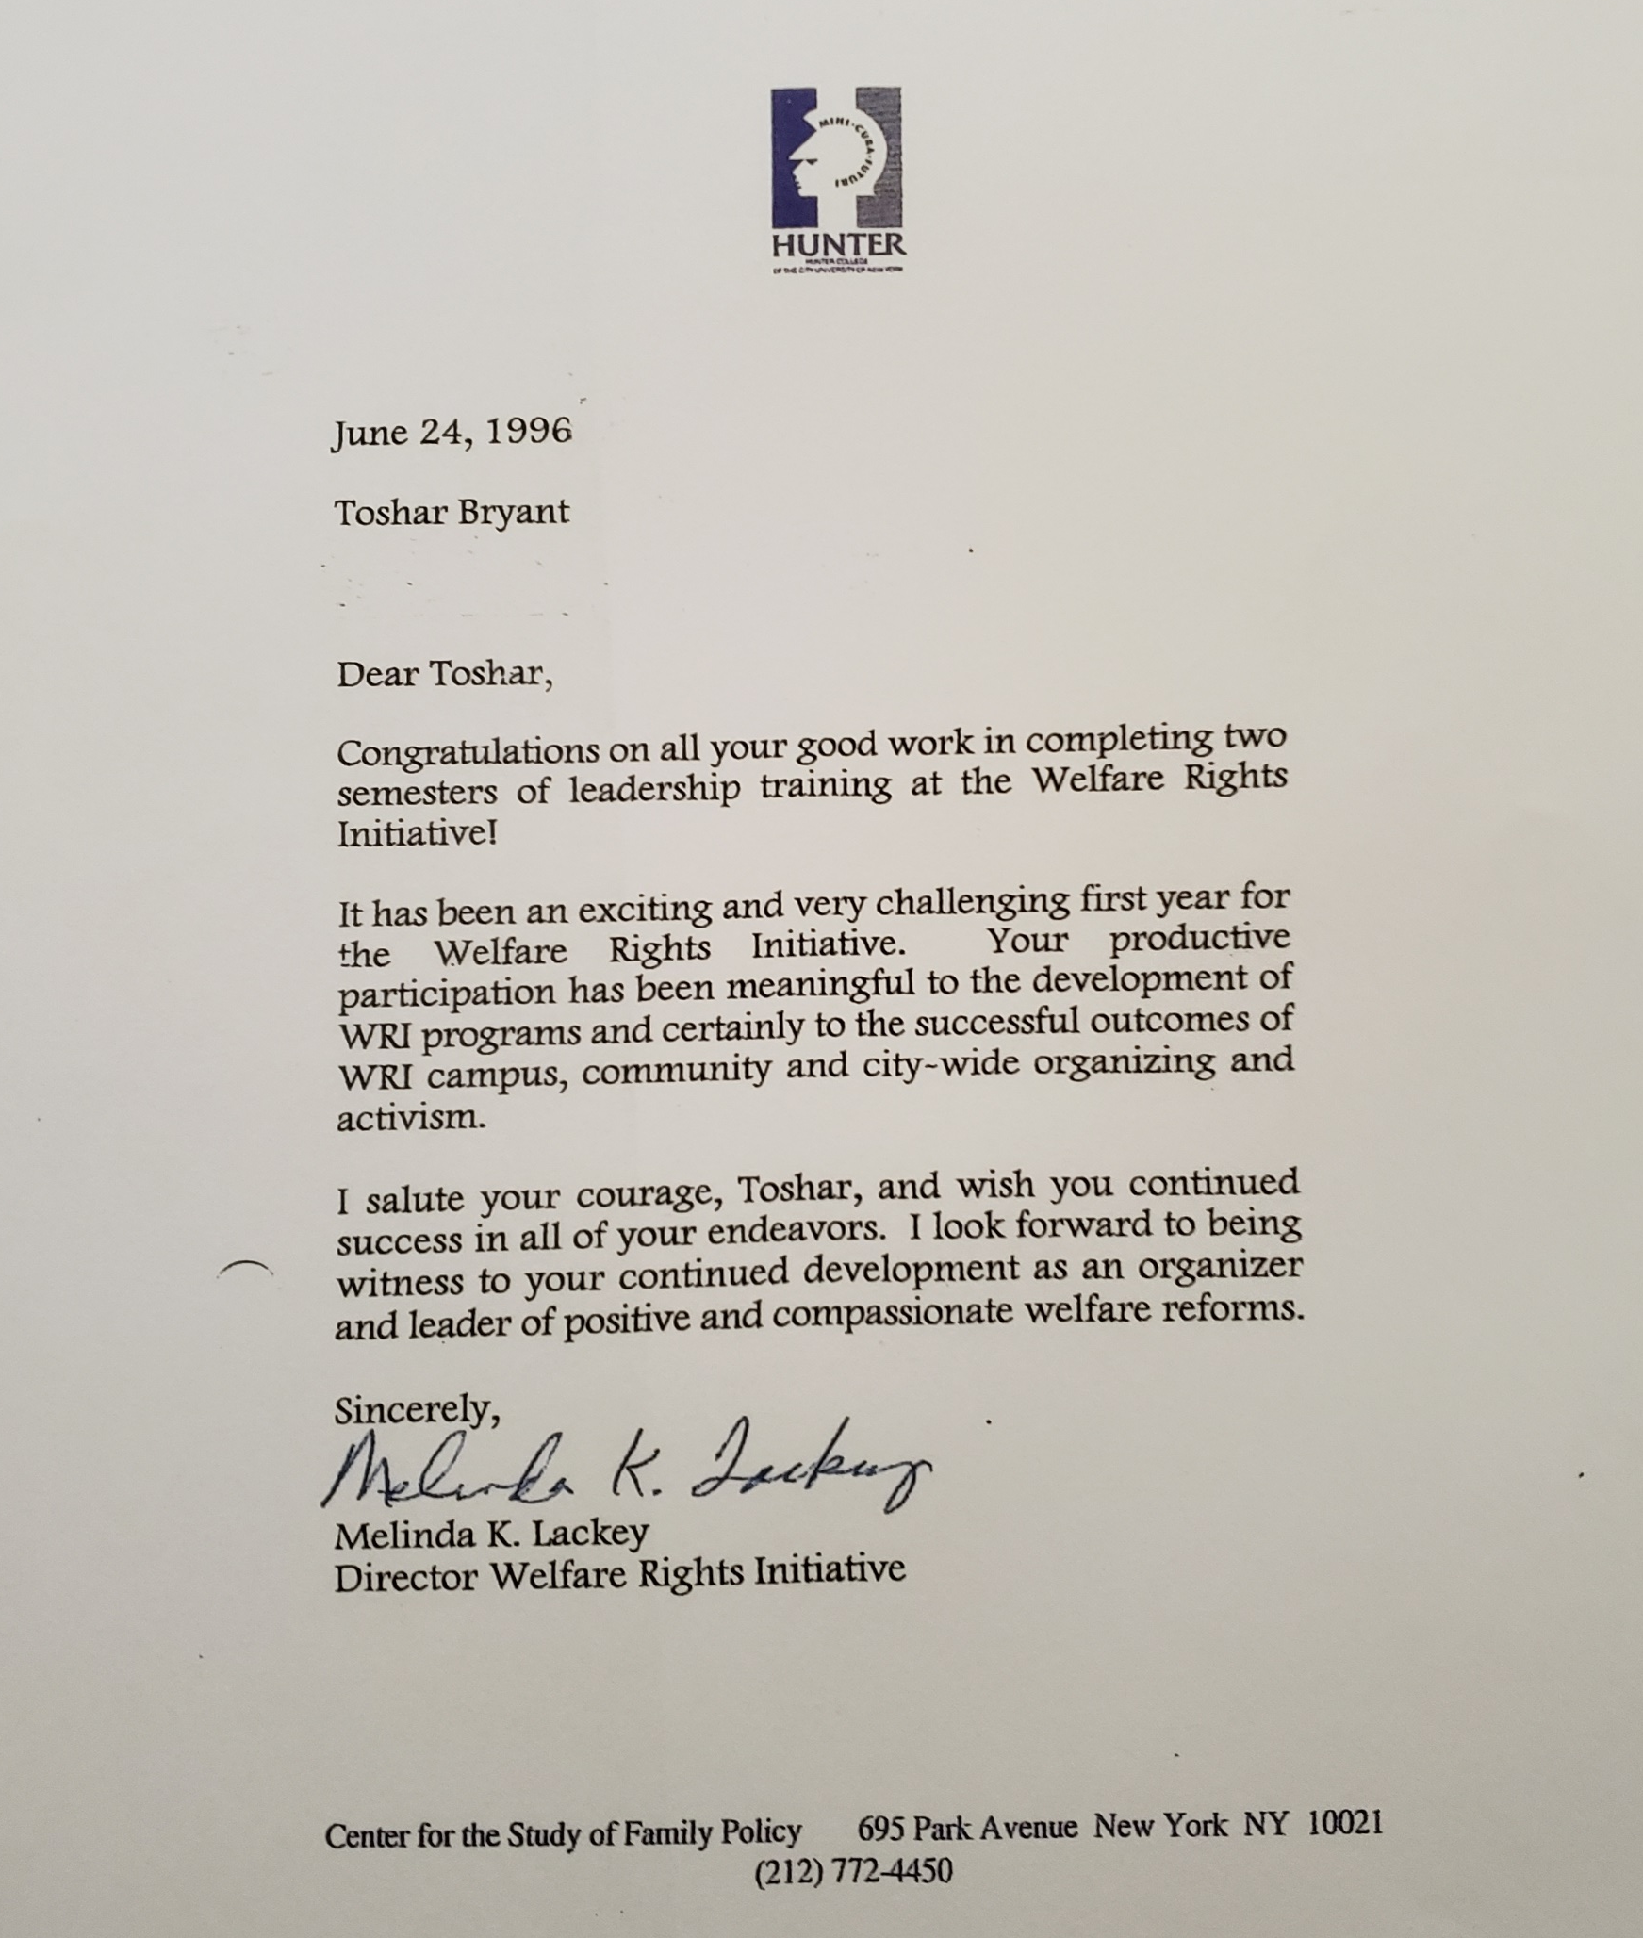
Accolades
www.Toshar.net | Toshar@Toshar.ne t| P.O. Box 284 Palm Harbor Fl,24682 | Bookings: 646-588-0827

Slide 16
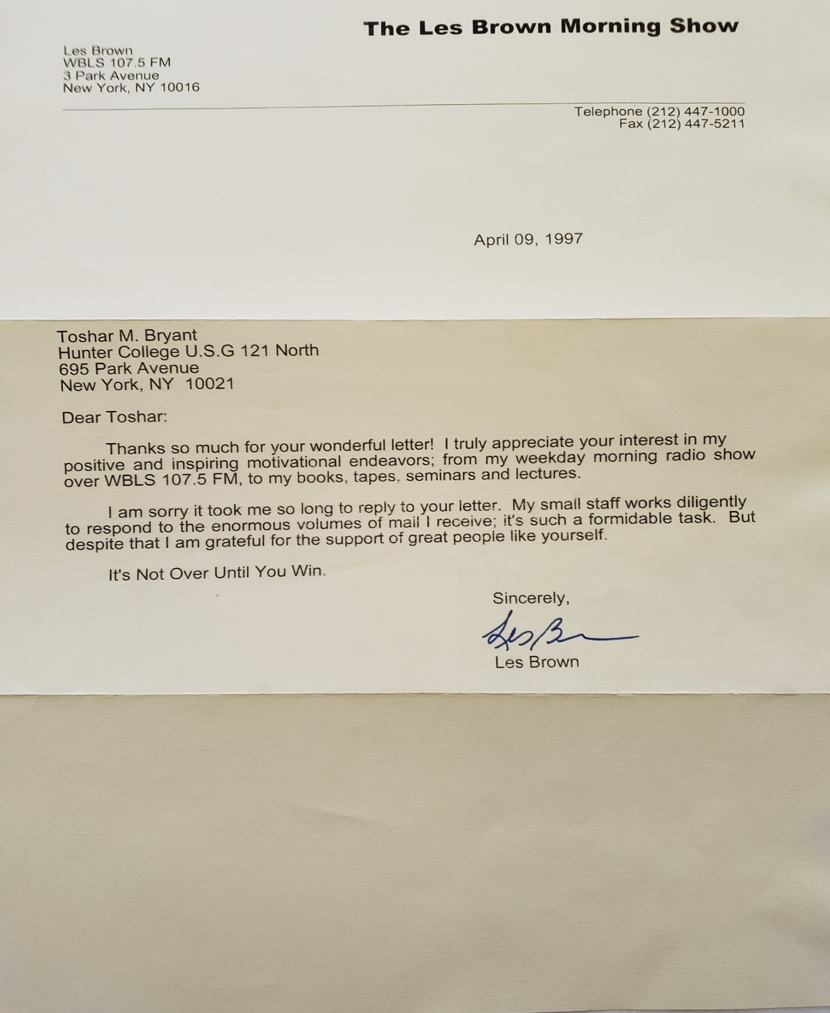
Accolades
www.Toshar.net | Toshar@Toshar.net | P.O. Box 284 Palm Harbor Fl,24682 | Bookings: 646-588-0827

Slide 17
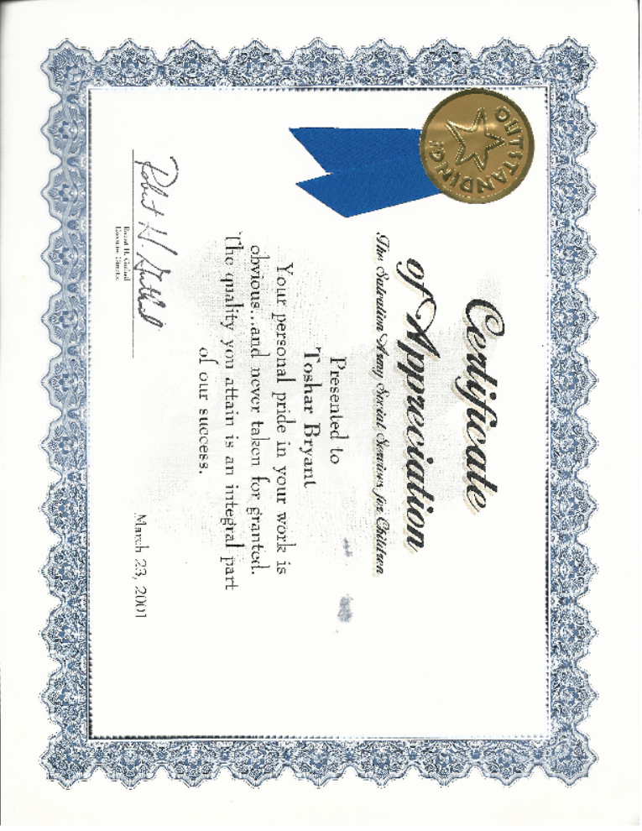
Accolades
www.Toshar.net | Toshar@Toshar.net | P.O. Box 284 Palm Harbor Fl,24682 | Bookings: 646-588-0827

Slide 18
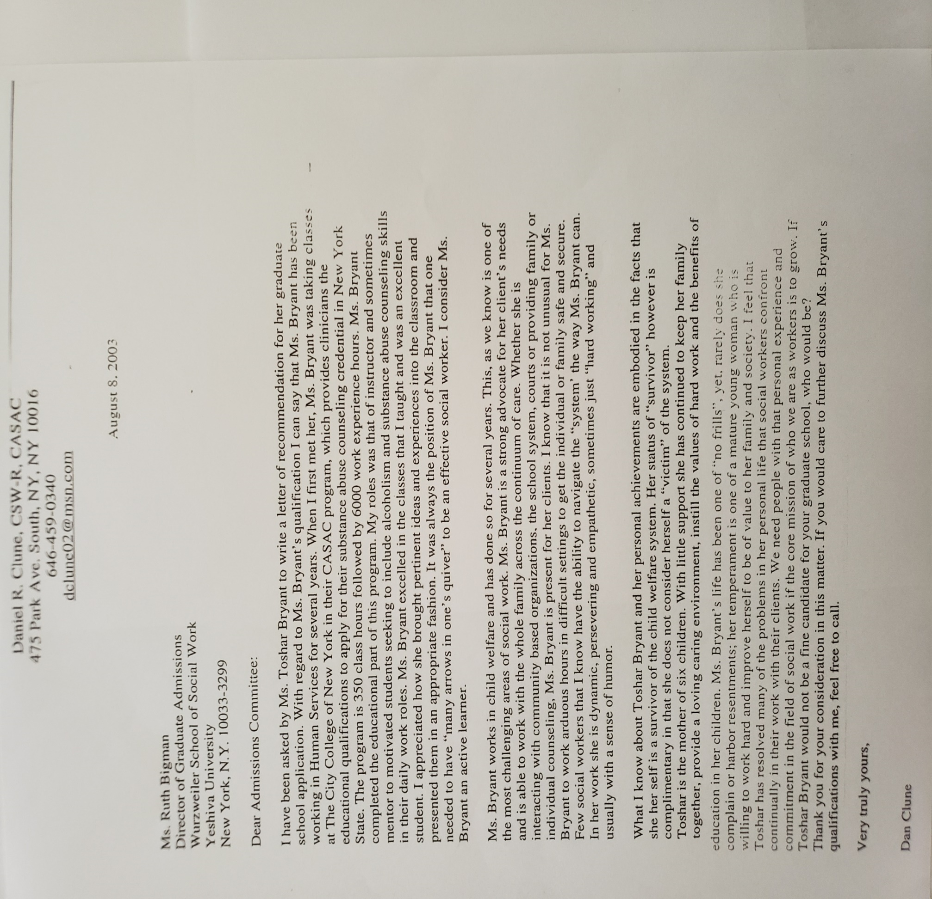
Accolades
www.Toshar.net | Toshar@Toshar.net | P.O. Box 284 Palm Harbor Fl,24682 | Bookings: 646-588-0827

Slide 19
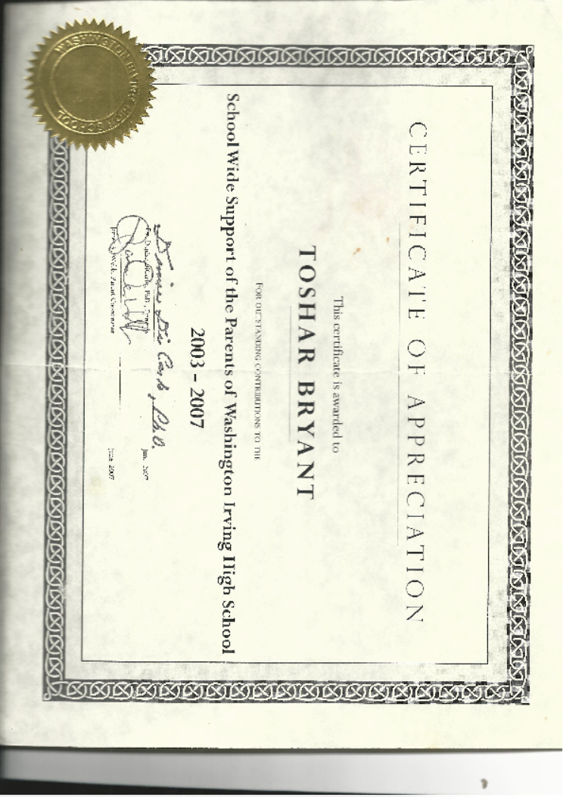
Accolades
Accolades
www.Toshar.net | Toshar@Toshar.net | P.O. Box 284 Palm Harbor Fl,24682 | Bookings: 646-588-0827

Slide 20
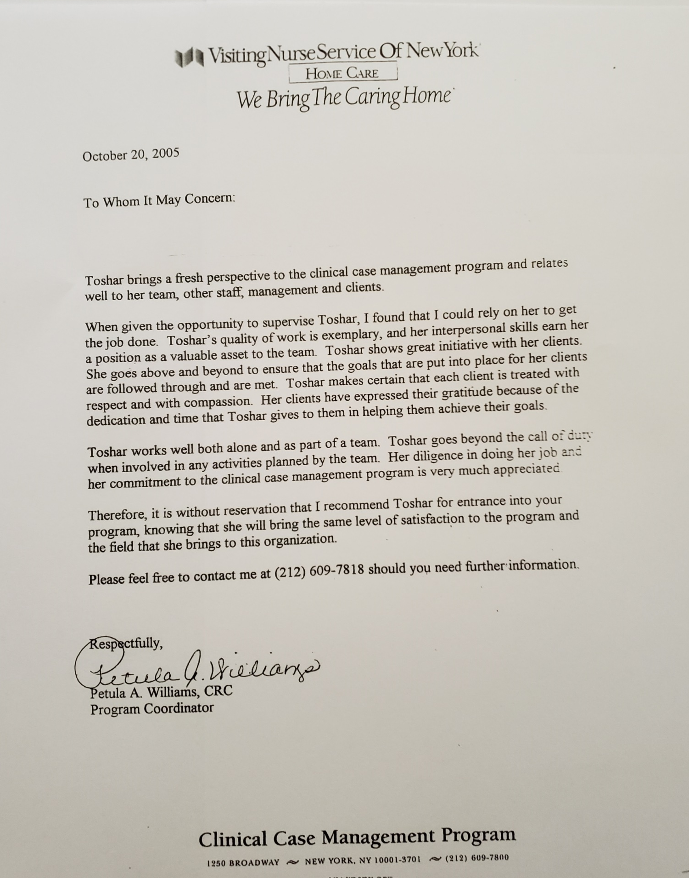
Accolades
www.Toshar.net | Toshar@Toshar.net | P.O. Box 284 Palm Harbor Fl,24682 | Bookings: 646-588-0827

