Slide 1
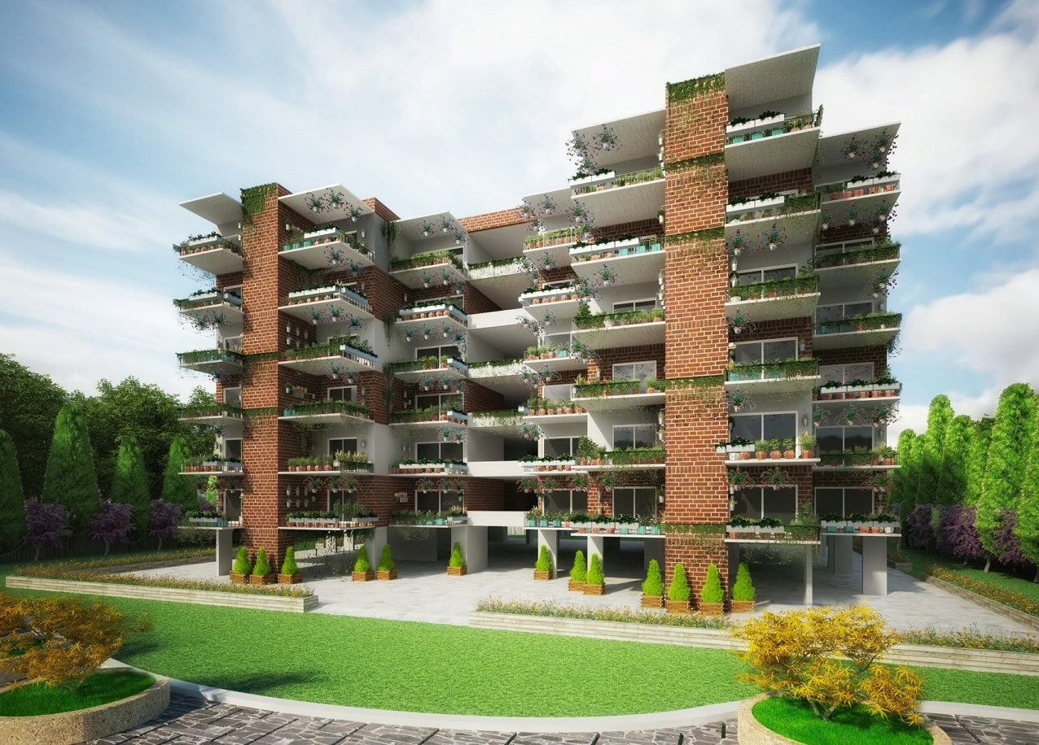
Torpedopot
Central Watering System (CWS-01)
Prepared by:
Darral Addison
Founder & CEO at Torpedopot™ (c) 1-215-290-9013
darral@torpedopot.com Www.Torpedopot.com Www.agriculturalblockchain.com
Copyright © 2020 Torpedopot™ - All Rights Reserved.

Slide 2
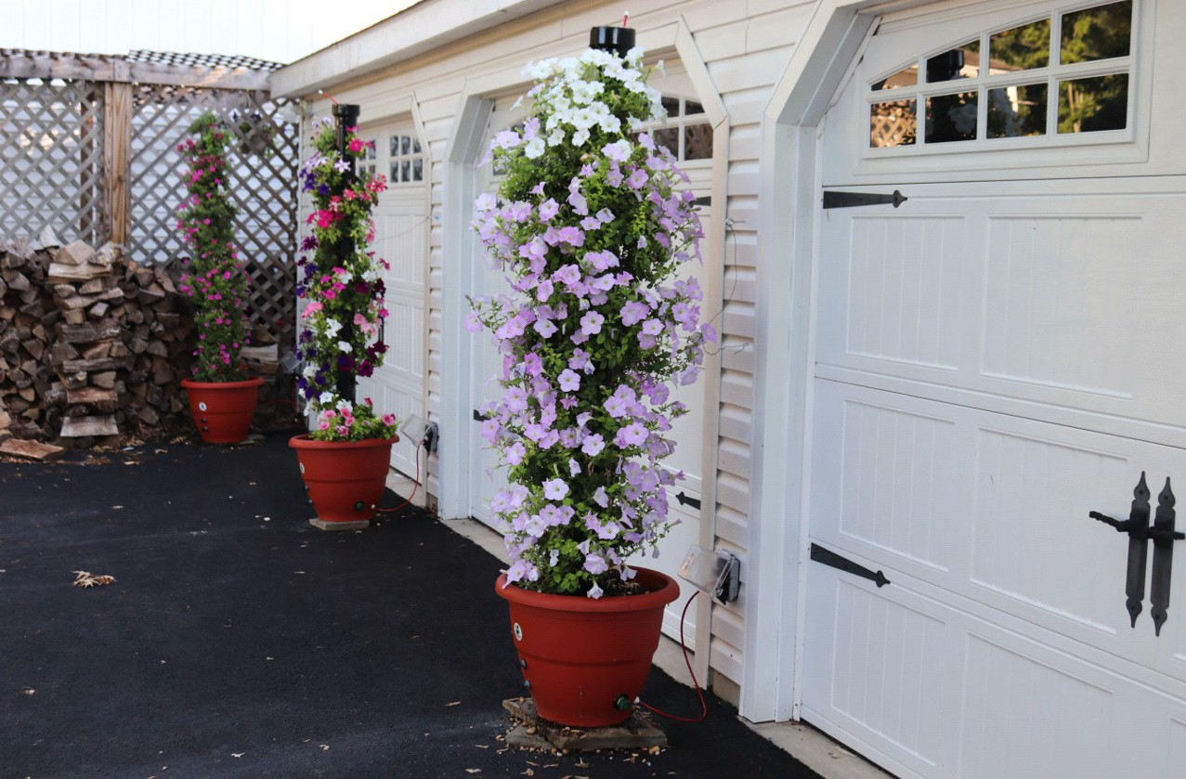



CWS is an Indoor/Outdoor Watering Solution
Torpedopot is designing and installing small, single-family residential water distribution systems. Our systems are pretty easy to install. Torpedopot utilizes home-run installations with central manifolds to balance pressures at the outlets and minimize water delivery wait time, reducing wasted water and energy. Our manifolds reduce the amount of piping and fittings,speed-up installation, and balance pressures throughout the system.
Ease of Installation - The installation of is generally easier than rigid pipe. The mechanical fittings are secure and reliable when installed properly.
Durability - Our piping will typically expand if the system is allowed to freeze, and return to its original size when the water thaws.
Cost Effectiveness - Our systems have lower installation costs
Energy Efficiency - our system offers reduced heat loss and improved thermal characteristics. This is ideal for cold climates.
Our water distribution system are recognized in all major building model codes and are commonly used for wa- ter distribution applications and water service lines.
International Residential Code (IRC-2003)
International Plumbing Code (IPC 2003)
National Standard Plumbing Code (NSPC 2003)
Uniform Plumbing Code (UPC-2003)

Slide 3
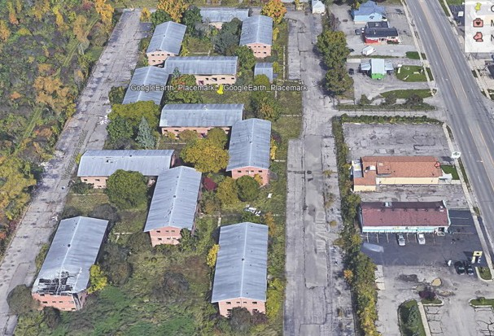
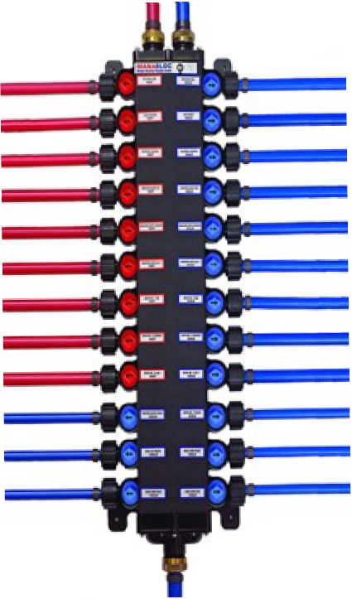
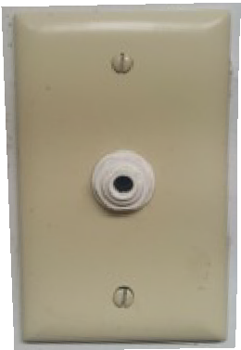
B1
B1
B
B
B
B
B1
B
B
“The Central Watering System is great be- cause it improves the overall resale value of your property. “You have certain consumers out there who will look for this in a home.”
B
B
B
The Torpedopot Central Watering System (CWS) utilizes flexible tubing that's connected to a more extensive water distribution system found in the laundry room or basement. The Torpedopot Central Watering System (CWS) is a built-in system with 1/4 inch Pex tubing that is run through the interior walls of the home. It's connected to a large manifold typically located in a laundry room or basement.
Water-ports that resemble electrical outlets are added to walls through- out the home, allowing the user to attach and detach a Torpedopot. This is done without hauling around a watering can or hose.
The average cost of a system is about $4,500 – based on a 2,400-square foot home – and that includes the cost of installation. Prices go up from there, depending on the system's features and the number of water ports required.
TP-123 manifold
Central Watering Systems aren't just for newly constructed homes. Existing homes can be retrofitted to accommodate a new system with minimal construction needed.
We do it with minimal repairs needed. We're not coming in and tearing
drywall out and all that kind of stuff. Most of the time, when we walk out of the house, you don't need to do anything but start using your system."
Water-port (WP11)
Commercial units with a built-in home watering system are generally 250K more than without it.

Slide 4
Cost Vs Value
Manifold
Value
The flexible hose gives the user the ability to gang hundreds of pots together using a single Water-port. You can run flexible tubing from all planters located in every room in the house including the garden, using one manifold central water supply system. The tubing in the Torpedopot™ is specially formulated to resist degrada- tion from mildew, algae, fungi, and biofilm that can accumulate on the inside or outside of tubing in filling and processing applications. The antimicrobial feature is fully compounded into the tubing to protect both the inner and outer surfaces from degradation, foul odors, microorganisms, and discoloration. It is resistant to environ- mental stress cracking.
Installation is simple
Drill Through the Stud and Sill Plate. Drill the holes in the center so screws or nails don't reach the pipes and damage the pipes. Use a nail plate. Then start running the flexible lines. Pull the lines up through the holes drilled in the sub-floor. Leave a little slack in the line to allow for expansion and contraction. Attach the flexi- ble hose to the inner wall plate and screw the wall plate to the wall only after you have checked that there are no leaks in the system. Make sure the valve on the wall plate is set to off Attach the manifold and ensure the valves are turned to the off position. Attach the hose to the manifold. Before turning the water on ensure that there are no leaks each of the water lines Turn the water on at the source and inspect the the lines do not leak. Attach the wall plate and plug in the flexible tubing for each planter
Cost
The national average for a major water system project is about $2.50 per square foot of construction area. In general, the larger the building the more expensive it is to plumb. Bigger buildings typically require more fix- tures and pipes usually need to run farther.
Sometimes it’s not so much the size of the building as the height. For instance, a two-story home will cost more to pipe than new construction for a one-story home with the same square footage. Running pipes to multiple floors is more complex and labor-intensive, so it’s more expensive.

