Slide 1
Building Your Own Agile Maturity Assessment
Kasie Kremenak

Slide 2
Kasie Kremenak
CoachingwithKasie.com

Slide 3
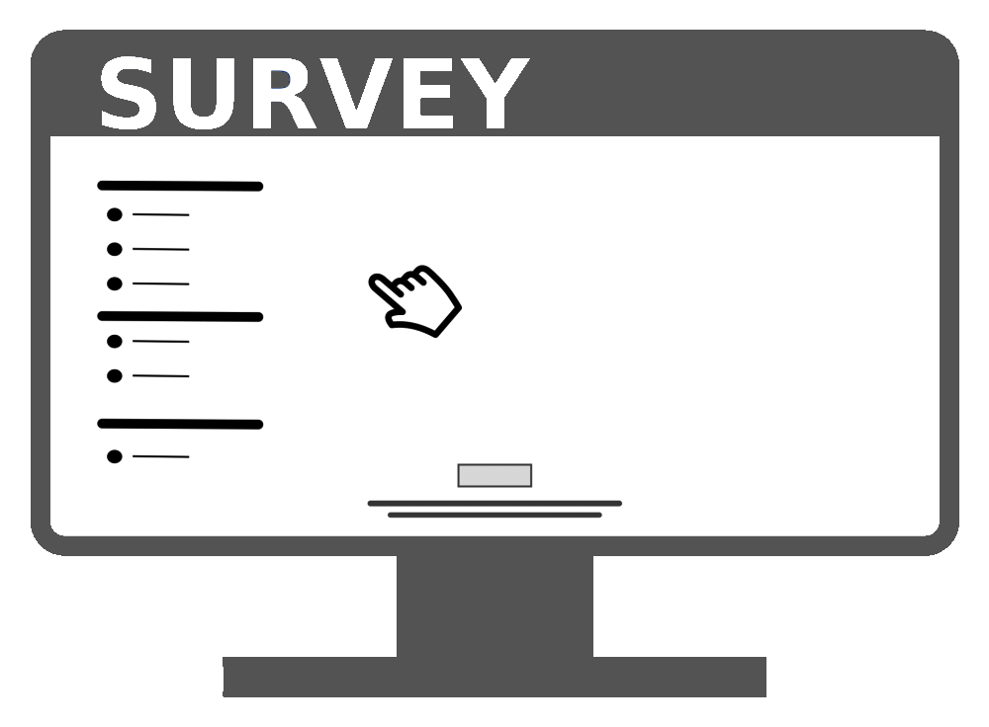
What to Expect ….
Presentation
Polling
Small Group Collaboration/Independent Work
Large Group Sharing and Discussion
Notes:
Online and in-person attendees
Location of speaker
Engaging all participants - each table will be group and all online attendees will be a group

Slide 4
After this Workshop ….
You will have the necessary tools to create and facilitate an agile maturity assessment that is relevant to your teams or your organization and can be used to improve agility.
Notes:
Read the slide
So when you walk out of here today you will have a tool you can use to immediately assess agile maturity with your teams. So hopefully that is why you are here. If you want to assess agile maturity that is probably an indication that you don’t think your teams are perfectly agile, you probably don’t think your organization is perfectly agile. So let’s start with a poll ….

Slide 5
What are the Biggest Challenges you Face with your Agile Transformation?

Slide 6
What are the Biggest Challenges you Face with your Agile Transformation?
ⓘ Start presenting to display the poll results on this slide.
Notes:
According to the 2022 state of agile report by Digital.ai formerly version one the top challenges are inconsistencies in process and practices, culture, resistance to change, lack of skills and experience and absence of leadership participation

Slide 7
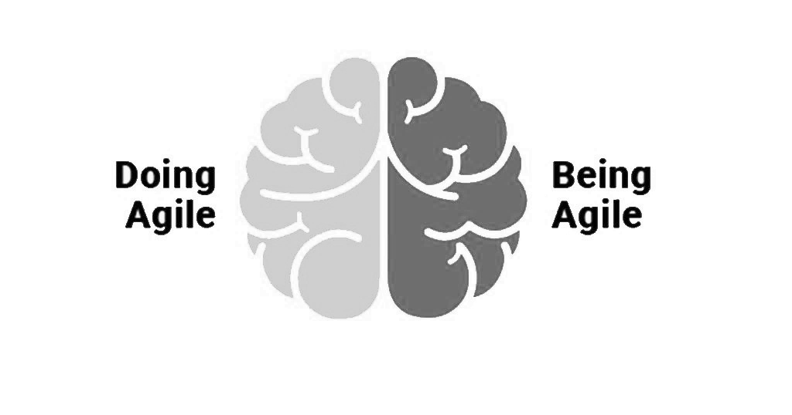
The Why Behind Agile Maturity Assessments ….
Help teams come to a common understanding of what agile maturity looks like
Build a clear path for continuous improvement
Alignment on practices and processes
Leadership engagement
Doing Agile vs Being Agile
Notes:
By using a tool like an agile maturity assessment you can start to address some of those challenges. Agile maturity assessments help build a common understanding of what good looks like. It helps the teams to align on and build a path to get better. By painting a clear picture of what agile maturity looks like you start to see increased alignment on processes across teams and product lines. The data and insights that are gained help to engage leadership. And it helps teams to truly understand where your organization is at on the spectrum of doing agile and being agile. By going through this assessment a team will learn things about themselves. Information emerges that they may not have been aware of and they gain a common understanding of where they want to go next.

Slide 8
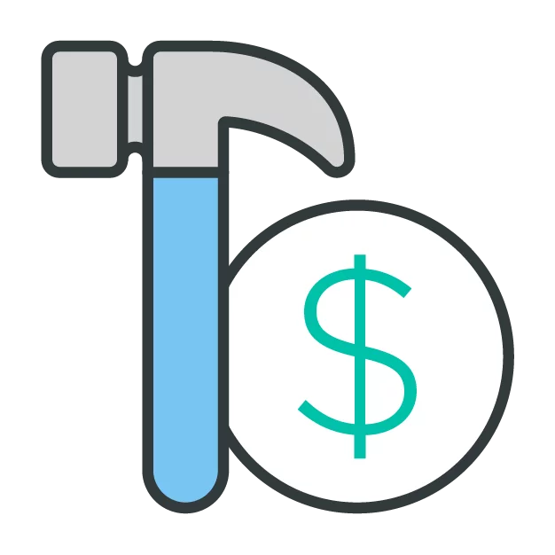
Build vs Buy ….
Budget
Scale
State of Agile Transformation
Timing
Right Fit
Notes:
The first decision you have to make when you are ready to assess agile maturity is do we build or do we buy.
There are a lot of great assessments on the market that have already been created for you. They come with in-depth metrics, technology, and reporting. But .. they are pricey, and many times organizations don’t want to fund something like this until they see the value so Budget is a consideration. Do you have it or not.
The next consideration is scale. How many teams will be completing the assessment. If you are starting small with a few teams, it may make sense to build your own. If you plan to involve 100’s of teams then the manual collection of data becomes unmanageable so buying something with automated reporting and dashboarding may be better for you.
Think about where your organization is at in its agile journey. If you are just starting out, buying an assessment tool may not be fit for purpose.
And timing or sense of urgency is important. If you have a need to assess quickly, building is the better option because many of the options on the market require a lot of effort to get started; there is training on facilitation, software configuration, security issues to address, the list goes on.
Most importantly can you find one on the market that is fit for purpose. Does is use the appropriate language, assess the things that are important to your organization, and provide data that helps drive continuous improvement.
Unfortunately, I haven’t found one that is perfectly fit-for-purpose for all organizations, teams, or agile frameworks. Often there are so many dimensions, questions, and measures that it becomes overwhelming and simply unusable. So I, along with several other agile coaches, decided to build our own as you will learn to do here today.

Slide 9
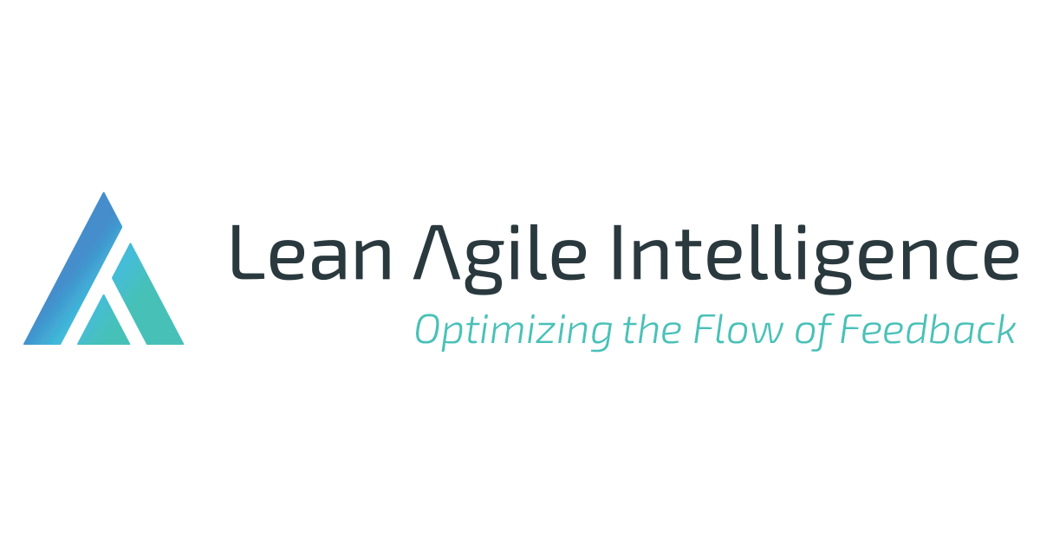
Keep it Simple ….
Cover the basics
Gather enough information to ACT
Be intentional
Use what’s already out there
Purchase a tool when you’re ready
Notes:
My recommendation is to build an assessment that covers the basics and gives you enough information to act. You don’t want to measure things you won’t use. KEEP IT SIMPLE and Be intentional about what you include,
you may not want to include measures for things your organization is not ready to change. For example, if you know the structure of your teams is an issue, but leadership has made it clear this will not change in the near future, don’t measure it. You already know the team structure is an issue so assessing this will not provide value.
You don’t have to start from scratch either. There are many assessments that have been shared in agile communities you can use as your starting point. Ben Linders has a great site with over 90 shared assessments that people have built on their own.
And then as you mature your process and you scale to additional teams or product lines or business units, when you have buy-in and budget, consider purchasing a tool
The Lean Agile Intelligence assessment platform is a great tool to mature into because it allows you to completely customize your assessment so you can use what you’ve already built and grow from there.
So if you are in a place where building as assessment makes sense, we’re going to walk through the process of putting it together, facilitating it, and analyzing the data together today .. So let’s jump in.

Slide 10
Let’s Create an Assessment
Step 1: Select the categories you want to assess.
Agile Practices
Leadership Agility
Technical Practices
Team Health
Notes:
The first step is choosing the categories you would like to assess. You can select as many categories as you want but you’ll want to ensure you make the assessment right-sized, the more categories you have, the longer it takes to facilitate the assessment and you can get more data than you can act on which isn’t really value add.
When selecting the topics to assess, there are some fundamental things that will provide a lot of value.
Assessing how teams are doing with some basic agile principles and practices can be very beneficial. Evaluating things like how they prioritize, how they collaborate with customers, how they visualize work, and how often they are meeting commitments can help identify places where the team has not adopted practices that are going to help shift their behaviors and experiences.
With Leadership agility being one of the top challenges in agile transformations, this category can help to uncover where opportunities to improve leadership support exist.
Another critical piece of the puzzle is how teams are approaching things technically. If the team is missing this piece they are really going to struggle to deliver value. This would be a category where you would uncover opportunities around quality, devops practices, or the state of technical debt.
In addition, teams can only be as successful as their environment allows. If the way the teams are working is at odds with the culture of the organization, their ability to effectively deliver value and mature in their agility will be stifled. Assessing operational agility can be helpful in identifying areas where there may be misalignment.
And finally, Team Health or team dynamics is another area to consider in the assessment. When we think about how a mature agile team might work together, we expect to see things like swarming, knowledge sharing, trust, and accountability. These are all things we can measure through an agile maturity assessment.
The is not an exhaustive list, there are a few more that we’ve included in assessments on your handout as well. We’re going to get started with building an agile maturity assessment by selecting the categories we’d like to assess.

Slide 11
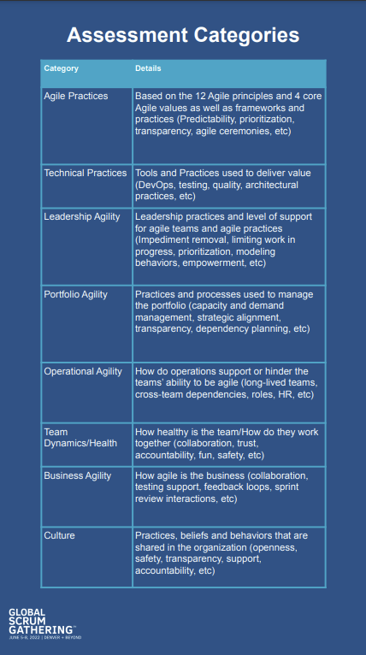
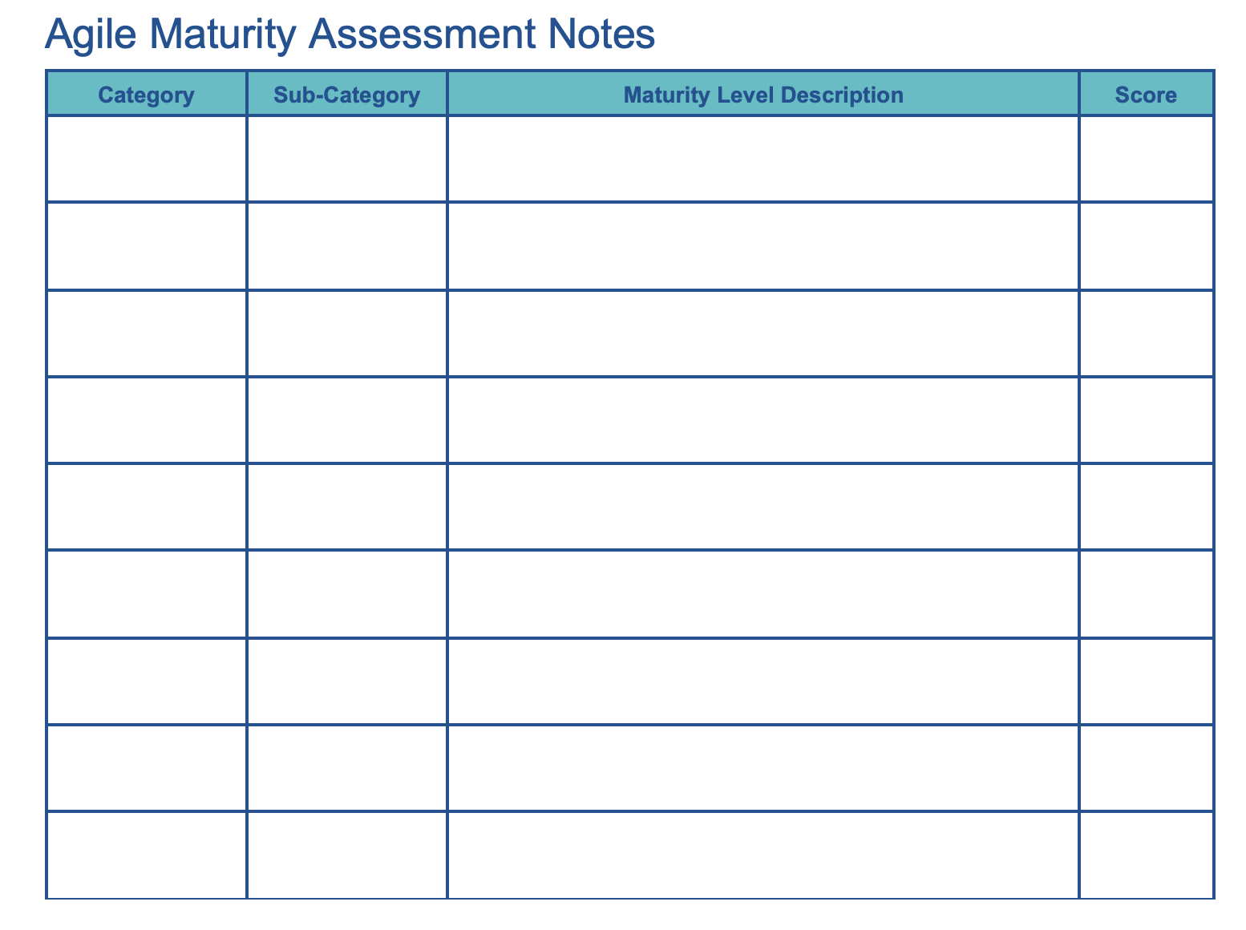
Let’s Create an Assessment
Step 1: Select the categories you want to assess.
Notes:
I would like each of you to take a few minutes to review the handout titled “Agile Maturity Assessment Categories” and thinking about where you’re organization is today, and the problems you are trying to solve, select at least 2 categories you might assess with your teams or organization. You can also choose a category that is not on this list. Write them down on your notes handout, leaving 3 – 5 spaces between each category. This will allow us to add maturity levels later. Once you’ve selected your levels, share what you came up with your at table and why you chose it. I’ll ask virtual attendees to share the same in the chat. We’ll spend 5 minutes on this activity so I’ll put up a slide with the activity details and a timer. Please let me know if you have questions.

Slide 12
5 Minutes
Select at least 2 categories you would like to assess with your teams.
Discuss the options you chose and why you chose them.
Notes:
Okay great, welcome back

Slide 13
Which Categories did you Choose?
ⓘ Start presenting to display the poll results on this slide.
Notes:
Okay great, welcome back, I’m curious to know what categories each of you selected. I’m going to open up another poll so you can share the categories you selected to include in your assessment.

Slide 14
Let’s Create an Assessment
Step 2: Define topics to assess under your categories
Agile Practices
Feedback Loops
Prioritization
Predictable Delivery
Agile Framework
Notes:
Next, we’ll define the different levels of maturity within each category. First you’ll determine how many levels you would like. Should have at least 3 but no more than 5
Once you’ve determined how many maturity levels you will have you will need to write a description for each level. As you determine the levels you want to ensure they are behavior driven. You want to remove subjectivity as much as possible and you want clear separation between levels.
For example, instead of using “The team does not estimate well” you might say “The team uses time when estimating and often misses delivery dates”
Let’s get started

Slide 15
Let’s Create an Assessment
Step 2: Define topics to assess under your categories
Technical Practices
Quality
Code Changes
Deployments
Notes:
Next, we’ll define the different levels of maturity within each category. First you’ll determine how many levels you would like. Should have at least 3 but no more than 5
Once you’ve determined how many maturity levels you will have you will need to write a description for each level. As you determine the levels you want to ensure they are behavior driven. You want to remove subjectivity as much as possible and you want clear separation between levels.
For example, instead of using “The team does not estimate well” you might say “The team uses time when estimating and often misses delivery dates”
Let’s get started

Slide 16
7 Minutes
Determine which topics you will assess under each category.
Share at your tables or via chat.
Notes:
Okay great, welcome back

Slide 17
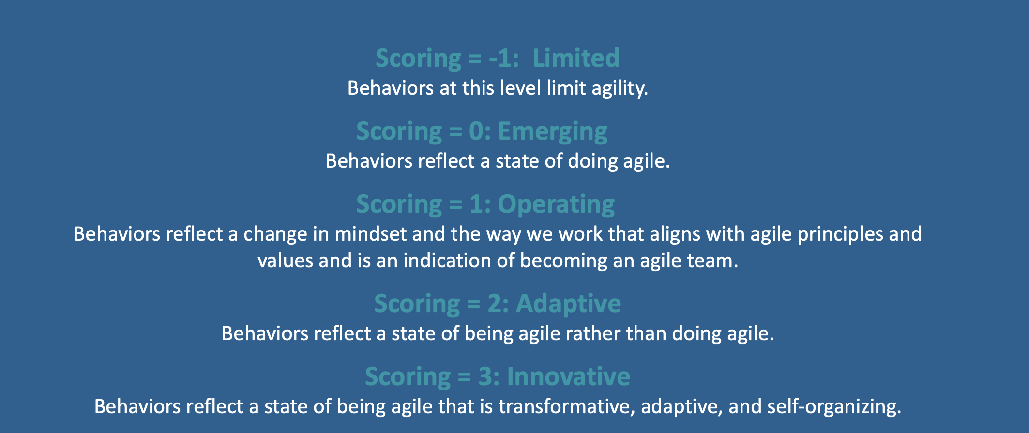
Let’s Create an Assessment
Step 3: Define Maturity Levels.
Determine what the levels will be
Notes:
Next, we’ll define the different levels of maturity within each category. First you’ll determine how many levels you would like. Should have at least 3 but no more than 5
Once you’ve determined how many maturity levels you will have you will need to write a description for each level. As you determine the levels you want to ensure they are behavior driven. You want to remove subjectivity as much as possible and you want clear separation between levels.
For example, instead of using “The team does not estimate well” you might say “The team uses time when estimating and often misses delivery dates”
Let’s get started

Slide 18
2 Minutes
Determine how many maturity levels you will have and what numbering system you will use
Label them
Notes:
Okay great, welcome back

Slide 19
Let’s Create an Assessment
Step 3: Define Maturity Levels.
Write descriptions for each level
Remove subjectivity
Clear separation between levels
Notes:
Next, we’ll define the different levels of maturity within each category. First you’ll determine how many levels you would like. Should have at least 3 but no more than 5
Once you’ve determined how many maturity levels you will have you will need to write a description for each level. As you determine the levels you want to ensure they are behavior driven. You want to remove subjectivity as much as possible and you want clear separation between levels.
For example, instead of using “The team does not estimate well” you might say “The team uses time when estimating and often misses delivery dates”
Let’s get started

Slide 20
Let’s Create an Assessment
Step 2: Define Maturity Levels.
Notes:
Next, we’ll define the different levels of maturity within each category. First you’ll determine how many levels you would like. Should have at least 3 but no more than 5
Once you’ve determined how many maturity levels you will have you will need to write a description for each level. As you determine the levels you want to ensure they are behavior driven. You want to remove subjectivity as much as possible and you want clear separation between levels.
For example, instead of using “The team does not estimate well” you might say “The team uses time when estimating and often misses delivery dates”
Let’s get started

Slide 21
Let’s Create an Assessment
Step 3: Define Maturity Levels.
Notes:
You’ve all got a handout titled Assessment Maturity Levels. There are examples from the assessment build by myself and my colleagues. You can use this to create your levels or you can come up with your own. We going to take about 15 minutes to build in some levels of maturity for the categories you selected earlier. You can take notes on your assessment handout. I’ll put up a slide with the instructions and a timer, and please as always let me know if you have questions or get stuck, this is the most difficult part of creating your own assessment.

Slide 22
10 Minutes
Describe each level clearly, removing subjectivity as much as possible.

Slide 23
Discussion ….
How did that go?
What was challenging?
What did you like about it?
Notes:
Okay, let’s reflect on that as a large gorup. How did you do? What was challenging? What did you like?
Let’s hear from some of you in the room and then we’ll read some comments from the chat
Well congratulations, you’ve just gotten through the most difficult part of the workshop, you’ve built an assessment. Of course it will take more time and focus when you are really ready to build but you’ve gotten started.
During our remaining time together we will discuss recommended approaches to facilitation, analyzing results, and acting on the data you’ve collected. Before we move into that discussion are there any other questions or comments?
Okay, let’s jump into facilitating the assessment.

Slide 24
Let’s Create an Assessment
Step 4: Determine Facilitation Approach.
Avoid groupthink
Create a safe environment
Simplify tooling
Quick analytics turn-around
Notes:
Facilitation can really impact the experience of the teams that are participating in the assessment as well as the data you receive so you really want to be intentional and prepared.
When determining your approach to facilitation is is important to facilitate in a way where you can avoid group-think. You don’t want responses that are influenced by others. You really want to get each individuals unique perspective on the category you are assessing.
With that being said, it is important to create a safe environment so be selective in who you include in the assessment. For example, it is probably a good idea to leave managers off the invite so the team can speak freely. I recommend having a neutral facilitator like an agile coach and including the delivery team, scrum master, and product owner in the assessment.
Tooling is another consideration. You want to be sensitive to the fact that this process is new so if you are introducing a new tool for polling or collecting data it can take away from the focus on the assessment itself.
Finally, it is really beneficial to discuss the results immediately after the assessment is complete so design a way to quickly gather insights on the data. We created an excel spreadsheet that had a list of the categories, a place to document the score, and any important notes with pre-configured charts that we filled out as we went through the assessment. This allowed us to move immediately from questions to results easily.
Once you have a plan for facilitation you are ready to facilitate the assessment with your teams.

Slide 25
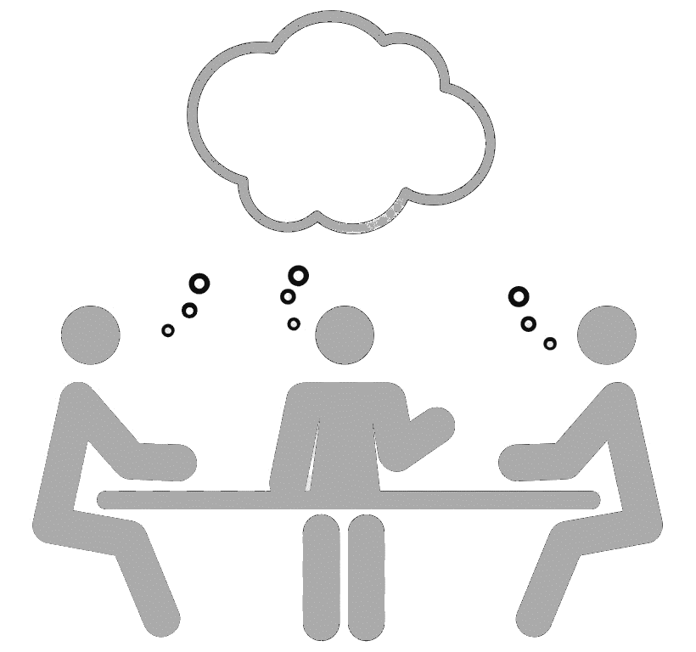
Time to Execute
Step 5: Facilitate the Assessment.
Create a safe environment
Ensure the levels are understood
Explain team vs individual assessment
The lowest level behavior identified is the score
Discuss and come to consensus
Notes:
As you begin to facilitate the assessment, you will want to discuss how the information will be used and who it will be shared with. This will help to create a safe environment and set clear expectations for the teams. Discuss how data will be used to form organizational trends and if team level data is available to leadership. I recommend only sharing team level info with the team and their direct leadership group. Use trend data for the Senior leadership level.
As teams are going through the maturity levels, make sure they are understood. If more detail would be helpful take time to explain each level before the team votes.
This next one is tough for teams so it is important to explain this upfront. When I say the lowest level behavior identified is the score what that means is that if the team feels like multiple levels could apply because they are doing things in level 1 but are also doing things in level 2, then the team scores a 1. The reason behind this is that if a team is demonstrating behaviors from a lower level, it is limiting there ability to be agile. They should no longer see any of the behaviors from the lower level before they score themselves at the higher level. I usually tell teams to start reading from the lowest level and as soon as they identify a behavior displayed on the team to stop and select that score.
As individuals select scores, ensure they are considering team behaviors and not rating themselves but even as they evaluate the team, it is inevitable that there will be different levels selected across the individual team members. Each team member should share the behaviors they see that influenced their vote. Once everyone has shared, have the team re-vote until they come to consensus. Be mindful of the time you are spending on each category. I recommend setting a time-box and if need be, table the question and come back to it later.
Once you have gotten through all the categories you are ready to analyze the results.

Slide 26
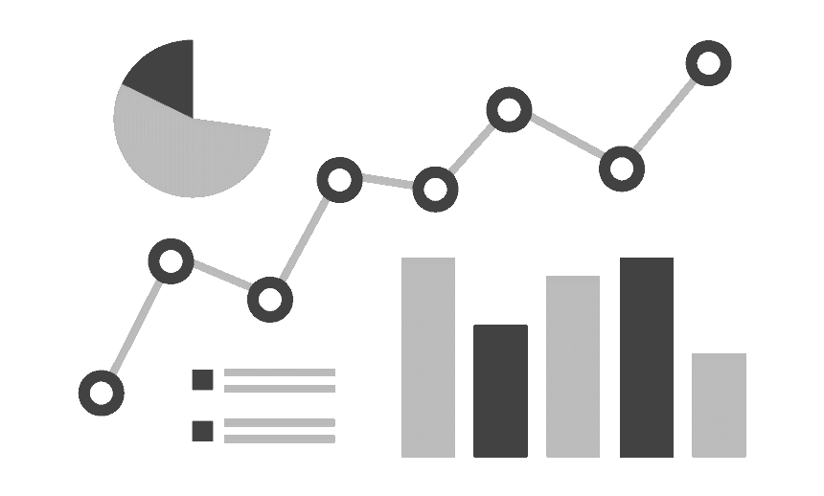
Analyze the Results
Step 6: Compile Results.
Immediate results are preferred
Have trend data available
Confidentiality agreements should be maintained
Rollup data for organizational trends
Notes:
As we discussed earlier, immediate results are preferred. Give the team a short break if you need some time to put the data together but I highly recommend you don’t wait days or weeks to review and discuss. The conversation is fresh and that will be really valuable as the team reviews the outcomes of the assessment.
If the team has taken the assessment before, have that trend data available so they can see how they progressed, regressed, or maintained agile maturity patterns quarter over quarter
Make sure your confidentiality agreements are maintained, saving the files in a location where only those agreed upon can view the information. Avoid sending copies that could be forwarded.
Use rollup data for organizational trends, sharing with the team how they compare to organizational trends.

Slide 27
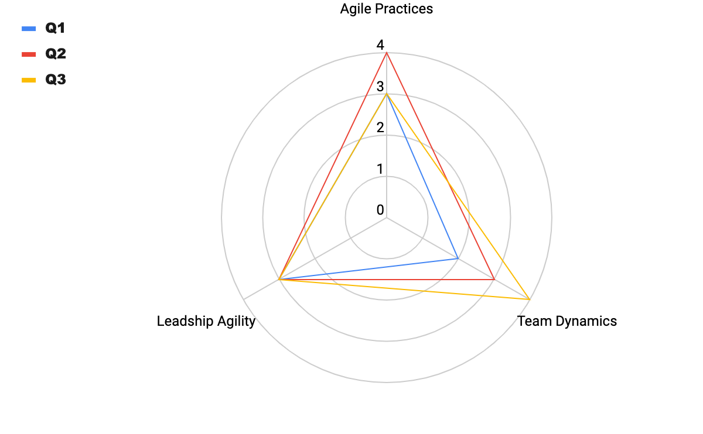
Analyze the Results
Step 6: Compile Results.
Notes:
Team level results
3 categories assessed over 3 quarters: leadership agility, agile practices, and team dynamics
This particular team scored Leadership agility at a 3 each quarter
Matured in agile practices from q1 to q2 but regressed in q3
And continuously matured in the team health category
Once the team has reviewed the results it is time to build a plan for continuous improvement

Slide 28
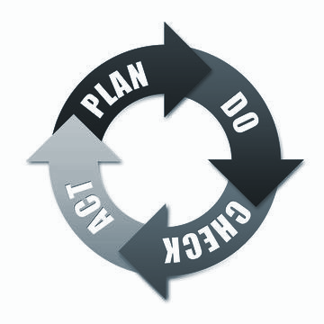
Time to Act
Step 7: Build an Action Plan.
Facilitate a conversation to identify where the team would like to focus
Set clear goals and timelines for improvements
Determine process and cadence for revisiting
Notes:
It is helpful to choose just a couple of areas to focus on for improvement. If the team selects too many areas to improve on their ability to focus and see progress will be limited. Having too many areas of focus decreases the team’s ability to achieve their goals.

Slide 29
In Summary ….
Understand and Focus on the Why
Measure what is Important and Useful
Remove Subjectivity
Good Facilitation Skills are key
Immediate results and discussion are recommended
Build Action plans and make them Visible
Reflect on how the assessment process went and Adjust

Slide 30
Questions/Comments
Questions or Comments????

Slide 31
Thank you
CoachingwithKasie.com

