Slide 1


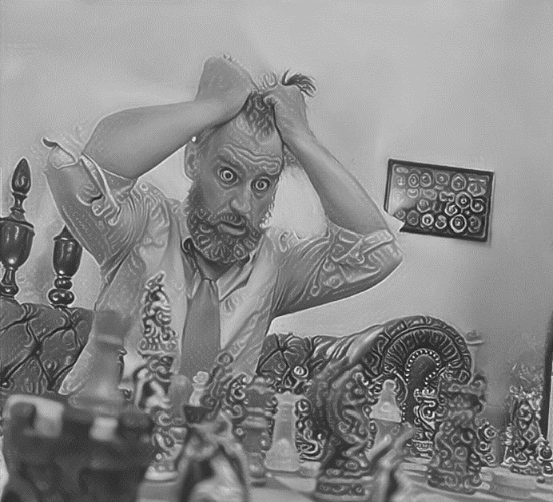
















QUICK CONNECT GUIDE (START HERE)
ORIGION
SPEAKS TO
MDL: ATLAS AULTMAN
VER. 4.58
- Proudly made in the U.S.A.
- Adopted
- Raised in multiple states
- Almost 3 decades in Military
Innovation (Change Leader)
- Former Commander &
Director (Leadership)
- Ex-Spec Ops & White House
Combat Comm (Mindset)
- War Veteran / Iraq &
Afghanistan / my kid-death
(Near + Death Experiences)
- Missions in 30+ countries
(Culture)
- 5 Bestselling books (Giving back)
- Top Speaker (Your Story)
- Lifetime Networker (Elite)
- Billion-dollar responsibilities
(Management)
DEVELOPMENT
- Grown in American Culture
- Adapted as “New Kid”
- Wrestling, Soccer, Pole-Vault
Football, Baseball, Running
- Pro Freedom
- LTR + kids
- Christian
www.leaders-kit.com/starthere
Emails, Low-to-no value people, Movies drain this Operating system. Avoidance of these things will allow more use for operator.
STRENGTHS
Accomplished, Charismatic, Networker, Find-it-all until win
Dedicated, motivated, innovative, skilled communicator
WEAKNESSES
Looks for admiration, competitive perfectionist at times,
Passive, closed off to some, non-forgiving after 3 strikes
*MYERS BRIGGS – ENFJ * ENNEAGRAM = Type 3 / Chameleon*
TARGETS
100 Podcasts, including JRE. New bestseller every
6 months. Growing 10K+ proven leaders per year.
* LOVE LANGUAGE – Q TIME, WORDS, PHYSICAL, ACTS, GIFTS
DO NOT RETURN TO PLACE OF PURCHASE - REPORT ISSUES TO A HUMAN NOT A FOLLOWER

