Slide 1
Presenting a Plan for Creating 24/7 Animal Emergency Care in Las Cruces
Prepared by Dawn Duncan
for
Animal Companions of Las Cruces

Slide 2
MISSION
Animal Companions Provides support and resources For Expanding and sustaining 24/7 emergency services in Las Cruces to serve a wide community of pet owners in southern new Mexico and to ease the burden of veterinary staff.

Slide 3
The Need
The only emergency hospitals in the region are in Albuquerque & el Paso, 1-3 hours away
Veterinarians IN the region, when surveyed, affirm the need and their willingness to send clients to las Cruces

Slide 4
Relevant Data
100 Cities nationwide comparable to Las Cruces in size—pie chart results
Only 1 of 3 out of 100 without emergency care
57 of 100 have their own in-town emergency care
40 of 100 have emergency care within 25 miles.
6 of those cities that have their own also have lower median income
Last 10 years have shown a growth rate in Las Cruces of 14.10%

Slide 5
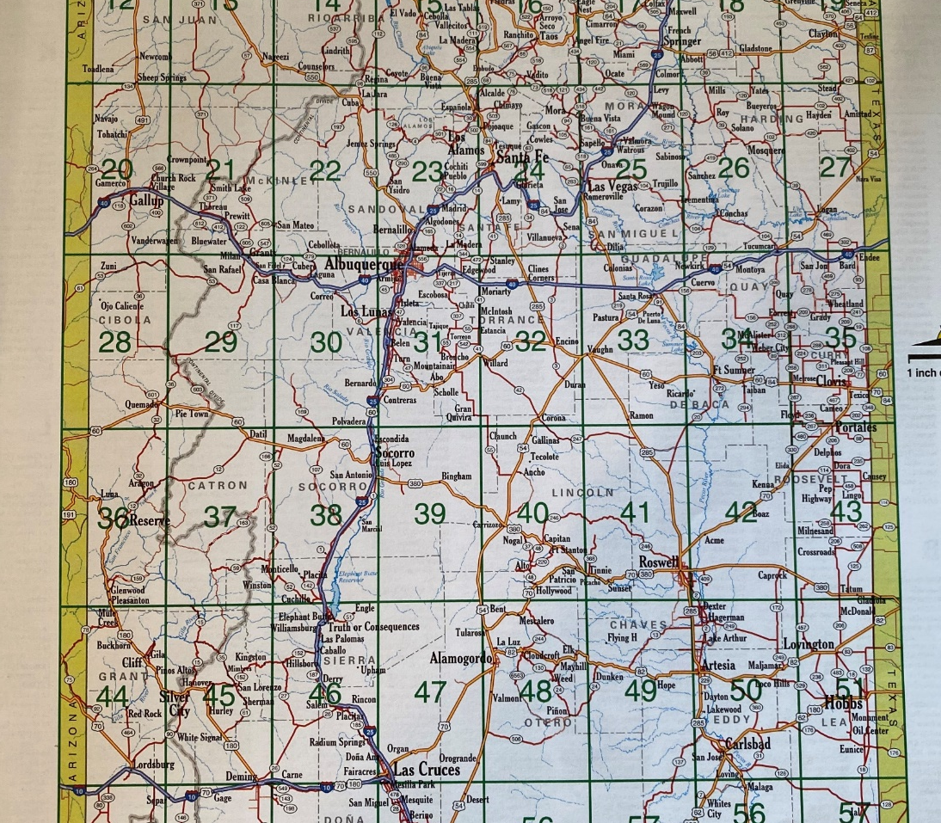
Towns Surveyed
Mapping and Creating Perimeter: ½ Way Points between Las Cruces and 3 Cities—El Paso, Albuquerque, and Silver City.
Researched 63 Towns within the Radius
Only 11 Towns within the radius have any veterinary services
*Note: We discovered that Silver City no longer offers emergency care, so the scope could grow

Slide 6
Data Indicating Potential Gains
Vets surveyed within the region report referring 5-15 cases a week to emergency care
They report the cost of such services generally between $450-$1,150 per case
Extrapolating for clinics in the area, this would amount to $144,000 weekly, or $619,200 monthly, or $7,430,400 yearly

Slide 7
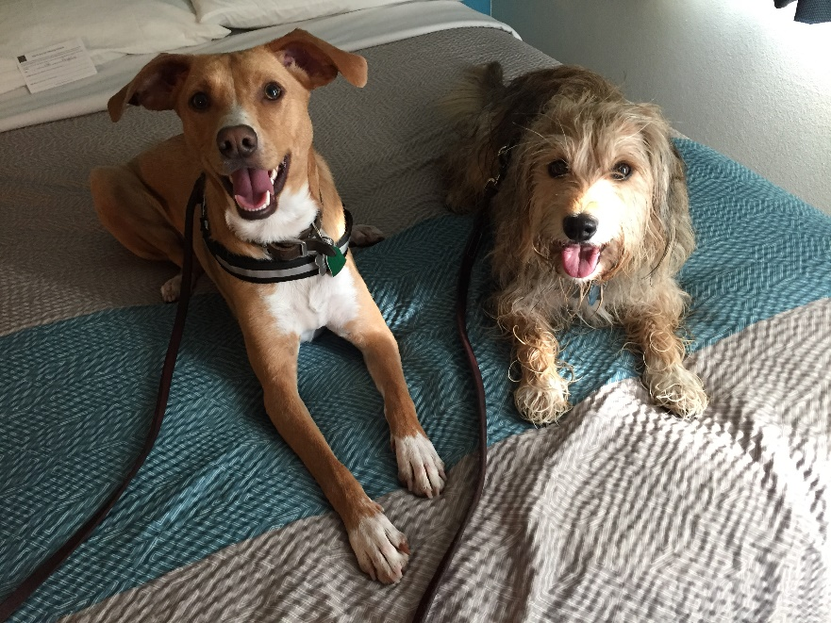
Where We Began: Three Options
Local Consortium—depending on will of local vets
Corporate—entice nationally recognized corporate veterinary service that specializes in emergency care to our city
Create New Hospital and Recruit Veterinarians Trained in Urgent Care

Slide 8
Our New Goals
Provide support and resources so our local veterinary clinics can expand services
Support a Televet Call Line for After Hours
Recruit Veterinarians to the Community
Advocate for Vet Tech Licensing and Educational Programs Leading to Licensure
Seek Funding to Assist with Achieving Our Goals

Slide 9
Long-term Staffing Solution
Create a brochure and presentation to entice Veterinary School graduates to Las Cruces
Focus on what attracts young people:
Outdoor living and recreation
University town
Good place to raise family
Arts and Festivals
Low cost of living

Slide 10
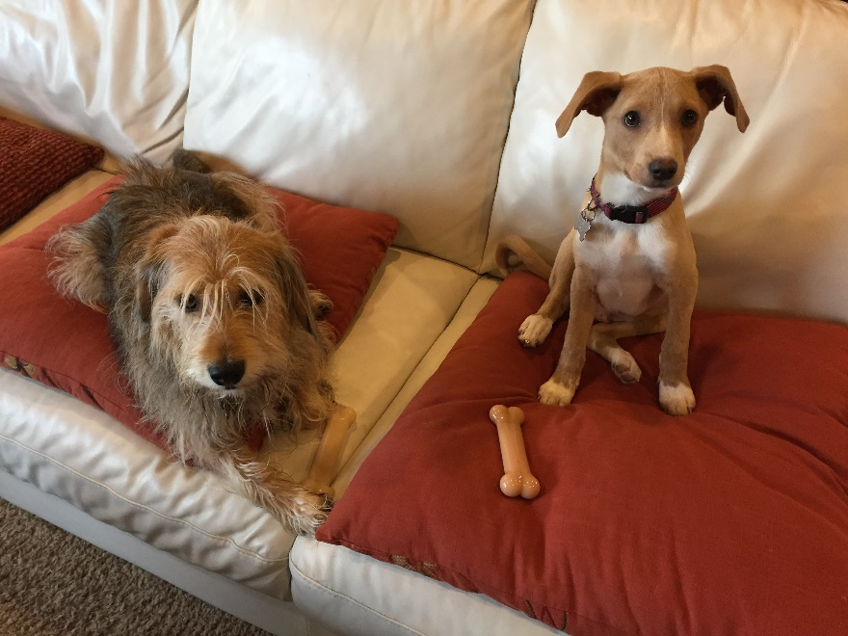
Let’s Make This Happen!
Animal Companions of Las Cruces is here to make our pets, our vets, and the lives of all in our community better through the creation of 24/7 emergency care in Las Cruces, NM that will serve our region.
The need is great!
What can you do to help? And how can we help you?
We welcome your assistance.

