Slide 1
Working Together to Support Veterinary Services in Las Cruces
Meeting Co-hosted by Mayor’s office &
Animal Companions of Las Cruces

Slide 2
Agenda & Ideal Outcomes
Provide research that supports need to act
Demonstrate the support of Animal Companions and local government
Share some ideas for support
Listen, listen, listen to your needs and your ideas about how we can help
Create community collaboration to solve the problem
Notes:
Our approach is to support all of our veterinary services. Our executive board consists of 5 members who use 4 different services, and we have made every effort to work positively and collaboratively with all as we introduce ourselves to them and show them how we want to help. Recruitment of more veterinarians to the area is a top priority, which includes us providing debt relief scholarships to sweeten any signing deals. The average debt at graduation for new vets is $300,000. This is why practices provide signing bonuses and why we want to help with scholarships. If we can do away with or limit non-compete clauses, we can also support a collaborative consortium that is not currently possible and make sure our vets are happy in their work. Veterinarians have one of the highest professional rates of suicide, and these clauses that cause unhappy vets to uproot their families and move far away, usually out of state, exacerbate that problem. Non-compete clauses are meant for business and research development, not for medical care. NM did away with such for doctors of humans in 2015. It is time to do the same for the medical practitioners who care for our pets.

Slide 3
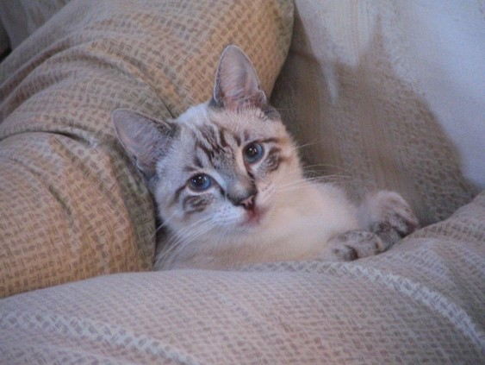
The Numbers Crunch
Out of 100 cities nationwide comparable in size, Las Cruces is 1 of only 3 without 24/7 emergency care for all in need; of cities that have emergency care, 6 have a lower median income than Las Cruces
Based on census & AMVA equation, approximately:
38,540 pets in Las Cruces & Mesilla combined
72,178 pets in Doña Ana County
Currently Las Cruces has 22 veterinarians.
3 clinics plus Animal Services Center are advertising for veterinary staff.
Notes:
Having been a professor for 29 years, I always start with research. These are the facts. When you see the number of pets listed, consider that at the moment there are 15 veterinarians in Las Cruces. Remember that fact when you see our goals. I have been told by some that emergency care won’t work here, that it has failed before. I find that attitude unacceptable. The facts tell us that we have the demographics that can support 24/7 emergency care, but we have to find the right way to make it happen, to sustain it.

Slide 4
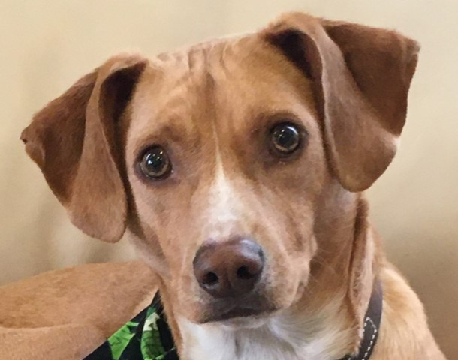
Our Mission
Animal Companions provides support and resources for establishing and sustaining 24/7 emergency services in Las Cruces, serving a wide community of pet owners in Southern New Mexico and easing the burden of veterinary staff.
Notes:
We formed 13 months ago to tackle the problem of no 24/7 emergency care across Southern New Mexico. This remains our overall mission.

Slide 5
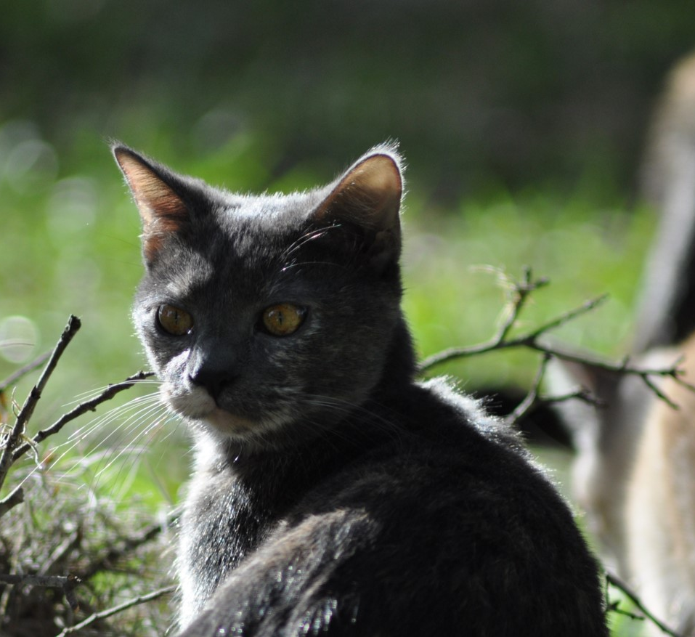
Our Goals
Provide support and resources to our local veterinary clinics
Recruit veterinarians to the community
Advocate for vet tech licensing and educational programs leading to licensure
Advocate for limits on non-compete clauses in veterinary medicine to minimize loss of scarce veterinary resources in New Mexico
Support a televet call line for after hours--ACCOMPLISHED
Notes:
Our approach is to support all of our veterinary services. Our executive board consists of 5 members who use 4 different services, and we have made every effort to work positively and collaboratively with all as we introduce ourselves to them and show them how we want to help. Recruitment of more veterinarians to the area is a top priority, which includes us providing debt relief scholarships to sweeten any signing deals. The average debt at graduation for new vets is $300,000. This is why practices provide signing bonuses and why we want to help with scholarships. If we can do away with or limit non-compete clauses, we can also support a collaborative consortium that is not currently possible and make sure our vets are happy in their work. Veterinarians have one of the highest professional rates of suicide, and these clauses that cause unhappy vets to uproot their families and move far away, usually out of state, exacerbate that problem. Non-compete clauses are meant for business and research development, not for medical care. NM did away with such for doctors of humans in 2015. It is time to do the same for the medical practitioners who care for our pets.

Slide 6
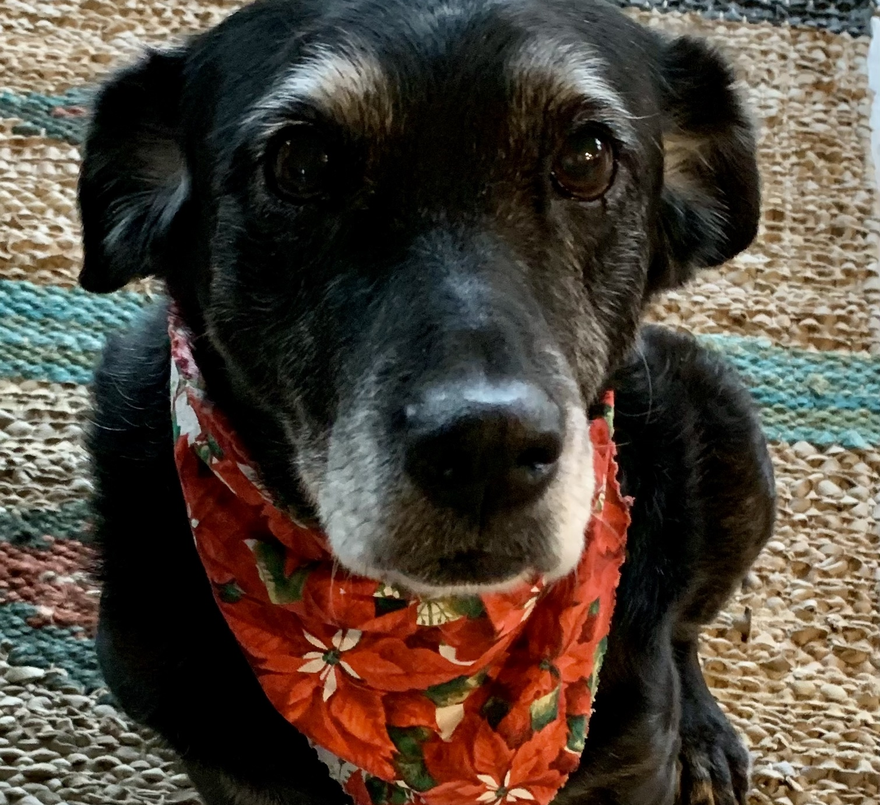
Local Support
Community Foundation of Southern New Mexico
158 donors and/or volunteers since January 2022
Example: Active volunteers logged over 625 hours in Sept/Oct
Mayor Miyagishima and the City Council of Las Cruces
Mayor Nora Barraza and Board of Trustees of Mesilla
Doña Ana County Commissioners
Notes:
Our approach is to support all of our veterinary services. Our executive board consists of 5 members who use 4 different services, and we have made every effort to work positively and collaboratively with all as we introduce ourselves to them and show them how we want to help. Recruitment of more veterinarians to the area is a top priority, which includes us providing debt relief scholarships to sweeten any signing deals. The average debt at graduation for new vets is $300,000. This is why practices provide signing bonuses and why we want to help with scholarships. If we can do away with or limit non-compete clauses, we can also support a collaborative consortium that is not currently possible and make sure our vets are happy in their work. Veterinarians have one of the highest professional rates of suicide, and these clauses that cause unhappy vets to uproot their families and move far away, usually out of state, exacerbate that problem. Non-compete clauses are meant for business and research development, not for medical care. NM did away with such for doctors of humans in 2015. It is time to do the same for the medical practitioners who care for our pets.

Slide 7
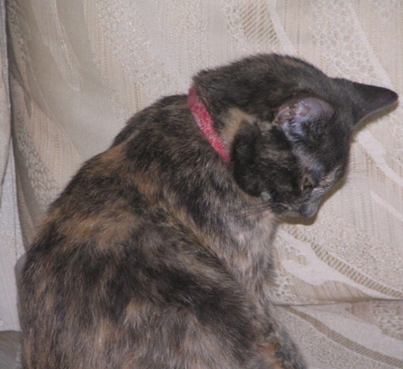
Ideas for Support
Assist with recruiting: connecting with vet schools, practice partnerships, brochure, presentations. Keep us aware of your hiring needs.
Provide debt relief scholarships for those willing to come, sweetens the deal
Provide housing for externship students 2-4 weeks, which attracts them to return
If desirable, help to set up a shared phone service for after hours to direct callers to local clinic providing emergency that night.
Notes:
Our approach is to support all of our veterinary services. Our executive board consists of 5 members who use 4 different services, and we have made every effort to work positively and collaboratively with all as we introduce ourselves to them and show them how we want to help. Recruitment of more veterinarians to the area is a top priority, which includes us providing debt relief scholarships to sweeten any signing deals. The average debt at graduation for new vets is $300,000. This is why practices provide signing bonuses and why we want to help with scholarships. If we can do away with or limit non-compete clauses, we can also support a collaborative consortium that is not currently possible and make sure our vets are happy in their work. Veterinarians have one of the highest professional rates of suicide, and these clauses that cause unhappy vets to uproot their families and move far away, usually out of state, exacerbate that problem. Non-compete clauses are meant for business and research development, not for medical care. NM did away with such for doctors of humans in 2015. It is time to do the same for the medical practitioners who care for our pets.

Slide 8
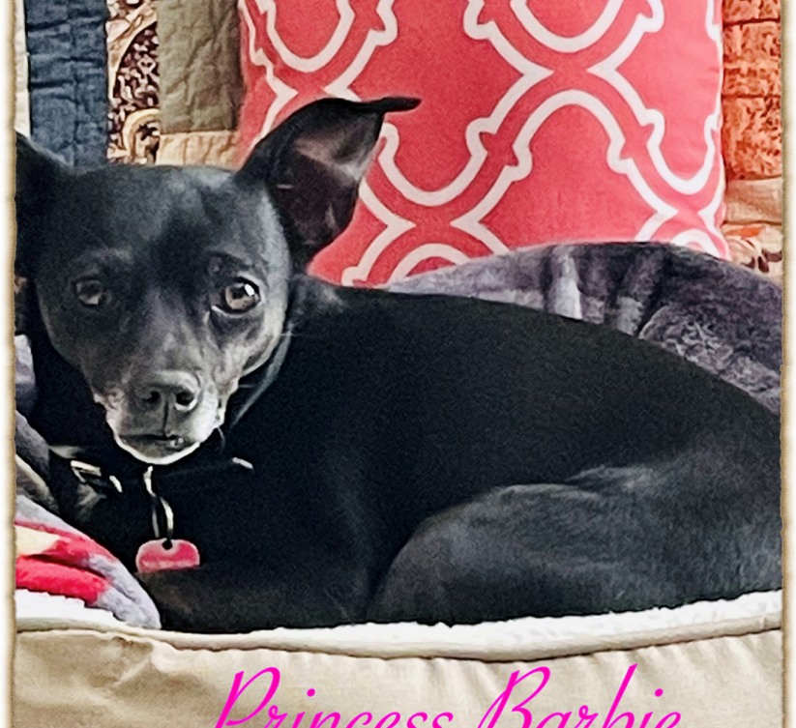
Time to Listen
Please take a few minutes now to complete the questionnaire to help formulate your ideas & talking points.
Time for Dialogue:
What do you see as your needs?
How can we help?
What incentives would you like to see from City/County?
Notes:
Our approach is to support all of our veterinary services. Our executive board consists of 5 members who use 4 different services, and we have made every effort to work positively and collaboratively with all as we introduce ourselves to them and show them how we want to help. Recruitment of more veterinarians to the area is a top priority, which includes us providing debt relief scholarships to sweeten any signing deals. The average debt at graduation for new vets is $300,000. This is why practices provide signing bonuses and why we want to help with scholarships. If we can do away with or limit non-compete clauses, we can also support a collaborative consortium that is not currently possible and make sure our vets are happy in their work. Veterinarians have one of the highest professional rates of suicide, and these clauses that cause unhappy vets to uproot their families and move far away, usually out of state, exacerbate that problem. Non-compete clauses are meant for business and research development, not for medical care. NM did away with such for doctors of humans in 2015. It is time to do the same for the medical practitioners who care for our pets.

Slide 9
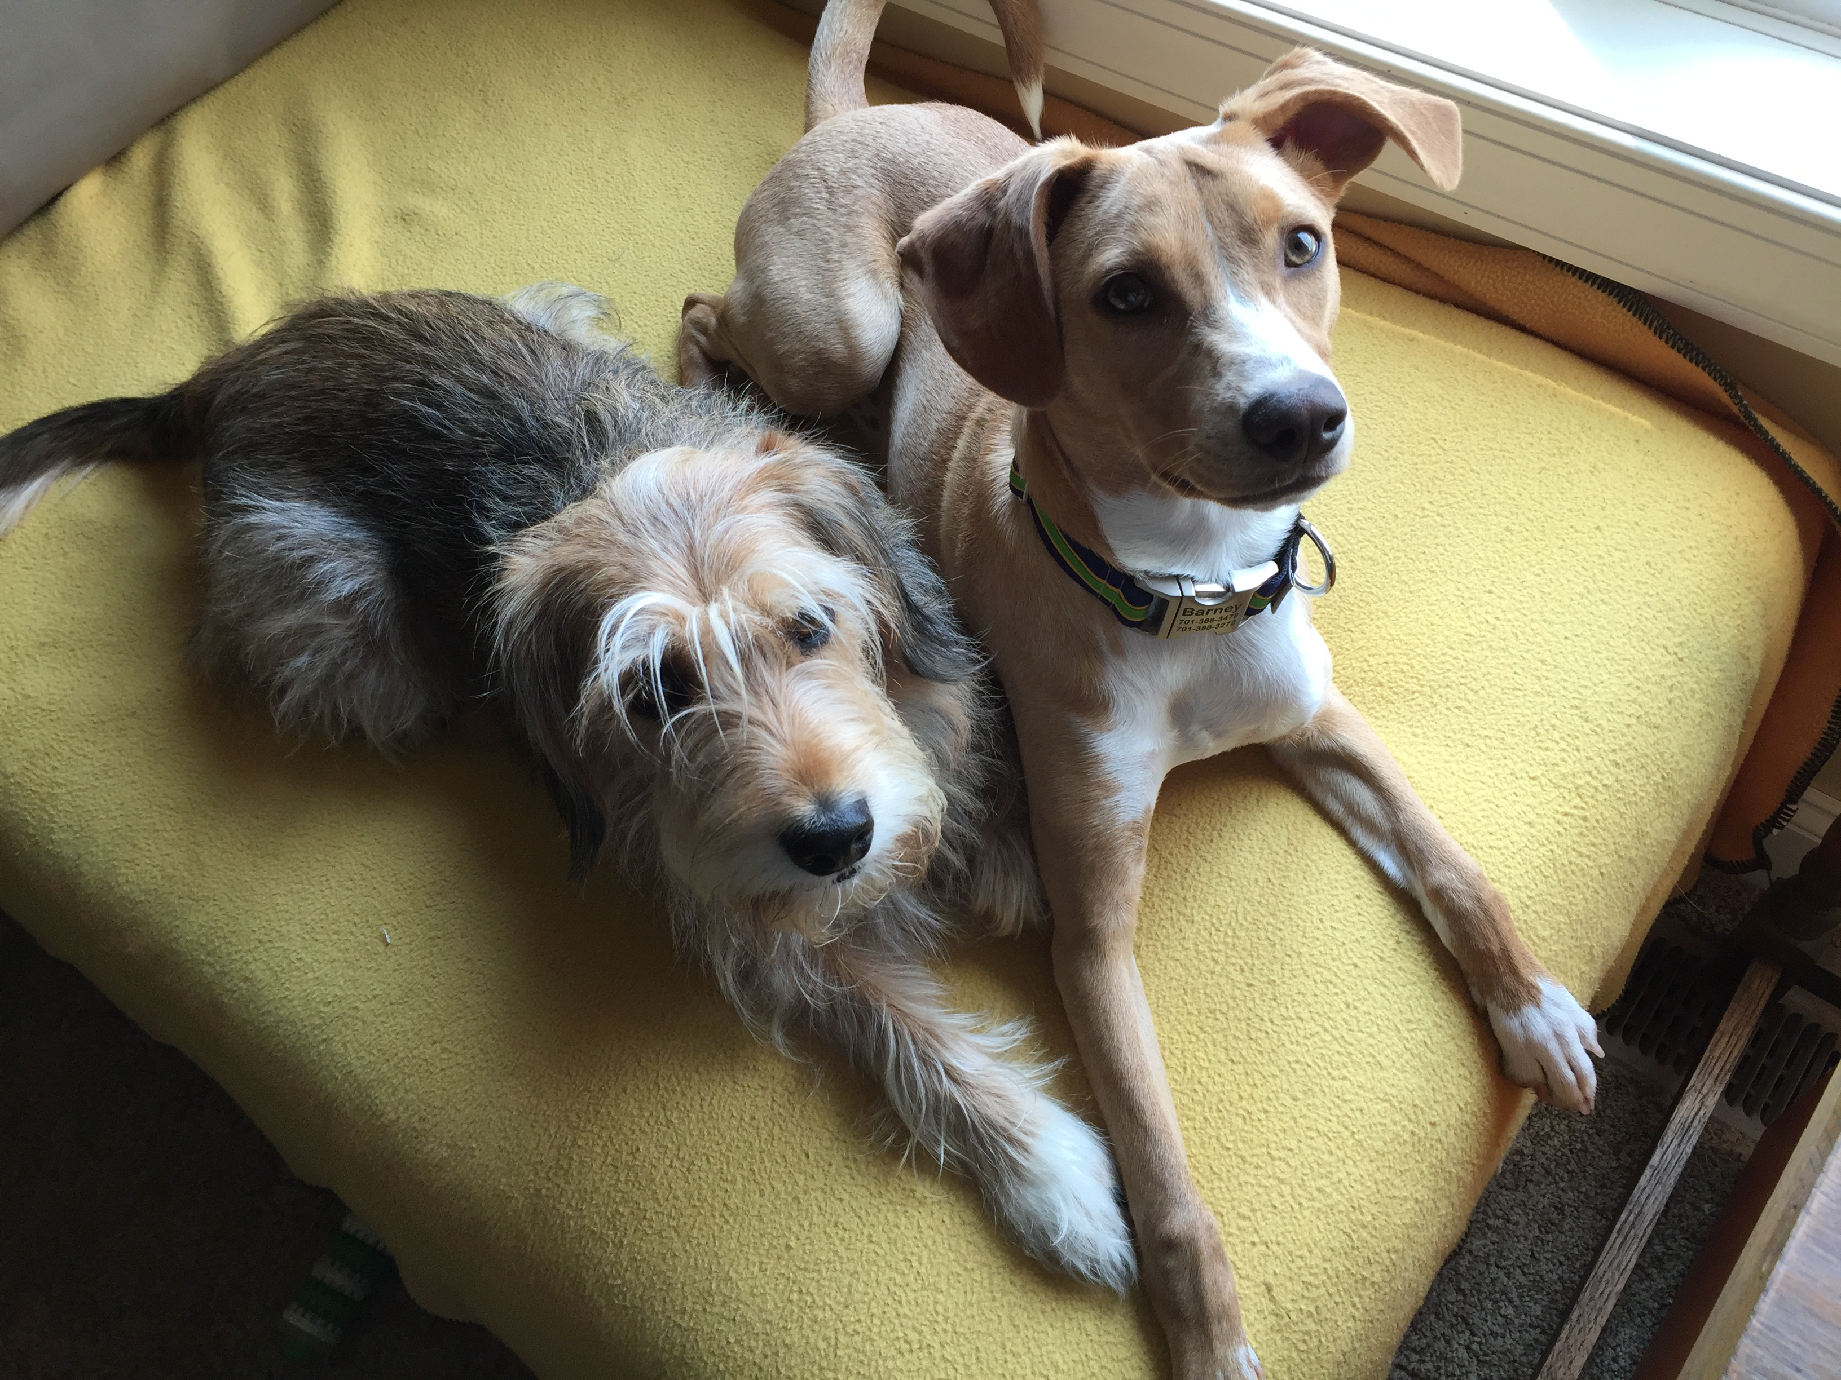
Thank You for Coming, for Considering How We Can Collaborate, for Helping Us Help You and All Our Animal Companions

