Slide 1
BURNS
Dr Alex Novak
i3EM Educational Day 6th July 2017

Slide 2
Introduction
Common presentation to ED
Range of severity from mild to life-threatening
Challenges include:
  Assessment of injury
  Initiating correct treatment plan
  Appropriate specialty referral
  Transfer issues
Often lack of clinical confidence in ED staff

Slide 3
Overview
Pathophysiology
Assessment
Treatment – minor
Treatment – major
Inhalational injuries
Electrical
Chemical
Oxford Pathways
Summary

Slide 4
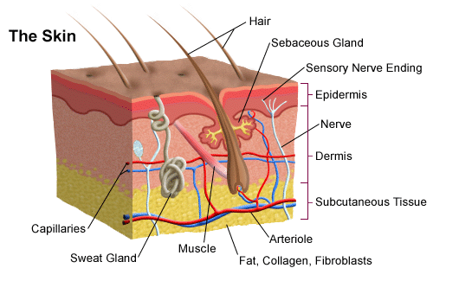
Skin Anatomy

Slide 5
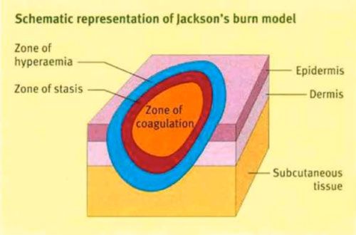
Burn Pathophysiology – Jackson’s Burn Wound Model
Zone of coagulation
  primary injury - irreversible tissue necrosis - extent dependent on the temperature (or concentration) and duration of exposure
Zone of ischemia
  reduction in the dermal circulation = damaged but potentially viable tissue. May progress to full necrosis unless the ischemia is reversed
Zone of hyperaemia
  Reversible hyperaemia and inflammation

Slide 6
Burns Assessment
Minor vs major - depends on:
  location
  depth
  surface area
Other considerations include:
  patient’s age
  presence of comorbid conditions
  associated injuries

Slide 7

Burn Assessment

Slide 8
Burn Depth
Epidermal
Superficial dermal partial thickness
Mid dermal partial thickness
Deep dermal partial thickness
Full thickness

Slide 9
Burn Depth – key points to remember
Intermediate, or mid-dermal burn depth wounds very difficult to assess in the first few days following injury - reassess these burn wounds at least within 48 hours
The extent and speed of capillary refill is the most useful clinical method to assess burn depth
Presence of capillary refill at the time of initial assessment does not mean that the burn will remain superficial - burn wound evolution frequently results in increased depth of burn injury tissue damage
Most burn wounds are usually a mixture of areas of different depths

Slide 10
Epidermal burns
Painful, red
Epidermis damaged but intact
E.g. sunburn, flash from explosion
stratified layers of the epidermis are burnt away - healing occurs by regeneration of the epidermis from the basal layer
May get some delayed blistering
Should heal within 7 days
NB: Epidermal burns are NOT included in the assessment of % total body surface area burnt

Slide 11
Superficial dermal burns
Blistered, painful pale pink/red, raw
Brisk capillary return within burns wound
Involve papillary dermis – pain due to exposure of sensory nerves
heal spontaneously by epithelialisation within 14 days

Slide 12
Mid dermal burns
Sluggish capillary return
Less painful, dark pink to red
zone of damaged non-viable tissue extending into the dermis, with damaged but viable dermal tissue at the base
preservation of the damaged but viable tissue = pivotal in preventing burn wound progression
not possible to predict healing times of these burns early after injury – review over 2 – 3 days

Slide 13
Deep dermal burns
Deep red or white colour, dull sensation, severely delayed or absent capillary return
characterised by the early (within hours) development of extensive blisters, which usually rupture early
extensive destruction of the dermal vascular plexus
Dry – less exudate than superficial burns

Slide 14
Full thickness
both epidermis and dermis destroyed and may penetrate more deeply into underlying structures
dense white, waxy or even charred appearance
sensory nerves in the dermis are destroyed - sensation to pinprick is lost
coagulated dead skin (eschar) of a full thickness burn has a leathery appearance

Slide 15
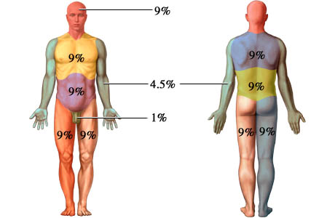
Burns Assessment - area
Use Rule of 9s (adults)
Paediatric charts avaialble

Slide 16
Burns assessment - tips
ask for help if unsure – senior/specialty (plastics)
do not include erythema in the overall %TBSA burn assessment
Do not assume a red burn wound appearance means the burn is superficial
Check if the epidermis is attached in areas of epidermal burn
Be mindful of burn injuries in older people…

Slide 17
Burns assessment in the elderly
Burn injuries in older people are complex for several reasons:
Superficial burns are uncommon in older people – as the dermis becomes thinner as people age, the same burn in a young person, is likely to be deeper in an older person.
Older people are more likely to have co-morbidities which can complicate and delay wound healing
The burn injury can be a symptom of broader health concerns relating to frailty and safety
Frequent reassessment of the wound particularly in the first 3 days following injury recommended

Slide 18
Minor burns management
Minor burns = <10% TBSA (adult) or <5% TBSA (child)
vast majority of superficial burns should heal in 10 – 12 days without complication
F – First Aid (20mins immersion cold water for up to 3hrs)
A – Analgesia (multimodal)
C – Clean (and deroof)
A - Assess
D – Dress (superficial - standard vs deep - silver)
E - Elevate

Slide 19
Burn Assessment - again

Slide 20
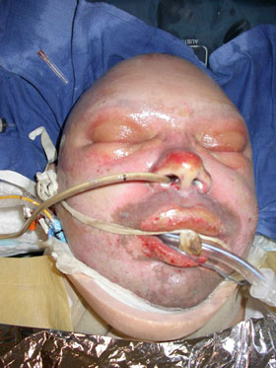
Major burns management – Airway
KEY STEPS:
ASSESS AIRWAY STABILITY
ASSESS FOR INHALATION INJURY
CONSIDER INTUBATION
MAINTAIN SPINAL PRECAUTIONS IF INDICATED

Slide 21
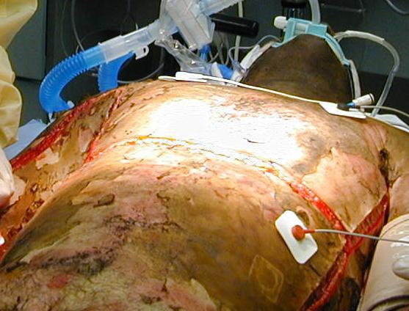
Major burns management – Breathing
KEY STEPS:
Administer High Flow 100% Oxygen
Assess Breathing
Assess for Circumferential Chest Burns
Assess for COHb Poisoning

Slide 22
Major burns management – Circulation
KEY STEPS
Inspect for any obvious bleeding – stop with direct pressure.
Check heart rate, blood pressure and neck veins.
Insert two large-bore peripheral intravenous (IV) cannulas,
Commence fluid resuscitation as indicated.
Check capillary refill and temperature of unburnt skin.

Slide 23
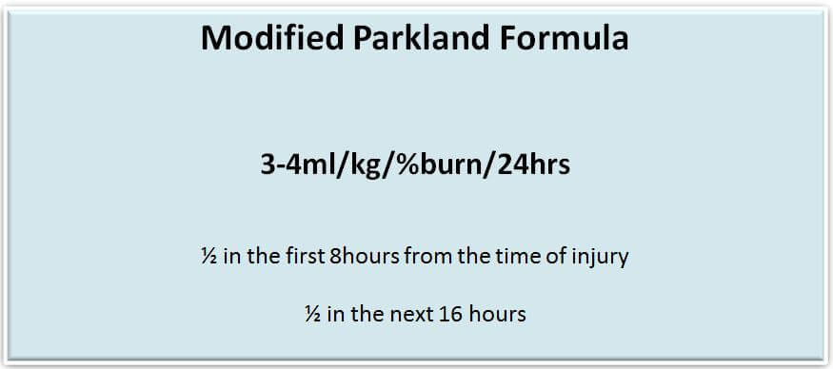
Fluid Resuscitation
NB vital to assess the adequacy of fluid resuscitation by measuring urine output and other perfusion markers (urine output should be maintained at 0.5 – 1.0mL/kg/hr in adult)

Slide 24
Major burns management – Disability
KEY STEPS:
Assess consciousness.
Check blood glucose.

Slide 25
Major burns management – Exposure
KEY STEPS:
Expose the patient, remove clothing and any jewellery.
Examine from head to toe (including posterior surfaces) for burns and other injuries.
Keep the patient warm and cover again ASAP to minimise heat loss.
NB Tetanus prophylaxis

Slide 26
Electrical Injuries – early management
KEY STEPS:
Cardiac Monitoring
Aggressive Management of Myoglobinuria
Additional Fluid Resuscitation
Management of Compartment Syndrome

Slide 27
Chemical burns
Determine the following:
  The type of agent involved and how much
  Strength and concentration of the agent
  Site of contact and whether swallowed or inhaled
  Manner and duration of contact
  Mechanism of action of the chemical
Decontamination of the burn injury (likely water irrigation)
If appropriate administration of a buffer or neutralising agent

Slide 28
Chemical burns – specific agents
Agent | Characteristics | Treatment
Hydrofluoric acid | Very painful. Contact with very small amounts of industrial strength acid can be fatal. Can cause arrhythmias. | Irrigate with water. and prevent systemic toxicity. Neutralise with topical calcium gluconate burn gel or local injection with 10% calcium gluconate
Cement (alkali) | Penetrates clothing, combines with sweat and creates an exothermic reaction. Acts as a dessicant and alkali. Pain and burning sensation do not occur immediately. | Prolonged irrigation with water.
Phosphorous | Ignites in presence of air | Water irrigation Debride visible particles
Petrol | Immersion or extensive skin contact usually causes partial thickness burn | Irrigate with water

Slide 29
Oxfordshire Burn Pathways
Check handouts!

Slide 30
Summary
ASSESSMENT is the key to appropriate management
Treatments often simple – first aid, fluid, debride/dressings
Often tricky in practice – seek help when faced with the unfamiliar
Cases themselves can be complex - beware the aforementioned pitfalls…!

Slide 31
references
http://www.vicburns.org.au
https://lifeinthefastlane.com/trauma-tribulation-032/
http://www.oxplastics.org/

