Slide 1
Finger injuries
Dr Alex Novak
i3EM Thursday 6th July 2017

Slide 2
Introduction
Hand injuries account for between 5-10% of attendances in emergency departments (EDs) in the UK - 20-30% are improperly diagnosed and go unrecognised
The hand is the most commonly injured part of the body
The fingertip the most common hand injury
Challenge to distinguish an occult tendon, ligament or nerve injury from the uncomplicated laceration or crush injury
Important to identify who is suitable for ED management vs specialist referral

Slide 3
Tendons (FDS and FDP)
The FDS and the FDP tendons travel distally from the forearm through the carpal tunnel, after which they traverse a fibro-osseous tunnel in each digit to insert in the respective phalanges
The profundus tendon pierces that of the superficialis over the proximal phalanx
The metacarpal heads, phalanges and intervening joints = dorsal wall
annular pulley system and fibrous flexor sheath = anterolateral wall
The fibrous sheaths are lined by the synovial membrane, which reflects around each tendon

Slide 4
FDS and FDP

Slide 5
Nerves
ULNAR NERVE:
Ulnar 2 FDP tendons to the little and ring fingers; the other long finger flexors are supplied by the median nerve
Sensation over the ulnar side of the hand and little finger
Dorsal ulnar region of the hand via the dorsal cutaneous branch of the ulnar nerve
MEDIAN NERVE:
sensation over the palmar index, middle fingers, thumb, and proximal palm near the thenar eminence
Test motor function with abductor pollicis brevis action, thumb abduction with palm up, raising the thumb to perpendicular
Weakness or absence of flexion of the IPJ of the thumb (FPL) and the DIPJ of the index finger (FDP) against resistance, if present, are due to a more proximal lesion (anterior interosseous nerve).

Slide 6
Finger innervation

Slide 7
Assessment - History
Age
Hand dominance
Occupation/hobbies
Where, when and how did the injury occur?
What was the position of the hand at the time of injury?
Both hands should be compared to better assess baseline function

Slide 8
Finger cascade

Slide 9
Examination - general
deformity, open wounds, bruising and swelling
Pallor or cyanosis - vascular compromise
Loss of cascade may indicate a flexor tendon injury
In small children, uncooperative or obtunded patients, in addition to hand posture, tendon continuity can be assessed by squeezing the forearm muscles while observing the fingers
With intact extensors, passive wrist flexion causes finger extension
When flexor tendons are intact wrist extension leads to flexion of the fingers

Slide 10
Nerve Injury
Absence of sweating = sign of nerve injury due to loss of sympathetic innervation
Two-point discrimination – static (6mm) or dynamic (4mm)
Sensory loss following a proximal crush injury or closed fracture suggests ongoing nerve compression and may require surgical decompression
Sensory loss in relation to a hand laceration is a sign of nerve division and requires surgical exploration
Temporary nerve malfunction may occur in a closed injury due to mechanical trauma (neuropraxia) – use serial examinations by the same observer

Slide 11
Sheaths and Pulleys
Sheaths of the thumb and little finger extend proximally into the palm as the radial and ulnar bursae respectively - extend below the flexor retinaculum and communicate in about 50% of patients
The annular and cruciform pulleys preventing bowstringing when flexing the metacarpophalangeal (MCP), proximal interphalangeal (PIP), and distal interphalangeal (DIP) joints
Three cruciform pulleys (C1-C3) and five annular pulleys (A1-A5) exist
From a biomechanical advantage point the A2 and A4 pulleys are considered the most important to prevent bowstringing

Slide 12
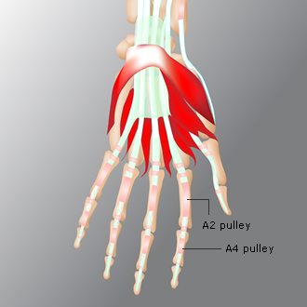
Sheaths and Pulleys

Slide 13
Flexor Tendon Injury Zones

Slide 14
Flexor Tendon Injury Zones
A distal-to-proximal 5-zone (I-V) classification system has been developed based on location, treatment considerations and prognosis
I - Zone I contains only the FDP tendon and extends from the insertion of the FDP to the insertion of the FDS tendon.
II - Zone II is the area extending from the insertion of the FDS tendon to the distal palmar crease (proximal end of the A1 pulley). This area is also known as 'No-Man's land', due to the shared flexor sheath and a higher risk of adhesions.
III - Zone III is the palm area from the distal palmar crease (proximal end of the A1 pulley) to the distal border of the transverse carpal ligament.
IV - Zone IV is within the carpal tunnel.
V - Zone V is proximal to the carpal tunnel in the distal forearm.

Slide 15
Thumb flexor tendon injury zones
Thumb flexor tendon injury zones differ from the fingers as the thumb has one less phalanx
TI - Zone TI is from the insertion of the flexor pollicis longus (FPL) to the proximal part of the A2 pulley.
TII - Zone TII is from the proximal part of the A2 pulley to the distal part of the A1 pulley.
TIII - Zone TIII is proximal to the A1 pulley as far as the carpal tunnel.

Slide 16
Finger Extension
Combination of extrinsic and intrinsic muscle action
Extrinsic extensors = primarily responsible for MCPJ extension, with extension of the IPJs being primarily an intrinsic function
The long extensors of the fingers are the extensor digitorum communis (EDC), reinforced by the extensor indicis and the extensor digiti minimi, joining the appropriate tendons of EDC on the ulnar side

Slide 18
Finger extension (2)
As the tendons pass over the MCP joints they are stabilised by tough transverse fibres called sagittal bands
The tendons of the EDC terminate in each finger as an aponeurotic extensor expansion, covering the dorsum of the proximal phalanx and the side of its base.
Attaches by a central slip into the base of each middle phalanx, and by two lateral slips to the base of each distal phalanx

Slide 19
Extensor Tendon Injury Zones

Slide 20
Extensor Tendon Injury Zones
I - area over the DIP joint and distal phalanx. Disruption of the tendon will cause mallet finger/swan-neck deformity
II - over the middle phalanx; assessment and treatment are the same as for zone I injuries
III - over the PIP joint. Injury here can result in a boutonnière's deformity
IV - on the proximal phalanx -treated like zone III injuries
V - over the MCP joint
VI - dorsum of the hand. The tendons are very superficial here and can be easily damaged
VII injuries - wrist and multiple tendons; these should be evaluated by a hand surgeon
VIII injuries - in the distal forearm. Injuries in this location often require tendon retrieval for complete lacerations and may need to be performed in the operating room

Slide 22
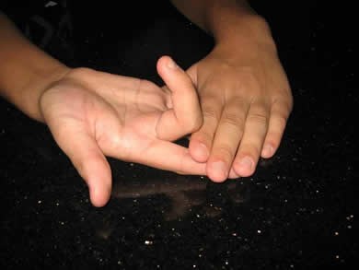
Flexor Tendon Injuries - Tendon Evaluation Tests
Testing the flexor digitorum superficialis (FDS)
The patient should bend the finger whilst the others are held in full extension (thereby inactivating the deep flexors). The DIPJ should be flaccid. The exception is the index finger, which has a separate muscle belly so that extending the other digits does not isolate the FDS.
For FDS to the index finger – test by checking the resisted PIPJ flexion while keeping the DIPJ extended.

Slide 23
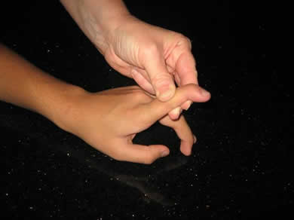
FDP test
Testing the flexor digitorum profundus (FDP)
With the examiner holding the PIPJ in extension, the patient should be asked to flex the tip of the finger.

Slide 24
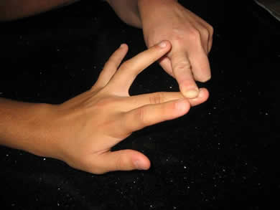
Extensor tendon test
Testing the extensor tendons
The fingers should be straightened against resistance. The long extensors straighten at the MCPJ, and resistance should be applied to the dorsum of the proximal phalanx.
Extension at the PIPJ can be caused by the intrinsic muscles. Observe for loss of active extension at the DIPJ, i.e. a mallet deformity.

Slide 25
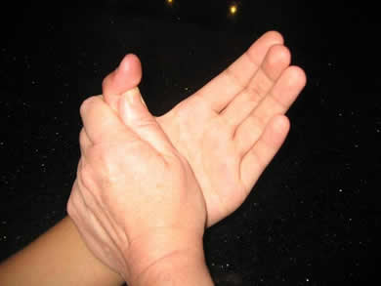
FPL test
Testing the flexor pollicis longus (FPL)
Hold the thumb over the proximal phalanx and ask the patient to bend the tip

Slide 26
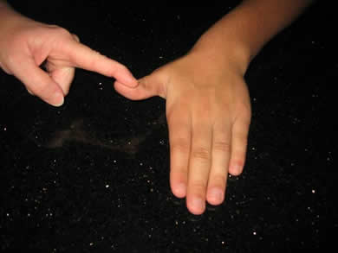
EPL test
Testing the extensor pollicis longus (EPL)
With the patient's hand palm-down on a table, ask the patient to lift up his/her thumb, against resistance

Slide 27
Mallet Finger

Slide 28
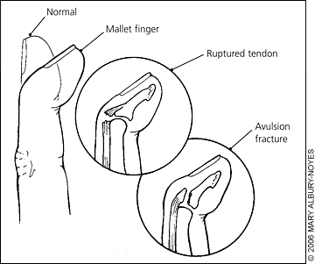
Extensor Tendon Injuries - Mallet Finger (Zones I and II)
Zone I and Zone II injuries may result in a mallet deformity, due to loss of continuity of the conjoined lateral bands at the DIP joint
Usually a direct blow that forcibly flexes an extended finger
If left untreated, apart from being painful, the digit becomes hooked/swan-neck deformity (compensatory hyperextension @ PIPJ)
Open injuries - ref to hand surgeon for primary repair
Closed mallet finger injuries - treated conservatively
May be due to bone or soft-tissue injury – need XRs

Slide 29
Mallet finger- treatment
Conservative treatment - continuous splinting of the DIPJ in neutral or slight hyperextension for at least six weeks
A well-fitting splint for a mallet finger = vital to ensure compliance and avoid skin breakdown, the main complication of conservative treatment
PIPJ must be left free to allow mobilisation and prevent stiffness
Refer if:
The absence of full passive extension (indicating possible bony or soft-tissue entrapment requiring surgical intervention)
Joint subluxation or an avulsion fracture of more than one-third of the articular surface

Slide 30
Extensor Tendon Injuries - Rupture or Division of the Central Slip

Slide 31
Extensor Tendon Injuries - Rupture or Division of the Central Slip (1)
Zone III injuries may involve rupture or division of the central slip
Axial loading or forced flexion with the PIPJ in extension, or volar dislocation of the PIPJ
Variable presentations– e.g. acute boutonniere deformity, volar dislocation or painful swollen PIPJ
Maximal localised tenderness over the dorsal aspect of the PIPJ, at the insertion of the central slip +/- bruising
Active extension at the PIPJ does not exclude a rupture as full extension may still be achieved by the lateral bands
Closed rupture of the central slip over the PIPJ is easily missed

Slide 32
Extensor Tendon Injuries - Rupture or Division of the Central Slip (2)
Elson's test - PIP joint of the injured finger flexed 90° over the edge of a table. Patient then tries to extend the PIP joint of the injured finger against resistance. The absence of extension force at the PIP joint and fixed extension at the DIP joint are signs of complete rupture of the central slip
will not demonstrate a partial rupture, and may be limited by pain
X-ray may show an avulsion fracture
If a central slip rupture is known or strongly suspected, the PIPJ should be splinted in a static extension splint, leaving the DIPJ free
Further follow-up in a hand clinic is required

Slide 33
Nerve Injury
The early recognition of nerve injury is important as primary repair has been found to be superior to delayed repair
Results of digital nerve repair are variable; in a review of 109 cases, no patients regained normal sensation, although 83% did achieve sensory results that could be classed as 'good'
Results are better in children than in adults
Loss of motor/sensory function
Nerve injury is also suggested by dry, shiny skin that does not wrinkle when immersed in water – this is due to a loss of sympathetic innervation
The tactile adherence test - loss of friction in the denervated area due to absent sweating

Slide 34
Extensor Tendon Injuries - Lacerations (Zone IV)
Zone IV tendon injuries over the proximal phalanx are usually due to lacerations.
The ED management should include a wound exploration under local anaesthetic cover.
Confirmed tendon injuries need referral to a hand surgeon for tendon repair, splinting and follow-up.

Slide 35
Fingertip injuries
= most common hand injuries in adults and children
Damage to the nail bed is reported to occur in 15-24% of fingertip injuries
Defined as any soft tissue, nail or bony injury distal to the dorsal and volar skin creases of the distal interphalangeal joint and insertions of the long flexor tendons of the fingers or thumb
Injury can include damage to skin and soft tissue, bone (distal phalanx) or to the nail and nail bed
Approximately half of fingertip injuries have an associated fracture of the digit, usually the distal tuft of the terminal phalanx
Fractures proximal to the waist of the terminal phalanx or intra-articular fractures require specialist surgical assessment to determine the need for internal stabilisation

Slide 36
Fingertip Injuries - Fingertip Anatomy

Slide 37
Fingertip Injuries - Fingertip Anatomy
The fingernail and its underlying matrix are supported by more than half the bone length of the underlying terminal phalanx
In the distal pulp of the finger the skin is stabilised by fascial bands running from skin to bone, which contain loculated fat; this arrangement stabilises the fingertip pulp skin under pressure
Nail growth is slow, approximately 0.1 mm daily, but often with an initial delay following traumatic avulsion, hence may take 4-6 months to grow back fully and up to 12 months to achieve maturity

Slide 38
Fingertip Injuries - Fingertip Amputations
Type I | Fingertip soft-tissue loss only
Type II | Fingertip loss at the level of the proximal third of the nail plate
Type III | Fingertip loss at the level of the eponychial fold
Type IV | Fingertip loss proximal to the DIP joint

Slide 39
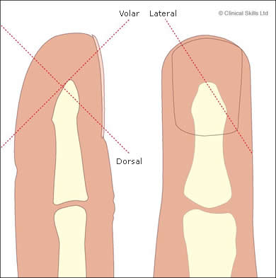
Fingertip Injuries - Fingertip Amputations
Oblique fingertip defects
Volar
Dorsal
Lateral

Slide 40
Fingertip injuries suitable for management by an ED specialist
Superficial skin loss defect <1 cm² in Zone I
Transverse Type I fingertip amputations
Type I and Type II fingertip amputations in children
Oblique partial fingertip amputation without bone exposure
Stable fracture needing splintage only
NB 1: Follow-up clinic and dressings facilities, as well as access to a physiotherapist, are required
NB 2: children have greater tissue regeneration and modelling capacity.

Slide 41
ED Treatment of Fingertip Injuries
Local anaesthesia ring block (essential for assessment, treatment and analgesia)
Cleanse thoroughly, remove dirt and foreign material
Trim off any devitalised tissue
Non-adherent dressings to be changed and the wound inspected 2-3 times weekly
A stable fracture of the terminal phalanx may be externally splinted for 2-3 weeks
A 1 cm² defect takes an average of five weeks to heal
Fingernail and its underlying matrix are supported by more than half the bone length of the underlying terminal phalanx
Type I and Type II amputations have sufficient bone support for straight nail regrowth without hook nail deformity
Avulsed nail can be placed in the nail fold, which acts as a template and stent for the nail bed and also decreases discomfort by acting as a natural protective cover

Slide 42
Fingertip injuries NOT suitable for management by an ED specialist
Type II or higher partial amputation of the fingertip
Oblique fingertip partial amputation with bone exposure or fracture
A large soft-tissue defect >1 cm²
An unstable fracture of the terminal phalanx

Slide 43
Preparation a patient for transfer to a hand specialist unit
IV fluids if the patient needs fasting for a general anaesthetic and for patient hydration
IV antibiotics e.g. first-generation cephalosporin
Control pain with IV morphine or a digital block
Get a radiograph of the digit and also of the amputated segment (if available)
Clean and dress the finger stump with non-adherent dressing, and wrap the stump lightly with sterile dressings and bandage
Elevate the affected hand in a sling

Slide 44
Care of the amputated part
Remove any foreign material from the exposed soft tissues
Clean the amputated part with saline, and wrap it in saline moistened gauze (damp, not soaking wet)
Place the wrapped segment in a plastic bag
Place the bag into a container filled with ice mixed with saline
DO NOT place the amputated part directly on ice

Slide 45
Subungual Haematoma

Slide 46
Subungual Haematoma
Crush injuries of lesser severity may cause subungual haematoma
Small nail bed laceration with resultant bleeding occurs, which cannot drain from an intact nail
Painful subungual haematomas should be drained for relief
Prospective studies comparing simple haematoma decompression versus nail plate removal and formal nail bed repair have shown no notable difference in outcome
Therefore if the nail plate is still adherent to the nail bed and not displaced out of the nail fold, regardless of the size of the subungual haematoma, conservative treatment is recommended
= Needle trephining using a hot paper clip or battery powered cautery

Slide 47
Nailbed lacerations

Slide 48
Nail bed lacerations (1)
Simple or stellate nail bed lacerations without underlying fractures have a better prognosis than nail bed avulsions
Can be repaired by separating and removing the nail plate from the nail bed with fine scissors
Nail bed is carefully repaired with fine absorbable sutures
The removed nail is trimmed of sharp edges and replaced in the nail fold to act as a stent for the nail bed, a template for the new nail, and as a protective cover to reduce pain and discomfort
A transverse suture through the nail and lateral folds will help retain the nail in position
Retain the nail for four weeks before discarding it by cutting the retaining sutures

Slide 49
Nail bed lacerations with associated fractures
Nail bed = supported internally by the terminal phalanx bone and externally by the nail plate
If laceration = associated with stable undisplaced fractures of the terminal phalanx bone, then simple nail bed repair/external splint
If displaced or unstable fractures then refer for specialist treatment as can result in nail bed irregularity, scarring, nail plate detachment and late nail deformity
Specialist referral is required due to a high risk of hook nail deformity in: nail bed lacerations with an underlying displaced or unstable fracture; nail bed avulsion; type III and IV fingertip injuries.
Nail bed avulsions - refer to a hand specialist as meticulous repair (e.g. loupe magnification, nail bed grafting or rotational flap surgery) may be required

Slide 50
The Thumb - movement
Eight muscles are responsible for thumb movement, and these may be divided into long (from the forearm) and intrinsic hand.
FPL is the only long flexor of the thumb, inserting into the base of the distal phalanx, and flexing the IPJ.
EPL inserts into the distal phalanx, extending the IPJ.
EPB inserts into the proximal phalanx, extending the MCPJ.
AbPL inserts into the first metacarpal, and carries the thumb laterally from the palm.
The AdP, FPB and AbPB all insert into the base of the proximal phalanx.
The FPB, AbPB and OP make up the thenar eminence and are supplied by the median nerve.

Slide 51
Thumb MCP joint stability
Ulnar side stability - static and dynamic mechanisms
Static stability - main and accessory UCLs, the volar plate, dorsal capsule
dynamic stability - adductor pollicis muscle and tendon in the first web space of the hand
UCL proper - from the head of the thumb metacarpal bone to the volar aspect of the proximal phalanx
Tightens in flexion and relaxes in extension of the MCP joint
Accessory UCL lies anterior to the UCL proper and inserts into the volar plate
Tightens in MCP joint extension and relaxes in flexion
Adductor pollicis aponeurosis inserts to the dorsal thumb tendons and capsule of the MCP joint

Slide 52
Ulnar Collateral Ligament

Slide 53
Ulnar Collateral Ligament Injury (Gamekeeper’s/Skier’s thumb)
UCL injuries may also involve injuries to the accessory UCL, volar plate, dorsal capsule, adductor pollicis insertion, and associated fractures of the proximal phalanx
Ultrasound has been shown to improve the positive predictive value of clinical examination alone from 80% to 94% in a study undertaken in a British ED.
Other options include stress radiography and arthrography.
Usually conservative treatment - immobilisation in a short thumb spica cast for four weeks to allow the ligament to heal. Thereafter, the cast can be discarded in favour of a short thermoplastic splint.
Supervised mobilisation is commenced at four weeks with all splints discarded after six weeks
Patients should avoid stressful activities with the injured thumb for 10-12 weeks

Slide 56
UCL injury - indications for referral to a hand clinic
Stener lesion
Complete rupture of the UCL
Displaced, rotated or large fracture fragment of the base of the proximal phalanx bone
Subluxation or instability of the MCP joint
Ongoing uncertainty of the severity of the UCL rupture or Stener lesion

Slide 57
Thumb spica

Slide 59
Volar plate injury

Slide 60
Buddy strapping

Slide 61
PIPJ dislocation

Slide 62
PIPJ dislocation - reduction

Slide 63
Phalangeal fractures
Unlike distal phalanx fractures, proximal and middle phalanx fractures require precise alignment for good functional and cosmetic outcomes
Majority of pharyngeal fractures = undisplaced transverse fractures
– Rx “buddy-strapping”
Unstable pharyngeal fractures include oblique fractures, malrotated fractures, and angulated fractures - manipulation under digital block to reduce to adequate alignment
Once alignment has been achieved, the fracture should be splinted in extension and refereed to the outpatient hand clinic

Slide 64
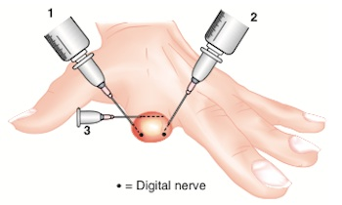
Ring block

Slide 65
Ring Block

Slide 66
Summary
Finger injuries are very common
Surprisingly complex – apparently small injury can result in significant loss of function
Understanding of anatomy crucial to accurate diagnosis and appropriate management

Slide 67
References
Acute Finger Injuries: Part I. Tendons and Ligaments
CHRISTIAN J. MEKO Am Fam Physician. 2006 Mar 1;73(5):810-816.
RCEM learning
LITFL

