Slide 1
AF in the Ambulatory Setting
Dr Alex Novak
i3EM
1st March 2018

Slide 2
Atrial Fibrillation
Very common problem in ED/GP/AAU/EAU settings
Wide variability in practice across different specialties/regions
Multiple guidelines available (ESC, NICE etc)
Application can be more complex/nuanced in practice

Slide 3
Rhythm vs rate control in ambulatory care
Rhythm: cardioversion
  Chemical – flecainide
  Electrical
Rate:
  Bisoprolol
  Metoprolol
  Digoxin
  Diltiazem

Slide 4
Anticoagulation
Key intervention to reduce risk of thromboembolic disease
Previously focussed mainly on warfarin – now a multitude of agents available (NOACs)

Slide 5
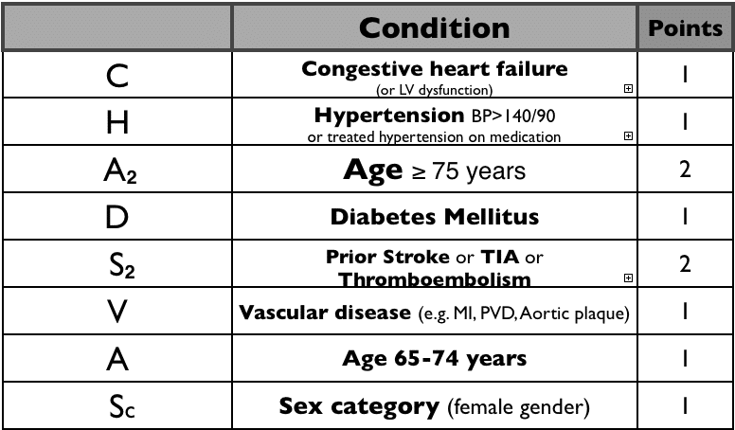
CHADSVASC

Slide 6
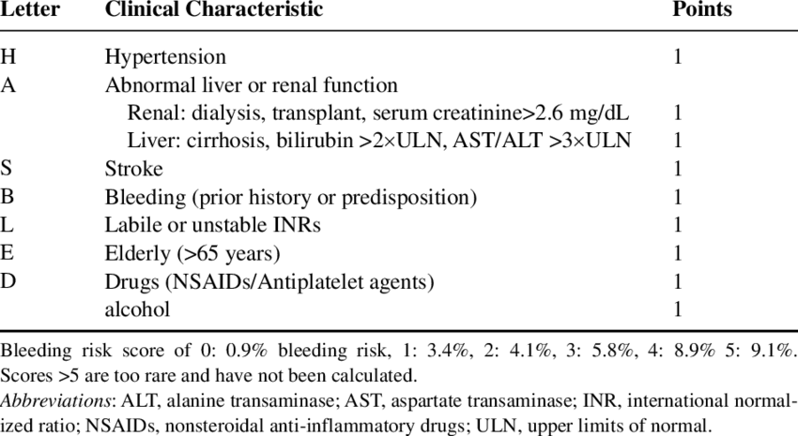
HASBLED

Slide 7
Choice of anticoagulant
Warfarin
LMWH heparin
NOACs (apixaban, rivaroxaban, dabigatran)

Slide 8
Cases
Initial management/concerns
Choice of approach/agent
Choice re anticoagulation
Further management

Slide 9
Case 1
84 yr old lady
PMH hypertension – on BFZ
General malaise - diarrhoea x 2 today
Lives with husband, no carers, daughter lives nearby
Looks sl dry but alert, comfortable
Bp 90/60, HR 140 obs otherwise NAD, chest clear, no leg swelling
K+3.1, Ur 7.8, Cr 120 otherwise bloods normal

Slide 10
Case 2
76 year old gentleman
PMH obesity, type II DM, CKD 3, OA
HR 160, bp 142/84
ECG AF 162 bpm
Hb 105, Trop 0.1, Ur 14 Cr 147 (baseline) else bloods NAD

Slide 11
Case 3
50 year-old gentleman
Usually fit and well – physical job (builder)
Drinking with friends last night night
This morning – sudden onset palpitations, sl lightheadedness
No other symptoms, no other significant PMH/DH
Well on examination – bp 105/64, p103, exam/obs otherwise NAD
ECG AF 106, bloods normal including trop, U+Es, FBC, LFT

Slide 12
Case 4
92 year old lady
PMH OA, mild dementia
Lives at home , carers QDS, family nearby
Increased fatigue, unsteady on feet
P123, bp 100/50, sats 93%, sl ankle swelling,
AF 115 on ECG
WCC 11.5, CRP 67, urine dip positive nitrites

Slide 13
Summary – AF in ambulatory care
Wide variability in practice and possibilities for management
Opportunity for pragmatic, patient-centred practice rather than protocol-driven

