Slide 1
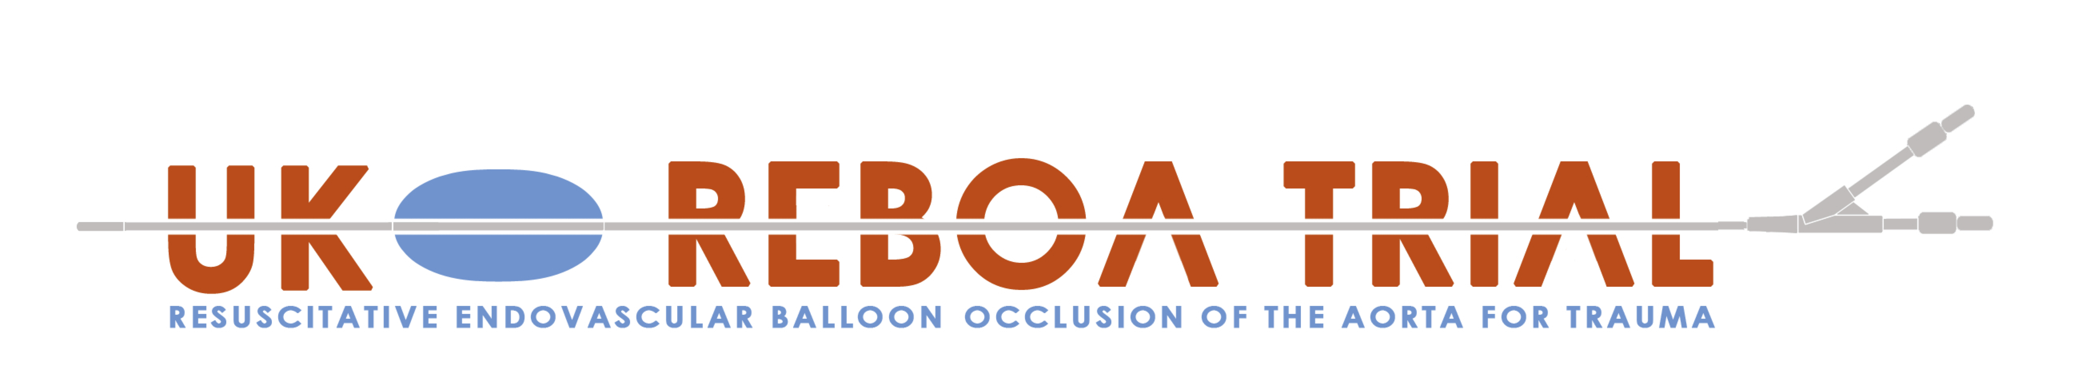

Overview
Jan Jansen
Chief Investigator
Health Services Research Unit, University of Aberdeen
Notes:
This is the first in a any series of presentation on the UK-REBOA trial.
My name is Jan Jansen and I am the clinical co-chief investigator for the trial.

Slide 2
What is REBOA?
Notes:
So first of all what is REBOA?
REBOA stands for …

Slide 3
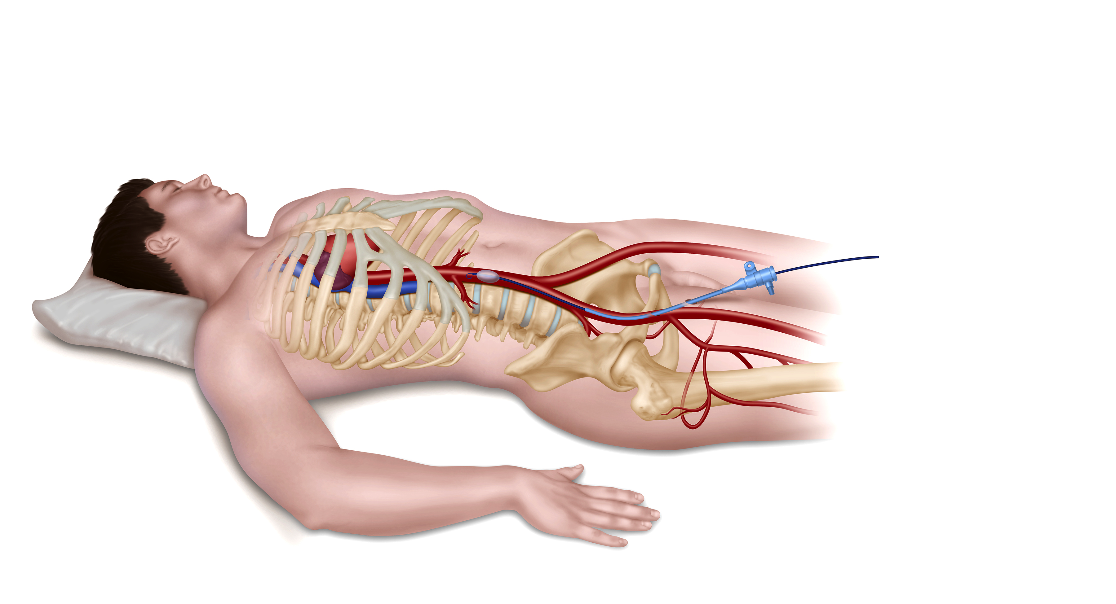
Notes:
The idea is to temporarily place an intravascular occlusion balloon in the abdominal or thoracic aorta
With the intent of
Limiting further blood loss
Increase afterload, and thus cerebral and myocardial perfusion

Slide 4
Haemorrhage remains the most common cause of preventable death after injury
Notes:
The reason why this is important is that haemorrhage remains the most common cause of preventable death after injury

Slide 5
Very topical
Notes:
REBOA is a topical at the moment
New papers on the subject appear almost every week and REBOA features heavily in trauma conferences

Slide 6
Why a trial?
Notes:
So why do we need trial
Because we don’t know if it truly makes a difference
For sure, it’s conceptually very attractive
But it has to be properly evaluated
Until now, there have only been case series, historical comparisons, and unmatched prospective comparisons
If we want to know if it really makes a difference, we have to conduct a trial

Slide 7
Notes:
Hence the UK-REBOA Trial

Slide 8
Pragmatic, multicentre, Bayesian, group-sequential randomised controlled trial
Notes:
The UK-REBOA Trial is a pragmatic multicentre Bayesian consequential randomised controlled trial

Slide 9
Standard MTC care vs
Standard MTC care + REBOA
Notes:
The trial compares standard major trauma centre care with standard major trauma centre care plus REBOA

Slide 10
In-hospital
Notes:
The trial only considers in-hospital REBOA -- this is already complex enough as it is
Prehospital patients cannot be included

Slide 11
Inclusion criteria
Notes:
The trial is very intentionally pragmatic
And this is reflected in inclusion criteria

Slide 12
Adult trauma patients (aged, or believed to be aged, 16 years or older)
with confirmed or suspected life-threatening torso haemorrhage
which is thought to be amenable to adjunctive treatment with REBOA
Notes:
All adult collocations which for the purpose of the trial please defined as someone aged 16 years or older was confirmed or suspected life-threatening tours language which is thought to be amenable to adjunctive treatment with REBOA, are eligible for inclusion.
These criteria are meant to reflect real-life practice, regardless of the trial.
In real life, the decision to use REBOA we made by the trauma team leader, after considering a wealth of information such as the patient’s the injury pattern, blood pressure, examination findings, results of arterial blood gas analysis, their response to transfusions, and so on. All of this should be reflected in the trial’s inclusion criteria

Slide 13
Exclusion criteria
Notes:
There are also exclusion criteria

Slide 14
Women known or thought to be pregnant
Children (aged, or believed to be
aged 15 or younger)
Patients with injuries which are deemed unsurvivable on clinical grounds

Slide 15
Primary clinical outcome:
90-day mortality
Notes:
The primary economic outcome is lifetime incremental cost per QALY gained, from a health and personal social services perspective.

Slide 16
Secondary outcomes
Notes:
- In-hospital mortality
- 6-month mortality
- Length of stay (in hospital and intensive care unit)
- 24h blood product use (from injury)
- Need for haemorrhage control procedure (operation or angioembolisation), defined as
whether such a procedure was required (from time of injury)
- Time from admission to commencement of haemorrhage control procedure (REBOA,
operation, or angioembolisation), defined as time to balloon inflation, incision, or first
angiogram
- Complications

Slide 17
ENROLMENT

Slide 18
ENROLMENT
ALLOCATION

Slide 19
ENROLMENT
ALLOCATION
FOLLOW-UP AND ANALYSIS

Slide 20
ENROLMENT
Patient meets entry criteria
Randomisation
ALLOCATION
FOLLOW-UP AND ANALYSIS

Slide 21
ENROLMENT
Patient meets entry criteria
Randomisation
ALLOCATION
Allocated to standard care plus REBOA
Allocated to standard care
FOLLOW-UP AND ANALYSIS

Slide 22
ENROLMENT
Patient meets entry criteria
Randomisation
ALLOCATION
Allocated to standard care plus REBOA
Allocated to standard care
Received/did not receive standard care plus REBOA
Received/did not receive standard care
FOLLOW-UP AND ANALYSIS

Slide 23
ENROLMENT
Patient meets entry criteria
Randomisation
ALLOCATION
Allocated to standard care plus REBOA
Allocated to standard care
Received/did not receive standard care plus REBOA
Received/did not receive standard care
FOLLOW-UP AND ANALYSIS
90 day mortality (primary effectiveness outcome)
90 day mortality (primary effectiveness outcome)

Slide 24
Pilot Phase: 5 MTCs
Full Trial: 10 MTCs

Slide 25
120 patients

Slide 26
A high profile trial

Slide 27
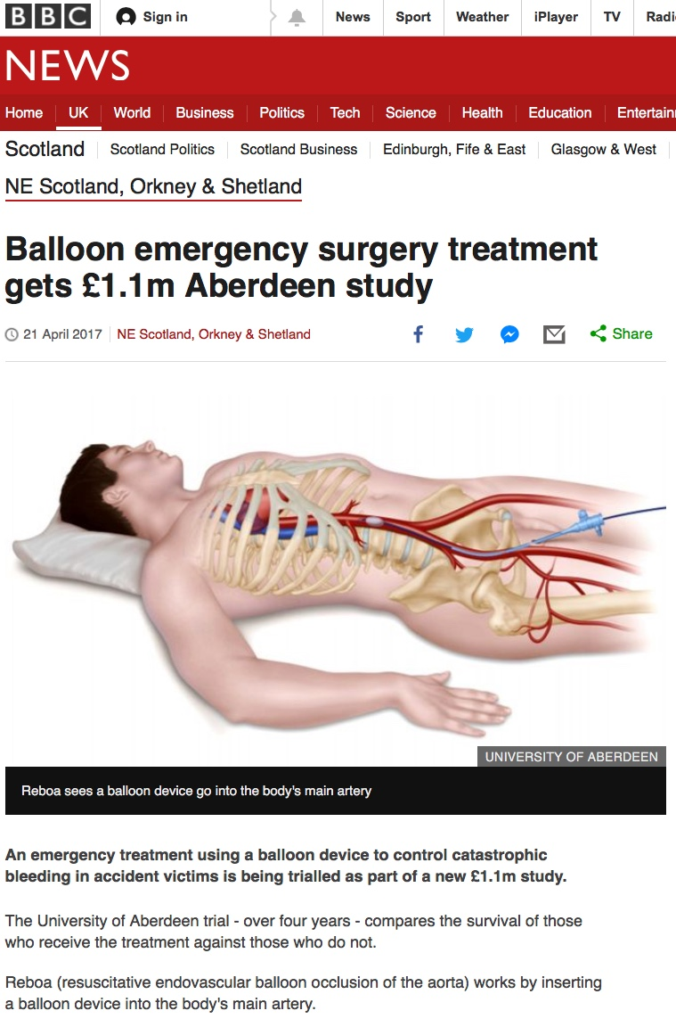

Slide 28
Clinical Setting

Slide 29
Bayesian design

Slide 31
Linkage to TARN

Slide 32



Slide 33


Slide 34
Notes:
Hence the UK-REBOA Trial

