Slide 1


Enrolling Patients
Jan Jansen
Chief Investigator
Health Services Research Unit, University of Aberdeen

Slide 2
We have made this very easy!

Slide 3
Standard MTC care vs
Standard MTC care + REBOA

Slide 4
ENROLMENT
Patient meets entry criteria
Randomisation
ALLOCATION
Allocated to standard care plus REBOA
Allocated to standard care
Received/did not receive standard care plus REBOA
Received/did not receive standard care
FOLLOW-UP AND ANALYSIS
90 day mortality (primary effectiveness outcome)
90 day mortality (primary effectiveness outcome)

Slide 5
ENROLMENT
Patient meets entry criteria
ALLOCATION
FOLLOW-UP AND ANALYSIS

Slide 6
Inclusion criteria
Notes:
Pragmatic

Slide 7
Adult trauma patients (aged, or believed to be aged, 16 years or older)
with confirmed or suspected life-threatening torso haemorrhage
which is thought to be amenable to adjunctive treatment with REBOA

Slide 8
Exclusion criteria

Slide 9
Women known or thought to be pregnant
Children (aged, or believed to be
aged 15 or younger)
Patients with injuries which are deemed unsurvivable on clinical grounds

Slide 10
ENROLMENT
Patient meets entry criteria
Randomisation
ALLOCATION
FOLLOW-UP AND ANALYSIS

Slide 11
ENROLMENT
Patient meets entry criteria
Randomisation
ALLOCATION
Allocated to standard care plus REBOA
Allocated to standard care
FOLLOW-UP AND ANALYSIS

Slide 12
by Trauma Team Leader

Slide 13
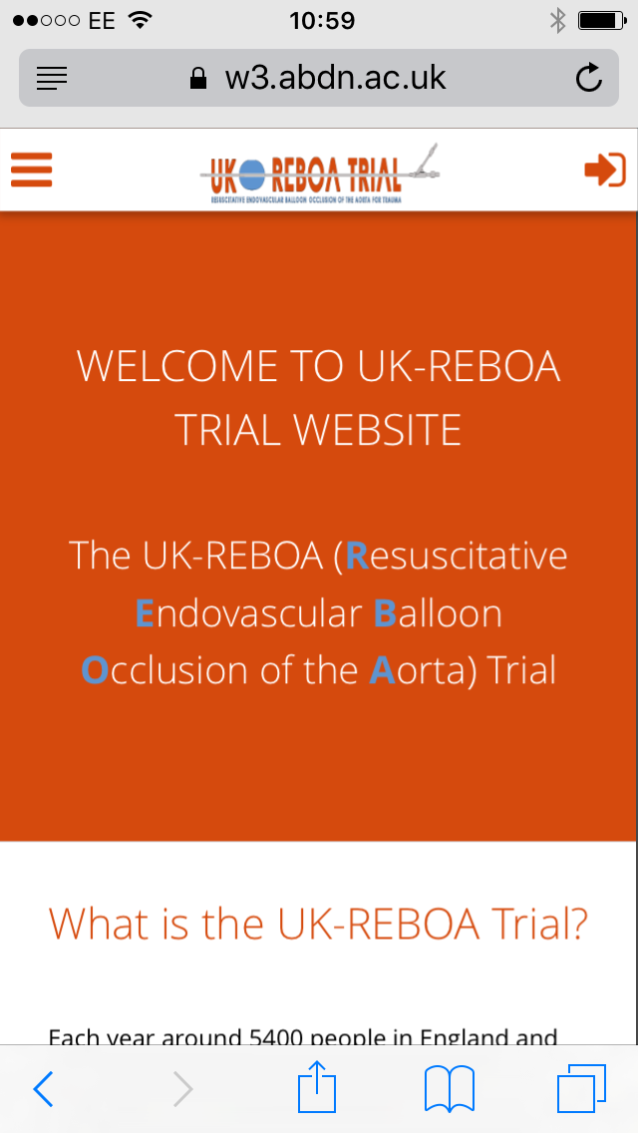

Slide 14
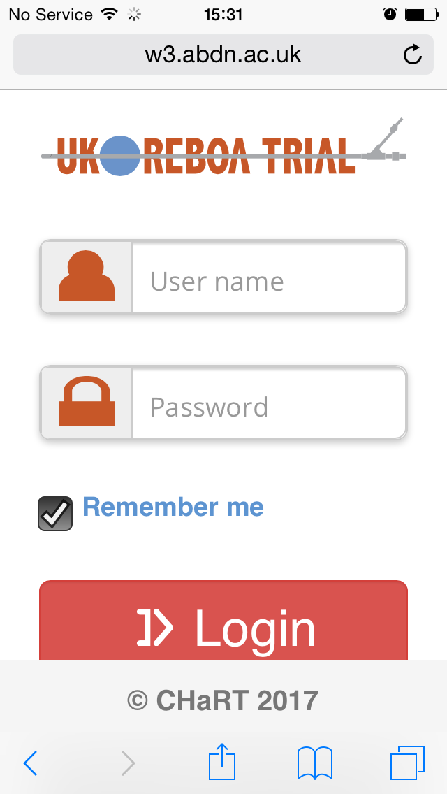

Slide 15
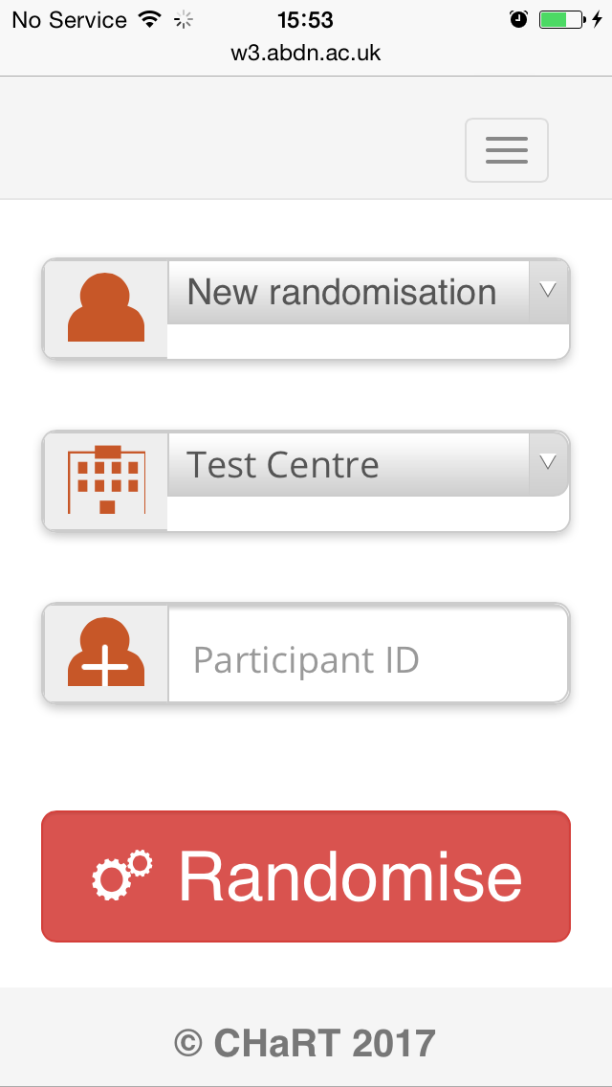

Slide 16
ENROLMENT
Patient meets entry criteria
Randomisation
ALLOCATION
Allocated to standard care plus REBOA
Allocated to standard care
FOLLOW-UP AND ANALYSIS

Slide 17
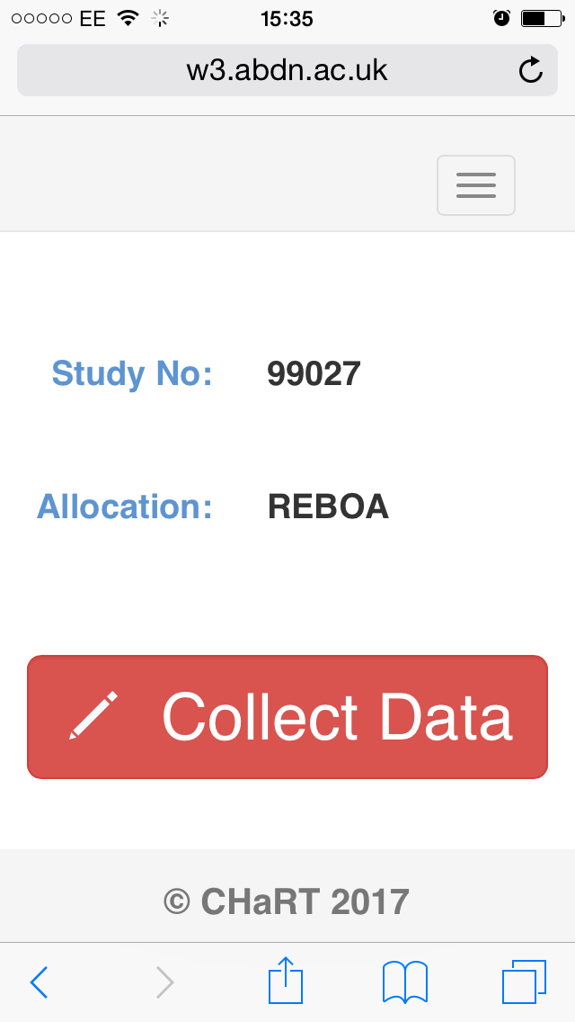
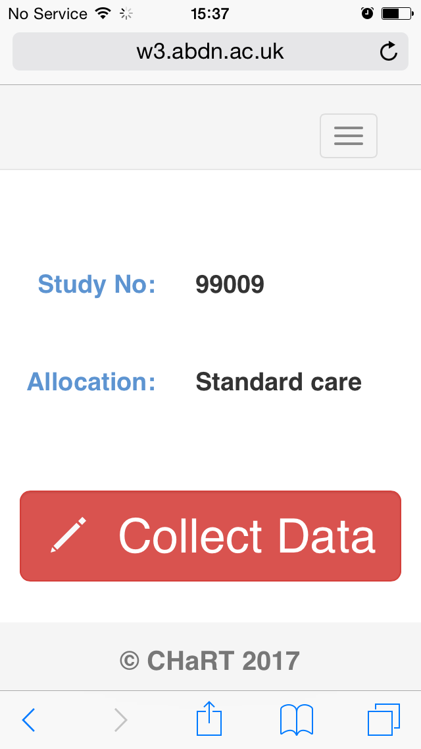

Slide 18
Takes <10 seconds!

Slide 19


Slide 21
Summary

Slide 22
Enrol patients!

Slide 23
Using the website

Slide 24
Pre-register and bookmark on your phone to save time

