Slide 1
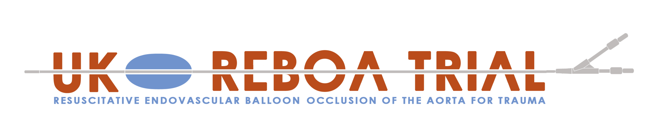

Preparation and
Arterial Access
Robbie Lendrum
Deputy Clinical Lead and Training Lead
Jan Jansen
Clinical Chief Investigator

Slide 2
For patients who have been entered into the trial, and randomised to “REBOA”

Slide 3
Preparation

Slide 4
Designate roles:
REBOA Operator
REBOA Assistant

Slide 5
Consider positioning

Slide 6
Evaluate anatomy

Slide 7
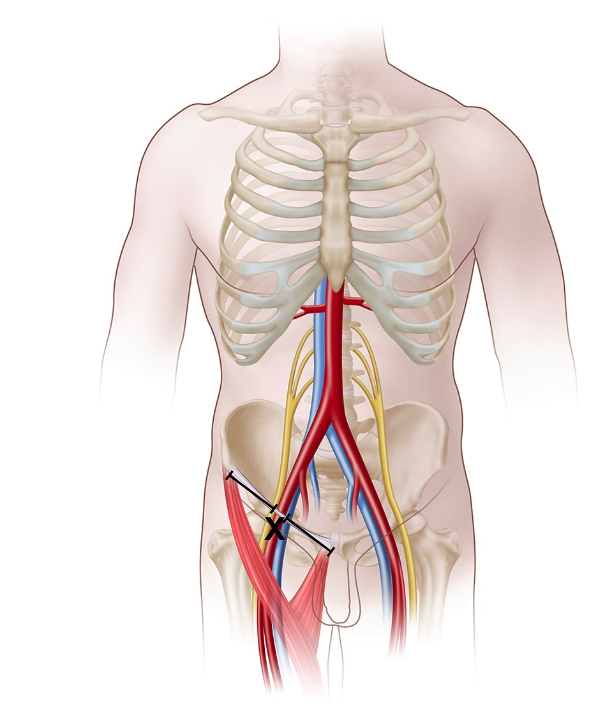

Slide 8
Open “PACK 1 (PREPARATION)”
Prep both groins
Whole-body drape
Set up ultrasound

Slide 9
Arterial Access

Slide 10
Open “PACK 2 (ACCESS)”

Slide 11
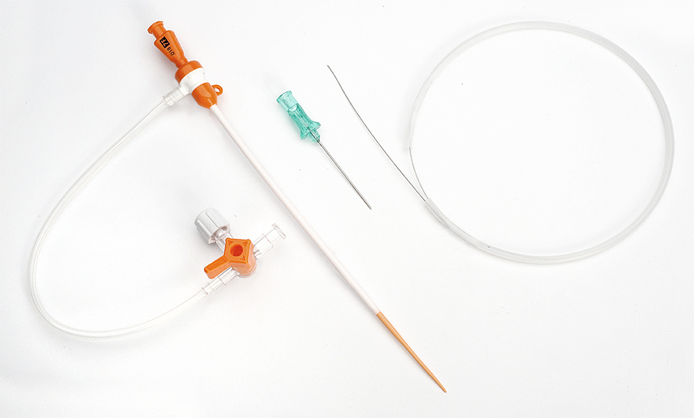

Slide 12
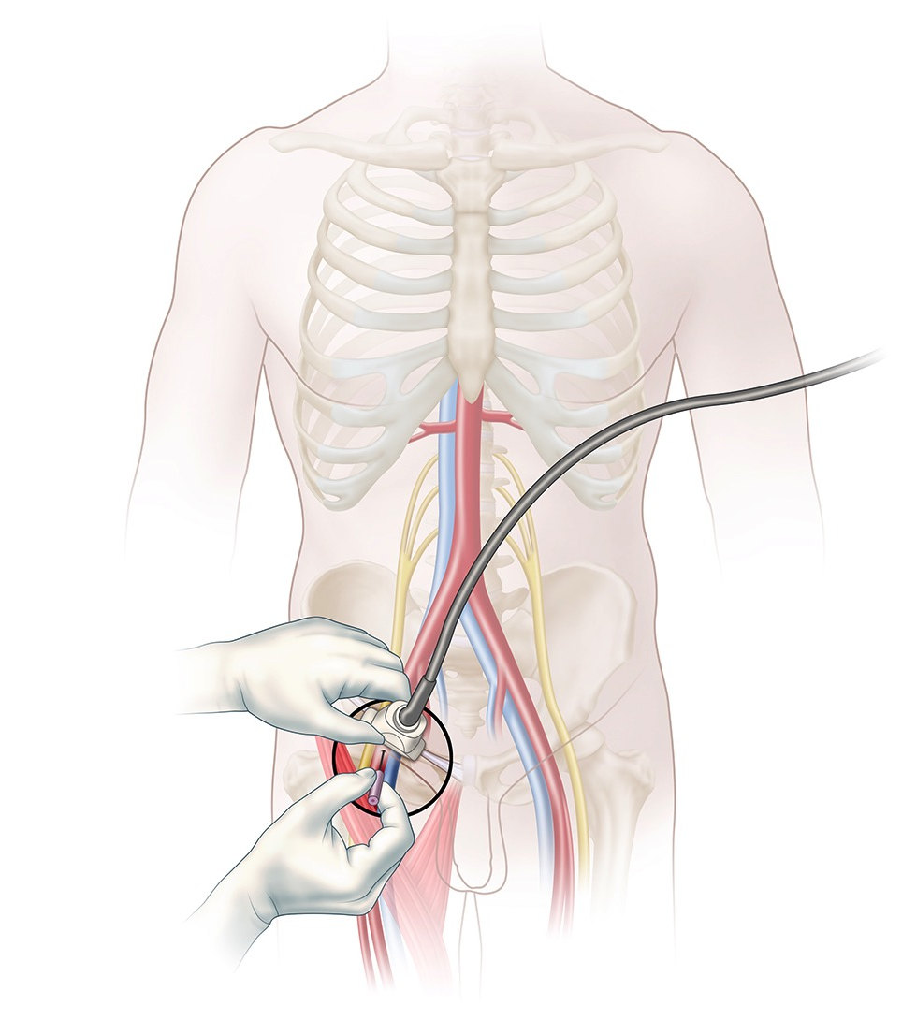
Ultrasound-guided common femoral artery cannulation
Notes:
Ultrasound guided common femoral artery cannulation (18G needle, mini access kit or A-Line)
Omit this stage if rewiring existing arterial line

Slide 14
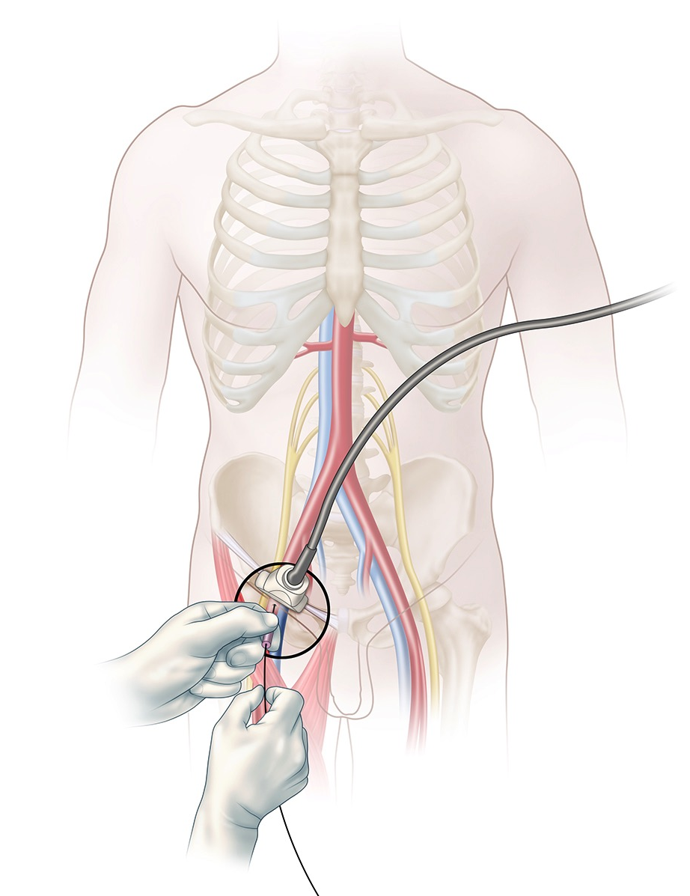
Insert short 0.035” guidewire

Slide 15
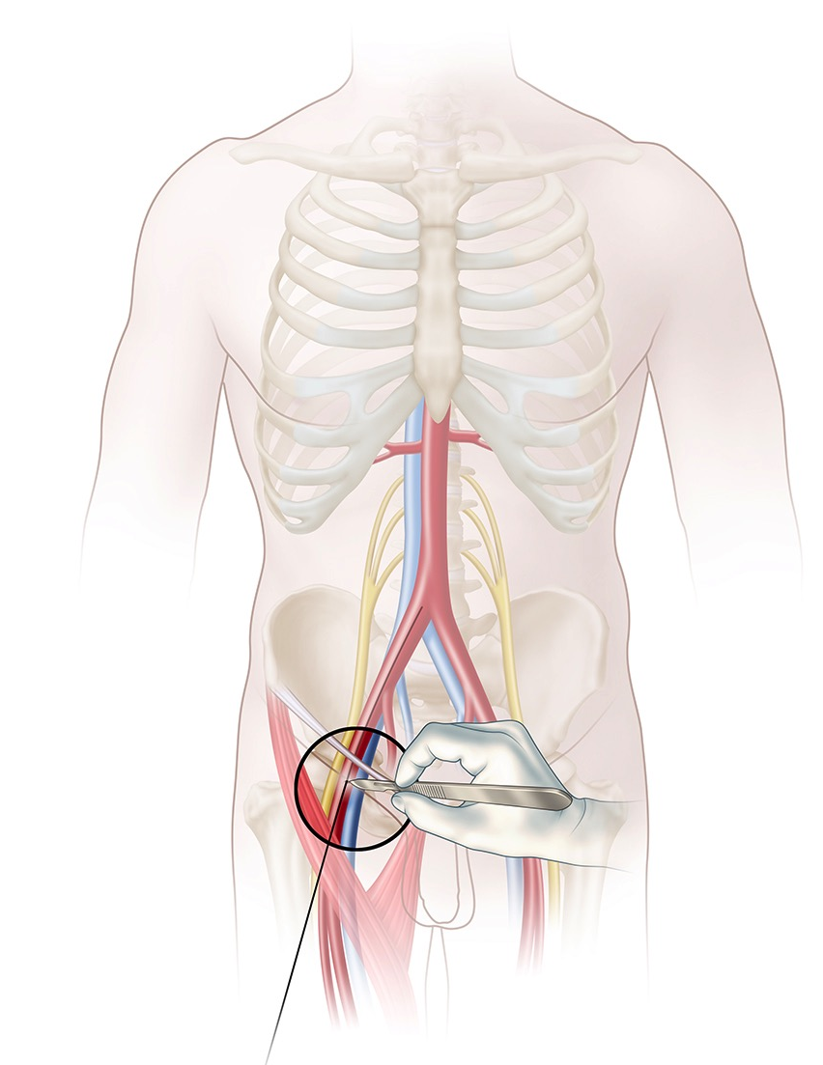
Skin incision

Slide 16
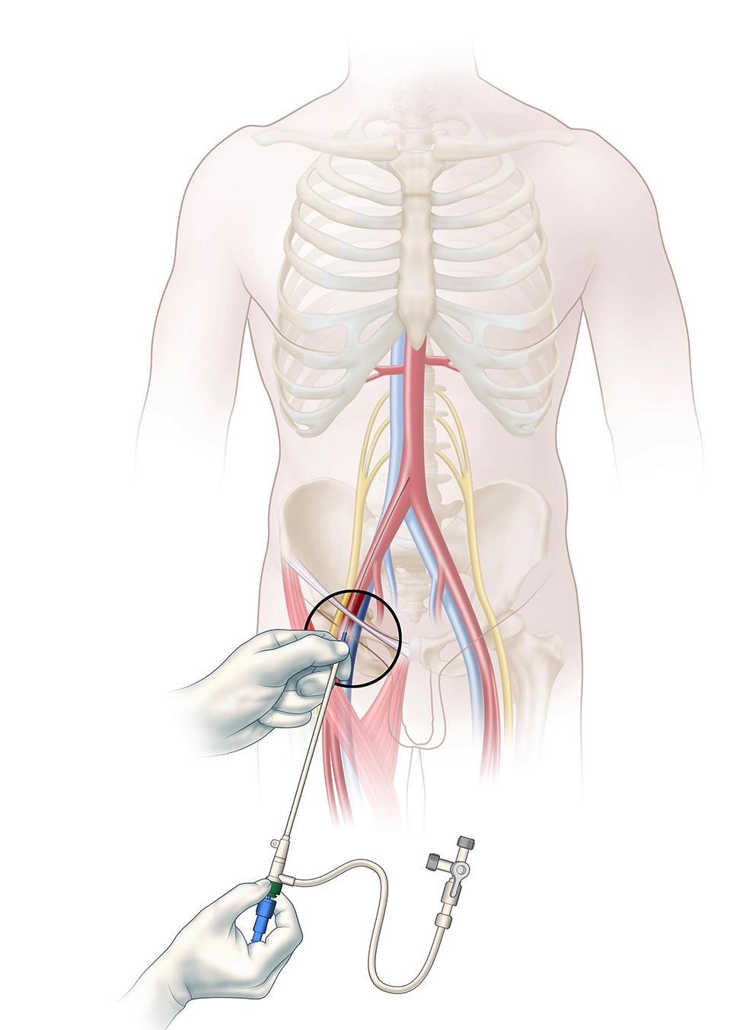
Insert (8F) sheath and dilator (together)

Slide 17
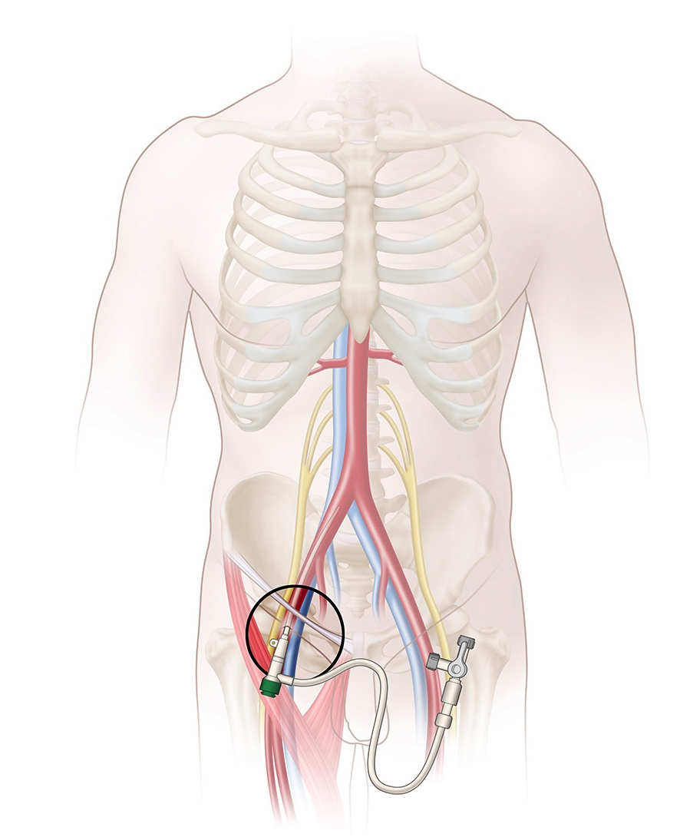
Remove dilator/wire (3-way tap closed to patient)

Slide 18
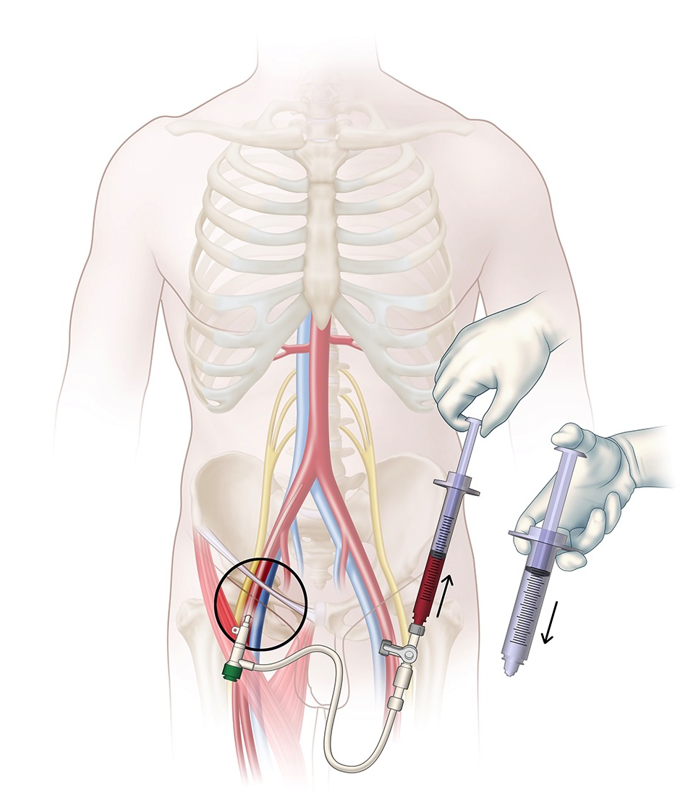
Aspirate blood from sheath sidearm to confirm placement and flush

Slide 19
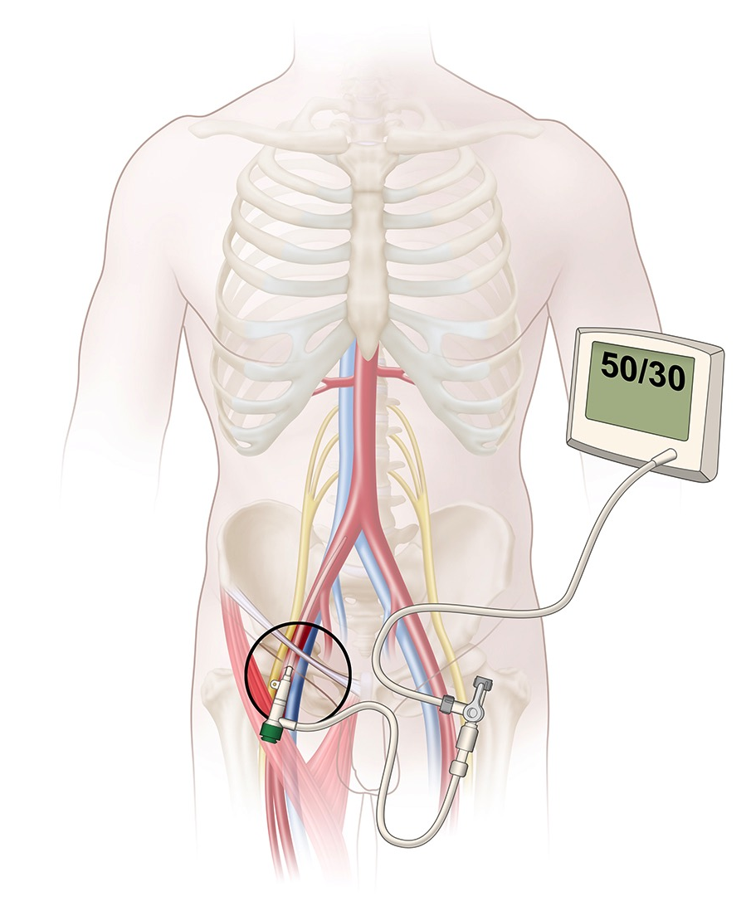
Attach pressure transducer to sheath sidearm

Slide 20
Ready for REBOA

