Slide 1
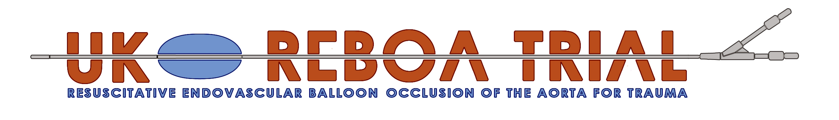

Functional Anatomy
Robbie Lendrum
Deputy Clinical Lead and Training Lead

Slide 2
Functional Anatomy
Zone 1: 20cm
Zone 2: 3cm
Zone 3: 10cm
Mean distance sheath CFA
  Aortic bifurcation 23 cm
  Supra-coeliac aorta 35 cm

Slide 3
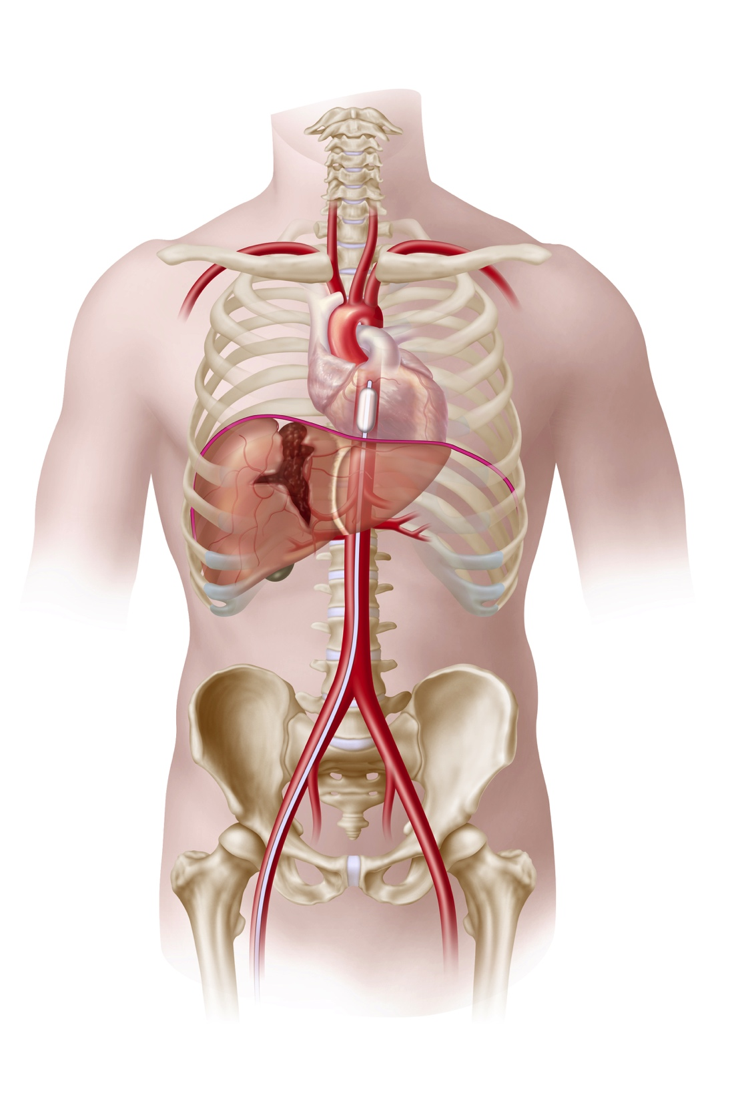
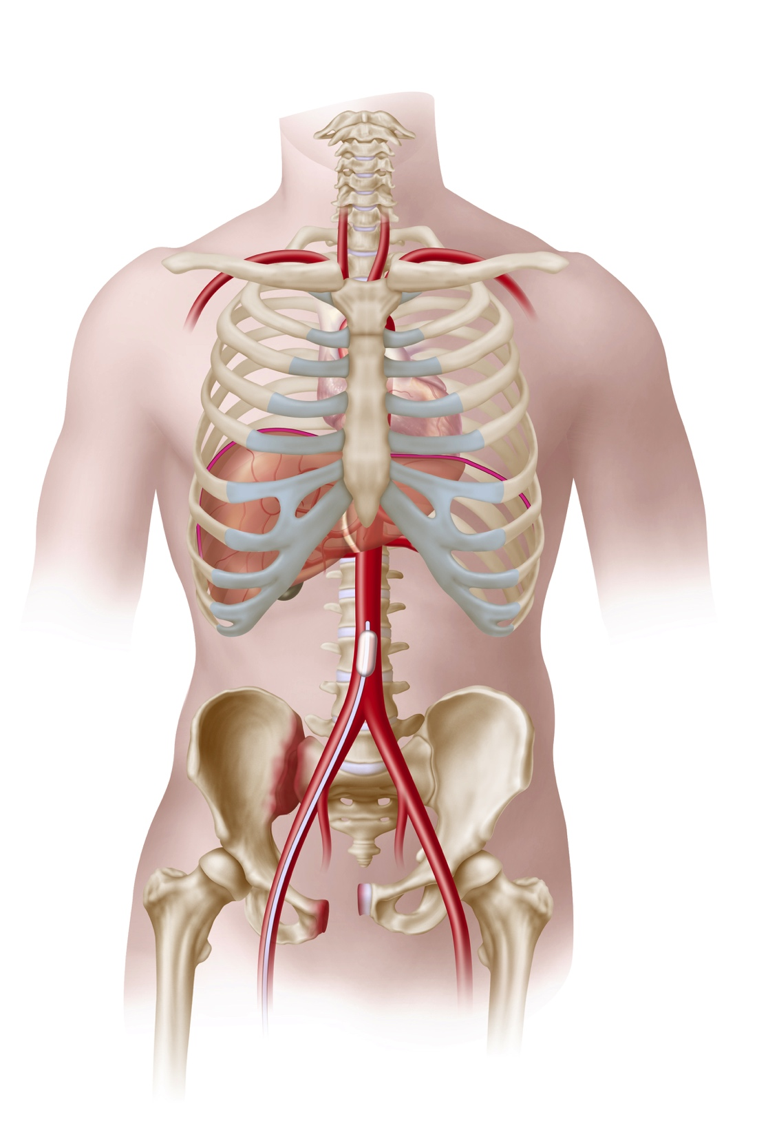
REBOA
Zone I
Zone III

Slide 4
External Landmarks
Zone 1 – Mid sternum – sheath 45cm
Zone 3 – Umbilicus – sheath
25 cm

Slide 5
Aortic diameter
Zone 1 – 20mm 8ml
Zone 3 – 15mm 5ml
(ER-REBOA)

Slide 6

Notes:
Hence the UK-REBOA Trial

