Slide 1
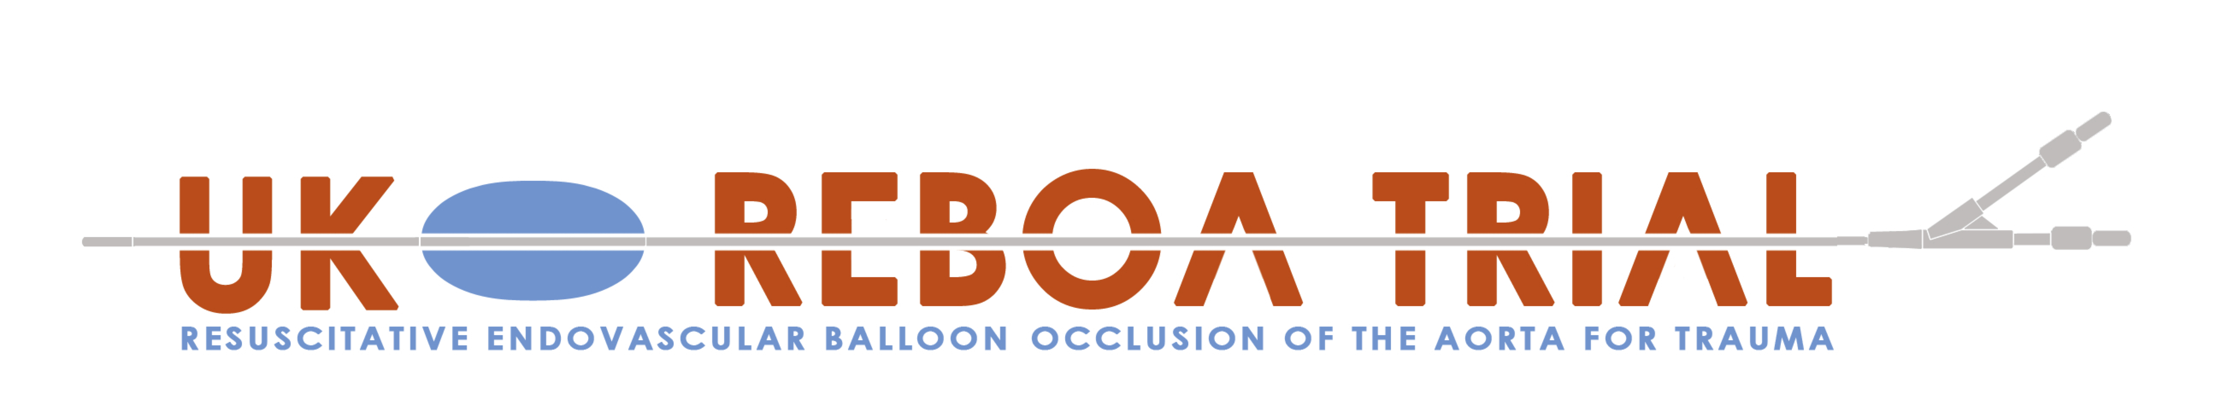

Balloon Occlusion
Robbie Lendrum
Deputy Clinical Lead and Training Lead
Jan Jansen
Clinical Chief Investigator

Slide 2
Open “PACK 3 (OCCLUSION)”

Slide 3
Identify:
ER-REBOA catheter pack
20 ml 0.9% Saline
Drawing up Needle
3 way tap
10ml syringe

Slide 4
Select occlusion zone

Slide 5
Zone III (aortic bifurcation):
Isolated pelvic injuries
Junctional injuries

Slide 6
Zone I (thoracic aorta):
Abdominal (+/- pelvic) injuries

Slide 7
Measure

Slide 8
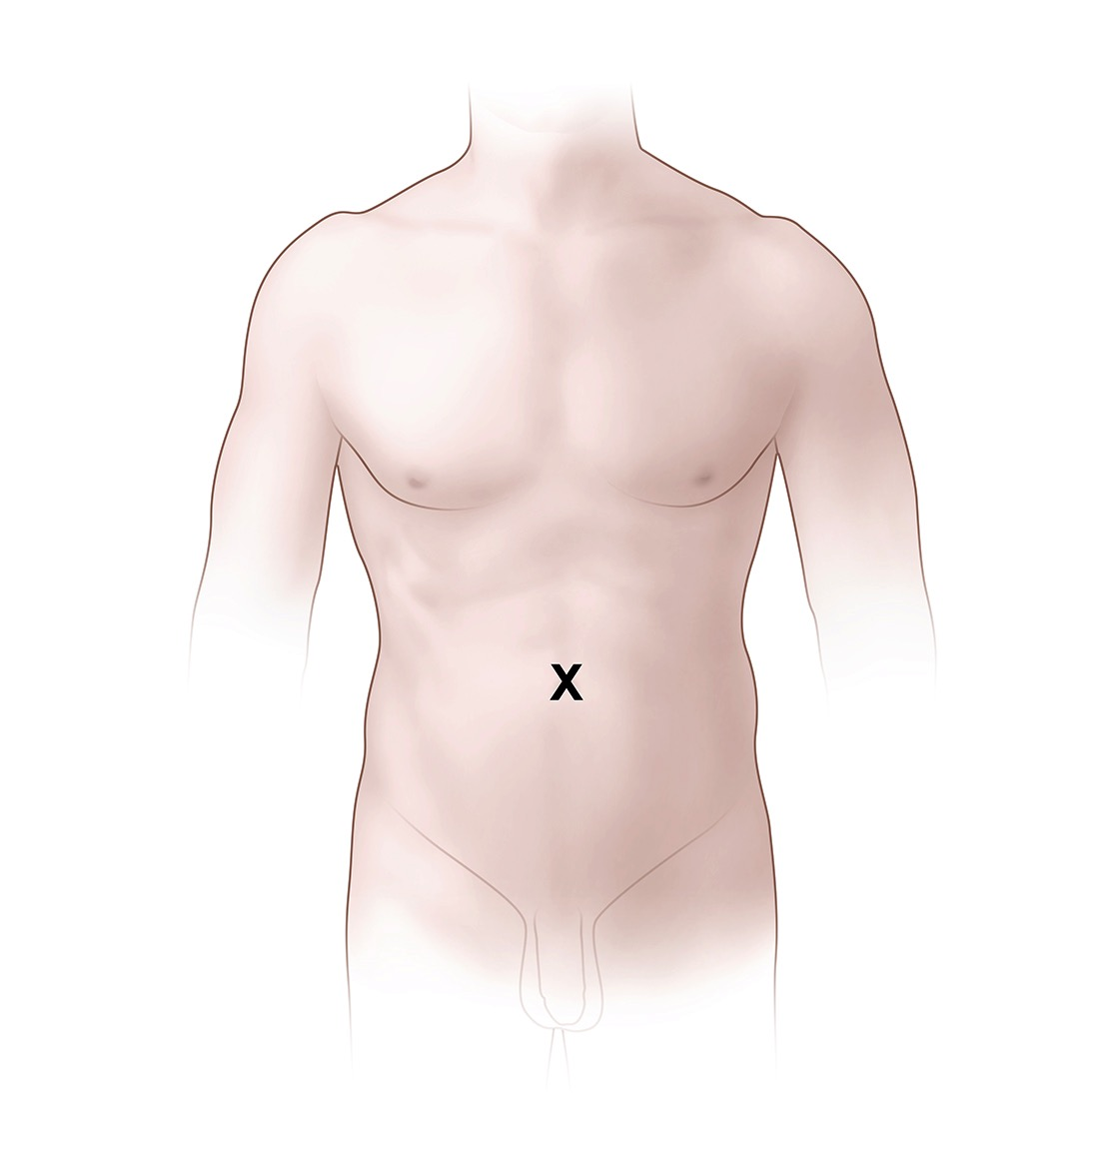
Surface markings for zone III - Umbilicus

Slide 9
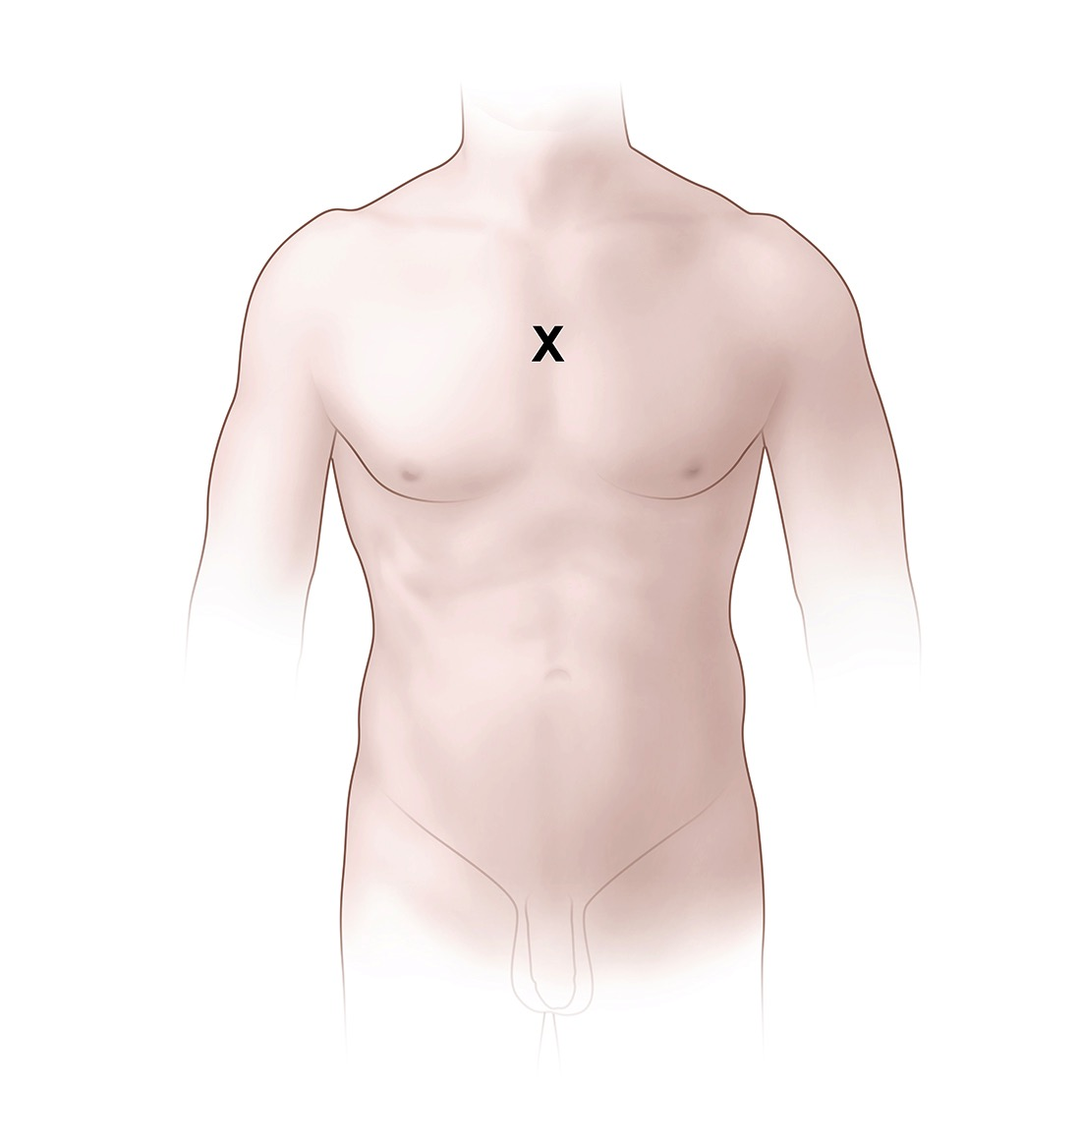
Surface markings for zone I - Mid-Sternum

Slide 10
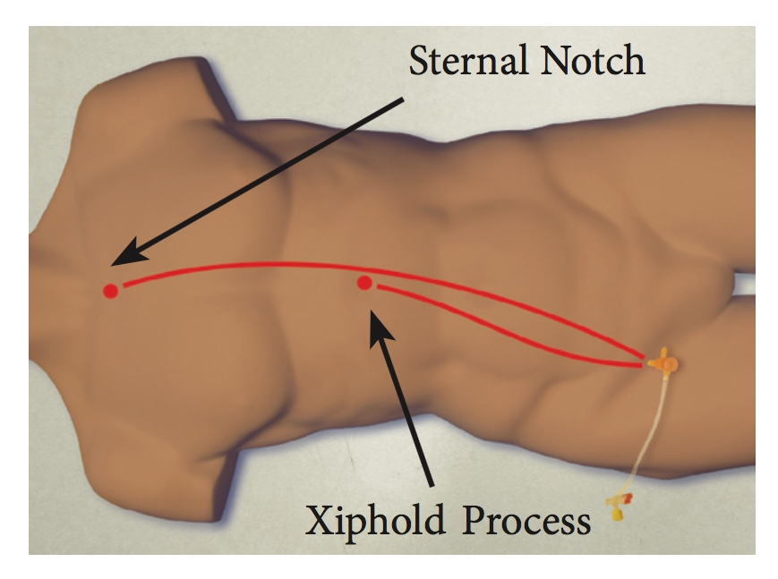

Slide 11
Zone I: Approximately 46 cm
Zone III: Approximately 28 cm

Slide 12
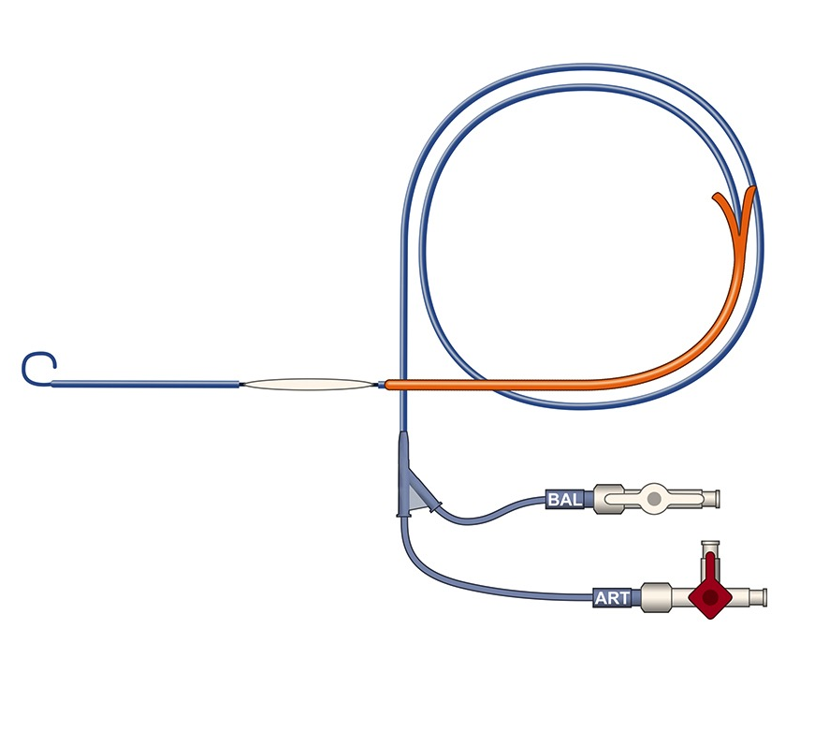
Attach transducer to “ART” lumen 3-way tap
Attach inflation syringe (10 ml saline) to “BAL” using additional 3-way tap

Slide 13
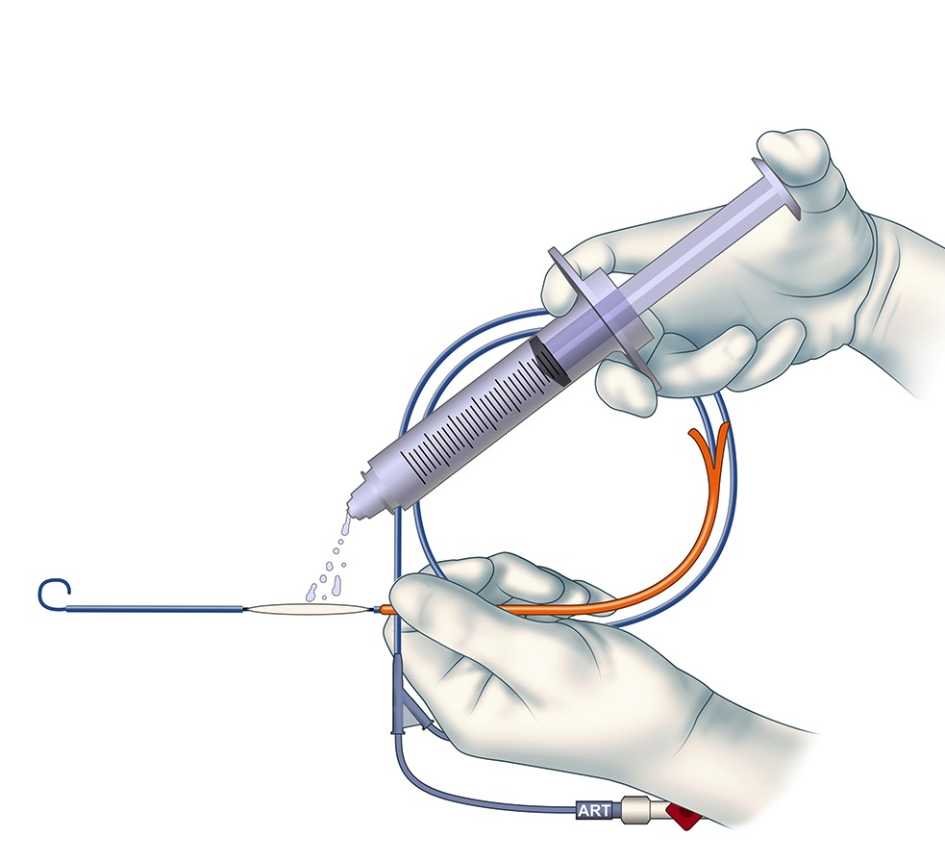
Wet Balloon

Slide 14
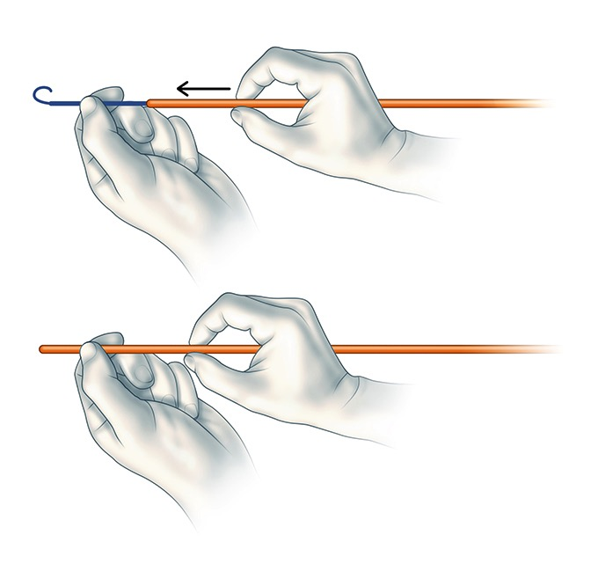
Slide orange sheath over P-tip to straighten

Slide 15
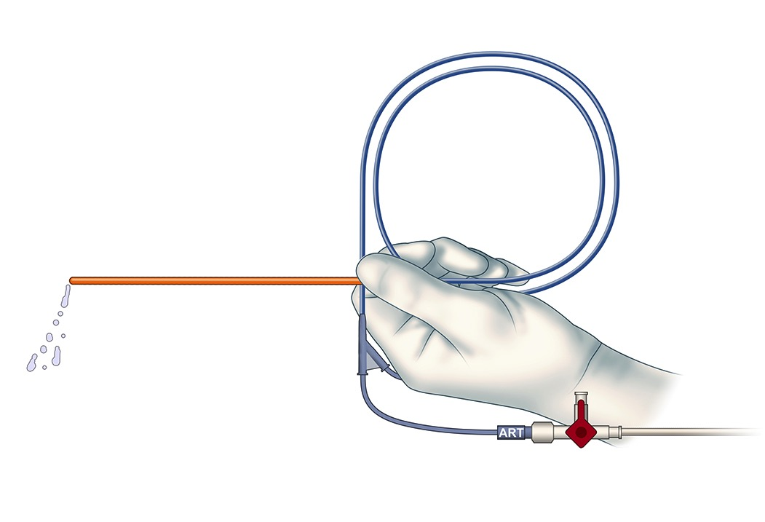
Flush catheter

Slide 16
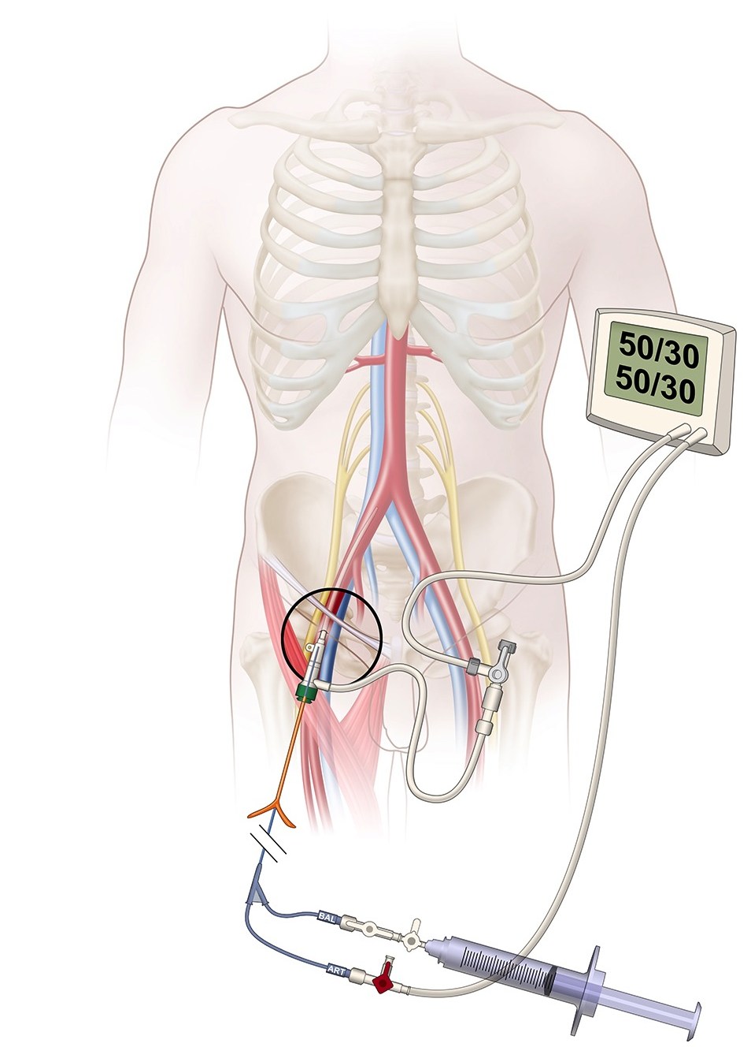
Insert assembly into arterial sheath 0.5cm and advance catheter only approximately 15cm

Slide 17
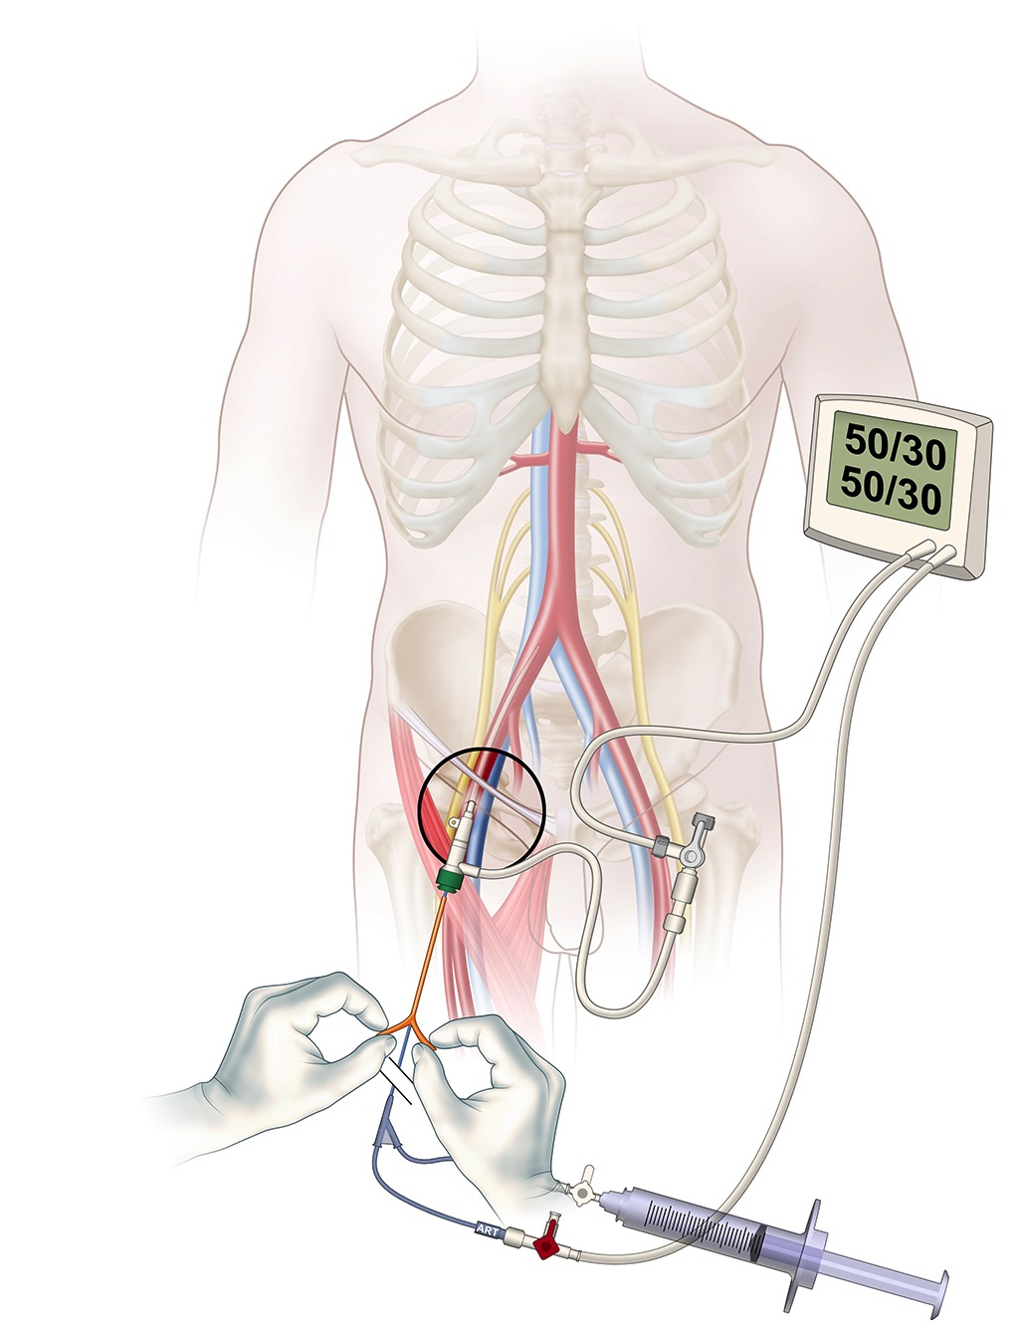
Withdraw and peel away orange sheath

Slide 18
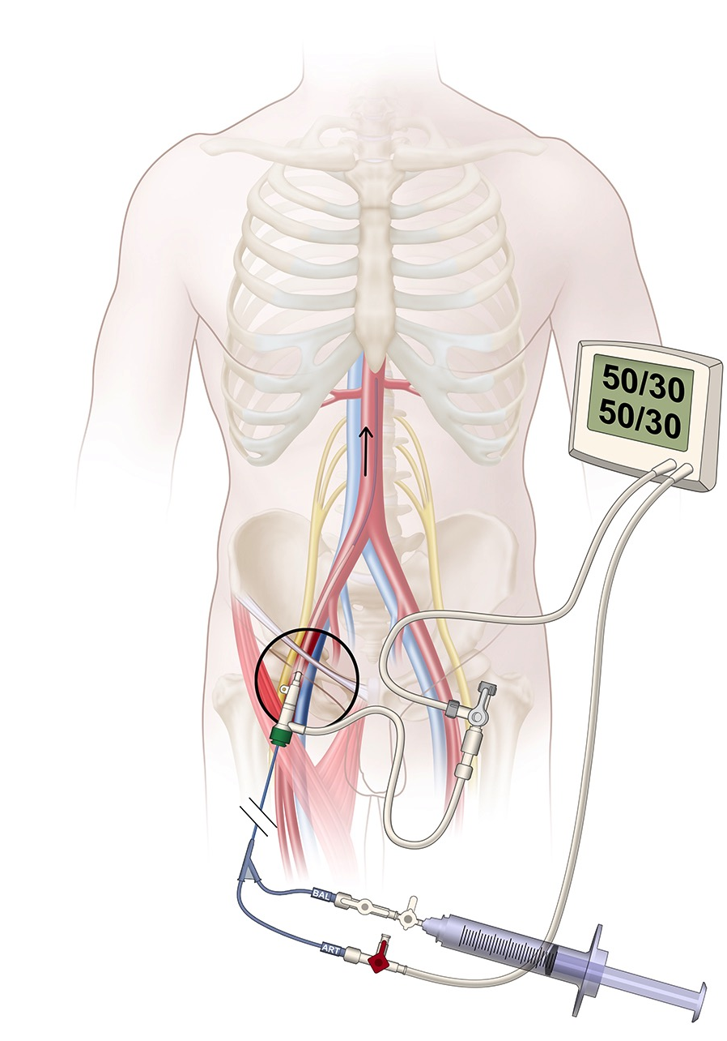
Insert catheter to desired depth (zone I or zone III)

Slide 19
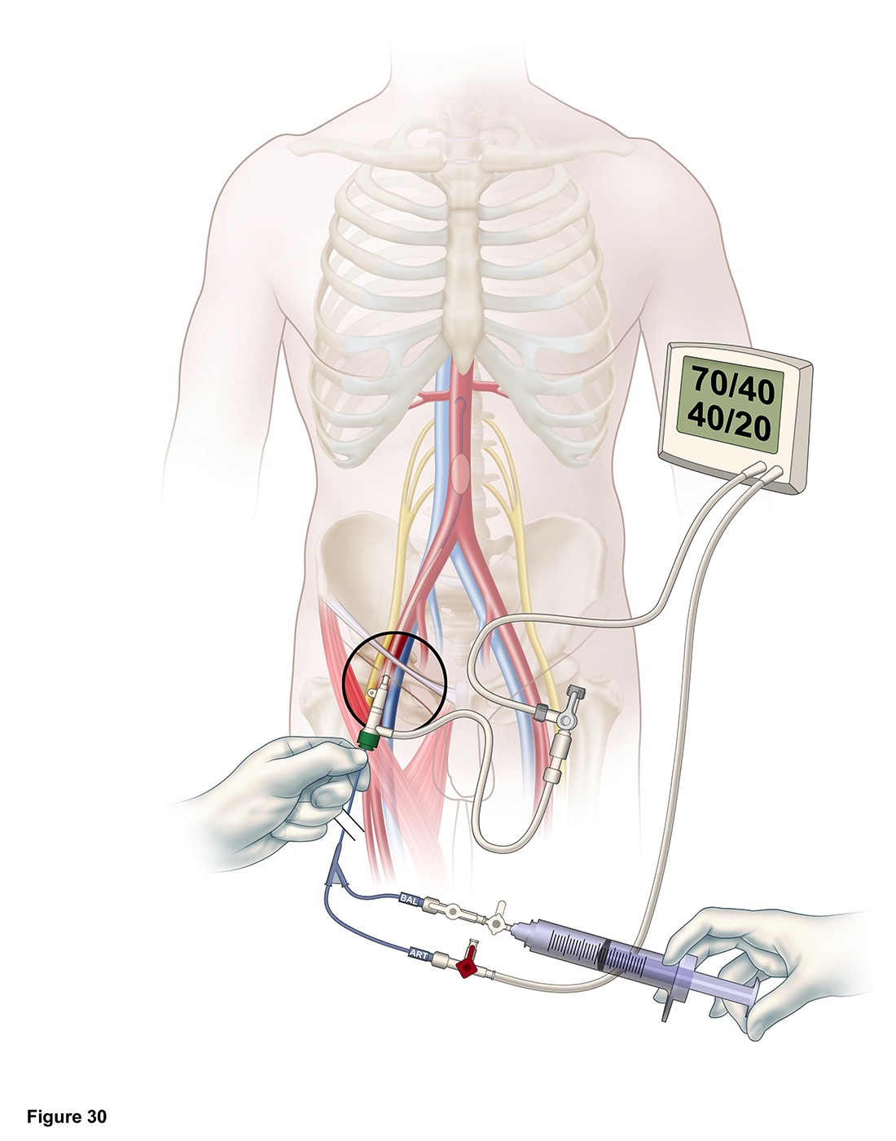
Inflate balloon with saline

Slide 20
Suggested inflation starting volumes:
Zone III: 2 ml
Zone I: 8 ml

Slide 21
You may need more – gauge against haemodynamic response

Slide 22
But beware of overinflation – experience has shown this to be very common

Slide 23
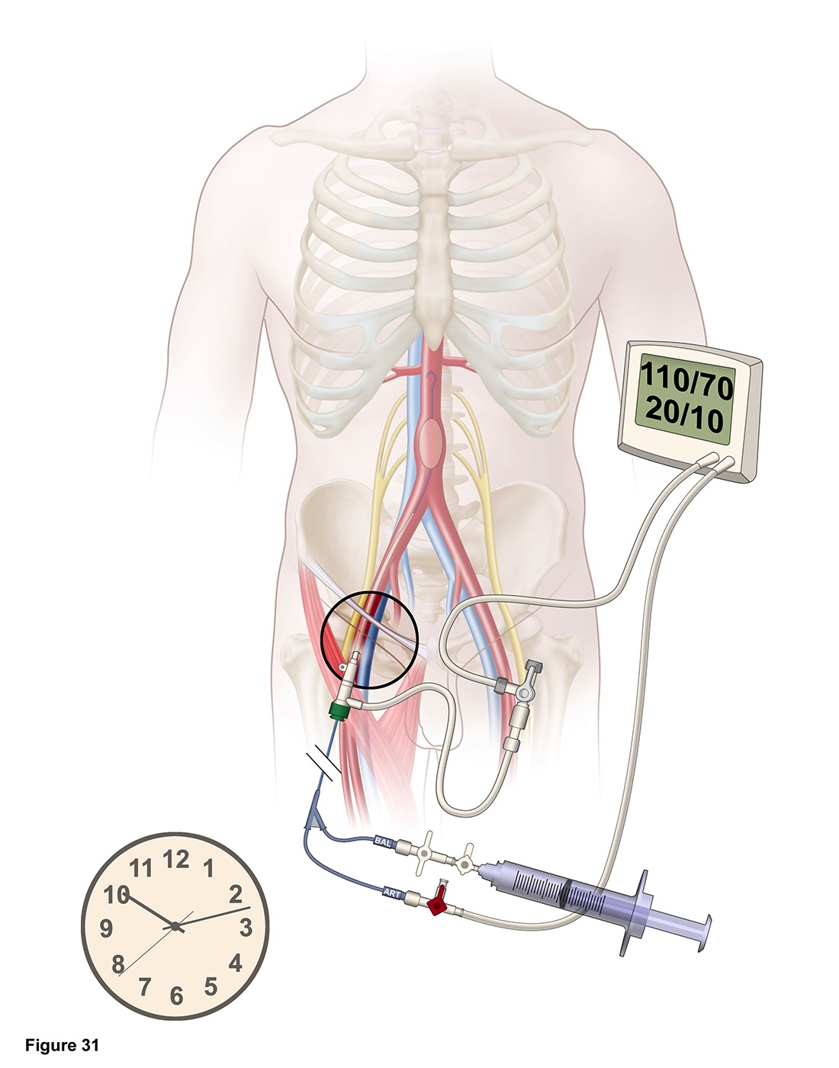
Turn “BAL” stopcock off to balloon

Slide 24
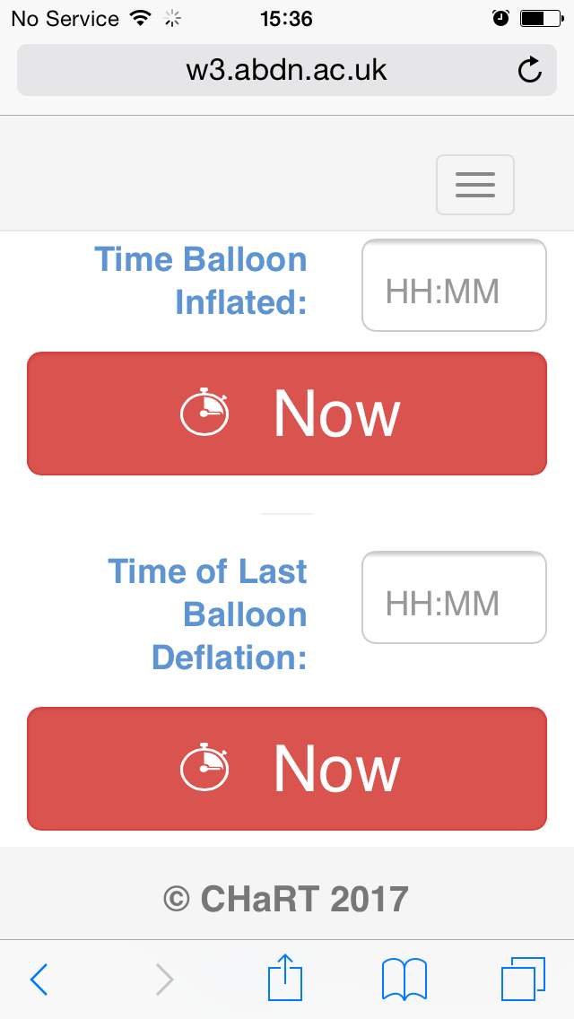
Record time of balloon inflation

Slide 25
Open “PACK 4 (SECURING)”

Slide 26
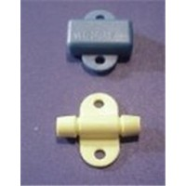

Slide 27
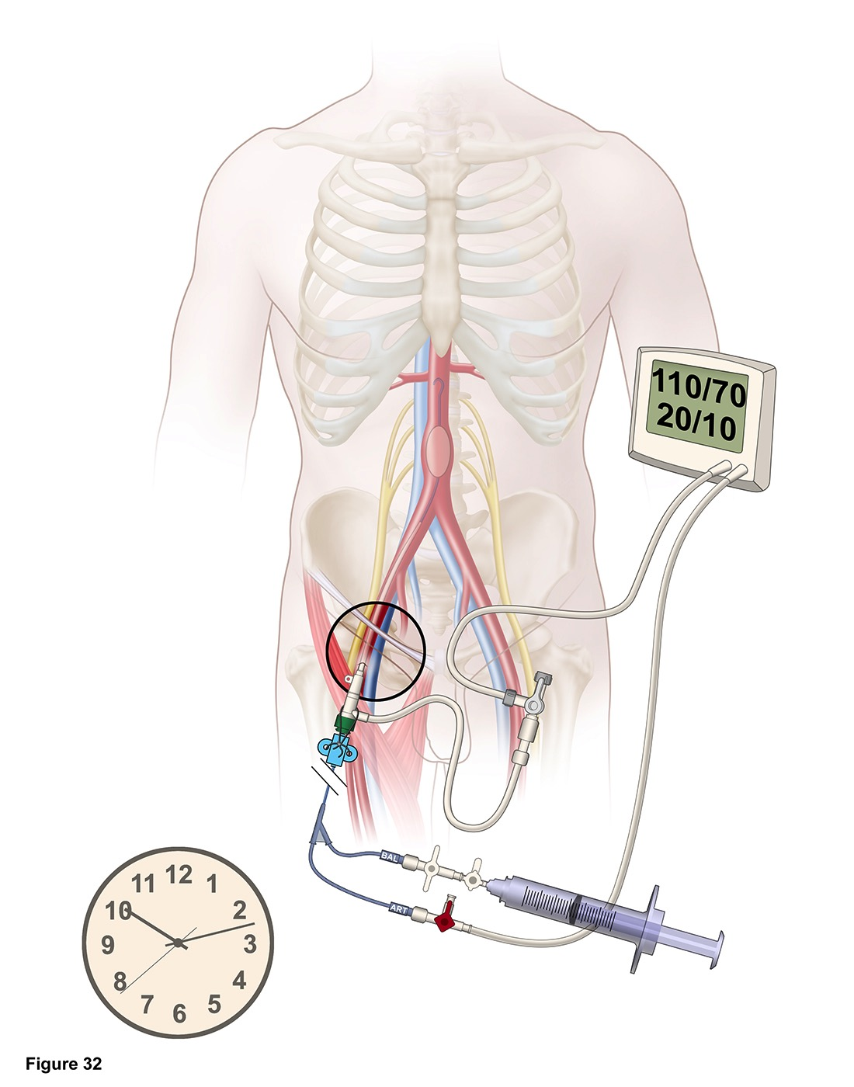
Secure catheter to prevent migration

Slide 28
Quickly progress to definitive haemorrhage control

